Slide 1
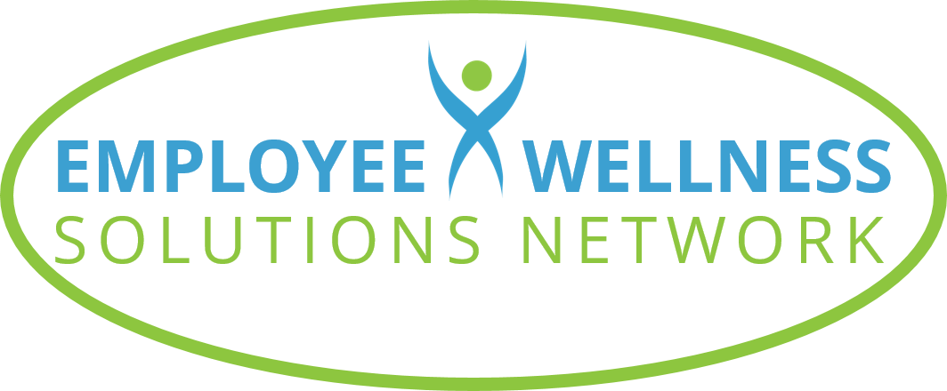
©2023 EMPLOYEE WELLNESS SOLUTIONS NETWORK INC. – ALL RIGHTS RESERVED

Slide 2
TODAY’S FOCUS…
Understand the importance of self-care and how to invest in yourself
Recognize the difference between healthy habits and draining habits
Learn how to build happiness, positivity, and resiliency
Understand the power of our thoughts and how to create a self-wealth mindset

Slide 3
Stress and Self-Care

Slide 4
When it comes wellness… how wealthy are you?
Ralph Waldo Emerson: The first wealth is health
Being healthy and happy allows us to live a rich life
Unfortunately… our focus on financial wealth is creating a lot of stress
Notes:
In 1860, American philosopher, Ralph Waldo Emerson, wrote "The first wealth is health.” While we can’t deny the importance of money, it’s essential to recognize that our health and well-being is the primary indicator of our wealth. If we take our health for granted, it impacts our ability to live a rich life – regardless of how much you have in your bank account. But society’s overwhelming focus on financial wealth as a key definition of success is creating a stress problem.

Slide 5
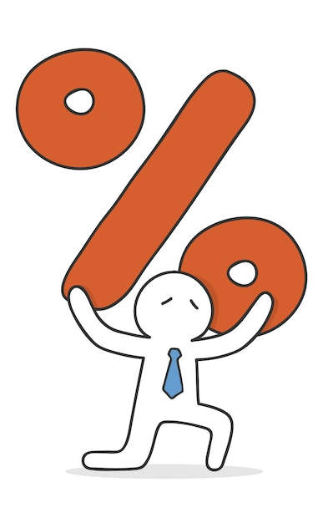
Canadians are stressed!
50%
Report that stress has a negative impact on sleep patterns
45%
Say work-related stress negatively affects their home life
29%
Say stress experienced at home negatively impacts their work
48%
Are highly stressed at least once every week
30%
Find most days “quite a bit” or “extremely” stressful
Notes:
Countless studies are pointing to stress becoming a way of life, which means that stress is getting in the way of us enjoying a life of health and happiness!
Half of all Canadians report that stress has negatively affected their sleep and almost the same number say work-related stress negatively affects their personal life.
Stress at home creates issues at work for 29% of Canadians. 48 percent of Canadians say they feel "really or seriously stressed" at least once a week. And according to Statistics Canada, almost 30% of adults aged 35 to 49 find most days “quite a bit” or “extremely” stressful.
These alarming statistics clearly indicate that we have a very real problem when it comes to stress.
sources:
https://www.ipsos.com/en-ca/stress-becoming-way-life-Canadians
https://www150.statcan.gc.ca/t1/tbl1/en/tv.action?pid=1310009604

Slide 6
Chronic stress
Stress is a leading cause of health issues
When we’re overwhelmed, healthy habits take a backseat
Quick, unhealthy meals and snacks
Lack of exercise
Not enough or poor quality sleep
Disconnect from people and activities we enjoy
Notes:
Stress is one of the leading causes of health issues, and most of us experience stress on a daily basis. We are constantly overwhelmed with responsibilities, which often results in us cutting corners when it comes to our health. To save time, we may opt for packaged snacks or a drive-thru dinner. At the end of the day, we’re too drained to do anything but collapse on the couch in front of the television. Many of us suffer from poor sleep habits due to stress as well. All of this stress negatively affects both our minds and bodies, taking a toll on our immune system, energy levels, and emotional well-being.

Slide 7
Chronic stress - symptoms
Cognitive
Lack of focus
Difficulty with decisions
Poor memory
Worrying
Physical
Headaches
High blood pressure
Gastrointestinal issues
Muscle tension & pain
Emotional
Negativity
Hopelessness
Sadness
Irritability
Behavioural
Low self-esteem
Procrastination
Restlessness
Social withdrawal
Notes:
Are you suffering from chronic stress? Stress can impact us in many different ways. Our emotional, cognitive, physical and behavioural well-being can be effective by chronic stress. Here are some symptoms you may experience.

Slide 8
Invest in yourself
Practice self-care to manage stress and improve your overall well-being
Engage in daily activities that support your health:
Mental
Emotional
Physical
Notes:
Self-care plays a very important role in our ability to manage stress effectively and improve our overall health. We’re not talking about splurging on spa days or vacations to luxurious resorts. This type of investment is about engaging in daily activities that support our mental, emotional, and physical health. It’s a simple concept, but one that is often overlooked. Eating nutritious whole foods, exercising regularly, and making time for stress-relieving activities can help you be happier, healthier, and more resilient. Practicing self-care adds value to your life and wellness. It’s all about choosing activities that you enjoy and making a commitment to start investing in you.

Slide 9
Benefits of Self-Care
Increases energy levels
Encourages positive thinking
Supports healthy relationships
Increases motivation and productivity
Fights fatigue
Reduces susceptibility to stress, depression, and anxiety
Improves self-confidence
Boosts immunity
Notes:
Self-care isn’t just about relaxing – although that IS important. Proper self-care offers a host of benefits that supports all areas of our well-being.
Making time for yourself, boosts your energy levels and encourages positive thinking, which helps us face life’s challenges with resiliency.
It supports healthy relationships because we can be more present and attentive to the people in our life, which fosters connection and empathy.
Proper self-care minimizes burnout, so we aren’t dealing with chronic fatigue and are more motivated and productive when it’s time to focus and work.
Making self-care a habit helps us better manage the demands of life and work, so we are less likely to experience stress, depression, and anxiety.
When you practice self-care, you know you're doing something positive for your mind, body, and spirit—and you'll naturally feel more confident as a result
Finally, healthy habits that are part of self-care (like exercise, drinking enough water, proper sleep and down time) support the health of our body are beneficial to your immune system.

Slide 10
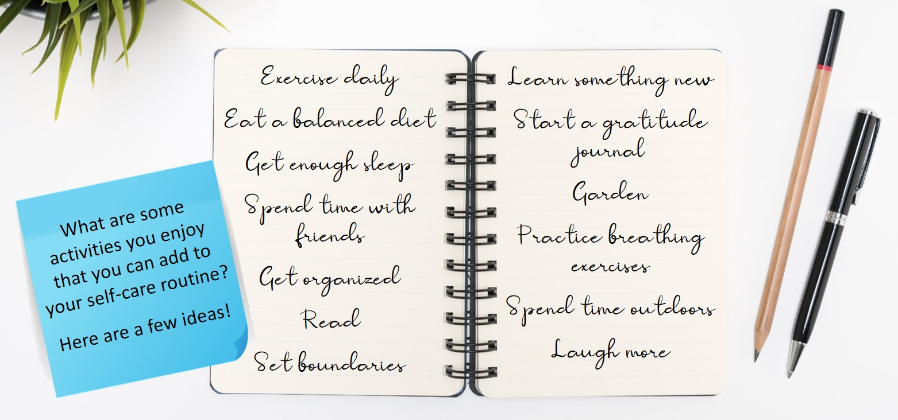
Making Time for Self-Care
Notes:
Practicing self-care isn’t always easy. With our schedules so full, we struggle to balance work, family, and social obligations and end up prioritizing those over ourselves. You may feel guilty about spending time on yourself when there so many other things you could be checking off your to-do list. It’s important to remind yourself that you ARE a priority! When you make time to care for yourself, you support your own health and happiness, which makes you more able to support those around you and deal with stressful situations when they arise.
To get started, decide on a single activity that you can add to your routine. Choose one that you can commit to and schedule it into your day. Wake up 15 minutes earlier in the morning to sit quietly while enjoying a tea or start your day off by stretching. Go for a walk during your lunch break or practice breathing exercises before bed.

Slide 11
Your habits and your self-wealth

Slide 12
Why your habits matter
Your daily habits can increase or decrease your self-wealth
Be mindful and pay attention to the impact of the choices you make
Small changes can help us live healthier and happier lives
Notes:
Every day, we make choices that affect our overall health and well-being. What we eat and drink, who we spend time with, how we spend our time, when we go to bed – all of these decisions can help increase or decrease our self-wealth. If you are living a life that is draining your overall health, you run the risk of increased issues such as burnout, sleep disorders, diabetes, high blood pressure, and heart disease. Being more mindful of the choices you make each day can help us live a more balanced life. Making small changes and adding activities that promote self-care can help us live healthier and happier.

Slide 13
Ask yourself…
Is what I’m doing healthy or draining?
Can I improve how I care for myself?
How can I add more wealth to my life?
YIKES!
Notes:
Consider your daily activities and habits. Ask yourself: is what I’m doing healthy or draining. Are there changes I can make to improve how I care for myself? How can I add more wealth to my life?
Here’s an example: The average Canadian spends 30.4 hours watching television every week! Cutting back on screen time to make room for more me-time is a great opportunity to create more balance in your life. Making self-care a priority – by replacing too much tv-watching with activities that fuel your physical, mental, and emotional well-being is a valuable investment in your overall health and happiness.

Slide 14
Healthy Habits
vs
Draining Habits
Getting enough sleep
Regular physical activity
Eating a diet of whole foods
Meditating
Enjoying a hobby
Practicing gratitude
Spending time with friends
Playing with your children
Making time to relax
Spending time outdoors
Spending more than 2 hours watching TV or on social media
Procrastinating
Consuming processed foods
Taking stimulants
Complaining
Not taking breaks at work
Always saying “yes”
Having too much clutter
Overspending
Notes:
Everything we do each day impacts our well-being. Healthy habits promote self-care and help us be our best. But we often engage in activities that drain us. They drain our energy. They are demotivating and make us less productive. Over time, they can also negatively impact our health and well-being. Here are some examples of healthy habits vs draining habits.

Slide 15
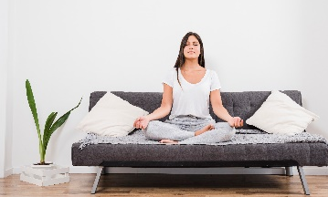
Healthy habits give you a boost
Get Organized
Use a planner
Meal plan
De-cutter your space
Choose Healthy Food
Limit sugar, alcohol, caffeine, and processed foods
Make meals at home
Meditate
Try breathing exercises
Journal
Practice gratitude
Notes:
Get Organized. Getting more organized can be a great start to a healthier you. Use a planner, meal plan, and de-clutter your space to create a more organized life. Getting rid of things that you no longer need can be refreshing and calming. It can also eliminate wasted time spent looking for items and the stress that goes with it.
Choose Healthy Foods. Sugar, alcohol, caffeine, and processed foods can have a negative impact on our immune system, energy levels, and emotional well-being. Busy schedules often mean we opt for convenient fast food, but usually lacking in the nutrition needed to fuel the body and mind. Commit to making healthy meals at home each week. Meal delivery kits can help you get started, and crockpot meals can be easy and nutritious.
Meditate. Meditation is a beneficial way to reduce stress and anxiety, improve self-esteem, and increase focus and concentration. If the idea of meditating is intimidating, try breathing exercises, journaling, or simply practicing gratitude. Practice focusing on your breath or positive thoughts to calm the mind during stressful moments.
Practice Good Sleep Hygiene. Make your bedroom a relaxing space to promote good sleep. Turn off electronics 45 minutes before bedtime. The blue light emitted by these screens restrains the production of melatonin, the hormone that controls your sleep-wake cycle. This makes it more difficult to fall asleep and wake up the next day. Instead, end the day by reading, stretching, or journaling to relax your mind.

Slide 16
Healthy habits give you a boost
Move Your Body
Choose activities you enjoy
Add movement to every day
Practice Good Sleep
Create the right space for sleep
Turn off electronics
Create a relaxing sleep routine
Notes:
Move Your Body. Our bodies need and crave movement, and being active offers our body and mind so many amazing benefits. It helps to improve sleep, naturally reduces stress, increases energy, and promotes positive feelings. Choose activities that you enjoy: walk, run, bike, workout, stretch, or dance. Just make movement a regular part of your day.
Practice Good Sleep Hygiene. Make your bedroom a relaxing space to promote good sleep. Turn off electronics 45 minutes before bedtime. The blue light emitted by these screens restrains the production of melatonin, the hormone that controls your sleep-wake cycle. This makes it more difficult to fall asleep and wake up the next day. Instead, end the day by reading, stretching, or journaling to relax your mind.

Slide 17
Healthy habits give you a boost
Get Outside
Use your breaks
Pair it with physical activity
Be Kind to Yourself
Use healthy internal dialogue
Avoid criticizing yourself
Be your own cheerleader!
Notes:
Get Outside. Take a walk in the park or enjoy your morning coffee on the deck. Spending time outdoors can reduce stress, lower blood pressure, and help us be more mindful. It can also improve our sleep, especially if you engage in a physical activity like walking, gardening, biking, or hiking.
Be Kind to Yourself. Practice self-compassion and acceptance through healthy internal dialogue. Negative thoughts and attitudes impact our sense of self-worth and confidence. Avoid criticizing the choices you made, the actions you did or didn’t do, how you look. Be your own cheerleader, and encourage yourself as you would a friend or loved one.

Slide 18
Build your happiness

Slide 19
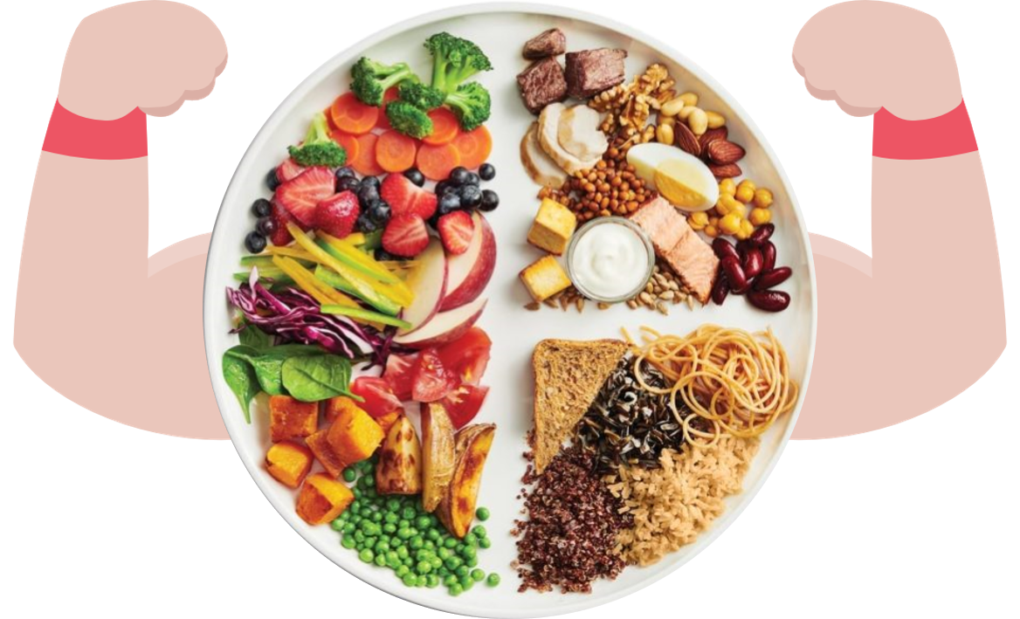
Flex your happiness muscle
Self-care activities build our physical, mental, and emotional health, which translates to a happier and healthier life
Learn to practice happiness!
Notes:
Making self-care a priority helps us engage in activities that benefit our physical, mental, and emotional health resulting in a happier and healthier life. If you won’t make your self-care a priority, who will? But happiness and resilience take practice. Just like strengthening your leg or arm muscles, building happiness requires repetition and focus. Self-awareness also helps make being happy a habit.

Slide 20
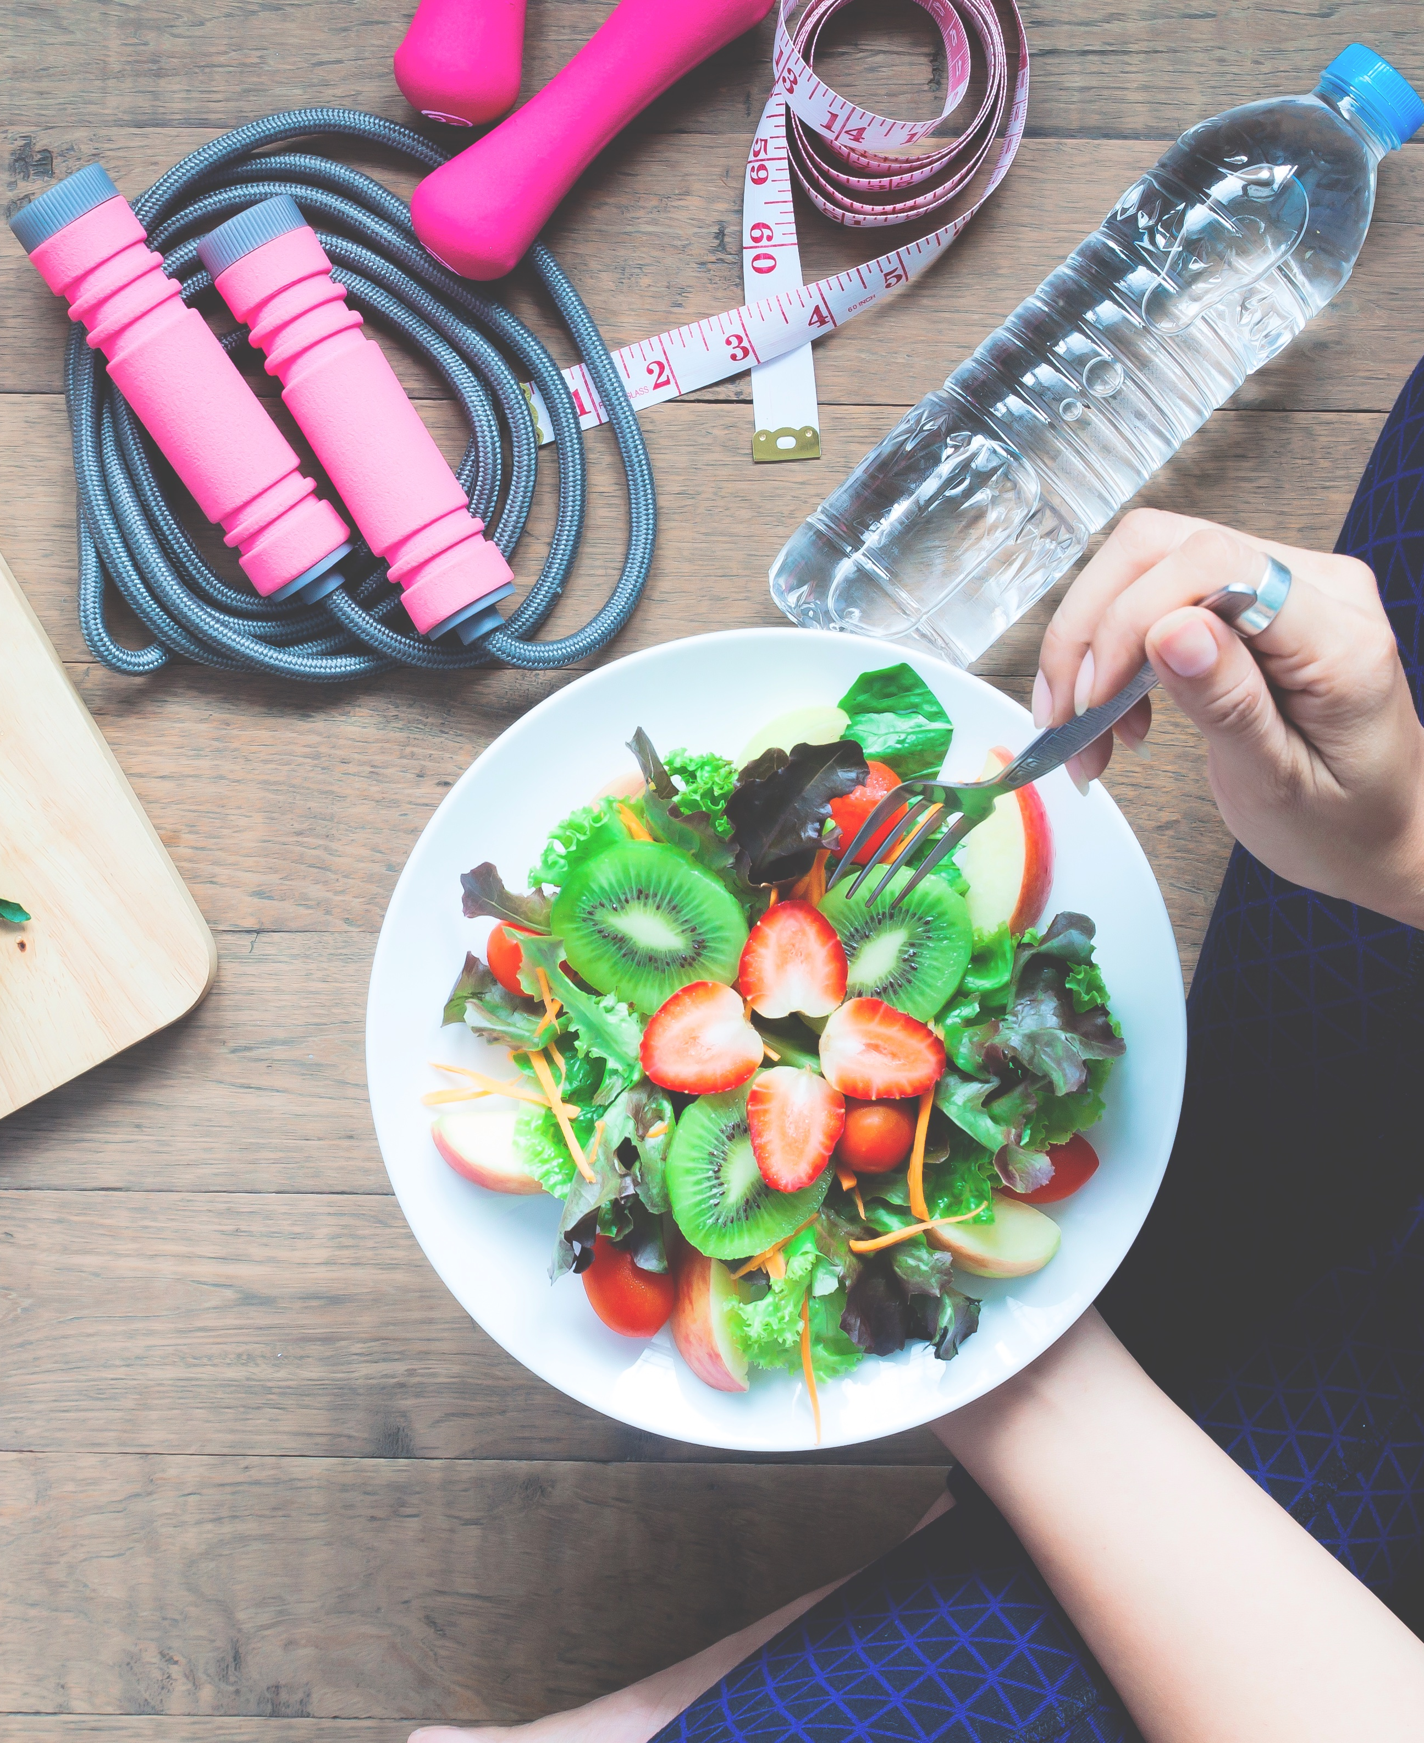
How to build your happiness
Prioritize yourself
Make small changes
Be kind to yourself when you make mistakes
Notes:
Prioritize yourself. Making time for you is not selfish. We need to focus on our mind, body, and spirit in order to live our best. Taking care of yourself also helps you be a better help to others. Small changes accumulate. Choose healthy foods, get enough rest, spend time doing activities you enjoy. When you fail or experience stress, practice self-compassion. Allow yourself time to recover and deal with the adversity, then move forward positively.

Slide 21
How to build your happiness
Find purpose and meaning
Focus on positivity
Live with intention
Approach challenges creatively
Notes:
Find purpose and meaning. Battle negativity by learning to shift your focus to the positive. Identify what you really want from life. Living with intention empowers us to create happiness and focus on joy. It also helps us approach challenges and obstacles with creativity and flexibility, which allow us to be more resilient and manage life more openly and meaningfully.

Slide 22
How to build your happiness
Focus on what you can control
Don’t let worry paralyze you
Avoid reacting emotionally
Use energy on solutions
Notes:
Focus on what you can control. Worry can be paralyzing. Learning to focus on what we can control and realizing that we can control our reactions to situations is liberating and powerful. When something goes wrong, we tend to get frustrated, angry, worried. Interrupt the pattern. We don’t need to react to challenges emotionally. Instead, focus this energy on identifying a solution.

Slide 23
How to build your happiness
Mind your mind
Be aware and control your thoughts
Accept what you don’t like, then focus on moving forward
Notes:
Mind your mind. Our thoughts become our actions, and our actions become our behaviours. We can either add or detract from a positive mindset. Be aware and control the direction of your thoughts. The first step to navigating change successfully is accepting that we don’t like it! Allow yourself to grieve what’s been lost, then focus on the present. What’s the opportunity ahead? Identify it and embrace the chance to move forward and grow.

Slide 24
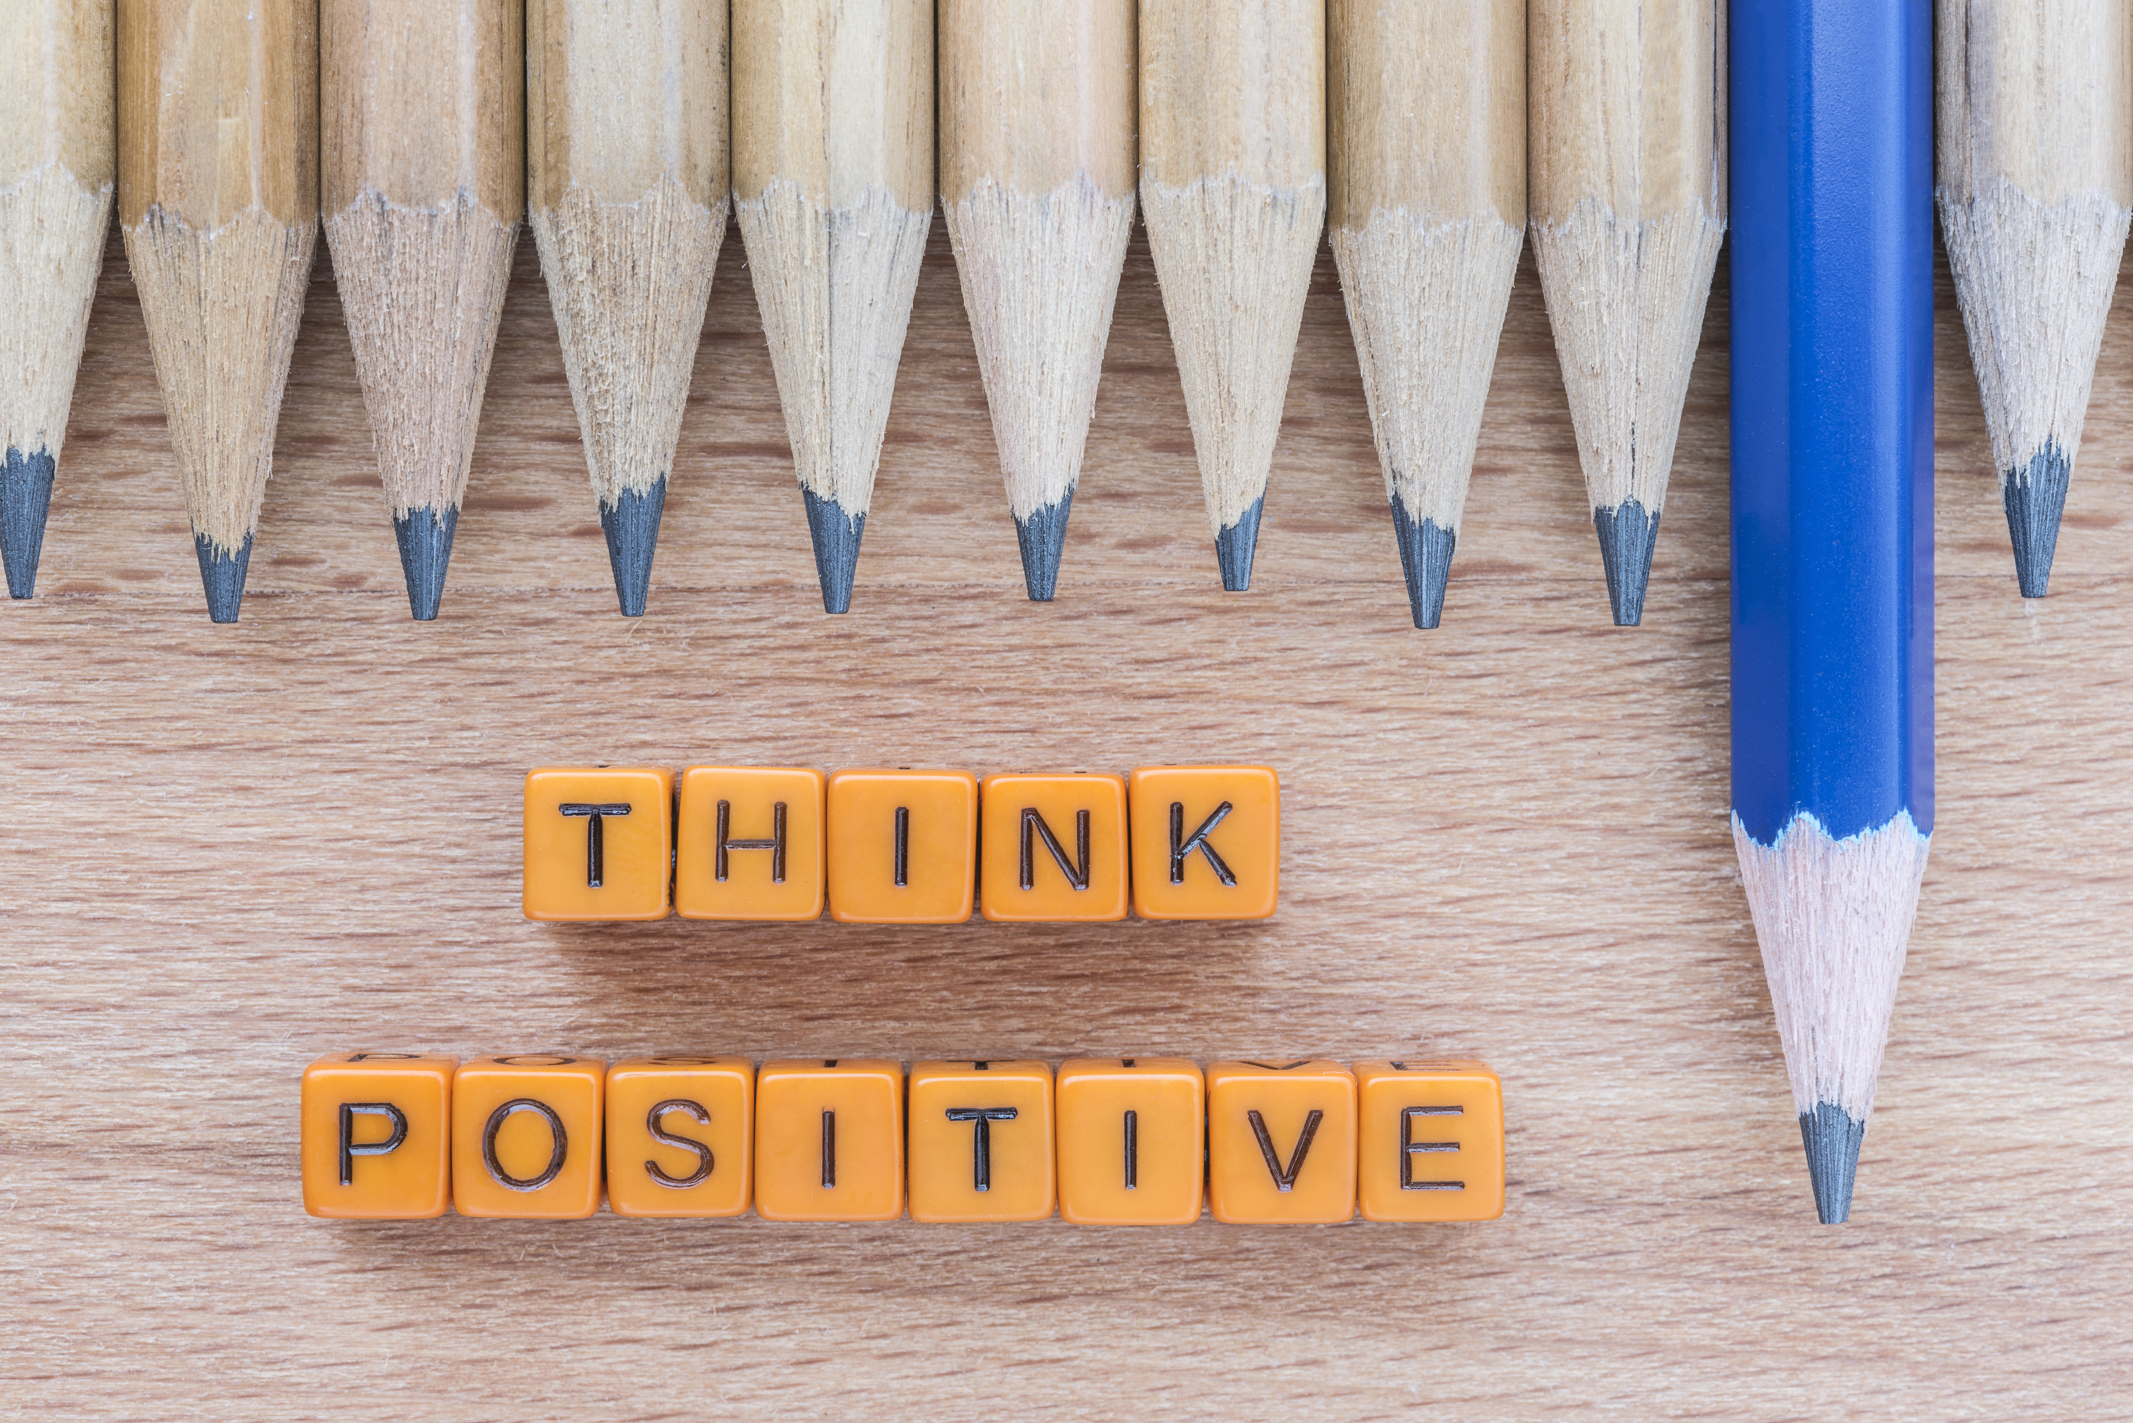
Prioritize positivity
Negativity and poor prioritizing creates unnecessary stress
Misplaced emotion
Negative self-talk
Time-wasters
Burnout
Instead, spend time building positivity and resilience
Positive mindset
Self-care activities
Notes:
Happiness and positivity go hand-in-hand. But we aren’t always good at making positivity a priority. When we misplace emotion or add negative narrative, we create unnecessary and unhealthy stress. When it comes to setting our priorities, we tend to choose work, time-wasters, quick convenient meals over time spent on building our self-wealth. What we need to do instead is prioritize positivity and engage in activities that benefit our physical, mental, and emotional health. This helps build resilience and helps us live a happier, healthier, and purposeful life.
Every day, each of us faces a variety of challenges both at home and at work. We often find ourselves dealing with a stack of issues that interfere with performing at our best. Over time, we experience frustration and ultimately burnout as a result of emotional distress. So, what’s the solution? Build your ability to face these challenges with positivity and resilience.

Slide 25
Your positivity toolbox
Manage your energy by identifying energy-suckers and energizers
Learn to say no without guilt
Quiet your internal voice and interrupt the negative thoughts
Spend time with nature
Practice gratitude and appreciate what’s in your life
Notes:
There are some things that we can do to help us build our positivity toolbox. Creating healthy habits in the face of frustration and challenge will make it easier to approach these situations in a healthy and effective manner.
Manage your energy. Identify energy-suckers and energizers. Energy-suckers are tasks that deplete your energy, demotivate, and destroy your spirit. Energizers are tasks that motivate, inspire productivity, and fulfill you. To avoid being mentally exhausted at the end of the day, balance these types of tasks and end off with something energizing.
Learn to say no. We feel guilty saying no, yet we’re already stressed and overwhelmed. We may feel obligated to help when asked, but always saying yes can lead to anxiety, resentment, and burnout. Sometimes, no is the best response. It can help reduce stress, increase time and energy for positive mindset activities, and boost self-confidence.
Quiet your internal voice. We can have 60,000 thoughts a day, and for some of us, 80% of these are negative. Interrupt the negativity with moments of stillness. Meditation can help bring awareness to your internal voice. You can then choose which thoughts to hold onto and which to let go of.
Spend time with nature. The average person spends almost 93% of life indoors. Being outside helps reduce stress and improve mood and cognitive function. Plan a family hike, spend a day at the beach, work in the garden. Choose an activity you enjoy and spend time with nature.
Practice gratitude. Take time to appreciate what’s in your life. Gratitude has numerous benefits to our physical, emotional, and mental health. It increases joy, decreases negative emotions, and increases our production of serotonin and dopamine. Start the day by thinking of something you’re thankful for or keep a gratitude journal.

Slide 26
Thoughts have power

Slide 27
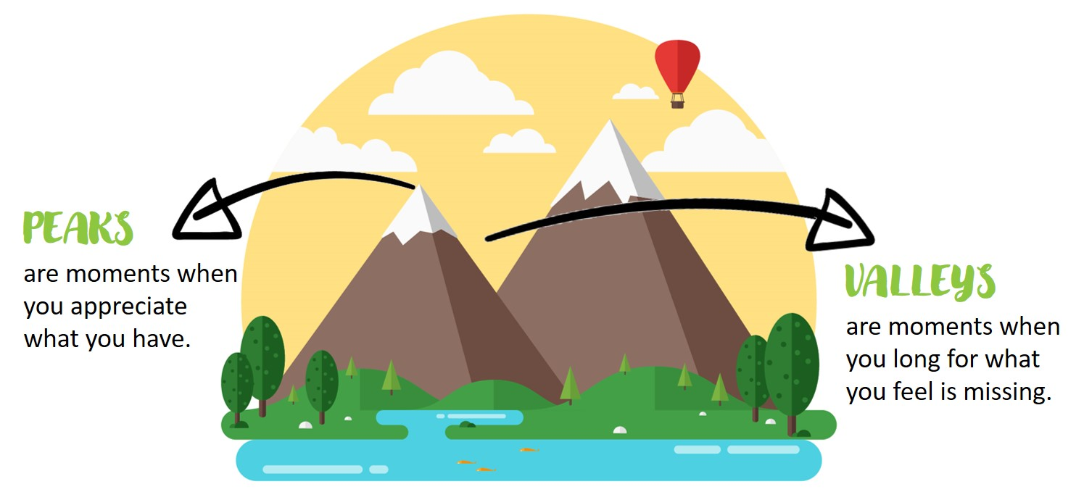
Peaks and valleys
Life is full of ups and downs, but they aren’t necessarily “good” and “bad”
We appreciate the peaks, but there is also value in the valleys!
Notes:
Life is full of ups and downs. We often think of peaks and valleys as good and bad times, but they also include the feelings you experience and your response to external events. Your personal peaks and valleys are an essential part of a normal and healthy life! And how you think about life’s challenges becomes a very large part of how you experience and move on from them. Valuable lessons are learned in the valleys and looking at the bigger picture can help you to concentrate on what matters most.

Slide 28
Value in the valleys
Truth
What can you learn that you weren’t aware of?
Approach
What can you do to move past this?
Growth
What can you learn to become better?
Perspective
Can you look at things differently?
Notes:
When you find yourself in a valley, consider your thoughts. Are you simply discounting it as a negative experience that you don’t want to have? A better way is to guide your thoughts in a more positive and productive direction. Appreciate the opportunity for discovery and growth that the valley offers.
A valley is an opportunity to learn. The pain you feel in a valley can wake you up to a truth that you have been ignoring.
A valley is an opportunity to practice your approach to difficult situations. How you manage your valley determines how soon you reach your next peak.
A valley is an opportunity to grow. If you don’t learn in the valley, you can become bitter. If you learn, you can become better.
A valley is an opportunity to consider perspective. Getting out of a valley occurs when you choose to see things differently.

Slide 29
Thoughts become things
Mindset = thoughts, attitudes, beliefs
This influences your mental, emotional, and physical health
Influence your mindset!
Positive self-talk
Set daily intentions
Practice gratitude
Encourage your productivity
Welcome positivity through action and habits
Notes:
Your mindset is determined by your thoughts, attitudes, and beliefs, and this influences your mental, emotional, and physical health. Positive thinking can increase feelings of self-worth, improve coping skills, reduce the risk of depression, decrease anxiety, and increase lifespan. We attract what we think, so be mindful of your thoughts and influence your mindset. How?
We talk to ourselves all day long, and what we think influences how we feel. People who practice positive self-talk tend to be more confident, have fewer negative emotions, and have greater satisfaction in life.
Setting an intention is a way to align your mind and heart. It allows us to become more mindful and offers motivation and purpose. Some examples include “I intend to see the good around me” or “I will respond with compassion and understanding”. Write out an intention and repeat it to yourself throughout the day.
Practice gratitude daily. Having appreciation can give us a happier outlook on life. It helps us see the good we already have in our lives and changes our perspective to attract more joy. Write down what you are thankful for and share positive experiences with others.
We all enjoy feeling productive. Write a daily, weekly, or monthly to-do list. Cross items off your list as you accomplish them – that’s always a great feeling! Even if new tasks are added, the checkmarks remind you that you’ve been productive.
Welcome positivity into each day. Create an idea or dream journal and fill it with drawings, photos, poems, dream vacations, and anything that inspires you. Fill a jar with positive quotes and start every day by reading one. Write down the accomplishments and positive events that you experience during the day.

Slide 30
Rich isn’t an amount of money, it’s a mindset about how you live. If you believe you can win, you can.
- Dave Ramsey

Slide 31
Thank You for Participating
Questions?
Images from Freepik

