Slide 1
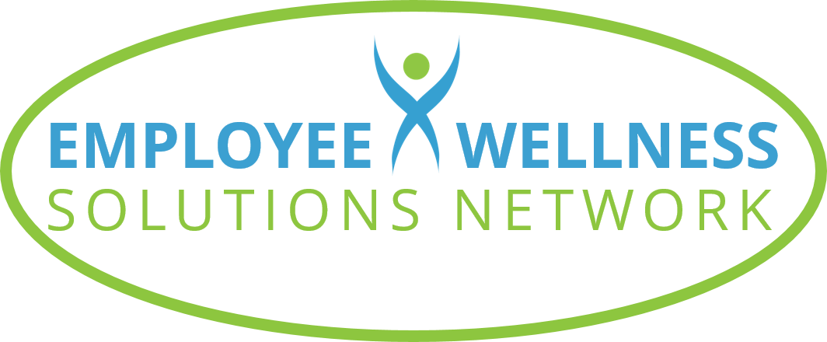
©2023 EMPLOYEE WELLNESS SOLUTIONS NETWORK INC. – ALL RIGHTS RESERVED

Slide 2
TODAY’S FOCUS…
Evaluate where we get our nutrition information
Review common nutrition “facts”
Identify reliable sources of nutrition information

Slide 3
Where Do You Get Your Facts?

Slide 4
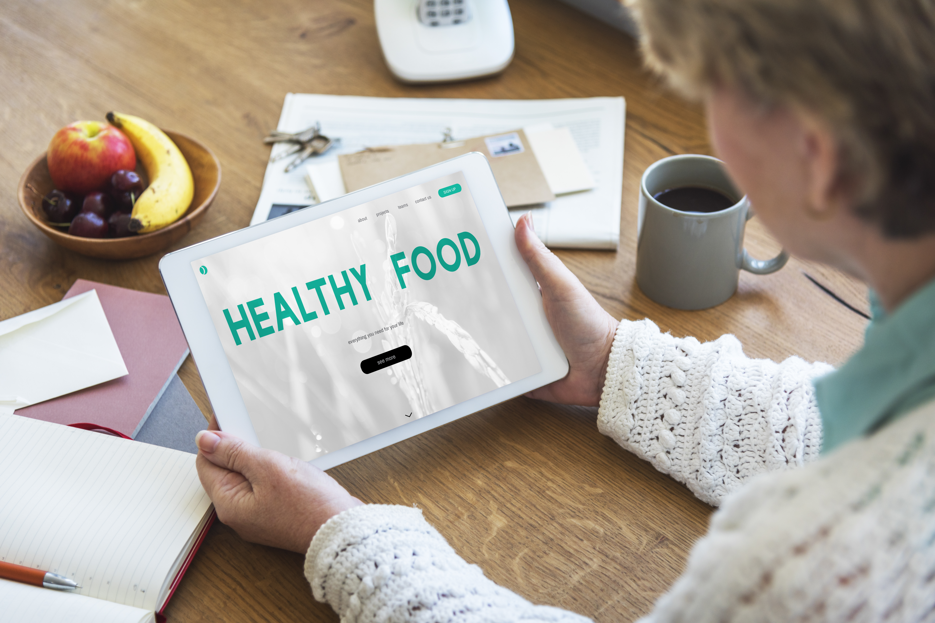
Common Sources of Nutrition Information
Celebrity doctors
Social Media
Family members & friends
Health food store
Research studies
Let’s look at the reliability of these sources…

Slide 5
Nutrition Facts from Celebrity Doctors
Research shows that we are conditioned to believe celebrity advice – especially if they are labelled as experts
Dr. Axe, Dr. Phil, Dr. Oz
Be mindful that recommendations can be connected to marketing strategies on promoted products
Only 46% of Dr. Oz’s advice was evidence-based!

Slide 6
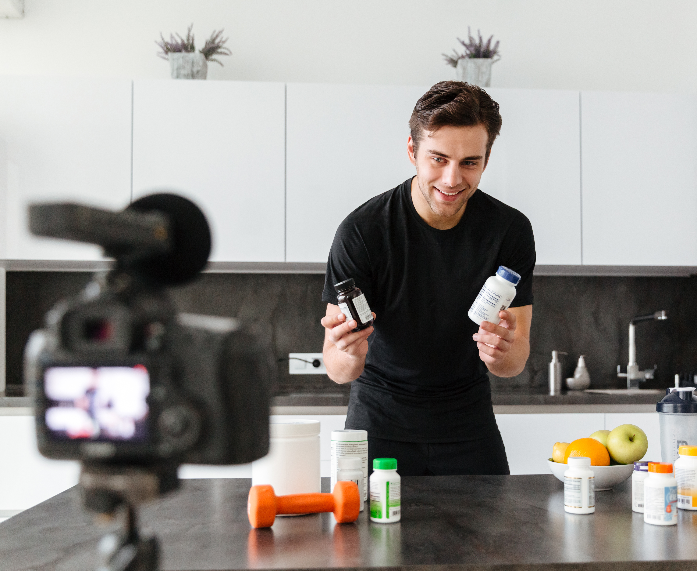
Nutrition Facts from Social Media
Social media helps information spread quickly – but it doesn’t mean that it’s reliable content
Evaluate what you see and read:
Does it sound too good to be true?
Does it suggest restricting entire food groups?
Is it promoting a solution that is “quick” and “easy”?
If the answer is YES, it’s best to move along and find a different source

Slide 7
Nutrition Facts from Family & Friends
Recommendations are often based on second-hand information and their interpretation of something they saw or read
Our health situation and needs are unique - What works for one person may not work for you
Appreciate their advice, but do your homework
Facts change as new research emerges

Slide 8
Nutrition Facts from Health Food Stores
Health food stores know their stuff – and their job is to sell it
They are influenced by company training and products they carry
What they recommend may not be the best option for your needs
There is A LOT of choice out there!
As of 2022, health and wellness industry is worth $4.4 trillion
Experts predict an annual growth rate of 9.9%

Slide 9
Nutrition Facts from Research Articles
We assume we can trust research articles because they are evidence-based – this isn’t always true!
Companies can influence research
Funding sources can influence results
It’s important to look deeper
Who funded the study?
How was the study conducted?
Was a control group used?
How large was the study?
Does it contradict existing knowledge?
Notes:
https://www.zippia.com/advice/health-and-wellness-industry-statistics/#:~:text=The%20health%20and%20wellness%20industry%20is%20worth%20%244.4%20trillion.,5.5%25%20from%202021%20to%202030.

Slide 10
Nutrition… It Can Get Confusing

Slide 11
Notes:
Video Link: https://www.youtube.com/watch?v=5Ua-WVg1SsA

Slide 12
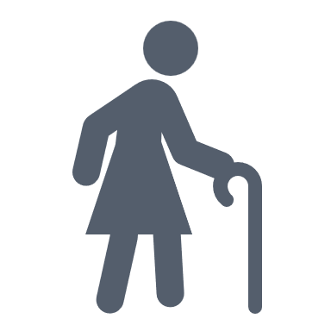
What’s Best For Me?
We all have unique nutrition needs – what works for one person may not work for others
We must view nutrition through a holistic lens that considers:
Biochemical Make-up
Age
Medical History
Gender
Emotional & Mental Health
Health & Wellness Goals
Life Stage
Lifestyle

Slide 13
Myths Debunked

Slide 14
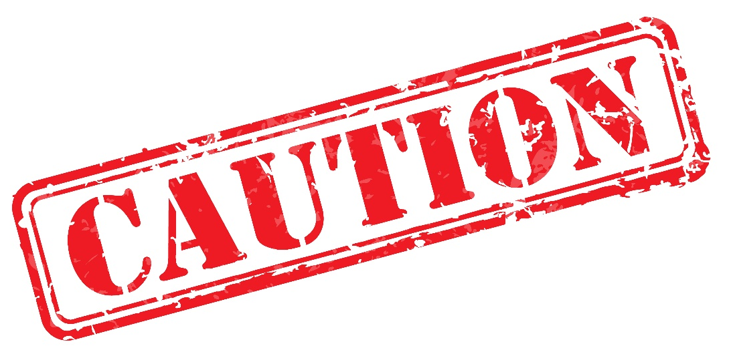
Keep In Mind…
We’ll be debunking common myths, but these are general recommendations only and may not necessary apply to everyone!

Slide 15
Myth: Carbs Are Bad
TRUTH: Carbohydrates are an important nutrient to include in a healthy diet
Carbs get a bad rap for their effect on blood sugar, but healthy carbs offer many benefits:
Absorb into your system slowly
Can improve digestion
Great source of fibre
Source of essential nutrients
Promote serotonin production
Offer a main source of fuel

Slide 16
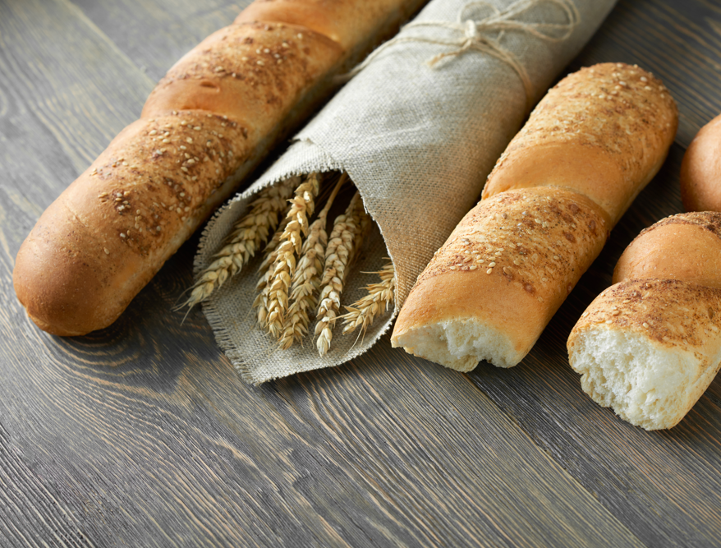
Myth: Carbs Are Bad
Tips on including carbs in your diet:
Choose carbs that are slowly digested and absorbed
Sweet potatoes, steel-cut oats, whole grain pasta, barely, quinoa, lentils, beans, non-starchy vegetables and fruit
Like potatoes? Eat a small portion with the skin and pair it with protein and a ½ tsp of olive oil and vinegar

Slide 17
Myth: More Protein = More Muscle
TRUTH: Muscle is made from protein, but…
Studies show that protein has no benefit on muscle growth beyond 30 grams
Insufficient protein will affect muscle mass

Slide 18
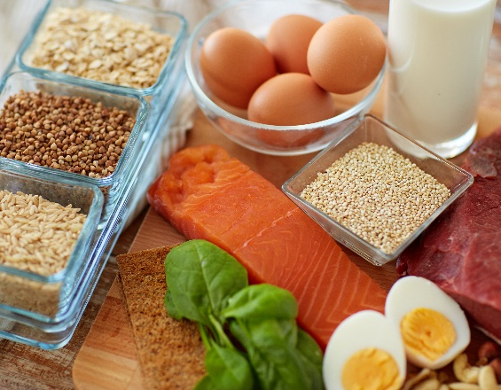
Myth: More Protein = More Muscle
Tips on including protein in your diet:
Consume 0.8 grams of protein per kg of body weight or 0.36 grams per pound
Healthy proteins include lean meats like chicken, turkey, eggs, fish as well as beans, legumes, nuts, seeds
Protein powder should never replace adequate food-based proteins
Choose powders free of chemicals, preservatives and artificial flavours

Slide 19
Myth: Eating Fat Makes You Fat
TRUTH: Fat is an essential part of a healthy diet
We need fat for our body to function properly
Essential fats aren’t produced by the body, so we need to get them from foods
Research indicates that dietary fat is not a determinant of body fat
Walter Willett Study showed that as dietary fat decreased calories, bodyweight increased
Notes:
Study Source: https://www.amjmed.com/article/S0002-9343(01)00992-5/abstract?code=ajm-site

Slide 20
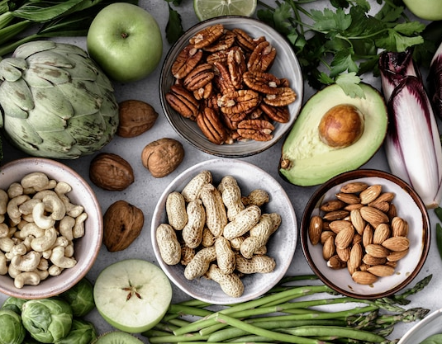
Myth: Eating Fat Makes You Fat
Tips on including fat in your diet:
Include a variety of good fats like olive and grapeseed oil, raw nut and seeds, and avocado
Heathy fats should make up 25% to 30% of your daily intake

Slide 21
Myth: Don’t Eat After 8 pm
TRUTH: Eating past 8 pm isn’t unhealthy if you make the right food choices
Nighttime eating can be a sign that you need more calories in your day
Know how to recognize real hunger (vs thirst, boredom, etc.)
Being in tune with your evening hunger and knowing how to satisfy it can help avoid poor choices that sabotage your health goals
A whole food snack may help to balance your blood sugar and help you sleep better
It’s important to establish a time when you will stop eating for the day

Slide 22
Myth: Don’t Eat After 8 pm
Tips on nighttime eating:
Keep portions small (150 calories or less)
Make it yourself and avoid processed foods
Ideas: Protein balls, small smoothie, roasted chickpeas, veggies and hummus, avocado and cottage cheese

Slide 23
Myth: Organic Food is More Nutritious
TRUTH: Organic food can be more nutritious – but not always!
Organic produce that has long distances to travel is not as nutrient dense as local produce
Products labelled “organic” can still fall into the processed food category, which is not a healthy choice
Many farmers use natural practices but aren’t certified “organic”

Slide 24
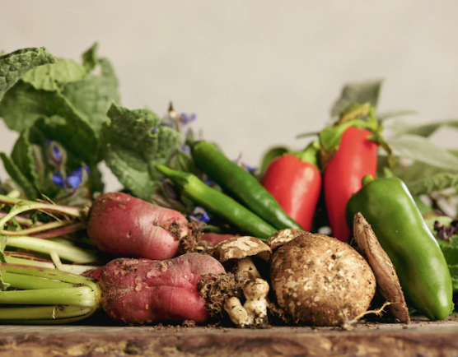
Myth: Organic Food is More Nutritious
Tips on eating organic:
Shop local for produce and protein when possible
Buy organic when it matters
Assess your budget to determine where organic choices will be more beneficial
Consider The Dirty Dozen vs The Clean 15

Slide 25
Myth: Organic Food is More Nutritious
The Dirty Dozen: Crops that farmers tend to use the most pesticides on
Notes:
Source: https://www.ewg.org/foodnews/dirty-dozen.php

Slide 26
Myth: Organic Food is More Nutritious
The Clean 15: Crops with the lowest amount of pesticide residue
Notes:
Source: https://www.ewg.org/foodnews/clean-fifteen.php

Slide 27
Myth: Get What You Need From Supplements
TRUTH: Nutrients work best as they are found in nature
Whole foods contain more than just vitamins and these other components have essential health promoting properties
Isolating vitamins is very different from whole food nutrition

Slide 28
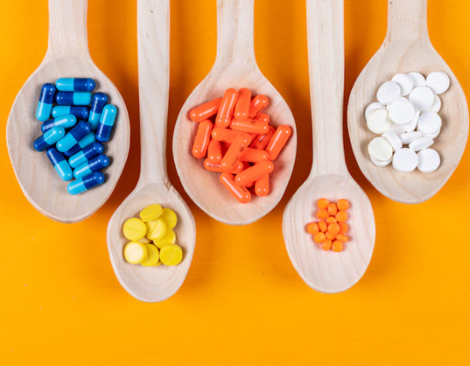
Myth: Get What You Need with Vitamins
Tips on supplement use:
Eat food in its whole form whenever possible for the best nutrition
Food First – Supplements Support
A diet based on whole foods, balance, and variety is key
Supplements are insurance that you’re getting vitamins and minerals you may be lacking

Slide 29
Finding the Right Information

Slide 30
Who Has the Facts?
Speak with your doctor, but follow up with a Nutritionist or Registered Dietitian
Get some guidance from a wellness consultant
Do your own research and look for the most accurate and reliable information
HOW?

Slide 31
Strategies to Identify Reliable Information
Does it list an author? Ideally it’s a Registered Dietitian (RD) or Professional Dietitian (PDt) – titles that are regulated
Has it been peer reviewed? This involves other field experts evaluating the research to help ensure quality
Does it list sources? Claims should be supported by scientific research and ideally more than one
Does it promote a product? Results that promote product(s) is often anecdotal and is subject to bias
Does it sound “too good to be true”? If so, it likely is. Quick fixes and miracle cures are sure indicators that it’s not accurate content
Is it free of grammatical errors? These mistakes hurt the credibility of the author – good content makes the effort to be written well
Notes:
Source: https://wellness.uoguelph.ca/services/health-services/all-health-services/dietitian-services/student-diet-nutrition-faqs/six

Slide 32
If you’re concerned about your health, you should probably avoid products that make health claims. Why? Because a health claim on a food product is a strong indication it’s not really food, and food is what you want to eat.
- Michael Pollan

Slide 33
Thank You for Participating
Questions?
Images from Freepik

