Slide 1
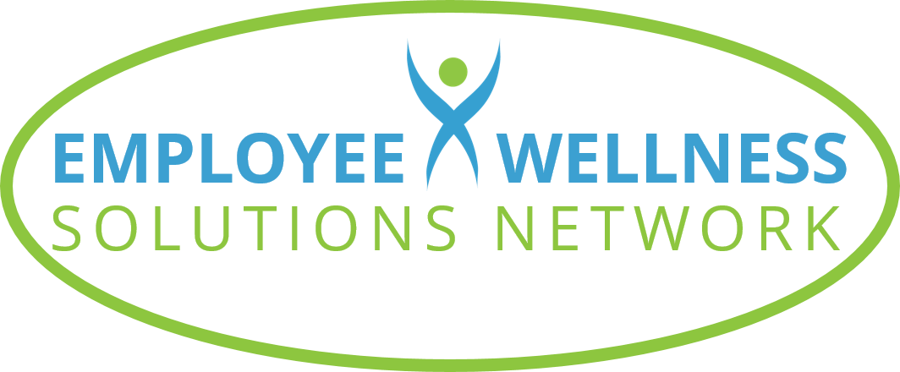
©2023 EMPLOYEE WELLNESS SOLUTIONS NETWORK INC. – ALL RIGHTS RESERVED

Slide 2
TODAY’S FOCUS…
Recognize the value and importance of physical activity to your well-being
Understand ways you can add more movement to your day
Know what you need to do to set yourself up for success and stick with it

Slide 3
The Need for Movement

Slide 4
Get off your butt!
Canadians spend 9.8 hours each day sitting - many sit for 13 to 15 hours every day!
Excessive sitting is linked to many diseases and conditions:
Obesity
Hypertension
Back pain
Cancer
Cardiovascular disease
Depression
Notes:
Excessive sitting is a fairly new problem in human history. Two hundred years ago, 90% of the world lived in agricultural communities. People sat for three to five hours per day, but only to take breaks from working. Today, Canadian adults spend an average of 9.8 hours sitting each day, but many of us sit for 13 to 15 hours per day! Excess sitting now is linked with many diseases and conditions, including obesity, hypertension, back pain, cancer, cardiovascular disease and depression.
Regular physical activity is one of the most important things you can do for your health. Being physically active can improve your brain health, help manage weight, reduce the risk of disease, strengthen bones and muscles, and improve your ability to do everyday activities.

Slide 5
You were made to MOVE!
Regular physical activity
Improves brain health
Helps manage healthy weight
Reduces risk of disease
Strengthens bones and muscles
Increases flexibility
Improves functionality
Notes:
Your body is meant to move! Busy schedules and daily demands on our time have many people opting out of the gym and shying away from lengthy workouts. Our lifestyles may be busy, but that’s not a license to be sedentary. Regular physical activity is one of the most important things you can do for your health. Being physically active can improve your brain health, help manage weight, reduce the risk of disease, strengthen bones and muscles, increases flexibility, and improve your ability to do everyday activities.

Slide 6
Move mindfully
Listen to what your body needs
Take a holistic approach
Build on this with functional movement
Consider alignment and form
Exercise based on your ability and level
Notes:
Mindful movement is listening to your body. It’s checking in with your body and what it’s asking for in terms of physical activity.
Take a holistic approach to movement. Think of your body as a unit. You want it to be a well-oiled machine where all components are connected and working together. Exercise is a way that connects you from head to toe. Be aware of your body and how it feels and incorporate your mind and breath to keep you focused.
Functional movement is all about working your body in the way that it is designed to be used. Alignment and form are essential. If your joints are straining or you feel pain, chances are it’s not the right exercise for you or you’re doing it incorrectly. Ensure you master proper form when exercising to help you stay injury-free. Your workouts should also be based on your ability and fitness level. You don’t need to push yourself to the point that you struggle to make it up a flight of stairs the next day. Smaller workouts, done more often, can have a better outcome.

Slide 7
Fitting in Fitness

Slide 8
You DO have the time
Let go of the “no time” excuse to exercise
Fitting in fitness is about making it a priority
Notes:
Do you scroll through your social media feed numerous times a day? Do you tend to say “yes” to virtually every request friends and family make? Can you spend ages surfing Netflix or Pinterest? It’s time to let go of the “No Time” excuse to exercise. Fitting in fitness is simply about making exercise a priority. Let’s look at some different approaches and tips to help you do that.

Slide 9
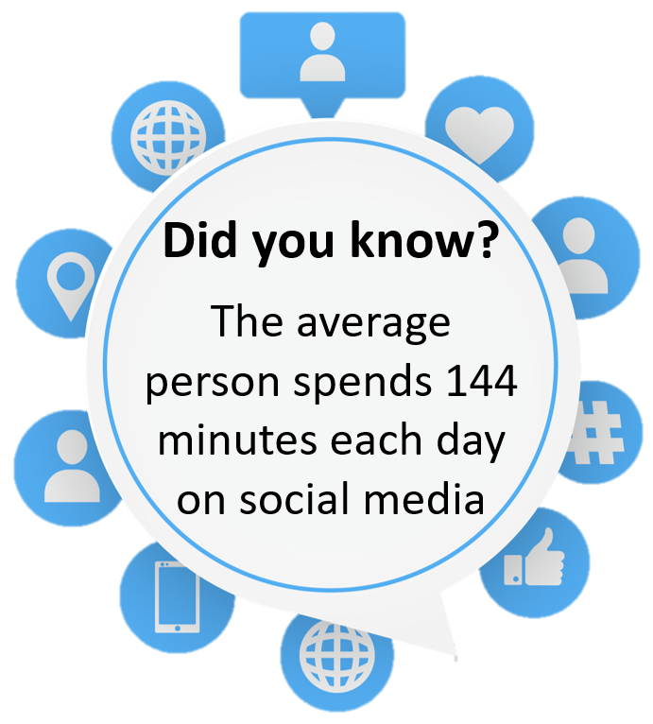
Finding opportunities to move
Pay attention to where you’re spending your time
Turn “time suckers” into minutes of movement
Add movement to everyday activities
Notes:
We all have 24 hours a day, yet some of us find time to fit in exercise, while others blame busy schedules and responsibilities for neglecting our physical activity. Take note of how you’re spending your time. Are there “time suckers” that you can turn into minutes of movement? Or are there activities that you can incorporate movement into?

Slide 10
Finding opportunities to move
Instead of… | Try…
Lounging during a movie | Sitting on an exercise ball
Idly waiting for the microwave | Dance in the kitchen
Sitting in a coffee shop | Enjoy a walking coffee date
Scrolling through social feeds | Do a 10-minute workout
Standing as you brush your teeth | Hold a wall-sit as you brush
Sitting in the boardroom for meetings | Have a walking meeting
Notes:
Sometimes we just need to change our thinking and approach simple activities differently. Here are a few examples of how we can do that.

Slide 11
Stack your habits
Pair movement with your daily habits and tasks
Meditate for 1 minute after pouring your morning coffee
March on the spot as you catch up on social media posts
Enjoy 10 minutes of yoga, light stretching, or deep breathing before you climb into bed
Put on workout gear immediately when changing out of work clothes
Follow dinner with a family walk
Notes:
Habit stacking is a strategy that focuses on introducing small changes by building onto your existing routine. Rather than try to schedule a new habit into your day, pair with something you already do. Approaching physical activity as part of the things that you already do can help reduce the likelihood that you’ll find an excuse not to do it. Like most things, the more you do it, the more natural it will feel!

Slide 12
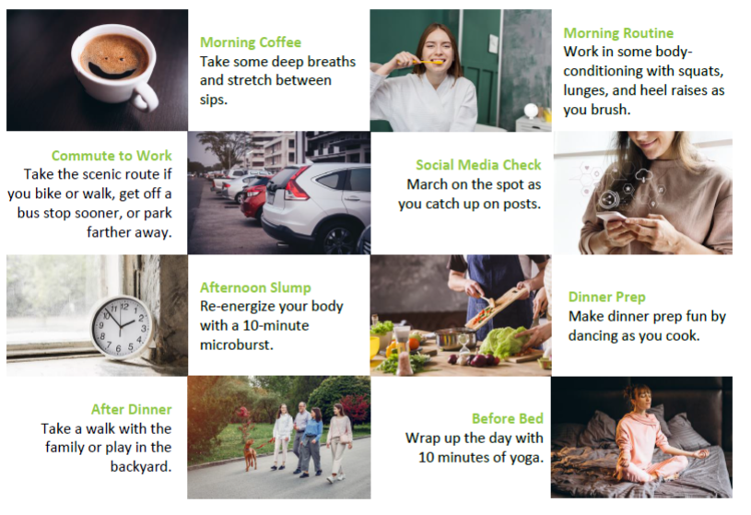
Stack your habits
Notes:
Habit stacking is a strategy that focuses on introducing small changes by building onto your existing routine. Rather than try to schedule a new habit into your day, pair with something you already do. Approaching physical activity as part of the things that you already do can help reduce the likelihood that you’ll find an excuse not to do it. Like most things, the more you do it, the more natural it will feel!

Slide 13
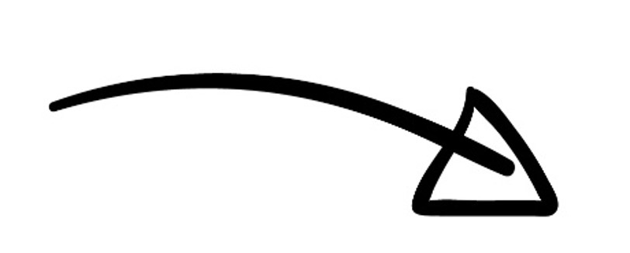
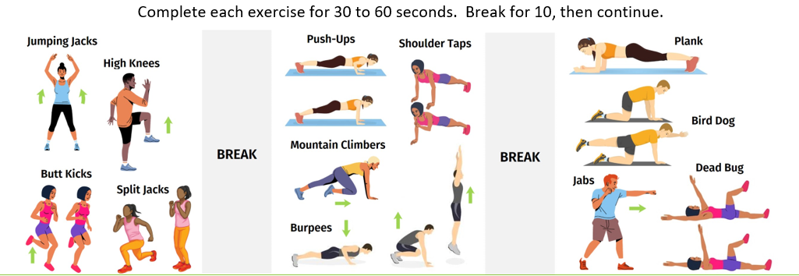
Microbursts
Microburst workouts to try
Only 10 minutes for a full-body workout
Notes:
Sneak exercise into your day with microbursts. Microbursts are small intervals of simple exercises that give you a full-body workout and increase your energy levels. It only takes 10 minutes – ideally at one time, but you can also look for ways to accumulate movements throughout the day. Integrating microbursts into your day can have a big impact on building fitness.

Slide 14
Take back the break
Don’t skip your breaks
Taking breaks increases productivity and restores focus
Make them active breaks
Take a walk
Squeeze in a microburst
Stretch
Notes:
Many of us skip our breaks and work through lunch in an effort to be more productive. In reality, taking breaks throughout the day increases productivity and restores focus. Maximize the benefits by adding movement to these pauses. Extensive research shows the importance of active breaks. Long periods of sedentary behaviour are linked to a variety of health problems such as weight gain, diabetes, and depression. Taking advantage of the opportunities to move our bodies helps to reduce these risks. So, take your breaks! It’s a simple change that will benefit your body and overall health!

Slide 15
Stretch it out
Don’t underestimate the value of stretching
Mental pause to help reduce stress
Boosts energy levels
Improves balance and posture
Reduces muscle fatigue and soreness
Notes:
Sitting or standing for long periods can take a toll on your body and mind. Although you may not consider stretching when you think of movement, it offers a lot of value – especially since many of us spend so much time sitting while we work. Stretching provides a mental break to help reduce stress. It also increases energy, improves balance and posture, and reduces muscle fatigue and soreness. Do some simple stretches throughout the day to increase circulation and stay focused and productive.

Slide 16
How to Stick With It

Slide 17
Set yourself up for success
Be Objective
Commit
Notice
Adjust
Notes:
Once you’ve made the commitment to adding more movement to your lifestyle, you want to set yourself up for success. There are four techniques that will help you approach physical activity the right way – for you – so you’ll stick with your plan long-term.

Slide 18
Set yourself up for success
Be Objective
Commit
Notice
Adjust
Track your current routine
Note where changes can add movement
Mindset matters – set realistic expectations
Define your WHY
Notes:
Be objective when you start. For one week, track your current routine and record how you spend your time. At the end of the week, review and take note of where small adjustments can be made to incorporate more movement. Your mindset matters as well. It’s important to set and maintain realistic expectations. Think of exercise as a means of caring for your body and define why exercise matters to you. Go beyond “I want to lose 50 lbs” or “I want to fit into my skinny jeans” and find your WHY. Working out shouldn’t be a punishment or a chore, but a way to care for yourself and help you achieve your ultimate goal.

Slide 19
Set yourself up for success
Be Objective
Commit
Notice
Adjust
Define a realistic schedule that works with your lifestyle
Approach exercise like an important commitment
Block time in your calendar
Set reminders
Use an APP
Notes:
Come away from the idea that you have to spend hours in the gym or that workouts are always long and draining. Find a schedule that works for you, and that will help you stick to it. Schedule exercise in your week like you would any other important commitment. Set aside 30 minutes or several 10-minute blocks. Blocking off time in your agenda or setting reminders on your phone can help keep you accountable.

Slide 20
Set yourself up for success
Be Objective
Commit
Notice
Adjust
Take note of changes – big and small
Celebrate wins
Notes:
Make a conscious effort to note changes you observe as a result of sticking to your plan to move. Do you have more energy? Do you feel less stressed? Do your clothes fit better? Use these wins to keep you motivated.

Slide 21
Set yourself up for success
Be Objective
Commit
Notice
Adjust
Set an intention with your movement
One size does not fit all: consider your interests, fitness level, injuries and goals
Work WITH your body – and adjust if needed
Notes:
Set an intention and move to give your mind and body what it needs. One size DOES NOT fit all when it comes to exercise. Do what your body is designed for, keeping injuries, conditions, preferences, and goals in mind. Explore the idea that movement can alter your mood. Use it to treat tightness or injury and notice how your mind and body are responding. If what you’re doing is working, stick with it, but if needed, know that you can adjust. If you can add more time for movement, do it. If what you committed to is feeling like too much, scale it back. Work WITH yourself and your body.

Slide 22
Don’t wait to start
Avoid getting stuck planning the perfect routine
Start where you are with what you have and build
Notes:
The best way to move forward with something is to get started! Start at a reasonable level and build from there. Avoid getting stuck in the planning phase, thinking that you need to have a gym membership or a specific room in your home filled with every piece of equipment. Start with what you have and build as you get stronger and discover what you enjoy. Procrastination is self-defeating and promotes negative feelings, and those have no place in your plan!

Slide 23
Do 5… then decide
You can do something for at least 5 minutes!
Commit to doing something for 5 minutes before quitting…
Once you start, you’re more likely to keep going
Notes:
Most things are bearable for at least 5 minutes, right? Keep that in mind when starting a workout that you’re not excited about and has you longing for the couch. Start your workout and give yourself permission to give in to the couch if it’s still overwhelmingly more appealing after 5 minutes. You’ll find that most of the time, that won’t be the case. You’ll be 5 minutes into your workout and motivated to get it done!

Slide 24
A few final tips
Something is always better than nothing
Choose movement that offers maximum benefit
Hectic is NOT aerobic
Notes:
Something is always better than nothing. Walking around the block is better than heading to the couch after dinner. Climbing a few flights of stairs is better than flipping through your phone while standing in the elevator. Lapping the parking lot before getting groceries is better than snagging the closest parking spot. Opportunities to move are everywhere!
Choose movements that offer maximum benefit. Our busy lifestyles often don’t leave us with many extra minutes. When demands leave you short on time, maximize the time you have on exercises that will deliver the most benefit. A few rounds of Tabata or a 4-minute microburst pack a workout punch compared to a leisurely walk.
Hectic is NOT aerobic. Some days you feel like you’ve been moving non-stop. Even though you feel like you’ve run a marathon, how much of that time was spent exercising? It’s still important to get your heart rate up and move through a full range of motion to strengthen your muscles.

Slide 25
Obstacles can’t stop you. Problems can’t stop you. People can’t stop you. Only you can stop you.
- Jeffrey Gitomer

Slide 26
Thank You for Participating
Questions?
Images from Freepik

