Slide 1
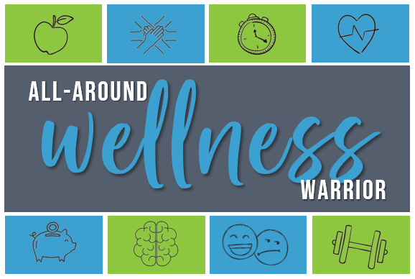
Join us for a 14-day challenge that will focus on simple, good-for-you habits like eating well, being active, managing stress, connecting socially, and more!
You CAN do it all and become an all-around wellness warrior!
Challenge Begins On:

