Slide 1
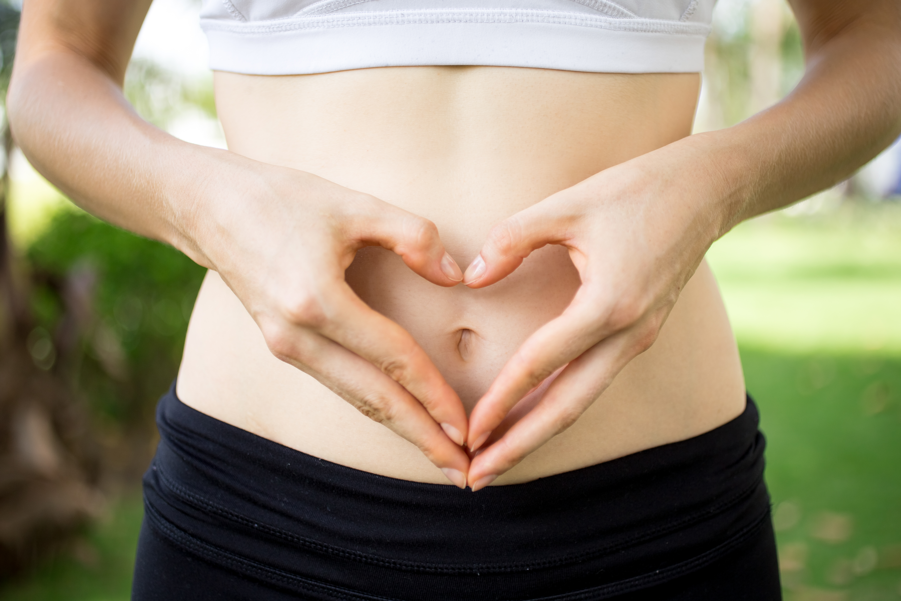
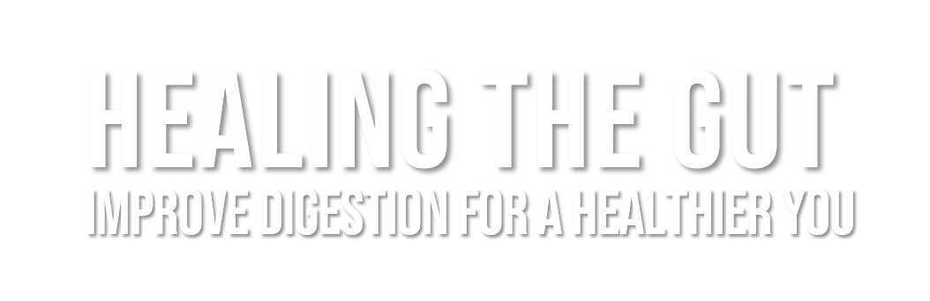


©2023 EMPLOYEE WELLNESS SOLUTIONS NETWORK INC. – ALL RIGHTS RESERVED

Slide 2

TODAY’S FOCUS…
Learn what a healthy BM is all about
Get to know your body’s microbiome
Understand the relationship between your gut and the rest of your body
Identify how to fuel your body with gut-friendly foods
Warning to viewers… we will be discussing poop

Slide 3
The Scoop on Poop

Slide 4
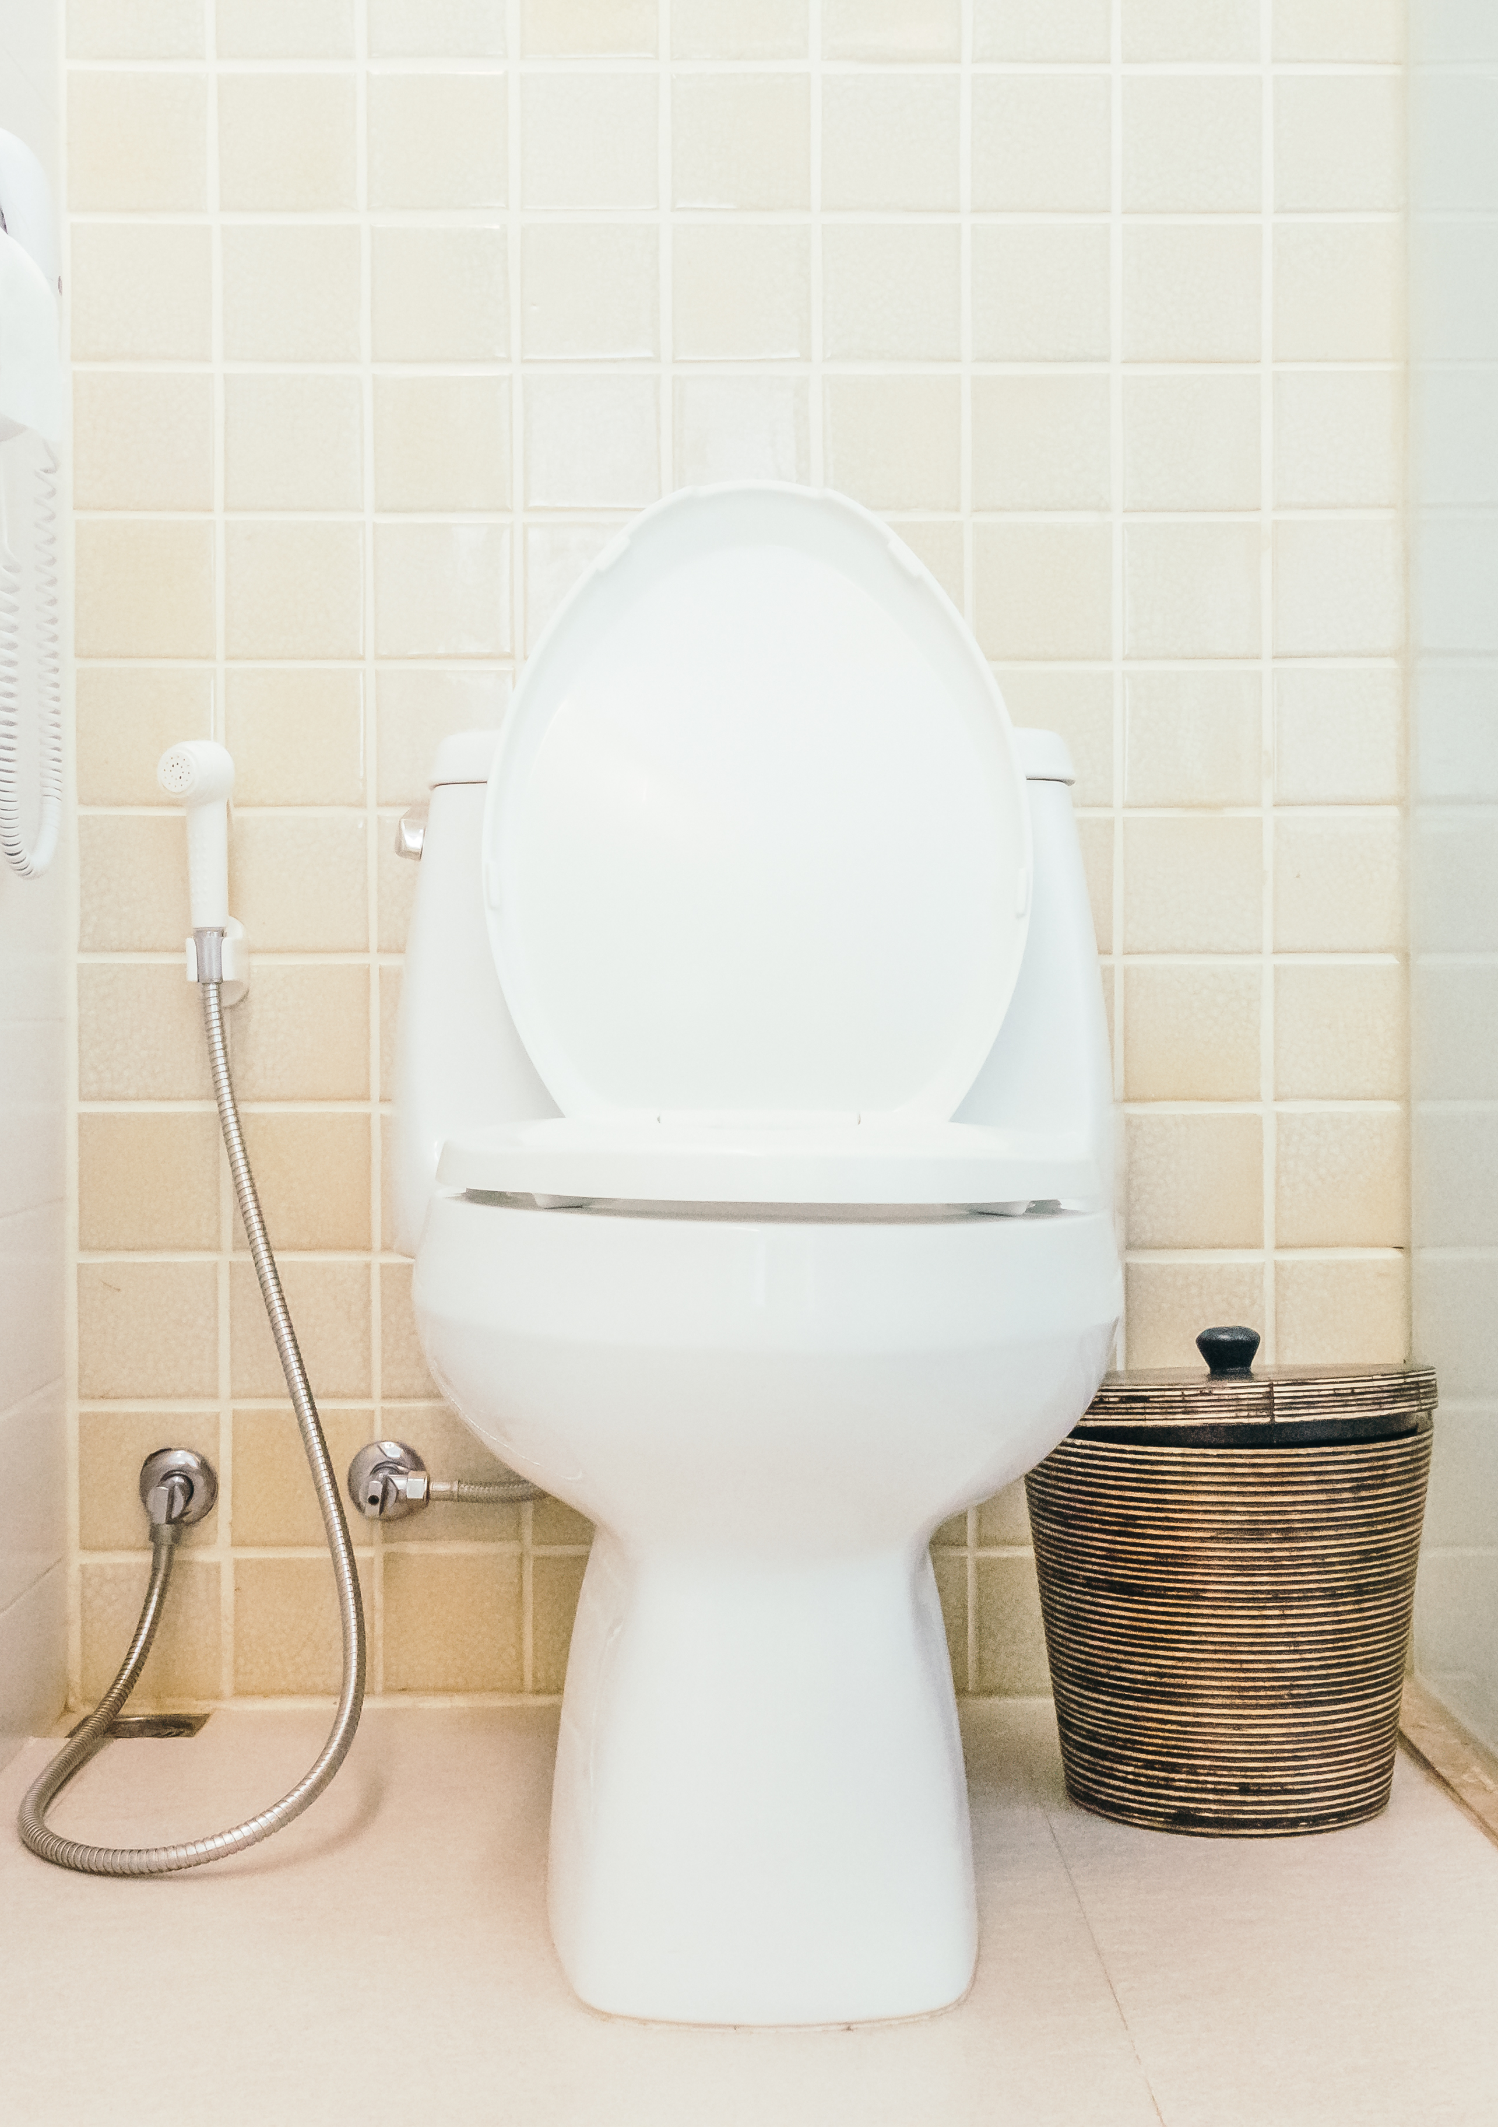
When it comes to BMs…
What’s “normal”?
Healthy bowel habits can vary depending on your digestive health, diet, lifestyle, and stress levels.
Good rule of thumb = 1 to 3 times per day
  More could mean food sensitivity, virus, bacteria, or gastritis
  Less could be constipation
Pay attention to what’s “regular” for you
Notes:
Our bowel habits is one of those things that makes us unique, but it’s not exactly dinner table conversation. We may not like to talk about poop, but it’s one of the greatest investigative tools for our health. Those small, digestive discomforts can sometimes be alleviated with simple dietary changes, or they could be warning signs of something gone awry. Understanding what your poop is telling you is a great place to start. But what’s “normal” and what does it mean when we talk about being “regular”?
Healthy bowel habits can vary greatly from person to person depending on the state of health – especially digestion – diet, lifestyle, and stress. When it comes to frequency, a good rule is 1-3 times a day. Any more and than that may be a sign of something abnormal like a food allergy or sensitivity, a virus or bacteria, or gastritis. Less than 3 times a day may be considered constipation, less than once a day may be a red flag for issues. Pay attention to what seems consistent for you. As long as it is not accompanied by abdominal pain and distention, gas, bloating, or other signs of digestive upset, odds are that this is what is normal for you!

Slide 5
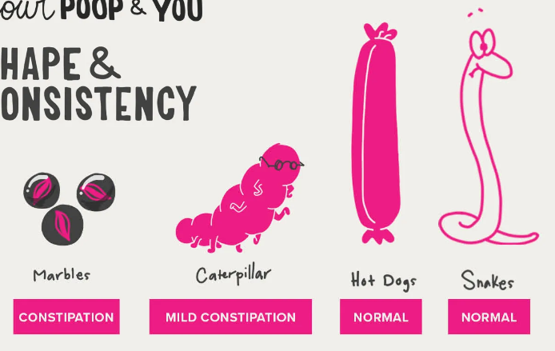
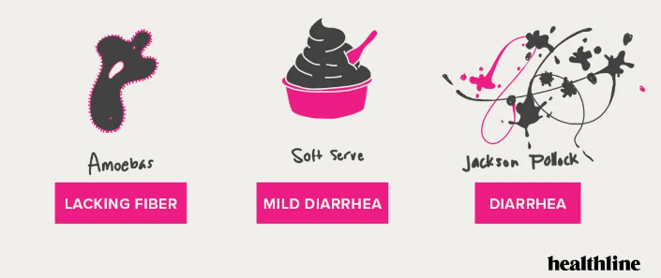
What does a healthy poop look like?
Colour, shape, size, and consistency are clues to your digestive health
Notes:
Although healthy poop can be as varied as the individuals who make it, there are a few general rules to follow if you want to assess your BMs for optimum health. The colour, shape, size, and consistency of your poop are clues to pay attention to.
Image source: https://www.healthline.com/health/digestive-health/types-of-poop#bristol-stool-chart

Slide 6
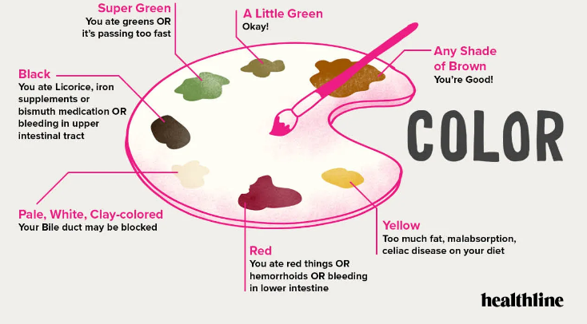
Colour
Red flags down if it’s brown! (or a little green)
Notes:
Your poop’s colour can be a helpful signal about what’s going on within your body. The colour of your stool is a combination of bilirubin – which gives your stool a lovely shade of brown – what you eat, and bile. Any shade of brown is A-OK. Even a hint of green is considered healthy. But if you notice a change in colour that you can’t account for, it’s important to take note. An unusual colour in your stool, consider it your body’s way of sending a signal to pay attention. While it’s likely that a colour change is nothing serious, if you notice a consistent change, take note, and check in with your doctor.
Image source: https://www.healthline.com/health/digestive-health/types-of-poop#bristol-stool-chart

Slide 7
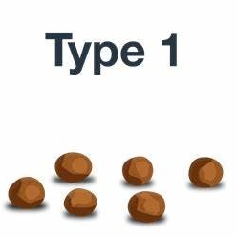
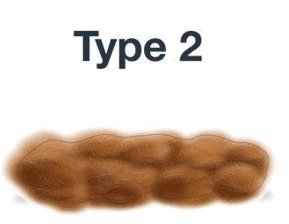
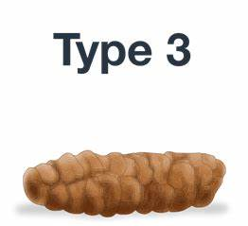
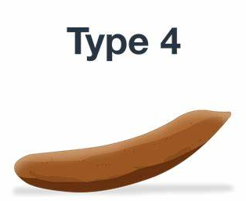
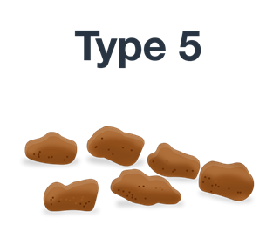
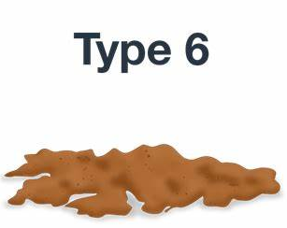
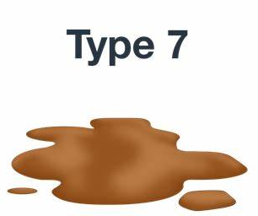
Shape & Consistency: Bristol Stool Chart
Separate hard lumps, like nuts. Hard to pass. | Sausage-shaped, but lumpy. | Sausage-shaped, but with cracks on surface. | Sausage or snake-like. Smooth and soft. | Soft blobs with clear-cut edges. | Fluffy pieces with ragged edges. | Entirely liquid. No solid pieces.
Notes:
The Bristol Stool Chart is a globally recognized medical aid developed by Dr. Ken Heaton from the University of Bristol in 1997. It’s a self-diagnostic tool to help patients feel comfortable discussing their bowel habits. It classifies stool into 7 different types based and is used as a tool to track any gastrointestinal distress, food allergies, malabsorption issues and implement strategies to improve the digestive process.

Slide 8
Shape & Consistency: Bristol Stool Chart
Separate hard lumps, like nuts. Hard to pass. | Sausage-shaped, but lumpy. | Sausage-shaped, but with cracks on surface. | Sausage or snake-like. Smooth and soft. | Soft blobs with clear-cut edges. | Fluffy pieces with ragged edges. | Entirely liquid. No solid pieces.
Possible constipation
Ideal
Possible inflammation
Notes:
Understanding what to look for in terms of shape and consistency can help you identify if your stool is in the healthy range.

Slide 9

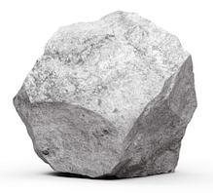
Sink or Float
Bottom of the bowl, you’re on a roll!
Floating stool could signal digestive issues
Often contains gas from poorly digested foods, intolerances or pathogens
Notes:
“Bottom of the bowl, you’re on a roll!” A floating stool can be a sign of digestive woes. A stool that floats often contains gas from poorly digested foods, intolerances or pathogens. Fat malabsorption, in particular, is a popular cause, especially when combined with a colour change, a foul odor, and the appearance of a “sticky” or greasy stool.

Slide 10

Smell
Smell is based on diet and bacteria in the intestinal tract
Foul smell can indicate an imbalance
  Sign of a food allergy, inflammation, or bacterial infection
  Change in odor along with diarrhea, pain, blood, or mucous means it’s time to visit the doctor
  Medications can also cause a change in odor
Notes:
Even a healthy, well-formed, consistent stool will have a smell. The smell is based on diet and the makeup of bacteria in the intestinal tract. While it may not be a scent you want to leave behind, odor is normal. A foul smell, however, can indicate an imbalance in the system. Undigested food can putrefy and ferment in the gut causing a “rotting” odor. A bad odor can be the sign of a food allergy, inflammation, or bacterial infection. Certain medications can also be culprits. If you are noticing a consistent change in odor, accompanied by symptoms like diarrhea or runny stool, abdominal pain, blood or mucous, make an appointment with your physician for further investigation.

Slide 11
Getting to Know Your Microbiome

Slide 12
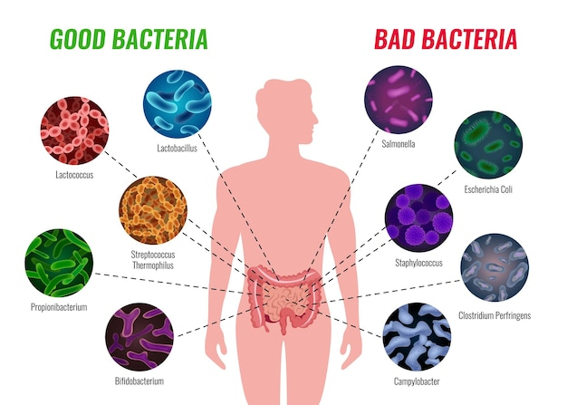
The Good and the Bad
30 to 50 trillion good and bad bacteria live in your body
Notes:
Did you know that there are, on average, 30 to 50 trillion bacteria living in your body?
You constantly have both good and bad bacteria in your body. When you get an infection, there's more bad bacteria, knocking your system out of balance. Good bacteria helps eliminate extra bad bacteria, returning the balance.

Slide 13

Your Personal Ecosystem
Microbiome noun
  : A community of organisms (bacteria, fungi, viruses) inhabit a particular environment and especially the collection of microorganisms
  living in or on the human body
Notes:
The majority of the bacteria in your body is housed in the gut and is referred to as your microbiome. Our microbiome is the most unique component of our existence. It’s influenced by genetics, diet, lifestyle, and geography. Every day we are exposed to factors that either support the beneficial microbes or the pathogenic ones.
These bacteria contribute to and regulate the systems of human metabolism, digestion, physiology, cognition, and immune function. They are an interesting topic of research and are a vastly underrated contributor to human health. We know that if the gut is not properly nourished, gastrointestinal symptoms may develop such as bloating, cramping, heartburn, reflux, nausea, diarrhea, and constipation. New research, however, implicates an imbalanced microbiome leads to an increased risk of almost every chronic disease: heart disease, diabetes, autoimmune diseases like fibromyalgia and MS, autism/ADHD, obesity, allergies, and Parkinson’s Disease.

Slide 14
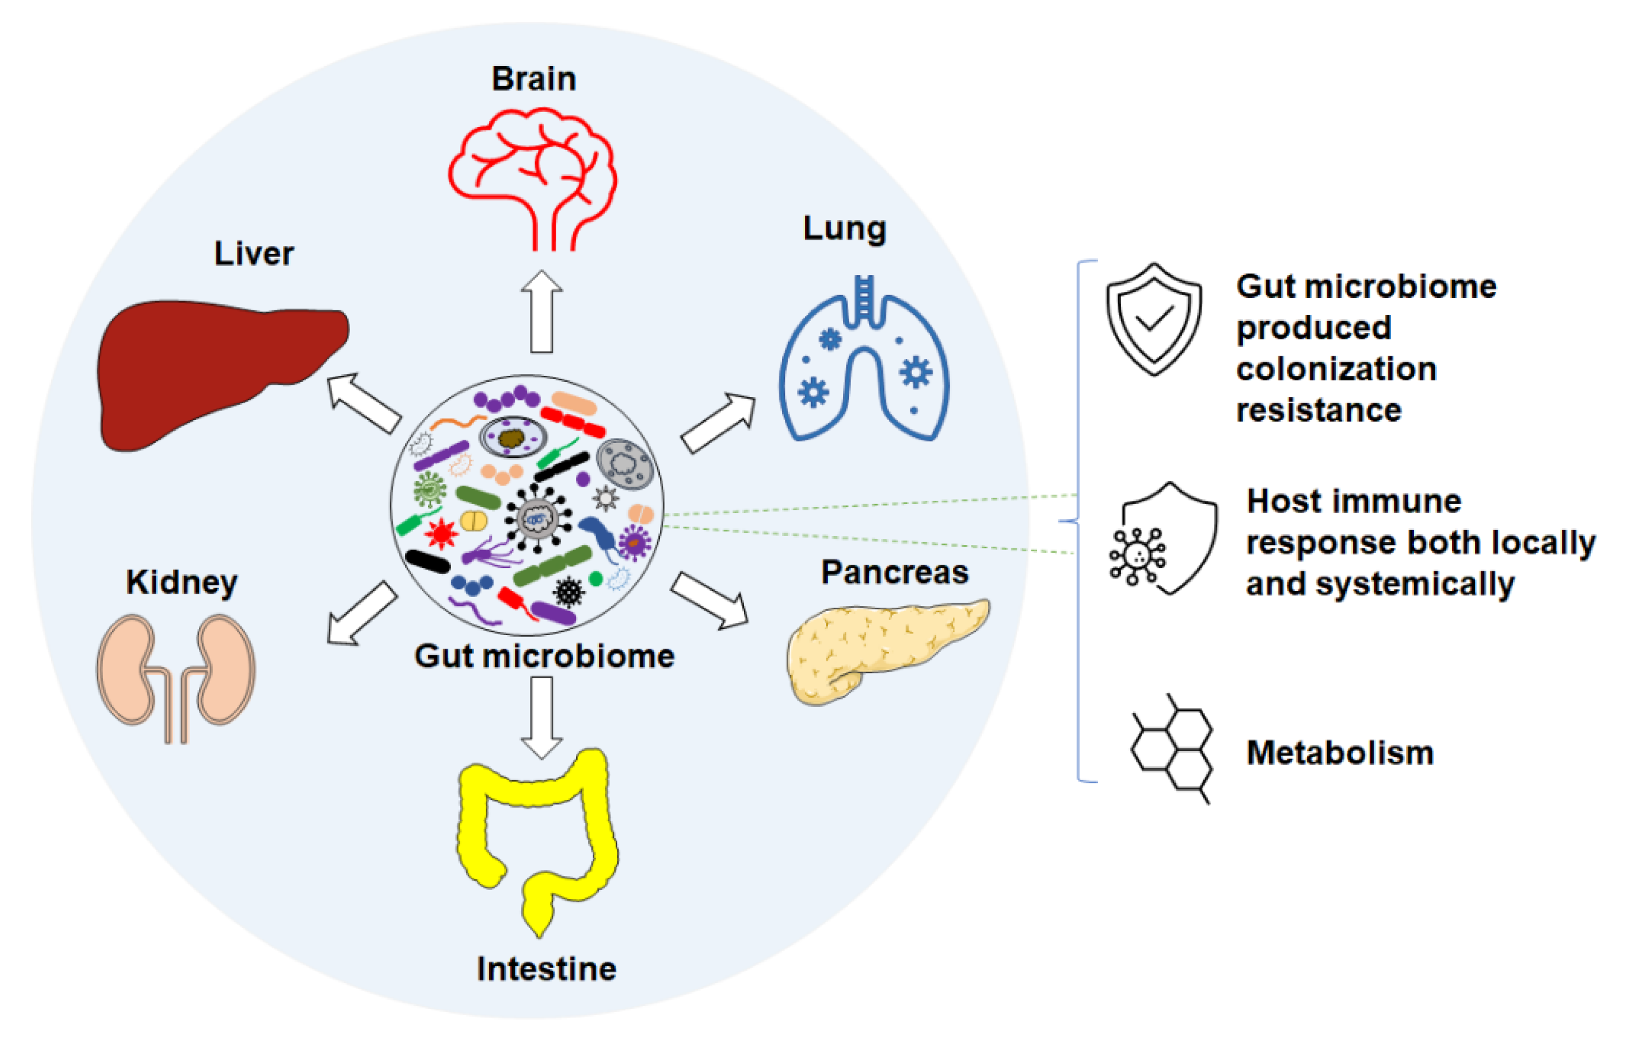
Your Personal Ecosystem
Notes:
Think of your gut as a delicate ecosystem – like an aquarium filled with different species of aquatic life. Fish, algae eaters, and plants make up a complex network, each with their specific roles. Plants filter the water, snails control algae levels, larger fish act as predators. All work to protect and balance their environment and compete for survival. When a threat disrupts its balance, the community shifts. The person responsible for the aquarium must ensure that every facet of this ecosystem has the food and resources required to survive. When anything seems off-balance, adjustments are made and monitored until homeostasis returns.
Image source: mdpi.com/2076-2607/9/5/1062

Slide 15
Your Gut and Everyday Life

Slide 16

The Gut-Body Relationship
Every system, organ, cell, tissue depends on your digestive system
Poor gut health = fatigue, pain, mood imbalance, immune issues, etc.
Notes:
Your gut affects your whole body and research continually emphasizes the power of digestion on your overall health. The digestive system changes the food that you eat into the energy and nutrients needed for your body to function efficiently. The health of every system, every organ, every cell and tissue depend on how well digestion is working. Poor gut health may make itself known through obvious symptoms like abdominal pain, gas, bloating, and unpredictable bowels, but it can also show up in the form of fatigue, joint pain, mood imbalance, and immune issues.

Slide 17

The Gut-Body Relationship: Energy Levels
Stress, hormones, posture, inactivity, food sensitivities affect your digestion
Poor digestion means your gut has to work harder, which ties up body’s energy
Notes:
Feeling Sluggish? Digestion is affected by stress, hormones, posture, lack of exercise, food sensitivities, and other imbalances. Poor digestion can lead to undigested food particles causing irritation as they make their way through the intestines. This can lead to gas, bloating, heartburn, and digestive disorders. The digestive system also ties up a lot of the body’s energy, and when things go wrong, your digestive system has to work harder. As the capacity to fully digest food decreases, so can your energy levels.

Slide 18

The Gut-Body Relationship: Mood
Gut-brain axis: neural network between your gut and your brain
Imbalanced gut = imbalanced moods
Notes:
Feeling moody? It might be your second brain. There is a direct link between the gut and the brain through an intricate neural network called the gut-brain axis. In fact, the gut contains the same tissue and produces the same chemicals as your brain! Healthy gut bacteria are building blocks to the production of serotonin and dopamine, the neurotransmitters that determine our emotional state. If your gut bacteria are imbalanced, so are your moods!

Slide 19

The Gut-Body Relationship: Illness
70% to 80% of your immune system lives in your gut
If you want to boost immunity, look to the gut!
Notes:
Too many sick days? If you feel like you catch every cold and flu around, you may need to look at improving the health of your gut. The gastrointestinal immune cells are the largest population of immune cells in the body, making up between 70% and 80% of your immune system. Gut flora and immune cells work and communicate synergistically to defend against pathogens like viruses and bacteria. They strengthen the gut wall, regulate inflammation, and produce antibodies against invaders.

Slide 20

Helpful Habits
Exercise
30 to 60 minutes is recommended
Helps increase blood flow and circulation
Reduces inflammation
Keeps bowels regular – reduces toxic load in colon
Notes:
EXERCISE is essential for healthy bowel movements and lowers your risk of colon cancer! Exercise helps to increase blood flow and circulation, reduces inflammation, and keeps the bowels regular reducing the toxic load in the colon. 30 to 60 minutes of moderate to vigorous activity is recommended. Anything works! Do something you love and rotate your exercises.

Slide 21
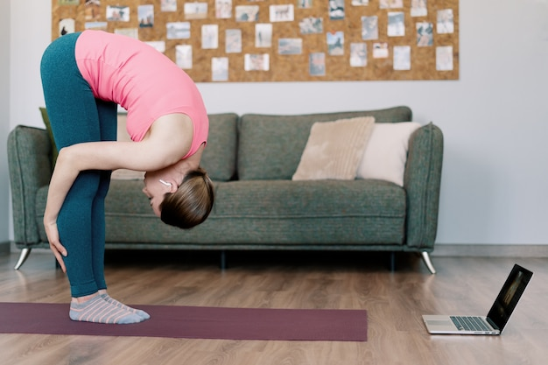
Helpful Habits
Stretching
Spinal twists can prevent stagnation
Pulling knees to chest can relieve gas and bloating
Forward bend messages the belly and can easy stomach pain
Notes:
STRETCH IT OUT daily. Your organs are muscles too and when digestion is stressed, some basic stretches can help stimulate the organs and promote better digestion.

Slide 22
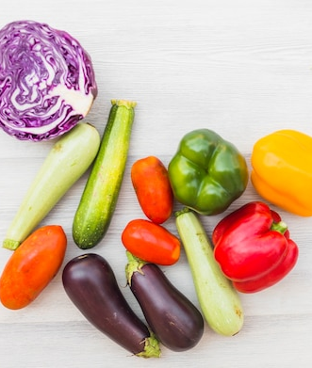
Helpful Habits
Healthy Eating
Foods you eat can impact the type of bacteria found in your digestive tract
How you eat also matters
  Eating too quickly
  Skipping meals
Notes:
While it’s not the only reason for digestive issues, your diet can often be the culprit. What you eat can contribute to digestive problems. Many people eat too much processed food and sugar, and not enough fibre, fruits, and vegetables. Poor eating habits, such as eating too quickly or skipping meals, may also be part of the problem.
Let’s spend some time looking at gut-friendly foods in more detail.

Slide 23
Fuel Up With
Gut-Friendly Foods

Slide 24

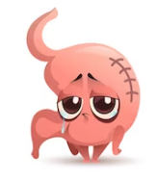
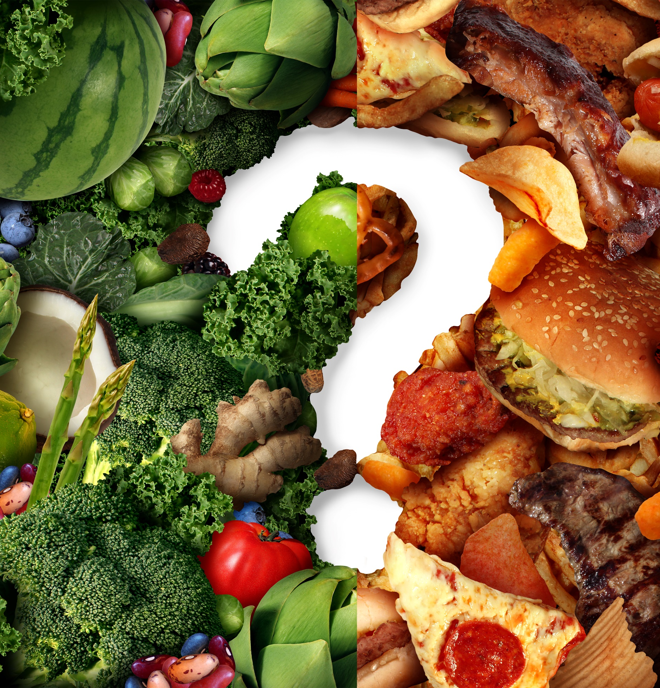
Whole Foods vs Processed Foods
Digestive Supporting
Fibre
Water
Antioxidants
Enzymes
Vitamins & Minerals
Nutrients
Natural synergy
Digestive Depleting
Sugar
Salt
Fats
Additives
Lacking fibre, nutrients, etc.
Notes:
Adjusting what you eat and how you eat can be simple changes that help you avoid becoming a statistic. One of the easiest strategies for digestive health is to fuel up on whole, natural foods that will strengthen digestion. Like an oil change for your car, a diet made up of easy-to-digest foods can tune up the engine, clean out the lines, and allow things to run efficiently. Knowing what to eat in order to give your digestive system what it needs to stay healthy is a powerful tool.
Listen to your body… As you make the shift to more whole, unprocessed foods, pay attention to how you feel after meals. We often neglect our awareness of how our body feels and its connection to the food choices we make. Eat foods that make you feel your best!

Slide 25
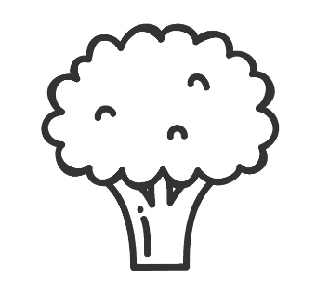

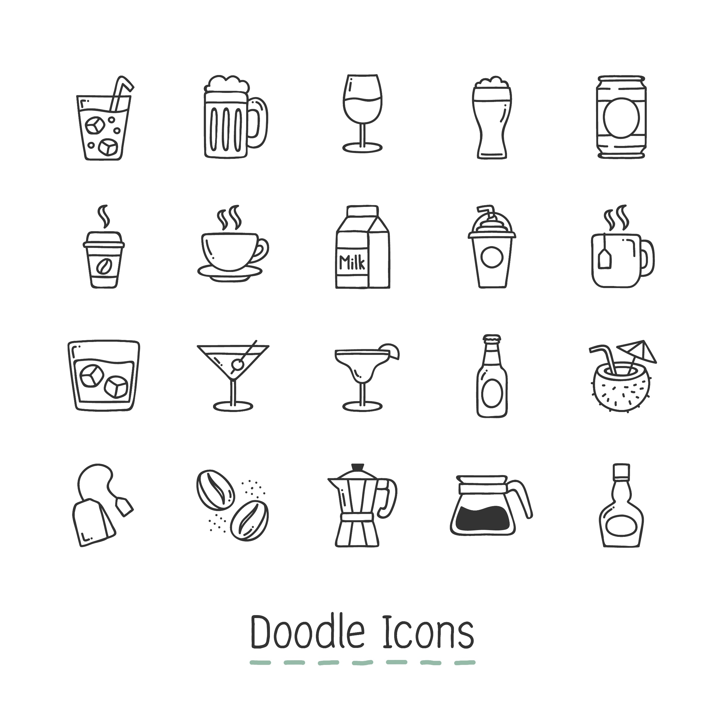
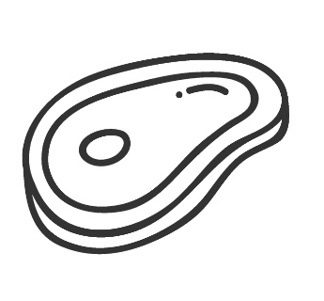
Nutrition Essentials
All nutrient-rich foods are good for your gut, but some are essential to support a healthy digestive system
Fibre | Probiotics | Zinc-Carnosine | L-Glutamine | Water
Notes:
All nutrient-rich foods are good for your gut, but there are some essentials to support a healthy digestive system: fibre, probiotics, zinc-carnosine, l-glutamine, and water.

Slide 26
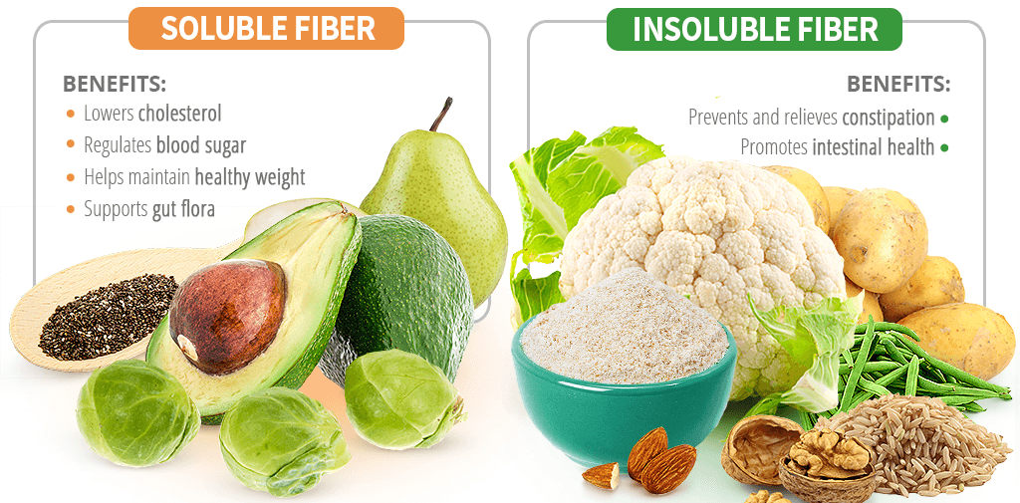

Nutrition Essentials: Fibre
Helps with constipation, diarrhea, boating
Promotes regularity and good bacteria
Combine both insoluble and soluble fibre
Notes:
FIBRE can be a solution to constipation, diarrhea, bloating and more! Focus on foods that are a blend of both insoluble and soluble fibre. Insoluble fibre, like bran and vegetable fibre, acts like a gentle brush sweeping debris through the large intestine. Soluble fibre, high in flax and chia seeds, binds to water and forms a gel that helps to move debris through the colon for elimination. Fibre promotes regularity and a healthy environment for good bacteria to flourish!
Image source: https://www.herbazest.com/wellness/whats-the-difference-between-soluble-and-insoluble-fiber

Slide 27
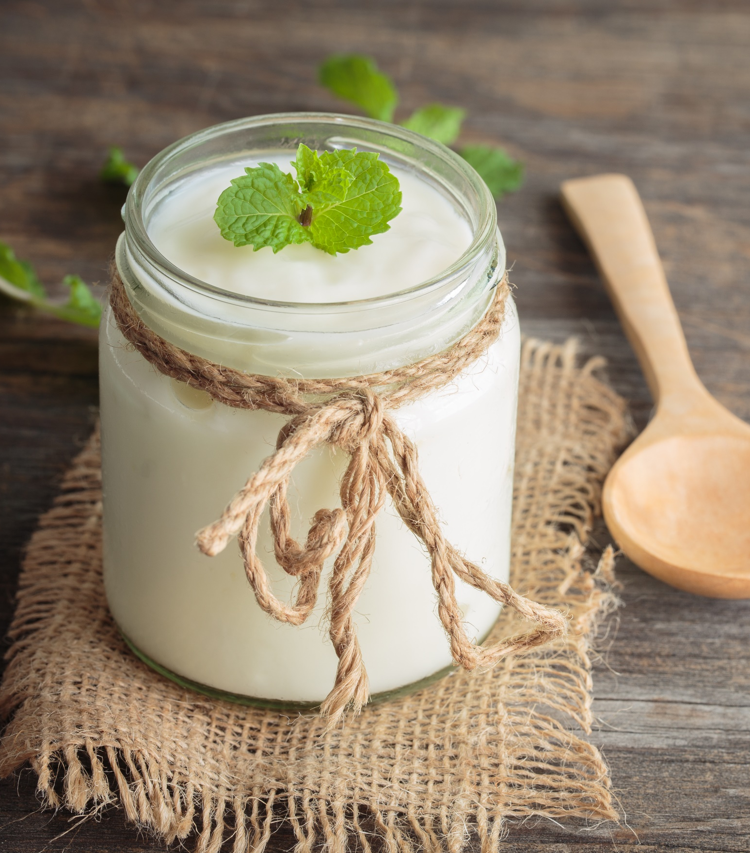
Nutrition Essentials: Probiotics
Food for the gut
Digestive system needs good bacteria to stay balanced and function optimally
Find it in fermented foods (yogurt, sauerkraut, kombucha, kefir)
Probiotics and fibre work together
Notes:
Probiotics are food for the gut. Like a plant requires fertilizer to remain balanced in its environment, your digestive system requires good bacteria to do the same. Probiotics enhance every facet of your bowel health. They can be found in fermented foods and beverages like yogurt, sauerkraut, kombucha and kefir, and in supplement form.
There’s also a link between probiotics and the fibre that you eat. Prebiotics are the indigestible fibres that feed the probiotics to keep the gut balanced with plenty of good bacteria that keep you healthy! Prebiotics come from undigested carbohydrates that move through the small intestine and ferment in the colon providing food for the good bacteria. Foods that are rich in these prebiotic fibres include bananas, onions, garlic, Jerusalem artichokes, apple skins, and chicory root.

Slide 28

Nutrition Essentials: Zinc-Carnosine
Restores gut health through tissue healing
Can be found in red meat, poultry, eggs, and fish
  1:1 combination of zinc and carnosine is most effective and can only be found in supplement form
Notes:
Zinc-Carnosine is one of the most powerful nutrient combinations to help to restore gut health through tissue healing. By healing and stabilizing the gut mucosa, this combination is helpful in cases of gastric inflammation and damage like GERD or ulcers. While zinc and carnosine can be found together in foods like red meat, poultry, eggs, and fish, a 1-1 combination of these nutrients is most effective for gut healing. This can only be found in supplement form.

Slide 29
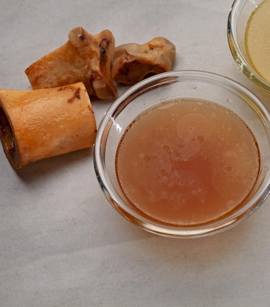
Nutrition Essentials: L-Glutamine
Protects body’s mucosal lining - good bacteria’s home
Glutamine-rich foods:
  Bone broth
  Red cabbage
  Spirulina
  Grass-fed beef
Notes:
L-GLUTAMINE is an amino acid that protects the mucosal barrier in the body. The mucosal lining of the digestive system houses our good bacteria, defends against pathogens, and secretes immune antibodies! Stress, toxicity, and food allergies can compromise this very delicate lining making you susceptible to inflammation and digestive disorders. It is synthesized by the body; however, it can be depleted by stress and illness. Including glutamine-rich foods like bone broth, red cabbage, spirulina, and grass-fed beef can help to protect and restore the integrity of the gut’s mucosal lining.

Slide 30

Nutrition Essentials: Water
Flushes toxicity from colon
Helps with nutrient absorption
Keeps intestines lubricated
Helps move food through the digestive track
Softens stool
Notes:
WATER ALWAYS DOES THE BODY GOOD and a few extra glasses could make a big difference in how digestion functions. Water is one of the most efficient and least invasive ways of flushing out the colon. It also helps to move food through your digestive tract, keeps the colon lining and muscles smooth and flexible, and hydrates the stool to promote easy and healthy bowel movements.

Slide 31
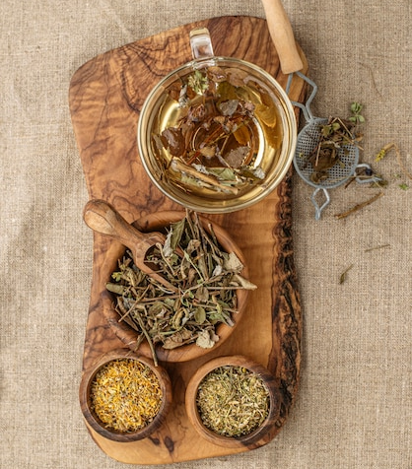
Nutrition Essentials: Water
Enhance water with herbal tea
  Slippery elm, licorice root, marshmallow root help protect gut lining
  Fennel helps promote good digestion and relief from gas and bloating
  Dandelion supports liver and gallbladder
Notes:
HERBAL TEAS can be an easy and comforting gut-supporting habit to add to your day. Slippery elm, licorice root, marshmallow root help protect gut lining
Fennel helps promote good digestion and relief from gas and bloating
Dandelion supports liver and gallbladder

Slide 32
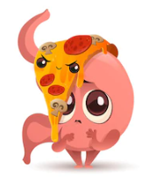
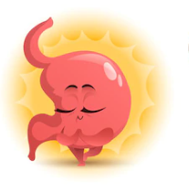

Final Tips on Food
❶
❷
❸
Feed your Body
Not just your stomach
Eat Mindfully
Be especially mindful about HOW you eat
Don’t Overeat
Too much puts stress on your system
Notes:
When you suddenly feel hungry, what do you reach for? Thinking about your health means making choices for the body as a whole, and not just its parts. Choosing to eat a doughnut at 4pm does fill your belly, but it can also cause your blood sugar to spike, your emotions to peak, and your energy to drop. Choosing fruits and vegetables, proteins, and good fats instead, will keep you satiated and provide prebiotics for good bacteria to flourish. This supports the digestive system and every organ system you need to feel great at the end of your workday.
You rush through meals so you can get the kids to soccer practice. You have lunch at your desk or during a stressful meeting. You eat dinner with one hand and respond to an email with the other. We’re busy, so we often find ourselves eating without thinking! MindLESS eating can mean a loss of control around food choices and portion sizes, which leads to a burden on your digestion. Eating while rushed or stressed can reduce stomach acid and enzyme production, and lessen the energy diverted to the digestive process, which makes digestion less efficient. Mindful eating is more about how you eat than what you eat. It puts you in control of your eating habits and primes the digestive system to work at its best. Nature provides us with food offering tantalizing smells, flavours, and colours that we often ignore. Your digestive system will benefit from taking the time to relax and fully appreciate your food and the process of eating.
Eating large amounts of food can leave you feeling uncomfortable, bloated, foggy-headed and exhausted! Overeating, especially of unhealthy foods, can lead to an overload of stress on your stomach and your intestines. It can upset blood glucose, and the extra calories, bad fats, additives, and preservatives can damage the digestive system and lead to other health disorders.

Slide 33


Quite literally, your gut is the epicenter of your mental and physical health. If you want better immunity, efficient digestion, improved clarity and balance, focus on rebuilding your gut health.
- Kris Carr

Slide 34

Thank You for Participating
Questions?
Images from Freepik

