Slide 1




©2023 EMPLOYEE WELLNESS SOLUTIONS NETWORK INC. – ALL RIGHTS RESERVED
Notes:
ttest

Slide 2
TODAY’S FOCUS…
Understand the relationship between our emotions and our body
Recognize the importance of both positive and negative emotions
Learn how to effectively navigate negative emotions
Understand how we can use our emotions productively

Slide 3
Feeling What We Feel

Slide 4
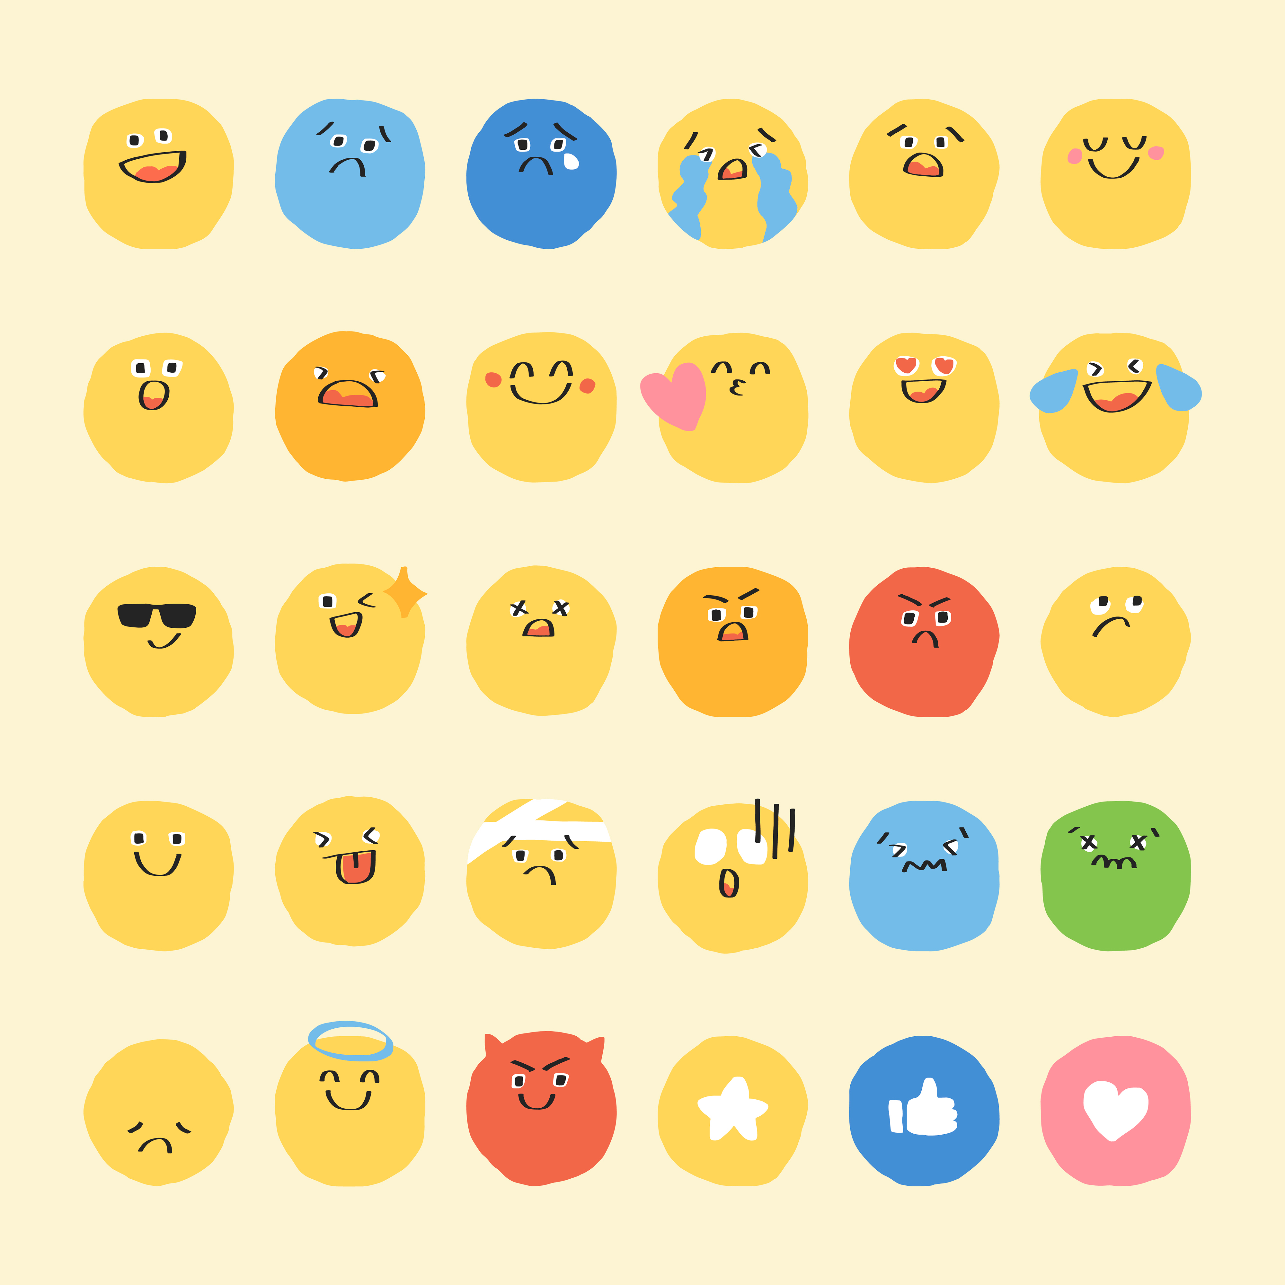
Feeling our Feelings
But research suggests…
Our feelings can also manifest physically within our bodies.
What does this mean?
When we’re happy, we smile and laugh.
When we’re sad, we often cry.

Slide 5
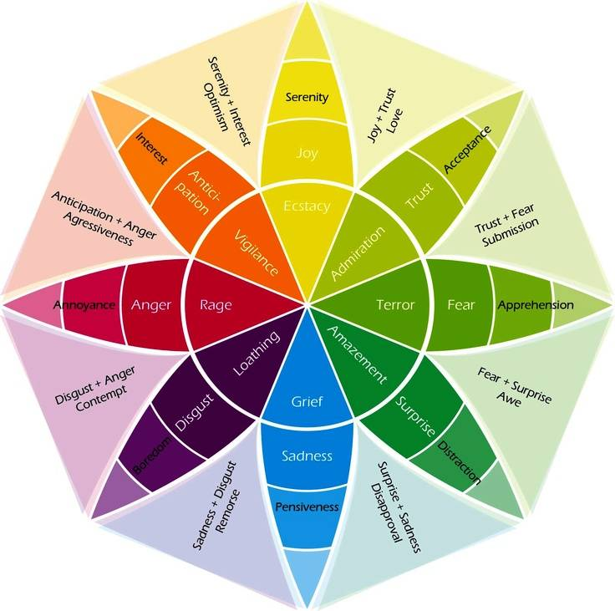
Feeling our Feelings
Similar to an emotion wheel, emotional body mapping can help us identify our feelings.
Think about times when:
  You feel butterflies in your stomach when you’re excited.
  Your chest feels tight when you’re anxious about a presentation.
  Your jaw is stiff after an angry argument.

Slide 6
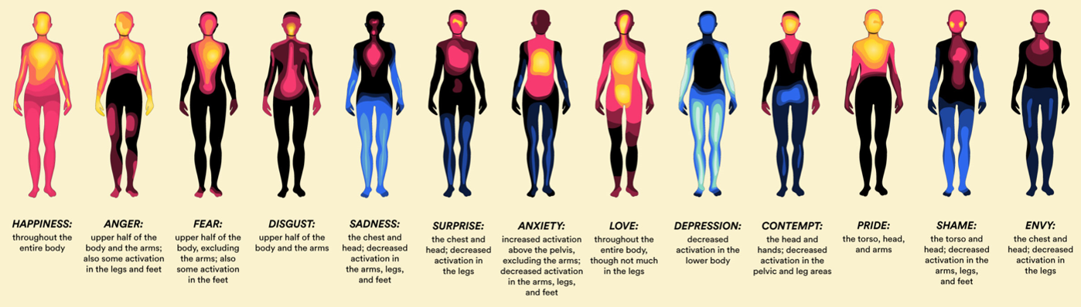

Feeling our Feelings
Body mapping shows how different emotions activate different parts of the body.
cooler colours = less activity
warmer colours = more activity

Slide 7
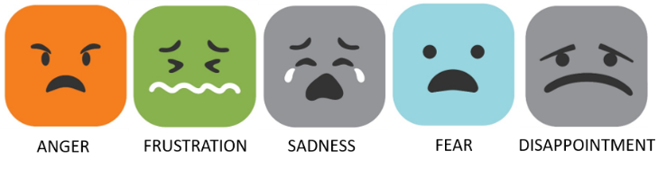
Unprocessed Emotions
Sometimes, we don’t want to feel certain emotions – usually the negative – so we avoid dealing with them.
When emotion isn’t fully processed, it can become repressed or “stuck” in our bodies.

Slide 8

Unprocessed Emotions
Stuck emotions can lead to concerns – both mental and physical:
  Mental health issues
  Increased stress and anxiety
  Muscle tension and pain
  Nausea and digestive problems
  Changes in appetite
  Fatigue and sleep problems

Slide 9
How to Know if You Have Repressed Emotions
Feeling nervous, low, or stressed.
Feeling uneasy or uncomfortable with others’ feelings.
Feeling irritated when asked about your feelings.
Usually cheerful and calm because you don’t linger on things that upset you.
Going along with situations despite what you need/want.
Using unhealthy activities as distractions from your feelings.
Avoid being alone.
Being passive-aggressive when dealing with upsetting situations.

Slide 10












Make Processing Emotions a Habit
Recognize your signs
Practice stillness
Acknowledge your feelings
Compartmentalize
Move intentionally
Recognize rumination

Slide 11
Positive and Negative

Slide 12
Positive and Negative
Emotions are a meaningful part of our human experience.
We tend to label emotions as good or bad, positive or negative.
  …But each emotion comes with physical reactions and feelings that are perfectly normal and, in most cases, completely healthy.

Slide 13
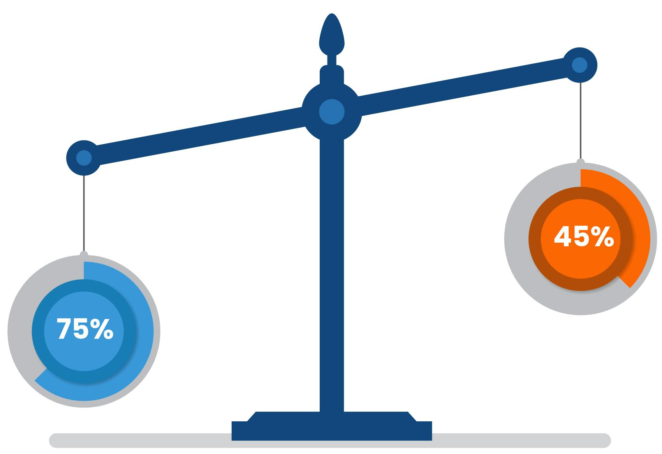
There’s a Place for Both
Positive emotions have been linked to good health and personal success…
But negative emotions can provide valuable information.

Slide 14

Positive and Negative
While we prefer positive emotions, negative ones can:
  Help us become more self-aware.
  Motivate us to act and make necessary changes.
  Help us make better decisions.
  Fosters gratitude, appreciation, and compassion.

Slide 15
Navigating the Negative

Slide 16
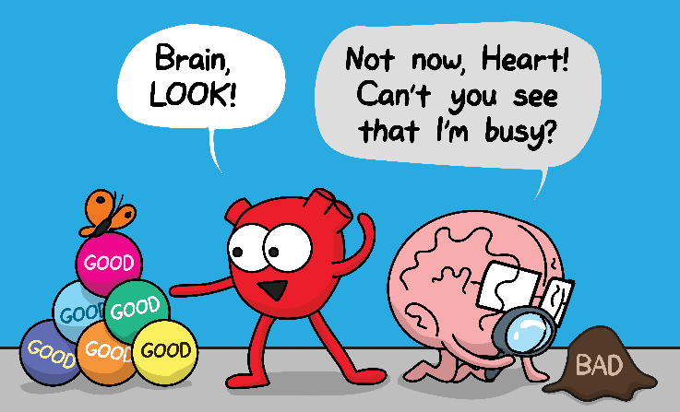
Our Negativity Bias
While we prefer positive emotions and experiences, we have a natural bias toward the negative.

Slide 17
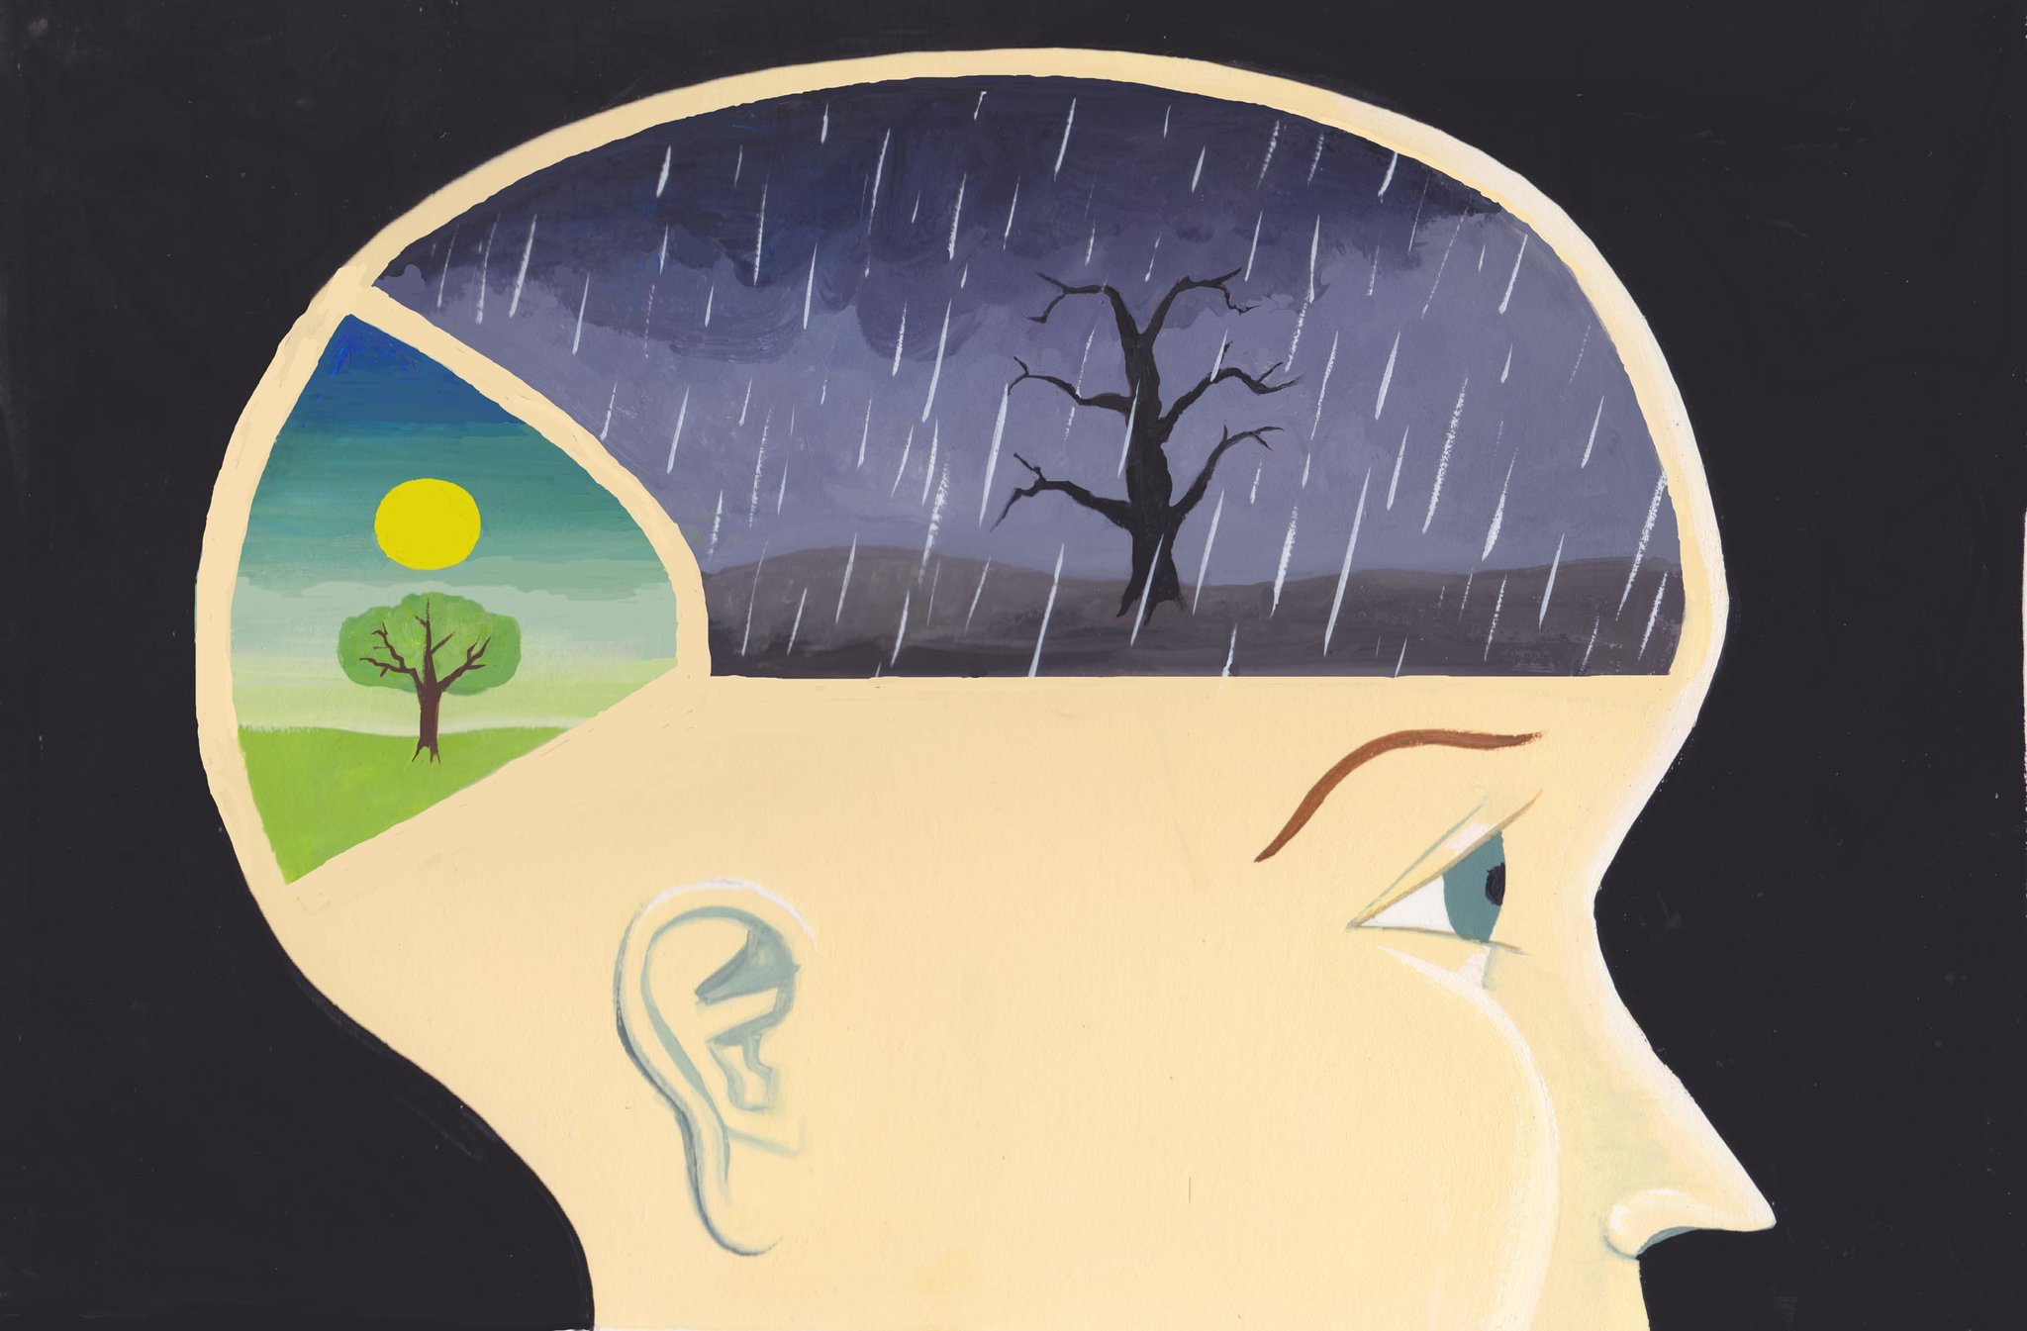


Wired to be Negative?
GAIN
GAIN
LOSS

Slide 18

Our Negativity Bias
This bias impacts how we feel, think, and act.
It makes our emotional response to negative events feel stronger.
We pay more attention to bad things, which makes them seem more important.

Slide 19



Beat the Bias
❶
❷
❸
Challenge negative self-talk
Practice mindfulness
Establish new patterns

Slide 20
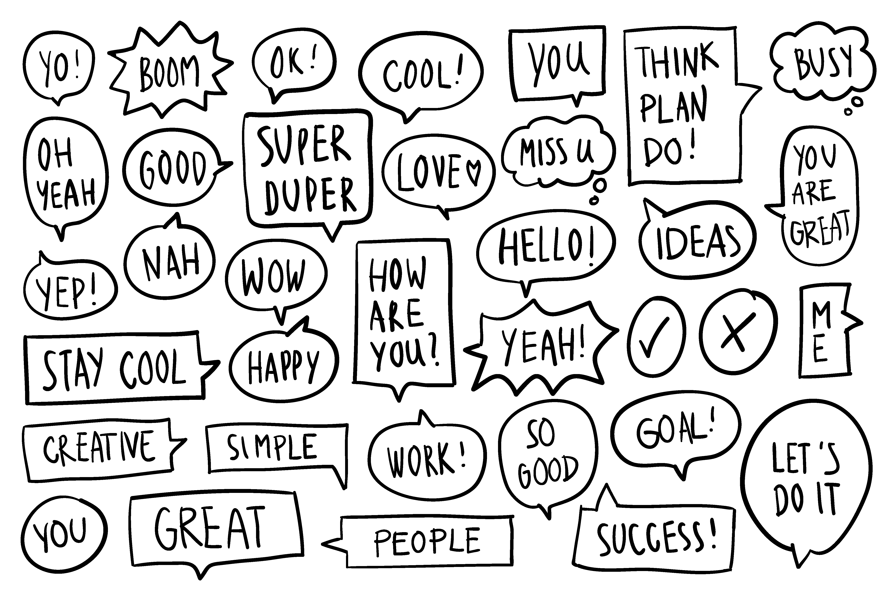

How to Handle Negative Emotions
Assess negative emotions and use them for personal growth.
Accept them and engage in activities that counter-balance their impact.

Slide 21

How to Handle Negative Emotions
T
Teach & learn
H
Hedonic well-being & happiness
Tears of Hope
Psychologist, Ceri Sims
E
Express & enable sensory and embodied experiences
O
Observe & attend to
A
Accept & befriend
P
Physiology & behavioural changes
R
Reappraise & reframe
E
Eudaimonia
S
Social support

Slide 22
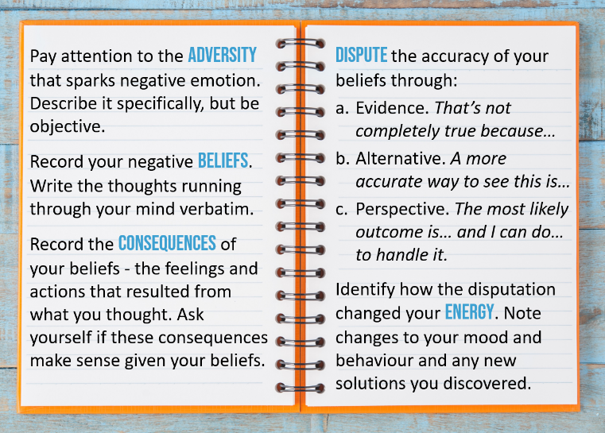
How to Handle Negative Emotions
The ABCDE Disputation Technique
Dr. Martin Seligman, Positive Psychology Expert

Slide 23
The Power of Emotion

Slide 24
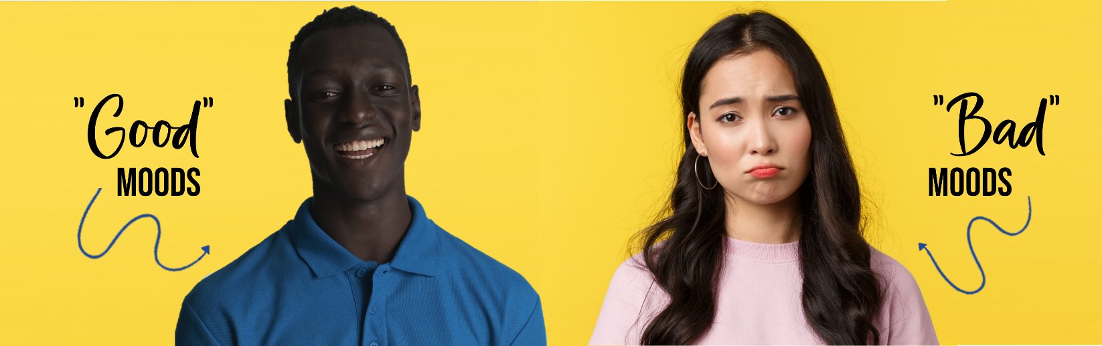
Use Your Moods
Research shows a link between our emotions and our performance - different emotions are useful for different tasks.
So… we can learn how to match our emotions with the tasks we do.

Slide 25
Use Your Moods
Positive emotions fuel creativity and imagination.
Your “good” moods are a good time for:
  Starting new projects
  Big-picture thinking
  Collaboration and teamwork

Slide 26
Use Your Moods
Negative emotions can help us focus.
Your “bad” moods are a good time for:
  Detail-oriented tasks
  Critical thinking and problem-solving
  Circling back to stalled projects or difficult challenges

Slide 27
Difficult Emotions as Creative Fuel
Anger is often a sign that values are being ignored. It can spark great ideas and action to make things right.
Jealousy provides clues about what we may want. Use it to identify what you can do to create what you’re missing.
Fear is strongest when we really want something. It can be a motivator to shift our focus to our desires.

Slide 28


Our feelings are our more genuine paths to knowledge.
- Audre Lorde

Slide 29

Thank You for Participating
Questions?

