Slide 1
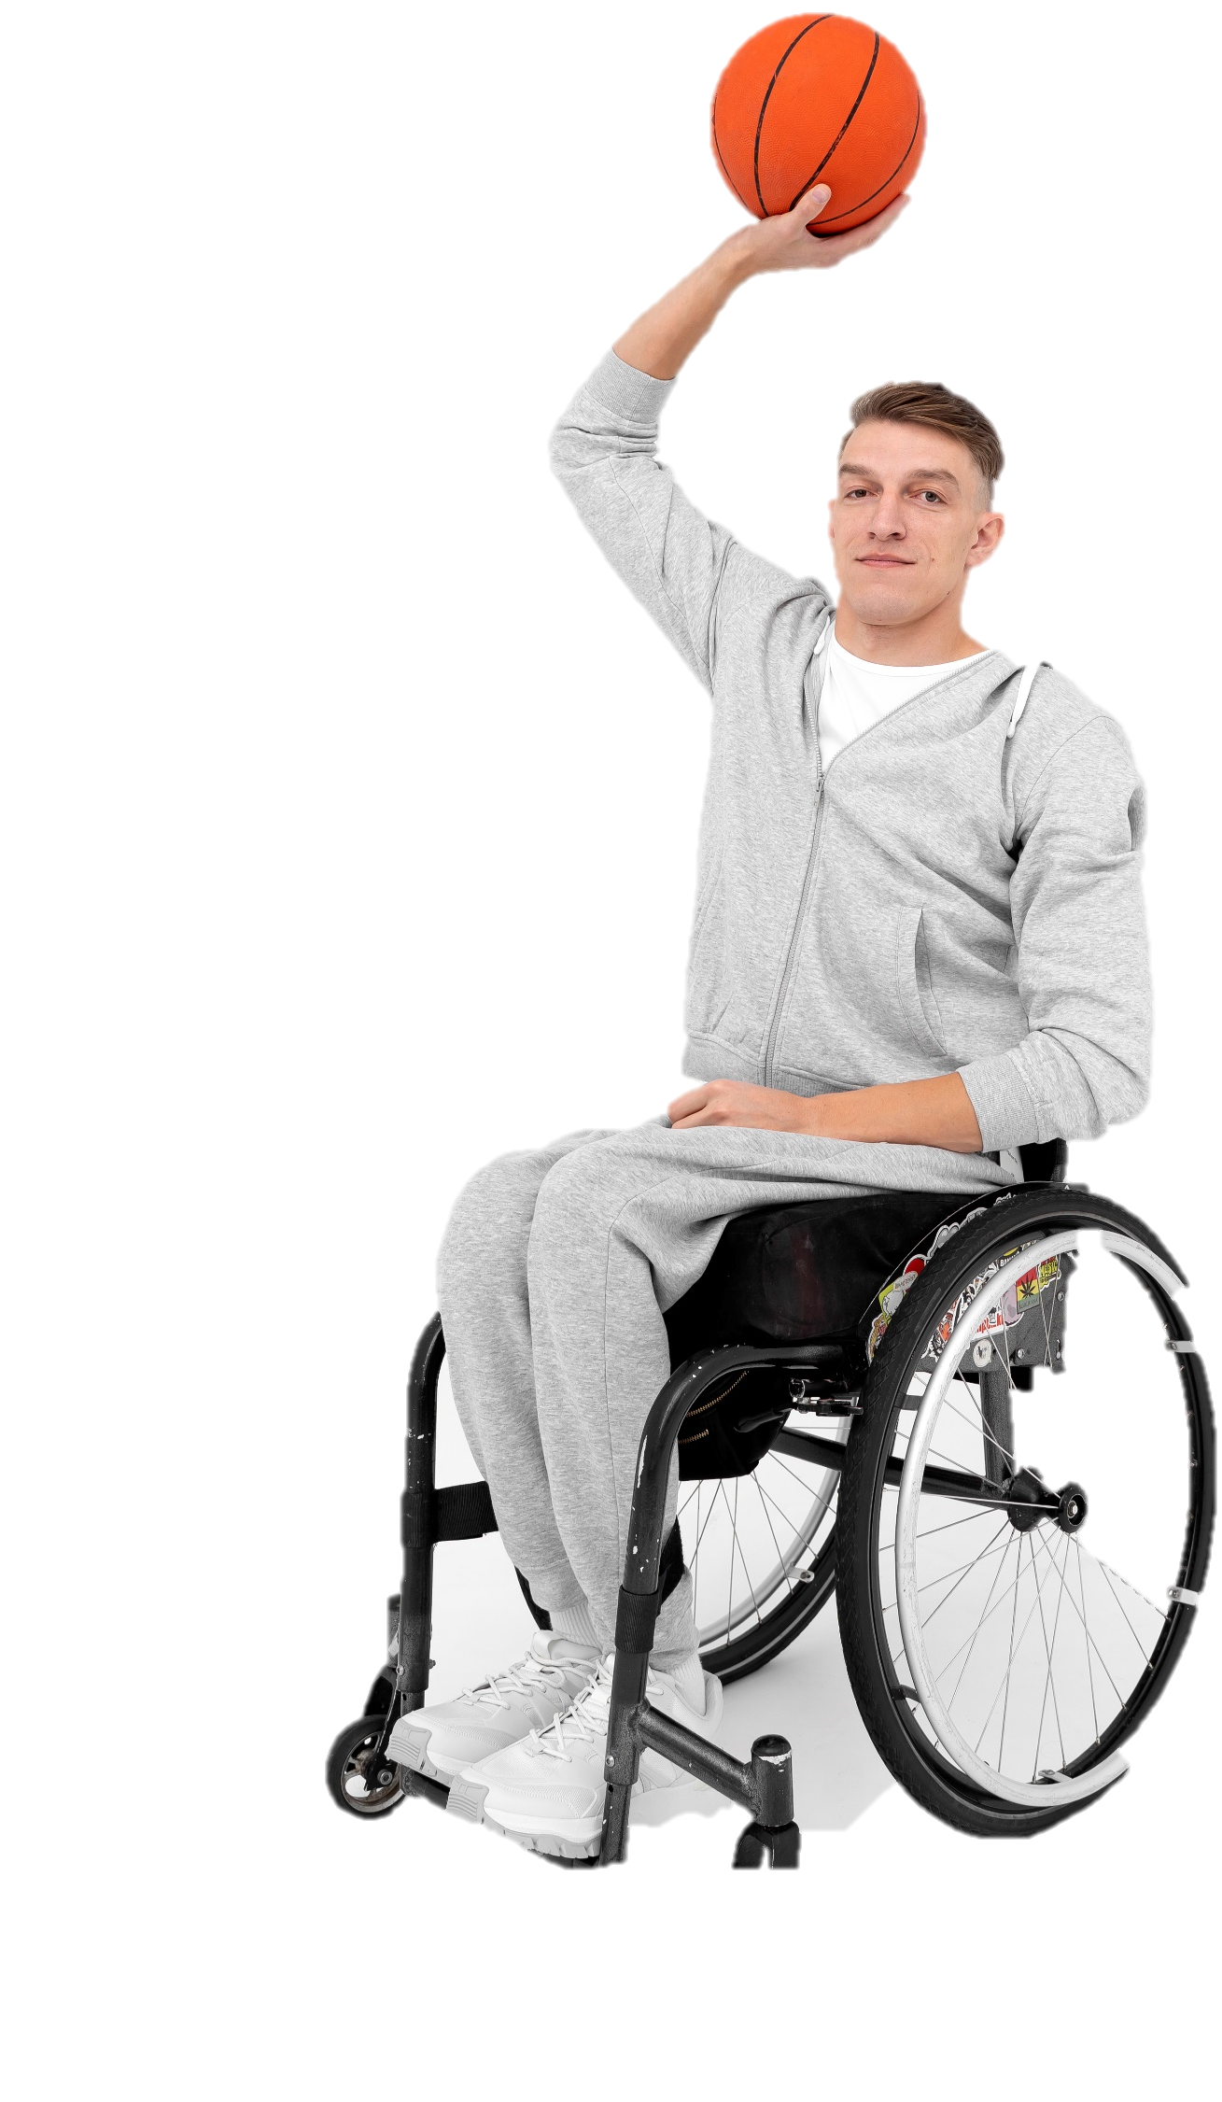
Move
Every day
Join a 2-week challenge that will get you moving and doing the activities you enjoy!
Challenge Begins On:

