Slide 1



©2023 EMPLOYEE WELLNESS SOLUTIONS NETWORK INC. – ALL RIGHTS RESERVED

Slide 2
Appreciate the link between your finances and your health
Understand what financial wellness is
TODAY’S FOCUS…
 Learn the importance of your money mindset
Recognize what you can do to improve your financial well-being
Understand how to prepare for the future
Please note that everyone’s financial situation is unique. The content we are sharing here is for information purposes only. If you are looking for financial advice, we recommend that you consult with a financial advisor who can review your personal finances and provide the appropriate guidance and support.

Slide 3
What is Financial Wellness?

Slide 4
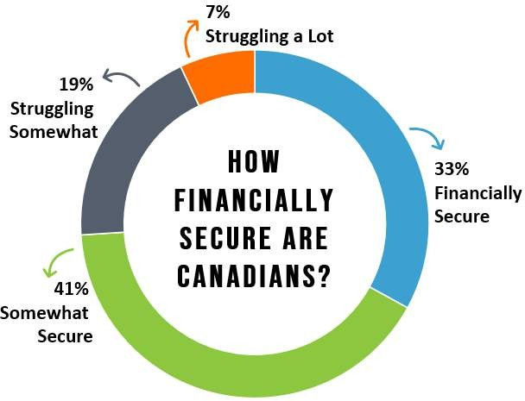
According to a 2018 study, only 33% of Canadians feel financially secure.
That means a lot of us could benefit from investing in our financial well-being!

Slide 5
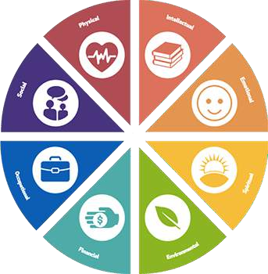






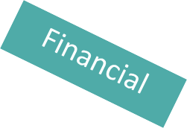

But What is Financial Wellness?
It’s an important part of
your overall well-being

Slide 6
Understanding Financial Wellness
Money and stress often go hand-in-hand, so financial wellness is about effectively managing your economic life to help AVOID this stress.
 Financial wellness goes beyond just money… it’s an intentional way to live when it comes to your personal finances so you can enjoy life.

Slide 7
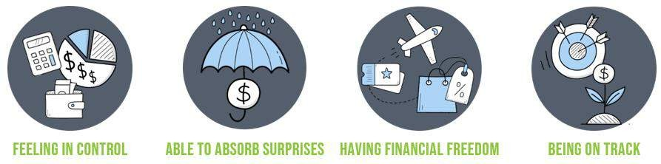
4 Elements of Financial Wellness

Slide 8
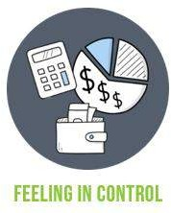
4 Elements of Financial Wellness
 You feel in control of your daily and monthly finances.
 Expenses are covered and bills are paid on time without much worry.

Slide 9

4 Elements of Financial Wellness
 Financial emergencies don’t cause
panic and high stress.
 You have a safety net (savings, insurance) to prevent unexpected expenses from turning into long- lasting setbacks.

Slide 10

4 Elements of Financial Wellness
 You have enough money to cover your needs, and extra to do things that make you happy.
 You have flexibility: you can take vacations, go out to eat, or willing pass on overtime hours.

Slide 11

4 Elements of Financial Wellness
 You have financial goals: you are identifying what’s important for your future and working towards the goals that will get you there.

Slide 12
Financial Wellness and Your Health

Slide 13
Financial Stress
Money is one of the most common sources of stress.
48% of Canadians say they’ve lost sleep because of
financial worries.
 Examples of where financial anxiety comes from:
Managing household expenses
Dealing with high levels of debt
Big purchases
Unexpected expenses
Inability to save for financial goals

Slide 14


How Financial Stress Impacts Your Health
Changes in physical health
Poor mental health
Issues with sleep
Unhealthy coping behaviours
Relationship difficulties

Slide 15





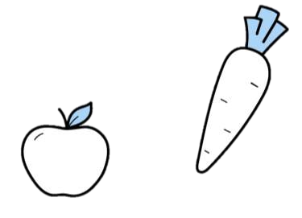

Better Financial Wellness = Better Health!
People who are financially prepared are 2.5 times more likely to have healthy habits like eating fruits and vegetables and exercising regularly.

Slide 16
Coping with Financial Stress
Education Yourself
Speak with experts, take a class, read books, or listen to podcasts to improve your financial literacy.
Practice Self-Care
Manage stress with proper sleep, regular exercise, a healthy diet, and relaxation techniques.
Get Support
Work with a financial professional to identify priorities and strategies appropriate for your financial situation.

Slide 17
Money Mindset

Slide 18

Your Outlook on Money
Money Mindset: What you believe and how you interact with your money.
Understanding your money mindset is the first step to gaining control over your finances and improving your financial well- being.

Slide 19




What’s Your Money Mindset?
Scarcity Mindset
Abundance Mindset

Slide 20
What’s Your Money Mindset?
Scarcity Mindset
No amount of money is enough.
You may feel stressed or discouraged when spending money or may avoid spending altogether.
You don't believe you’re good with money
or smart enough to have a lot of it.
You feel stressed about paying bills and unexpected expenses.
You feel bad about purchases or may overspend.
You avoid sharing the money you have (e.g. gifts, donations).
You avoid spending on things that bring you joy.

Slide 21
What’s Your Money Mindset?
Abundance Mindset
You’re focused on opportunity and potential wealth.
You enjoy the financial journey and working towards your goals.
You appreciate the money you have regardless of the amount.
You know there’s plenty of money and
you can always make more.
You don’t stress over bills or unexpected
expenses.
You enjoy being generous and sharing what you can with others.
You feel confident that you can make money and reach your financial goals.

Slide 22





Changing Your Money Mindset
Stop Negative Comparisons
Know What You Want
Be Intentional With Money
1
3
5
2
4
Practice
Gratitude
Write About What You Know

Slide 23
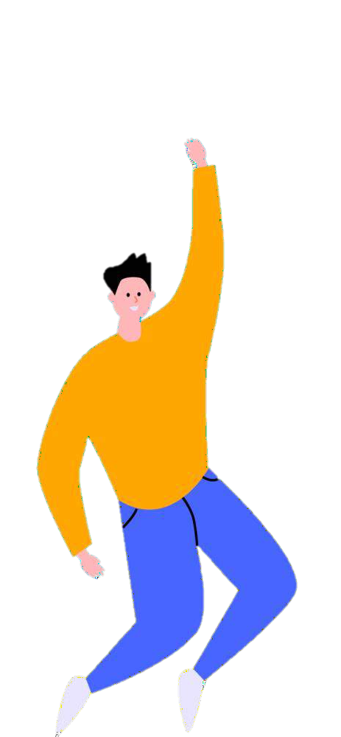
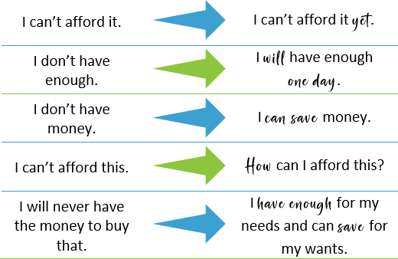
Changing Your Money Mindset
Self-Talk Matters!

Slide 24
Building Good Money Habits

Slide 25

Your Actions Make a Difference
Research shows that financial well-being has more to do with behaviours than with how much money you have.
 You need to build good money habits to get a better handle on your finances.

Slide 26
The Big One: Budgeting
 The most important action that can help you improve your financial well-being is creating a monthly budget.
 Creating and sticking to a spending plan is essential to establish a good relationship with money.
 You must understand how much money you have and how it flows in order to manage it appropriately.

Slide 27

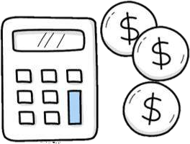

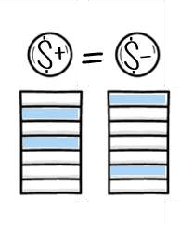

How to Budget
Gather your financial information
Calculate your net income
List your fixed and variable expenses
Calculate the difference
Track your spending
Repeat!

Slide 28

How to Budget
TIPS
Make budgeting a family affair.
Remember that every month is different.
Include debt repayment.
Use tools that work for you.
Maintain it with a weekly financial routine.

Slide 29

What else can you do?
Upgrade your environment
Create an environment that helps you accomplish what you want.
Example:
 To reduce the temptation to spend, delete shopping apps on your phone, leave your credit card at home, or pack your lunch.

Slide 30

What else can you do?
Reward Achievements
Establish an incentive to keep you motivated.
Monitor your progress and celebrate your success with an inexpensive reward.

Slide 31
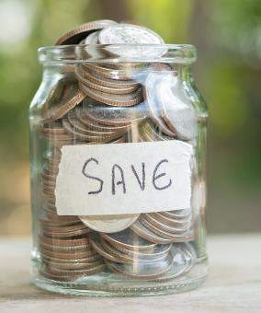
What else can you do?
Don’t Wait to Start Saving
Include saving in your budget – no matter the amount.
Establish a savings goal, so you
know what you’re working toward
and can track your progress.

Slide 32
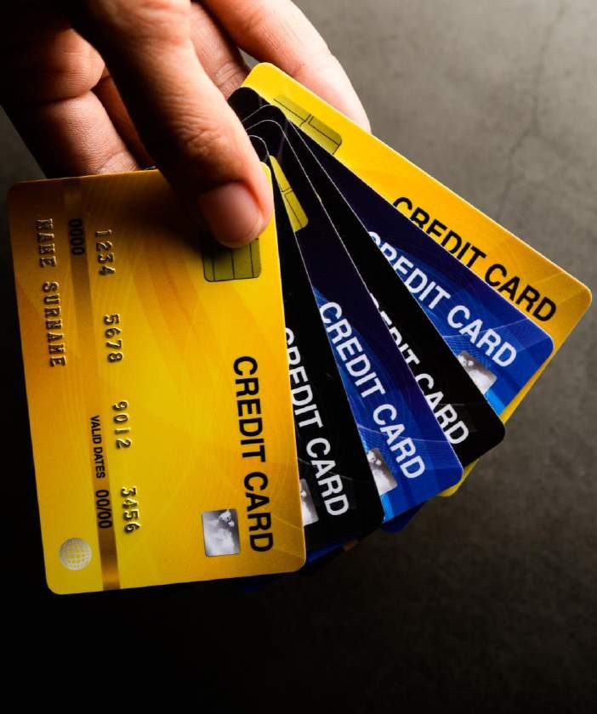
What else can you do?
Have a Debt Repayment Plan
Leverage your budget to pay more than the minimum if you can.
Adjust variable spending so you pay more towards debt.
Find a process that works for you.
 Examples: Snowball Method, Avalanche Method

Slide 33

What else can you do?
Consider a Side Hustle
Boost finances with a fun and rewarding side gig.
Examples:
  Sell crafts you make.
  Clean homes or offices.
  Offer dog-walking services.

Slide 34

What else can you do?
Leverage Micro Habits
Simple day-to-day actions that can lead to meaningful behaviour changes over time.
Examples:
  Limit coffee purchases by buying a gift card each month.
  Implement a 24-hour waiting period on new purchases.

Slide 35
Future Finances

Slide 36

Know Where You’re Going
Goals are an important part of your financial wellness journey.

Slide 37



Know Where You’re Going
SHORT-TERM GOALS
can be achieved within a year.
Examples:
Cut monthly spending.
Start an emergency fund.
Save for vacation.
MID-TERM GOALS
take 1 to 5 years to achieve.
Examples:
Save for a home down payment.
Pay off a larger debt.
LONG-TERM GOALS
take 5 or more years to achieve.
Examples:
Start a retirement fund.
Pay off mortgage.
Save for children’s
tuition.

Slide 38


Know Where You’re Going
Number-Based Goals
Associated with a specific value amount.
Examples:
  $5000 emergency fund
  Decrease spending by
$100
 $10,000 for a 10-year anniversary vacation
Habit-Based Goals
Associated with behaviours.
Examples:
  Pay monthly credit card bill in full
  Automate bill payments
  Plan and stick to weekly grocery lists

Slide 39
Financial fitness is not a pipe dream or a state of mind. It’s a reality if you are willing to pursue it and embrace it.
- Will Robinson

Slide 40

Thank You for Participating Questions?

