Slide 1
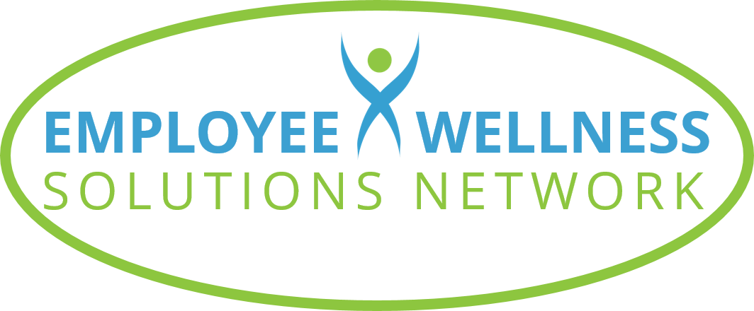
THE LINKS OF LIFE
©2022 EMPLOYEE WELLNESS SOLUTIONS NETWORK INC. – ALL RIGHTS RESERVED
Powered by

Slide 2
TODAY’S FOCUS…
Understanding how to balance obligations and pleasures
Recognize the power of your thoughts and motivations
Learn how to manage procrastination and toxic positivity
Understand how to maximize actions to achieve the life you want

Slide 3
FINDING BALANCE
We all have aspects of life that compete for our time: priorities, obligations, relationships, interests, activities
Balancing what we have to do and what we love to do is ESSENTIAL to our:
Physical and mental well-being
Professional success
Productivity
Personal happiness
Fulfillment

Slide 4
WORKING MORE MEANS WE GET
MORE DONE! RIGHT?

Slide 5
In fact, working more than
49 HOURS PER WEEK
Has a negative impact on our productivity!

Slide 6
Research shows that those who work
55 HOURS PER WEEK
compared to 35 to 40 hours
Have a 13% greater risk of heart attack
Are 33% more likely to suffer a stroke

Slide 7
THE WORK-LIFE BALANCE CYCLE
1
Pause & Denormalize
Reach a healthier balance by increasing awareness and implementing changes.
Balance is not a one-time activity. It’s a cycle of continuous re-evaluation and improvement.
5
2
Implement Changes
Pay Attention to Emotions
4
3
Consider Alternatives
Reprioritize

Slide 8
TIPS AND TECHNIQUES FOR BALANCE
Journal to assess how you spend your days | Organize and prioritize how you spend your time | Identify your balancing activities
Unplug from technology | Reduce time-wasting activities | Prioritize your health

Slide 9
DEALING WITH PROCRASTINATION
We all procrastinate from time to time, but chronic procrastination can become a problem

Slide 10
WHY DO WE DO IT?
We lack strong decision-making skills which keeps us from doing
We are overwhelmed by a task and choose to do something we’re more comfortable with
We focus on tasks we like more and neglect what we find challenging or boring
We don’t distinguish between urgent tasks and
important tasks
Work Ave
Procrastinate St

Slide 11
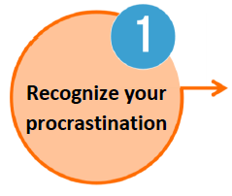
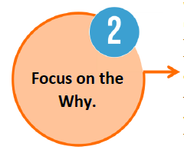
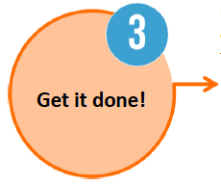
HOW TO OVERCOME PROCRASTINATION
AND GET THINGS DONE!

Slide 12
HOW TO OVERCOME PROCRASTINATION
AND GET THINGS DONE!
Look for clues that you are starting to put off important tasks

Slide 13
HOW TO OVERCOME PROCRASTINATION
AND GET THINGS DONE!
Look for clues that you are starting to put off important tasks
Understand why a task is on your list and what you gain by doing it

Slide 14
HOW TO OVERCOME PROCRASTINATION
AND GET THINGS DONE!
Look for clues that you are starting to put off important tasks
Understand why a task is on your list and what you gain by doing it
Follow the right approach based on whether you don’t like the task or you find it overwhelming

Slide 15
HOW TO OVERCOME PROCRASTINATION
AND GET THINGS DONE!
Look for clues that you are starting to put off important tasks
Understand why a task is on your list and what you gain by doing it
Follow the right approach based on whether you don’t like the task or you find it overwhelming

Slide 16
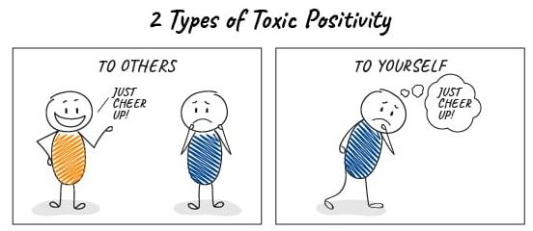
THE DANGER OF TOXIC POSITIVITY
Toxic Positivity is the practice of consciously pushing yourself to think positive, happy thoughts to minimize genuine pain, sadness, or fear

Slide 17
WHY INAUTHENTIC HAPPINESS IS DANGEROUS
It can harm personal and professional relationships
It can make you more unhappy
It can lead to burnout
Suppressed negative feelings can build up – they will eventually find a way out

Slide 18
HOW TO OVERCOME TOXIC POSITIVITY
DON’T BE AN EXPERT
People aren’t always looking for opinions or advice. Sometimes it’s best just to listen.
PAUSE
Think before you speak. Stop the optimistic autopilot and fully understand the situation before responding.
1
2
Studies show those who have meaning in their lives are happier and healthier.
FOCUS ON MEANING
Social media is a main source of toxic positivity.
DO A DIGITAL DETOX
4
3

Slide 19
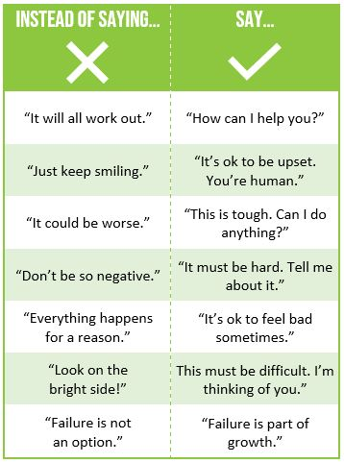

Slide 20
MAXIMIZING OUR ACTIONS
How we approach our day-to-day lives can make all the difference.
So what can we do to maximize our lives?
Practice gratitude
Be more mindful
Set meaningful goals

Slide 21
GRATITUDE IS POWERFUL
Practicing gratitude has been shown to rewire the brain with a more positive, consistent mindset, leading to improved physical and mental health
Don’t focus on what you don’t have
Make a daily list of what you’re grateful for
Appreciate the opportunities that come
with life’s challenges
Say thank you more often

Slide 22
MIND FULL TO MINDFUL
Mindfulness is the ability to focus on the present moment and being aware and accepting of what you’re sensing and feeling
Being more mindful offers many benefits:
Helps relieve stress and anxiety
Improves relationship satisfaction
Improves mental wellness
Reduces emotional reactivity
Helps the brain reduce distractions
Improves cognitive abilities and performance

Slide 23
HOW CAN YOU BE MORE MINDFUL?

Slide 24
SIMPLE THINGS MINDFUL PEOPLE DO
They don’t multitask. | They forgive mistakes and accept imperfection. | They practice gratitude. | They make time for quiet reflection. | They express and accept their feelings.
They nourish and move their bodies. | They laugh at themselves. | They pause before reacting. | They practice being curious. | They embrace opportunity.

Slide 25
MEANINGFUL GOALS GET RESULTS
Goals helps us create positive change and healthier habits
Provide us a sense of control
Help us gain clarity in our vision
Offer a source of accountability
Increase motivation
Let us feel pride and accomplishment

Slide 26
WHY SET VALUE-BASED GOALS?
Goals may change, but values are consistent
Values help indentify what’s important to you
Values drive and motivate us in a positive direction
They provide a reference point for what you want from life

Slide 27
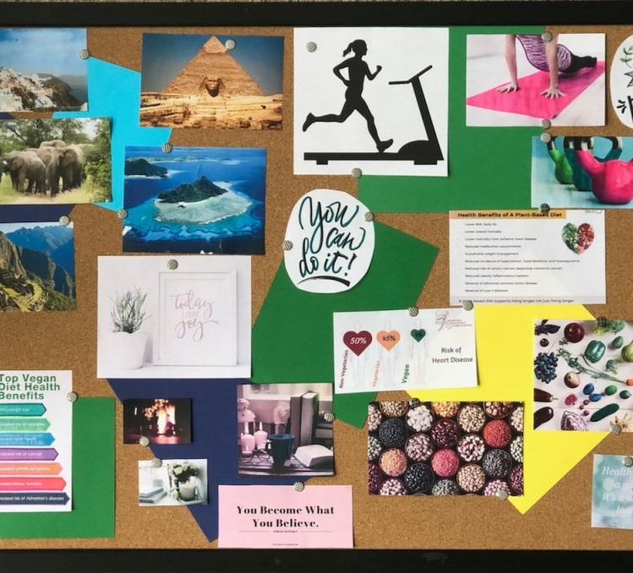
SUPPORT GOAL-SETTING WITH VISUALIZATION
Create strong mental images of what you want to achieve
“Seeing” your future success builds confidence
Create a vision board to see what you want to achieve

Slide 28
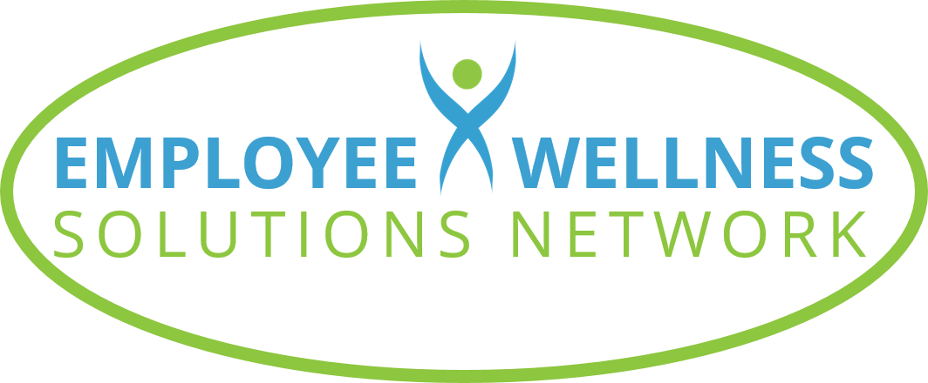
THANKS FOR PARTICIPATING!
ANY QUESTIONS?
Powered by

