Slide 1
BUILDING MENTAL STRENGTH
©2022 EMPLOYEE WELLNESS SOLUTIONS NETWORK INC. – ALL RIGHTS RESERVED
Powered by

Slide 2
TODAY’S FOCUS…
Understand the importance of a healthy sense of self
Recognize the need to manage our emotions
Learn how to embrace healthy thoughts
Learn how to effectively prioritize relationships

Slide 3
One of the greatest tragedies in life is to lose your own sense of self and accept the version that is expected by everyone else.
- K.L. Toth

Slide 4
THE SELF-RELATIONSHIP
The relationship you have with yourself is the foundation of all others
It helps you accept your WHOLE self – both strengths and weaknesses
It helps you make life choices
It allows you to live authentically, which means you’re happier!

Slide 5
CHECKING IN WITH YOUR SENSE OF SELF
Do I say yes to make others happy?
It’s ok to accommodate others, just not ALL the time.
What are my strengths?
Recognize what they are and use them to work on achieving your goals.
What makes me happy?
Do the things that bring you joy, and spend time with people who make you smile.
Do I live according to my values?
You want to feel good about how you’re living life.
Do my choices reflect my own interests?
Base your decisions on what matters to you.

Slide 6
HOW TO LIVE AUTHENTICALLY
Set Healthy Boundaries
3
Practice Positive Self-Talk
Be Grateful to Your Physical Self
2
4
6
Define Your Values
1
3
5
7
Spend Time Alone
Accept Yourself
Limit External Negativity

Slide 7
Labelling your emotions is key.
If you can name it, you can tame it.
Marc Brackett
Yale Center for Emotional Intelligence

Slide 8
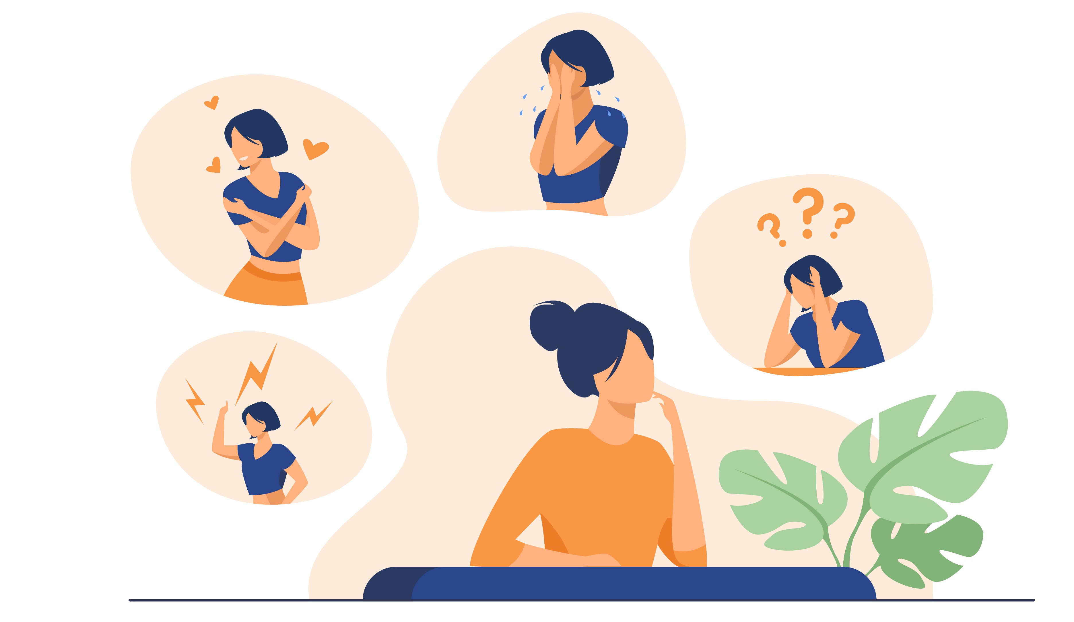
NAME WHAT YOU FEEL
Giving an emotion a name can lessen the intensity
Accept your feelings rather than fight them - emotions aren’t good or bad
Properly identifying a feeling helps you determine what to do with it

Slide 9
BROADEN YOUR EMOTIONAL VOCABULARY
A feeling wheel can be a helpful resource when trying to better define our emotions
Practice naming emotions – positive and negative
Writing freely about your feelings can help you understand them

Slide 10
MANAGING YOUR EMOTIONS
Emotional health is your ability to cope with and manage both positive and negative emotions

Slide 11
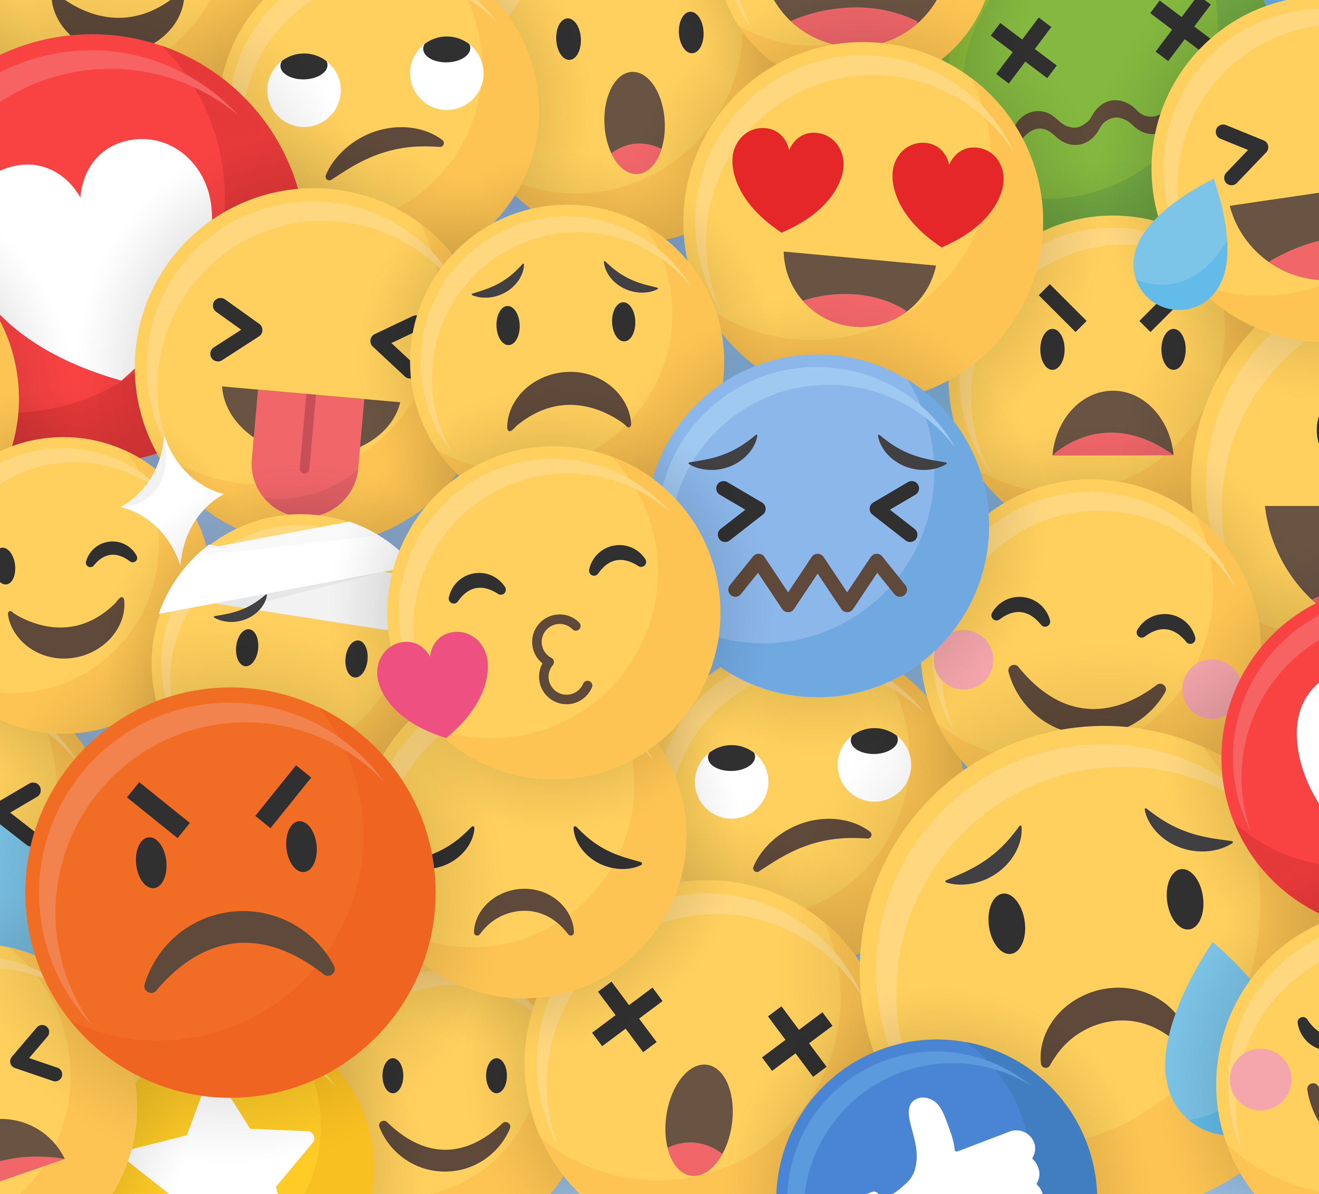
SIGNS YOU’RE STRUGGLING WITH EMOTIONAL HEALTH:
Isolating yourself
Lower energy levels
Increased substance use
Racing thoughts
Sleeping too much or too little
Lower performance
More interpersonal conflicts
Neglecting personal care
Feelings of irritability, guilt, or worthlessness

Slide 12
HOW TO WORK ON YOUR EMOTIONAL HEALTH
3
Keep self-talk positive.
Spend time with your thoughts: meditate, journal, take quiet walks.
4
3
Find meaning and purpose in what you do.
3
5
Stay connected with family and friends.
3
Exercise daily and sleep well.
2
6
Balance work and play, activity and rest.
3
Set personal goals.
1
7

Slide 13
The key to a healthy life
is having a healthy mind.
Richard Davidson
Professor of Psychology and Psychiatry

Slide 14
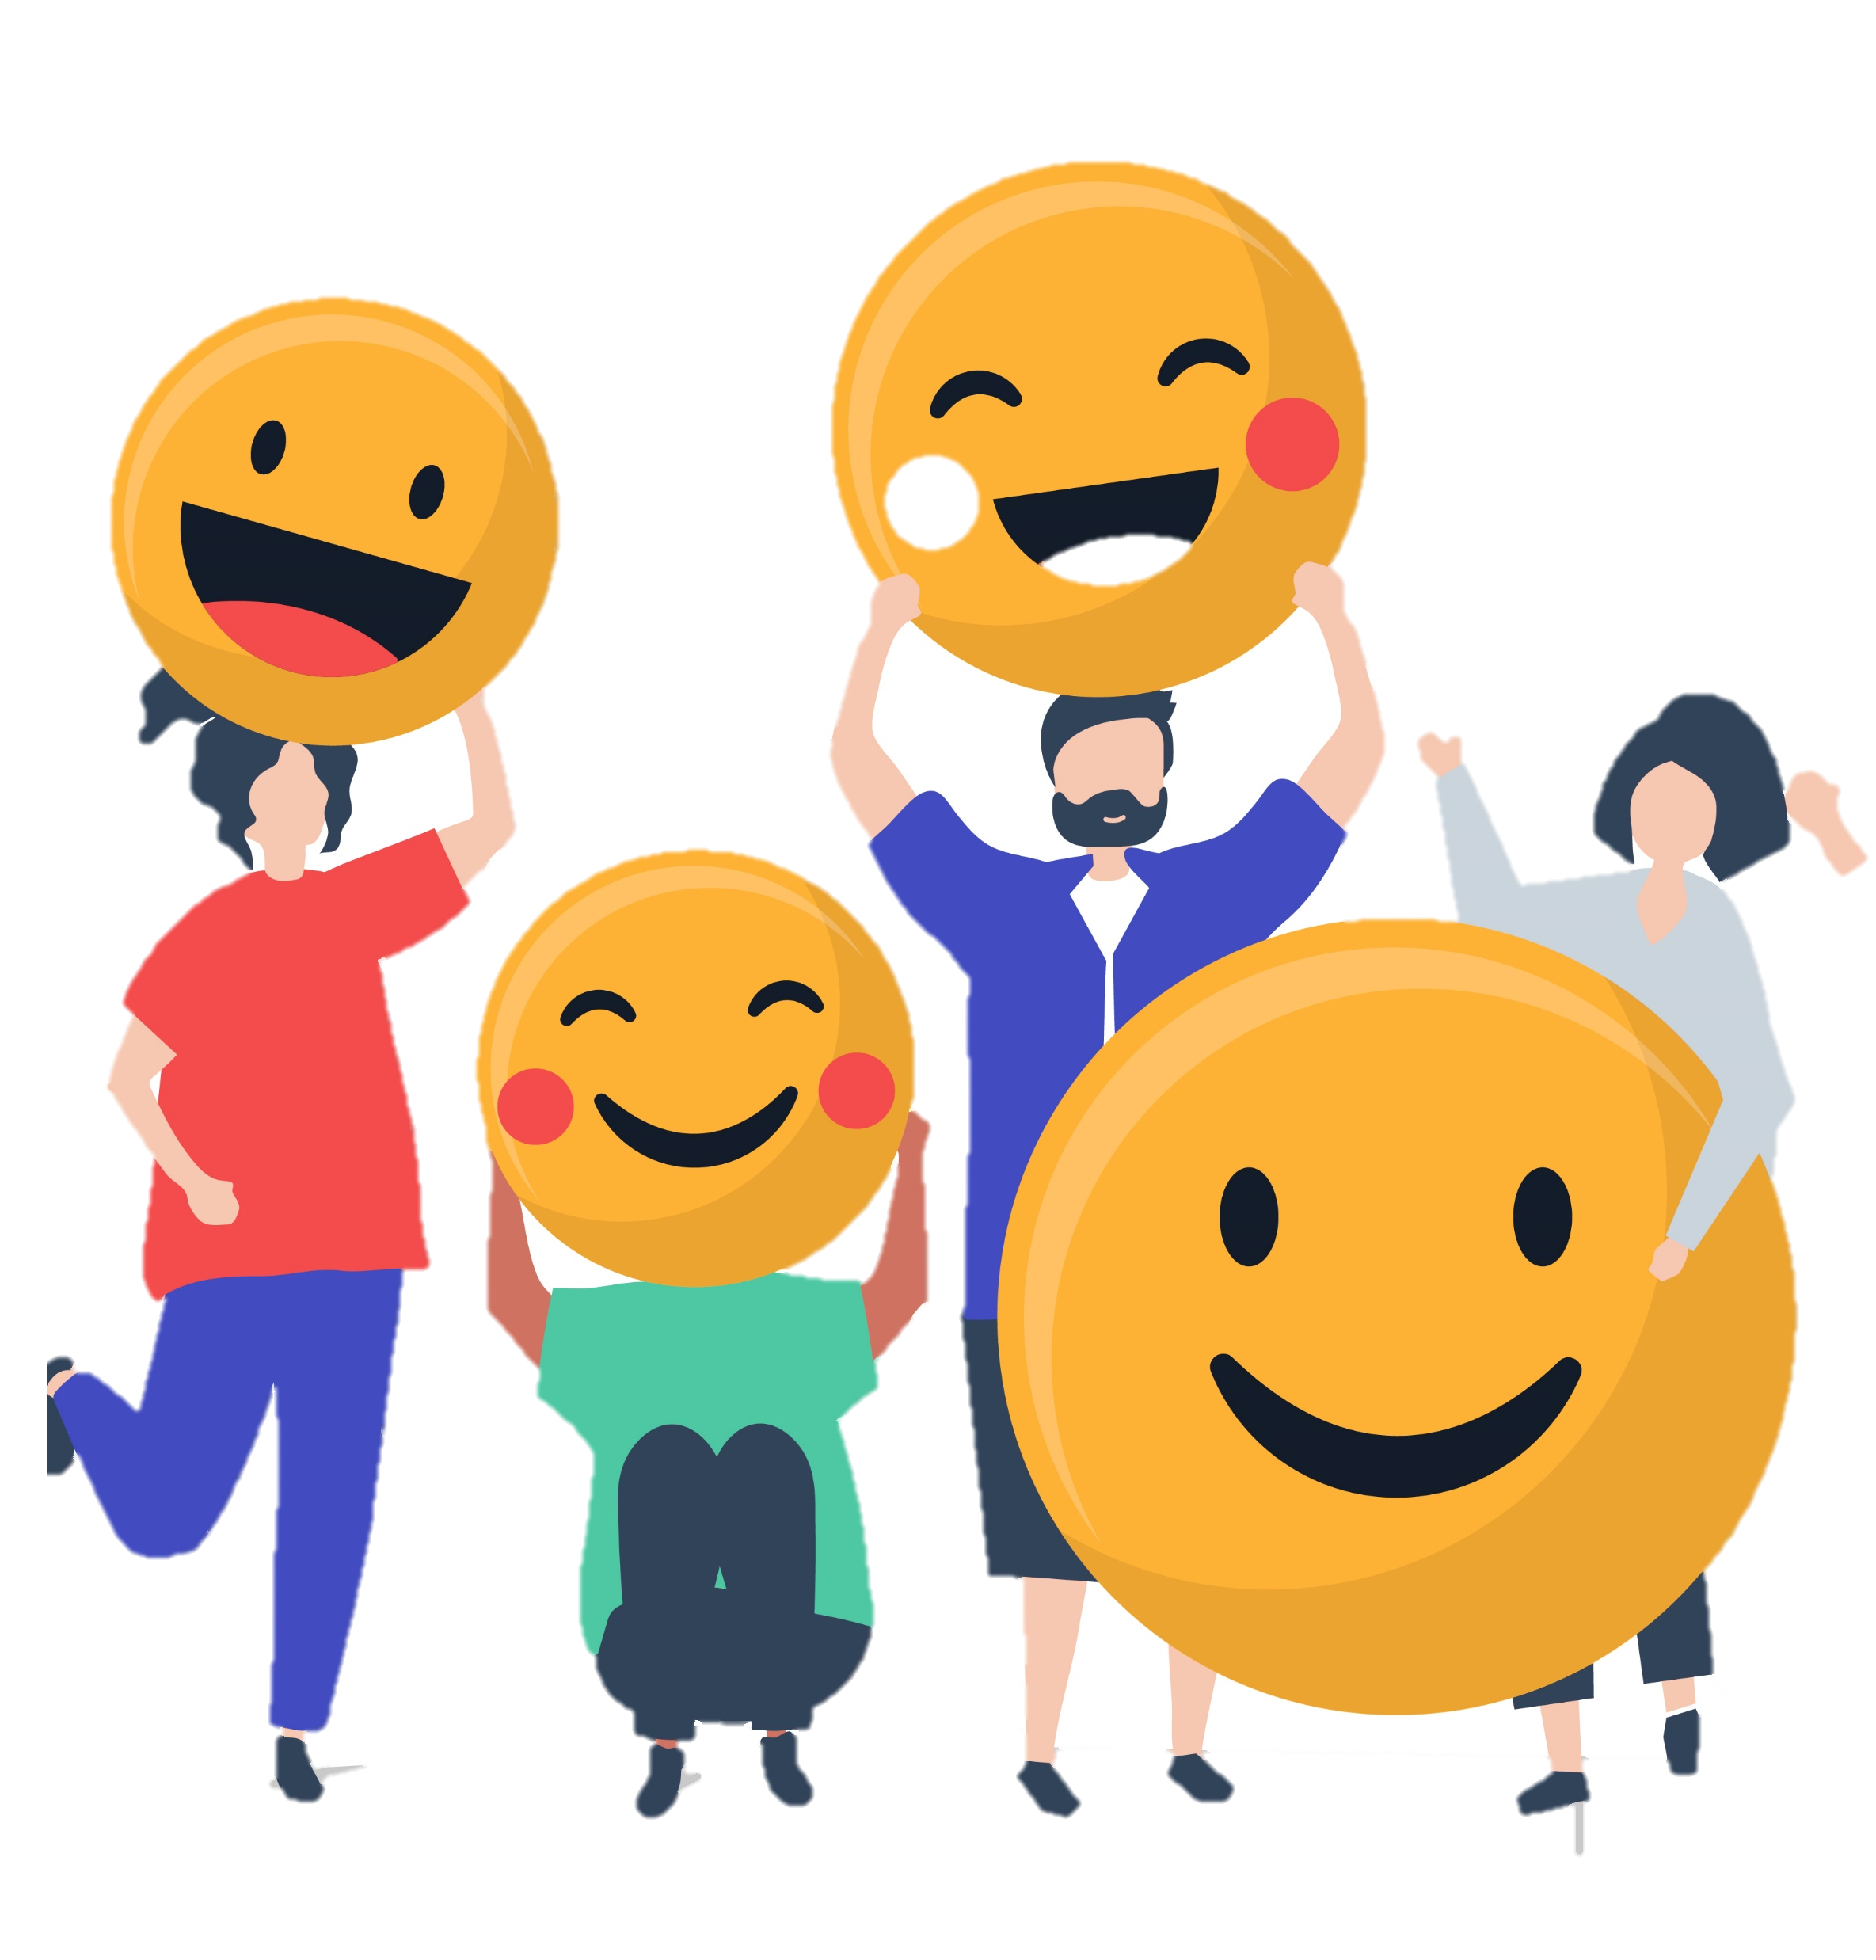
POSITIVE THINKING IS POWERFUL
Research has demonstrated the benefits of positivity to our health and well-being:
Longer life span
Lower rates of depression
Stronger immune system
Better cardiovascular health
Better psychological and physical health
Better ability to cope with stress

Slide 15
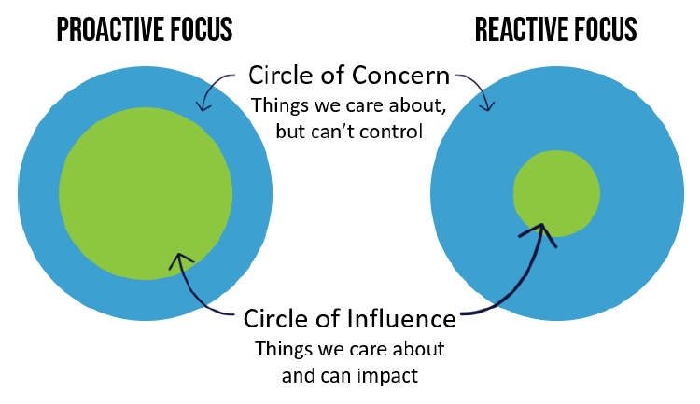
ARE YOU PROACTIVE OR REACTIVE?
When faced with change we either react to the situation or choose to respond to it.
Approaching a situation with positive energy allows us to expand our circle of influence.

Slide 16
MANAGE YOUR WORRIES
WORRY TIME
Schedule time to worry in advance (only 15-30 minutes).
Write your worries and review them at the end of the week.
DREAM TIME
Balance worry time with time spent thinking about the future.
Define what you want – it’s a great goal-setting starter!
BOTH ARE IMPORTANT!!

Slide 17
HOW TO WORRY CONSTRUCTIVELY
There IS a right way to worry!
Here are a few tips to get the most out of Worry Time.
Review what you’ve written. If there are items that have been resolved or no longer bother you, cross them off your list!
1
Focus on the circled
items. For each,
brainstorm 5 solutions.
Think creatively. Even involve others in conversation to spark ideas.
Circle the worries that you can control or have some influence over – by taking action or changing your mindset.
3
2

Slide 18
Genuine relationships depend first on a
healthy relationship with ourselves.
Sonia Choquette
American Psychologist

Slide 19
SOCIAL CONNECTIONS AND YOUR HEALTH
Having strong supportive relationships help us live happier and longer lives
According to research…
Feeling like we belong and having people to confide in are strong indicators of health. | Healthy behaviours are more likely in those with greater social connection. | People with strong social connections have a 50% greater chance of longevity.

Slide 20
Supportive social networks come in different forms and
play different roles in your life…
Emotional Support
Important during times of stress or when we are sad or lonely.
Instrumental Support
People that care for your physical needs and offer help when it’s needed.
Informational Support
Those we go to for guidance and advice when making decisions or facing a new situation.

Slide 21
WHAT MAKES A HEALTHY RELATIONSHIP?

Slide 22
QUALITIES OF A HEALTHY RELATIONSHIP
Open communication
Mutual respect
Honesty
Dependability
Empathy
Interdependence
Understanding of the relationship’s purpose

Slide 23
CREATING HEALTHY BOUNDARIES
LISTEN TO YOUR EMOTIONS.
Your feelings can help identifiy the need for boundaries
They can signal when others have overstepped.
COMMUNICATE CEARLY.
Be honest about what you need and what you’re ok and not ok with.
Not every no needs an explanation.
BE ASSERTIVE.
Be direct and don’t apologize for your boundaries.
Expect some resistance, but stay firm.
RESPECT YOURSELF.
It’s not ok to always put others’ needs before your own.
Define priorities including needs, wants, and nice-to-haves.
RESPECT
OTHERS.
Your boundaries should not be self-serving at the expense of others.
Be fair with your expectations.
ACCEPT YOUR BOUNDARIES.
Boundaries help maintain balance between your needs and those of others.
They minimize conflict because they are based on communication.

Slide 24
SOCIAL CONNECTIONS AND SOCIAL MEDIA
64% of Canadians have a social media account.
2 out of 3 Canadians use their account every day.
We use social media to stay connected, but research shows it may actually leave us feeling lonelier, more disconnected, and more anxious.

Slide 25
How you use social media makes a difference…
ACTIVE USE
When you actively interact with others on social media.
PASSIVE USE
When you scroll through your feed inactively consuming content.
Most social media activity is passive.

Slide 26
BE MINDFUL ABOUT YOUR SOCIAL MEDIA ACTIVITY
Don’t compare yourself to what others are posting
Nurture relationships you value Follow a tweet with an invite to meet or chat by phone
Don’t lean on social media for social interaction or as a boredom—buster
Be selective when choosing who to friend, what to follow, and when to comment

Slide 27
THANKS FOR PARTICIPATING!
ANY QUESTIONS?
Powered by

