Slide 1




Creating Joy Amidst the Chaos
Notes:
Images by freepik

Slide 2

INTERACTIVE POLL
PollEv.com/employeewell194
Notes:
PollEv.com/employeewell194

Slide 3
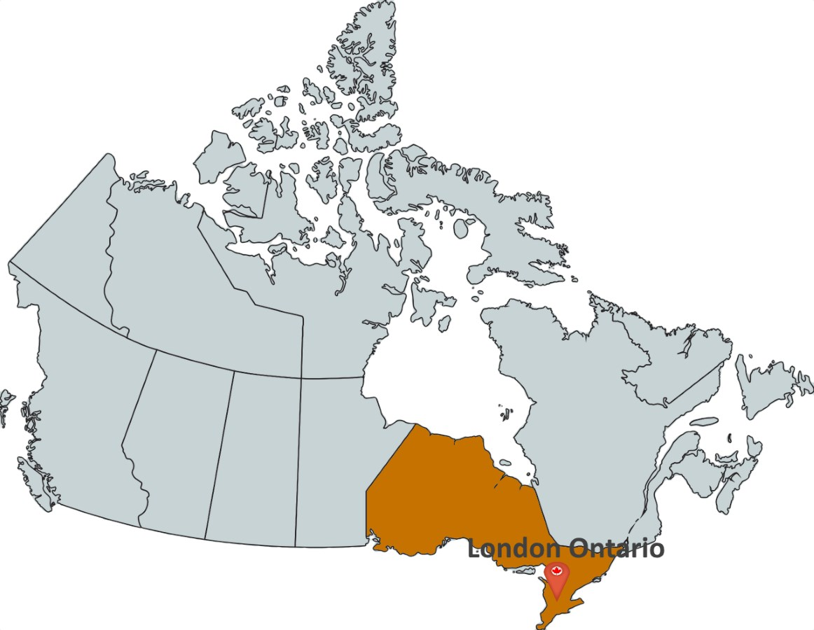


Slide 4


“Stress management implies control and is not a substitute for medical treatment or professional intervention.”
Notes:
What is Stress?
Identify Sources of Stress
Common Stress Symptoms
Unhealthy Stress Management
Healthy Stress Management: The Four A’s
3 Types of Coping Skills

Slide 5
INTERACTIVE POLL
PollEv.com/employeewell194
What does wellness mean to you?
Notes:
PollEv.com/employeewell194

Slide 6
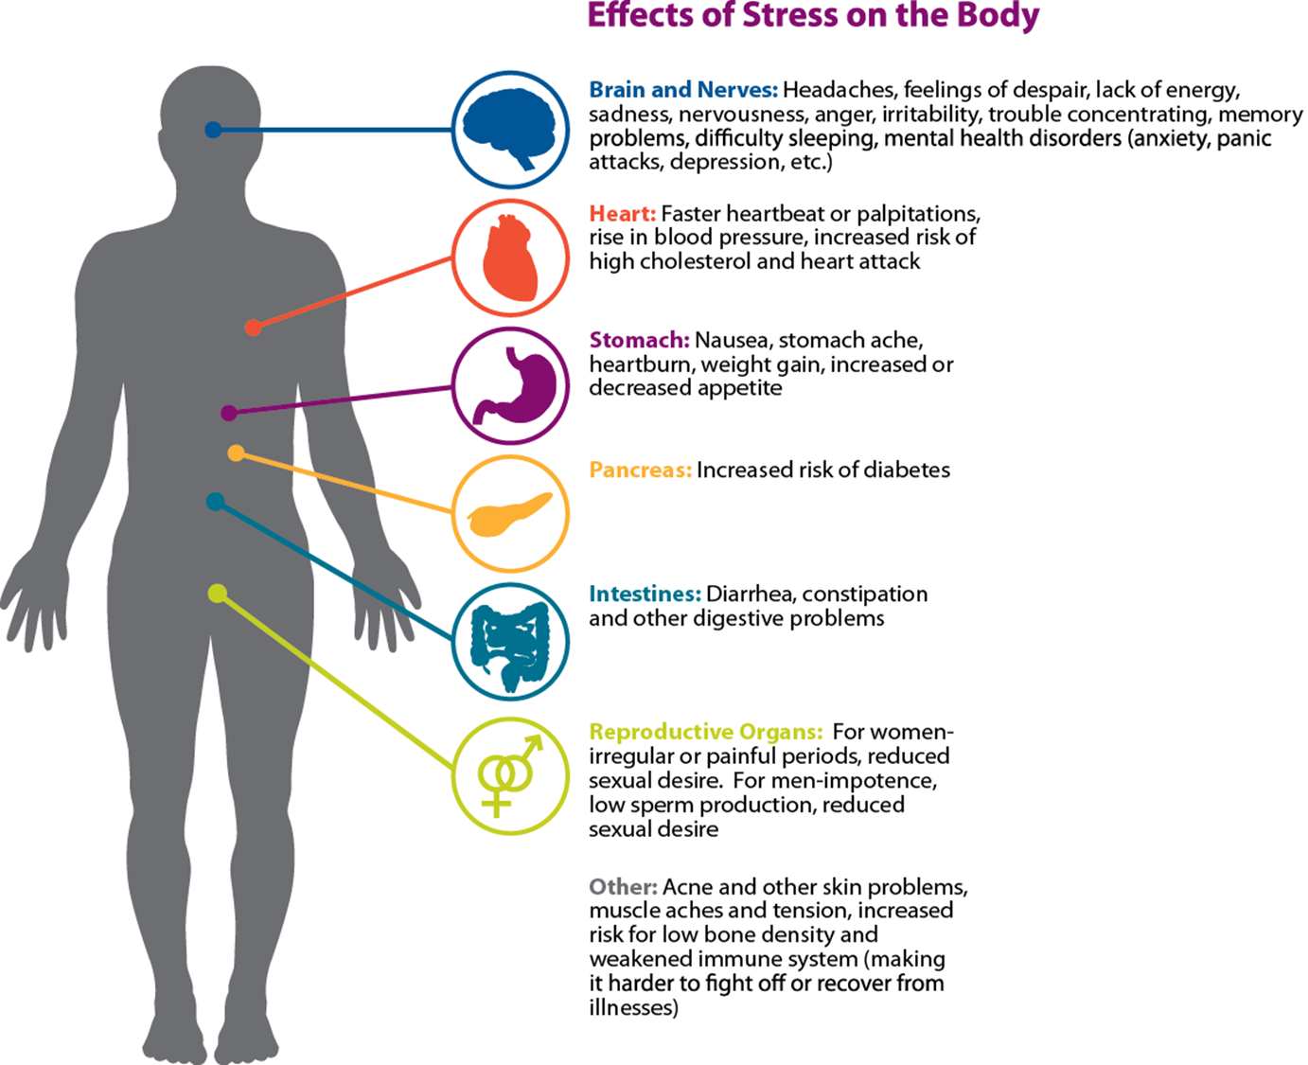
Effects of Emotional Stress on the Body
Notes:
Symptoms of stress affects all of our organs – go over some high level concerns

Slide 7
Our Reality Right Now….
“loss of control”
“disengaged”
“feelings of isolation”
“anxious, depressed”
“fear of the unknown”
“disconnect”
“unmotivated”
Notes:
Symptoms of stress affects all of our organs – go over some high level concerns

Slide 8
Self-Care
RE-FRESH
Optimizing
Energy
ELITE PLUS
ELITE 30
Resiliency
RE-FOCUS
Accepting
Change
Happiness
RE-CHARGE
Finding
Purpose
What Can We Control?

Slide 9
FOOD
EXERCISE
SLEEP
Self-Care
RE-FRESH
Optimizing
Energy
ELITE 30
Notes:
Accept the things you cannot change. Allow yourself to grieve what has been lost, but then try to focus on what’s needed in the present rather than dwelling on the past. What’s the opportunity? Name it.
Keep an open mind. While it feels uncomfortable, seeing change through a new lens can allow your imagination to run free and creativity to flow. It can bring about new experiences that may enhance the lifestyle you’ve always known.
Communicate. It’s ok to be uneasy and unsure in the face of transition. If you’re feeling overwhelmed, talk to others about what you need. Seek the guidance and support of a good friend, family member, or counsellor when life feels out of control. Communicating is a great coping strategy for releasing negative thoughts and moving into a more positive mindset.
REMAIN CONNECTED: To your support system
Take care of your emotional and mental wellness by staying connected to the things that matter (and things you can control). Exercise, eating well, proper sleep hygiene, and nurturing our relationships! Even though we can’t extend a hug or enjoy pizza and a movie together, a video chat or telephone call can be a great source of support.
Action Step: Do your best to lead a healthy lifestyle. It is one of your greatest supports. Keep the lines of communication open and talk to people you trust about how you’re feeling. You may want to connect with a counsellor who can offer some custom-based strategies and coping skills. Schedule an appointment with your healthcare provider if stress, fear, or anxiety get in the way of your daily activities for several days in a row. Don’t be afraid to call on whomever you need to at this time. Odds are, they are struggling in some way too.
Self-Awareness and pre-parediness
Imagine you’re going to take a raft trip down a river. Along with slow water and shallows, your map shows that you will encounter unavoidable rapids and turns. How would you make sure you can safely cross the rough waters and handle any unexpected problems that come from the challenge?
Perhaps you would enlist the support of more experienced rafters as you plan your route or rely on the companionship of trusted friends along the way. Maybe you would pack an extra life jacket or consider using a stronger raft. With the right tools and supports in place, one thing is sure: You will not only make it through the challenges of your river adventure. You will also emerge a more confident and courageous rafter.
Toolkit - Make connections. ...
Avoid seeing crises as insurmountable problems. ...
Accept that change is a part of living. ...
Move toward your goals. ...
Take decisive actions. ...
Look for opportunities for self-discovery. ...
Nurture a positive view of yourself. ...
Keep things in perspective.

Slide 10





SELF-CARE – RE-FRESH
Optimize Your Energy
ELITE PLUS
ELITE 30
PRO 15
BASIC 5
Healthy Food = Healthy Energy

Slide 11

ELITE PLUS
ELITE 30
PRO 15
BASIC 5

Slide 12


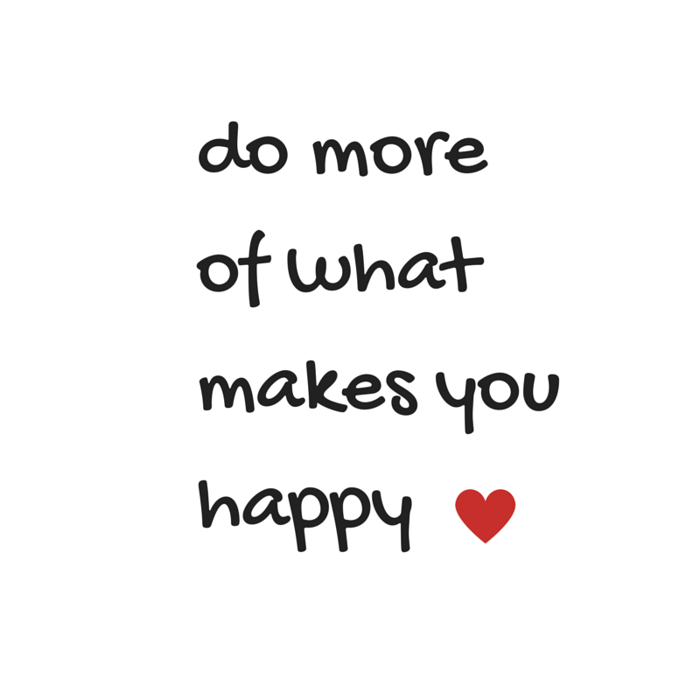
Prioritize Your Health
Mindful Movement
ELITE PLUS
PRO 15
No Movement = Sloth-mode

Slide 13
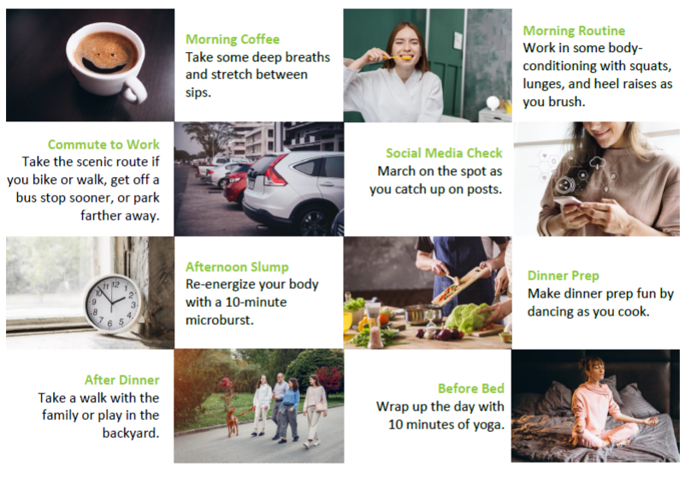
Do 5, Then Decide
  Something is better than nothing.
  Choose movements that offer maximum benefits
  (try a microburst).
  Hectic is NOT aerobic.
  Exercise is NOT a chore.
“It’s deciding that the longevity of your body and mind are important enough.”
Habit Stacking
PRO 15

Slide 14

Healthy Sleep
Set a regular sleep schedule
Go to bed earlier so you don’t over-sleep
Get up after 15 mins!
PRO 15

Slide 15

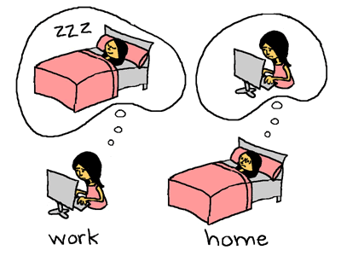
Prioritize Your Health
Restful Sleep
ELITE PLUS
ELITE 30

Slide 16
Your Day
Control the Controllable
What is the Opportunity?
Resiliency
RE-FOCUS
Accepting
Change
ELITE 30
Notes:
Accept the things you cannot change. Allow yourself to grieve what has been lost, but then try to focus on what’s needed in the present rather than dwelling on the past. What’s the opportunity? Name it.
Keep an open mind. While it feels uncomfortable, seeing change through a new lens can allow your imagination to run free and creativity to flow. It can bring about new experiences that may enhance the lifestyle you’ve always known.
Communicate. It’s ok to be uneasy and unsure in the face of transition. If you’re feeling overwhelmed, talk to others about what you need. Seek the guidance and support of a good friend, family member, or counsellor when life feels out of control. Communicating is a great coping strategy for releasing negative thoughts and moving into a more positive mindset.
REMAIN CONNECTED: To your support system
Take care of your emotional and mental wellness by staying connected to the things that matter (and things you can control). Exercise, eating well, proper sleep hygiene, and nurturing our relationships! Even though we can’t extend a hug or enjoy pizza and a movie together, a video chat or telephone call can be a great source of support.
Action Step: Do your best to lead a healthy lifestyle. It is one of your greatest supports. Keep the lines of communication open and talk to people you trust about how you’re feeling. You may want to connect with a counsellor who can offer some custom-based strategies and coping skills. Schedule an appointment with your healthcare provider if stress, fear, or anxiety get in the way of your daily activities for several days in a row. Don’t be afraid to call on whomever you need to at this time. Odds are, they are struggling in some way too.
Self-Awareness and pre-parediness
Imagine you’re going to take a raft trip down a river. Along with slow water and shallows, your map shows that you will encounter unavoidable rapids and turns. How would you make sure you can safely cross the rough waters and handle any unexpected problems that come from the challenge?
Perhaps you would enlist the support of more experienced rafters as you plan your route or rely on the companionship of trusted friends along the way. Maybe you would pack an extra life jacket or consider using a stronger raft. With the right tools and supports in place, one thing is sure: You will not only make it through the challenges of your river adventure. You will also emerge a more confident and courageous rafter.
Toolkit - Make connections. ...
Avoid seeing crises as insurmountable problems. ...
Accept that change is a part of living. ...
Move toward your goals. ...
Take decisive actions. ...
Look for opportunities for self-discovery. ...
Nurture a positive view of yourself. ...
Keep things in perspective.

Slide 17
Focus on YOU
Assess Your Energy Levels
Make a List
Determine Energy Cycles
Time Management vs Energy Management
ELITE 30
Energizers (what gives you fulfilment?) vs
Suckers (what destroys your spirit?)
Balance Ener-gizers with Ener-suckers
Time of Day
Notes:
Time management – things, chores, events, appointments – schedule in your TO DO list
Energy management – balancing your lows and highs during your day (throw out the rules for how we are “supposed” to fill our time.
Make a list – everything that drives you, fulfills you, energizes you, brings you joy during your day = energizers
-everything that drains you, what you don’t like to do, easily distracted and procrastinate, less productive = energy suckers
List of energizers = strengths; List of suckers = weaknesses
GOAL – actively manage tasks during your day that balances out the time spent on draining tasks so you’re not mentally exhausted at the end of the day.
How you spend your day – does it align with your values? Investing in things that aren’t important to us is leaving us feeling unfulfilled, which drains energy. Consciously choose what’s important to you and your schedule.
Energy Cycles – self-awareness of your energy – best in am? Most productive in am? Have that long meeting, tackle that TO DO item that you’re putting off. Is your best in the pm? Switch these important tasks around so you have the energy to complete them.
*Consciously choose how your cup wants to be (filled or empty) at the end of your day.

Slide 18
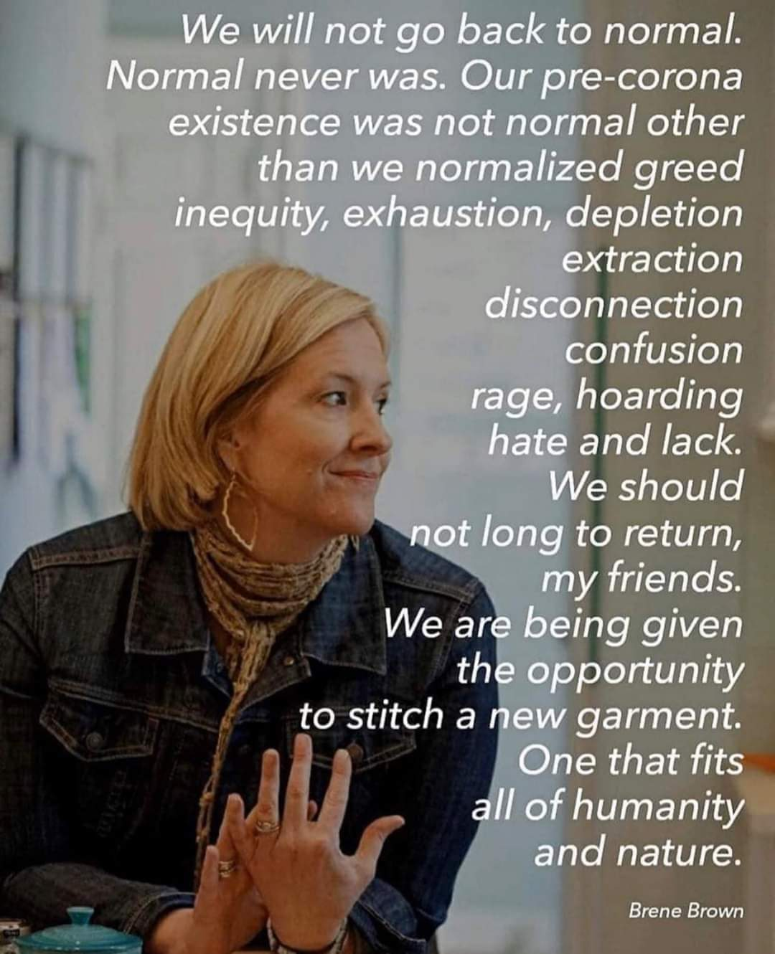
ELITE PLUS
ELITE 30

Slide 19
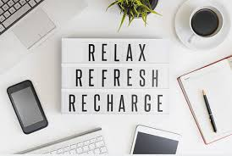
RELAX to Reflect
ELITE PLUS
Deep Breathing – 10 times, 2x/day
Meditation – calm.com
Self-Development
&
Developing Others
ELITE 30
PRO 15

Slide 20
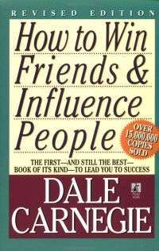








Slide 21
Connection
Empowerment
What’s your Purpose?
Happiness
RE-CHARGE
Finding
Purpose
ELITE 30

Slide 22


Create a buffer
5-10 minutes
ELITE 30
Can I control?
Options of 3, not 1

Slide 23






Name Your Worries
ELITE 30
PRO 15
BASIC 5

Slide 24
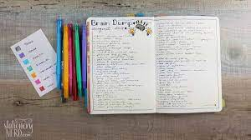
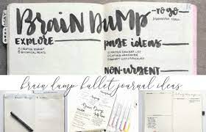
Brain DUMP
PRO 15
BASIC 5

Slide 25
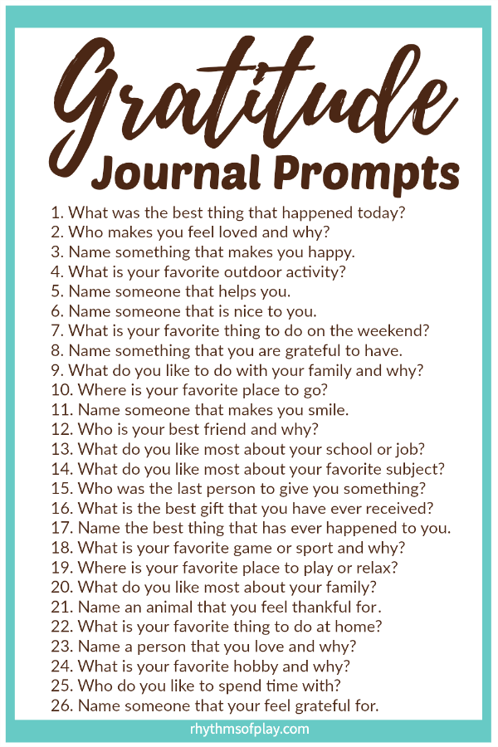

Gratitude Journal
PRO 15
BASIC 5
What are you grateful for today?

Slide 26
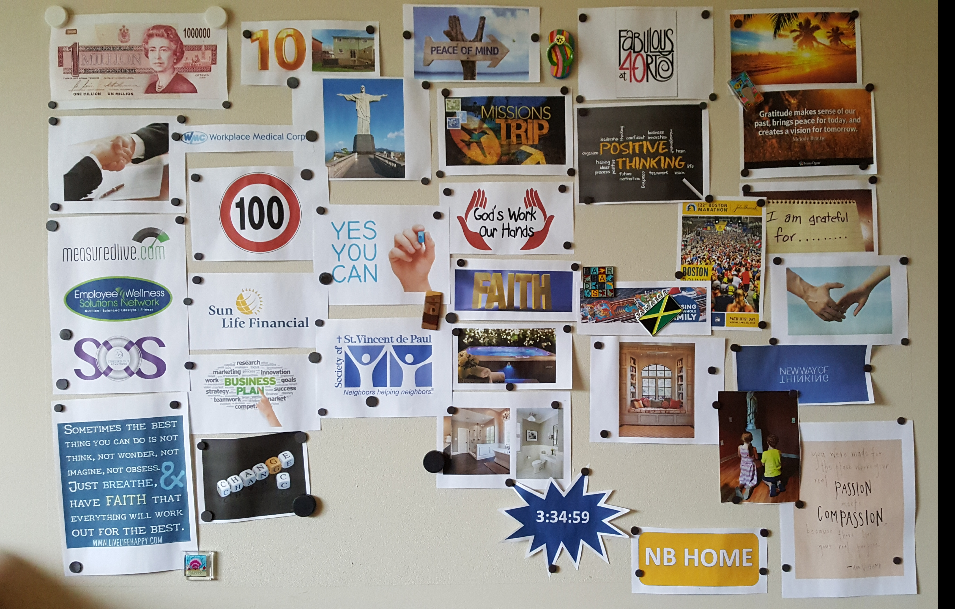
GOAL BOARD

Slide 27
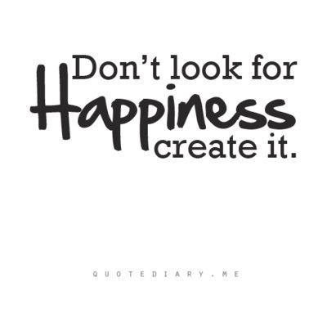
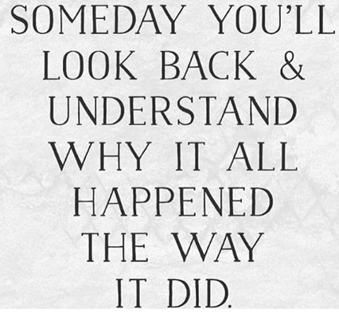
ELITE PLUS
Do More of What
Makes You Happy
ELITE 30
PRO 15

Slide 28
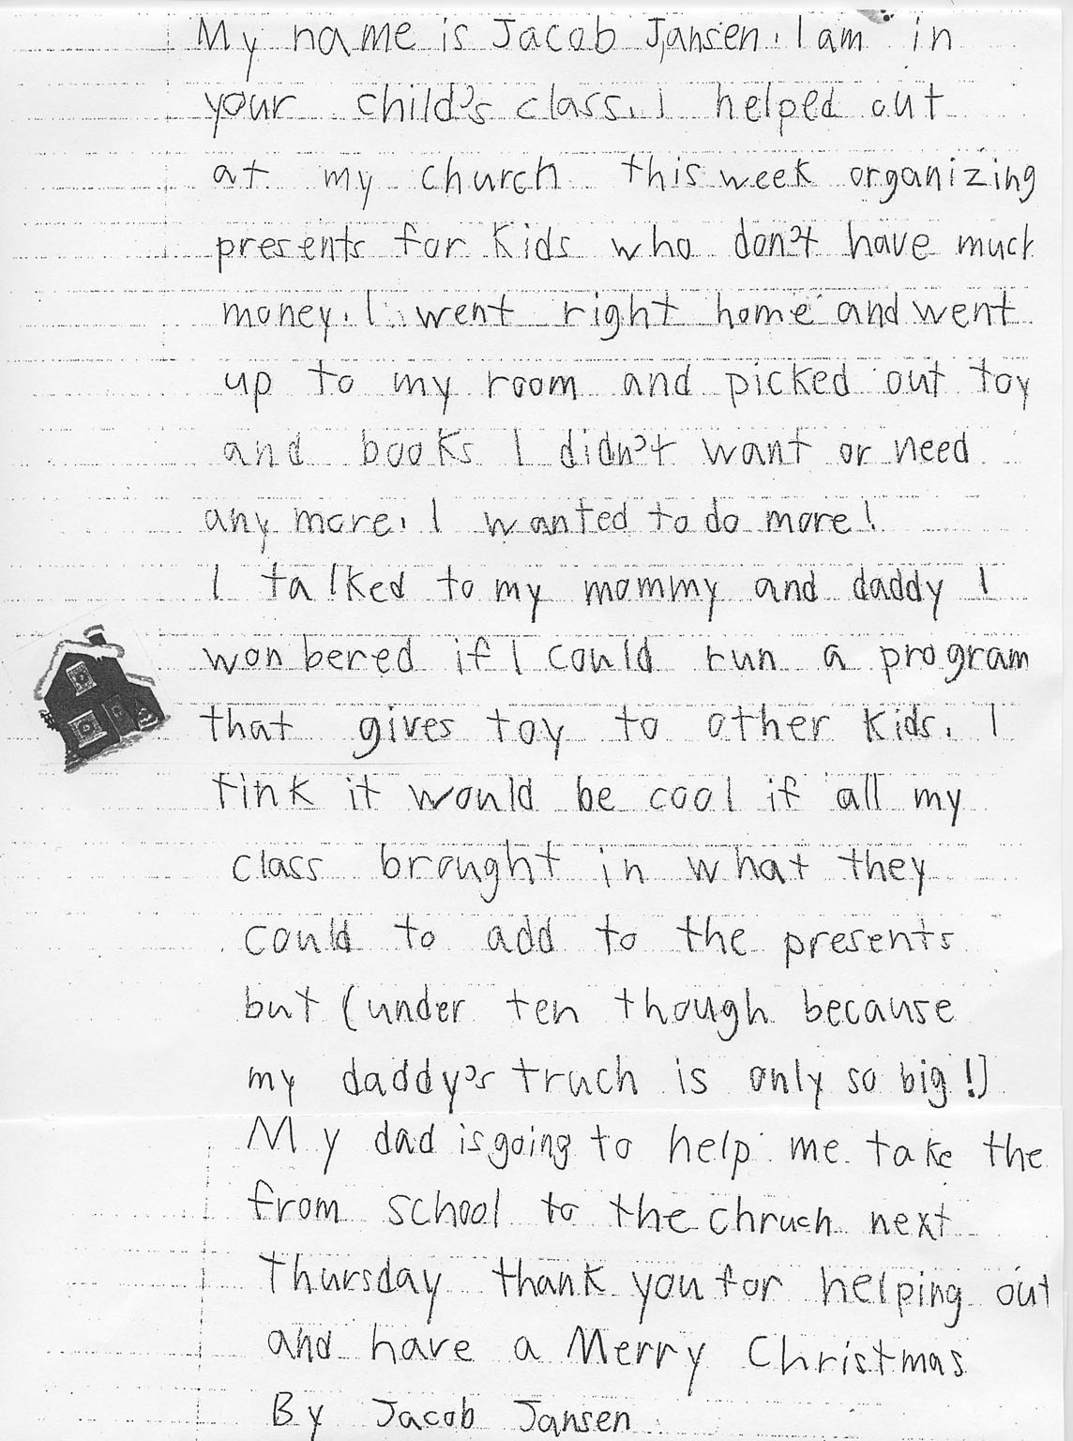
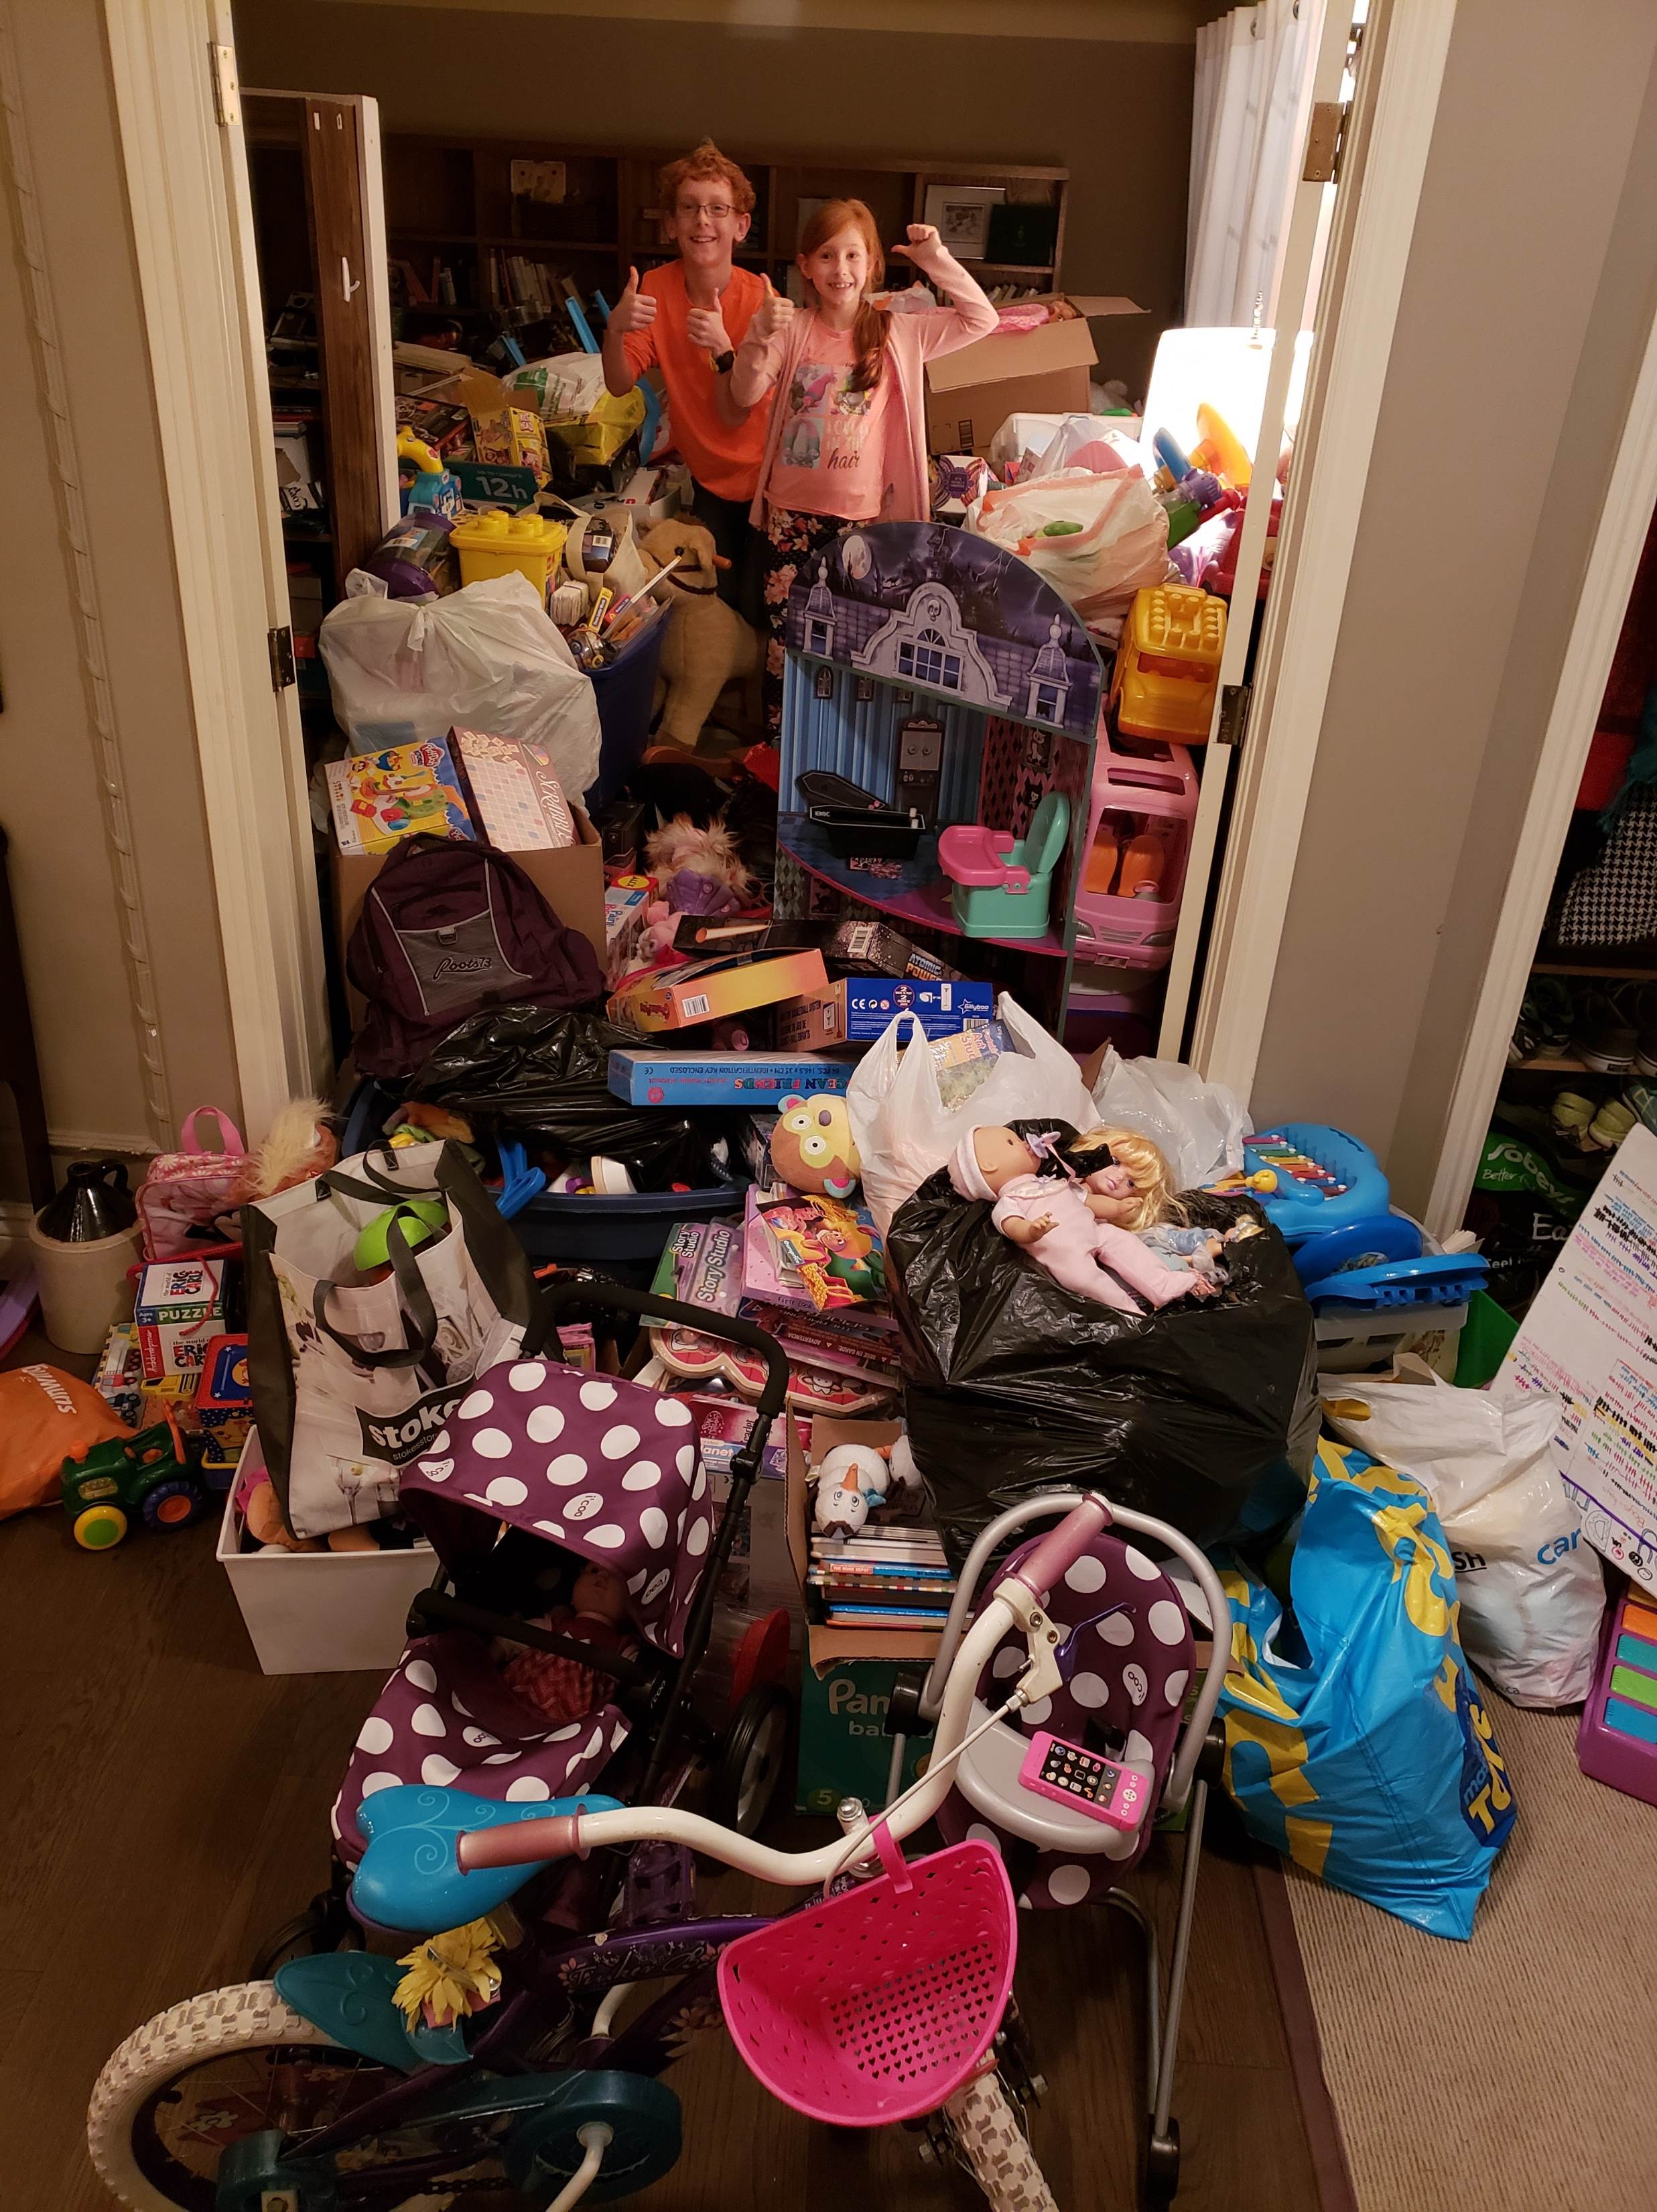
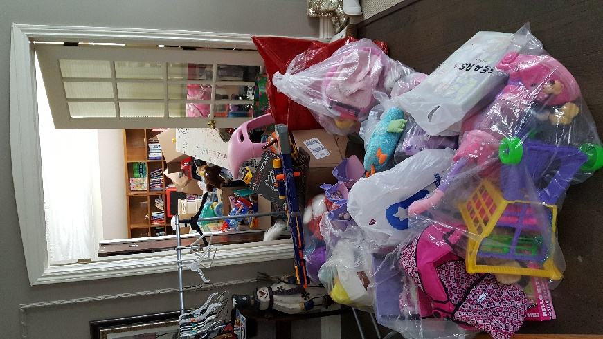

ELITE PLUS
ELITE 30
PRO 15

Slide 29


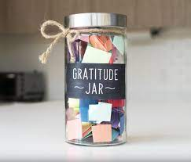
ELITE PLUS

Slide 30



TAKE-AWAY from Jay Shetty
What is one thing you can do TODAY to make it a great day for you?
Meaghan Jansen
Meaghan@ewsnetwork.com
Notes:
All of these things adaptive responses are very useful if we are running for our lives. A short term response to a short term problem.

Slide 31
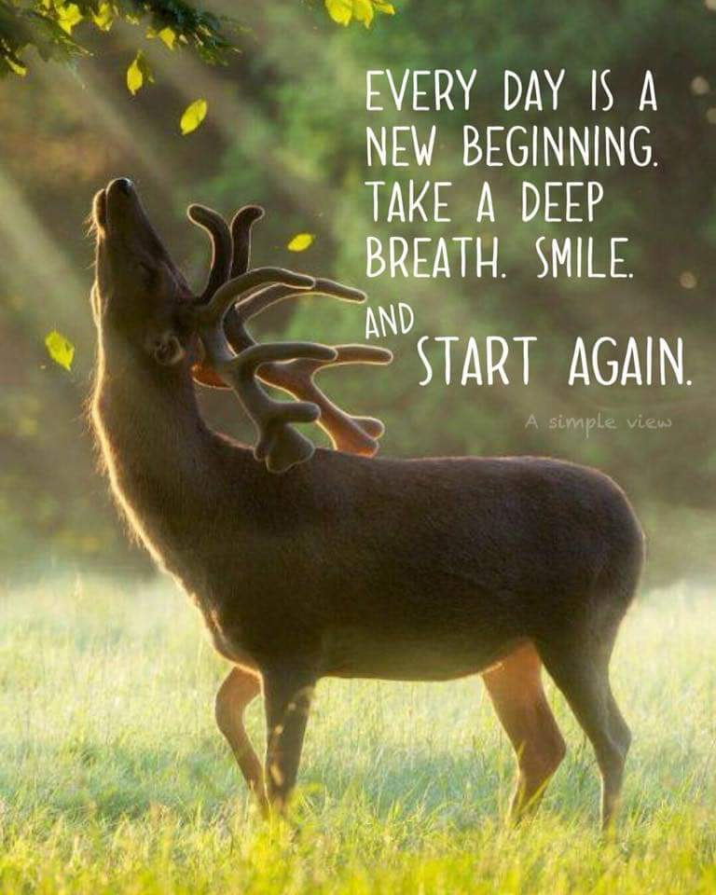
ELITE PLUS
Meaghan Jansen
Meaghan@ewsnetwork.com

Slide 32
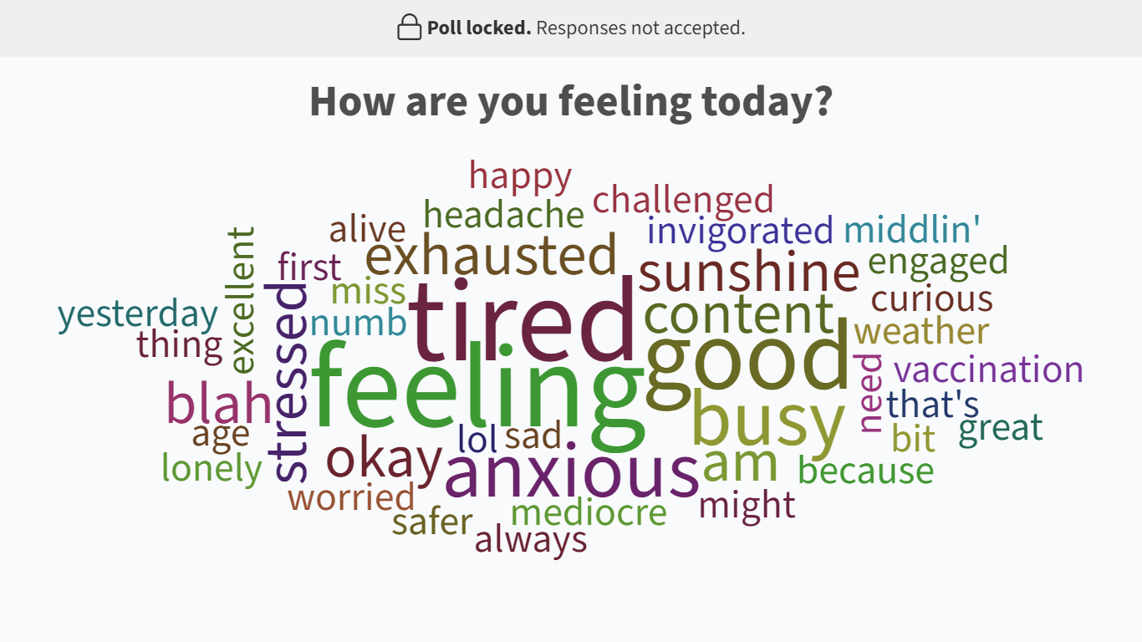
ELITE PLUS
Meaghan Jansen
Meaghan@ewsnetwork.com

