Slide 1

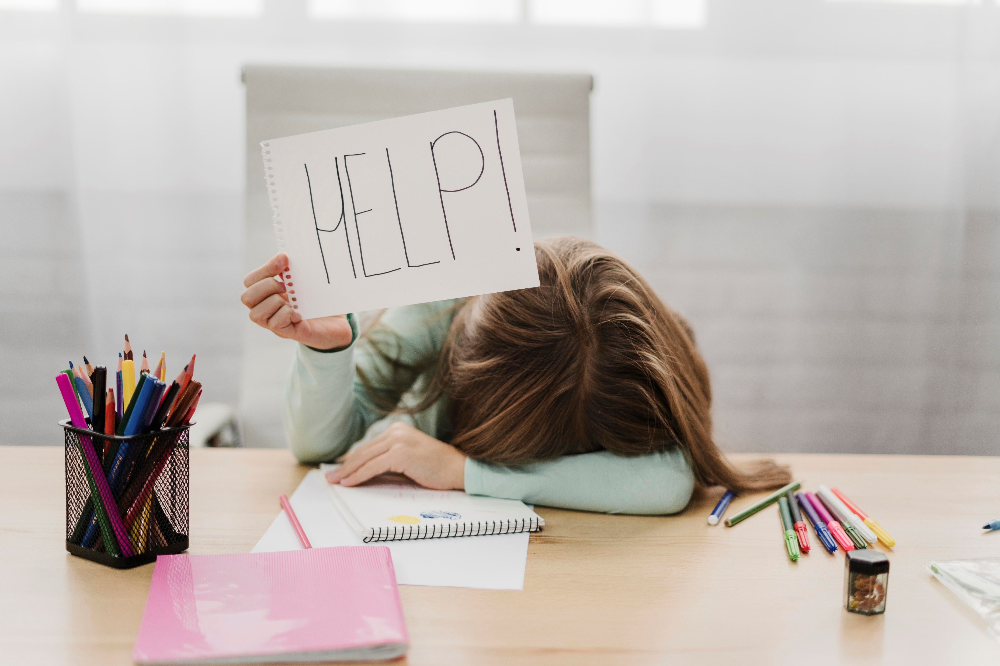

Dear Stress,
Let’s Break Up!
Notes:
Images by freepik

Slide 2
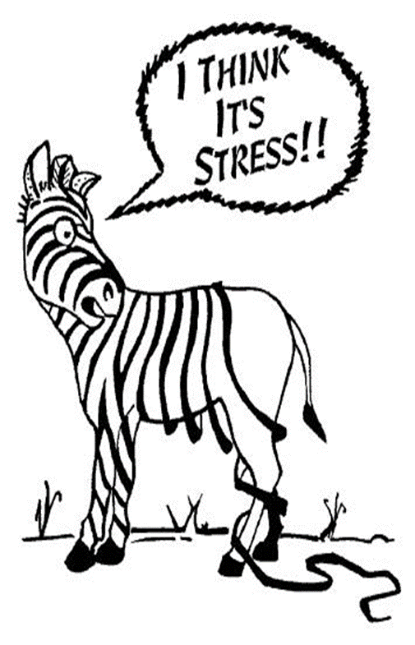

“Stress management implies control and is not a substitute for medical treatment or professional intervention.”
- EAP, health care professional
Notes:
What is Stress?
Identify Sources of Stress
Common Stress Symptoms
Unhealthy Stress Management
Healthy Stress Management: The Four A’s
3 Types of Coping Skills

Slide 3




Stress is Serious
Stress is a risk factor for heart disease and stroke
  Every 7 minutes, a Canadian dies from heart disease or stroke
  Every year, 70,000 heart attacks in Canada
  Every year, 50,000 strokes in Canada – That’s 1 every 10 minutes!
StatsCan, 2019

Slide 4


Stress is Serious
Canadians report a high degree of life stress (as of 2019)
  18-34 years
  22.6%
  35-49 years
  28.3%
  50-64 years
  23.6%
StatsCan, 2019
Notes:
Correlation between heart disease in women and marital/psychosocial stress
No matter where you live, the pressures of everyday life can influence your wellbeing
When it’s not possible to avoid excessive stress, you need a strategy

Slide 5

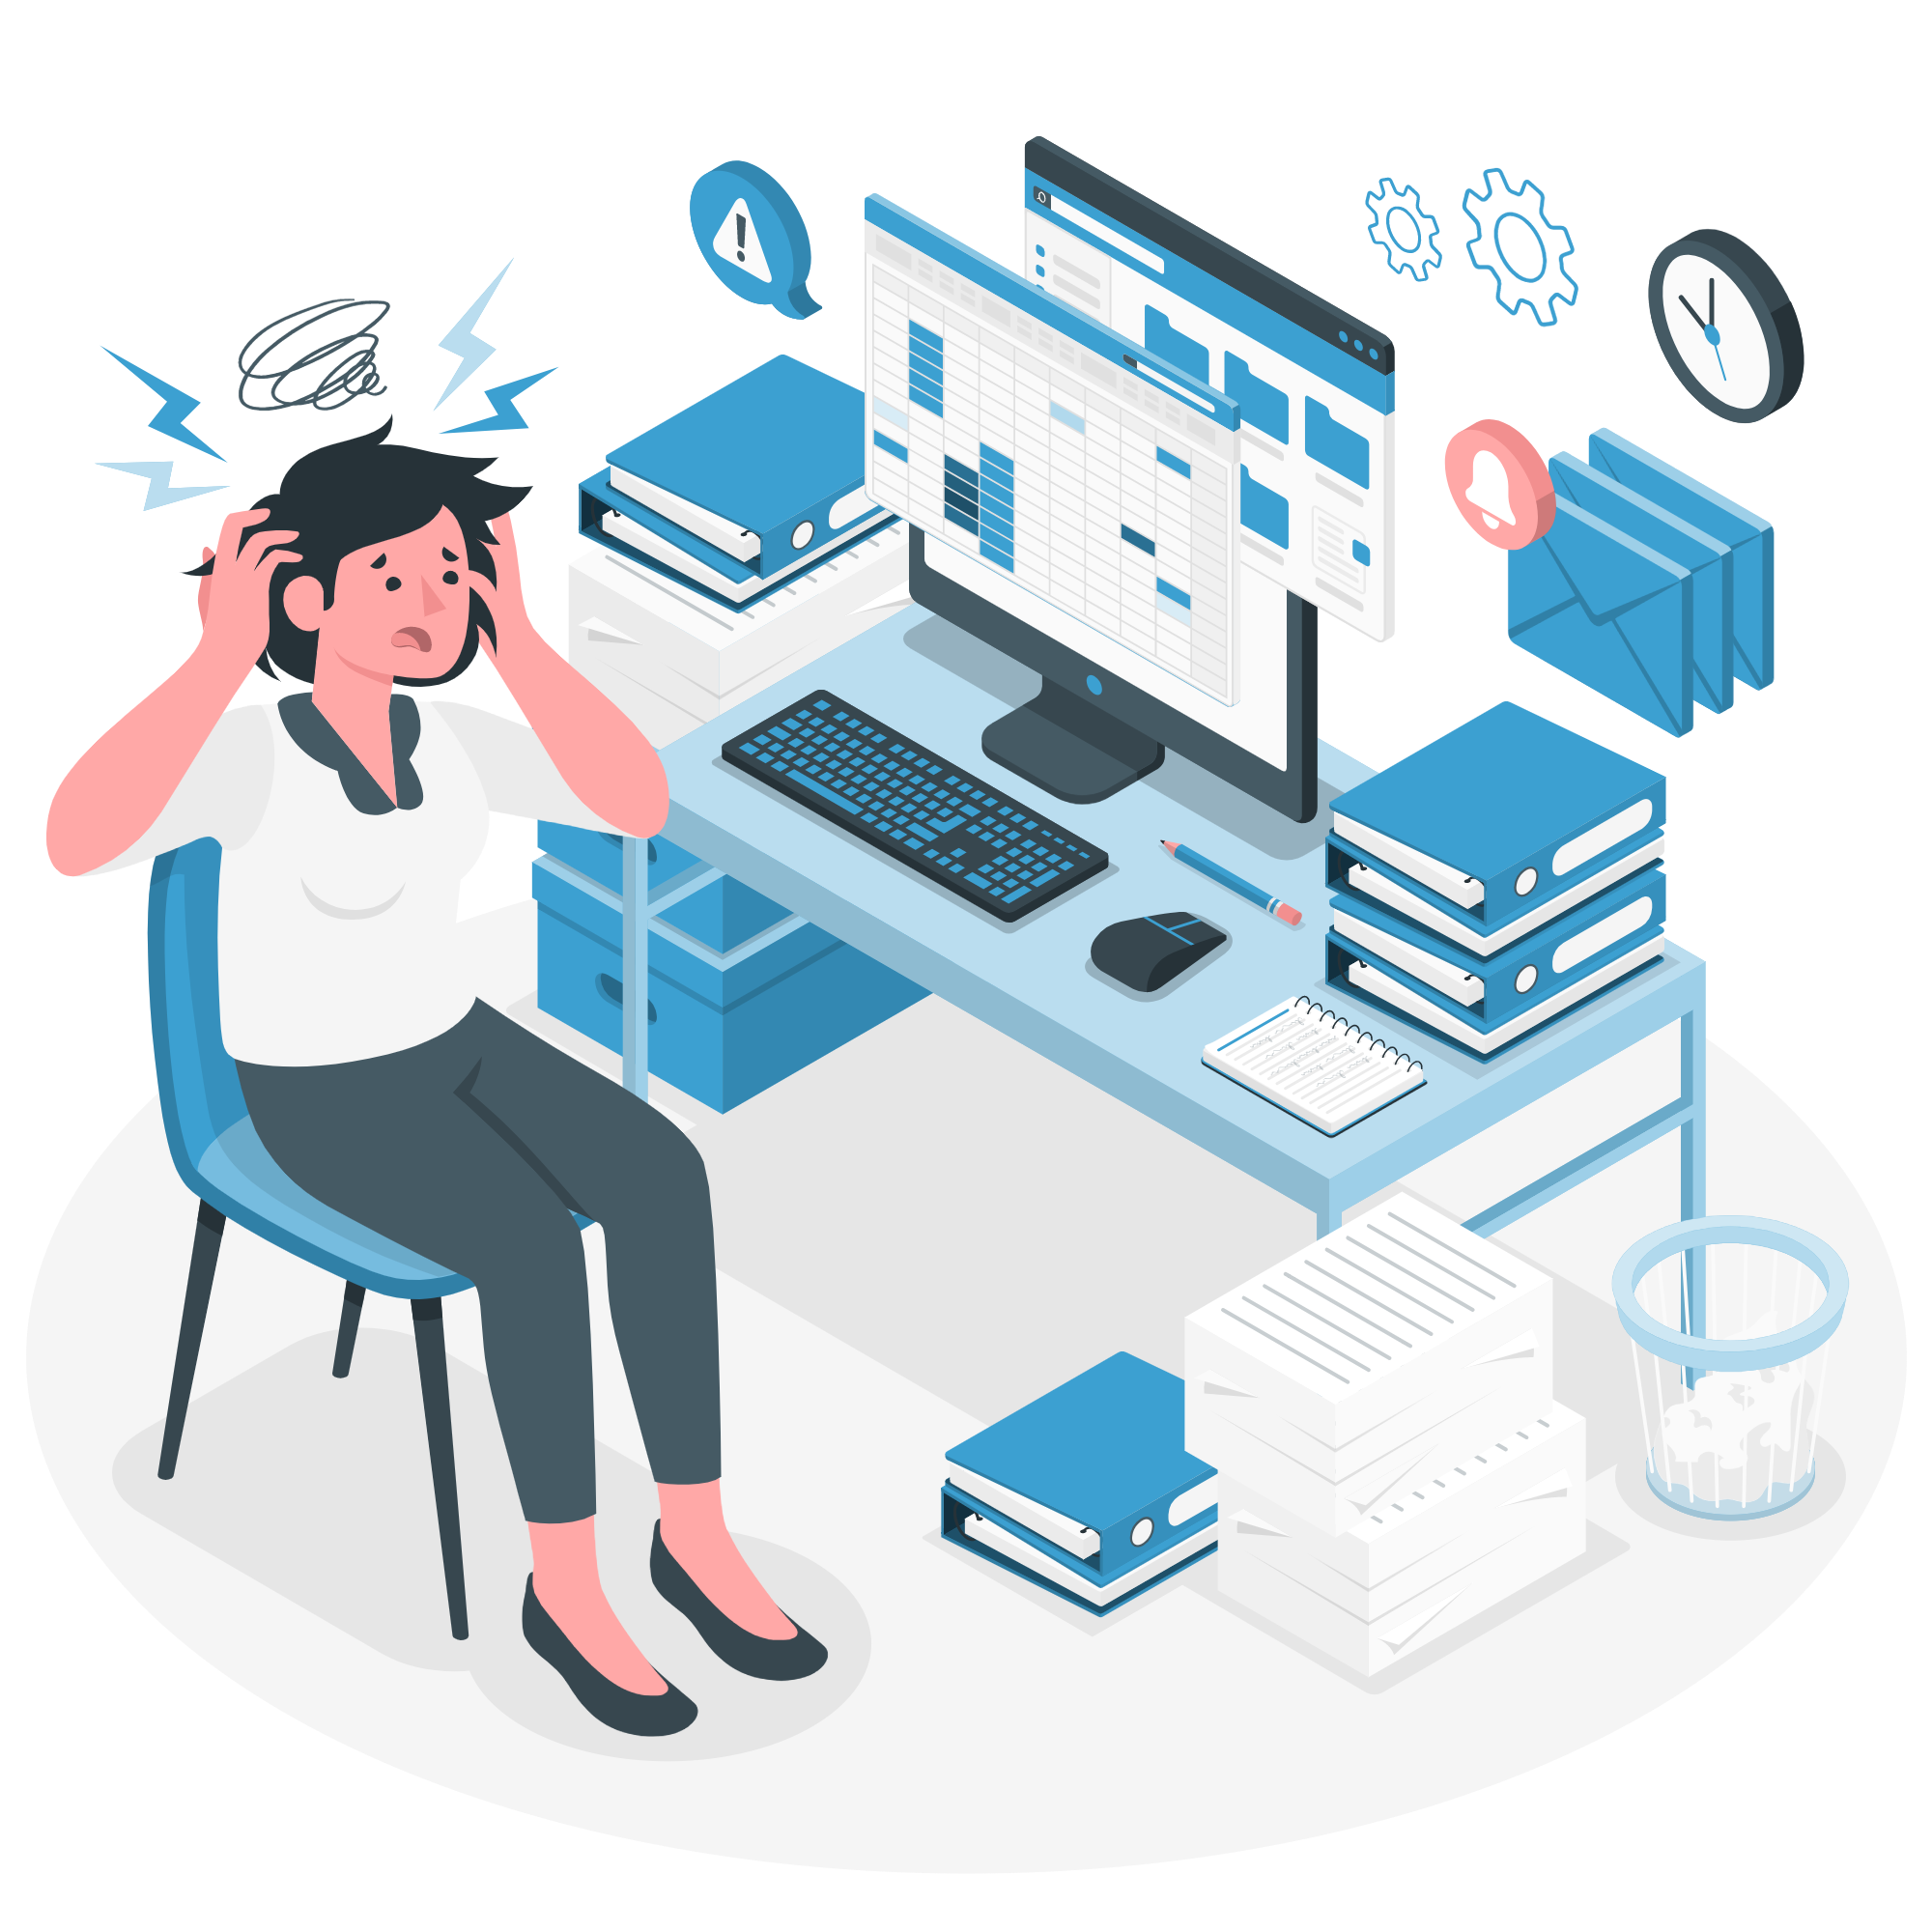
What is Stress?
Stress is the body’s physical response to a perceived threat.
There are 2 types of stress:
Eustress
Stress that helps a person perform at a higher level and achieve their goals.
Distress
Stress that is overwhelming and hinders performance and overall well-being.
Notes:
The stress response (also called the fight or flight response) is critical during emergency situations, such as when a driver has to slam on the brakes to avoid an accident. It can also be activated in a milder form at a time when the pressure's on but there's no actual danger — like stepping up to take the foul shot that could win the game, getting ready to go to a big dance, or sitting down for a final exam. A little of this stress can help keep you on your toes, ready to rise to a challenge. And the nervous system quickly returns to its normal state, standing by to respond again when needed.
Ongoing or long-term events, like coping with a divorce or moving to a new neighborhood or school, can cause stress, too.
Long-term stressful situations can produce a lasting, low-level stress that's hard on people. The nervous system senses continued pressure and may remain slightly activated and continue to pump out extra stress hormones over an extended period. This can wear out the body's reserves, leave a person feeling depleted or overwhelmed, weaken the body's immune system, and cause other problems.
Good (eustress) vs bad (distress) stress

Slide 6

Stress Response
Body secretes stress hormones such as adrenalin (epinephrine), cortisol, and glucocorticoids
At the same time, it inhibits other hormones such as insulin, growth hormones, and reproductive hormones
Stress hormones travel through the blood stream, which is why they can affect so many different parts of the body!
Notes:
In both cases, the body secretes the same hormones…
Again think of the zebra running for its life. If you’re being chased by a lion, its ok if you ovulate later!!

Slide 7
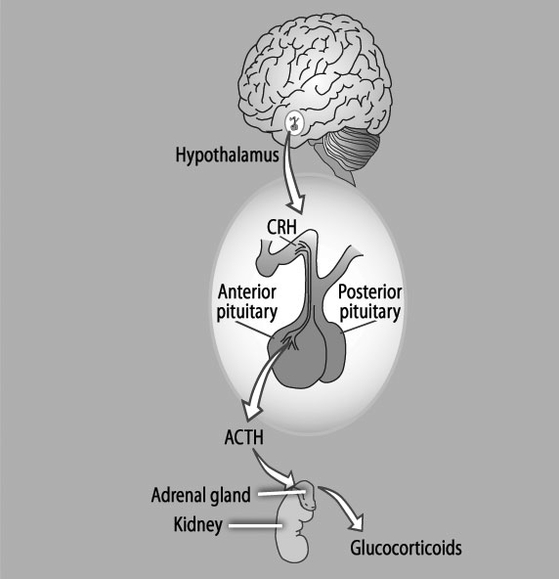
Stress Hormones
Notes:
Glucocorticoids = an umbrella term for many different stress hormones. Stress hormones are told to be released by the brain. The adrenal glands secrete the hormones…found on top of the kidney.

Slide 8
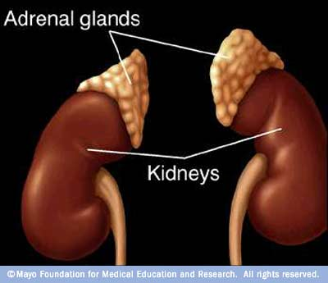
Adrenal Glands
Located above the kidneys
3 inches wide, ½ inch high
Notes:
Body doesn’t know the difference. It reacts the same way….hormones release, pupils dilate, heart rate increases, breathing rate increases, sweating starts…
It’s how we deal with the stressors will determine how our bodies perceives it. Too much = adrenal fatigue, lethargy, sickness, anxiety, ENERGY ZAPPER!

Slide 9
Adrenal Fatigue
Excessive fatigue
Non-refreshing sleep
Feeling overwhelmed / unable to cope with stress
Craving salty or sweet foods
Most energetic in the evening
Sleep disturbances and not feeling rested
Low stamina
Poor recovery after exercise, injury, or illness
Difficulty concentrating (mental fog)
Poor digestion
Low immune system
PMS
Low BP
Extreme sensitivity to cold
Notes:
Overworking of adrenals can cause some problems – naturopath, health care professional, can help diagnose

Slide 10
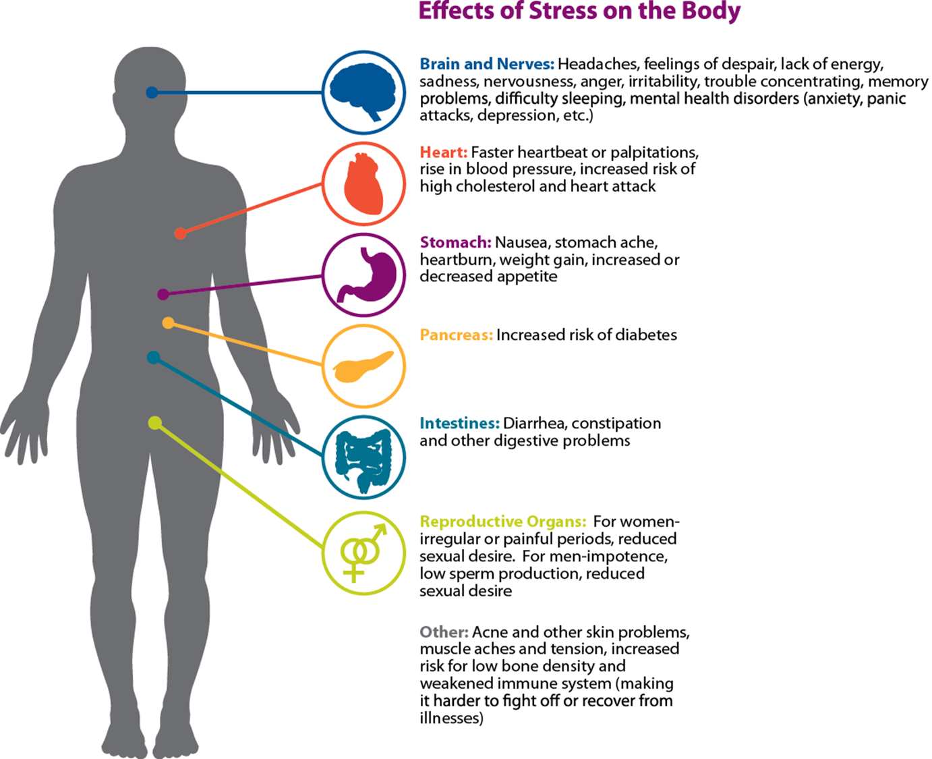
Effects of Stress on the Body
Notes:
Symptoms of stress affects all of our organs – go over some high level concerns

Slide 11
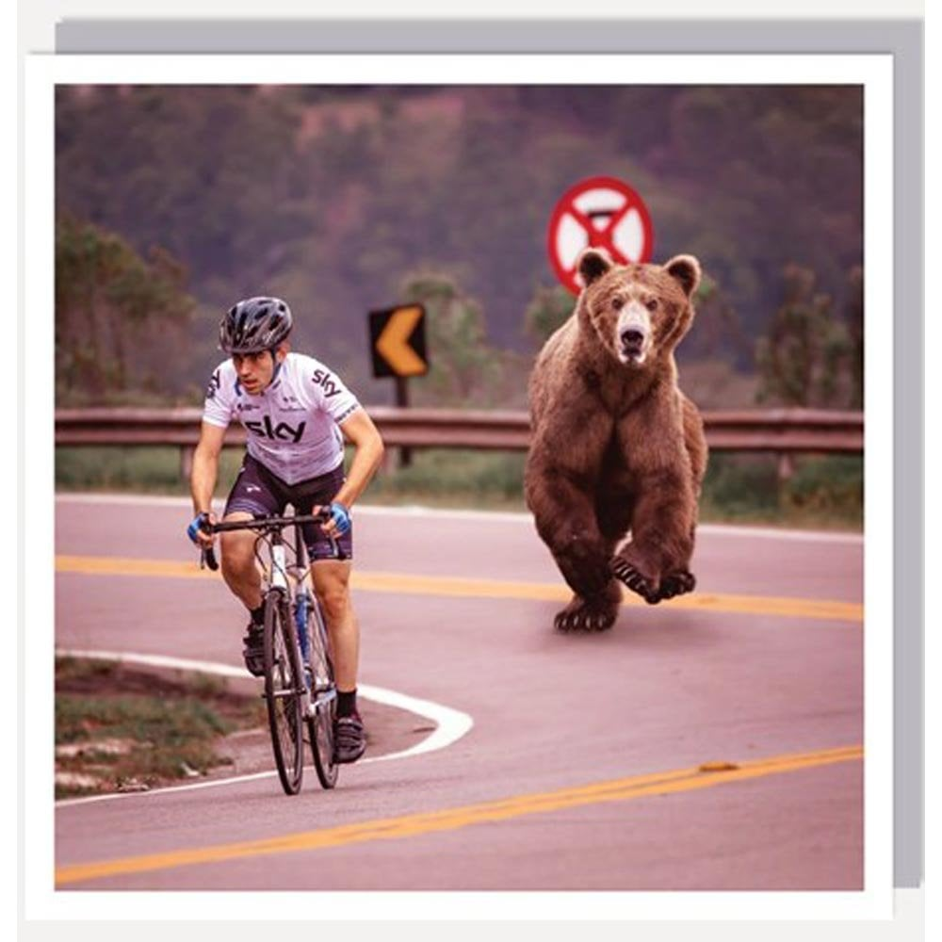
Stress Response
Diverts energy from storage sites throughout the body to active muscle tissue
Blood pressure increases
Heart rate increases
Pain perception is blunted
Immune system is heightened
Brain is alert and processes information more acutely
This is useful when running for our lives… short-term response is good!
Notes:
All of these things adaptive responses are very useful if we are running for our lives. A short term response to a short term problem.

Slide 12

Step 1: Identify Sources of Stress
“I just have a million things on the go right now.”
“Things are always crazy around here.”
“I have a lot of nervous energy, that’s all.”
“Stress is just a normal part of my life. There’s no way of avoiding it.”
What symptoms affect you?
Notes:
Stress management starts with identifying the sources of stress in your life. Your true sources of stress aren’t always obvious, and it’s all too easy to overlook your own stress-inducing thoughts, feelings, and behaviors. To identify your true sources of stress, look closely at your habits, attitude, and excuses. Until you accept responsibility for the role you play in creating or maintaining it, your stress level will remain outside your control.
- Do you explain away stress as temporary (“I just have a million things going on right now”) even though you can’t remember the last time you took a breather?
- Do you define stress as an integral part of your work or home life (“Things are always crazy around here”) or as a part of your personality (“I have a lot of nervous energy, that’s all”).
- Do you blame your stress on other people or outside events, or view it as entirely normal and unexceptional?

Slide 13
Common Stress Symptoms
Physical | Emotional | Behaviours
Headache | Anxiety | Overeating/Undereating
Chest pain | Worrying/Depression | Angry outbursts
High Blood Pressure | Seeing only the negative | Drug abuse
Shortness of Breath | Anger | Excessive drinking
Muscle aches/Back pain | Mood Swings | Social withdrawal
Sex problems | Job dissatisfaction | Crying spells
Clenched jaws | Feeling insecure | Relationship conflicts
Constipation/Diarrhea | Confusion | Decreased productivity
Increases Sweating | Burnout | Blaming others
Sleep problems | Forgetfulness
Weight gain/loss | Resentment
Skin breakouts | Guilt | Source: mayoclinic.com
Notes:
Three common ways people respond to stress:
Angry or agitated. You may feel heated, overly emotional, and unable to sit still.
Withdrawn or depressed. You may shut down, space out, or show very little energy or emotion.
Tense and frozen. You may freeze under pressure, look paralyzed, but under the surface feel extremely agitated.

Slide 14




Unhealthy Stress Management
Smoking
Excessive drinking
Overeating or under-eating
Zoning out for hours in front of a screen
Withdrawing from friends, family, activities
Using pills or drugs to relax
Excessive sleeping
Procrastinating
Busying yourself to avoid facing problems
Taking your stress out on others
Notes:
These coping strategies may temporarily reduce stress, but they cause more damage in the long run

Slide 15

Step 2: Healthy Stress Management
The Four A’s:
Change the situation…
❶ | Avoid the stressor
❷ | Alter the stressor
Change your reaction…
❸ | Adapt to the stressor
❹ | Accept the stressor
Notes:
These coping strategies may temporarily reduce stress, but they cause more damage in the long run

Slide 16

Healthy Stress Management
Avoid Unnecessary Stress:
Learn how to say “no”
Avoid people who stress you out
Take control of your environment
Avoid heated conversations
Narrow down your to-do list
Notes:
Not all stress can be avoided, and it’s not healthy to avoid a situation that needs to be addressed. You may be surprised, however, by the number of stressors in your life that you can eliminate.
Learn how to say “no” – Know your limits and stick to them. Whether in your personal or professional life, refuse to accept added responsibilities when you’re close to reaching them. Taking on more than you can handle is a surefire recipe for stress.
Avoid people who stress you out – If someone consistently causes stress in your life and you can’t turn the relationship around, limit the amount of time you spend with that person or end the relationship entirely.
Take control of your environment – If the evening news makes you anxious, turn the TV off. If traffic’s got you tense, take a longer but less-traveled route. If going to the market is an unpleasant chore, do your grocery shopping online.
Avoid hot-button topics – If you get upset over religion or politics, cross them off your conversation list. If you repeatedly argue about the same subject with the same people, stop bringing it up or excuse yourself when it’s the topic of discussion.
Pare down your to-do list – Analyze your schedule, responsibilities, and daily tasks. If you’ve got too much on your plate, distinguish between the “shoulds” and the “musts.” Drop tasks that aren’t truly necessary to the bottom of the list or eliminate them entirely.

Slide 17

Healthy Stress Management
Alter the Situation:
Express your feelings – don’t bottle it up!
Be willing to compromise
Be more assertive
Manage your time
Manage your energy (energy blocking)
Notes:
If you can’t avoid a stressful situation, try to alter it. Figure out what you can do to change things so the problem doesn’t present itself in the future. Often, this involves changing the way you communicate and operate in your daily life.
Express your feelings instead of bottling them up. If something or someone is bothering you, communicate your concerns in an open and respectful way. If you don’t voice your feelings, resentment will build and the situation will likely remain the same.
Be willing to compromise. When you ask someone to change their behavior, be willing to do the same. If you both are willing to bend at least a little, you’ll have a good chance of finding a happy middle ground.
Be more assertive. Don’t take a backseat in your own life. Deal with problems head on, doing your best to anticipate and prevent them. If you’ve got an exam to study for and your chatty roommate just got home, say up front that you only have five minutes to talk.
Manage your time better. Poor time management can cause a lot of stress. When you’re stretched too thin and running behind, it’s hard to stay calm and focused. But if you plan ahead and make sure you don’t overextend yourself, you can alter the amount of stress you’re under.
Energy Blocking – instead of feeling mentally exhausted at the end of each day, try to start your day off on a high and end it on a high. Make a list of all things that fulfill you – Energizers - and a list of Energy-suckers. Then, balance them so your days aren’t completely filled with energy-suckers.

Slide 18

Healthy Stress Management
Adapt to the Stressor:
Reframe the problem
Look at the big picture
Adjust your standards
Focus on the positive
Notes:
If you can’t change the stressor, change yourself. You can adapt to stressful situations and regain your sense of control by changing your expectations and attitude.
Reframe problems. Try to view stressful situations from a more positive perspective. Rather than fuming about a traffic jam, look at it as an opportunity to pause and regroup, listen to your favorite radio station, or enjoy some alone time.
Look at the big picture. Take perspective of the stressful situation. Ask yourself how important it will be in the long run. Will it matter in a month? A year? Is it really worth getting upset over? If the answer is no, focus your time and energy elsewhere.
Adjust your standards. Perfectionism is a major source of avoidable stress. Stop setting yourself up for failure by demanding perfection. Set reasonable standards for yourself and others, and learn to be okay with “good enough.”
Focus on the positive. When stress is getting you down, take a moment to reflect on all the things you appreciate in your life, including your own positive qualities and gifts. This simple strategy can help you keep things in perspective.

Slide 19

Healthy Stress Management
Accept What You Can’t Change:
Don’t try to control the uncontrollable
Look for the upside
Share your feelings
Learn to forgive – yourself!
Notes:
Some sources of stress are unavoidable. You can’t prevent or change stressors such as the death of a loved one, a serious illness, or a national recession. In such cases, the best way to cope with stress is to accept things as they are. Acceptance may be difficult, but in the long run, it’s easier than railing against a situation you can’t change.
Don’t try to control the uncontrollable. Many things in life are beyond our control— particularly the behavior of other people. Rather than stressing out over them, focus on the things you can control such as the way you choose to react to problems.
Look for the upside. As the saying goes, “What doesn’t kill us makes us stronger.” When facing major challenges, try to look at them as opportunities for personal growth. If your own poor choices contributed to a stressful situation, reflect on them and learn from your mistakes.
Share your feelings. Talk to a trusted friend or make an appointment with a therapist. Expressing what you’re going through can be very cathartic, even if there’s nothing you can do to alter the stressful situation.
Learn to forgive. Accept the fact that we live in an imperfect world and that people make mistakes. Let go of anger and resentments. Free yourself from negative energy by forgiving and moving on.

Slide 20
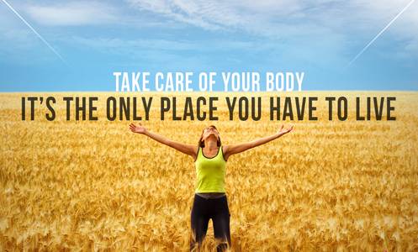
Step 3: Ways to Cope
Physical / behavioural coping skills
Cognitive / mental coping skills
Personal / social coping skills
Notes:
Physical/Behavioural Coping Skills
Physical/behavioural skills involve taking care of yourself and staying as healthy as possible.
Cognitive/Mental Coping Skills
How you perceive or interpret events relates to how stressful (or non-stressful) you’ll find them. Cognitive/mental coping skills involve using your thoughts and mind constructively to counteract negative effects of stress.
Personal/Social Coping Skills
life should be a pleasure. One of the best ways to beat stress is to make happiness a priority. Too often we get so caught up in our work and routines that we feel empty, isolated, and unfulfilled.

Slide 21





Ways to Cope
Physical / Behavioural Coping Skills
Yoga & Stretching
Healthy Diet
Good Rest
Deep Breathing
Rest and Digest
            Yoga & Stretching
            5-10 minutes daily promotes relaxation and increases flexibility
Health Diet
More plant-based foods, lots of water, less sugar, fat, and salt
Good Rest
Don’t try to sleep if your body resists
Exercise is often-neglected intervention in mental health care
Deep Breathing
10 breaths 2-3 times per day
Rest & Digest
Do more of these activities…
Notes:
Physical/Behavioural Coping Skills
Physical Activity: Canadian Physical Activity Guidelines recommend that adults accumulate at least 150 minutes of moderate – vigorous intensity aerobic physical activity per week, in bouts of ten minutes or more.
Improved sleep
Better endurance
Reduced cholesterol
Weight loss
Improved cardiovascular fitness
____________________________________
Improvement in mood
Increased in alertness and energy
Higher self-esteem
Less stressed
More self-confident
Reduced anxiety
Yoga and Stretching: 5-10 min/day can promote relaxation and increase flexibility.
As you stretch, think about the area being stretched; imagine the tension leaving as you gently take these areas to their comfortable limit.
Exhale into the stretch; inhale on the release. Breathe deeply and slowly – do not hold your breath.
Close your eyes for better awareness of your body’s responses.
Healthy Diet: Canada’s Food Guide recommends a diet rich in vegetables, fruit, whole grains, low-fat dairy, and meat alternatives.
Good Rest: Can’t sleep? Then get up. Clock watching, tossing and turning will only make you tense, and that means stress. Read a book or watch television, which will help with relaxation. Reducing your anxiety about not sleeping will ultimately make it easier to sleep.
Exhalation Breathing: Slow your breathing to help calm you down. Do this exercise for 10 minutes or more. Repeat this motion several times. Then slowly inhale and exhale without moving your arms.
Lie on your back with your arms at your sides.
As you begin to breathe in, raise your arms toward the ceiling (elbows bent). Move your arms all the way up and over your head to the floor as you inhale.
Reverse the order: breathe out slowly and smoothly as you return your arms to your sides.
***take them through one while sitting? – 10 deep breaths, 2-3 times per day – show how to do it.

Slide 22
Ways to Cope
Rest & Digest
Brain-Dump Before Bed
Pleasure Reading
Hot Shower
List Writing
Wellness Care
Proper Breathing
Rest and Digest
Do more of these!

Slide 23

Ways to Cope
Cognitive / Mental Coping Skills
Problem Solving: Options of 3! Every problem has at least three solutions.
Reappraisal: Your interpretation of the stressor can magnify its impact, making it more stressful.
Meditation: 10 minutes, 2 times per day – it requires patience and practice!
Notes:
Cognitive/Mental Coping Skills
Problem Solving: When faced with a stressful circumstance, many of us become overwhelmed and panic. Remember, every problem has at least one good solution.
Write down a list of every possible solution to your problem or way of dealing with your stressful situation.
Rank the solutions in order of feasibility and effectiveness.
Put your top-ranked solution into action.
Assess whether it solved your problem. If it did, great! If not, then select the next solution on the list and see if that works, and so on.
Options of 3 – having more than 1 option to a problem is best – leaves some breathing room.
Reappraisal: Sometimes your interpretation of a stressor can magnify its impact, making it feel more stressful than it really is.
Identify your thoughts about the predicament. What am I saying to myself about this situation?
Challenge your thoughts about the circumstance. Is what I’m feeling realistic? Am I grounded in fact, not fear?
Reappraise your position. How can I change my thinking to reflect more realistically on this condition?
Meditation: Meditation can help to settle your mind, make you live in the moment and observe your thought processes. Meditation requires patience and stamina. Start by meditating for 10 to 15 minutes once or twice a day. Increase this to 20 minutes no more than twice a day. Avoid meditating just before going to bed or you might be too energized to sleep.
Choose a quiet room where you won’t be interrupted.
Take time to relax; don’t rush into it.
When you are thoroughly relaxed and breathing slowly and evenly, close your eyes. Slowly repeat a pleasant-sounding word such as peace or harmony, also known as a mantra, over and over in your mind as you breathe in and out. Continue in this state for 10 to 20 minutes.
To come back: Pay attention to your breathing. Be aware of your body and your posture. You may wish to say your mantra out loud, deliberately and slowly. Open your eyes and look around the room. After a minute or so, stand up and stretch.
***take them through a short one?

Slide 24

Ways to Cope
Personal / Social Coping Skills
Spend quality leisure time with family and friends
Develop your hobbies and personal interests
Enjoy nature and outings
Give to others
Take a vacation or break from your usual routine
Practice gratitude
Set goals!
Notes:
Personal/Social Coping Skills
Spend quality leisure time with family and friends.
Develop your hobbies and personal interests.
Enjoy nature and outings.
Give to others. Volunteering can be rewarding and satisfying. Helping others helps divert attention from yourself and can reduce your anxiety.
Take a vacation or break from your normal routine. A vacation is only refreshing when it doesn’t add stress. Plan ahead and don’t try to pack too much into the time available.
Practice Gratitude – write down, first things in am, journal – keep a log or a jar – refer back to it if need be
Goal Set – focus on what you can control….

Slide 25

Simple Tips
Tried-and-true ways to achieve your goals:
Put your goals in writing or use pictures to create a vision board
Make a list of obstacles so you’re not surprised when they come along
List the benefits of achieving your goal to keep you motivated and energized
Reward yourself as you achieve your goals including the mini-wins along the way!
Notes:
Focus your energy
Help you form plans
Give you a greater sense of control
Give you a feeling of accomplishment
Help you measure progress
Increase motivation
Go over points – vision board = pictures to goals. Highly visible spot – where you’ll see it each day. Or sticky notes – in your car, mirrors, lunchbag, purse, etc…

Slide 26
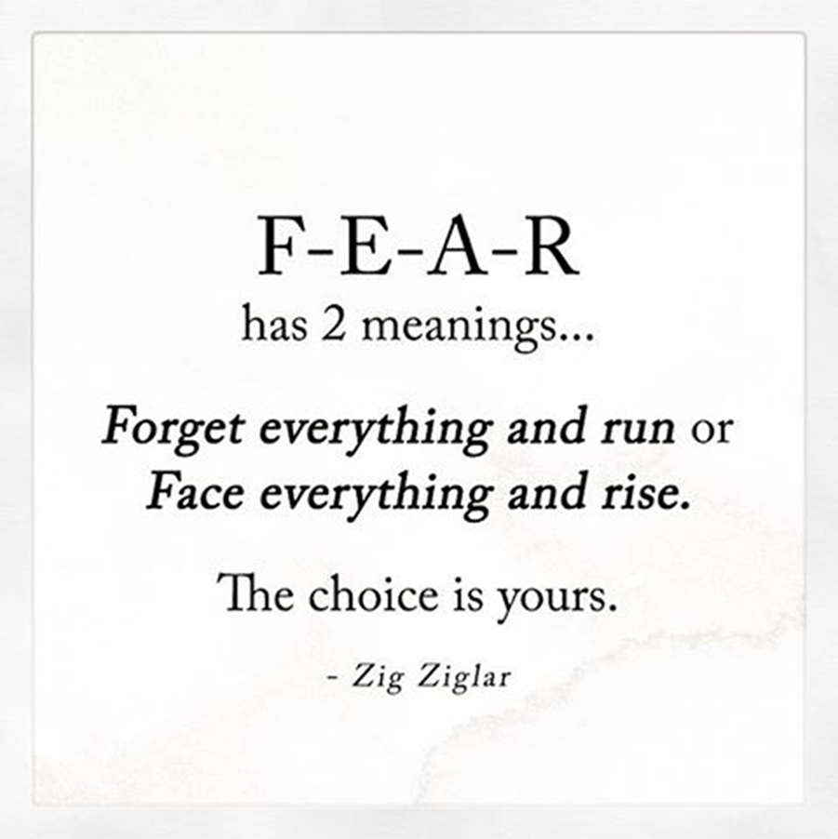
Simple Tips

Slide 27
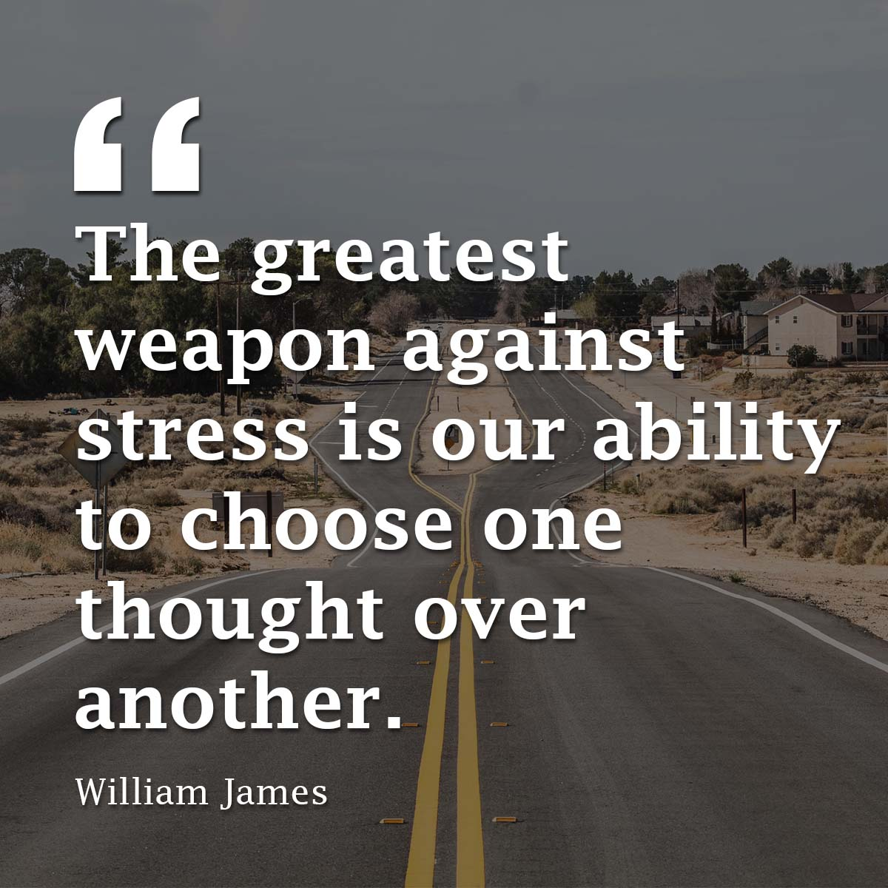

Denise Eccles
deccles@ewsnetwork.com

