Slide 1
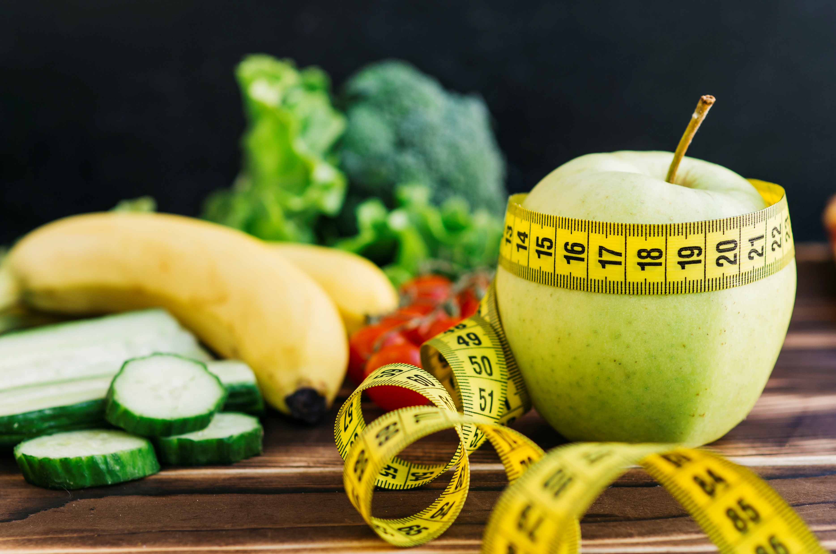
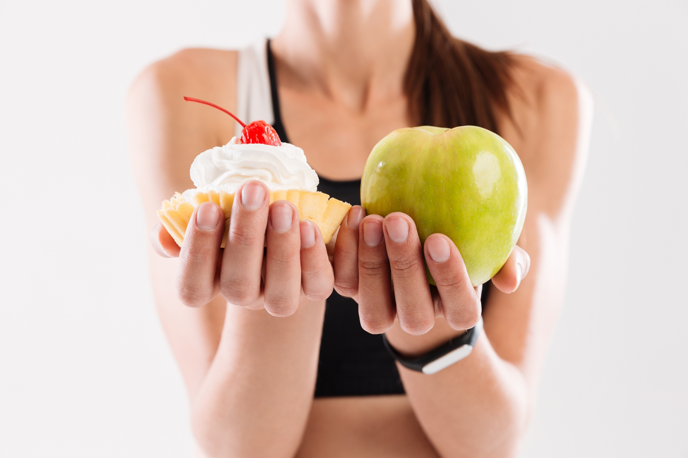
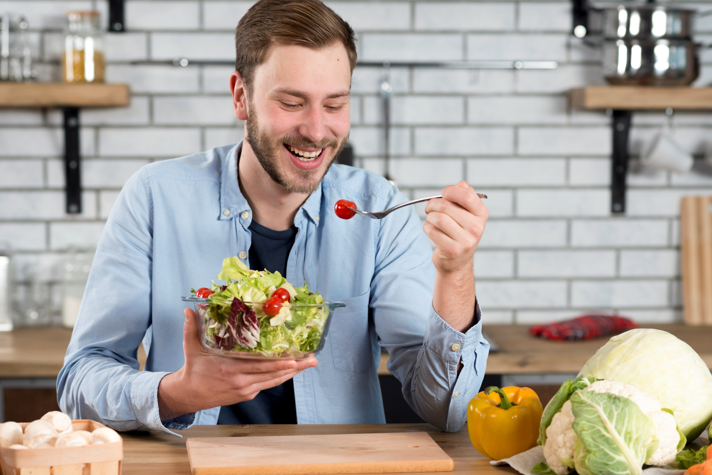
Eating Your Emotions
EMOTIONAL EATING
Notes:
Images by freepik
All online sources are referenced. Any other information used was taken from The Intuitive Eating Workbook, Evelyn Tribole and Elyse Resch, 2017.

Slide 2
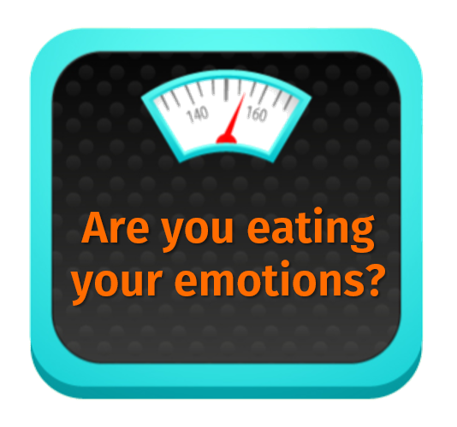
What is emotional eating?
The desire or act of eating that is driven by a feeling or emotion rather than true physiological hunger.
Often an act that takes place without awareness – behind your own back!
Why do we do it?
An attempt at self-care – we never do anything without a good reason!
Discomfort of a feeling – we address this through eating.
In the moment, it works!
Notes:
Emotional eating is the desire or act of eating that is driven by a feeling or an emotion rather than physiological hunger. (We will be discussing the difference between physical and emotional hunger so you have a better understanding of true hunger). It is often something we do impulsively and without much awareness. Typically we won’t stop and question why we are eating, we probably don’t think about it too much before we do it, and for many of us it tends to be an automatic response without conscious thought.
https://www.healthlinkbc.ca/health-topics/aa145852
Why do we do it?
We never do anything without a good reason. We are eating as a response to a stimulus – something in our environment has triggered us to turn to food as a coping mechanism. Emotional eating is actually an attempt at self-care – we want to make ourselves feel better. This may seem counterintuitive, as many people believe that emotional eating is self-sabotage, but at the root of emotional eating is the attempt to provide ourselves comfort. That can look different for many people. Some may only emotionally eat when they are angry, others may turn to food when they are lonely, and many of us can relate to turning to food when we are bored. These are all forms of self-soothing.
Because eating is necessary for our survival, food has become such a natural coping mechanism for many people. Not everyone drinks alcohol or smokes cigarettes, for example, but we all need to eat. Our bodies are very familiar with this process and our brains respond to the foods we consume! Many foods will produce feel-good neurotransmitters by activating our brain’s reward system, causing us to feel better in the moment and alleviate this emotional discomfort.

Slide 3
Our relationship with food…
Starts at a very young age
Is primed in our animal brain: food = survival
Is cultural
Exists on a spectrum
Dieting increases our likelihood of emotionally eating
Each act of eating serves us in some way (pleasant or destructive)
It’s important to distinguish physiological needs from emotional needs
Notes:
Our relationship with food starts as soon as we are born and exists on many levels. Think about a baby receiving mother’s milk – that baby will soon learn that feeding time not only alleviates hunger, but also provides warmth, touch, comfort, and bonding. Eating becomes an event we unconsciously associate with pleasure.
https://www.health.harvard.edu/staying-healthy/understanding-the-stress-response
You may notice in prolonged periods of stress you crave mostly unhealthy foods. Not only will stress hormones increase appetite and lead to cravings, but research has shown our brain is wired to associate stress with lack of resources such as food. Once upon a time, we didn’t have a surplus of food, so if our hunter-gatherer ancestors came across food that contained sugar or fat (think fruit and meat) they would gorge and eat as much of it as they could! These foods would help them store energy and body fat needed for survival in times of food scarcity. This instinct to eat in periods of uncertainty made sense then, but not anymore when we have an overabundance of food available to us.
Cultural: food is central to many of our celebrations, religious events, milestones, family gatherings. This further sediments the associations with pleasure, comfort, family, belonging, and security.
Exists on a spectrum: Each act of eating serves us in some way. It doesn’t always have to be to cheer us up when we are down. Food is part of many happy events, like weddings, family dinners, and holidays. We may feel compelled to eat when we are celebrating even the smallest victories because this is how we have been conditioned. We may grab a few cookies when we have a tough day at work. Or we may find ourselves bingeing to the point of discomfort. Everyone’s experience is unique and valid.
Diet culture can increase our likelihood of emotional eating. Research shows restricting calories and foods can lead to a vicious cycle of emotional eating, often through binge and restrict episodes. https://www.rehabs.com/pro-talk/understanding-the-binge-eating-cycle-the-role-of-dieting/
Healing our relationship with food begins with awareness and understanding the signals of real, physiological hunger.

Slide 4
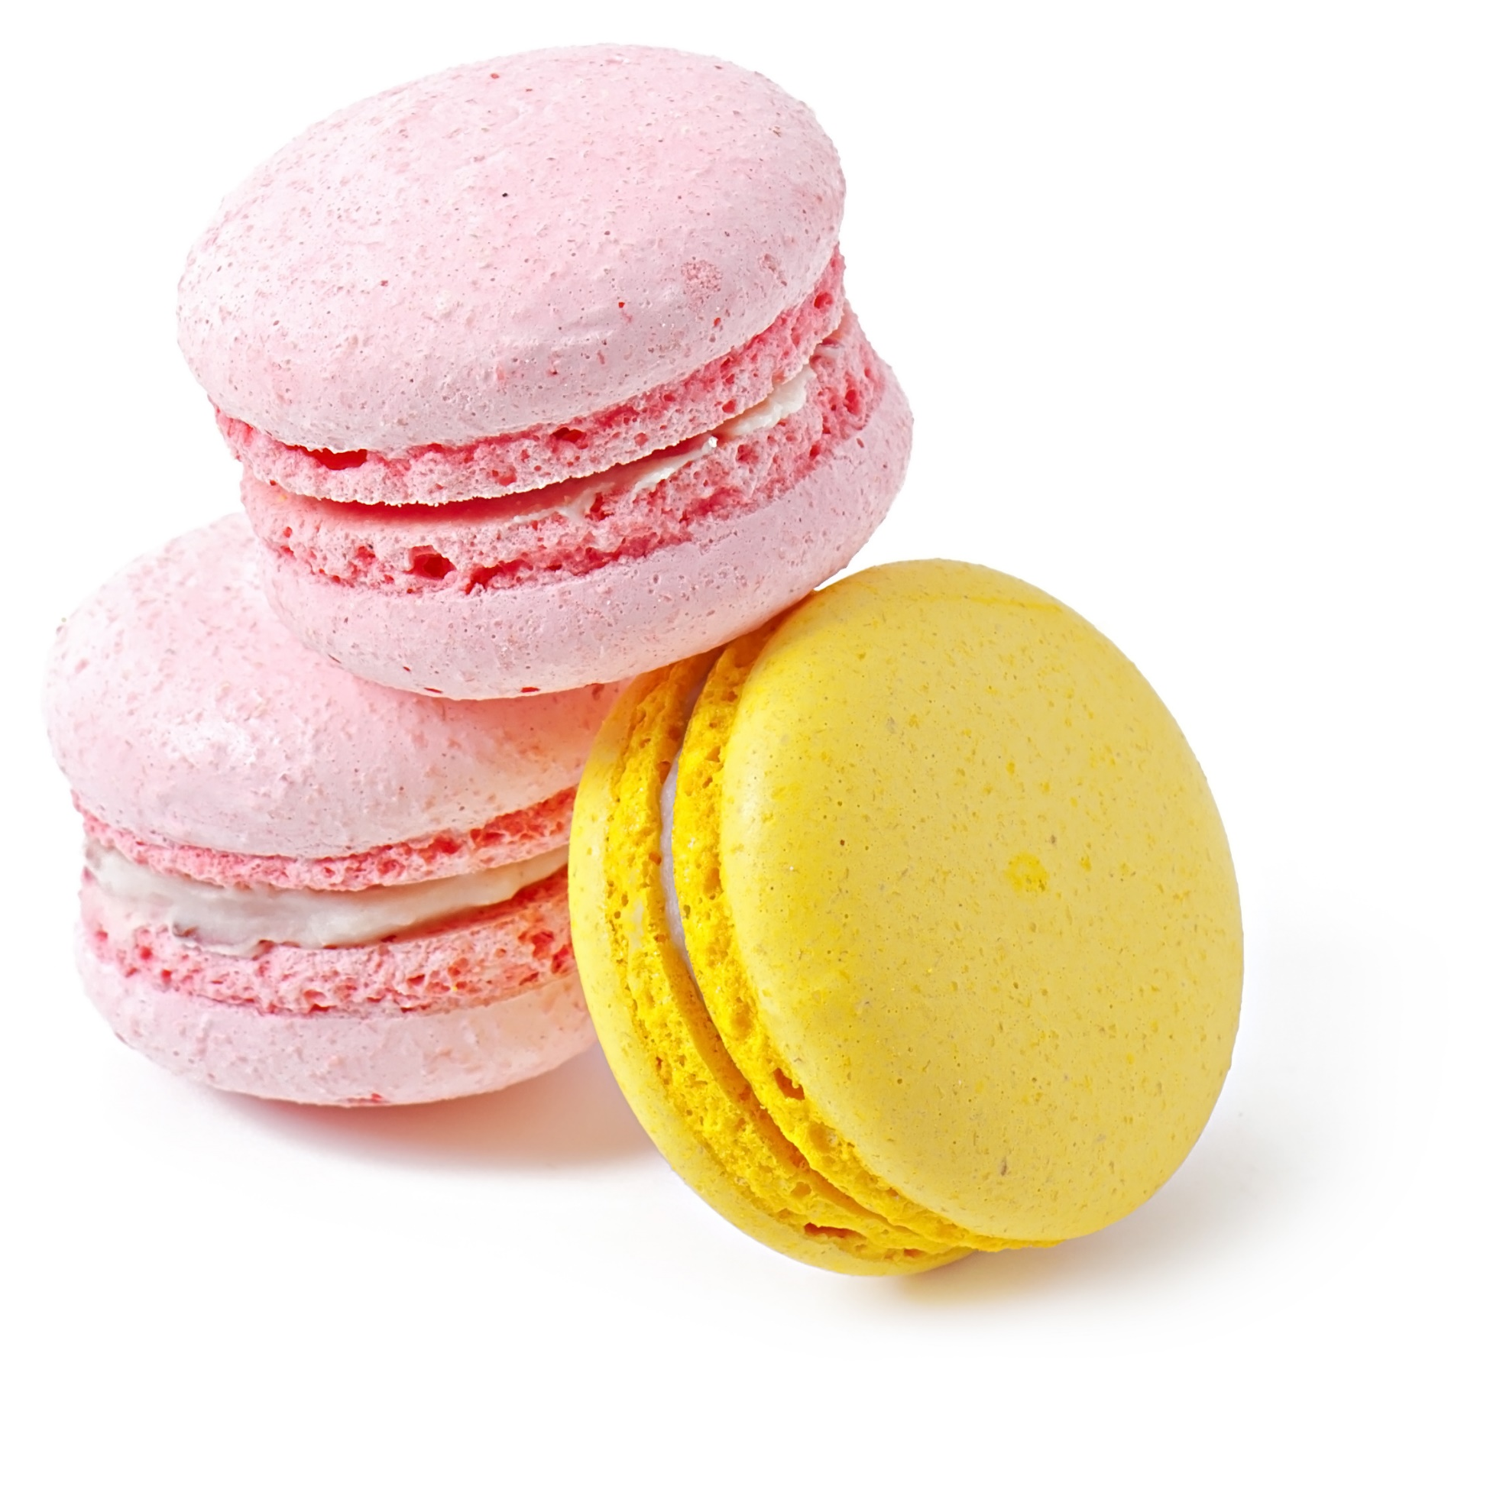
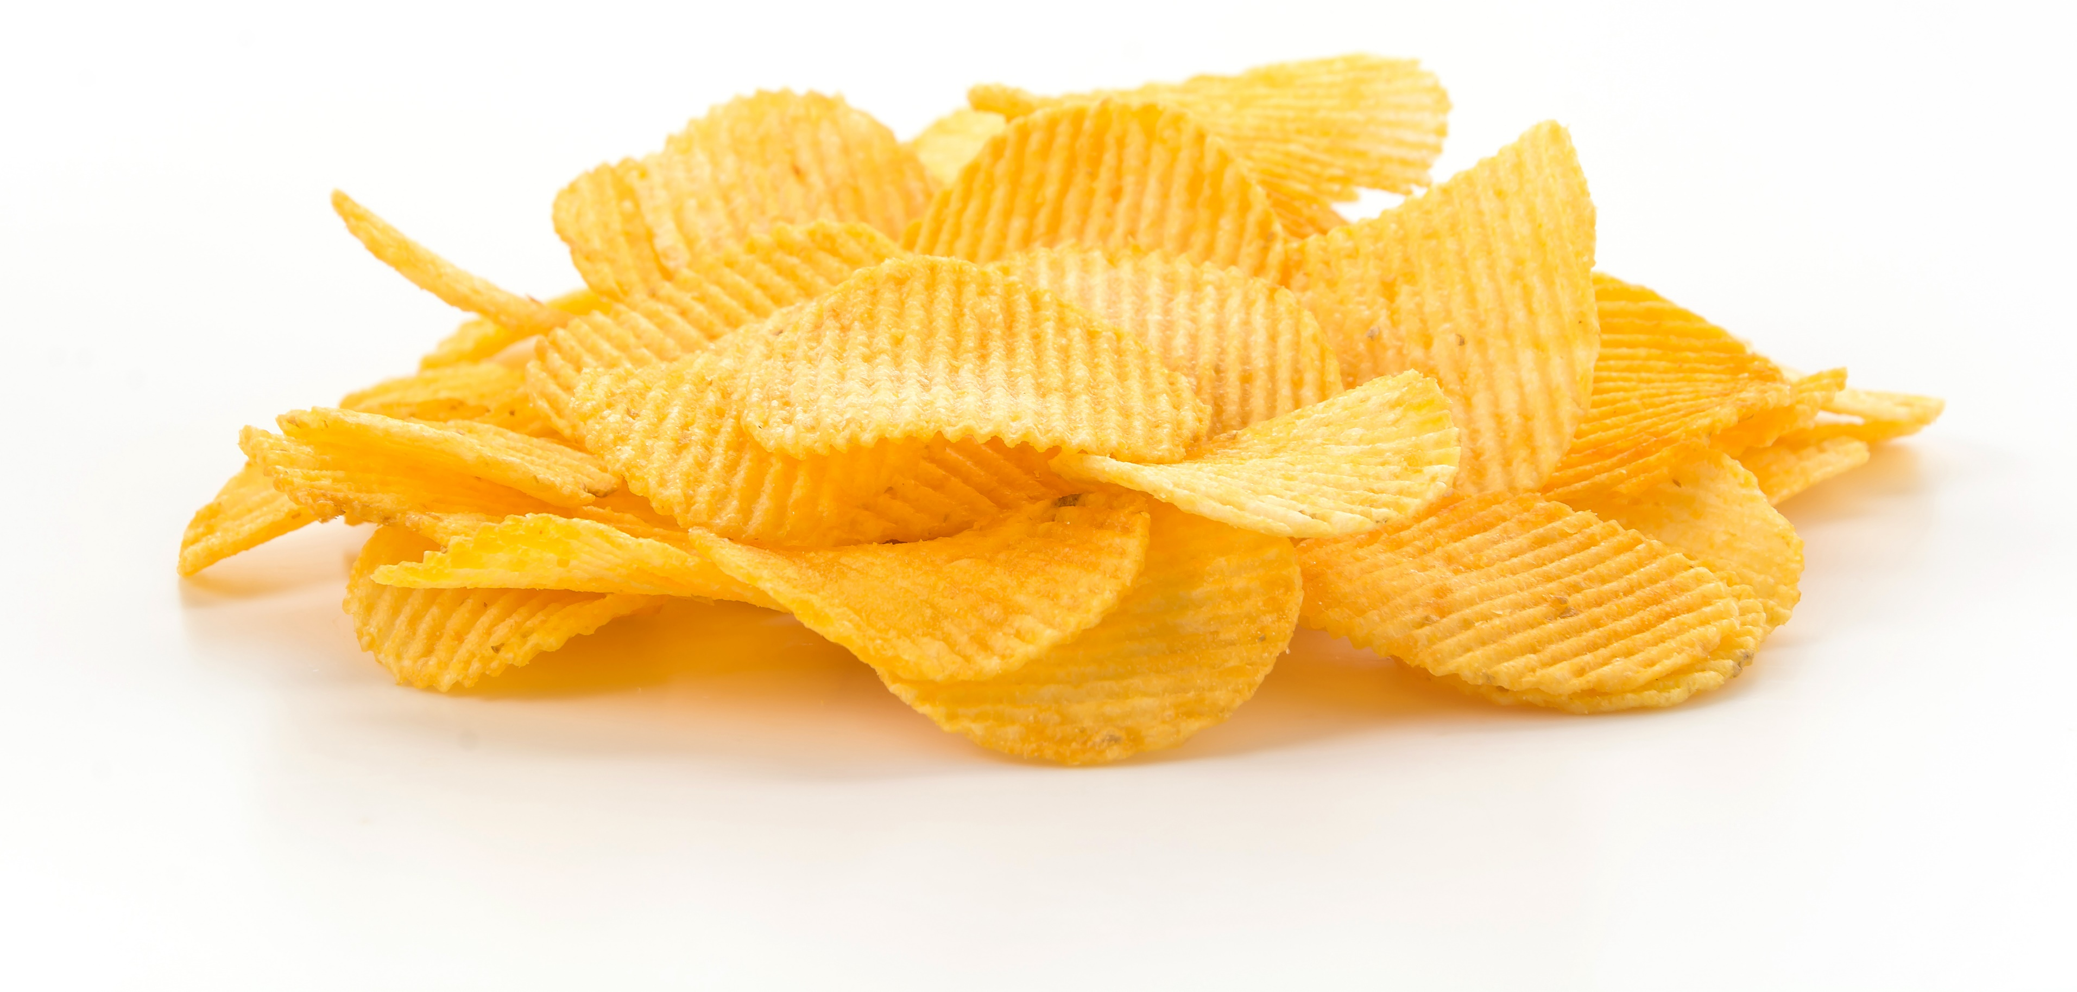
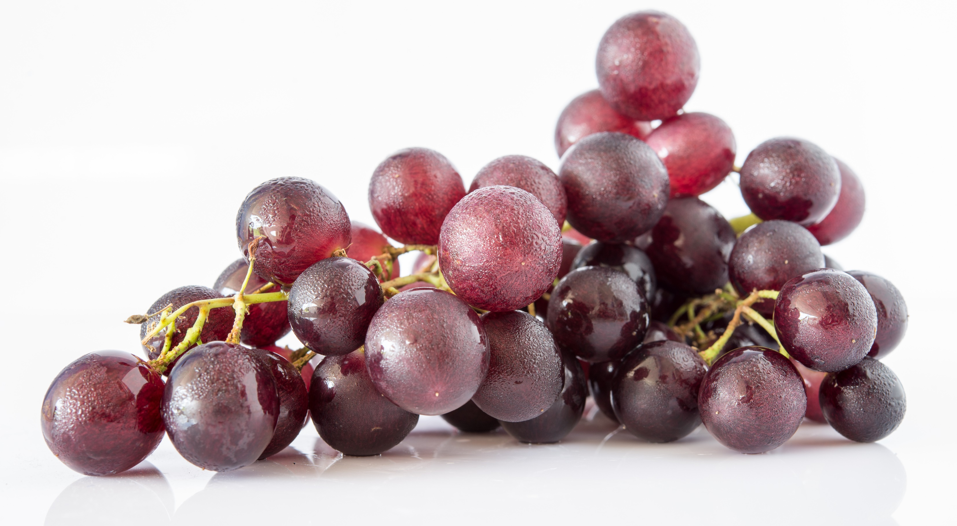
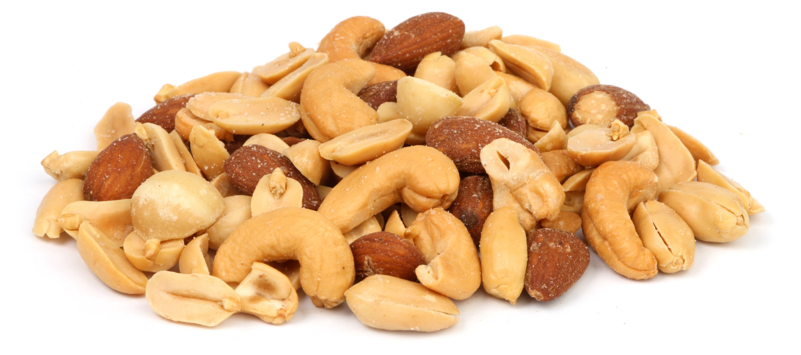
EMOTIONAL HUNGER |  | PHYSICAL HUNGER
Comes on suddenly Feels like it needs to be satisfied instantly Craves specific comfort foods Isn’t satisfied with a full stomach Triggers feelings of guilt, powerlessness, and shame |  | Comes on gradually Can wait Is open to options – lots of things sound good Stops when you’re full Doesn’t result in you feeling bad about yourself after eating
Notes:
A really helpful tip to distinguish emotional hunger from physical hunger is to notice where the hunger is coming from.
PHYSICAL hunger begins in the body and sends a message to the brain (ie: tummy begins to rumble, brain interprets hunger)
EMOTIONAL hunger begins in the brain and sends a message to the body (ie: stuck in traffic, feel frustration, brain sends signals to your body to produce stress hormones which leads to cravings)
https://www.helpguide.org/articles/diets/emotional-eating.htm
Physical hunger will come in waves, gradually it will increase, you will notice it for some time if you are paying attention – different for each person. Stomach might grumble, might experience a mild headache, dry mouth or salivation. Only if it is ignored for prolonged period of time will it become intense.
Emotional hunger comes on suddenly, often no warning, and will feel immediately intense. If you begin paying attention you will notice it usually starts with a thought or a feeling and then produces a response in the body, like salivation. Ie) thought: “I’m really sad I can’t see my friend this weekend” followed by an intense craving for ice cream. OR just an emotion, like seeing something on the news that upsets you and suddenly wanting to eat.
Physical hunger can wait. When it begins there is not a feeling of urgency, you can take your time and decide what you are going to eat and prepare a snack or meal. Emotional hunger will feel like it needs to be satisfied IMMEDIATELY!
Physical hunger is open to options, many foods sound good and you feel satisfied after you have eaten enough. Emotional hunger craves specific comfort foods, like pizza, donuts, chips, and even after feeling temporary relief from eating, you will not feel satisfied even with a full stomach because the underlying emotions have not been dealt with or processed.
Physical hunger will not result in negative feelings after eating. They may be neutral or even positive because you feel better.
When it comes to emotional eating, many people will experience initial relief from their discomfort, but the feeling of relief is short-lived. It’s followed by the negative feelings that pushed them to eat in the first place and can be even worse after an eating episode due to other negative feelings, like guilt, powerlessness, and shame. Many people become upset with themselves for eating in the first place, which triggers them to continue emotionally eating to self-soothe. They can become trapped in the cycle of emotional eating.

Slide 5
Food can be a coping mechanism
Food as a form of self-care:
numbing, acts like a friend, familiar, soothes, distraction, fills time
Food gives us momentary control
Notes:
Most of us have used food in some way or another as a coping mechanism. This isn’t always a bad thing. Sometimes food might be the appropriate response. After all, it is a form of self-care like mentioned previously. Food can serve many functions– it might numb us when we want to stop feeling, it could act like a friend in a moment of upset, it is familiar and comforting when life feels uncertain, it distracts us, helps us forget about our problems, it might remind us of a happy time in our life, allow us to procrastinate on tasks we don’t want to do, and can act as a reward after a long day. We each use food to cope in different ways.
As much as it may seem like emotional eating is an out of control behaviour, research shows it gives us the feeling of momentary control. Coping mechanisms tend to work this way as feelings of being in control and self-efficacy can help us manage stress. https://www.mentalhelp.net/stress/self-efficacy-and-the-perception-of-control-in-stress-reduction/
When life feels overwhelming, we like to have somewhere to turn that is familiar, something that is safe and predictable. Food can make us feel better, giving us a momentary feeling of control.

Slide 6
Food can be a coping mechanism
Have you recently eaten for any reason other than hunger?
In what ways did emotional eating BENEFIT you, such as offering you a distraction or an escape from feelings?
In what way did emotional eating HURT you, such as physical discomfort, numbing of positive feelings, feeling bad about yourself?
Do the cons outweigh the pros?
Notes:
REFER THEM TO HANDOUT for exercise.
Think about a time you used food to cope recently. The situation that triggered you to eat doesn’t always have to be a big one, it could be you ate to pass the time when you were bored. It can be helpful to ask yourself if you have eaten recently for any reason other than physical hunger. Sometimes people have difficulty recognizing their eating as emotional, but any type of eating that is not due to real hunger is a form of emotional eating. Once you have identified an emotional eating event, answer the questions on your handout.
This is an exercise you can do anytime after you find you have “eaten your emotions”. This isn’t to beat yourself up or make yourself wrong. It can be helpful to begin identifying patterns and noticing if your response is a positive, neutral, or negative coping mechanism. If emotional eating is something you find yourself struggling with regularly, you might consider keeping a journal to document your feelings before, during, and after eating. This can help you identify your triggers.

Slide 8
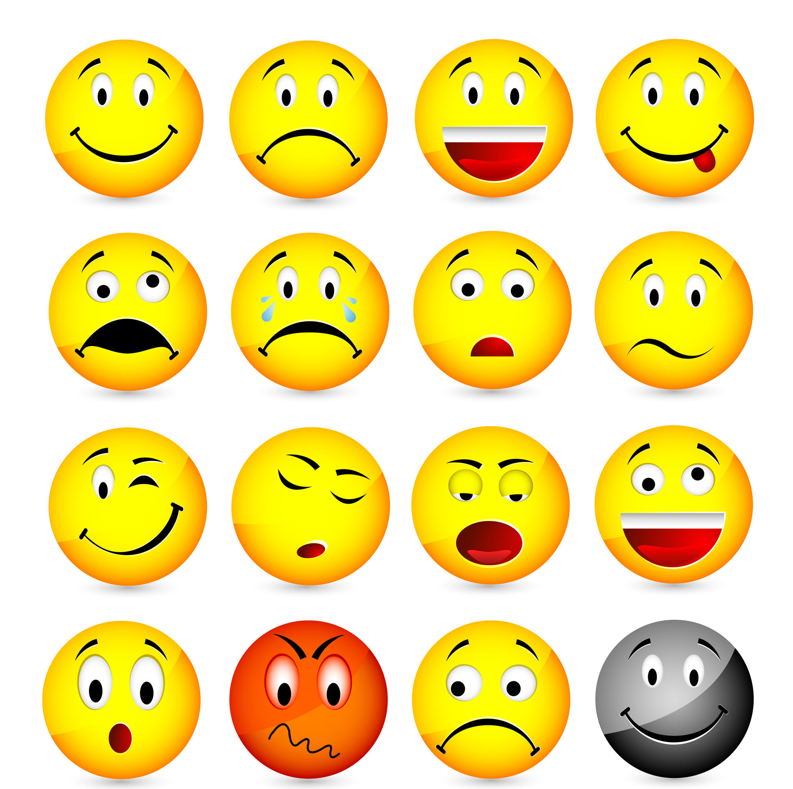
Emotional Triggers that Lead to Eating
Anxiety
Boredom
Emptiness
Feeling lonely or unloved
Frustration, anger, or rage
Depression
Procrastination
Rebellion
Stress
We sometimes use food when we feel good as well!
Notes:
It is important to begin naming the feelings that lead us to emotionally eat. If we can develop our emotional literacy and identify our triggers, we can begin finding other ways to cope that aren’t food-related. This is a critical step because remember, emotional eating can be a very impulsive act. It’s something that happens without a lot of consciousness or awareness. If we start exploring our emotional triggers, we can better catch them when they occur and make a more conscious choice in the moment.
We sometimes use food when we experience positive emotions as well.
If you are having trouble properly identifying how you are feeling (any many of us have a limited emotional vocabulary) it can be helpful to look at an Emotion Wheel. There are many out there, one of the more comprehensive wheels is the Junto Wheel. (Pictured on next slide)
https://mentallyagile.com/blog/2020/3/24/wheel-of-emotions
The inside depicts 7 basic emotions, while the outside layers represent extensions of those emotions. You start on the inside with the core emotions. Let’s say, for example, you identify sadness to be an emotional trigger. You then work your way outside of the wheel to see if there is a more specific feeling that better describes what you are experiencing. Sometimes it might just be sadness, other times it could be grief, feelings of isolation, embarrassment, or loneliness, for example. Being as specific as you can will help you find the most appropriate response to your trigger (ie: if you are just sad, you might need some time alone, conversely if you are lonely, you might need to reach out to a friend).
The more specific you can get with yourself when identifying emotions, the easier it becomes to find helpful ways to express and manage them.
https://www.healthline.com/health/emotion-wheel#how-to-use-it

Slide 9
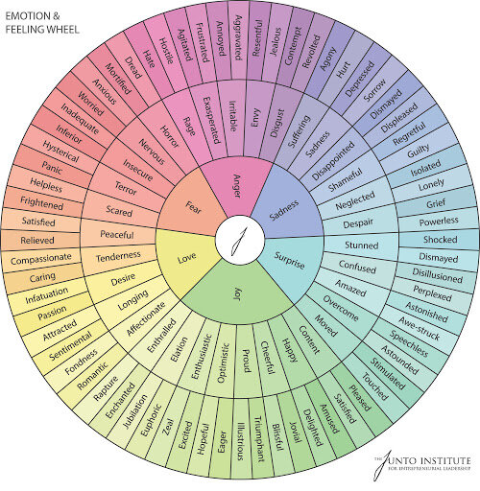
The Emotion Wheel

Slide 10
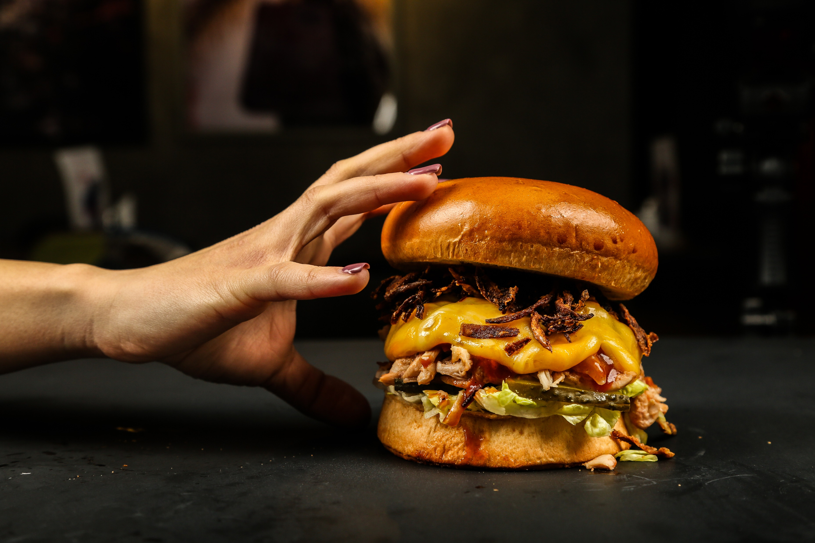
The Importance of Self-Care
Without proper self-care, food can become more rewarding
Notes:
Remember, eating is a form of self-care, and it is common to turn to food for reasons other than hunger every now and again. But if food is one of your only coping strategies, it is time to consider other alternatives! If you aren’t paying attention to your personal needs, food can appear more rewarding. Food is one way to comfort and nurture yourself, but there are many other ways of doing this. Once you have a handle on your emotional triggers and the situations that cause you to turn to food, you can begin to ask yourself what else you could do to meet your needs.

Slide 11
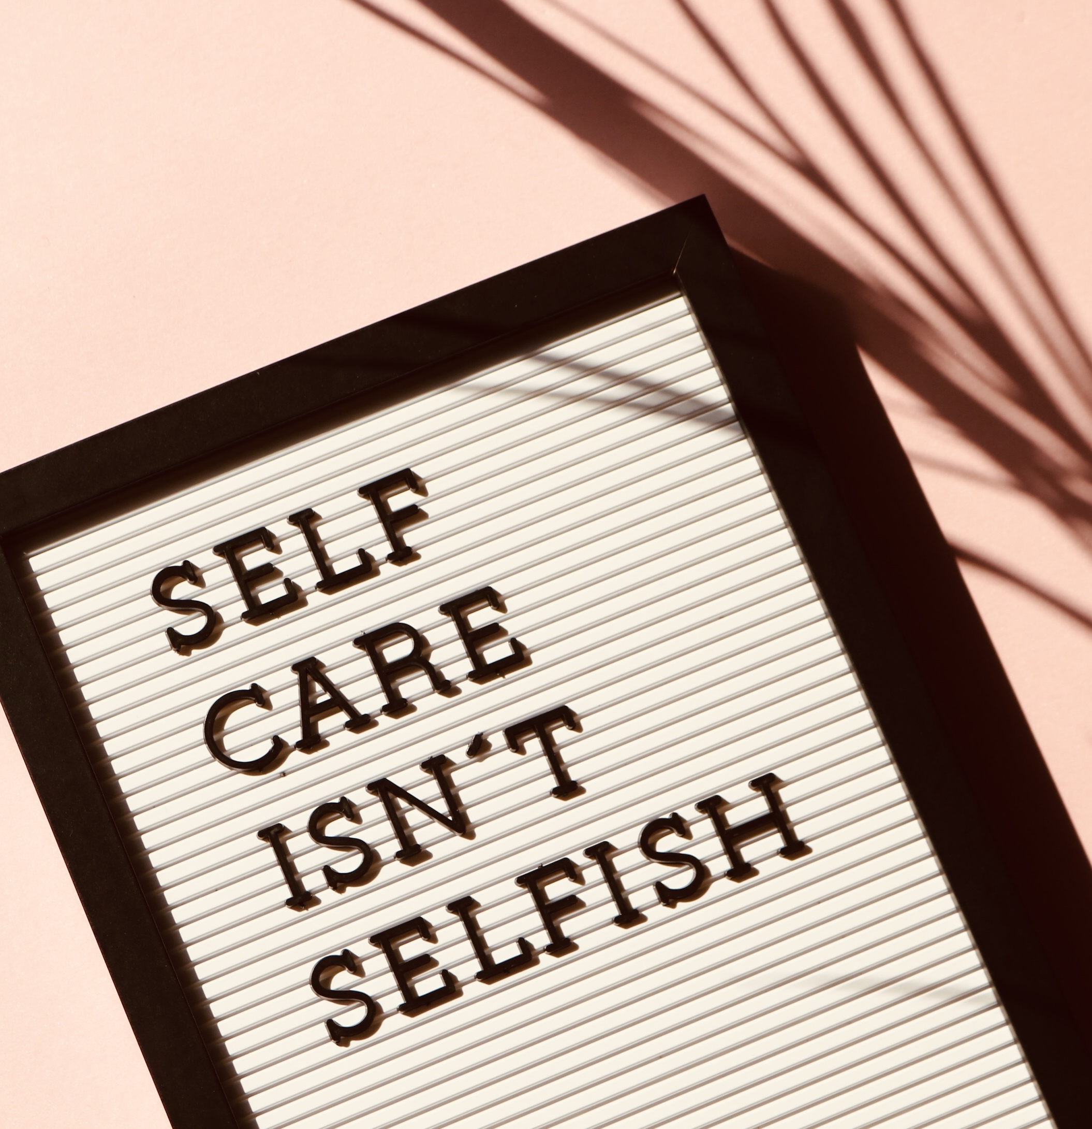
The Importance of Self-Care
Ask yourself:
How many hours of sleep am I getting each night? Do I get a quality night’s sleep?
What kind of balance do I have in my life? Consider work, play, family, movement, rest, and relationships.
Am I eating regularly and getting balanced meals?
What are current stressors in my life?
Notes:
REFER TO HANDOUT.
Emotional eating is sometimes the result of neglecting the very basics of self-care. If we don’t pay attention to our needs, we will struggle to meet the demands of everyday life and adopt unhealthy coping strategies. Studies show when self-care is regularly practiced, the benefits are broad and have even been linked to positive health outcomes such as reduced stress, improved immune system, increased productivity, and higher self-esteem. https://www.everydayhealth.com/self-care/
Self-care is a regular, intentional process of protecting and sustaining mental health. It is backed by science and not selfish or self-indulgent. https://www.psychologytoday.com/ca/blog/rethink-your-way-the-good-life/201910/self-care-isn-t-selfish-or-superficial
The following questions will help you assess fundamental areas of your wellbeing: stress, sleep, life balance, and eating habits. Approach this exercise with compassion – if your self-care basics are not being met, think about one small way you can make improvements in each area.

Slide 12
The Importance of Self-Care
Nurturance and compassion are fundamental to coping with emotions without turning to food
How can you do it?
Recognize your emotional needs
Nurture yourself: ask for hugs, play with pets, listen to music, read, enjoy a bubble bath, meditate
Be compassionate: come from a place of curiosity, not judgement
Notes:
Beyond just the basics of self-care (sleep, life balance, stress, and eating) is self-nurturance. Self-nurturance is being extra nice to yourself! Attending to your needs should be about thriving, not just surviving.
A self-care routine will look different for every person and is unique to you. Now might be a good time to reflect and ask yourself how you could cultivate more joy in your life. There are ways we all deny our personal needs, such as sleep deprivation, putting others before ourselves, working long hours, saying yes too often when we need to say no, etc. Self-care is a way to give back to ourselves and helps to prevent burnout. What do you need to say no to more? What can you start saying yes to? Perhaps you need to say no to extra demands from your boss, limit your screen time, and stop staying up late. Perhaps you can say yes to spending more time with your family, getting outside and moving, and developing a regular bedtime routine, etc.
What could you do on a daily basis that would give you some joy, peace, love, or comfort? Some examples include asking for hugs, playing with your pets, listening to music, reading, enjoying regular bubble baths, meditating, getting a massage, and writing a gratitude list. https://www.developgoodhabits.com/self-care-ideas/
EXERCISE: Come up with your own ideas on the handout. See if you can try at least one or two this week. Pick one activity that will be easy enough to incorporate everyday. If practicing self-care everyday seems like too much, start with 2-3 times a week and build the frequency up each week.
There are different categories of self-care. When you examine your life, you might be drawn to prioritize one area depending on your daily challenges. Ideally, you will be able to incorporate something from all categories during the course of your week.
Emotional self-care, such as self-talk, weekly bubble baths, saying “no” to things that cause unnecessary stress, giving yourself permission to take a pause, or setting up a weekly coffee date with a friend
Physical self-care, such as prioritizing sleep, adopting an exercise routine you can stick with, choosing healthy and nourishing foods over highly processed ones
Spiritual self-care, such as attending a religious service, spending time in nature, meditating, incorporating regular acts of kindness into your day, or keeping a gratitude journal
Compassion is important too– self-compassion is critical when it comes to shifting your relationship with food. We want to approach difficult emotions from a place of curiosity and not judgement. This can be challenging, as we are often our own worst critics. It can be helpful to begin noticing your self-talk (the kinds of things you say to yourself) and make an effort to replace negative self-talk with compassion and understanding. (ie: instead of saying “I’m a failure, I screwed up and ate too many cookies”, you could say “even though I ate those cookies, I stopped myself from eating more. I know this is a journey and I am not going to get it right every time, no one is perfect”). Imagine what you would say to a good friend going through the same thing and start talking to yourself that way.
Compassion means kindness, not expecting perfection, and acknowledging that everyone struggles. Self-compassion is a practice, it doesn’t happen overnight. It might start with a simple awareness of the things you say to yourself (most of us are shocked when we start paying attention) and beginning to talk to ourselves in a kinder way. https://self-compassion.org/the-three-elements-of-self-compassion-2/

Slide 13
Learn to sit with your feelings
What am I feeling right now?
Take a time out and accept your emotions as they come
What do I really need in this moment?
Rather than food, the answer may be time with your partner, or quiet time alone
How can I fulfill this need without turning to food?
Understand the underlying need.
Notes:
Now that you have begun to develop more awareness around your triggers that drive you to emotionally eat and the importance of self-care, the next step will be taking a time-out to explore your feelings and identify the need behind them. Emotional eating is a short-term fix, while exploring WHY we are emotionally eating is a long-term solution.
EXERCISE: next time you find yourself wanting to eat for reasons other than hunger, pause and ask yourself– what is it that I am feeling right now? Use the emotion wheel if you have trouble identifying your feeling.
i.e) “I am feeling very helpless right now because this situation at work is out of my control.” Remember to use self-compassion as you explore the feelings that come up (curiosity, not judgement).
What is it I really need in this moment?
Ie) “I need to do something that gives me a feeling control and also helps to lessen my anxiety. I know food does that, but it’s only a temporary solution.”
How can I fulfull this need without turning to food?
i.e.) “The underlying need is feeling like I have some control in my life. It makes me feel really good when I organize spaces in my home. I haven’t cleaned out my closet it a while, I think I will spend some time doing that.” – note that everyone’s choice of activity will be different. Yes, making your bed and organizing your home can be a form of self-care for some people, while for others it may cause more distress. Choose something that appeals to you. (Reference listed at end of presentation for self-care ideas).

Slide 14
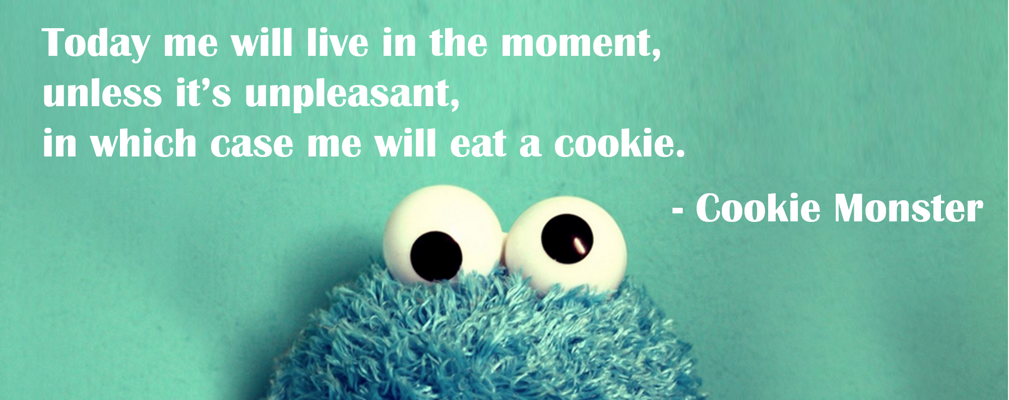

Slide 15
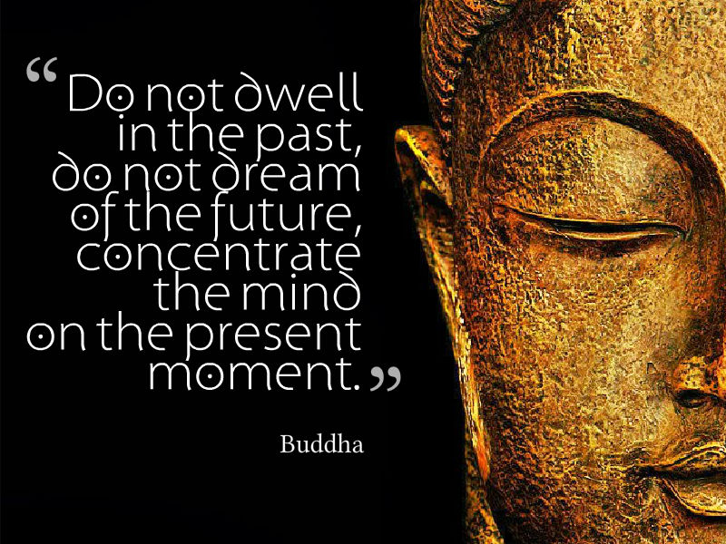
Mindfulness
Investigate
Work with emotional reactions
Live in the present moment
Notes:
Sometimes there might not be an immediately obvious underlying need or solution to your feelings. Very often, negative emotions rise up when we least expect them. This is where mindfulness can help. Mindfulness teaches us that we cannot bypass our feelings. You may have noticed that when you try to ignore your emotions, distract yourself, or push them down, they only pop up in other areas of your life. The only way out of a feeling is to go through it. Being present with our thoughts and feelings means we are getting comfortable with being uncomfortable. This does not come naturally to us!! Emotional pain is similar to physical pain– whenever we hurt ourselves, we want to soothe the pain. Sometimes there is nothing we can do though – we just need to let our wound heal in its own time. The same can be said for emotions.
https://mindfulnessexercises.com/mindfulness-of-emotions/
Mindfulness process:
Investigate: It can be helpful to find a quiet place to sit or lie down for a few minutes where you won’t be disturbed. Slow your breath, close your eyes, and start to tune into your body. Approach your investigation with a spirit of curiosity – feelings are neither bad nor good, they just are. Pay attention to where you feel this emotion in your body (chest tightens, throat closes, eyes tingle, heart rate increases, etc) – every emotion has a physical sensation. Simply tune in and notice the sensation in your body, you do not have to do anything about it.
Practice sitting with these feelings and sensations for a few minutes. Breathe deeply and see if you can relax any areas of tension. If your mind wanders, bring it back to the feeling in your body or your breath. You don’t need to do anything to change the way you are feeling: when we sit with our feelings, they do eventually pass. A great visual is waves in the sea – emotions are like waves, they come and go on their own. A helpful way to work with your reactions is called non-identifying. Instead of saying: “I am anxious” you would say “I am experiencing anxious thoughts/feelings”. Also pay attention to the story you tell yourself about the feeling or thoughts. Often suffering is rooted not in the emotion, but in our resistance to it. Ie) “I can’t be sad right now because it means I am weak. I have too much to do and can’t feel like this”. Simply let it be.
Live in the present moment – now that you’ve taken a time out, you can make choices moving forward from a place of awareness rather than reactivity. If you decide you are going to eat the cheesecake, for example, that’s fine – do so mindfully and without guilt! Mindfulness can be practiced by tuning into our sense, like noticing the breath, noticing the sounds around us, and paying attention to how something feels like the warm water as we wash dishes. Our senses can act like anchors to bring us into the present moment.
Mindfulness can be practiced informally throughout the day. It doesn’t take any extra time – you simply become present in whatever it is you are doing. For example, if you are taking a shower, take time to notice the scent of your body wash and how the soap feels on your skin, or if you are driving, you may take notice the scenery around you, the colour of the sky, the shape of the trees, etc. Perhaps you start practicing mindfulness while you are eating, such as taking time to slow down your bites, savoring the flavours and taste, and noticing the smell and appearance of your food. More ideas: https://www.moniquetallon.com/10-simple-ways-to-practice-mindfulness-in-our-daily-life/

Slide 16
A helpful distraction…
Sometimes we do need an “escape” from our situation and emotions!
Give yourself permission to NOT be with your feelings
Identify non-destructive activities to enjoy: watching a movie, dancing, doing a puzzle, playing a video game
Notes:
Just like we need to take rest days between workouts to allow our muscles to recover, we also need to rest our emotional muscles and allow them to recover. Emotionally charged events, like a global pandemic, can be draining! It is difficult to be with our emotions and thoughts all the time -- sometimes we simply need a break from our feelings and the world around us.
Think about some non-destructive activities you can try that will allow you a mental break when life becomes overwhelming. For example, watching a movie, downloading an audiobook or reading a novel (fiction is best), putting on your favourite playlist and dancing, playing online games with friends, getting lost in a home improvement project, and learning a new skill, like language, music, and sewing.
Note: distracting yourself shouldn’t be your only coping mechanism because it doesn’t help you explore what is bothering you. However, there is a time and a place for distraction if you are still doing the work to be mindful of your feelings. We all have an emotional limit and helpful distraction can be a useful coping mechanism.

Slide 17
A few final helpful strategies
Maintain social connection with people you enjoy
Move!
Take time to meal plan and prep
Practice deep breathing to calm and refocus yourself
Try a new recipe or food every week!
Eat balanced meals containing protein, fat, carbs at each meal
Eat every 3-4 hours
Notes:
-Even if we are asked to physical distance (use this term instead of social distance), we still need to prioritize social connection. If you are feeling isolated or like you aren’t getting the amount of contact as you would like, make it a habit to schedule calls with friends. Schedule the time the way you would if you were meeting a friend for coffee– have regular Skype meetings, Facebook calls, Zoom, etc. Put it in your calendar. If you are stuck at home with family, social connection may not be as much of an issue. However, it is still important to make sure you are getting in quality time with family. It might be helpful to put away smart phones and devices on occasion and find other ways to connect with those you live with.
-Movement is critical to our physical and mental health. Exercise has many cognitive benefits, including reducing depression and anxiety, improving memory, boosting mood, and increasing resilience to stress, just to name a few! You don’t need an hour to get the benefits either, research shows even 15 minutes a day can have an effect. It is recommended to get in 30 minutes 5 times a week, but don’t worry if you can’t get that in. Even a little is beneficial. https://www.helpguide.org/articles/healthy-living/the-mental-health-benefits-of-exercise.htm
-Taking time to meal plan and prep – having healthy, balanced options on hand can help us make better choices when we find ourselves wanting to reach for comfort foods. Preparing meals ahead of time is a great strategy if you find yourself too tired to cook at the end of the day. Many of us have different schedules now than we did before the pandemic and routine can help us create more structure. Even if you do work from home and can find time to make your meals throughout the day, having a some meal ideas before you shop will increase your odds of sticking to those recipes. Meal planning does take time and effort, however it can make a huge difference throughout your work week when you are busy. Don’t expect perfection – just start somewhere, even if that’s planning 2 or 3 meals a week. Have emergency meals ready to go for those days that are long and you find yourself unprepared, needing to get supper on the table quickly (i.e) a frozen pizza or leftovers from a previous meal, dated and labeled).
-Deep breathing (you can do this anytime you feel overwhelmed): place one hand on your chest, another on your belly, noticing where you feel your breath. See if you can make your breath bigger in your belly than your chest – your belly should feel like a balloon expanding as you inhale, and deflate as you exhale. Take at least 5 deep belly breaths to calm and ground yourself.
-Try a new recipe or food every week – get excited about the food you are eating! Experimenting keeps things fresh and interesting.
-Keep your energy levels consistent and blood sugar stable by eating a balance of protein, fat and carbs at every meal and eating every 3-4 hours. Don’t forget to drink plenty of water and fluids, make sure you stay hydrated! Dehydration can lead to problems including mood changes and brain fog. https://www.cdc.gov/healthyweight/healthy_eating/water-and-healthier-drinks.html

Slide 18
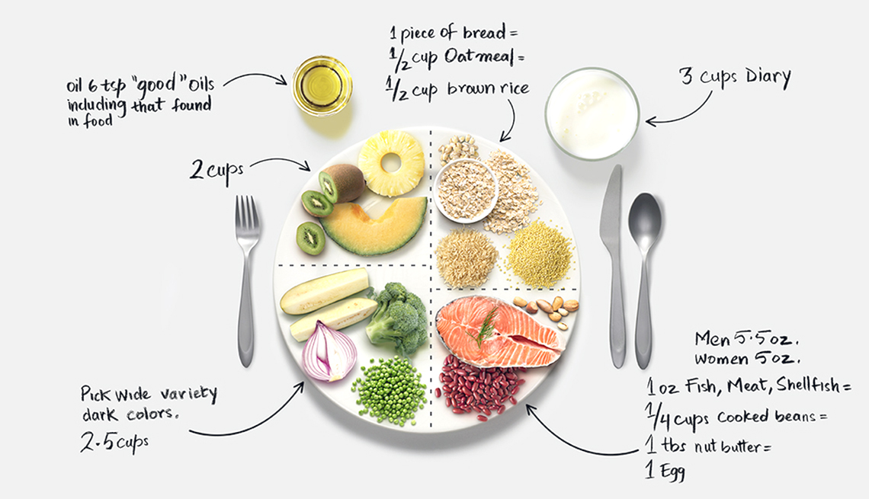
Notes:
Balanced plate illustration: Please remember, this is only a guideline. Your plate doesn’t have to look like this all the time -- *note measurements listed in this picture are for general guidelines purposes only, this will vary depending on many factors including your age, gender, and activity level.
https://food-guide.canada.ca/en/tips-for-healthy-eating/make-healthy-meals-with-the-eat-well-plate/
½ your plate = vegetables (raw or cooked) and fruit. Eat the rainbow, prioritize more vegetables over fruit, especially dark coloured vegetables like leafy greens, broccoli, carrots and beets. These are nutritionally rich!
Healthy fats = handful of nuts and seeds, ½ an avocado, serving of fatty fish like salmon, 1-2 tbsp of hemp hearts, flax, chia seeds, olive oil, coconut oil, etc. The brain is made up of 60% fat!
¼ of your plate: complex carbohydrates from vegetables and/or grains. Examples: piece of wholegrain toast, serving of brown rice, quinoa, corn, sweet potato, peas, etc.
¼ plate (can be from plants and/or animal sources) – eggs, fish, beans, legumes, lentils, tempeh, edamame, chicken, beef, etc. If you included nuts as your healthy fat, these also are a source of protein. Many beans and legumes are also rich in complex carbohydrates!
Ignore *3 cups of dairy*. Calcium is an important mineral we don’t have to get from cow’s milk. If you don’t have an issue with dairy, then milk, yogurt and cheese are excellent options, but for those who don’t consume dairy, calcium comes from many other sources including almonds, seeds (chia, poppy, sesame) bone-in fish, dark leafy greens like kale, beans, lentils, and fortified drinks, to name a few.
Missing from this diagram is water. Aim for at least 8 cups a day.

Slide 19
QUESTION TIME!

Slide 20
Meditation
https://www.headspace.com/covid-19
https://www.mindful.org/free-mindfulness-resources-for-calm-during-covid-outbreak/
Apps: Calm, Headspace, Insight Timer
Healthy Eating
http://www.cookspiration.com/home.aspx
https://www.abbeyskitchen.com/category/nutrition/
Psychology
Kristin Neff: self-compassion.org
Canadian Psychological Association: https://cpa.ca/
https://www.developgoodhabits.com/self-care-ideas/
Resources

