Slide 1
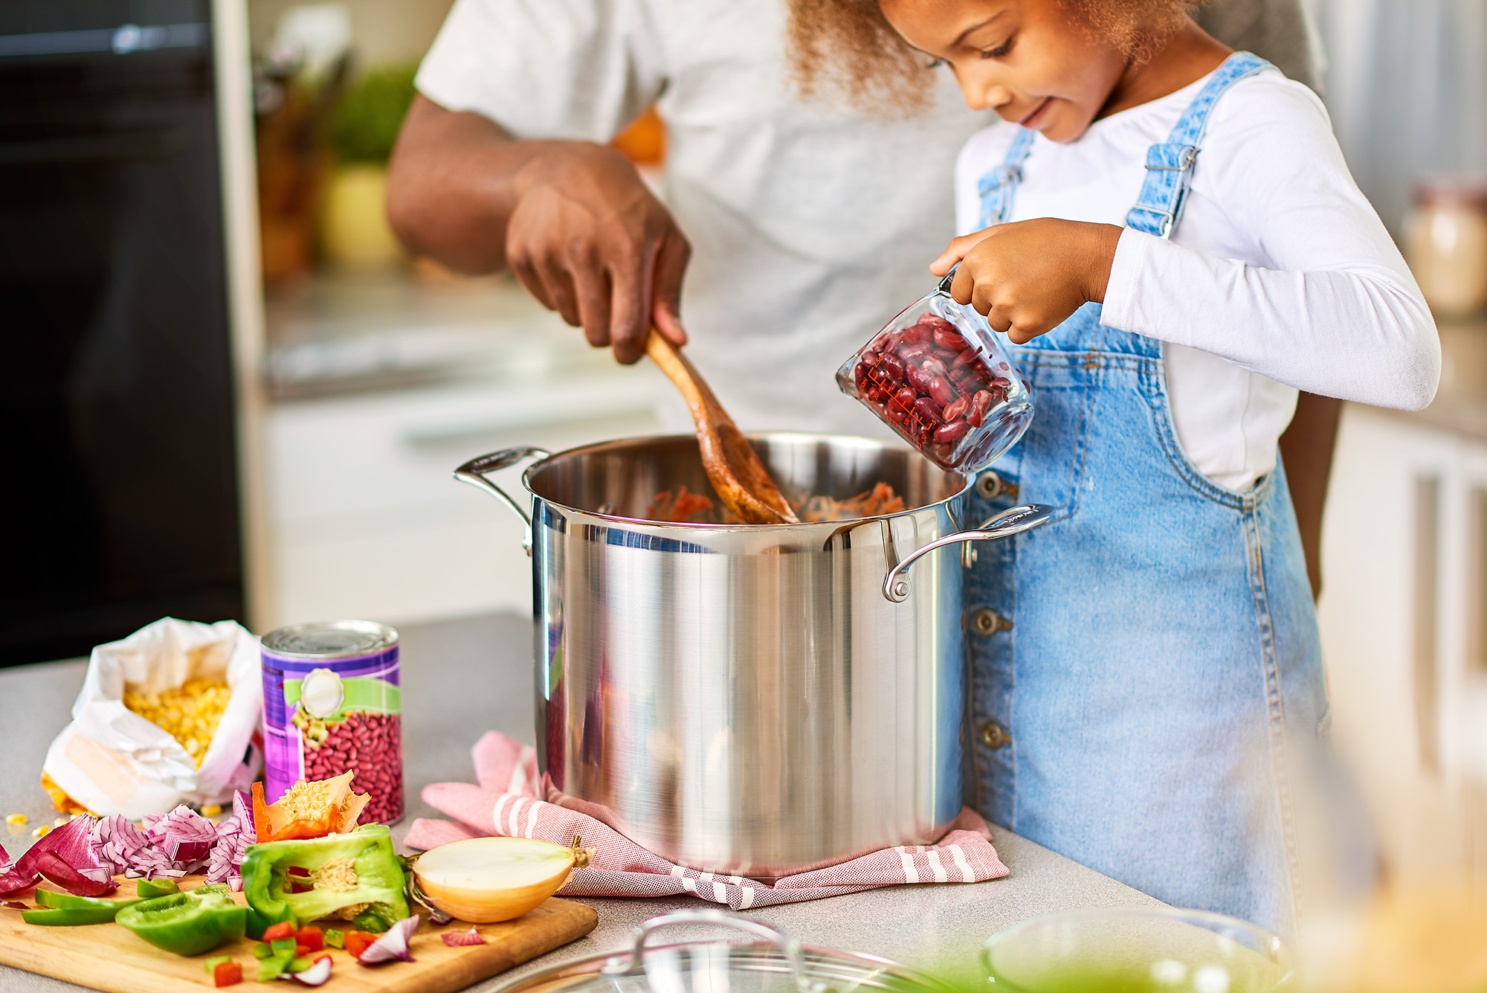
EASY & EFFICIENT MEAL PLANNING
Powered by:
©2020 EMPLOYEE WELLNESS SOLUTIONS NETWORK INC. – ALL RIGHTS RESERVED

Slide 2
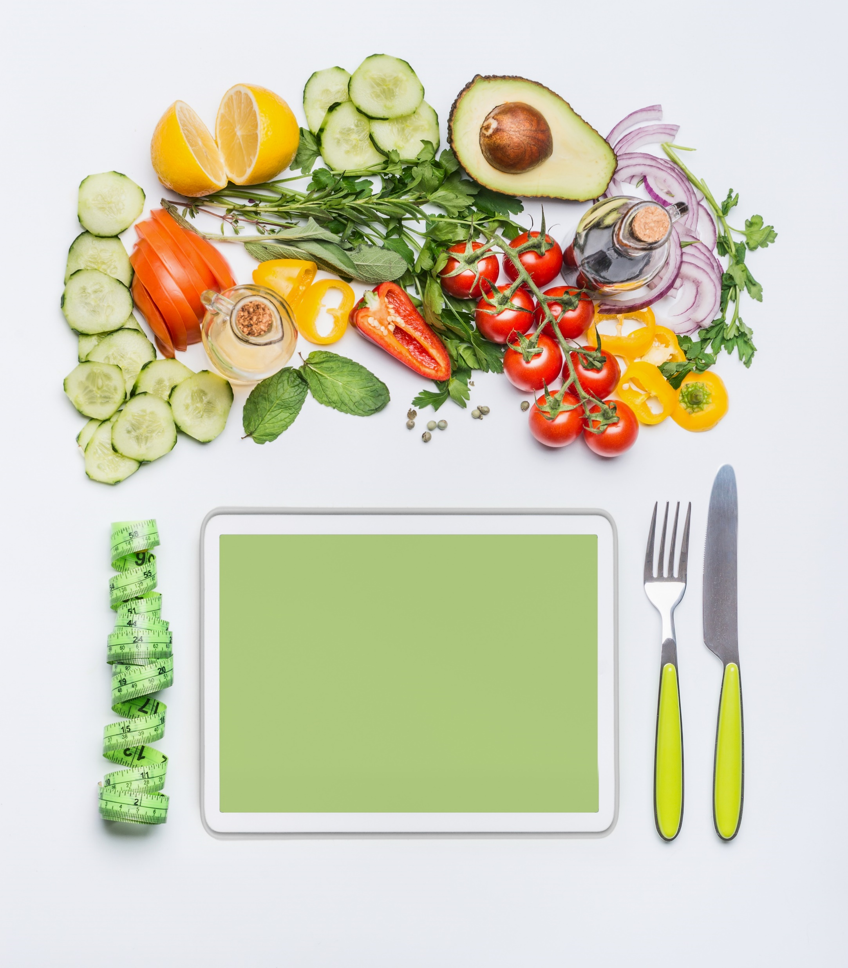
I
Objectives
Why Meal Plan?
Follow the Guide
7 Steps to Success
Tools & Support
www.EWSNetwork.com

Slide 3
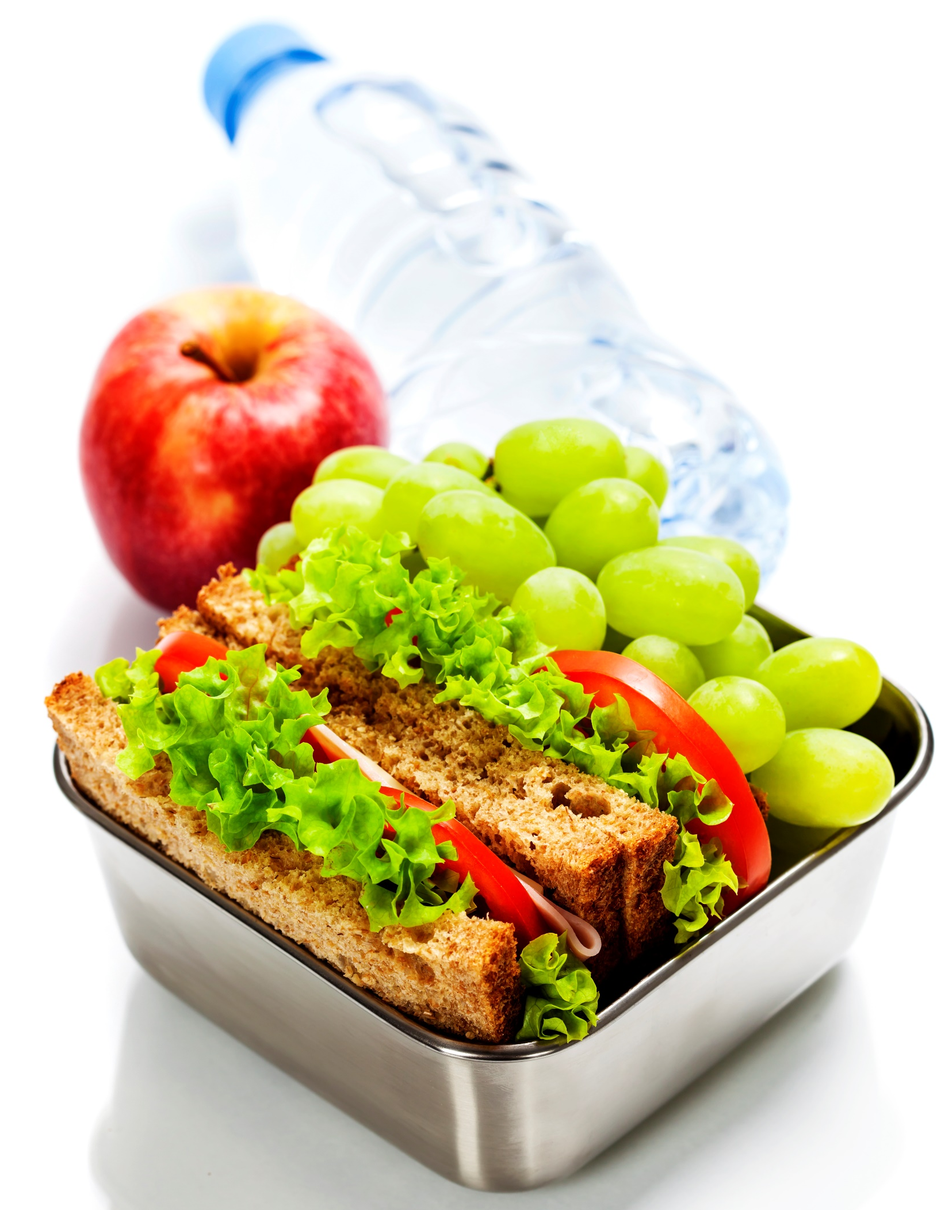
I
Why is a Meal Plan Important
Saves Money
Saves
Time
Improves Nutrition
Health & Well-being!
Notes:
also, using leftovers efficiently cuts food waste, while planned buying in bulk makes it easy to stockpile freezer meals at reduced prices.
You won’t run out of missing ingredients, or make frantic searches in the freezer, realizing chicken fingers are all you have left for dinner.
Knowing what to serve each day--and having the ingredients already on hand--cuts back on the drive-through habit.

Slide 4
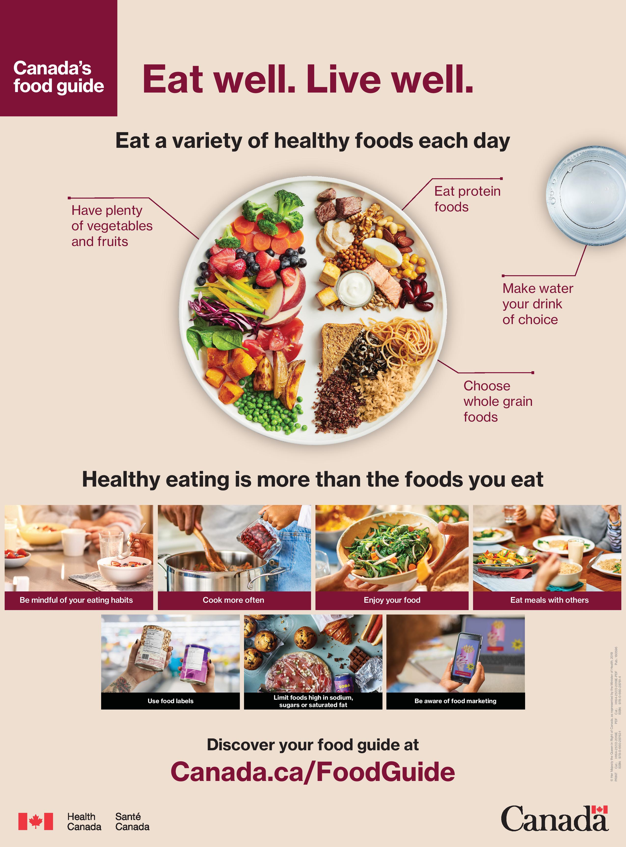
I
Follow the Guide
Canada Food Guide
Notes:
The New Canada Food Guide helps us understand what a healthy plate should look like. We can plan our meals, knowing that there is a healthy guideline in place that will help to prevent chronic illness, provide what our body needs, and maintain a healthy weight. Use the visual of the Eat Well Plate to guide your meal choices.
There’s no right or wrong way to plan meals. You can plan for the whole week ahead, or you can plan for a couple of days at a time. Do what works for you.
A little planning goes a long way in helping to develop and maintain healthy eating habits. You will find that the more you plan what you eat, the easier it gets. Eventually it will become routine and a lot less work. Be patient, be consistent.

Slide 5
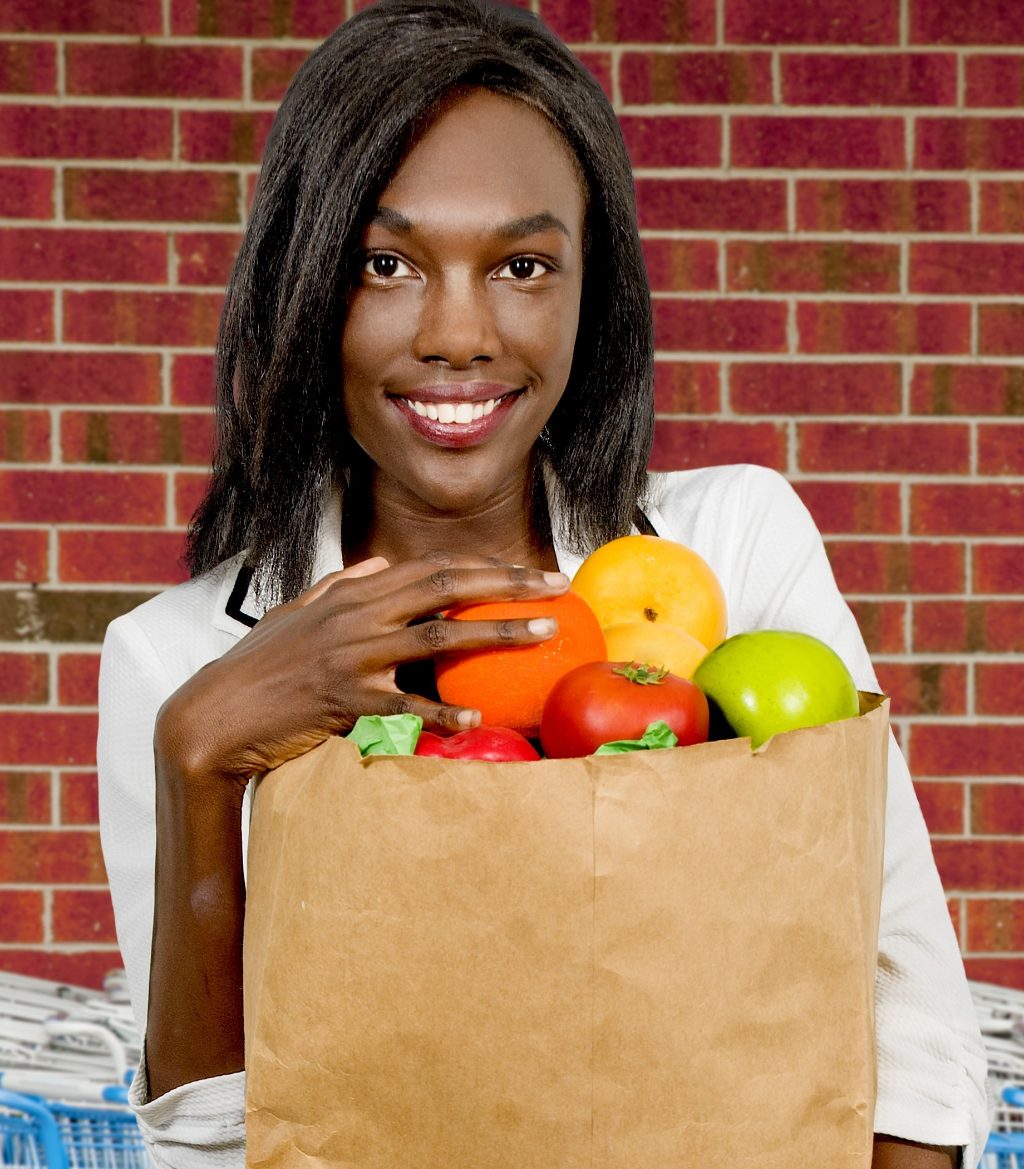
I
7 Step Strategy for Success
Have some core adaptable recipes
Involve the family
Be wise with proteins
Plan for and use leftovers
Organize your shopping list
Use local seasonal foods
Plan for “On the go…”
Notes:
The goals to meal planning: make a draft plan, shop from a list, retain flexibility in the marketplace, held up your plan and held yourself accountable.
1. Have your “go to” recipes for those hectic nights. See resource page on handout and at end of presentation
2. Ask others in the family for lunch or dinner ideas, new foods to try, family favourites.
3.Plan meals and snacks using healthy proteins and nutritious fresh foods prepared with little or no added fat, sugar or salt. Limit the processed or prepared foods.
4. Check the fridge, cupboard and freezer. Read the flyers too!
Note what needs to be used up soon so it does not go to waste.
Use leftovers for lunches or as part of another meal.
5. Post the menu plan on the refrigerator door. Refer to it during the coming week as you prepare meals.
Let everyone know to add items to the list as you run out.
Make shopping easier. List foods under headings (produce, meats, etc.). Exemplar will be provided later in presentation.
6. Take advantage of local seasonal foods, support your local economy and the people in it who feed you. Enjoy the fresh taste
7. Don’t forget to plan for the road!
Keep meals simple during the busy work week.
Post menu plans in a visible spot. First one home starts cooking!
Store menus in a binder to use again.

Slide 6
I
1) Get to the Core of the Matter
Core Recipes Are What Matters!
Keep things simple.
Make them adaptable.
Choose meals that you can cook in bulk.
Be realistic and choose meals your family will WANT to eat.
Choose the days of the week you will eat them.
Notes:
Before you can actually execute your meal plan, you need to choose recipes you’ll cook during the week ahead. This is possibly the most important step in meal planning. Choosing the right recipes: like family favorites, staple healthy meals, meals you can cook in bulk. The core recipes that you choose to cook/adapt weekly will set you up for success.
Choose some staple meals that you know like the back of your hand. You shouldn’t need a recipe for these and can put the meal together within 15-30 minutes rather than an hour. Shopping will also be easier when you have some predictable staples for common ingredients you know you need to always keep on hand.
Feeding your family the same meals week after week can get boring. Your core recipes should be adaptable. For example – your weekly lasagna can easily become a veggie lasagna by replacing meat with mushrooms, spinach and ricotta cheese. Add pineapple to a chicken stir fry and make it Hawaiian! Change up your taco Tuesday by doing a taco salad or a taco bowl. Same ingredients but no shells, just served over lettuce or rice!
If you can cook these staple meals in bulk, it allows you to prepare for a busy week, month, few months ahead. Life can be unpredictable. When circumstances come our way that create a barrier to eating healthy, (a family member in the hospital, an unexpected week of overtime, a hockey tournament..etc.) its nice to know that even the core recipes will be waiting for you in the freezer when needed!
Sometimes meal planning is a grand attempt at a healthier way of eating, eating within a budget, or meals that are 30 minutes or less. But if these meals aren’t appealing, your meal plan won’t work for you and you’ll be tempted to order pizza. Take your time and find meals that you and your family will WANT to eat.

Slide 7
I
2) Involve the Family
Family Matters
Delegate tasks
Make it routine
Let them choose
Example:
Mia likes to measure
Joshua likes to grate cheese
Sean likes to plate food
You can use all of these skills on an almost daily basis. Ask for help.
Sunday is meal planning day.
Mia picks a healthy meal for Monday and includes the purple carrots she wants to try.
Joshua picks a healthy meal for Thursday
Sean picks a healthy meal the following Monday
Notes:
Meals are more than food. They are times to teach, connect, and share. The Canada Food Guide puts an emphasis on the social aspect of eating and that includes enjoying preparing, cooking, and eating meals as a family, with friends, neighbors, colleagues…etc..
Meal planning and preparation can be time consuming and stressful. As they say, many hands make light work. We hope these ideas will help relieve some of the stress and will provide you with fun, new ways to get your family involved while learning in the process.
Kids love to help. Find 1 or 2 ways that they can help out.
Let them help you make your shopping list, suggest new foods to try, discuss healthy food choices
Invite them to help you prepare and cook meals. Choose age and skill appropriate tasks to reduce both of your frustration levels. Chopping, measuring, dumping, mixing, serving..etc..
Have them be your assistant as you take an inventory of what you have in your fridge and your pantry. Call out ingredients and let the child tell you if it can be found.
Let each child choose a meal for the week. If more than 1 or 2 children, rotate their participation weekly.
Ask what they are able to make themselves so there are less meals for you to plan. Have ingredients on hand for things like a Turkey and cheese sandwich, carrot sticks and dip, or individual yogurts.
Do this every week just as you would assign chores or tasks at home.

Slide 8
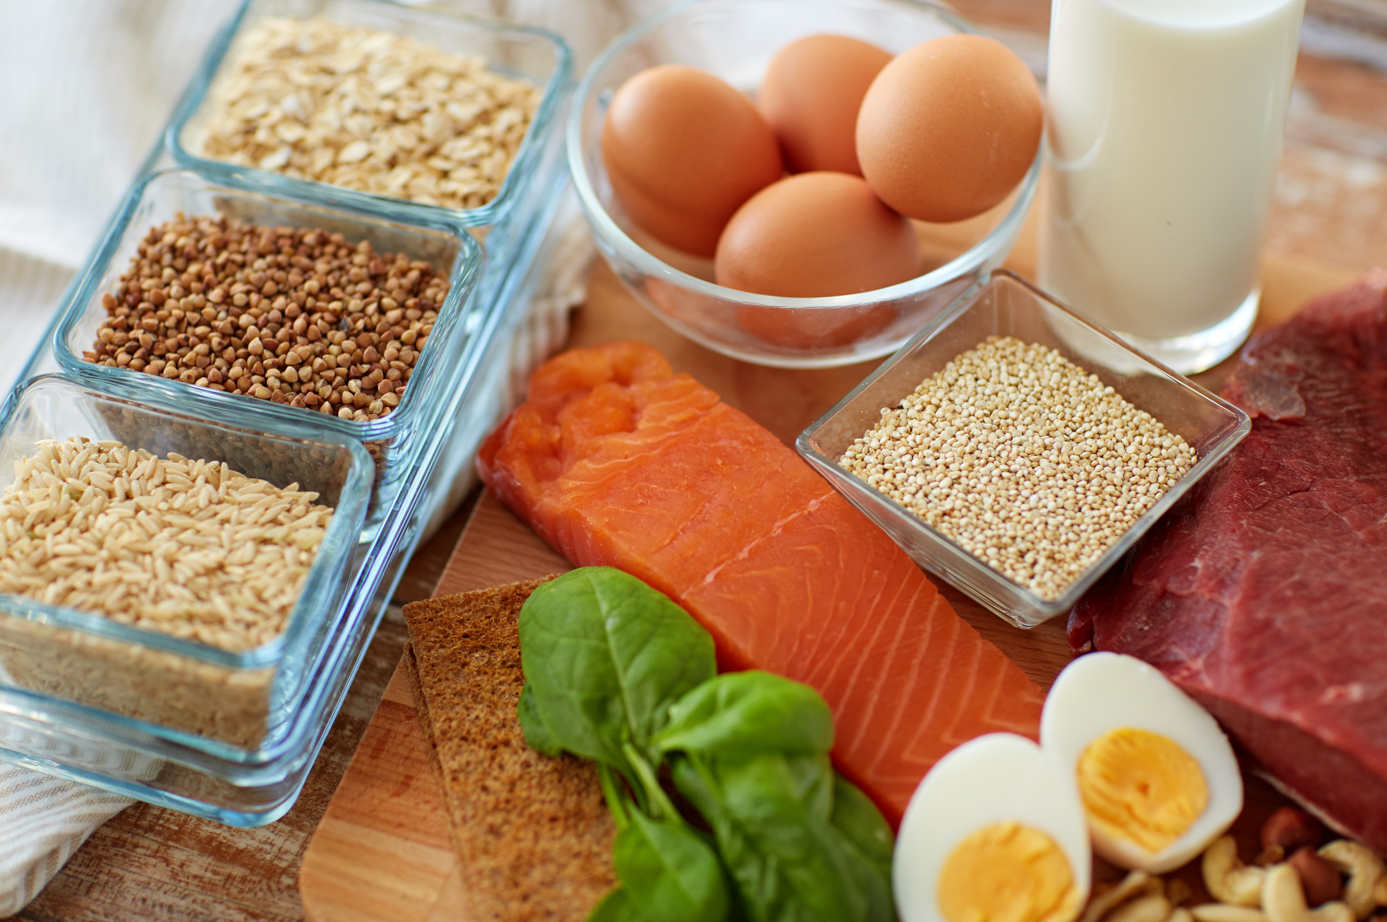
I
3) Be Wise with Proteins
Choosing Meats:
Choose lean cuts and stretch it out.
Keep less expensive cuts for slow cooker meals and soups.
Buy fish such as salmon, trout, sardines, albacore tuna and herring.
Plan for Meatless Meals:
Choose healthier nuts and seeds – raw, unsalted like almonds and walnuts.
Stock up on dry and canned beans and lentils.
Quinoa is a great source of protein.
Eggs are convenient, versatile, and inexpensive.
Notes:
Where your budget will allow choose leaner cuts of meat and poultry and stretch it out (flank steak, extra-lean ground beef, chicken, turkey). Add more vegetables and create a few meals like stir fries, casseroles, or soup. Or choose less expensive cuts and tenderize in recipes using a marinade, slow cooker, or instant pot.
Fish is a healthy protein that can fit in any budget. Yes it can be expensive but also often found on sale or in canned versions.
Plan for plant-based meals
Add nuts and seeds to quickly increase protein of meatless meals
Canned beans and lentils offer a great substitute to stir fries, soups, chili, even burgers! Have plenty on hand.
Quinoa is an easy pair with loads of vegetables for a full protein meal
Eggs aren’t just for breakfast. Omelets, frittata, homemade veggie quiche, devilled eggs are quick, easy, and affordable.

Slide 9
I
4) Plan for and Use Leftovers
Use it, don’t lose it.
Double or triple a recipe that you know the whole family enjoys.
Estimate servings and cook extra.
Anticipate using leftover chicken, fish, or meat for sandwiches.
Start small. Don’t overload your plate.
Even small amounts are worth freezing.
Keep leftover vegetables for a weekly veggie stock, pasta sauce, quiche, or soup.
Freeze fruit that isn’t eaten for morning smoothies.
Choose a night for a leftover buffet! Short on leftovers? You can add anything to omelets!
Notes:
A whopping 58 per cent of all food produced in Canada — 35.5 million tons — is lost or wasted, according to a new report, and about a third of that wasted food could be "rescued" and sent to communities in need across the country. The report, entitled "The Avoidable Crisis of Food Waste,"
According to the research, some 4.82 million tons of food, or nearly $21 billion worth, is lost or wasted during the processing and manufacturing process. Some 2.38 million tons of food, or more than $10 billion worth, is lost at the consumer level.
Be smart with portions, storage, and excess. Leftovers are a great way to tighten the budget, create a quick meal, and lessen food waste.
1) Double or triple a recipe that you know the whole family enjoys.
It can be hard to find a meal that everyone likes. When you do, cook double or triple and have a meal prepared in the freezer that you can just pop into the oven with no complaints!
Estimate servings and cook extra.
Anticipate using leftover chicken, fish, or meat for sandwiches.
Start small. Don’t overload your plate. Putting to much on your plate increases the chance of waste.
Even small amounts are worth freezing.
Keep leftover vegetables for a weekly veggie stock, pasta sauce, quiche, or soup
Freeze fruit that isn’t eaten for morning smoothies.
Choose a night for a leftover buffet! Short on leftovers? You can add anything to omelets!

Slide 10
I
5) Organize Your Shopping List
Make a list, check it twice
Make a master list of staples.
Let your freezer, fridge and pantry determine your meals for the week and add on where needed!
Let sales dictate the week’s add on recipes or meal ideas. Check grocery store ads, digital flyers, and price compare apps..etc...
Organize the items on your list by aisle.
Find an app that does the work for you!
Notes:
Master List: you can use every time you shop. Cross of anything you don’t need each week.
Keep a notepad on the fridge to record when you run out of an item or realize you need something.
Have some leftover spaghetti sauce? Add a lasagna to your meal plan. Leftover rice and chicken? Make a stir-fry bowl night.
Make a rough draft of your list and then code each item.
Produce = P
Dairy = D
Meat = M
And organize by category to make your shopping quick and efficient and also avoid the aisles that can result in impulse purchases.

Slide 11
I
6) Support Local and Eat Seasonal
Get Local
Build your meals around seasonal produce.
Cheaper
Fresher
Tastier
Supports local economy

Slide 12
I
7) Plan for “On the go..”
Don’t get stuck
Check your schedule.
Pack portion sized snacks (see handout)
Have pre-made meals (see handout)
Plan for healthy on the road options
Rely on restaurants with healthier options (Starbucks, Chipotle, Qdoba, Subway…etc.)
Substitute a salad, chili, or broth-based soup instead of a burger or sandwich
Choose lean meats like chicken or turkey
Load up on vegetables
Look for grilled options rather than deep fried (i.e. grilled chicken instead of crispy chicken)
Look for low fat, low sodium options
Notes:
Check your Schedule – whether for work or recreation. Plan for the days when you will be on the road

Slide 13
I
Time for Tools
Smart Swaps
Use the Canada Food Guide
Healthy Portable Snacks
Meal Planner Template
There’s an App for That!

Slide 14
Build Your Toolbox and Support
I
1. Canada Food Guide
What Should I Eat in Each Meal?
Focus on vegetables and fruit for 50% of your plate.
25% whole grains, 25% meat and alternatives.
Focus on plant-based protein as a healthy option
Limit dairy, processed foods, and prepare food at home when possible.
Drink water
Foods higher in fat, calories, sugar (not part of the Eat Well Plate) are absent or only a small portion of the meal.
Notes:
Start with the basics and build from there!
The New Food Guide is a simplified eating strategy that doesn't require you to measure your meat with your fist to calculate its serving size, or any other complicated calculation. It makes healthy eating simple:
“Eat a variety of healthy foods each day, limit foods that aren't so great for you (skip processed and prepared foods with added sugars, sodium and saturated fat, try to order take-out less), and cook more at home. “

Slide 15
Build Your Toolbox and Support
I
2. Smart Swaps
Yams/Sweet Potatoes | White Potatoes
Oven-roasted chicken/turkey breast, extra-lean ham | Bologna, salami
Brown, wild rice | White rice
Quinoa | Rice
Frozen yogurt or sorbet | Ice Cream
Low-Sodium broth-based soups | Cream based soup
Whole wheat wraps, pitas, crackers, bread | White wraps, pitas, crackers, bread
Frozen pizza with whole wheat, thin crust, chicken, vegetables | Deep dish pizza with pepperoni
Notes:
An easy way to up increase the nutrition factor of your meal plan.
Take a look at your list, see where you can make a swap for a healthier option.
Simple swaps make a big difference.
Healthy swaps you can easily make won’t dramatically change your food habits or your recipes, but will have massive impacts on your overall health.
You can reduce your calories, and eat healthier without sacrificing taste or serving size.

Slide 16
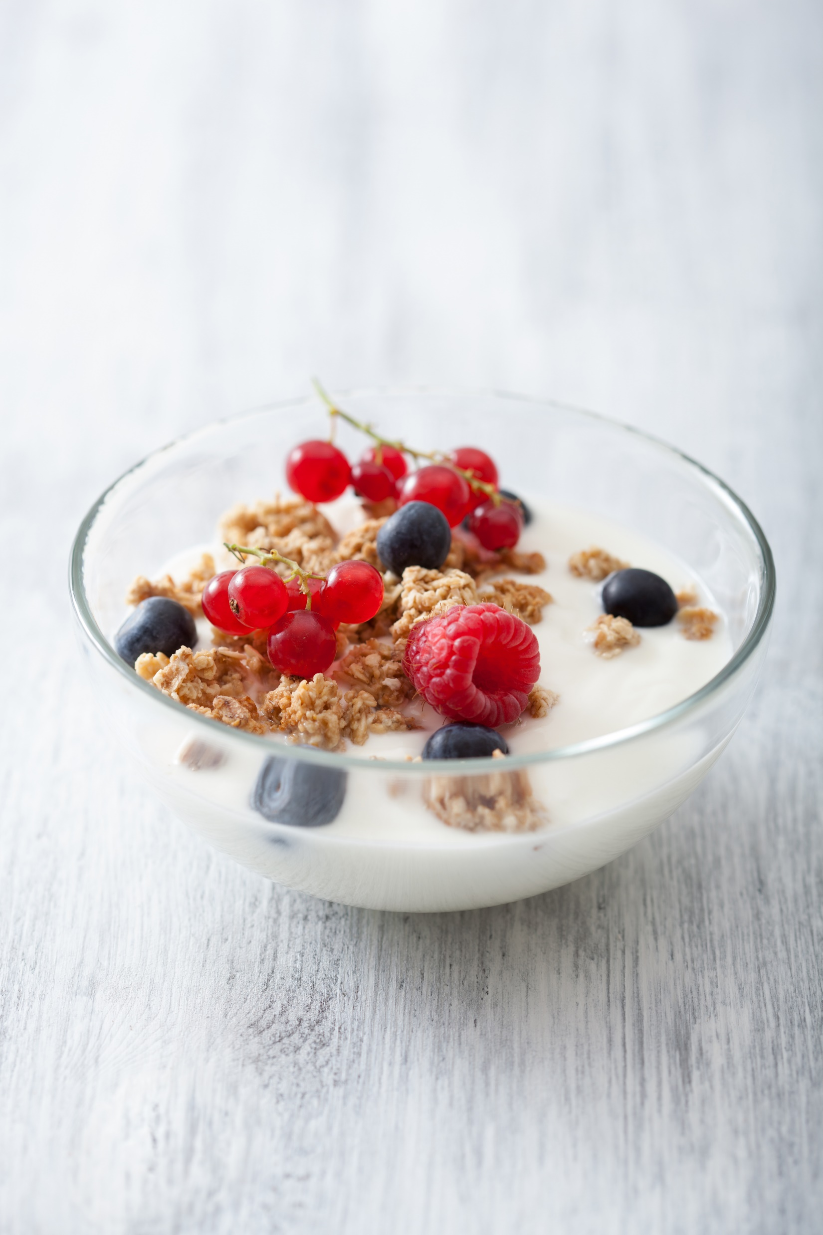
Build Your Toolbox and Support
I
3. Healthy portable snacks
Greek yogurt – 100g individual size (low sugar) | Apple, pear, orange or kiwi
Cheese portion | Sliced carrots, sugar snap peas, bell peppers
Pumpkin seeds or almonds (1/4 cup) | Apple
Edamame beans ( ½ c. shelled) | Celery sticks and baby carrots
Hard boiled egg + 2 tbsp hummus | 2 Roasted beets
Cottage cheese (½ cup) | Berries (½ cup)
Granola bars, protein bars, homemade healthy muffins: use the 5-5-10 rule!
Notes:
Make your snacks work for you. A snack should satisfy your hunger and provide energy to sustain you through your day. The easiest way to accomplish this is to pair a protein/fat with a high-fibre carbohydrate. Smart snacking can be an important strategy to keep your energy high when your schedule is hectic. It is important to keep healthy snacks on hand to avoid reaching for a convenient sugary or salty treat. Snacking throughout the day can help stave off hunger in between meals and prevent you from feeling tired, sluggish and irritable. Getting too hungry in between meals can lead to overeating when you do get to your next meal. Combining healthy protein with complex carbohydrates with fiber, like whole grains, will keep you feeling full for a longer period of time.
Any whole food makes a great snack in the proper portion but this combination ensures that you won’t be reaching for a quick carb or sugar for satisfaction, resulting in slowing you down for the afternoon. 2pm nap anyone? Not with these combo’s!

Slide 17
Build Your Toolbox and Support
I
4. There’s an App for That!
Allrecipes Dinner Spinner
Mealime
Yummly
Foodprint
Pepperplate

Slide 18
Build Your Toolbox and Support
I
Sample Day:
Tuesday – Taco Tuesday
Breakfast: Fruit smoothie with spinach and hemp seed
Lunch: Homemade leftover chicken and vegetable soup (using leftover chicken spinach, and veggie scraps)
Dinner: Halibut fish tacos with slaw and local seasonal roasted sweet potato
Snack 1: Boiled egg (pre boiled in the week) and 2 slices of avocado
Snack 2: Local apple and 10 raw almonds
Notes:
So now you know what to do and have the tools to do it. It’s time to get started.
-You’ve made a list of your core recipes with some family input
-You’ve made a list that includes your current stock inventory and freezer meals and created ideas of meals with leftovers you need to use up
-Plot these meals into your Weekly Meal Planner Guide and take note of the empty spots.
-Consider what you want or what your meal plan may be lacking. This is where you decide what you have not had in a while, what your family is asking for, and whether you want to try a new recipe. Fill in the blanks. To find new recipes use a meal planning app, go to those recipes you pinned on Pinterest with good intention but never got to. Pull out some favorite cookbooks or go to a favorite blog.
-Create lunches from leftovers from previous dinners (plan to cook a few meals in bulk for extra servings)
-Use what you buy more than once (If you bought strawberries for your spinach salad, use them in a fruit salad. Use the spinach again in a spaghetti sauce…etc..)
-Snacks should always include fruits and vegetables
-Purchase vegetables that your family enjoys and keep them local and seasonal where you can
I understand that it takes a little time. But the amount of time you spend making those lists, searching for recipes, and going through your refrigerator, cupboards, and pantry will come back to you every night at dinner when you are asked “What’s for dinner?” and realize you have a quick and simple answer and removed the guesswork, and the stress! It will take some time to create this new system, and there might be some mess ups but keep practicing. No impromptu trips to the grocery store needed, no wasted money on takeout, or wasted time in a slump on the couch after a heavy unhealthy meal. Takeout and delivery will be a true family treat! Meal Planning: Good for our bodies, and our budget!

Slide 19
I
Question Time!

Slide 20
I
Sources
https://food-guide.canada.ca/en/
https://www.cbc.ca/life/food/23-recipes-as-fresh-and-healthy-as-canada-s-new-food-guide-1.4991859
https://www.ontario.ca/foodland/page/why-buy-local
https://nutrition.org/study-shows-a-high-fiber-diet-rich-in-plant-protein-is-best-for-gut-microbiota-derived-fatty-acids/
www.EWSNetwork.com

