Slide 1
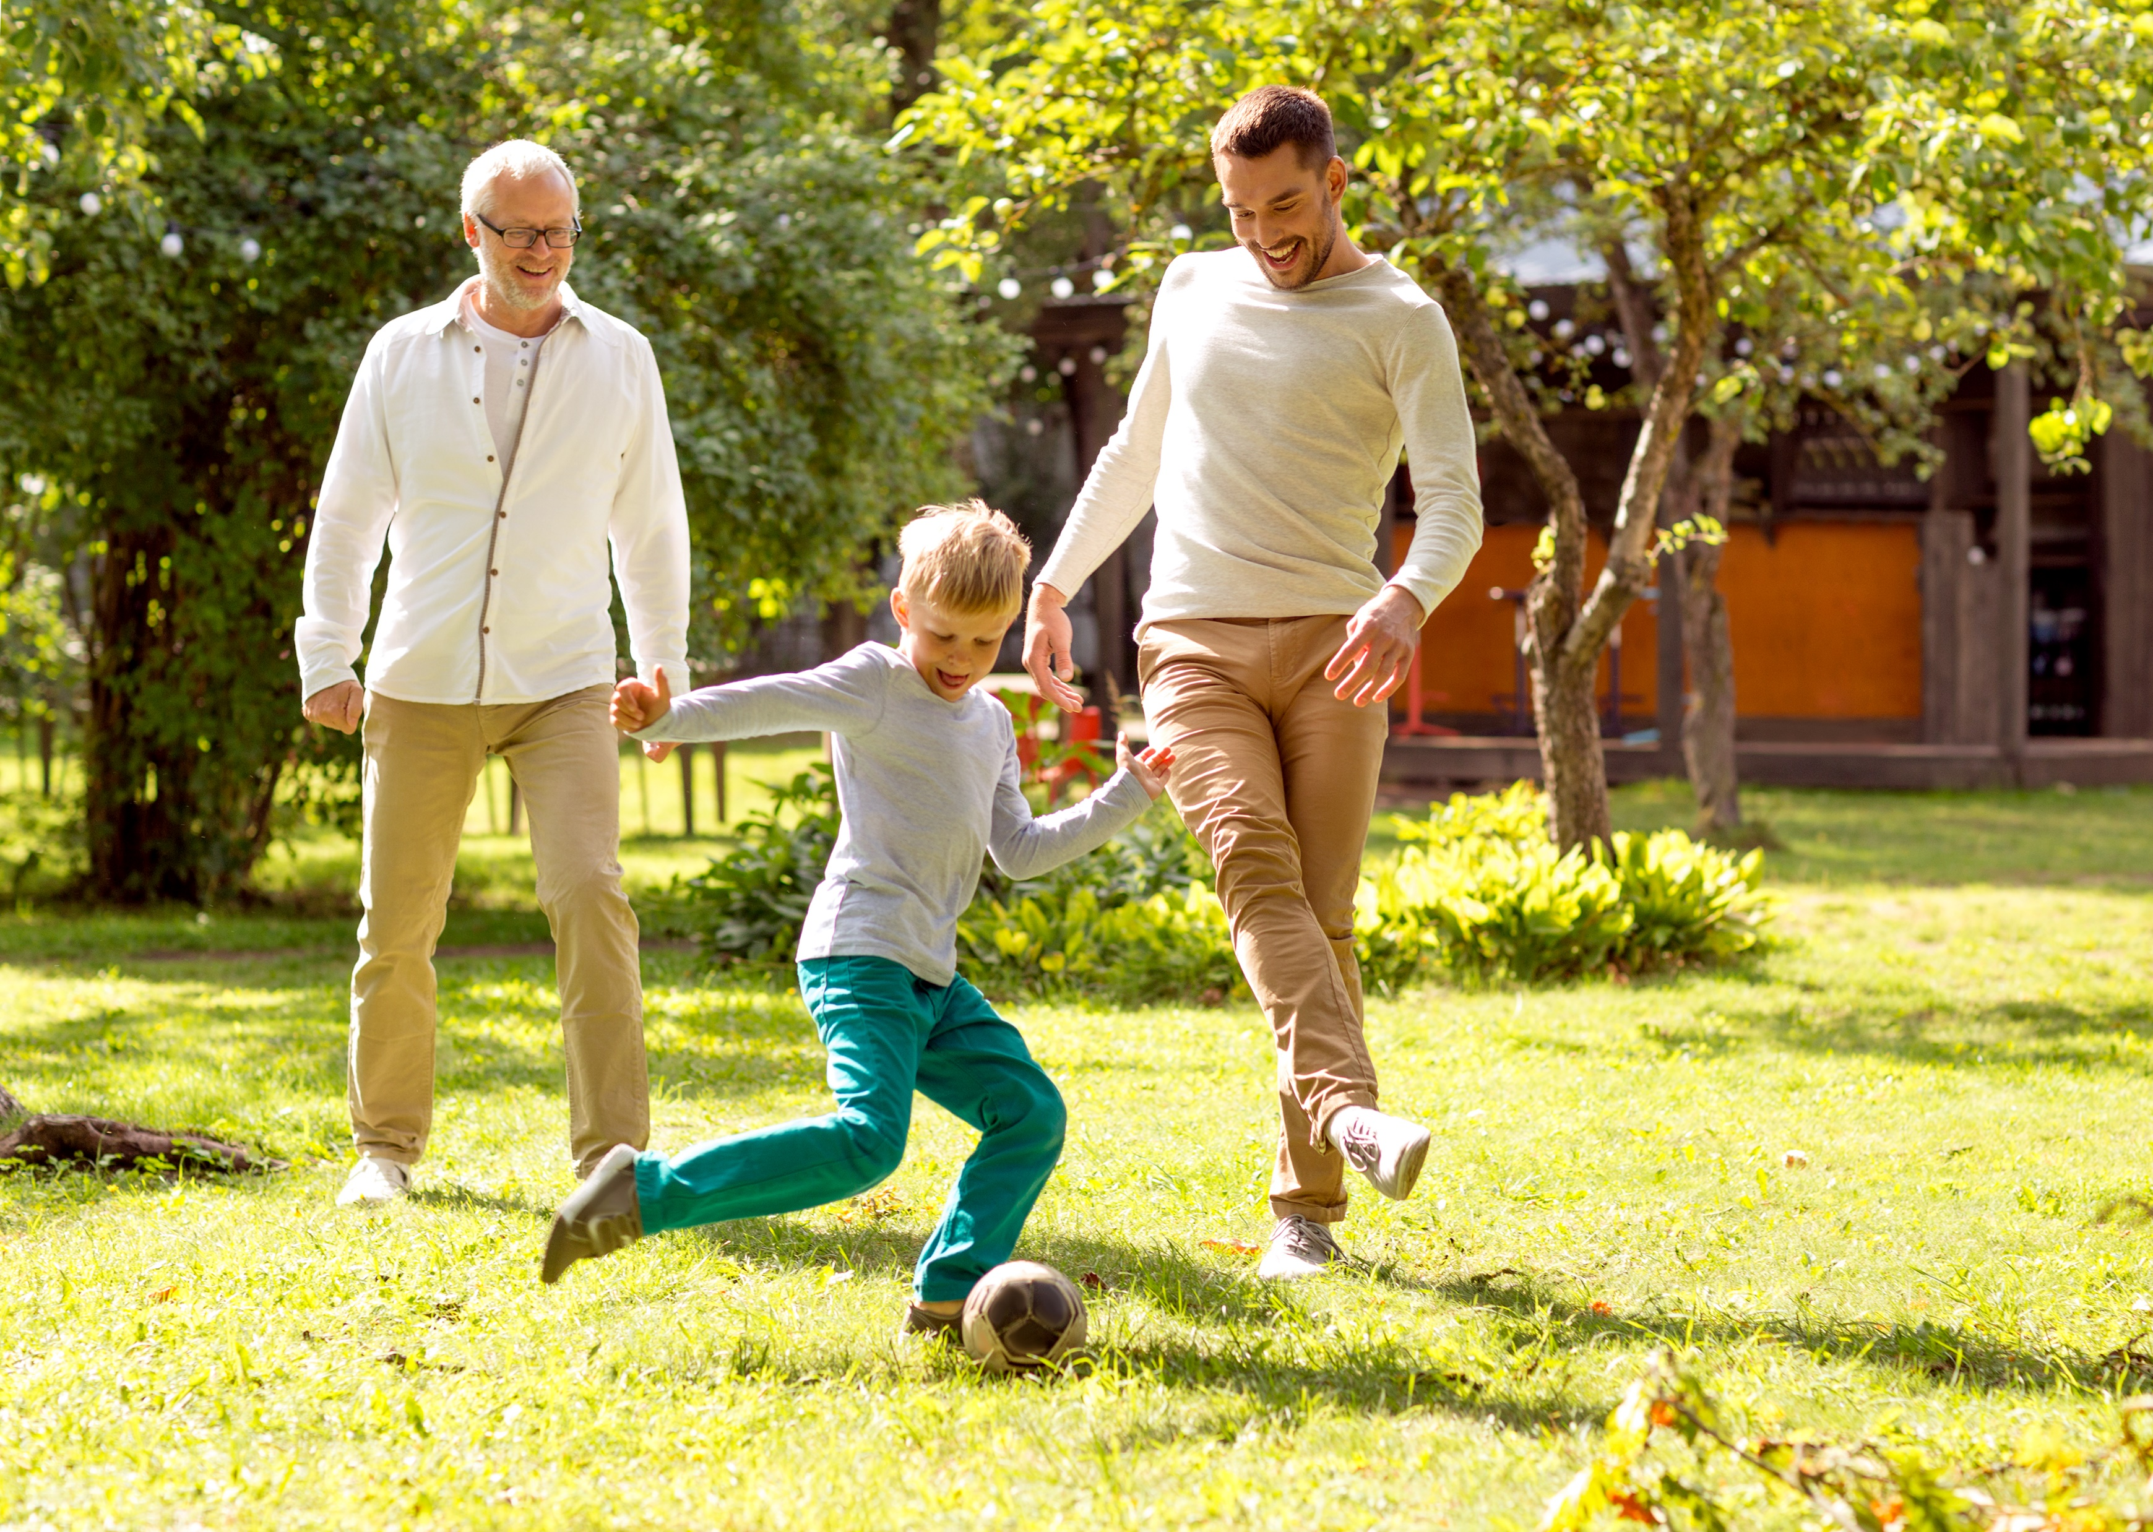
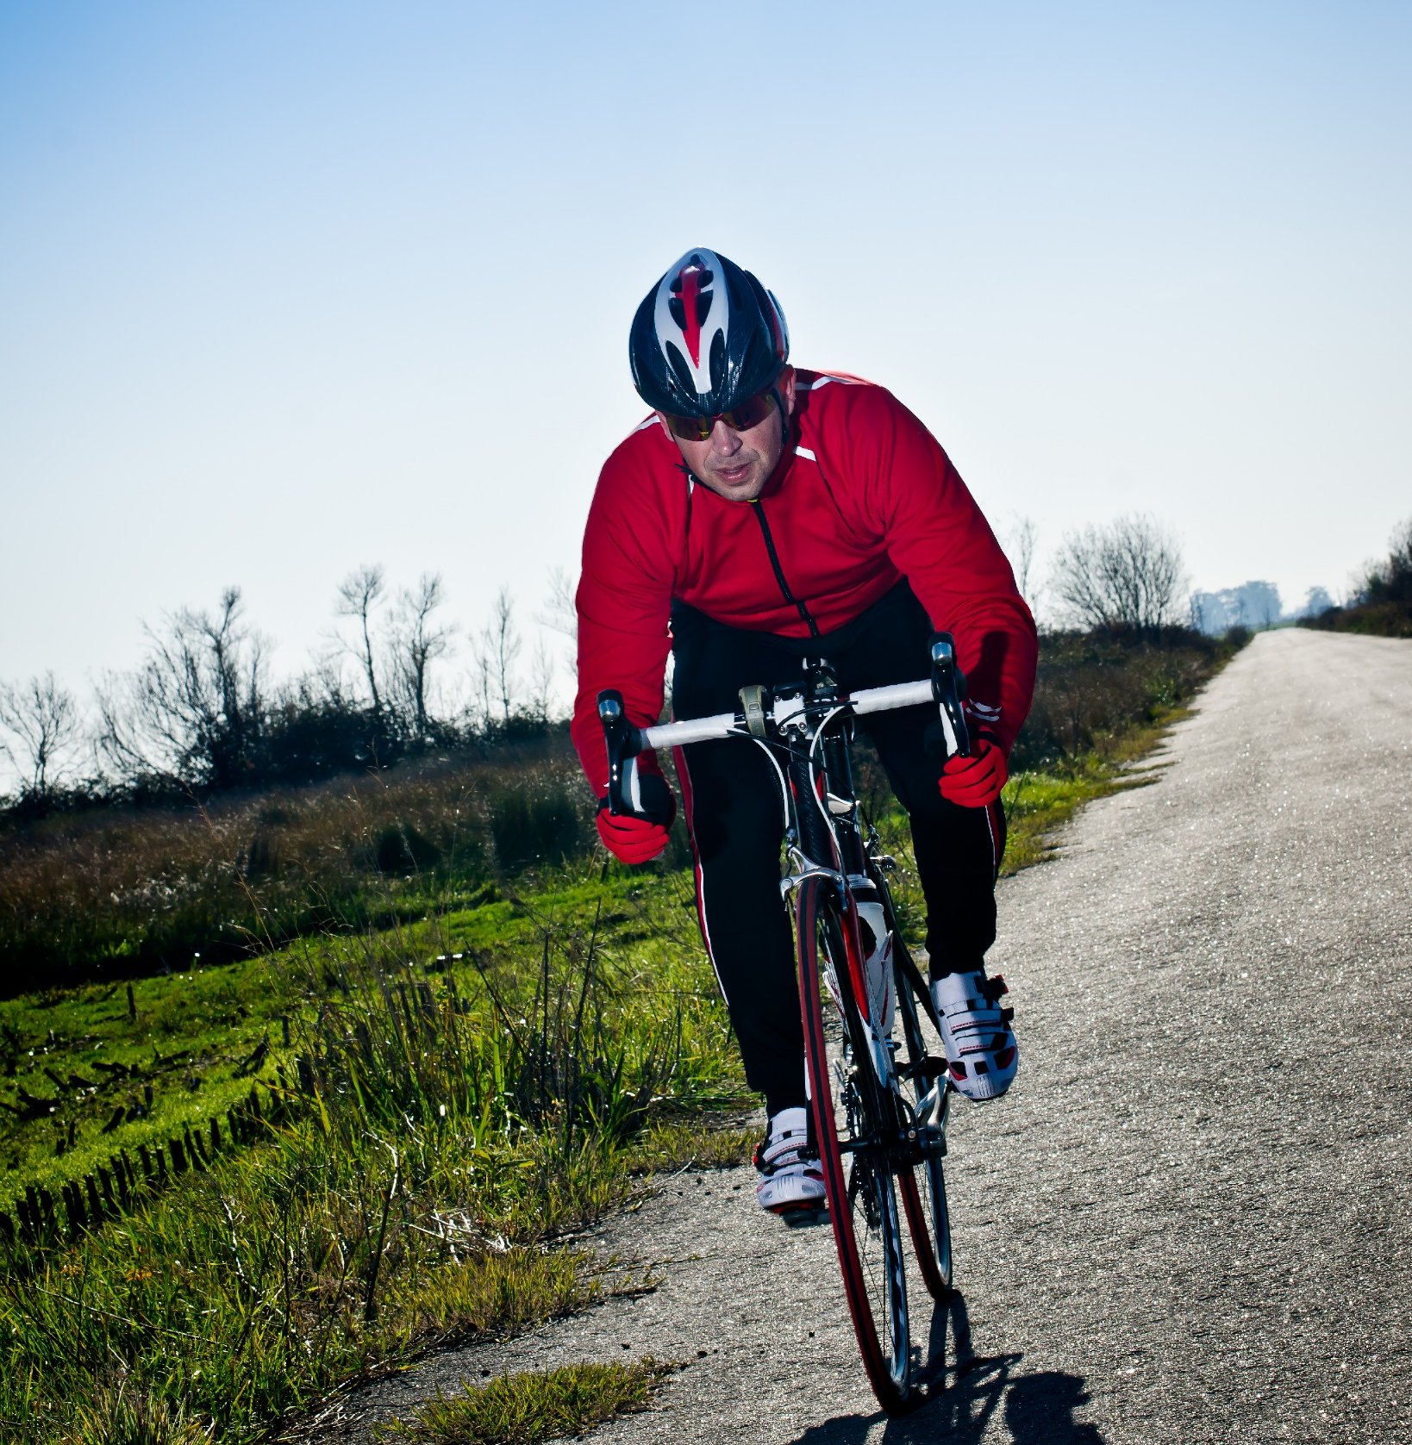
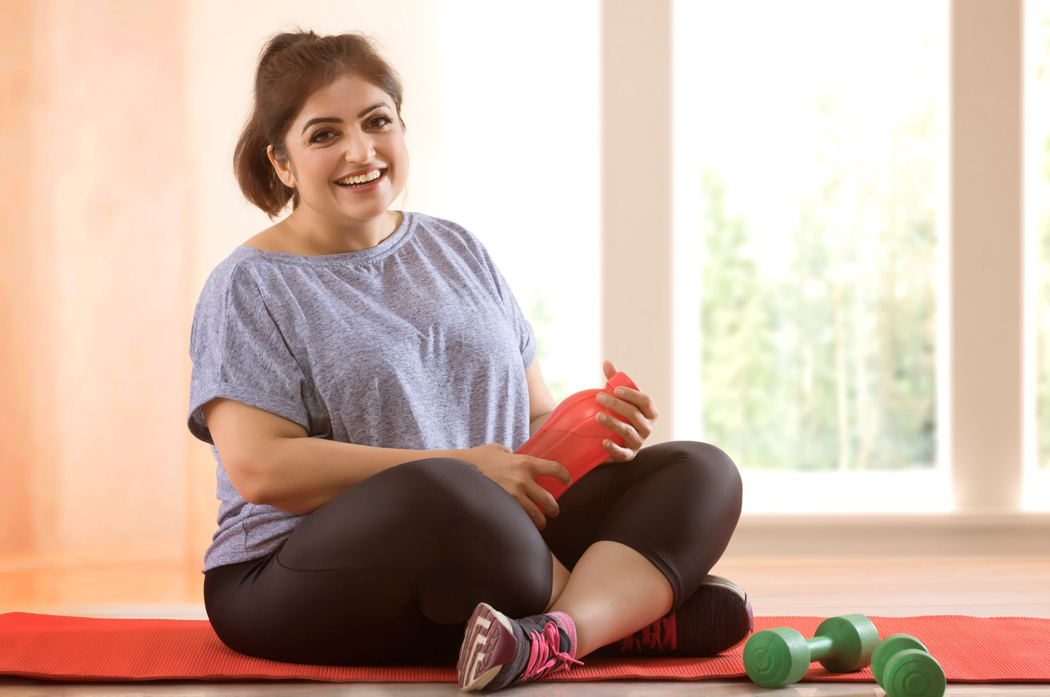
PHYSICAL ACTIVITY:
IT’S IN YOU TO MOVE!
Powered by:
©2020 EMPLOYEE WELLNESS SOLUTIONS NETWORK INC. – ALL RIGHTS RESERVED
Notes:
Notes:
- Presentation notes are not to be printed. Please use LNL handout as client resource.
- Video to play on slide 2: Link is provided if you have issues playing it within the presentation for any reason.
- 2 handouts to print so that clients can assess risk and initiate change. The links are here as well as on the last page as a reminder.
Please print the following for your group
https://diabetes.ca/diabetescanadawebsite/media/managing-my-diabetes/tools%20and%20resources/are-you-at-risk.pdf?ext=.pdf
And deciding on change:
https://diabetes.ca/diabetescanadawebsite/media/managing-my-diabetes/tools%20and%20resources/decisional-balance.pdf?ext=.pdf

Slide 2
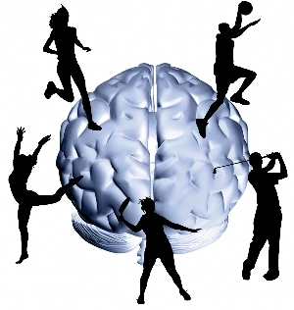
I
Objectives
Born to Move - Quiz
Canada is in trouble…
Mini-movements work!
How much exercise do I need to lower my mortality rate?
Why Move? 5 strategies
Are you motivated to move?
www.EWSNetwork.com
Notes:
Go over points
After points, direct them to the quiz. Take a few minutes to allow them to complete….Go over results after the end of the talk.

Slide 3
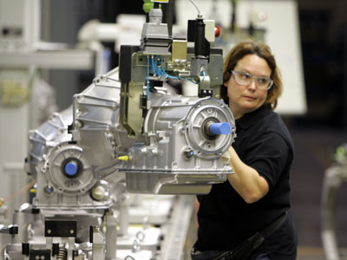
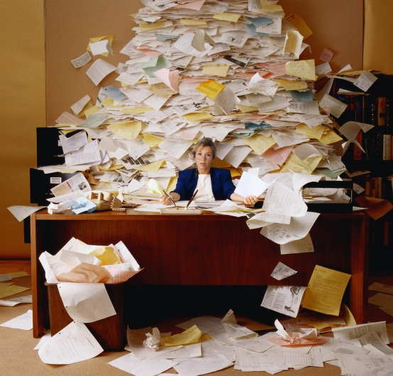
I
Born to Move – History of Movement
Millions of years
Thousands of years
Hundreds
of years
NOW!!!
Notes:
Main points - go over slide:
millions of years: we hunted for food and lived in the forest = moving is all we did!
Thousands of years: we lived on and worked on a farm = movement was apparent
Hundreds of years: we worked in factories = manual labour
Today , we sit for most of our lives (cars, computers, social networking, answering emails, phones, drive thru, attractive satellite TV packages, looking for that perfect parking space). Our movement has significantly decreased…causing all sorts of major problems.
THINK OF THIS PROGRESSION…..
- creatures of movement (baby learning to move, energy levels of toddlers)
- grade school: recess, playing/running
- high school: fitness was/is now optional [obesity rates have increased in childhood obesity]; standardized fitness scores measured against norms [discouraging for some students…disinterested in fitness from the on!]…What a way to hate physical activity!
- high school: other pressures, body image, laziness, computer games, social networks (all encouraging kids to sit!)
- graduation and entering college: freshman 15 then enter corporate world…before you know it, kids are well over weight/over fat because of the track record of lack of movement!
BY NO MEANS IS THIS EVERYONE! UNFORTUNATLEY, THESE TRENDS ARE MORE COMMON THOUGH!
We’ve come a long way in the last 50 years….too bad our kids are adopting this lounge lizard lazy lifestyle
Reality is – our bodies are made to move….we have a perfect anatomical moving machine with flexible spinal cartilage, tissues, muscles allowing us to move in every direction possible to crawl, climb, jump, run…How do we thank our ancestors for this great gift? We sit on couches, car seats and in front of computers/TV as if we were never given this gift of movement!
I’ll show you today, how easy it is to move….after all, activity is natural and we were all BORN TO MOVE

Slide 4
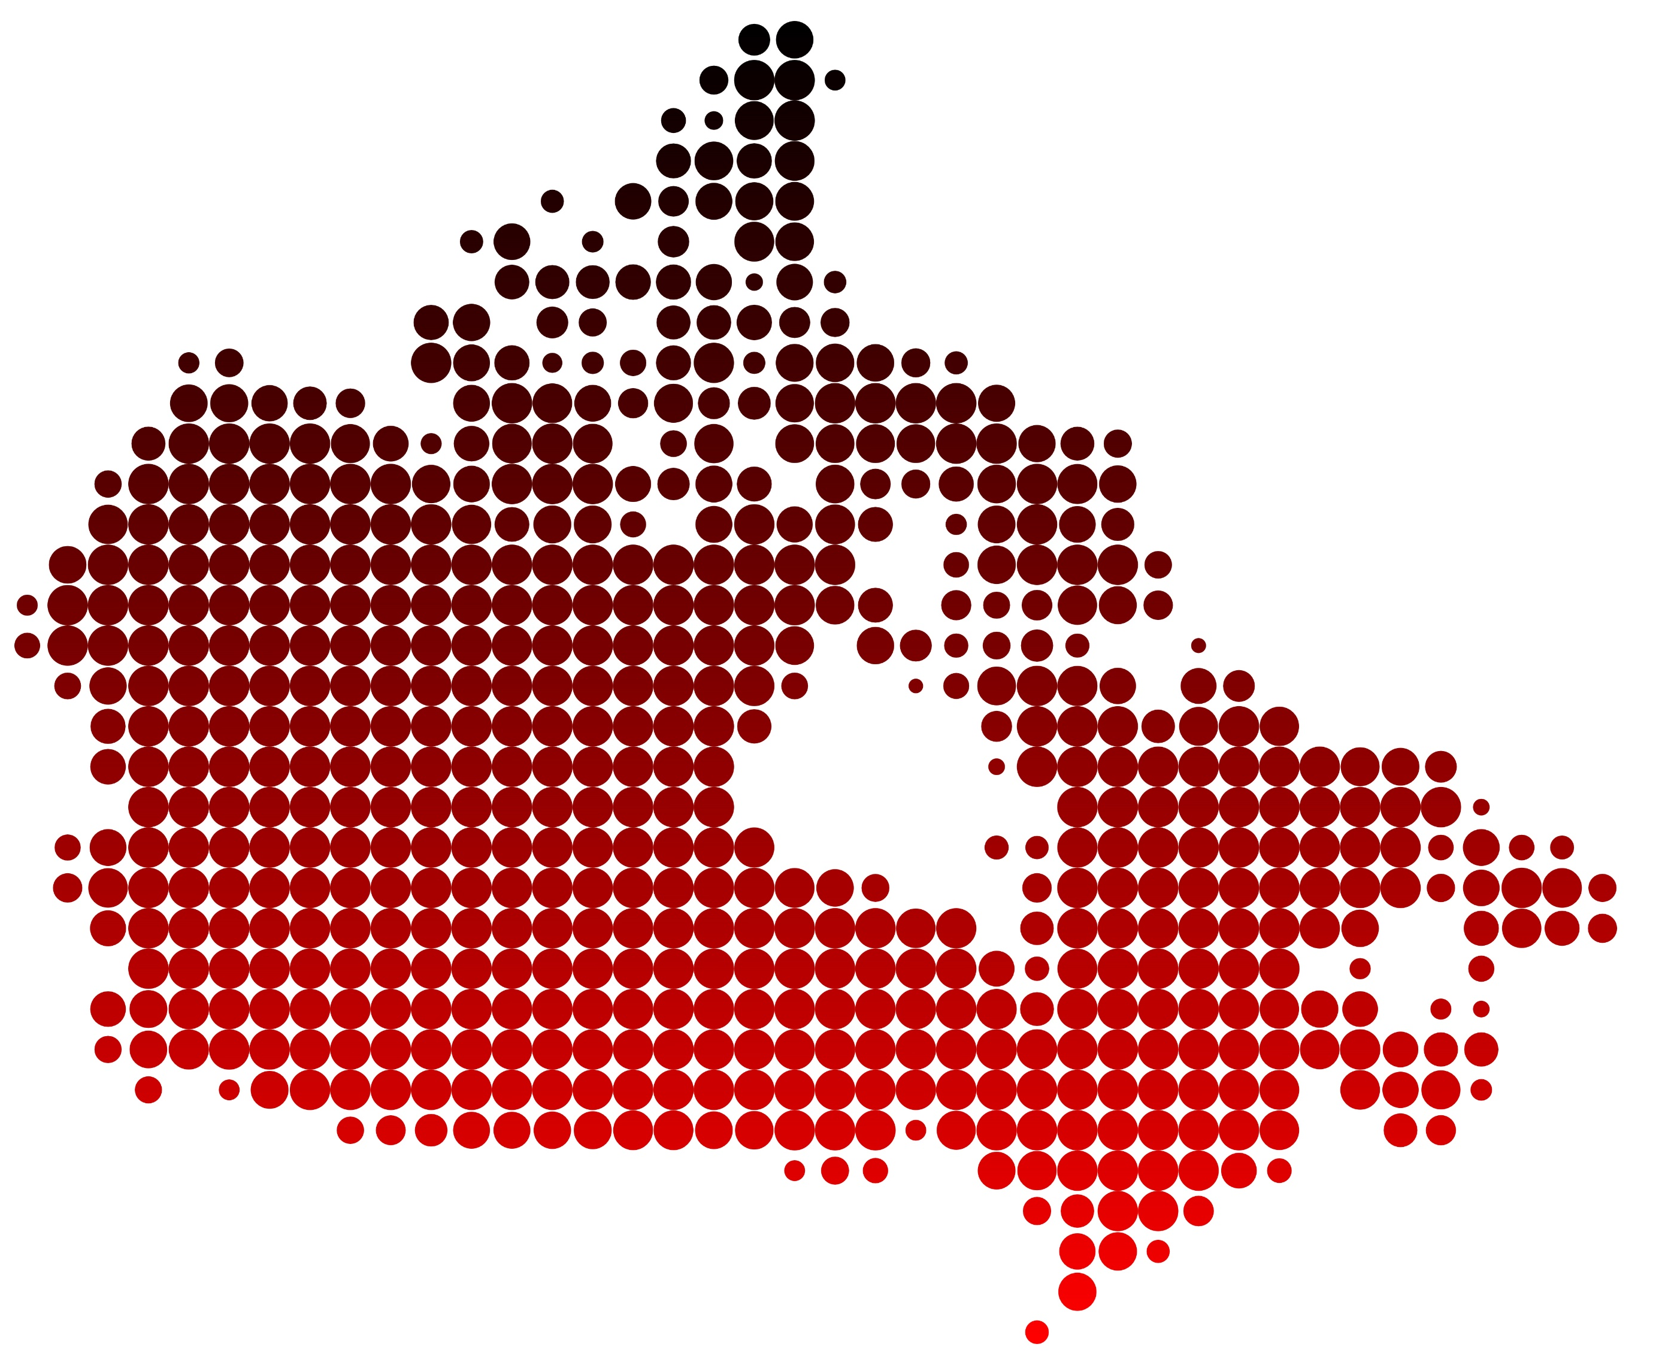
I
We’re in Trouble…
64% of Canadians are currently overweight or obese. That’s over 6 in 10 adults who carry around extra weight every day!
Five million Canadian adults have high blood pressure.
Approximately 40% of Canadian adults have high cholesterol.
It is estimated that Canadians consume approximately 10% of their total calorie intake from saturated fats.
Over 2 million Canadians have diabetes.
Notes:
Main points:
-go over stats
-inactivity has been attributed to many of these ailments! The sad thing is we have AND make the choice everyday to MOVE or NOT!
-physically, our bodies can’t handle afford to keep supporting our rising weight…look at our lower back problems, diabetes rates, and heart disease problems all stemming from sedentary living, obesity, and hypertension. It’s a question of survival of the species. If we don’t change something, our futures are bleak!
https://www.canada.ca/en/public-health/services/publications/healthy-living/obesity-excess-weight-rates-canadian-adults.html
https://www150.statcan.gc.ca/n1/pub/82-625-x/2015001/article/14184-eng.htm
https://www150.statcan.gc.ca/n1/pub/82-625-x/2018001/article/54982-eng.htm

Slide 5
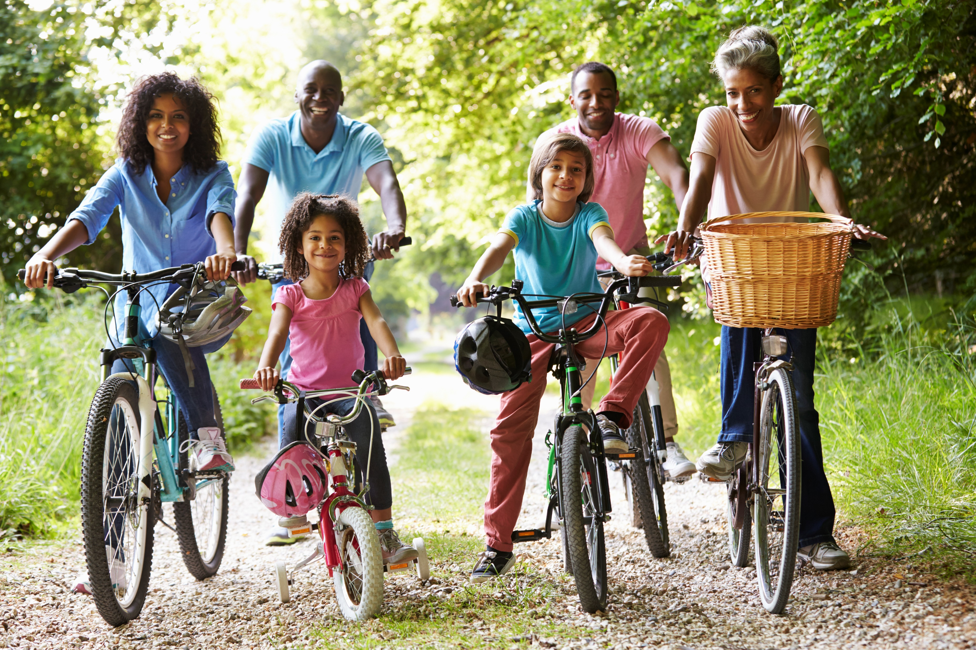
I
Break Down the Barriers
Are Structured Exercise Programs Good?
Lack of time for a structured workout.
Schedule your workouts.
Sometimes too threatening psychologically.
Build on what you are already doing.
Nagging injuries, pain, and discomfort.
Be safe. Take it slow!
Not enjoyable enough. Too boring. Too repetitive.
Do what you like/love!
Requires too much time away from family.
Make it work with your existing priorities.
Notes:
Main points:
-has anyone encountered any of these barriers to a physical activity program? It’s more common than we think!
-or we do get “on the program” and fall off the wagon and find ourselves building up that “next Monday syndrome”….each week!
By no means would I suggest not getting on a structured program – if it works for you. For some, it does work and people are successful at it. For those – keep it up! For those who don’t/can’t/fall off the wagon, there are other things you can do to move more – leading to accumulated time of exercise that is just as beneficial. We’ll get into this next.

Slide 6
I
Every Minute Matters
Every time you perform a small amount of activity, you…
Improve circulation and help prevent stagnation.
Use muscles to burn more oxygen and calories.
Force your heart and lungs to work a little harder.
Ease stress and strengthen your bones and connective tissues.
Notes:
Main points:
So don’t worry if you can’t find 45-60 mins in your day to exercise or do a workout. Just do your best – even if it’s 2 minutes! In the course a day, those 2 minutes add up!

Slide 7
I
Every Movement Matters
Mini Movements Matter
Adding just 5 minutes of walking to every hour of work had health benefits!
Adding a 20 minute walk to your day can add up to seven years to your lifespan!
Just 15 minutes per day can relieve stress, improve concentration, enhance mood and encourage healthy sleep.
An exercise study at McMaster University found that 10 second bursts of 10 minute HIIT sessions had the same benefits of a 45 minute moderately intense exercise session.
It’s worth scheduling mini movements!
Notes:
Work Walk Work - The researchers studied 30 sedentary adults under three different conditions: six hours of uninterrupted sitting, 30 minutes of moderate-intensity treadmill walking in the morning followed by six hours of uninterrupted sitting, and six hours of sitting with five-minute moderate-intensity treadmill walking sessions added each hour.
Both the morning treadmill session and the five-minute sessions increased participants’ energy, but only the hourly activity led to improved mood, decreased levels of fatigue and reduced food cravings at the end of the day. https://www.nytimes.com/2016/12/28/well/move/work-walk-5-minutes-work.html
Add 3 to 7 years to your lifespan - https://www.independent.co.uk/life-style/health-and-families/health-news/a-daily-walk-can-add-seven-years-to-your-life-10478821.html
Feeling down, stressed or not sleeping well? Take a walk, do some yoga, go for a short run. https://www.shapefit.com/exercise/15-minutes-exercise-every-day-stay-healthy.html
10 second bursts - https://www.cbc.ca/news/canada/hamilton/headlines/the-1-minute-workout-how-to-get-fit-in-60-seconds-mcmaster-study-1.3555420

Slide 8
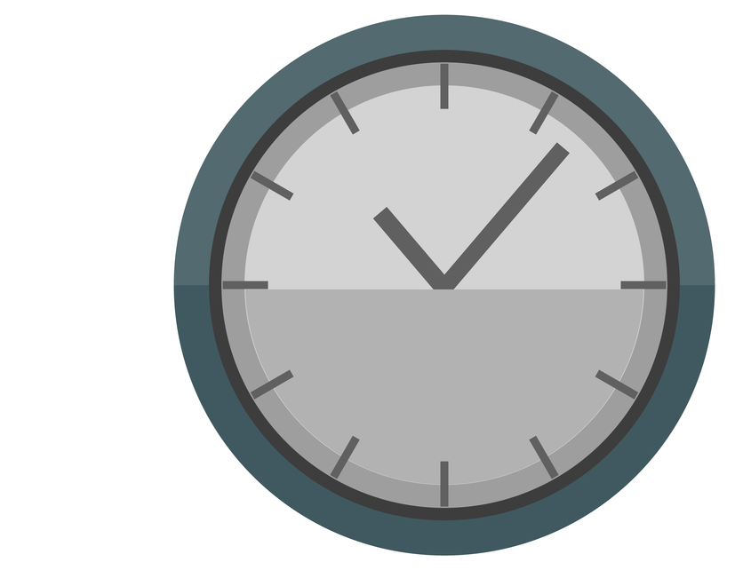
I
It’s Time…
43 minutes is just 3% of your day!
Just 3%
24 hour day
Notes:
Main points:
-43 minutes per day….can you find 5-6 minutes here and there?
-what are some ways your 43 mins can add up? ASK AUDIENCE WAYS IN WHICH THEY CAN ACCUMULATE EXERCISE…
-park farther away
-walk to do errands
-get up and stretch/walk every 15 mins [when possible]
-drop kids off at sporting event and get some steps in
-others????

Slide 9
What Will it Take to Lower my Risk?
I
0-1000 steps/day
[highest death rate]
0 minutes/day
0%
It all adds up!
2000 steps/day
15 minutes/day
1%
Mortality rate
2%
4000 steps/day
29 minutes/day
3%
5%
4%
6000 steps/day
43 minutes/day
10000 steps/day
[lowest death rates]
72 mins/day
8000 steps/day
58 minutes/day
Physical Activity Level
Notes:
Main Points –
-go over how to read this graph….
-mortality rates decrease with an increase of physical activity [accumulated or longer timeframes]
-largest slope = 15 minutes/2000 steps/day or 1% of your 24-hour day…..
-6000 steps/43 minutes per day = best chance at lowering mortality rates [marginal differences with longer time/more steps]
-fit in what you can…it all adds up!

Slide 10
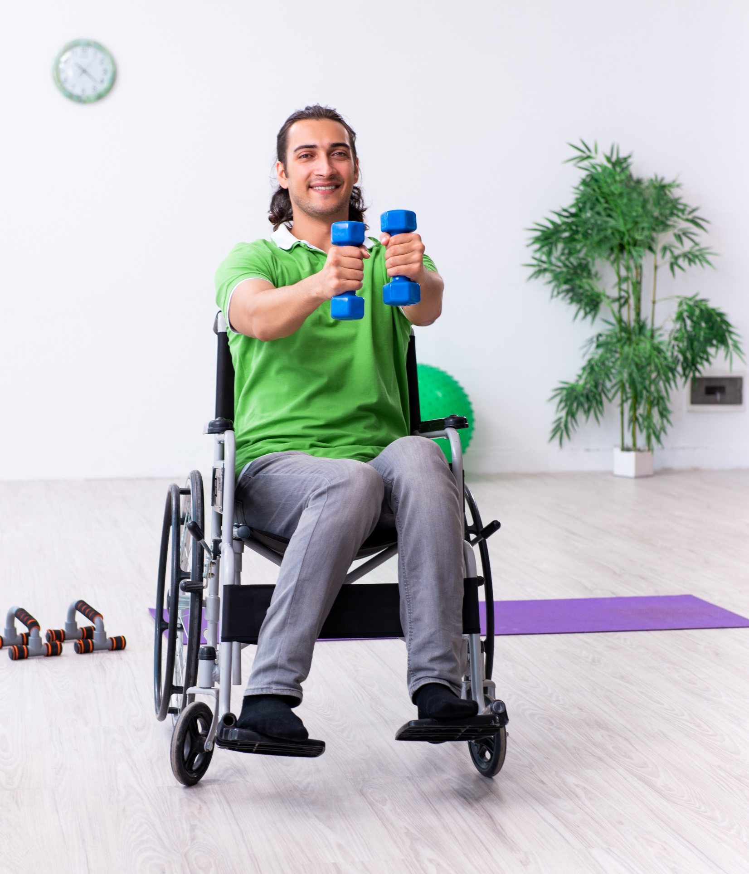
Did You Know?
I
The Canadian Physical Activity Guidelines recommend a minimum of 150 minutes of physical activity per week.
10 minutes or 30 minutes - It doesn’t matter!
Frequency, intensity, and consistency can improve cardiovascular fitness in 2 weeks!
Break it down:
50-minute sessions - 3 days a week
30-minute sessions - 5 days a week
Two 15-minute sessions - 5 days a week
Two 10-minute sessions - 7 days a week

Slide 11
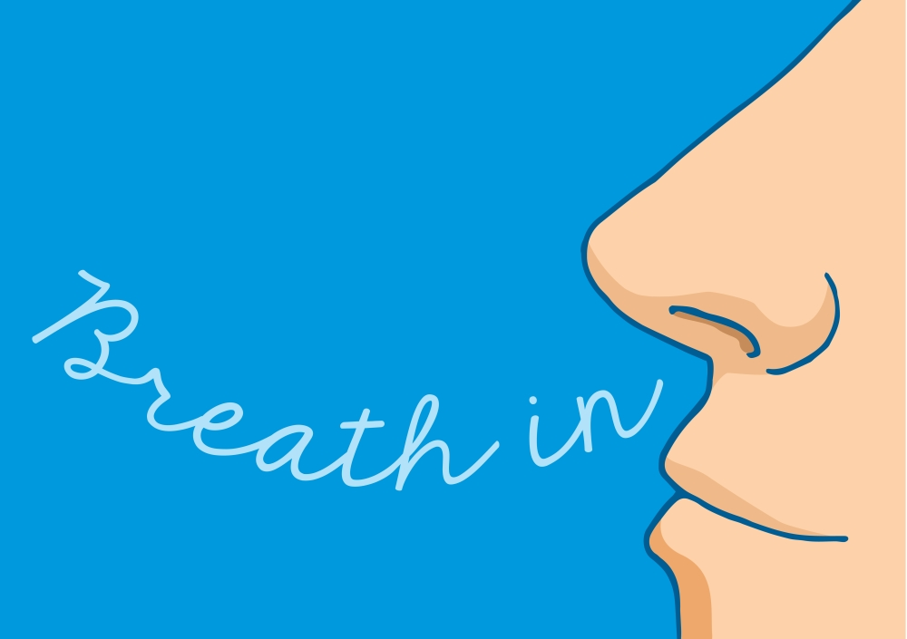
Why Move?
I
Oxygen is Free. Get as Much as You Can!
The more oxygen you process, the more fat you burn, and the more energy produced for muscle movement.
1 minute of moderately elevated breathing (walking one block) burns 5 extra calories.
Work harder and the body burns extra fuel.
Climbing a few flights of stairs/day for 2 minutes/day burns 15 extra calories.
That’s 1.5 lbs. of fat loss after 1 year!
10 - Oxygen Events Day TODAY!
Notes:
Tiny cellular structures in our muscles that act like small furnaces [burning oxygen, fat and sugar to make energy for movements]
As activity increases, so does demand for oxygen [breathe harder]
The amount of oxygen you breathe at any given time is comparable to how much fuel your furnaces are using. The greater your oxygen consumption, the greater your caloric expenditure.
Make your day a 10-Oxygen Event Day
-ASK AUDIENCE WHAT ARE SOME OXYGEN EVENTS THEY CAN THINK OF….
-pick 10 ways you can increase your oxygen today: park farther away, look for a way to take the stairs every day, quicken your step to run an errand, do some walking lunges down the hallway, walk backwards [increases caloric expenditure by 25%], avoid sitting for more than 15 consecutive minutes, add one-minute brisk walking to your walking route, swing your arms at waist-high level on your walks

Slide 12
Why Move?
I
2. Little Changes Make a Big Difference.
Small changes make the difference.
Arm position matters. Be a swinger! (Sweetgall study)
No arm swing = 100 steps in one minute
Pendulum swing = 116 steps in one minute
Bent-arm swing = 125 steps in one minute
Take a look at all the small things you can do to make a significant difference in your overall weight.
See handout
Let’s slow the slope
of Canadian obesity stats!
Notes:
ARM POSITION MAKES A DIFFERENCE…
-hands held together in front = least distance
-arms swing while straight = little more distance
-arms bent at elbow while walking = most distance
STUDY – Robert Sweetgall’s book – walking off weight
Refer to handout looking at some of the small things people can do to make big differences.

Slide 13
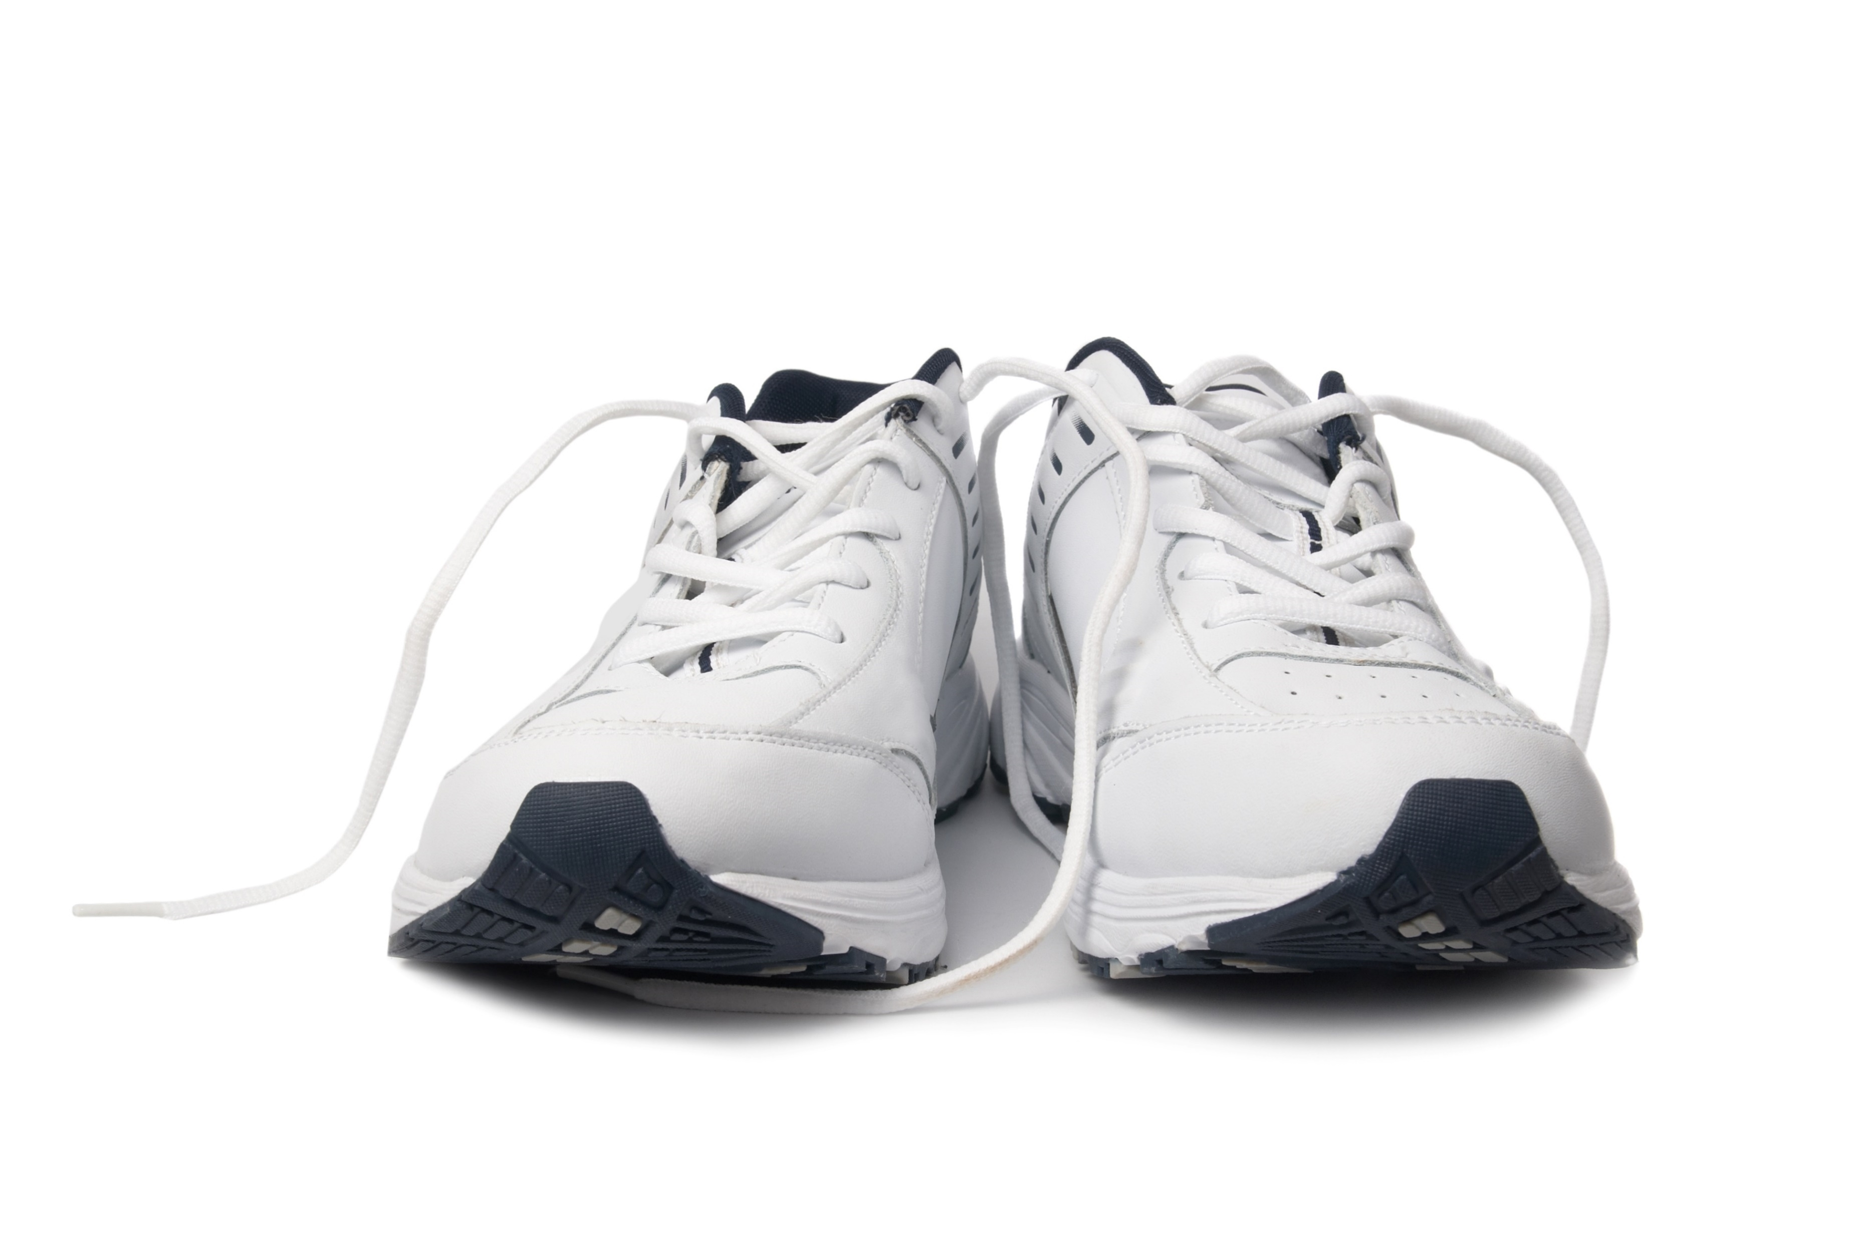
Why Move?
I
3. It Aids in Digestion. Start With a Walk After Meals.
Walking after meals is the best remedy for post-meal sluggishness.
After a meal, wait at least 10 seconds before walking.
The difference between sitting still or walking a few minutes after every meal is a 2-inch difference on your waistline after a year of 1000 meals.
Why?
Relieves bloating and aids digestion.
Keeps you from being tired after eating.
Suppresses desire for more food/dessert.
Provides double-elevated metabolism:
movement and digestion.
Notes:
It is expected that, in 10 years, diagnosed diabetes will rise by 31%.
Diabetes can reduce lifespan by five to 15 years.
Every year diabetes contributes to:
30% of strokes
40% of heart attacks
50% of kidney failure
70% of non-traumatic lower limb amputations
https://www.diabetes.ca/DiabetesCanadaWebsite/media/About-Diabetes/Diabetes%20Charter/2019-Backgrounder-Canada.pdf

Slide 14
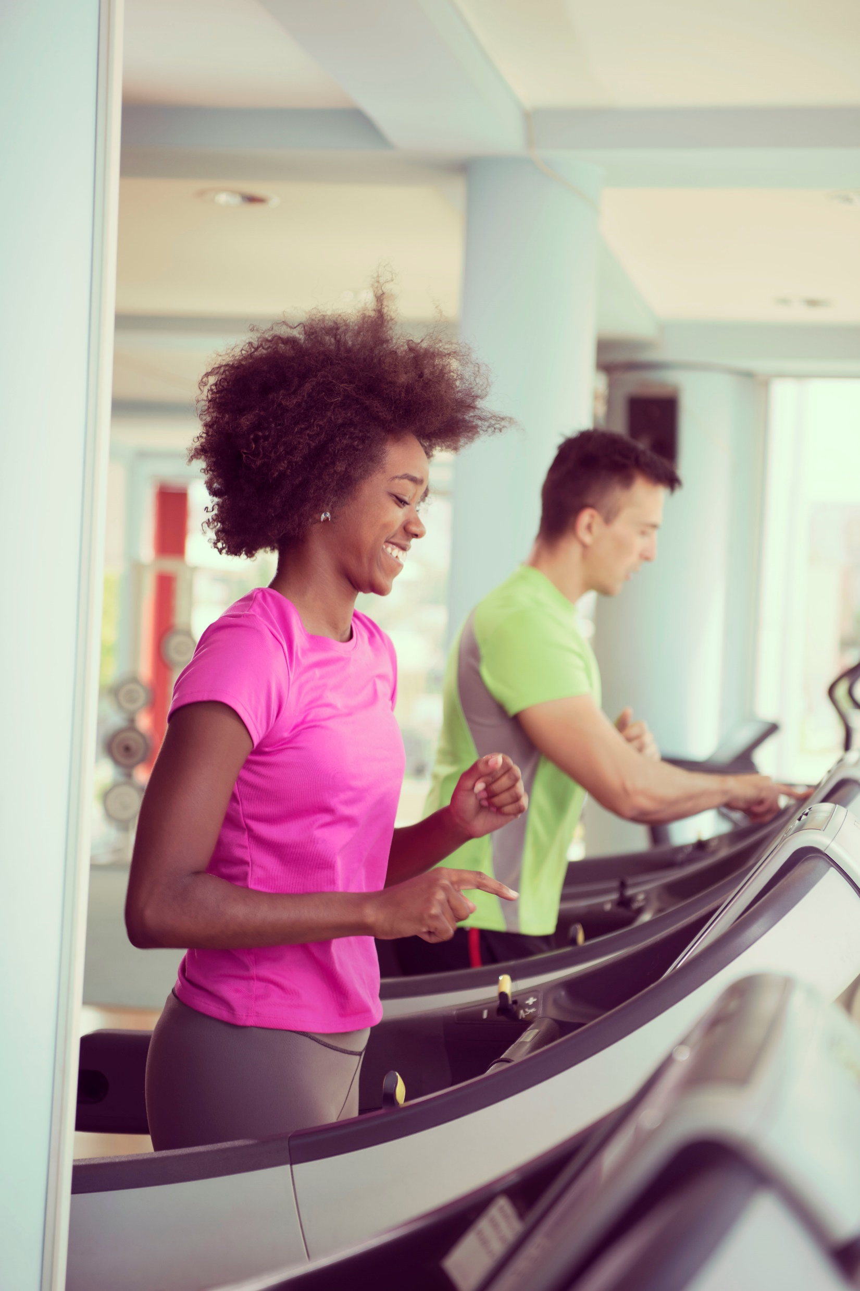
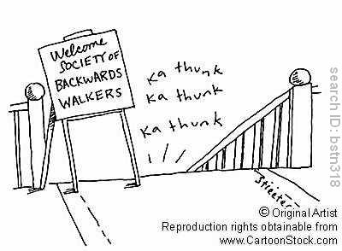
Why Move?
I
4. It’s Great for Weight Loss/Maintenance.
The “Sugar” Walk
The “Morning” Walk
The Middle-Speed Walk
Muscle-Toning Walks
Penguin walk, Backwards walk, etc.
Notes:
Refer to handout looking at some of the small things people can do to make big differences.
Sugar walk – for every M&M, it’s one football field to burn. Think of that next time you eat a sweet/sugar! If you are going to indulge in a desert or a sugary snack, either walk first and enjoy after as a reward OR walk first then enjoy! Think of this when you go out for dinner/dessert.
https://www.prevention.com/fitness/a20477045/healthiest-walking-workout-for-diabetics/
Morning walk – early morning = residual caloric burn for entire day; most likely to get it done vs later in the day [lots of distractions]; eat a light breakfast before so you’ll have the kick in your step to really get lots out of that walk! Can lower blood pressure. Exercising on an empty stomach, after an over-night fast, won’t give you the same effect….the more pep in your step, the better!
https://www.ajc.com/lifestyles/health/study-morning-walk-can-lower-blood-pressure-well-meds-can/9FgBUhje0Jb7n4ZUEuDbsN/
Middle-Speed walk – what is your fastest pace? Take 10-15% off of that and that is your middle-speed. It’s the speed at which you can walk with less discomfort. Your heart and breathing rates should still be elevated. Walking longer rather than faster is most important for weight loss. HR should be 60-65% MHR.
Ie: 40-50 yrs. = MHR is 170-180 bpm. 60-65% = 110-120bpm
Pace that is most comfortable may increase as your fitness levels do.
Muscle Toning Walks – build leg muscle – more efficient body/machine!
Penguin walk – tie TheraBand around legs – shuffle front, back, both sides. Do 1 min intervals at a time.
Backward walk – highlights hamstrings and calves – burns 25% more cals than front walking. Balance/falling issues – don’t do it!
Read cartoon for the backward walk…..

Slide 15
Why Move?
I
5. It’s Great for Stress Reduction.
The Money Collector Walk
The Meditation Walk
The Let It Go Walk
The Burn Rubber Walk
The Gratitude Walk
Notes:
Money Collector walk – walk until you find a coin – add it to a coin jar.
Meditation walk – concentrate on posture, breathing, your arm swing
Let it Go walk – concentrate on the stresses in your life that you worry about but what you can’t change/control. Come to the realization that you can’t control them and accept that it’s OK to let it go!
Burn Rubber walk – fast, intense walk when you’re angry/frustrated. Climb stairs, walk fast [with that exaggerated arm swing!], walk up hills
Gratitude walk – walk while only thinking about what you’re grateful for. Do this at least once/week for 15-20 mins. Stress levels and hormones will decrease with these walks!

Slide 16
I
Some Things to Think About
Acquiring about 5000 steps a day or 30 minutes of walking = 15 pounds of weight loss in a year.
For every minute you walk, you extend your life an extra 2 minutes.
If you walk 2000-2500 cals/week, that’s approximately 115,000 cals/year = 33 extra lbs. of weight loss/year.
By walking 2000-2500 cals/week, an average middle-aged person extends life by 2 years (Harvard Alumni Study).
You can expend 30-100 more calories/hour by standing rather than sitting. Think of how much more you can fit into your day while standing?
Notes:
Main points:
-it’s easy to get in extra steps once you try.
-try taking the long way to the bathroom at work, take the stairs, walk to work, park further away…
-a few extra steps here and there burns more calories without you hardly noticing any extra effort.
It all adds up
Pedometers can be purchased for under $10 and are fairly accurate. Gives you an estimate at least so you can challenge yourself to add more and more steps each day. Challenge a co-worker or family member!
Breakdown:
5000 steps = 30minute of walking
30min of walking = approximately 150 cal.
Yearly: 150x7 = 1400
1400x52 = 54 600
If 1lb = approximately 3500 calories, over a year you could lose up to 15lbs simply by consistently increasing your steps everyday!

Slide 17
Summary
I
Strive for dedicating 3% (43 minutes) of your day to physical activity.
Accumulating exercise is just as good as all at once!
Don’t worry about 10,000 steps/day. The greatest change in death rate is 6000 steps/day.
Make today an Oxygen Day!
Enlist in a stress-reduction and/or weight-loss walk.
Now is the time to start. Pick one strategy you’re going to start doing today!
Would you rather…..

Slide 18
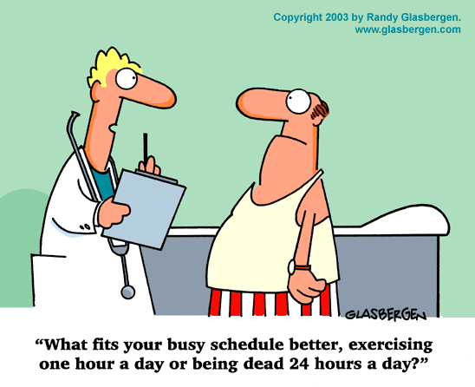
I
Prevention Strategies
www.EWSNetwork.com

Slide 19
I
Sources
It’s Your Move. Robert Sweetgall, Robert Neeves, PhD, Exercise Physiology
Ten Minute Meals, Five Minute Workouts. Darcy Williamson, Robert Sweetgall, Pat Zak, PhD.
Walking Off Weight and Workbook. Robert Sweetgall
Statistics Canada
Heart and Stroke Foundation
www.EWSNetwork.com

Slide 20
Question Time!
I
©2020 EMPLOYEE WELLNESS SOLUTIONS NETWORK INC. – ALL RIGHTS RESERVED

