Slide 1
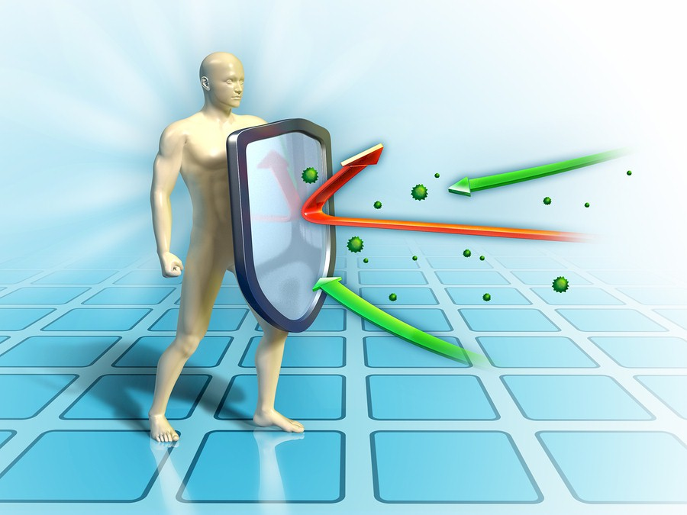
BUILDING & MAINTAINING A STRONG
IMMUNE SYSTEM
Powered by:
©2020 EMPLOYEE WELLNESS SOLUTIONS NETWORK INC. – ALL RIGHTS RESERVED

Slide 2
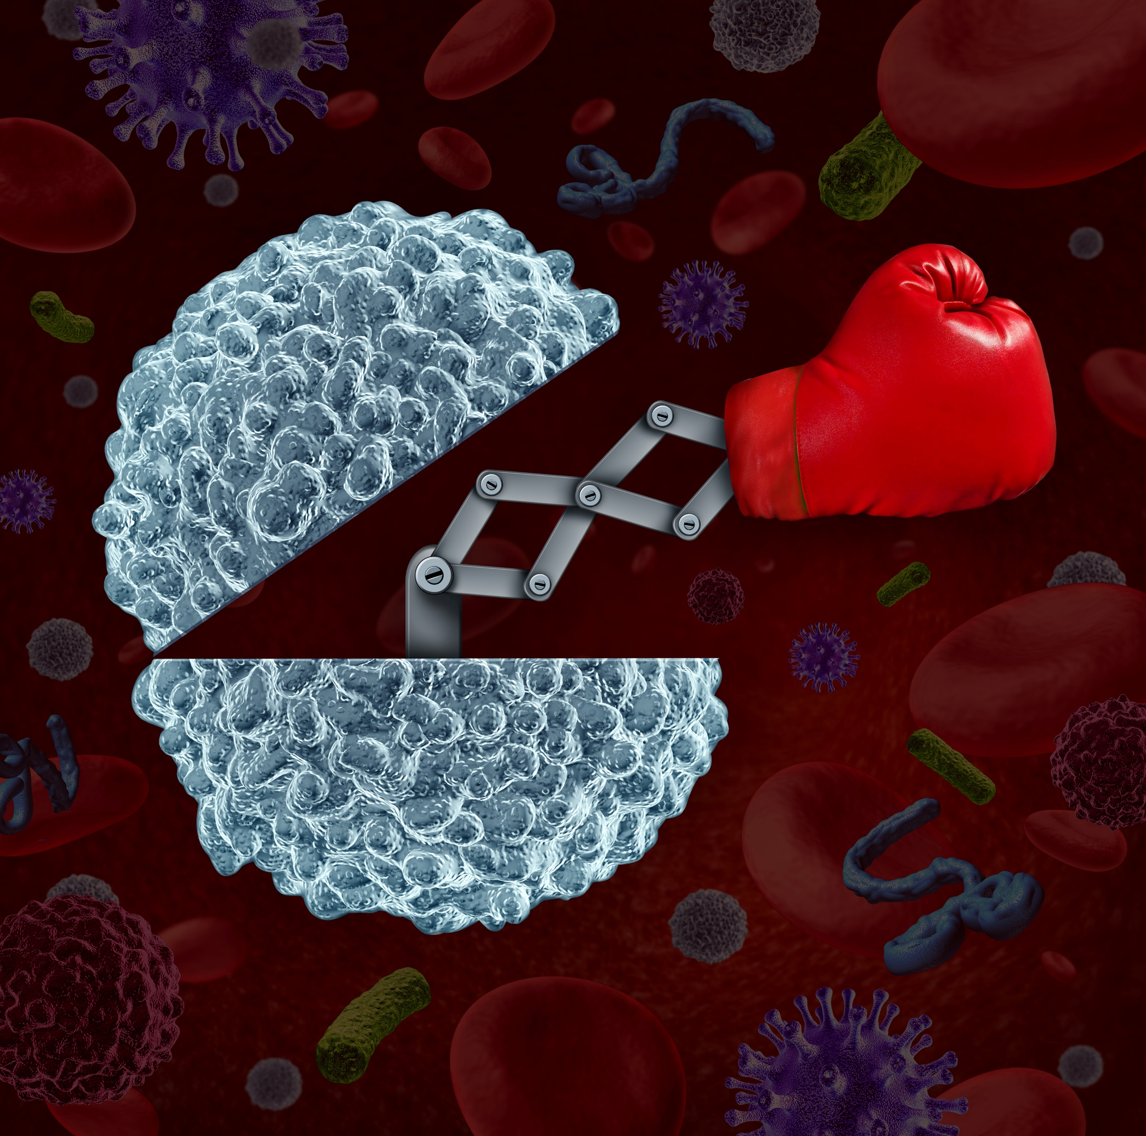
I
Immune System 101
Your immune system is designed to defend against millions of bacteria, microbes, viruses, toxins, and parasites that would love to invade your body!

Slide 3
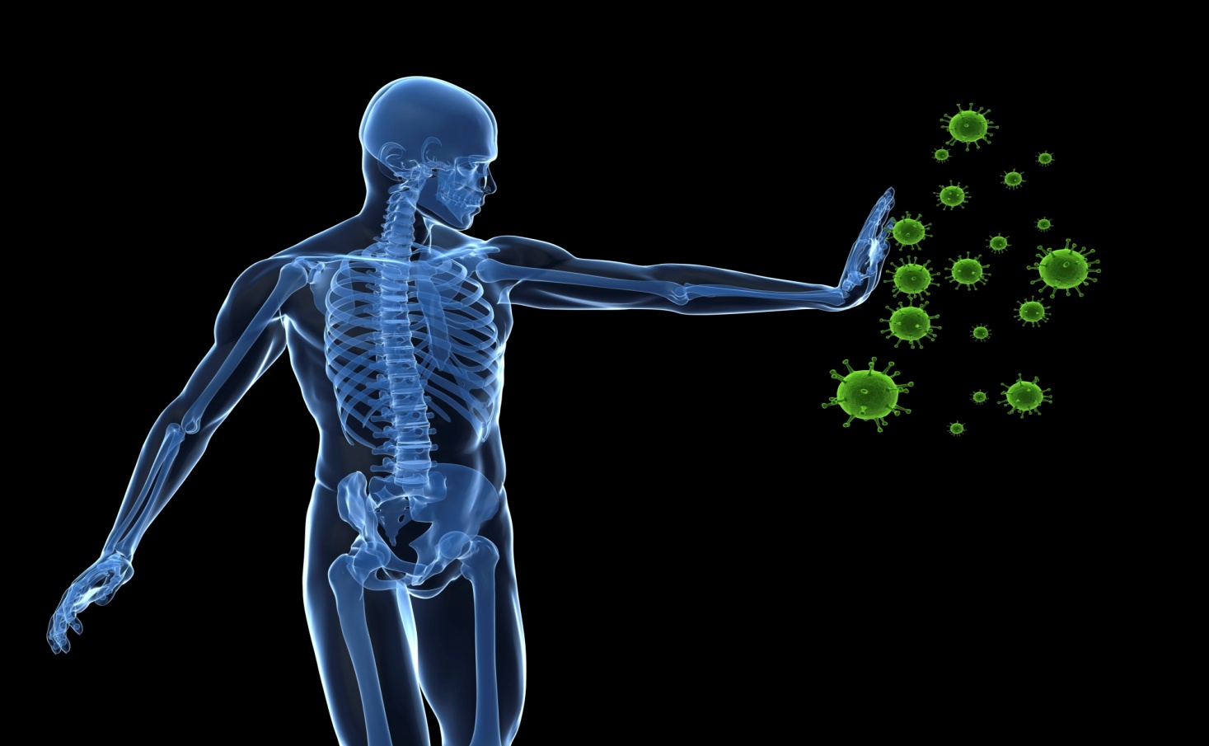
I
Your Immune System is Your Defense!
The immune system:
Recognizes the presence of infection.
Contains the infection and works to eliminate it.
Regulates itself so it does not damage the body.
Remembers pathogens to prevent diseases from recurring.
www.EWSNetwork.com
Notes:
Pathogens = a bacterium, virus, or other microorganism that can cause disease (bacteria, viruses, parasites, fungi)

Slide 4
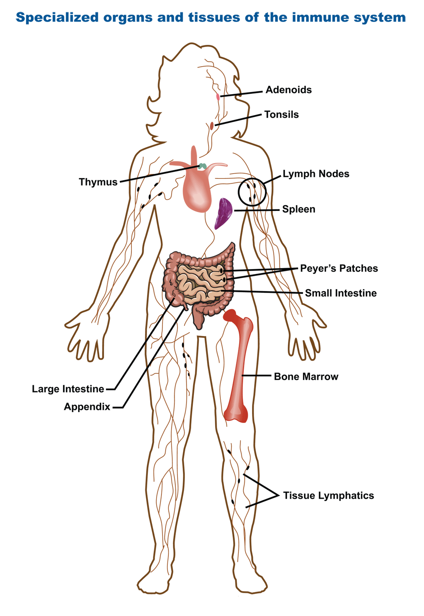
I
The Organs of the Immune System
Adenoids & Tonsils
Thymus
Lymph Nodes
Spleen
Bone Marrow
Intestines
Appendix
www.EWSNetwork.com
Notes:
Adenoids & tonsils = work together to trap allergens that are inhaled or swallowed from entering into your immune system. Adenoids are made up of cells that make antibodies to help your body fight infections
Thymus = function is to produce mature T-cells. Immature thymocytes, also known as prothymocytes, leave the bone marrow and migrate into the thymus. As they mature, T cells that are beneficial to the immune system are spared, while those T cells that might evoke a detrimental autoimmune response are eliminated. The mature T-cells are then released into the blood stream.
Lymph nodes = function as an immunologic filter for the bodily fluid known as “lymph”. Located throughout the body. Nodes drain fluid from most of our tissues. Antigens are filtered out through the lymph in the lymph node before returning the lymph to circulation. They capture antigens that present these foreign materials to T & B cells, initiating an immune response.
Spleen = an immunological filter of the blood. Made up of B cells & T cells, macrophages, dendritic cells, natural killer cells and red blood cells. This organ can be thought as an immunological conference centre. In the spleen, B cells become activated and produce large amounts of antibody. Also, old red blood cells are destroyed in the spleen.
Bone marrow = All the cells of the immune system are initially derived from the bone marrow. Bone marrow produces B cells, natural killer cells, granulocytes and immature thymocytes, in addition to red blood cells and platelets.
Intestines = large intestines are inhabited by trillions of bacteria often referred to as probiotics (pro=encouraging, biotic = life). Without probiotics, humans would be extremely vulnerable to food borne illnesses, be deficient in key nutrients and vitamins and have a much weaker immune system in general
Appendix = a “safe house” for the beneficial bacteria living in the human gut. Populated with different microbes that help digestive system break down the food we eat. In return, the gut provides nourishment and safety to the good bacteria.

Slide 5
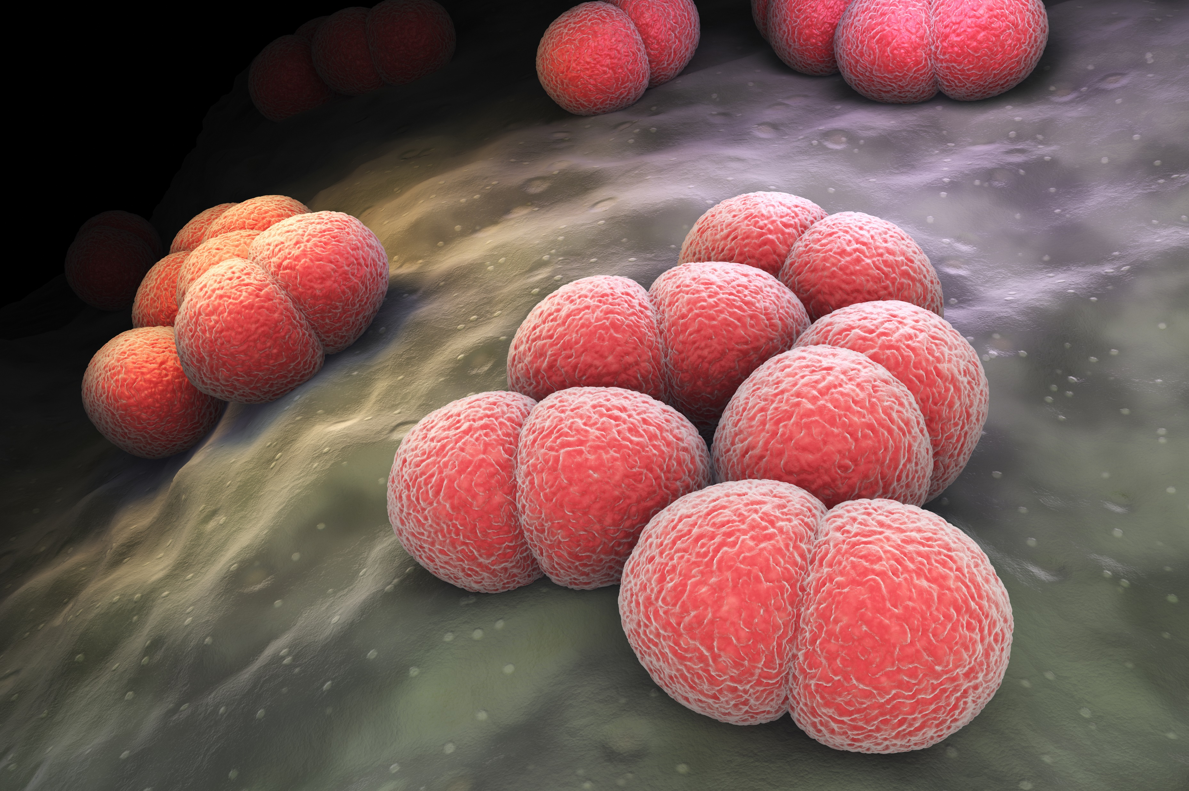
I
A Balanced Immune System
www.EWSNetwork.com
Notes:
The immune system is our protector against harmful pathogens both in our internal and external environment. Boosting the immune system can help to keep your immune system functioning well at the times when you need it most. Sometimes the immune system can over react, causing autoimmune issues and disease. This is when the immune system is in overdrive and begins to attack its own cells. An immune underreacion is a state where the immune system is suppressed or weakened leaving your body more susceptible to bacteria, virsues, infections, and even cancer. You can always rely on healthy lifestyle factors like Nutrition, Exercise, Sleep and Stress Management to create a balanced immune system. It is best to focus on simple strategies that help to modulate the immune system and help to bring it back into balance. This way we end up with an immune system that is strong and efficient without causing any negative side effects.

Slide 6
I
Nutrition & The Immune System
Keys to a
Healthy Immune System
Protein
Antioxidants
Essential Fatty Acids
Vitamins
Minerals
www.EWSNetwork.com
Notes:
Research over the past ten years has shown that nutrition plays a major role in supporting the production and action of both the cells and the soluble factors of the immune system.
You can ensure your body and immunity run smoothly by including plenty of colourful fruits & veggies & 8-10 glasses of water per day. You can help your immune system get stronger by adding a variety of immune-boosting foods such as….(next slide)

Slide 7
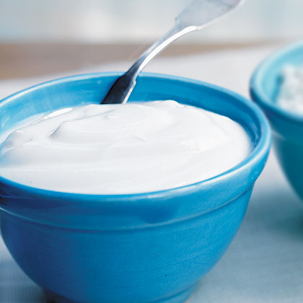
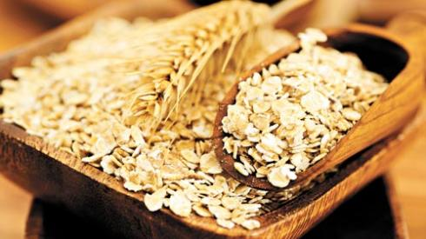
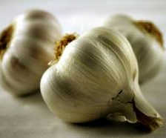
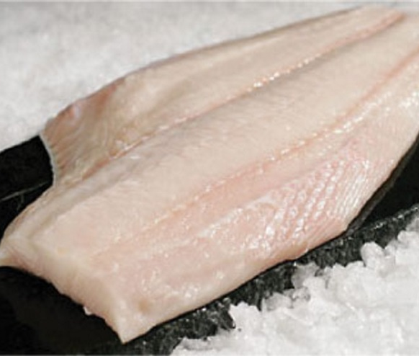
I
Nutrition: Foods for Immunity
Garlic
Contains the active ingredient allicin, which fights infection and bacteria. Add crushed garlic to your daily cooking.
Recommendation:
2 cloves per day
Fish
Salmon, mackerel, and herring are rich in omega-3 fats, which reduce inflammation, increasing airflow and protecting lungs from colds and respiratory infections.
Recommendation:
2 servings per week
Fermented Foods
The live active cultures in yogurt and fermented foods are healthy bacteria that keep the gut and intestinal tract free of disease-causing germs.
Recommendation:
Include fermented foods in your daily diet.
Oats & Barley
These grains contain beta-glucan, a type of fibre with antimicrobial and antioxidant capabilities more potent than echinacea.
Recommendation:
Include in your daily diet.
www.EWSNetwork.com

Slide 8
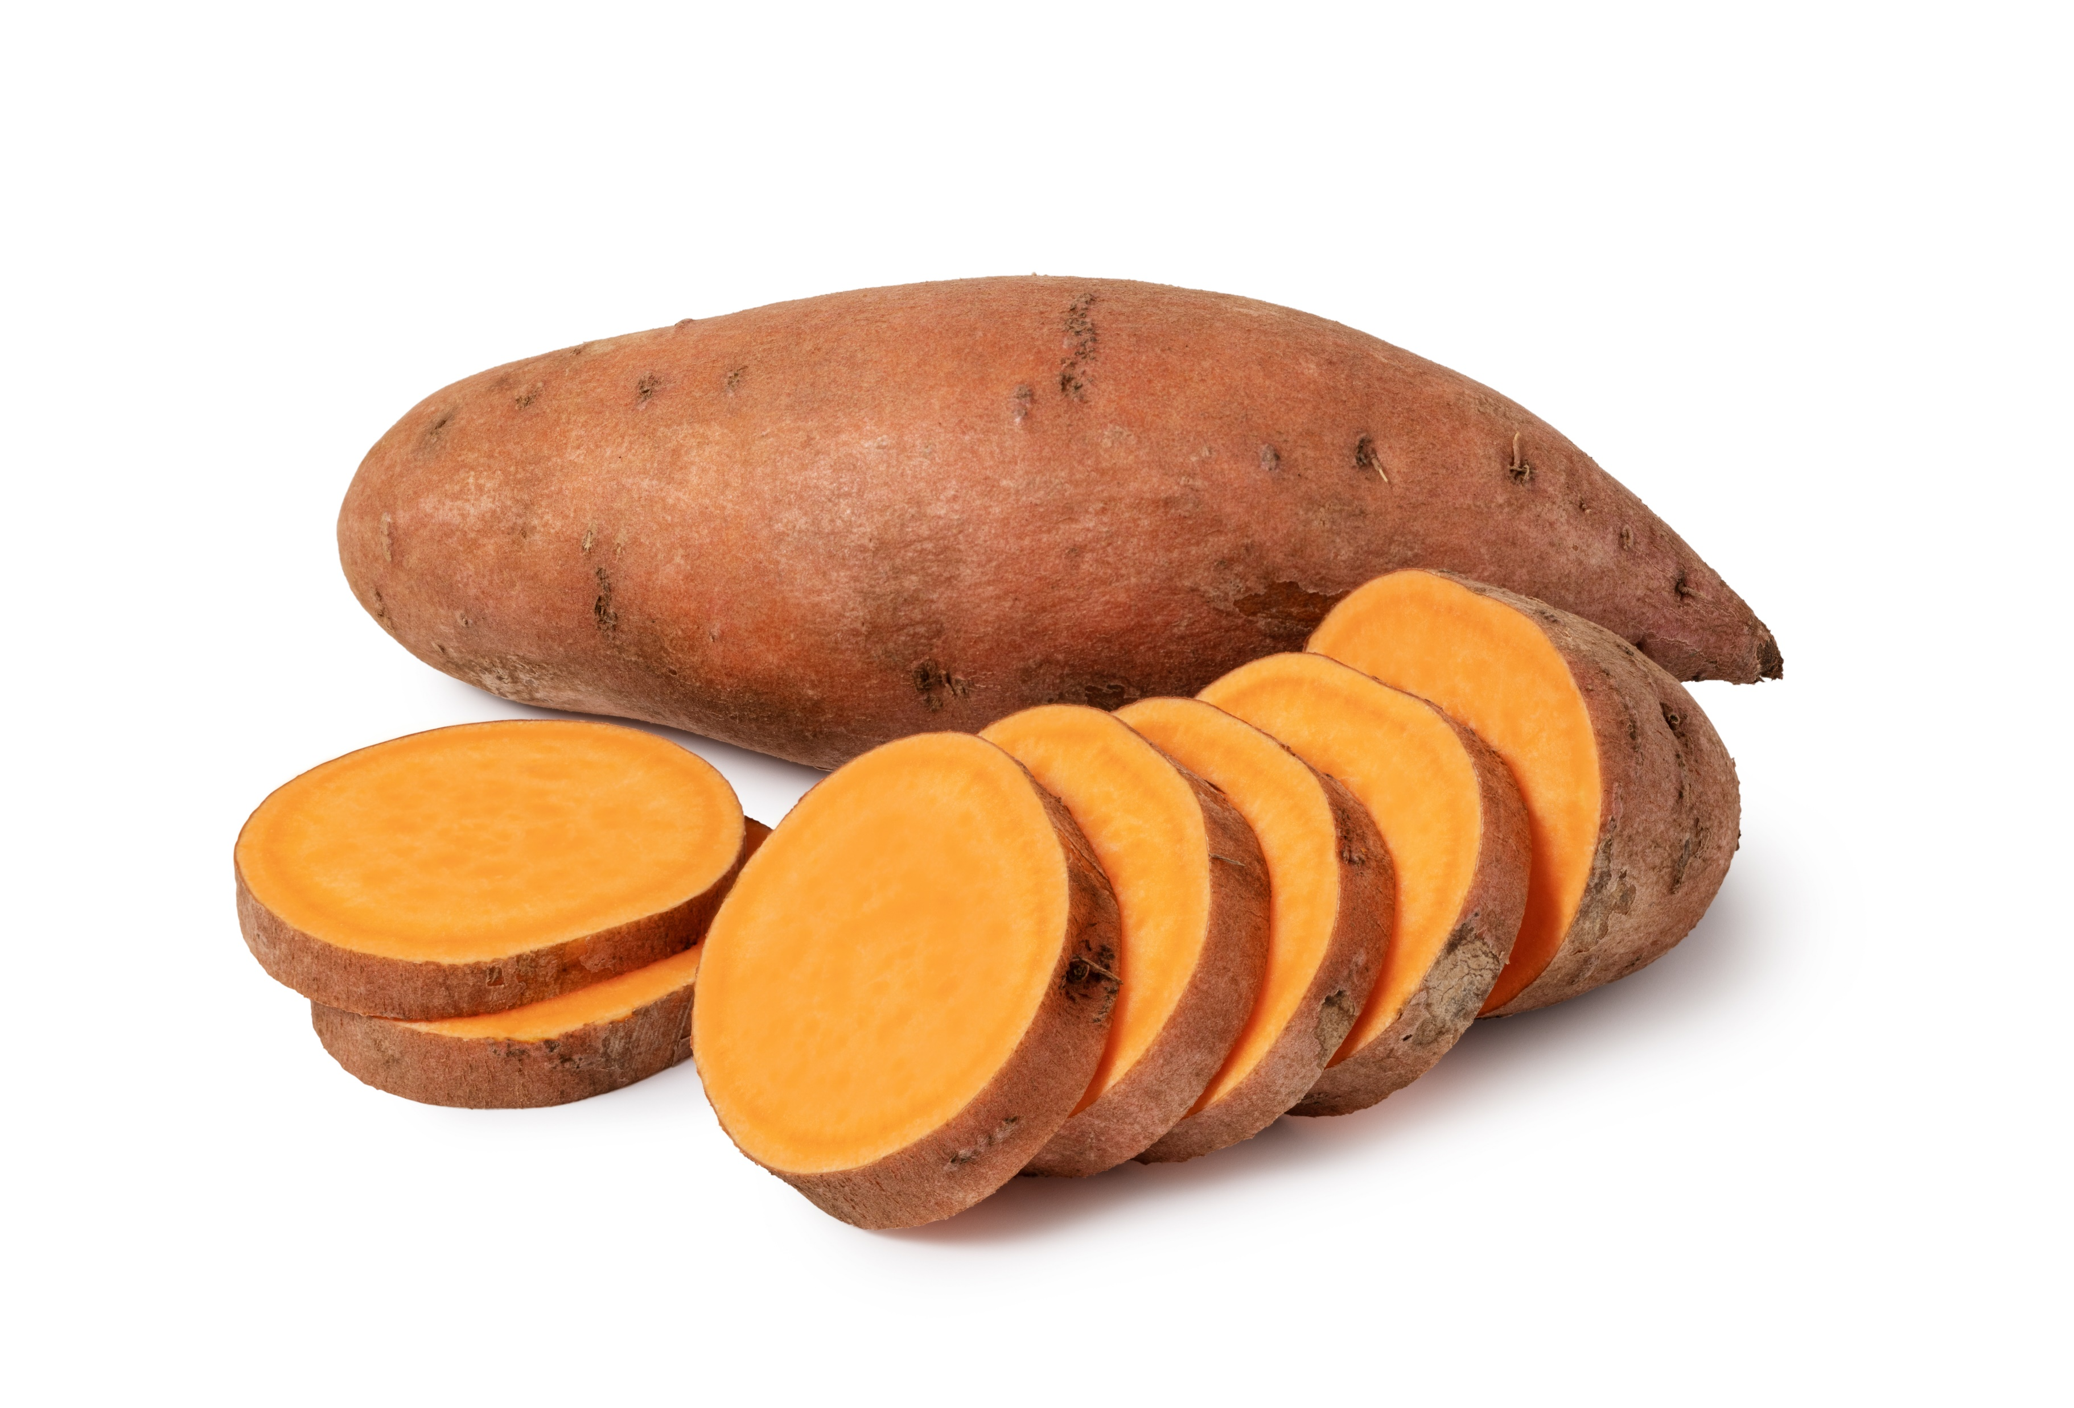
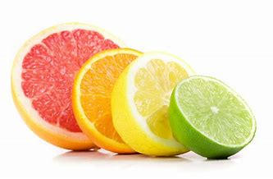
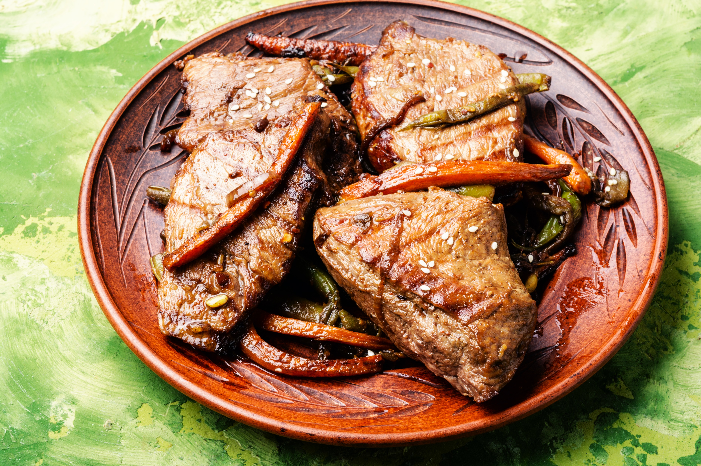
I
Nutrition: Foods for Immunity
Sweet Potato
Orange vegetables contain beta-carotene/ vitamin A. These are important for healthy mucus membranes of the intestinal and respiratory tracts that stop the entry of foreign bacteria.
Recommendation:
A half cup serving daily
Citrus
A good source of vitamin C to boost the immune system. Also a source of citric acid which may help to loosen mucous and phlegm in respiratory illness or infection.
Recommendation:
At least 1 serving daily
Beef, Poultry, Beans
These foods contain zinc which is important for development of white blood cells. They help to build immunity and neutrophils for healing.
Recommendation:
Include in your daily diet
Green Tea
Contains the amino acid
L-theanine which can improve immunity mostly because of its ability to build a resistance to stress.
Recommendation:
2 servings a day
www.EWSNetwork.com
Notes:
Other great immune-boosting foods:
Tea – the amino acid, L-theanine, is abundant in both black and green tea – decaf versions have it too. Optimal dosage is several cups daily.
Beef – contains zinc which is important for development of white blood cells. Optimal dosages is a 3oz serving of lean beef provides about 30% of DV for zinc. (Zinc can also be found in oysters, fortified cereals, pork, poultry, yogurt & milk.
Sweet potatoes – good source of Vitamin A, which your skin relies on to stay strong & healthy. Skin serves as first line fortress against bacteria, viruses and other undesirables. Optimal dosage is a half cup serving and 40% of DV of vitamin A.
You can assure your daily dose of many of these immune boosting foods by making Grandma’s Chicken Soup! You will find the recipe in your handout.
And don’t forget Grandma’s homemade chicken soup!
https://health.onehowto.com/article/what-are-the-best-vegetables-to-boost-your-immune-system-8758.html

Slide 9
Exercise & The Immune System
I
Exercise can boost your immune system and help your body fight off harmful diseases, colds, and infections.
Notes:
Recent studies have shown that if you complete moderate exercise just a few times every week, you can drastically reduce the number of colds that you get every year. Outside of just keeping you in shape and helping you to become healthier over time, exercise can boost your immune system and help your body fight off harmful diseases and colds/infections.

Slide 10
I
Exercise: Be Regular
Regular exercise will:
Strengthen your heart.
Better equip your lungs at handling oxygen and distributing it to the rest of your body.
Provide a boost to the cells in your body that are assigned to attack bacteria.
www.EWSNetwork.com
Notes:
Beware of over-exercising! Too much exercising can actually cause your immune system to weaken. In order to avoid having this effect on your immune system, make sure that you get enough rest for your body.

Slide 11
I
Sleep & The Immune System
Not getting enough sleep has been linked to a number of mental and physical health problems, including those that stem from an impaired immune system.
www.EWSNetwork.com

Slide 12
I
Sleep: It Matters!
T-cells go down if we are sleep-deprived and inflammatory cytokines go up, which could potentially lead to greater risk of developing a cold or flu.
Loss of sleep also plays role in fighting illnesses and infections when we have them.
Try to get 7 to 9 hours of sleep per night in order to help keep your immune system working at its optimal condition.
www.EWSNetwork.com
Notes:
Bodies fight infection with fever and fevers tend to rise at night while we sleep. If we are awake, fever reaction may not be primed and not waging war on infection as best as possible.

Slide 13
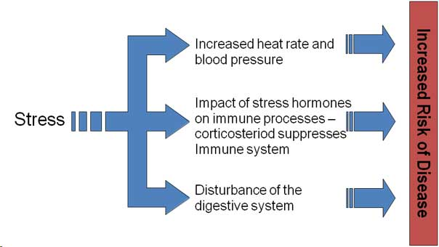
I
Stress & The Immune System
The long-term activation of the stress-response system – and subsequent overexposure to cortisol and other stress hormones – can disrupt almost all of your body’s processes. This puts you at increased risk of numerous health problems.
www.EWSNetwork.com
Notes:
Go over points

Slide 14
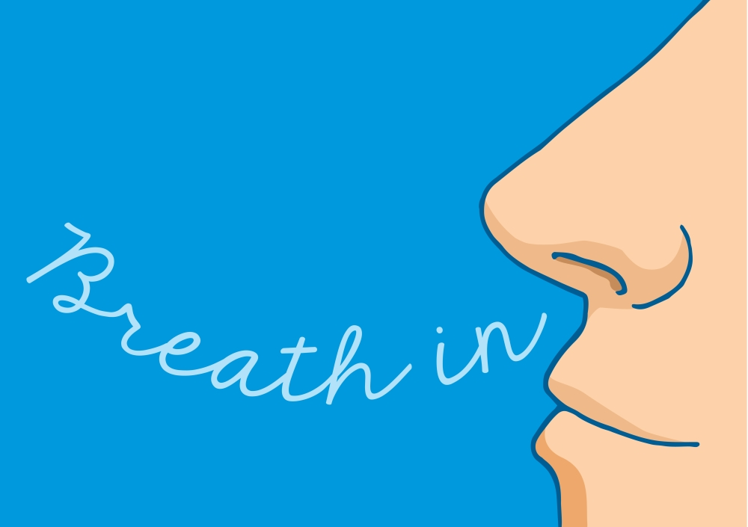
I
Stress: Take Care Through Self-Care
It is important to learn how to incorporate stress management techniques into your daily life. Here are some suggestions to get you started.
Practice deep breathing and learn to meditate
Foster healthy friendships
Have a sense of humour
Write in a journal
Seek professional counselling when needed
Exercise
www.EWSNetwork.com
Notes:
Go over points

Slide 15
I
You are Your Best Defense!
Your immune system needs your help in order to work at its optimal levels.
By incorporating the right foods and regular exercise and working to get enough sleep and manage your stress levels, you can reduce your chances of catching colds and flus and avoid more serious health problems.
You and your family deserve to live your best lives possible and a strong immune system will help all of you to do just that!
www.EWSNetwork.com
Notes:
Direct them to the handout. Tak

Slide 16
Question Time!
I
©2020 EMPLOYEE WELLNESS SOLUTIONS NETWORK INC. – ALL RIGHTS RESERVED

