Slide 1
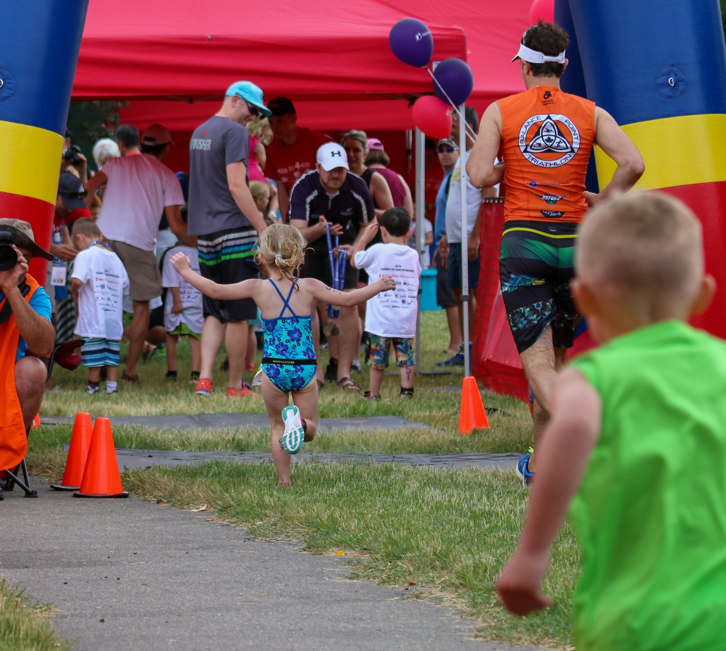
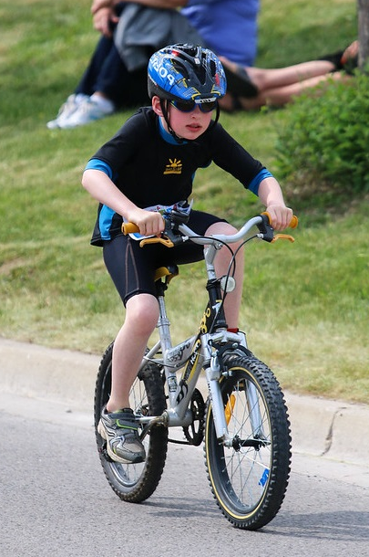
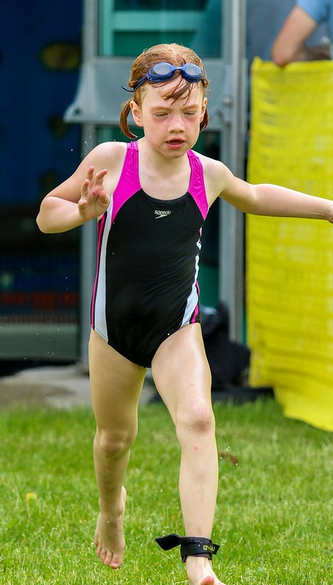
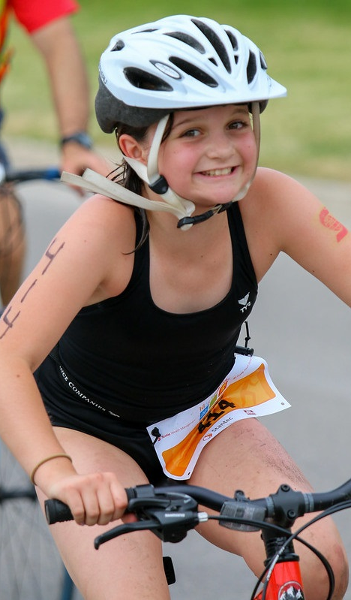
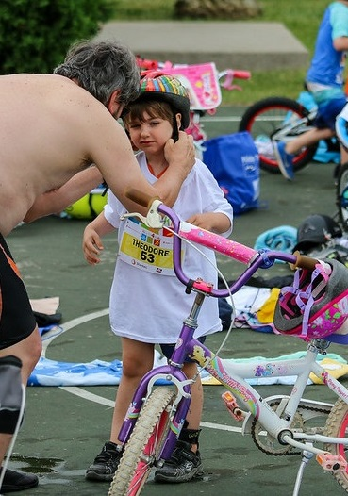
LONDON KIDS TRIATHLON is back!
GLHA give it a TRI!
Sunday June 14th , 2020
(Ages 3-15)
The most fun you and
your TEAM will ever have!
SWIM - BIKE - RUN for YOU!
Register at www.londonkidstriathlon.com
Presented by:
Supporting:

Slide 2
LONDON KIDS TRIATHLON is back!
LondonTFC give it a TRI!
Sunday June 14th , 2020
(Ages 3-15)
The most fun you and
your TEAM will ever have!
SWIM - BIKE - RUN for YOU!
Register at www.londonkidstriathlon.com
Presented by:
Supporting:

