Slide 1
Seasonal Affective Disorder
Getting Through the Dark Months
Notes:
Images by freepik

Slide 2
Overview
An introduction to SAD
Symptoms and causes
Risk factors
Treating SAD
Other ways to help with SAD

Slide 3
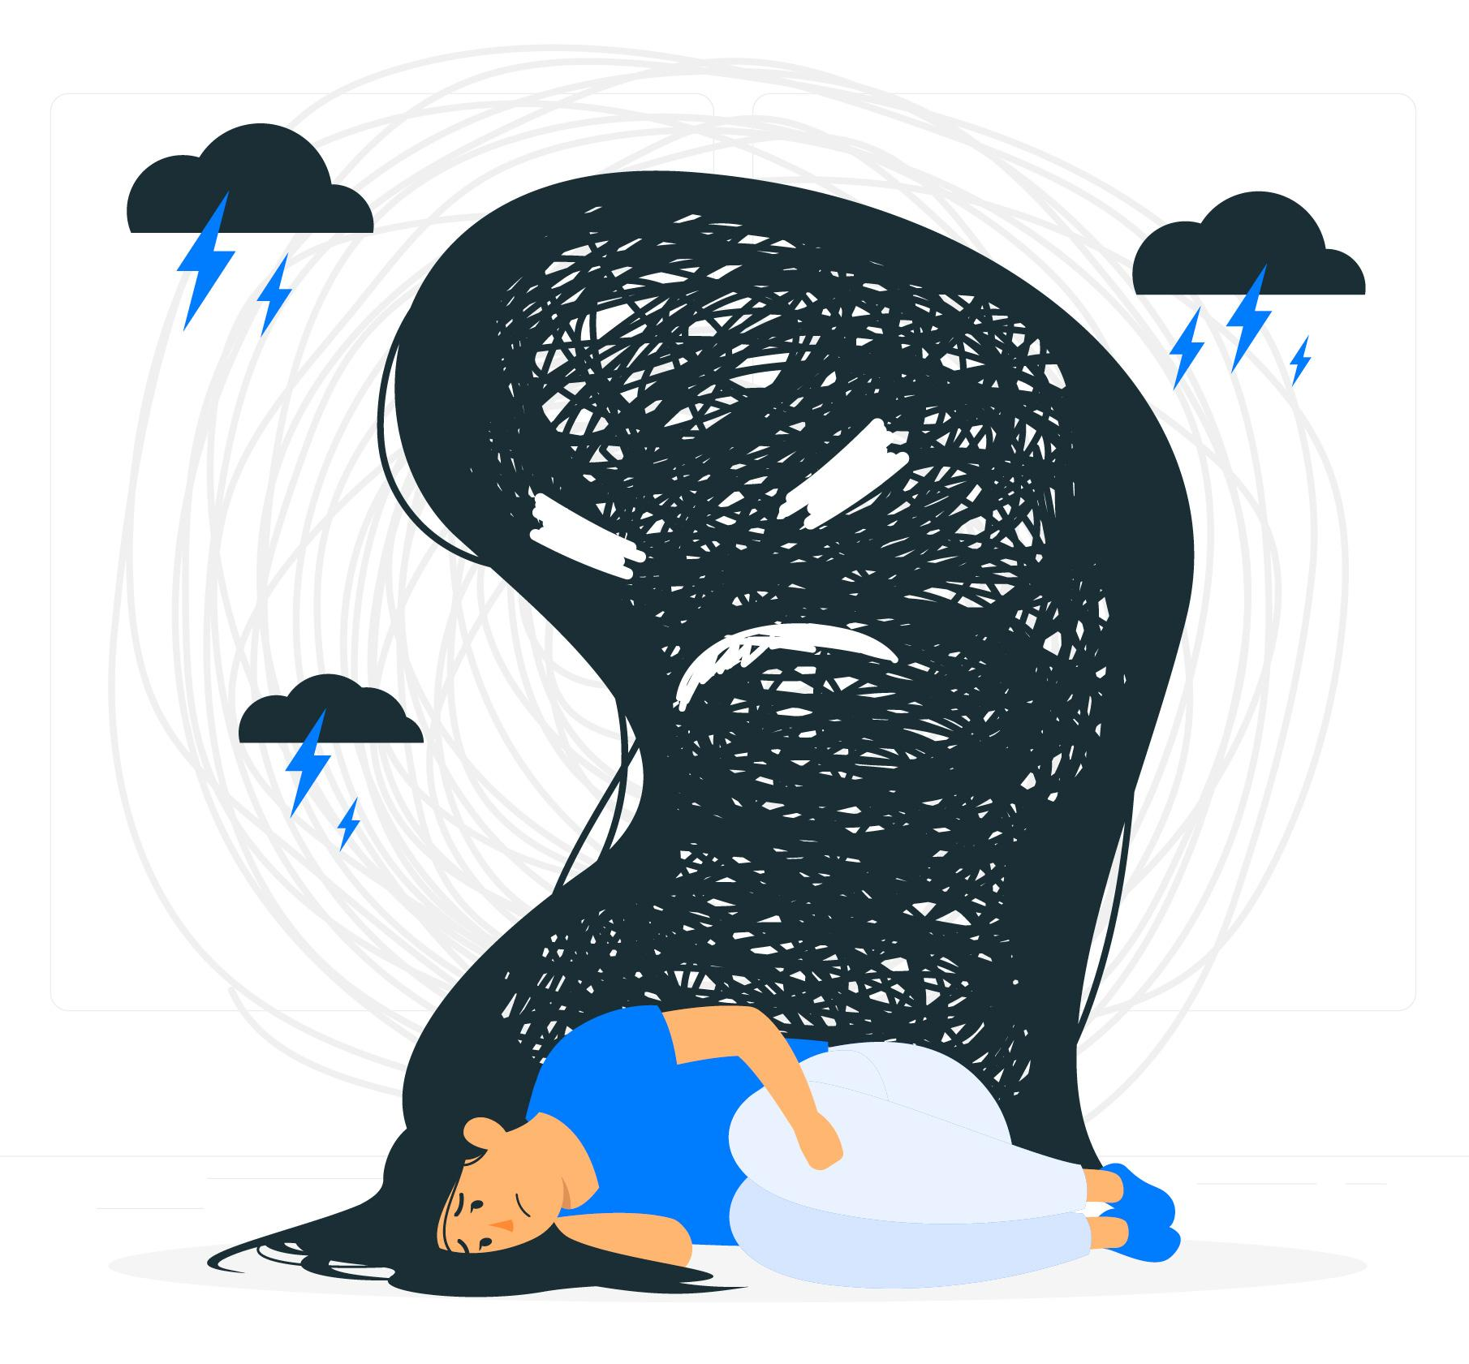
What is Seasonal Affective Disorder?
A condition related to the shortening of daylight hours
A mild to moderate form of depression that occurs during the fall and winter months
Key feature: it’s cyclical. It appears each year as the seasons change and disappears during spring and summer
It’s not the same as the “winter blues”!
Notes:
Winter blues =/= SAD
Most people experience SAD symptoms to a certain extent, especially at higher latitudes. These individuals who do not meet diagnostic criteria for depression during the fall/winter months, but who experience mild to moderate symptoms during fall or winter, are considered to have a milder form of this disorder also known as subsyndromal SAD or the “winter blues.”

Slide 4
The symptoms of SAD
Incorrectly blaming yourself
Difficulty doing easy or enjoyable activities
Difficulty thinking and concentrating
Feeling more lethargic
Difficulty getting up when days are shorter
Oversleeping
Craving carb-heavy foods
Notes:
The symptoms of SAD are exactly the same as non-seasonal depression symptoms
The only difference with SAD is the seasonal pattern it follows.

Slide 5
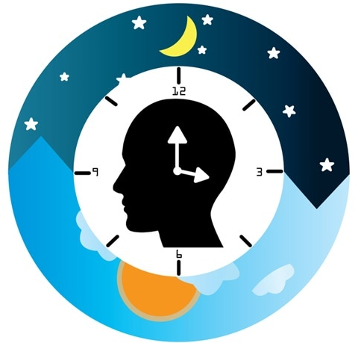
Three main contributors
Circadian Rhythm
Melatonin
Serotonin
Notes:
Circadian Rhythm is your body’s internal clock. Some researchers believe that the shorter days during the winter months “confuse” your internal clock. Thus, your body has trouble regulating when to sleep and wake up.
Melatonin is a sleep related hormone. Your body normally makes more melatonin mid-late evening, it remains high for the night, and then drops in the early morning hours. Light affects how much melatonin your body produces. In the shorter days of the winter months, your body may produce melatonin earlier or later in the day than usual. This increase may lead to depression. Melatonin pills are sometimes used to treat jetlag to help regular your sleeping schedule (hence the picture).
Serotonin is a “feel good” neurotransmitter in the brain (hence the smiley face in the chemical structure picture). Less sunlight can lead to a drop in serotonin.

Slide 6
Are you at risk?
Women more than men
Over 20 years of age
Immediate family members have been affected
Live in the northern latitudes

Slide 7
Treating SAD
Light therapy
Cognitive behavioural therapy
Medication
The Optimal Wellness Effect
Practicing Self-Care
Building Resiliency
Finding Happiness
The National Institute for Health and Care Excellence recommends that SAD should be treated in the same way as other types of depression.

Slide 8
Treating SAD with light therapy
Uses a light box that is much brighter than indoor lighting
Increases serotonin, decreases melatonin
Effective for 70% of participants after a few weeks¹
Long-term benefits unclear
Commercially available
Compliance and consistency is crucial!
¹National Institute of Health, 2013
Notes:
Light therapy is meant to replace the missing daylight hours with a light box that shines much brighter than ordinary indoor lighting. How it works is it emits a controlled amount of cool, white fluorescent or full spectrum light with a built-in screen to filter out harmful ultraviolet rays.
This encourages your brain to reduce melatonin levels (which makes you sleepy) and increase serotonin levels (which heightens your mood).
Research has shown that light therapy relieves SAD symptoms for 70% of patients after a few weeks of treatment (National Institute of Health, 2013). Although research suggests a positive short-term effect, there is no strong evidence to support its long-term benefits. They are commercially available so make sure you choose a light box that is medically proven to treat SAD and produced by a certified manufacturer
Clinical practice guidelines for SAD recommend daily use of light therapy each year from onset of the first symptom until the time in the spring when SAD symptoms would naturally resolve on their own. Compliance and consistency with the daily regimen are very important for benefits.

Slide 9
Treating SAD with CBT
Cognitive behavioural therapy is based on the idea that the way we think and act may affect the way we feel
Therapist fosters behavioural skills (identify, schedule, doing enjoyable things), and cognitive skills (identify and challenge negative thoughts)
Should counteract the lethargic moods and “hibernation” tendencies
Notes:
CBT starts with the idea that the way we think and behave may affect the way we feel. Changing the way you think about circumstances and how you deal with them can help you feel better. A CBT trained therapist will meet with you over several weeks either through an individual, group, or computer-based program depending on your needs
The therapist works with the patient to foster two types of skills: behavioral (doing) skills and cognitive (thinking) skills. The behavioral skills involve identifying, scheduling and doing pleasurable, engaging activities every day in the winter. Over time, these proactive behaviors are meant to counteract the down, lethargic mood and the tendency to give in to “hibernation” urges that are so common in SAD. The cognitive skills involve learning to identify and challenge negative thoughts when experiencing SAD symptoms.

Slide 10
Treating SAD with medication
When severe, SAD can be treated with selective serotonin reuptake inhibitors (SSRIs)
Increases serotonin, which lifts mood
MUST be taken as prescribed and even when you begin to feel better
Notes:
Antidepressants are sometimes used to treat SAD when the symptoms are severe. Selective serotonin reuptake inhibitors (SSRIs) are the preferred type of antidepressants for SAD. It works by increasing the serotonin levels in your brain, resulting in an uplifted mood. Be aware of that it can 4-6 weeks to kick in, should be taken as prescribed and even when you start to feel better, and a common side effect is an upset stomach

Slide 11
Working from home/remote
Isolation
Lack of social connection
Working too many hours
What are your boundaries?
Is your work set-up well lit with
natural light?
Notes:
Here are other ways to treat SAD
If you want to get the most sunshine out of your day, it is really important to be up during the sunlight hours. Set a regular sleep schedule and go to bed earlier so you do not oversleep. Oversleeping and fluctuations in the sleep-wake schedule causes increases in melatonin levels, which can contribute to feelings of depression. Aim to sleep for 7 to 9 hours per night

Slide 12
Self-Care
RE-FRESH
Optimizing
Energy
ELITE PLUS
ELITE 30
Resiliency
RE-FOCUS
Accepting
Change
Happiness
RE-CHARGE
Finding
Purpose
Other Treatments for SAD

Slide 13
SELF-CARE – RE-FRESH
Assess Your Energy
Assess Your Energy Levels
Make a List
Determine Energy Cycles
Time Management vs Energy Management
ELITE 30
Energizers (what gives you fulfilment?) vs
Suckers (what destroys your spirit?)
Balance Ener-gizers with Ener-suckers
Time of Day
Notes:
Time management – things, chores, events, appointments – schedule in your TO DO list
Energy management – balancing your lows and highs during your day (throw out the rules for how we are “supposed” to fill our time.
Make a list – everything that drives you, fulfills you, energizes you, brings you joy during your day = energizers
-everything that drains you, what you don’t like to do, easily distracted and procrastinate, less productive = energy suckers
List of energizers = strengths; List of suckers = weaknesses
GOAL – actively manage tasks during your day that balances out the time spent on draining tasks so you’re not mentally exhausted at the end of the day.
How you spend your day – does it align with your values? Investing in things that aren’t important to us is leaving us feeling unfulfilled, which drains energy. Consciously choose what’s important to you and your schedule.
Energy Cycles – self-awareness of your energy – best in am? Most productive in am? Have that long meeting, tackle that TO DO item that you’re putting off. Is your best in the pm? Switch these important tasks around so you have the energy to complete them.
*Consciously choose how your cup wants to be (filled or empty) at the end of your day.

Slide 14
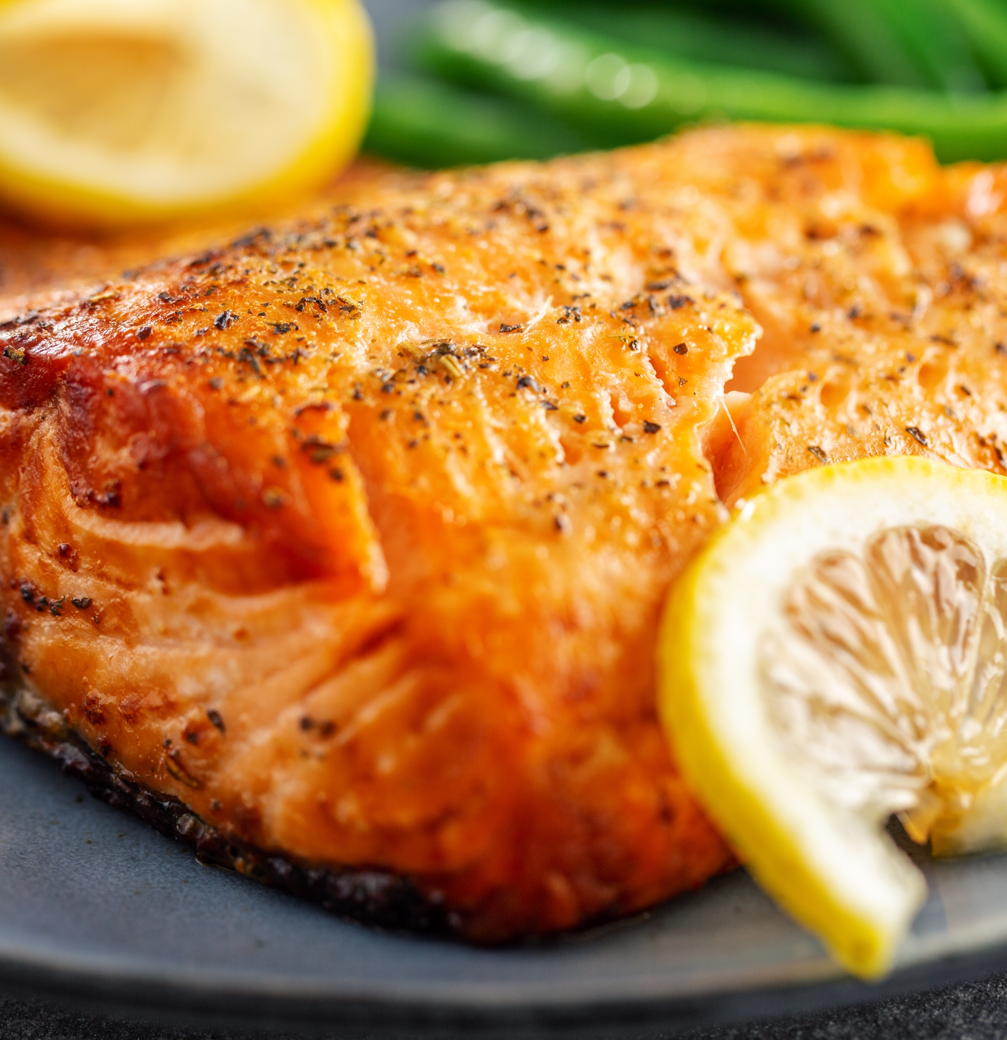
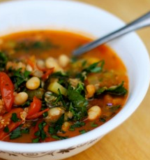
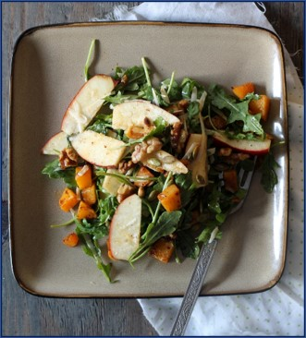
Treating SAD with a healthy diet
Great Choices
Reduce SAD symptoms
Notes:
Good: Increase your vegetable and fruit intake, omega 3 proteins (salmon), and have more hearty soups that still have complex carbohydrates and lean protein (squash, barley, sweet potato, quinoa, chick peas, kale). Also, it’s not about avoiding ALL carbs but replacing white carbs (white bread, white rice, white pasta) which complex carbs (whole grains) such as the whole grain sandwich with chicken and veggies.

Slide 15
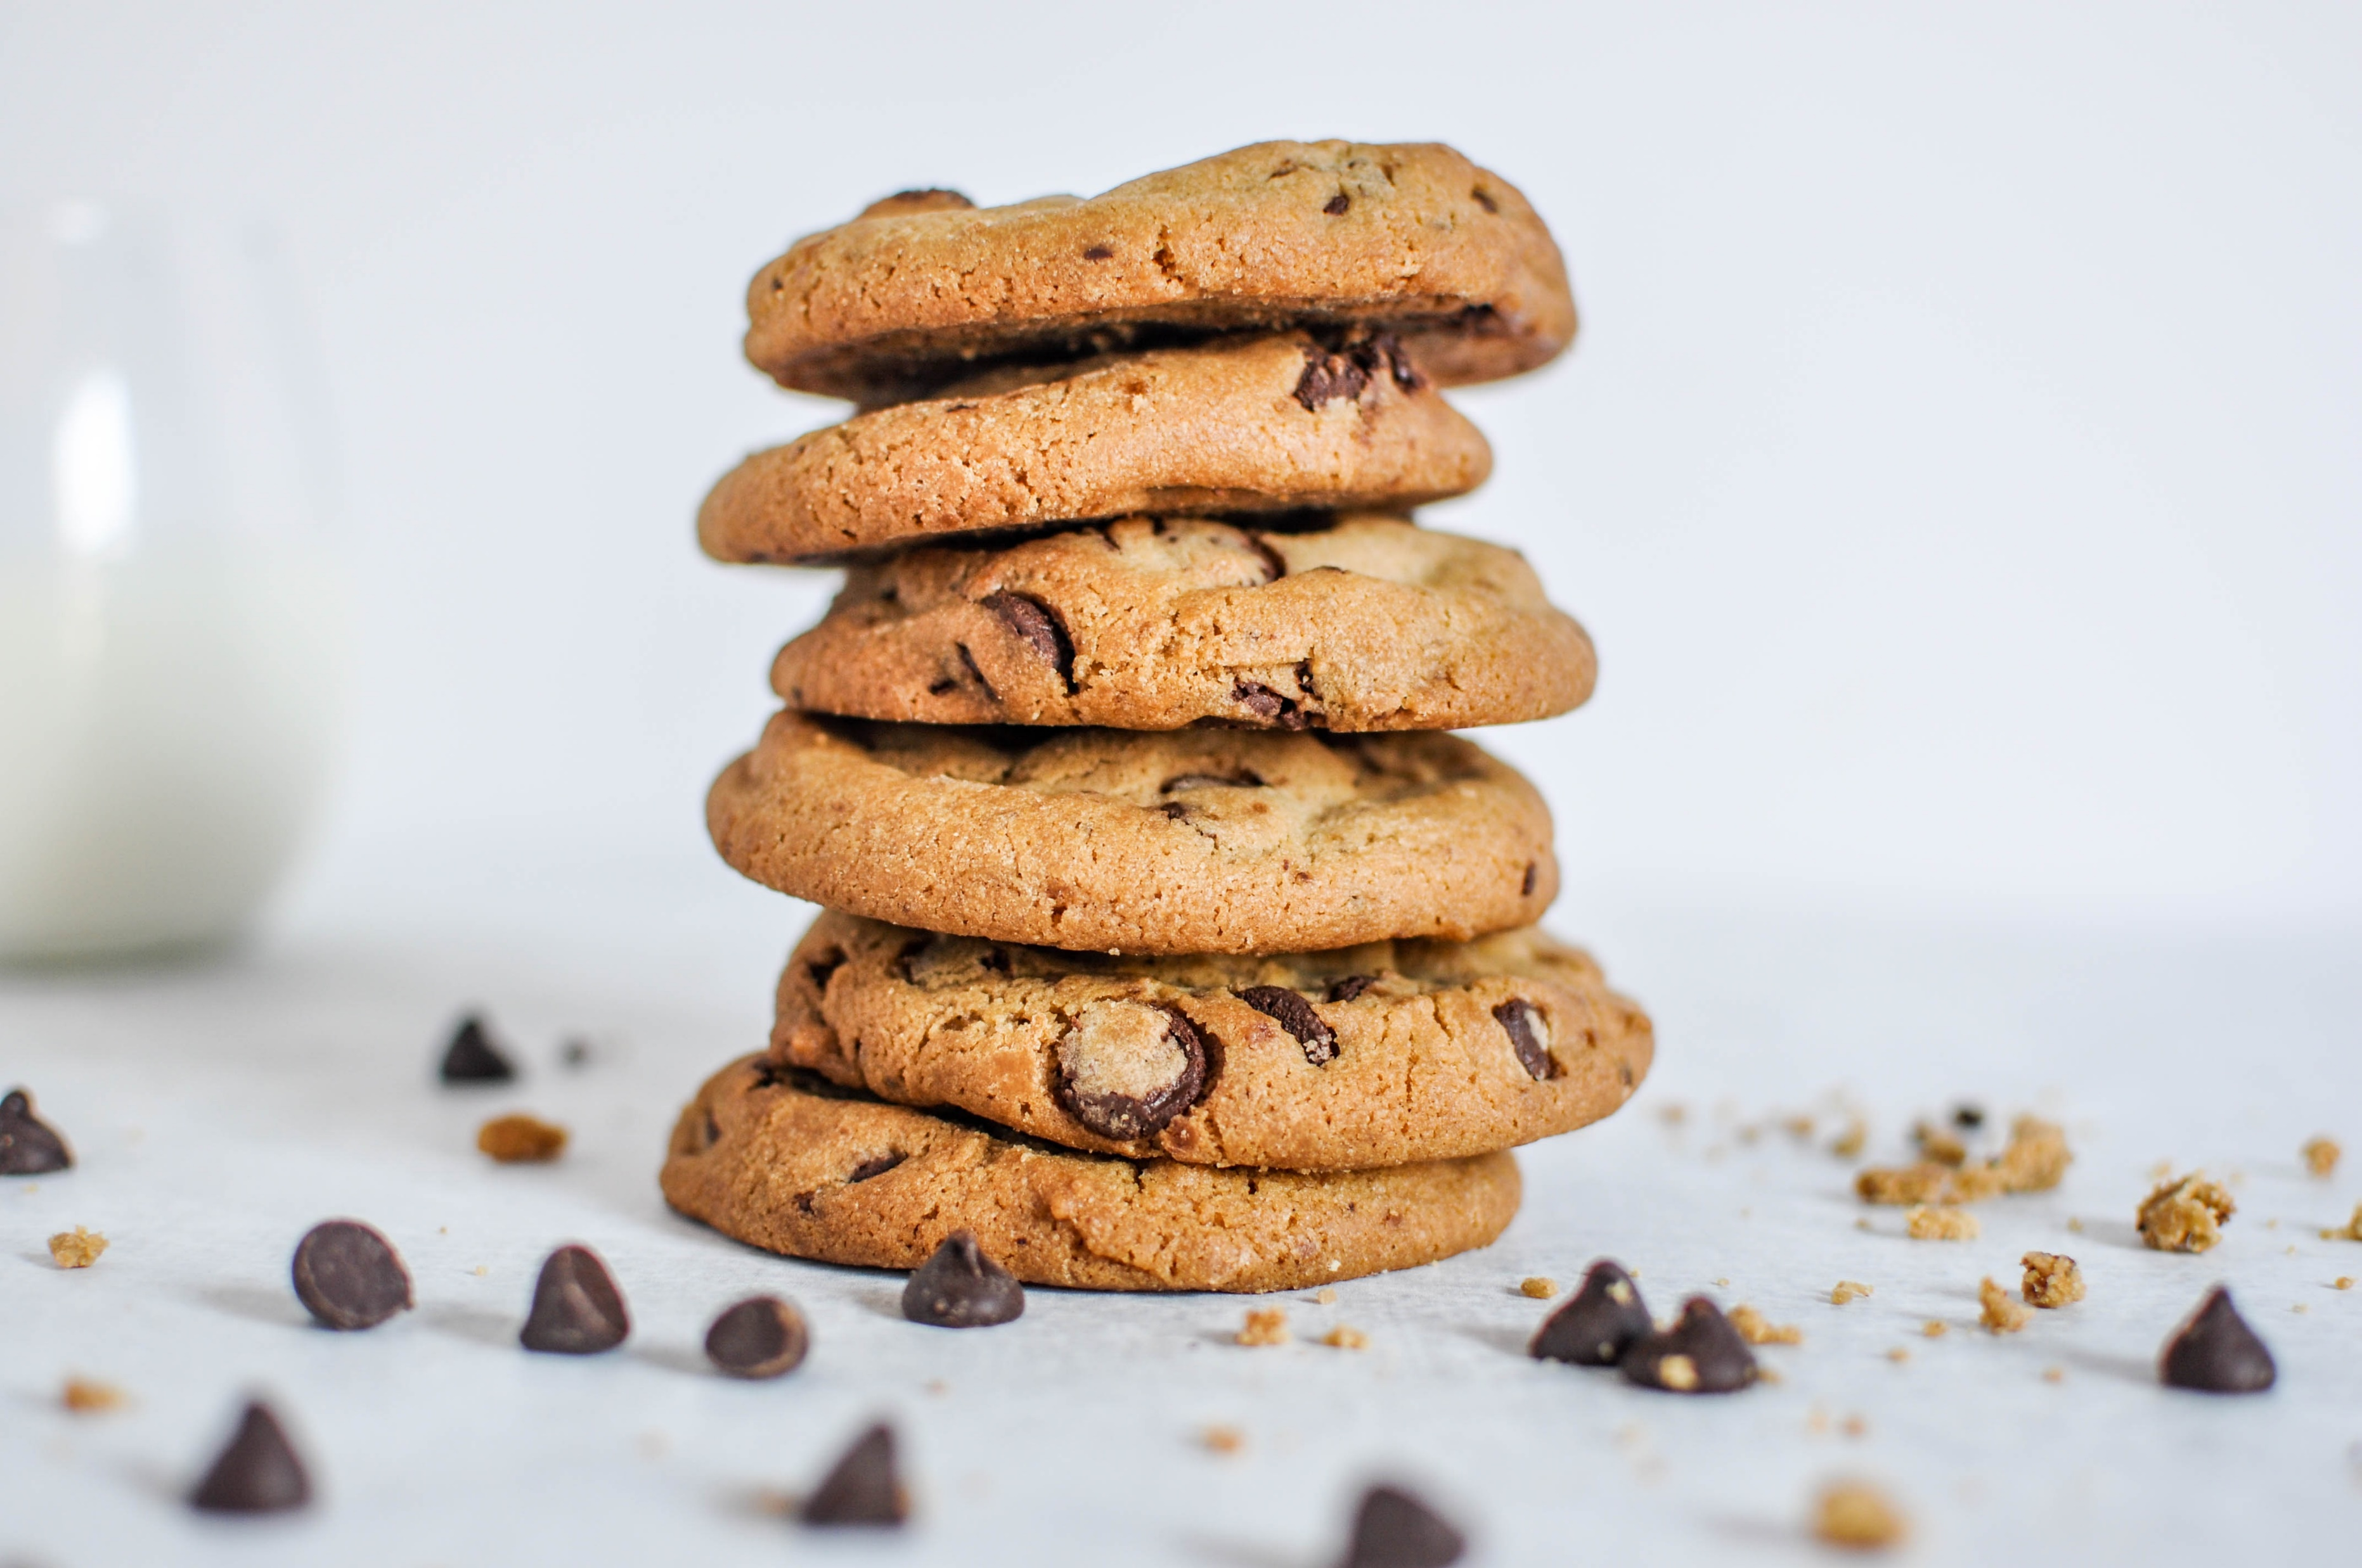
Treating SAD with a healthy diet
Eating whenever I have time as long as it’s healthy
Not So Great Choices
Increase SAD symptoms
Avoiding all carbs to keep my glucose levels down
Notes:
Bad: Avoid heavy carb meals like rice and potatoes or white pasta, and high-sugar foods like cookies. We tend to crave carbohydrate-rich food in the winter, but it might be a wise idea to minimize carbs in your diet. Our bodies like the feeling of high sugar and high carb food because boost serotonin levels in the brain. Unfortunately, this can result in a crash later on after the spike in your blood glucose levels have gone down. As said, you do not want to avoid all carbs! This will cause other problems where your body will go in “starvation mode” and deplete other resources that your body needs. Lastly, it is important to eat 3 regular meals with snacks in between to regulate glucose levels – NOT eating whenever you have time even if it’s healthy.

Slide 16
ELITE PLUS
ELITE 30
PRO 15
BASIC 5

Slide 17
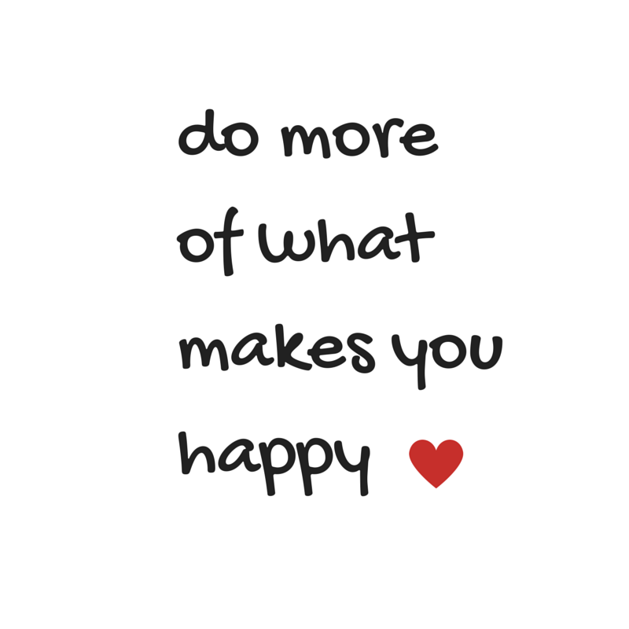
Prioritize Your Health
Mindful Movement
ELITE PLUS
PRO 15
No Movement = Sloth-mode

Slide 18
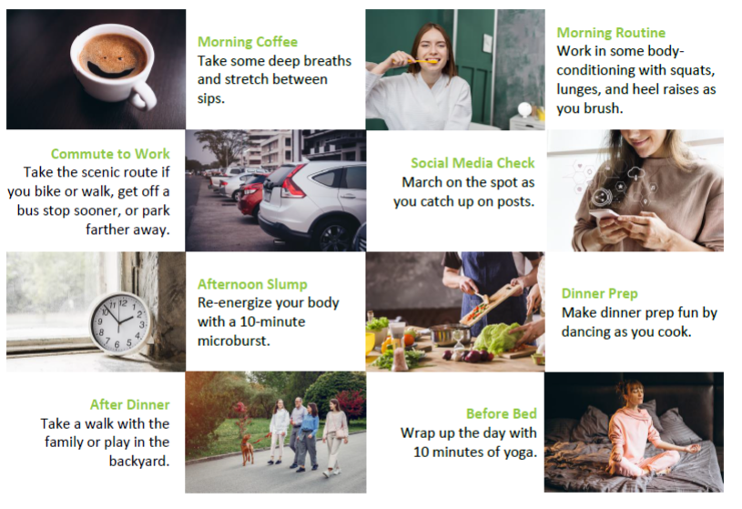
Take 5, Then Decide
Something is better than nothing.
Choose movements that offer maximum benefits
(try a microburst).
Hectic is NOT aerobic.
Exercise is NOT a chore.
“It’s deciding that the longevity of your body and mind are important enough.”
Habit Stacking
PRO 15

Slide 19
Treating SAD by regulating sleep
Set a regular sleep schedule
Go to bed earlier so you don’t over-sleep
Get up after 15 mins!
Remember… increased melatonin may lead to increased feelings of depression
Notes:
Here are other ways to treat SAD
If you want to get the most sunshine out of your day, it is really important to be up during the sunlight hours. Set a regular sleep schedule and go to bed earlier so you do not oversleep. Oversleeping and fluctuations in the sleep-wake schedule causes increases in melatonin levels, which can contribute to feelings of depression. Aim to sleep for 7 to 9 hours per night

Slide 20
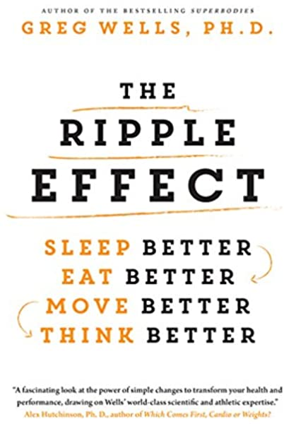
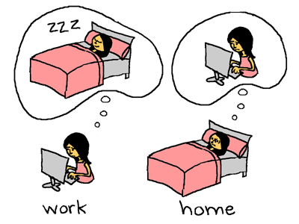
Prioritize Your Health
Restful Sleep
ELITE PLUS
ELITE 30

Slide 21
RESILIENCY – RE-FOCUS
Accepting Change
Time to Adjust
Control the Controllable
What is the Opportunity?
Accept what you can’t change; Keep an open mind; Communicate; Self-Compassion
ELITE 30
Focus on the present; Acknowledge negative story; Disrupt the pattern (options of 3, not 1)
New beginning; Goal setting; Positive mindset; Tapping into meaningful purpose
Notes:
Accept the things you cannot change. Allow yourself to grieve what has been lost, but then try to focus on what’s needed in the present rather than dwelling on the past. What’s the opportunity? Name it.
Keep an open mind. While it feels uncomfortable, seeing change through a new lens can allow your imagination to run free and creativity to flow. It can bring about new experiences that may enhance the lifestyle you’ve always known.
Communicate. It’s ok to be uneasy and unsure in the face of transition. If you’re feeling overwhelmed, talk to others about what you need. Seek the guidance and support of a good friend, family member, or counsellor when life feels out of control. Communicating is a great coping strategy for releasing negative thoughts and moving into a more positive mindset.
REMAIN CONNECTED: To your support system
Take care of your emotional and mental wellness by staying connected to the things that matter (and things you can control). Exercise, eating well, proper sleep hygiene, and nurturing our relationships! Even though we can’t extend a hug or enjoy pizza and a movie together, a video chat or telephone call can be a great source of support.
Action Step: Do your best to lead a healthy lifestyle. It is one of your greatest supports. Keep the lines of communication open and talk to people you trust about how you’re feeling. You may want to connect with a counsellor who can offer some custom-based strategies and coping skills. Schedule an appointment with your healthcare provider if stress, fear, or anxiety get in the way of your daily activities for several days in a row. Don’t be afraid to call on whomever you need to at this time. Odds are, they are struggling in some way too.
Self-Awareness and pre-parediness
Imagine you’re going to take a raft trip down a river. Along with slow water and shallows, your map shows that you will encounter unavoidable rapids and turns. How would you make sure you can safely cross the rough waters and handle any unexpected problems that come from the challenge?
Perhaps you would enlist the support of more experienced rafters as you plan your route or rely on the companionship of trusted friends along the way. Maybe you would pack an extra life jacket or consider using a stronger raft. With the right tools and supports in place, one thing is sure: You will not only make it through the challenges of your river adventure. You will also emerge a more confident and courageous rafter.
Toolkit - Make connections. ...
Avoid seeing crises as insurmountable problems. ...
Accept that change is a part of living. ...
Move toward your goals. ...
Take decisive actions. ...
Look for opportunities for self-discovery. ...
Nurture a positive view of yourself. ...
Keep things in perspective.

Slide 22
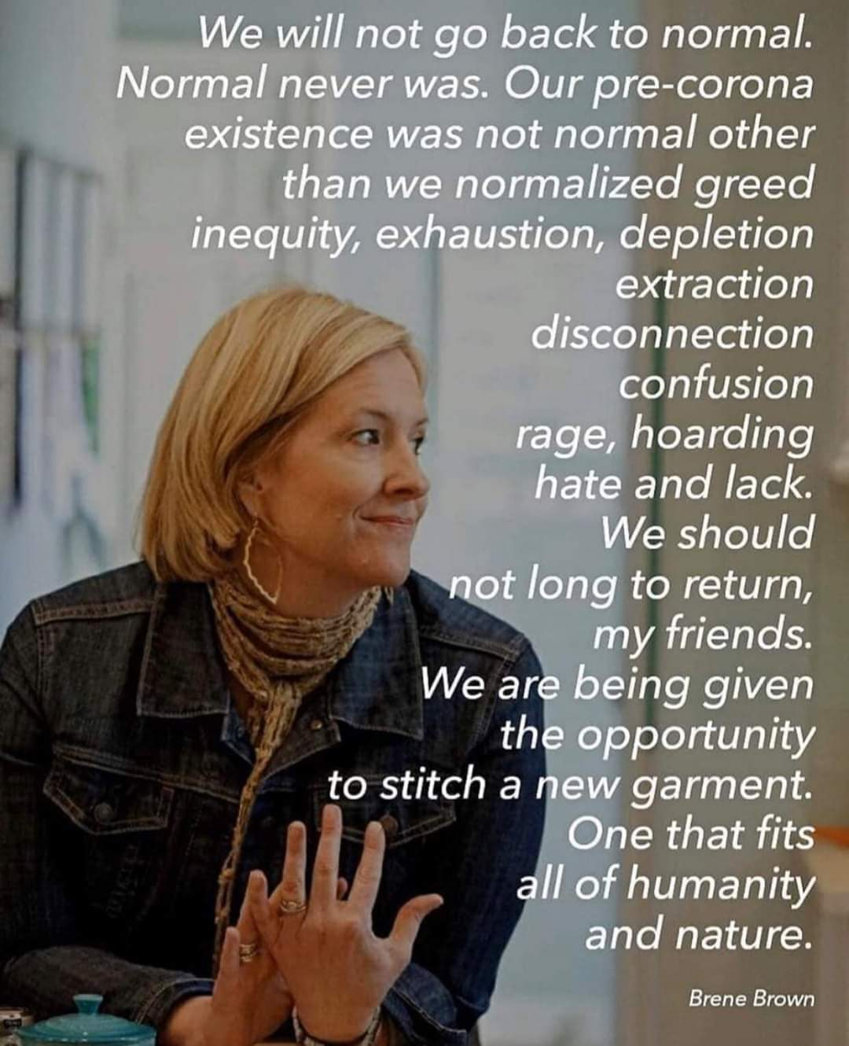
ELITE PLUS
ELITE 30

Slide 23
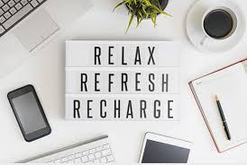
RELAX to Reflect
ELITE PLUS
Deep Breathing – 10 times, 2x/day
Meditation – calm.com
Self-Development
ELITE 30
PRO 15

Slide 24
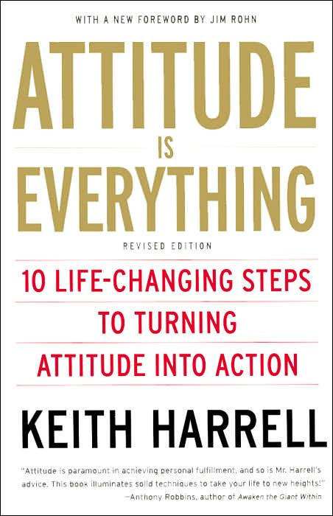
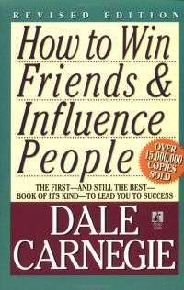

Slide 25
HAPPINESS – RE-CHARGE
Finding Meaningful Purpose
Connection
Empowerment
What’s your Purpose?
Meaningful relationships. Meaningful work.
What brings you joy?
ELITE 30
What drives you? What motivates you? What balances you? Positive mindset.
Who are you, truly? What fills your cup? What fulfills you?

Slide 26
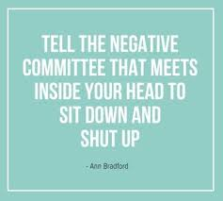
Create a buffer
10 minutes
ELITE PLUS
ELITE 30
PRO 15
Can I control? Options of 3, not 1
BASIC 5

Slide 27
Name Your Worries
ELITE 30
PRO 15
BASIC 5

Slide 28
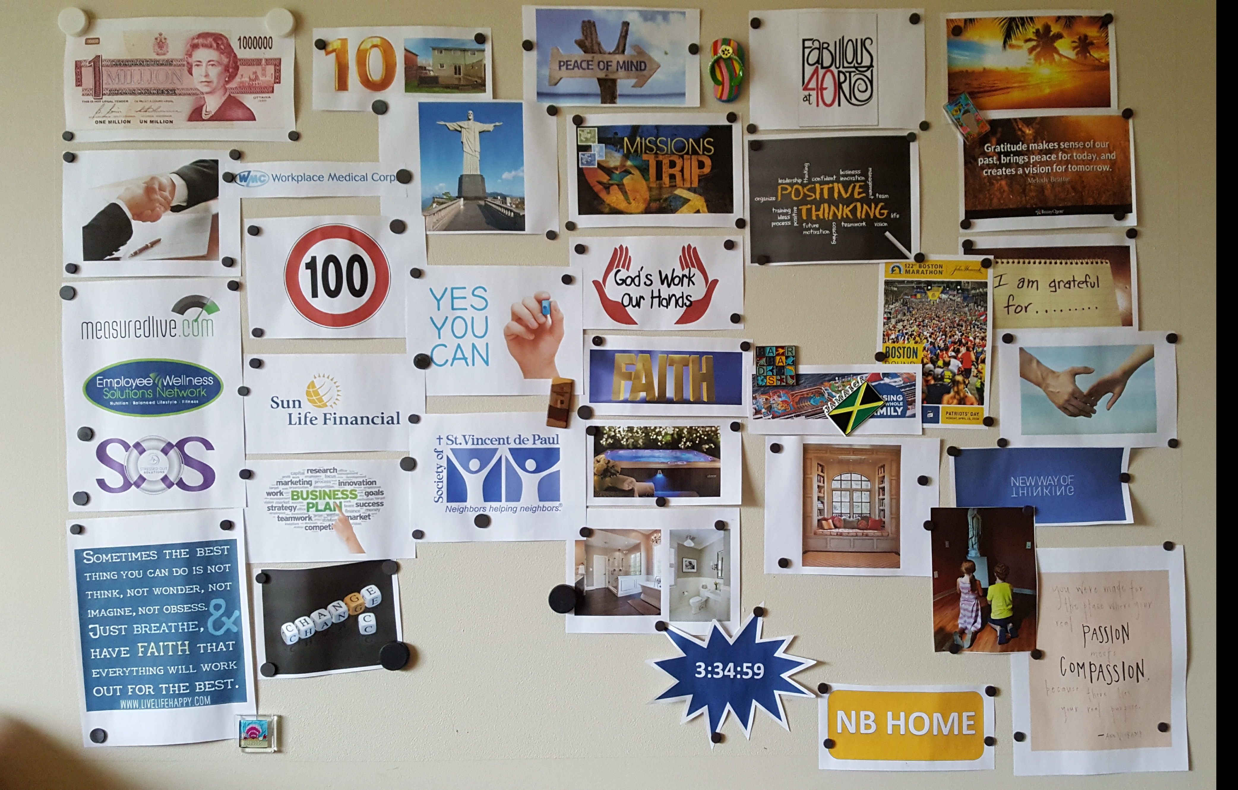
GOAL BOARD

Slide 29
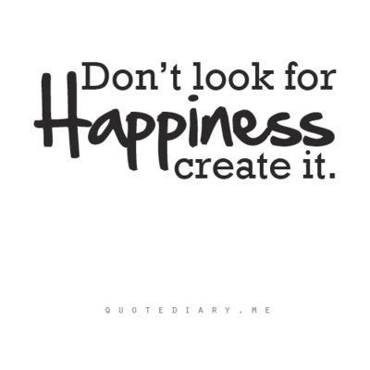
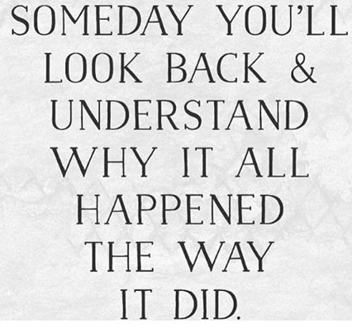
ELITE PLUS
Do More of What
Makes You Happy
ELITE 30
PRO 15

Slide 30
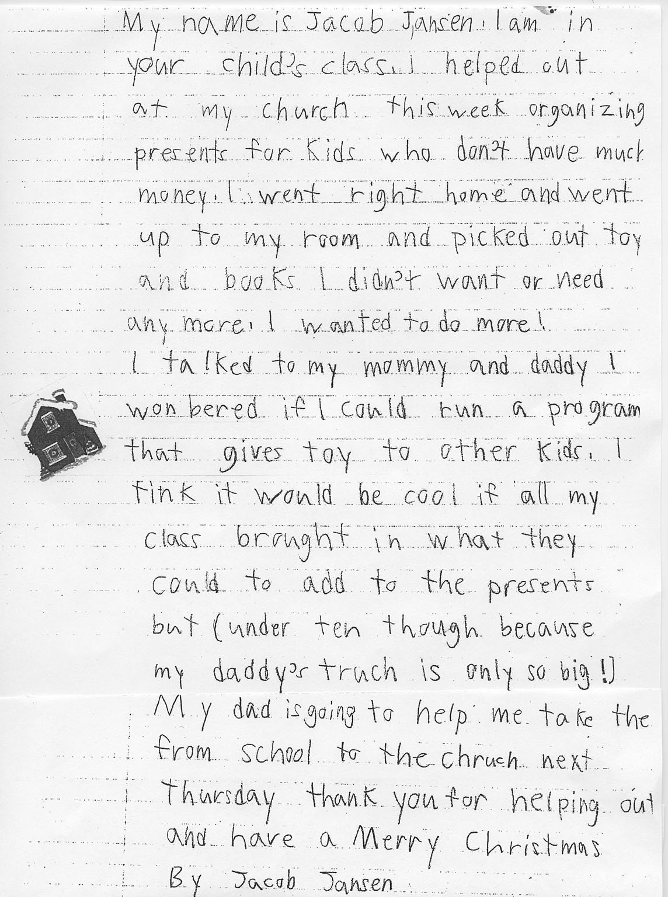
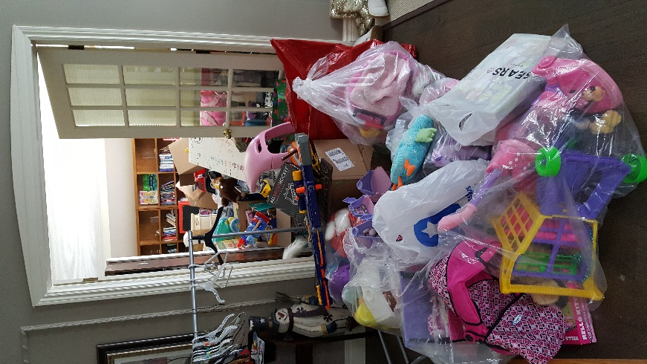
ELITE PLUS
ELITE 30
PRO 15

Slide 31
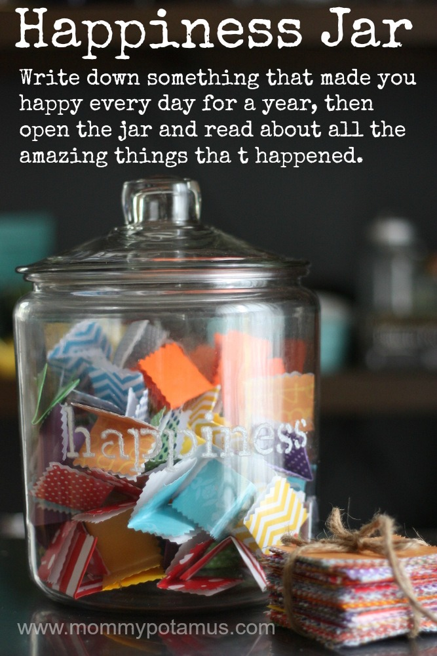
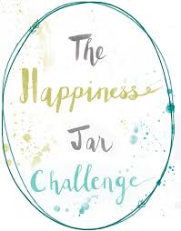
ELITE PLUS
BASIC 5

Slide 32
Health Coaches here for YOU!
Laura Holt Perrier
Rose Koldenhof
EFAP

Slide 33
Armstrong, R. (2007). How to beat the winter blues. The Independent.
Canadian Mental Health Association. (2004). Seasonal Affective Disorder.
Mayo Clinic Staff (2007). Seasonal Affective Disorder. Retrieved from www.mayoclinic.com
National Health Service Choices. (2013). Seasonal affective disorder – treatment. Retrieved from www.nhs.uk
National Institute of Health. (2013). Beat the winter blues: Shedding light on seasonal sadness.
Piccoli, G. (2007). Beating the Winter Blues: A practical guide on how to get through winter at Cornell. Cornell University, Gannett Health Services.
Images by freepik
Resources

