Slide 1
RETHINKING
WORK-LIFE BALANCE
Are You Working for the Weekend?
Powered by:
©2020 EMPLOYEE WELLNESS SOLUTIONS NETWORK INC. – ALL RIGHTS RESERVED

Slide 2
I
Are You “Working for the Weekend?”

Slide 3
I
Finding The Best “Fit”
Why Are We Talking About This?
Work-Life Balance is Not
Redefining Work-Life Balance
3 Principles of Work-Life Harmony
Be Real
Be Whole
Be Innovative
Goal: Achievement and Enjoyment
Review and Strategize
Exercise
www.EWSNetwork.com

Slide 4
I
Why Are We Talking About This?
60s-70s
Finding a work-life balance was mainly considered an issue for working mothers.
80s
Structural changes took place.
90s
Work-life balance became an issue for men, women, singles, couples, parents, non-parents, etc.
21st Century
Recognition that workload predicts other stressors (anxiety, depression, mental stressors) that can feed into different areas of life.
Notes:
60’s 70’s – As women’s role started to change and they entered the workforce, they had to master trying to balance the demands of their jobs with raising children, being a wife, and taking care of the household.
80’s – Recognizing that the workplace needed to change to support the dual role that women now played, new infrastructure was emerging. For example, policies and procedures, along with benefits were added/changed to support balance for both genders (maternity leave, EAP’s, flextime, etc.). Also, in the 80s, men became concerned about their own work-life situation.
90’s – The emergence of a company culture and choosing a job that fits your lifestyle.
21st century – Being increasingly connected means it is more difficult than ever to find a balance.

Slide 5
I
Why is it Integral Right Now?
Changing values - particularly among millennials
Boundaries between family and career are blurred
Stressors increasing as we continue to struggle to find the “good life”
Technology is changing how and when we get things done.
Employees are willing to give up their personal time to do work
People are working remotely more so than ever before
Notes:
A new trend is emerging with the demand of the millennial lifestyle: fluid, flexible and connected.
The old 9 to 5 is outdated and doesn’t reflect the current state of our lifestyles.
Integrating work into life is fluid and natural and this flexibility is something they look at as a competitive advantage in the workplace.
Millennials are the first generation to enter the workforce with access to technology that enables them to seamlessly work remotely. Millennials are eager to capitalize on technology to make life more flexible.
If you ask the average millennial how many times they check their phone, or how much time they spend ‘connected’ via email, apps, etc., it’s a lot. In fact, if you were to tally it up, it would be most of the time.

Slide 6
I
Redefining Work-Life Balance?
What work-life balance is not:
The goal is not equal balance between work and life.
Balance is everchanging, not static.
Work and life are not separate entities.
Notes:
Work-life balance is impossible. You can never full balance work and life. A scale is only balanced momentarily until something throws it off. If we look at life as a scale that needs to be balanced, we view work as a separate entity to life, and this gets in the way of our overall happiness and fulfillment.
Balance is fleeting. Every day we are forced to allocate our time according to our priorities and circumstances. Accepting that other areas will not receive the same amount of attention is ok. Different ages and stages of our lives need different things. In our 20’s, we may be very career-focused, while in our 30’s, we may be very family-focused. We don’t always get to choose what demands are placed on us, at work, at home, in our family lives, etc.
Often, life just happens and we need to constantly adjust and reprioritize. For example: taking time off when a child is ill, and understanding that, with a looming deadline, more hours will be allocated to your work the following week. Everything we do in life has consequences or rewards. The expectation that we have to give our all at all times to all areas of our lives results in feelings of failure and guilt.
Life is what’s happening, and work is just one thing that we do within in our lives. When we separate it, we overemphasize the value of labour. We can overextend ourselves out of fear of a bad performance review, missing important information, or perhaps risk losing our jobs to someone who is willing to do “more”.
Work is a part of life. Life is brought into our work. Bringing both into the same realm can bring joy and meaning to our work and our personal lives. Recognizing that balance is flawed can redefine “success” in life.

Slide 7
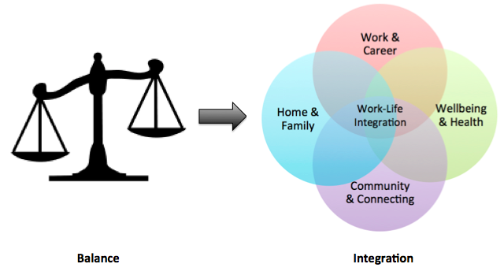
I
Redefining Work-Life Balance?

Slide 8
I
How are you Coping?
Symptoms of unbalance & overwhelm
Physical
Headaches, upset stomach, sleep disturbances, changes in appetite, muscle tension, fatigue, heart palpitations
Emotional
Depression, anxiety, irritability, difficulty making decisions, angry outbursts, resentment, feelings of powerlessness
Personal
Lost time with friends and loved ones, job burnout, isolation – stopping social activities, relationship loss/difficulties, self- medicating

Slide 9
Does it even exist?
I
Work-Life Balance?
Notes:
-PLAY VIDEO

Slide 10
I
Redefining: Call it What You Want
Work-Life Integration
Work-Life Harmony
Work-Life Alignment
What do they all have in common?
Notes:
What if you enjoyed working?
Shouldn’t that be the ultimate purpose when most of your waking hours are spent on the job?
If you enjoyed your work, or even just found joy in small aspects of your work, would you be more productive? Seeing your employment not simply as a job that you are working, but as part of a life that you are building.
At times, work can demand more of your time and attention. There might be seasons of work, and seasons of leisure or personal development. There can be times when your personal life can demand more time and attention, and work becomes a secondary priority. It is fluid. Trying to balance both at all times is unachievable, contributes to stress, and is a struggle.
A new spin on work-life balance is that idea that the two concepts are one, with our roles in work and life being integrated. Seeing how all the parts of life can create the whole and all fit together. Removing the boundaries and the separation and aligning your goals to create the life that works for you.
Here is an example:
Boundaries are fluid between different areas of life. If you are integrating work and life, you might choose to have breakfast with the family and drop off the kids at school. You then work from 9am to noon, eat lunch and go to the gym, and return to work for an afternoon meeting. After work, you pick up the kids, get home to make dinner, and respond to emails for a couple hours before bedtime.
Incorporating personal vision, life purpose, hobbies and interests, and taking a personalized approach to all facets of your life. The idea of integration, harmony or alignment removes the guilt attached to a streamlined focus on one particular area when needed and can bring a higher level of happiness and productivity than “balance” ever could.

Slide 11
I
Work-Life – It’s All Life
Look at how you spend your time. Are your hobbies opposite interests to the work that you do?
Are your goals working together, or is it impossible to achieve your personal and professional goals?
Think of how you feel about how you are treated at work.
Set short and long-term goals and aim high.
Consider your values.
Notes:
Ideally, you should be working at something you enjoy and that you would choose to do anyway. If you can consider how you spend your free time, you may be able to find ways to recreate that interest within your current career path. Do you like to plan and build projects in your spare time? Is there a construction aspect to your work?
If your personal goal is to give back to your community, and you have a professional goal of becoming a better leader, can you find a way to work take a leadership role in a community initiative through work? With work as life, there really shouldn't be a differentiation between personal and professional goals.
Do you feel empowered and appreciated? Most of your waking hours are spent in the workplace, which makes your job a large part of your personal joy and satisfaction. Ensuring you are treated with respect will mean that you enjoy going to work.
Sometimes a routine gets a little too comfortable and we can forget to think long term. Time slips by and without personal and professional goals, you might look back and wonder where the time went. Set goals and take steps each day to get there. If what you are doing isn’t helping you to achieve your goals, re-evaluate what you’re spending your time on.
When we take the view that work and life are interconnected, we should ensure that our values match the values of the company that we work for. At times you might feel that you need to work in a job that you really aren’t happy in just to get some experience, but if time and opportunity allows, try to find work or an organization that aligns with what you believe in. Your productivity will soar, and you will have a greater sense of achievement and enjoyment.

Slide 12
3 Principles of Work-Life Harmony
I
Is it Achievable?
In his book, Leading the Life You Want: Skills for Integrating Work and Life, Stewart Friedman offers a three part framework for finding “harmony” in combining personal and professional demands.
Be Real
Be Whole
Be Innovative
Notes:
This framework is what makes the demands on your life, and the choices around them, personal. Having a strong sense of who you are, what values are important to you, and being clear on your goals, allows you to devise an action plan that is personal and effective.

Slide 13
I
Be Real
Accept what works for you!
Be authentic.
What is important to you?
You get to decide how you prioritize your time.
What does balance mean for you and does there need to be a clear divide?
Notes:
No one wants to be told how to prioritize their time. We each have our own unique idea of where our priorities lie and it’s important that we are authentic about this truth. Do your spoken priorities match your unspoken priorities? You may choose to make your relationship and the goal of starting a family a priority, while someone else may choose to work around the clock towards an upcoming promotion. You could be in a stage in your life when career is priority and being available 24/7 is acceptable for you.
What does work mean to you and where do you prioritize it right now? The “balance” that you are looking for can be very different from a friend or coworker.
Even when we talk about integration. Perhaps boundaries between work and other areas of your life will help YOU to achieve your goals in a very straightforward and structured way. Whether it’s boundaries or integration, do what works for you and re-evaluate as needed.

Slide 14
I
Be Whole
Be aware of how different parts might work together.
All parts are blending together and working towards a greater quality of life.
Integrate different areas of one’s life.
Notes:
All parts are blending.
It makes sense to have meaning and being clear on priorities in your life by viewing your roles and responsibilities as pieces to the whole that we call “life”.
For instance, it’s possible to go to your child’s sports meeting rather than staying in the office because you can check e-mails between innings or finally take that dream vacation you’ve been dying for while conferencing into the daily meeting.
You might take some time to do that water colour painting you have been meaning to get to while also listening to a podcast related to a professional goal.
Rather than working for the weekend, we can integrate weekend-type activities to keep you positively fueled throughout the workweek. The same goes for the weekend. If you have work on the brain, and simply cannot seem to focus on the down time the weekend should be providing, acknowledge it. Rather than be contained in the mindset that it has to wait for Monday, devote some time on the weekend to working through your thoughts and creating small points of action.

Slide 15
Be Innovative
I
Get things done in ways that work for you!
Focus time and attention on things that you can control.
Find new, efficient ways of doing them.
Experiment to find what works.
Notes:
Take a close look at how much you can control the boundaries between work and personal life
Consider reaching out for support with time-consuming household tasks.
- Could you order your groceries online and have them delivered?
- Hire a kid down the street to mow your lawn?
- Have your laundry picked up and dropped off at your home or office?
- Order your stamps online, so you don't have to go to the post office?
It's hard to make time for exercise when you have a jam-packed schedule. Can you download an app on your phone to do a short workout in the office mid-day? What about an online personal training program. Rather than cutting exercise out of your schedule for lack of time, recognize its ability to boost your energy and concentration and integrate it in a more innovative way.
You will need to act with creativity by experimenting with how things get done in ways that are good for you and for the people around you.

Slide 16
I
In Everything You Do…
Achievement & Enjoyment
Always aim for these two concepts in everything that you do.
Achievement: meeting a goal, seeing efforts equal change.
Enjoyment: Happiness, pride, satisfaction, love, sense of wellbeing.
Setting an intention to achieve something and enjoy something today can make for a pretty fulfilled day!
Notes:
-These two key everyday concepts define a positive work environment and a positive life. They give meaning to everything that we do.
-Achievement and Enjoyment are the values that define a happy life. You can’t have one without the other. When you try to lean to heavy on one of these values, you sacrifice your happiness in life.
-Finding achievements and enjoyment at work and in your personal life can have you more focused on happiness throughout the day, the week, and the long term.
-Stop and consider both of these values in every facet of life. It’s easy to find achievement and enjoyment in our leisure activities, hobbies, and interests: those things that we CHOOSE to do. Can you find a small achievement and enjoyment in everything you do in every area of your life?
Personal Life
Achievement: You’ve made a commitment to exercise. If you exercise today that is an achievement. You have achieved something because you met a goal.
Enjoyment helps you to give meaning to the achievement and the purpose of what you are living for. You commit to exercise because you know it energizes you allows you to be fully present in the evening with your kids. Your achievement of exercise today allows you to fully enjoy your evenings with your family.
Work-Life
Achievement: You’ve made a commitment to put in some extra hours at work today feeling a sense of flow and better ability to meet a demanding deadline. Acknowledging a state of flow and meeting your deadline is an achievement.
Enjoyment: Why was meeting the deadline important to you? You’ve been feeling a little unmotivated at work, and you created a situation that could bring enjoyment to your life in the form of pride for a job well done. You matched your skill in the moment to a challenge on the job bringing self satisfaction.
Focusing on these two things everyday can get you out of the mindset of “I’ll be happy when…”
-I get that promotion
-I get through all of this work and can enjoy life
-My child graduates and I can focus on myself.

Slide 17
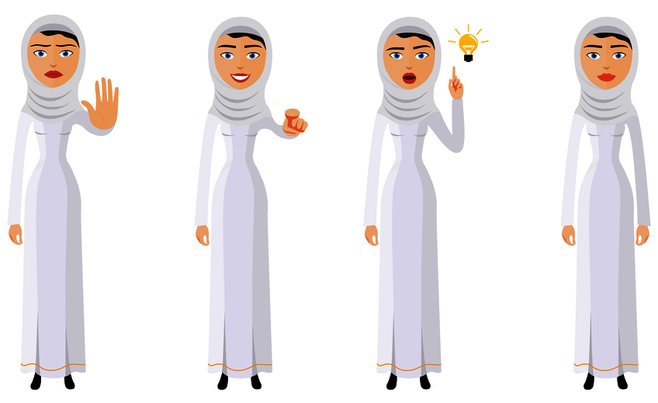
I
Review and Strategize
Accept that there is no perfect situation.
Find a job that you love or love in the job that you have.
Prioritize your values and be clear on your goals.
Ask for help/support where needed.
Set boundaries and work hours if needed.
Notes:
- Work-life “balance” is defined by you! WLB is your definition of how to be a harmoniously integrated whole. Only you can set your priorities and boundaries to shape your life
- You may not enjoy all aspects of your job or your work environment. If that is the case, find aspects of the job that you like/love and find joy in those duties. Get involved in what matters to you and help to create the change that you wish to see (achievement and enjoyment).
- It’s more of an issue today because of how work and family have changed over time. What are your values and goals? Re-evaluate these as needed, but ensure what you are doing everyday is a step in a positive direction. If not, be willing to try new things.
- Ask for help and support where needed and put strategies in place. Talk to your employer, your spouse or significant other, or outside resources to lessen the burden of those tasks that aren’t bringing achievement and enjoyment into your life
- It isn’t static. Be aware of symptoms of imbalance and your own barriers. Re-evaluate circumstances in your life often. There may be times that you need more structure within the different areas of your life to keep focused. Don’t be afraid to set boundaries or work hours if needed. You are in control of what you need.

Slide 18
I
Take Action
How can you integrate more of YOU into your life?
List interests and hobbies.
If you had the time to do any of these things today, what would it be?
Find opportunities to integrate!
www.EWSNetwork.com
Notes:
The value of a creative outlet on work productivity and performance ranking is demonstrated in research. According to San Francisco State University, embracing your creative after-work hobbies - even if it’s just trying your hand at a new dessert recipe - could be a major boost to your day job. You are more likely to have better problem-solving abilities and perform better on the job.
What skills do you have and how can you integrate them?
What passions, interests hobbies, talents do you have and how can you integrate them?
REVIEW HANDOUT EXERCISE WITH THE CLIENTS
What are your hobbies or interests?
How can you share this at work?
- Work a bake-off
- Take a 15-minute knitting class on your lunch hour
- Organize a holiday photo shoot at work
- Make healthy lunchroom snacks
- Take break time walks
- Arrange an after-work paint night

Slide 19
I
Q&A
Question Time!
www.EWSNetwork.com
Notes:
https://worklifebalance.com/work-life-balance-defined/
https://www.inc.com/jacob-morgan/work-life-balance-is-becoming-work-life-integration.html
https://womenandtech.indiana.edu
https://www.inc.com/ryan-jenkins/this-is-what-millennials-value-most-in-a-job-why.html
https://worklifebalance.com/work-life-balance-defined/
https://www.sais.org/news/206381/Total-Leadership-Be-a-Better-Leader-Have-a-Richer-Life.htm

