Slide 1
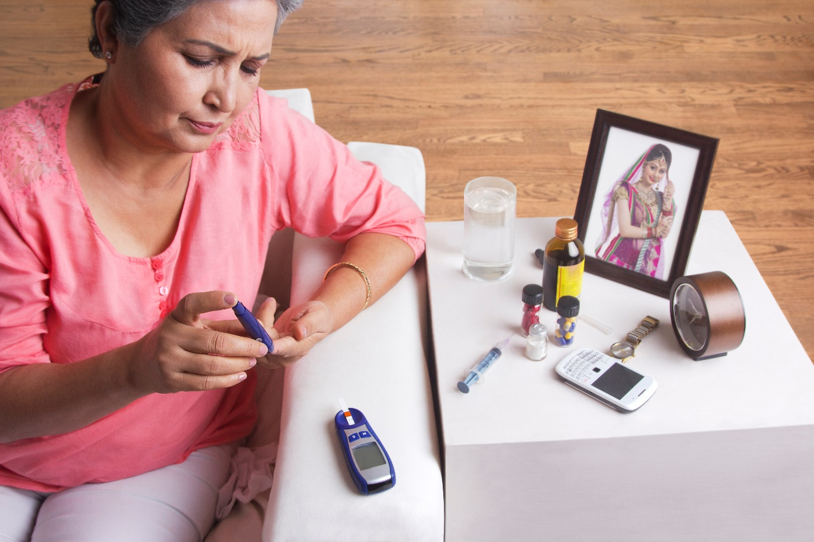
DIABETES 101:
THE ESSENTIAL FACTS YOU NEED TO KNOW!
Powered by:
©2020 EMPLOYEE WELLNESS SOLUTIONS NETWORK INC. – ALL RIGHTS RESERVED
Notes:
Notes:
- Presentation notes are not to be printed. Please use LNL handout as client resource.
- Video to play on slide 2: Link is provided if you have issues playing it within the presentation for any reason.
- 2 handouts to print so that clients can assess risk and initiate change. The links are here as well as on the last page as a reminder.
Please print the following for your group
https://diabetes.ca/diabetescanadawebsite/media/managing-my-diabetes/tools%20and%20resources/are-you-at-risk.pdf?ext=.pdf
And deciding on change:
https://diabetes.ca/diabetescanadawebsite/media/managing-my-diabetes/tools%20and%20resources/decisional-balance.pdf?ext=.pdf

Slide 2
Are you worried about diabetes?
I
We All Should Be Concerned
Notes:
- PLAY VIDEO

Slide 3
I
What You Need to Know
Common Terms
What Happens When We Eat?
Types 1 & 2 (Description and Symptoms)
Long-Term Effects
Statistics
Risk Factors and Complications
Good News: Reduce Chances, Prevent Complications
Prevention: Healthy Eating, Active Living, Healthy Measurements
Handouts & Resources
101
www.EWSNetwork.com

Slide 4
I
Common Terms Explained
Diabetes
A group of metabolic diseases featuring high blood glucose (sugar) levels caused by problems with insulin production. It is generally called type 1 or type 2 diabetes.
Prediabetes
A condition where individuals have higher than normal glucose levels, but not yet high enough for a diagnosis of diabetes.
Blood Glucose
The main sugar found in the blood and the body's main source of energy.
Insulin
A hormone that regulates the way glucose is stored and used in the body. The beta cells of the pancreas make insulin.
A1C
Also known as HbA1c, it is a blood test that shows the average amount of sugar in your blood over three months. It shows how well you are controlling your diabetes.
Notes:
Expand on Diabetes definition:
Normally, insulin, a hormone produced in the pancreas, controls blood glucose levels, but people with diabetes either do not produce insulin or their insulin does not work properly. Diabetes cannot be cured, but it can be controlled through medication, diet, and exercise.
Expand on Blood Glucose:
The A1C blood test is used to measure a person's average blood glucose level over 2 to 3 months. Type 2 diabetes is usually diagnosed based on elevated fasting blood glucose (7.0 millimole/liter (mmol/L) or greater).
Expand on Prediabetes as prevention:
Prediabetes can be an opportunity for you to improve your health.
-https://www.medtronicdiabetes.com/diabetes-care/about-diabetes/diabetes-glossary
https://www.canada.ca/en/public-health/services/chronic-diseases/reports-publications/diabetes/your-guide-diabetes.html#Dia

Slide 5
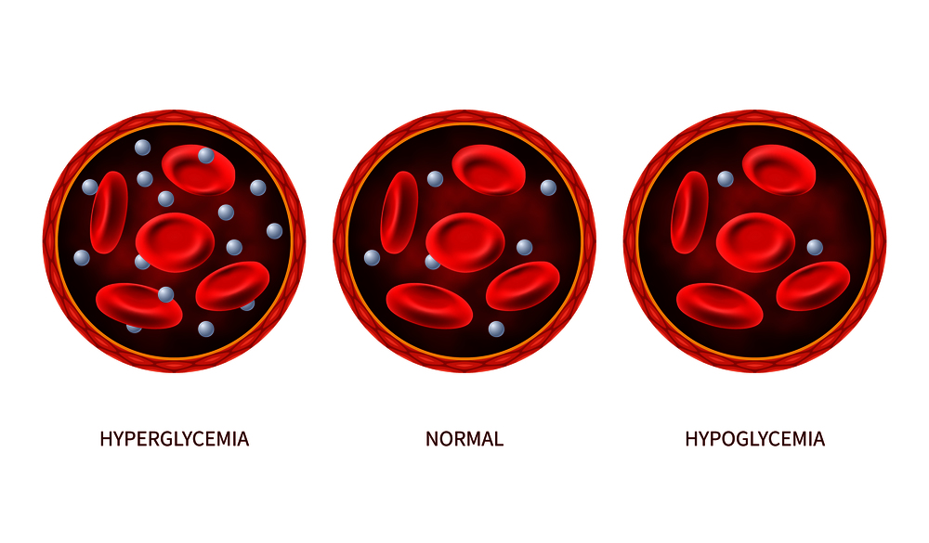
I
Human Glucose Levels
Notes:
Hyperglycemia: Blood glucose that is too high is known as hyperglycemia. Any carbohydrate-containing food such as starches, fruit, milk, yogurt, and sweets will raise blood glucose.
Hypoglycemia: When blood glucose drops too low, this is known as hypoglycemia. Hypoglycemia is most commonly caused by diabetes medication used to lower blood glucose, but sometimes they can overcorrect and cause blood glucose to drop too low.
This can happen if somebody taking these medications skips meals, exercises more than usual, or takes the medications incorrectly.
Hypoglycemia is rare in those without diabetes, but can also be caused by kidney issues, certain GI problems, tumors, or liver disease.

Slide 6
I
What Happens When We Eat
Normal Blood Glucose Control
x
High Blood Glucose
Too little insulin is made
Cells aren’t using insulin efficiently
Liver releases too much glucose
Build up of Blood Glucose
Insulin is released in the right amount
Insulin helps glucose enter the cells
Insulin is released at the right time
Insulin stays in a healthy range
Glucose remains in the bloodstream
Notes:
Normally, the pancreas will excrete insulin to move glucose out of the blood and into the cells. From here, it is used for energy. When the cells don’t properly absorb glucose, it results in a buildup of glucose in the blood after food is eaten. Hyperglycemia
Impaired glucose tolerance happens when the pancreas either does not release enough insulin or the cells become resistant to the insulin. Insulin resistance (or impaired glucose tolerance)
Being overweight increases your risk of insulin resistance. The cells in the body become less sensitive to the insulin that is released from the pancreas. There is some evidence that fat cells are more resistant to insulin than muscle cells. If a person has more fat than muscle, or a high BMI, the insulin becomes less effective and glucose circulates through the blood rather than used as energy.
https://www.verywellhealth.com/what-to-know-about-insulin-resistance-1087434

Slide 7
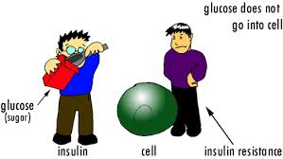
I
Insulin Resistance
Notes:
Cartoon to explain how insulin works/doesn’t work

Slide 8
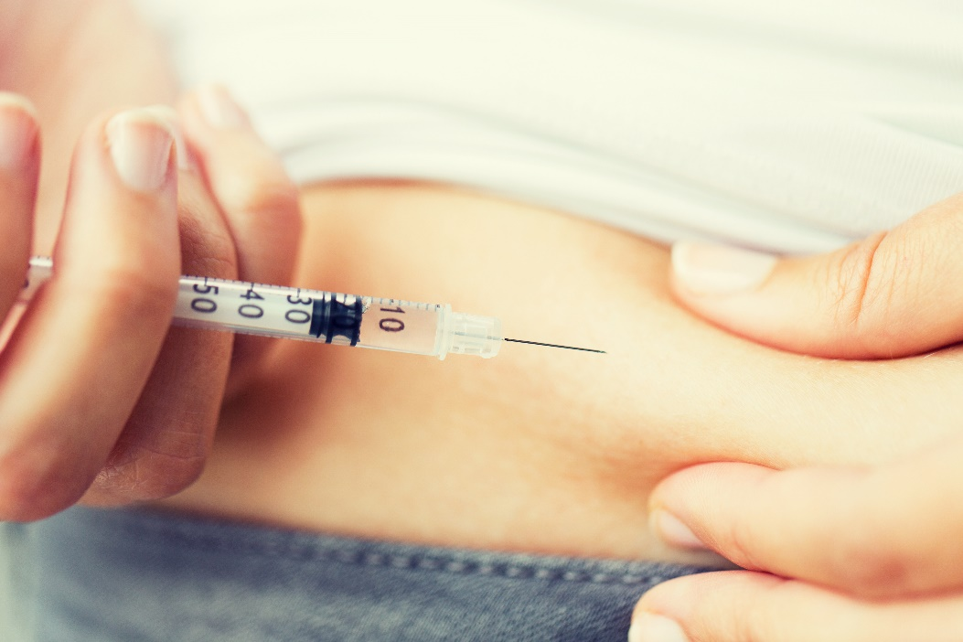
I
Diabetes by Type
Type 1 Diabetes
Previously called juvenile diabetes or insulin-dependent diabetes
A disorder of the body’s immune system that results in the pancreas not producing any insulin
Most often detected early in life
There is no cure
Type 2 Diabetes
Previously called adult-onset diabetes
Results when the body doesn’t respond appropriately to insulin - a condition called “insulin resistance”
The more common variety
Most often found adults >40 and runs in families
Can be controlled with weight management, good nutrition, and exercise

Slide 9
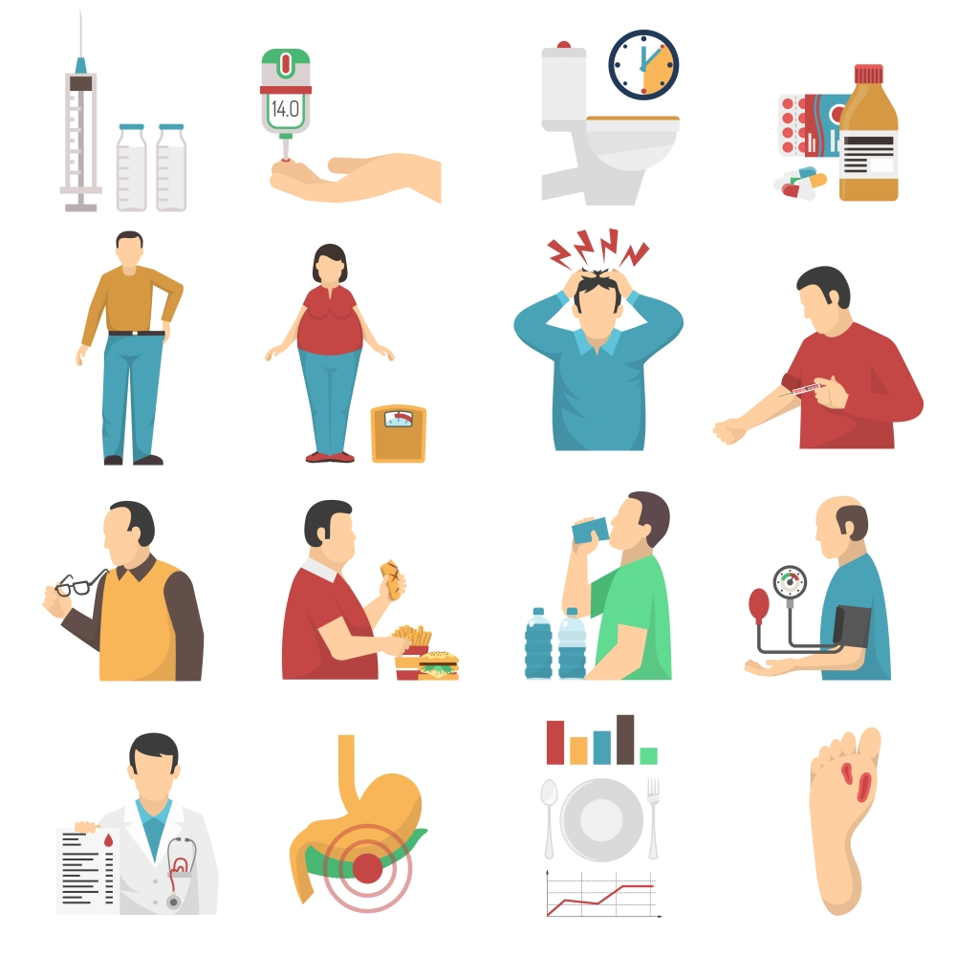
I
Symptoms
Constant thirst
Frequent urination
Fatigue
Blurred vision
Frequent infections
Slow-healing injuries
Unplanned weight loss

Slide 10
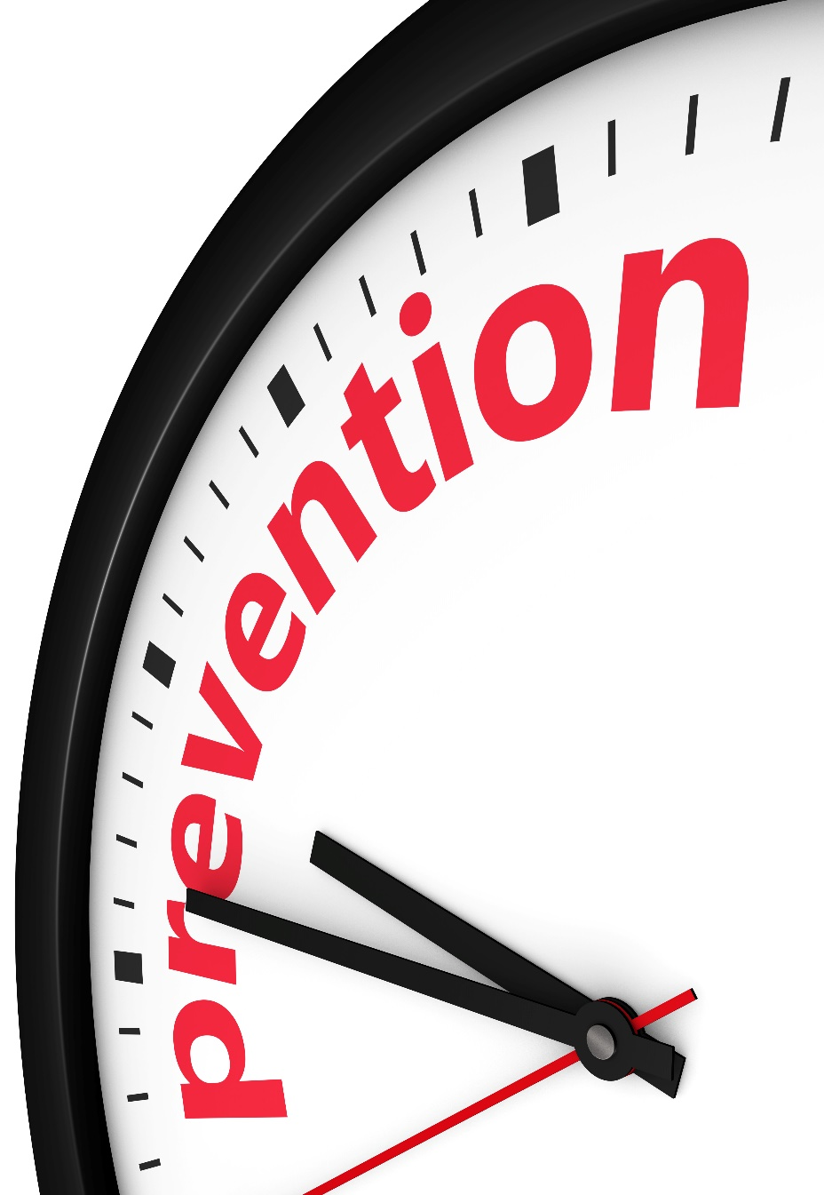
I
Long-Term Effects of Diabetes
Are you aware of the long-term effects of diabetes?
Damage to arteries
Vision loss/blindness
Loss of circulation
Damage to kidneys
Nerve cell damage
You can delay or prevent these complications by taking care of yourself and managing diabetes.
Notes:
Damage to arteries leads to heart attack and stroke
Vision loss due to damaged arteries in the eyes
Loss of circulation in the legs and feet, which can lead to amputation or erectile dysfunction
Kidneys can become damaged and fail if diabetes is poorly controlled for a long time
Nerve cell damage leads to loss of feeling to touch, heat, cold, and pain

Slide 11
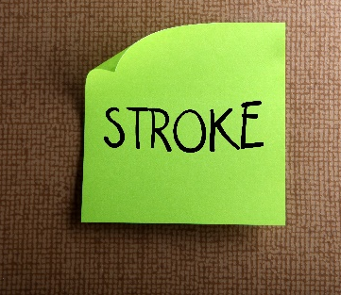
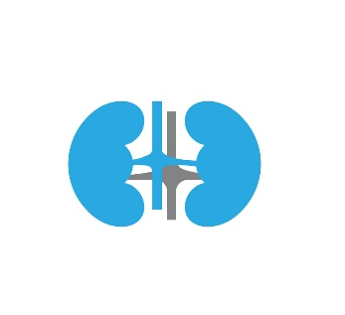
Diabetes in Canada – What Are The Numbers?
I
3.6 million
1 in 10
30%
Canadians are living with diagnosed type 1 or type 2 diabetes in 2019
31%
15 years
40%
Diagnosed diabetes in 10 years
Reduced life span
3x
12x
20x
25x
50%
More likely to be hospitalized with CVD
More likely to be hospitalized with end stage renal disease
More likely to be hospitalized for non-traumatic lower limb amputation
Higher risk of blindness
Notes:
It is expected that, in 10 years, diagnosed diabetes will rise by 31%.
Diabetes can reduce lifespan by five to 15 years.
Every year diabetes contributes to:
30% of strokes
40% of heart attacks
50% of kidney failure
70% of non-traumatic lower limb amputations
https://www.diabetes.ca/DiabetesCanadaWebsite/media/About-Diabetes/Diabetes%20Charter/2019-Backgrounder-Canada.pdf

Slide 12
I
Risk Factors
Are you at risk?
Type 1 Diabetes | Type 2 Diabetes
Genetics | Genetics
Race | Race
Viral Infections | Weight
Autoimmune Conditions | Health
 | Exercise
 | Diet
 | Age and Sex
There are steps that can be taken to prevent the onset of type 2 diabetes
Notes:
https://www.endocrineweb.com/conditions/type-1-diabetes/type-1-diabetes-risk-factors
Type 1
Family history: If a family member has or had Type 1 diabetes, your risk is higher. It is important to note that diabetes is a combination of family history and lifestyle/environmental factors. The genetic mutations that cause diabetes involve the proteins responsible for insulin production or the ability of the body to use insulin.
Race/ethnicity: Certain ethnicities have a higher rate of type 1 diabetes. In the United States, Caucasians seem to be more susceptible to type 1 than African-Americans and Hispanic-Americans. In China, type 1 diabetes rates are 10 to 20 times lower than in Europe, Australia, and North America. Finland’s rates of type 1 diabetes are the highest in the world: 60 out of every 100,000 people - almost 3x the U.S. average.
The vast differences indicate that the genetic makeup of ethnic groups likely plays a role in development of type 1 diabetes.
People in northern countries are also at a higher risk. Reasons are unclear, but experts speculate that it’s related to living indoors, lack of sunlight, etc.
Viral infections: Researchers have found that certain viruses may trigger the development of type 1 diabetes by causing the immune system to turn against the body instead of helping it fight infection and sickness. Viruses that are believed to trigger type 1 include German measles, coxsackie, and mumps.
Other autoimmune conditions: As explained above, type 1 diabetes is an autoimmune condition because it causes the body’s immune system to turn against itself. There are other autoimmune conditions that may make you more likely to develop type 1 such as Grave’s disease, Hashemites’ thyroiditis, multiple sclerosis, celiac disease and pernicious anemia.
Type 2
Genetics: While there is a relationship between diabetes risk based on a diagnosis in family, it is likely more lifestyle-based than genetic. There may be a genetic factor as well, however.
Race: People who are African American, Alaska Native, American Indian, Asian American, Hispanic/Latino, Native Hawaiian, or Pacific Islander are at higher risk for type 2 diabetes, even if they are not overweight.
https://www.niddk.nih.gov/health-information/diabetes/overview/risk-factors-type-2-diabetes
Weight: Being overweight or obese is a strong risk factor, especially if BMI is 26 or higher. For Asian Americans, 23 or higher. For the Pacific Islands, 26 or higher.
Health: Cardiovascular health conditions, such as high blood pressure, low HDL (good cholesterol) and high triglycerides increase your risk. A history of chronic disease like heart disease and stroke are also associated with type 2 diabetes. Depression and PCOS are also related.
https://www.ncbi.nlm.nih.gov/pmc/articles/PMC4826609/
Exercise: regular physical activity is one of the most important things you can do to lower your blood sugar. Increased physical activity can work just as effectively as some medications, but with fewer side effects.
If you're at risk of developing type 2 diabetes, regular exercise can help delay or even prevent diabetes from developing. Regular physical activity also helps:
- prevent sugar from building up in your blood
- lower your blood pressure (since your muscles use sugar for energy)
- reduce your risk of developing type 2 diabetes
https://www.diabetes.ca/managing-my-diabetes/tools---resources/physical-activity
Lack of exercise and a sedentary lifestyle: Time spent watching TV was positively associated with risk of obesity and type 2 diabetes. In the multivariate analyses adjusting for age, smoking, exercise levels, dietary factors, and other covariates:
- Each 2h/d increment in TV watching was associated with a 23% increase in obesity and a 14% increase in risk of diabetes.
- Each 2-h/d increment in sitting at work was associated with a 5% increase in obesity and a 7% increase in diabetes.
- In contrast, standing or walking around at home (2 h/d) was associated with a 9% reduction in obesity and a 12% reduction in diabetes.
-Each 1 hour per day of brisk walking was associated with a 24% reduction in obesity and a 34% reduction in diabetes. We estimated that, in our cohort, 30% of new cases of obesity and 43% of new cases of diabetes could be prevented by adopting a relatively active lifestyle (<10 h/wk of TV watching and > or =30 min/d of brisk walking). https://www.ncbi.nlm.nih.gov/pubmed/12684356/
Diet: Diet is a factor that can help to prevent and reverse diabetes and its complications. Dietary habits and sedentary lifestyle are the major factors for rapidly rising incidence of diabetes among developing countries. In type 2 diabetics, elevated A1c level has also been considered one of the leading risk factors for developing complications. Improvement in the elevated HbA1c level can be achieved through diet management to prevent complications. Awareness about prevention, complications and improvement in dietary knowledge can lead to better control and prevention of the disease as well as quality of life.
https://www.ncbi.nlm.nih.gov/pmc/articles/PMC5426415/
What is best? Explain that this would be a lunch-and-learn on its own, but recommend the standard: Plant-based diets, more fruits and vegetables, less saturated fat and salt, elimination of processed foods, sugar, alcohol…etc.
Age & Sex: The steep rise of type 2 diabetes mellitus (T2DM) and associated complications go along with mounting evidence of clinically important sex and gender differences. T2DM is more frequently diagnosed at lower age and body mass index in men; however, the most prominent risk factor, which is obesity, is more common in women.
https://www.ncbi.nlm.nih.gov/pmc/articles/PMC4890267/
Many factors can play a role including, for example, menopause:
Study: Researchers from the Netherlands examined medical histories, lifestyle information and many other health factors related to about 3,600 women. None of the women had diabetes at the start of the study. Over an average of 9.2 years of follow-up, 348 of the women developed diabetes.
- Premature menopause. Women who reached natural menopause before age 40 were nearly four times more likely to develop diabetes than women who reached it after age 55 (late menopause).
- Early menopause. Women who reached menopause between ages of 40 and 44 were more than twice as likely to develop diabetes as those who reached it after 55.
- Normal menopause. Even women who reached menopause at so-called normal age (45 to 55 years) had 60% increased risk of developing diabetes compared with women who experienced late menopause.

Slide 13
Good News:
Prevention and Reduce Complications
I
Whether you have a family history of diabetes, have pre-diabetes, or are at risk for diabetes, there are actions you can take.
We can reduce the chances of developing type 2 diabetes with reversible and preventable factors:
Weight control and maintenance
Physical activity
Healthy lifestyle
Stress management
Medications, if needed, to control blood sugar

Slide 14
I
Prevention Strategies
Research shows that physical activity and especially healthy eating help to lower the risk of diabetes and other chronic conditions, and can help you move toward or maintain a healthy weight.
www.EWSNetwork.com

Slide 15
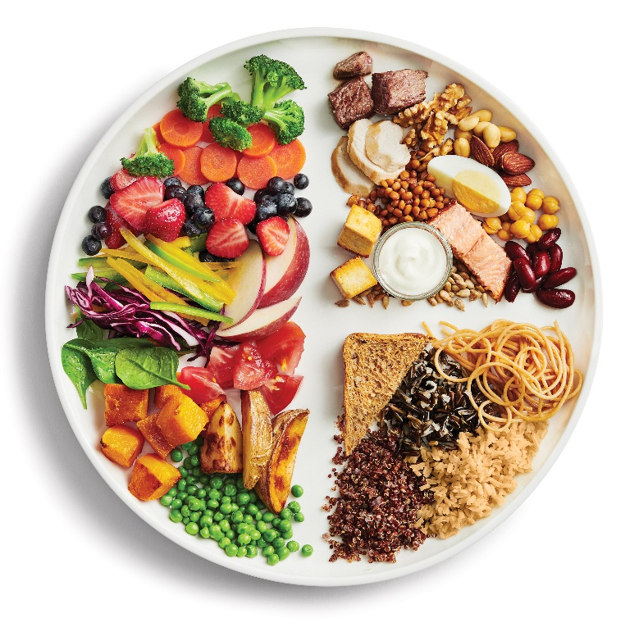
I
Prevention: Healthy Eating
Food is the key to preventing or managing diabetes. Eat healthy foods that provide the nutrition you need to keep your blood sugar balanced and your energy high.
Eat every 2-3 hours
Limit sugars and sweets
Limit foods high in saturated and trans fats
Eat more fibre
Drink more water
Follow Canada’s Food Guide to healthy eating or consult a Dietitian or Nutritionist
Notes:
Aim for three meals a day at regular times. Eating regularly gives your body energy throughout the day and helps keep blood glucose steady.
Check out the Eat Well Plate from the Canada Food Guide to help balance portion sizes and food choices.
Fill half your plate with fruits and veggies, which are high in fibre and packed with nutrition.
Choose high fibre whole grains such as oats, millet, brown or red rice, quinoa and whole grain whole wheat, rye or barley. High-fibre foods digest slowly and can help keep blood glucose in a healthy range.
Include plant-based meat alternatives such as tofu, and choose fish, lean meat and poultry.
Limit added sugar. High-sugar food leads to high blood glucose and the need for more insulin.
If you have diabetes or are at high risk of diabetes, please consult your physician, a dietitian, or nutritionist for a diet that can be tailored to your specific needs.

Slide 16
I
Prevention: Active Living
Physical activity is important for health and wellbeing, whether you have diabetes or not.
Regular physical activity increases your sensitivity to insulin.
Aerobic exercise helps keep your blood sugar down.
Resistance training can increase muscle mass, which helps to lower blood glucose.
A fitness program should include both.
Being active can help you:
maintain a healthy weight.
reduce cholesterol and blood pressure.
Reduce stress and tension and improve mood.
Improve sleep and mental activity.
Make time every day
Move more and sit less
Start slow and increase efforts
Aim for 150 minutes per week
www.EWSNetwork.com
Notes:
- When you are physically active your body responds better to insulin and you have better control of your blood sugar.
- When your muscles use the glucose in your blood as fuel, it helps to keep your blood sugar down.
- Muscles use glucose as fuel, so the more muscle mass there is, there is a reduction insulin resistance.
- Being at a healthy weight is associated with better ability to control blood sugar levels, which can help prevent the progression to type 2 diabetes.

Slide 17
I
Prevention: Lower Your Risk
How Do You Measure Up?
Healthy Measurements:
A1C < 7
Blood pressure < 130/80 with diabetes
< 140/80 without diabetes
Cholesterol LDL < 3.0 mmol/L
(High risk < 2.0 mmol/L)
HDL > 1.0 mmol/L
BMI 18.5-24.9
www.EWSNetwork.com
Notes:
We can reduce the chances of developing diabetes complications:
Blood glucose/blood pressure/cholesterol control
Regular visits to healthcare providers
Early detection and treatment of complications
A healthy BMI and body weight
Follow a balanced meal plan
Be physically active
The Body Mass Index (BMI) is a simple, widely accepted way of assessing body weight in relation to health for most people aged 20 to 65. Exceptions include people who are very muscular, athletes, and pregnant or nursing women. The BMI is a statistical measure of the weight of a person scaled according to height. BMI is calculated by dividing the individual's body weight by the square of their height (Kg/m2).
https://www.cfpc.ca/uploadedFiles/Resources/Resource_Items/Patients/Cholesterol_EN.pdf
https://www.diabetes.ca/managing-my-diabetes/preventing-complications/high-blood-pressure

Slide 18
I
Resources
Reduce your risk today!
Everyday is a great day for a fresh start!
Make an appointment with your health care provider
Assess your risk
Adjust your diet
Ensure you are active at least 150 minutes per week
www.EWSNetwork.com

Slide 19
Question Time!
I
©2020 EMPLOYEE WELLNESS SOLUTIONS NETWORK INC. – ALL RIGHTS RESERVED
Notes:
There will be a worksheet from Diabetes Canada to assess risk that is found on the LNL Handout
https://diabetes.ca/diabetescanadawebsite/media/managing-my-diabetes/tools%20and%20resources/are-you-at-risk.pdf?ext=.pdf
And deciding on change:
https://diabetes.ca/diabetescanadawebsite/media/managing-my-diabetes/tools%20and%20resources/decisional-balance.pdf?ext=.pdf

