Slide 1
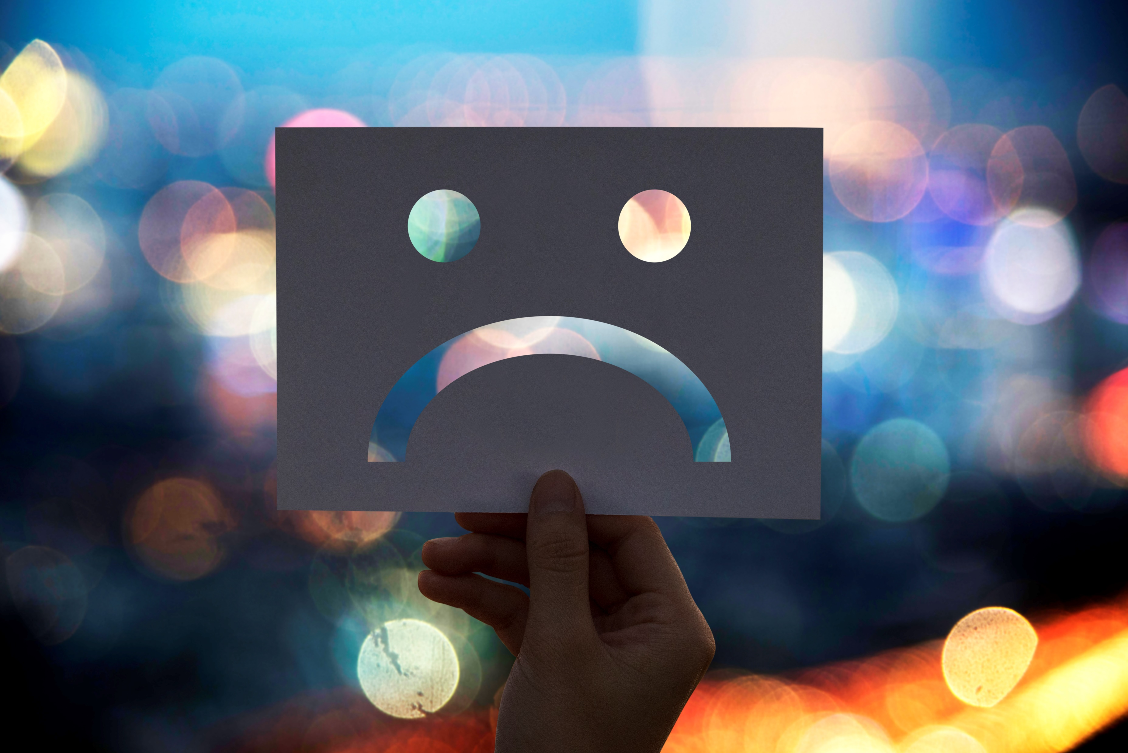
Seasonal Affective Disorder
Getting Through the Dark Months
Notes:
Images by freepik

Slide 2
Overview
An introduction to SAD
Symptoms and causes
Risk factors
Treating SAD with diet and exercise
Other ways to treat SAD

Slide 3
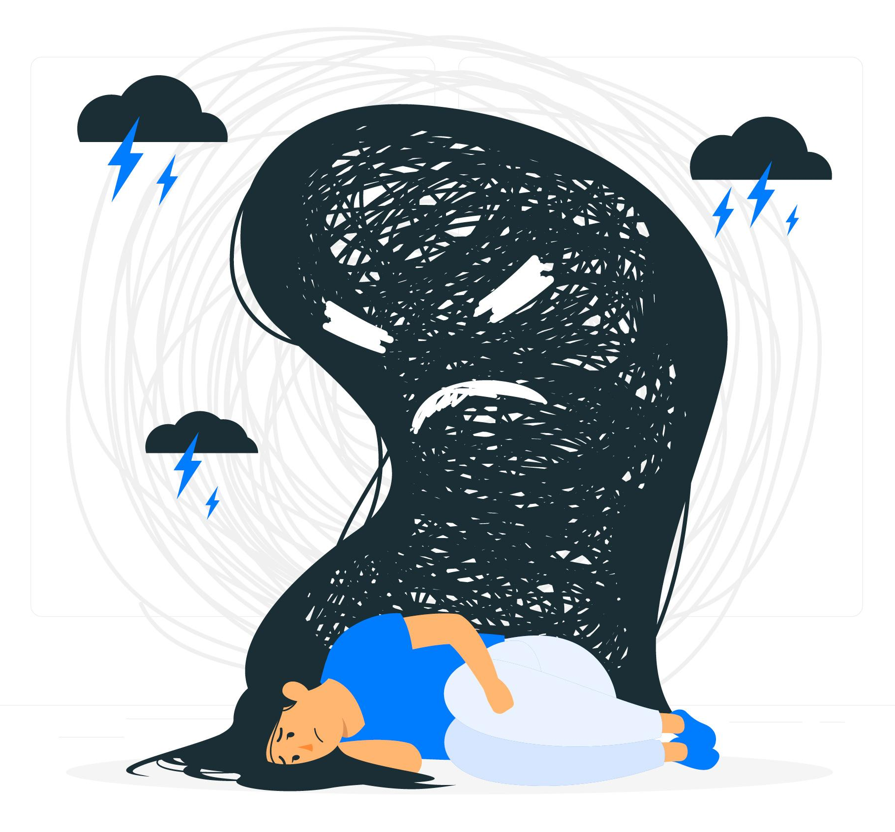
What is Seasonal Affective Disorder?
A condition related to the shortening of daylight hours
A mild to moderate form of depression that occurs during the fall and winter months
Key feature: it’s cyclical. It appears each year as the seasons change and disappears during spring and summer
It’s not the same as the “winter blues”!
Notes:
Winter blues =/= SAD
Most people experience SAD symptoms to a certain extent, especially at higher latitudes. These individuals who do not meet diagnostic criteria for depression during the fall/winter months, but who experience mild to moderate symptoms during fall or winter, are considered to have a milder form of this disorder also known as subsyndromal SAD or the “winter blues.”

Slide 4
The symptoms of SAD
Craving carb-heavy foods
Incorrectly blaming yourself
Difficulty doing easy or enjoyable activities
Difficulty thinking and concentrating
Feeling more lethargic
Difficulty getting up when days are shorter
Oversleeping
Notes:
The symptoms of SAD are exactly the same as non-seasonal depression symptoms
The only difference with SAD is the seasonal pattern it follows.

Slide 5
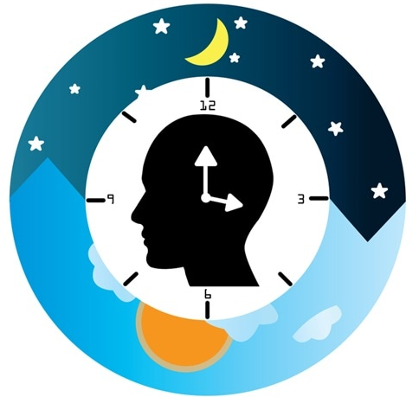
Three main contributors
Circadian Rhythm
Melatonin
Serotonin
Notes:
Circadian Rhythm is your body’s internal clock. Some researchers believe that the shorter days during the winter months “confuse” your internal clock. Thus, your body has trouble regulating when to sleep and wake up.
Melatonin is a sleep related hormone. Your body normally makes more melatonin mid-late evening, it remains high for the night, and then drops in the early morning hours. Light affects how much melatonin your body produces. In the shorter days of the winter months, your body may produce melatonin earlier or later in the day than usual. This increase may lead to depression. Melatonin pills are sometimes used to treat jetlag to help regular your sleeping schedule (hence the picture).
Serotonin is a “feel good” neurotransmitter in the brain (hence the smiley face in the chemical structure picture). Less sunlight can lead to a drop in serotonin.

Slide 6
Are you at risk?
Women more than men
Over 20 years of age
Immediate family members have been affected
Live in the northern latitudes

Slide 7
Treating SAD
Healthy diet
Regular exercise
Regulating sleep
Light therapy
Cognitive behavioural therapy
Medication
The National Institute for Health and Care Excellence recommends that SAD should be treated in the same way as other types of depression.

Slide 8
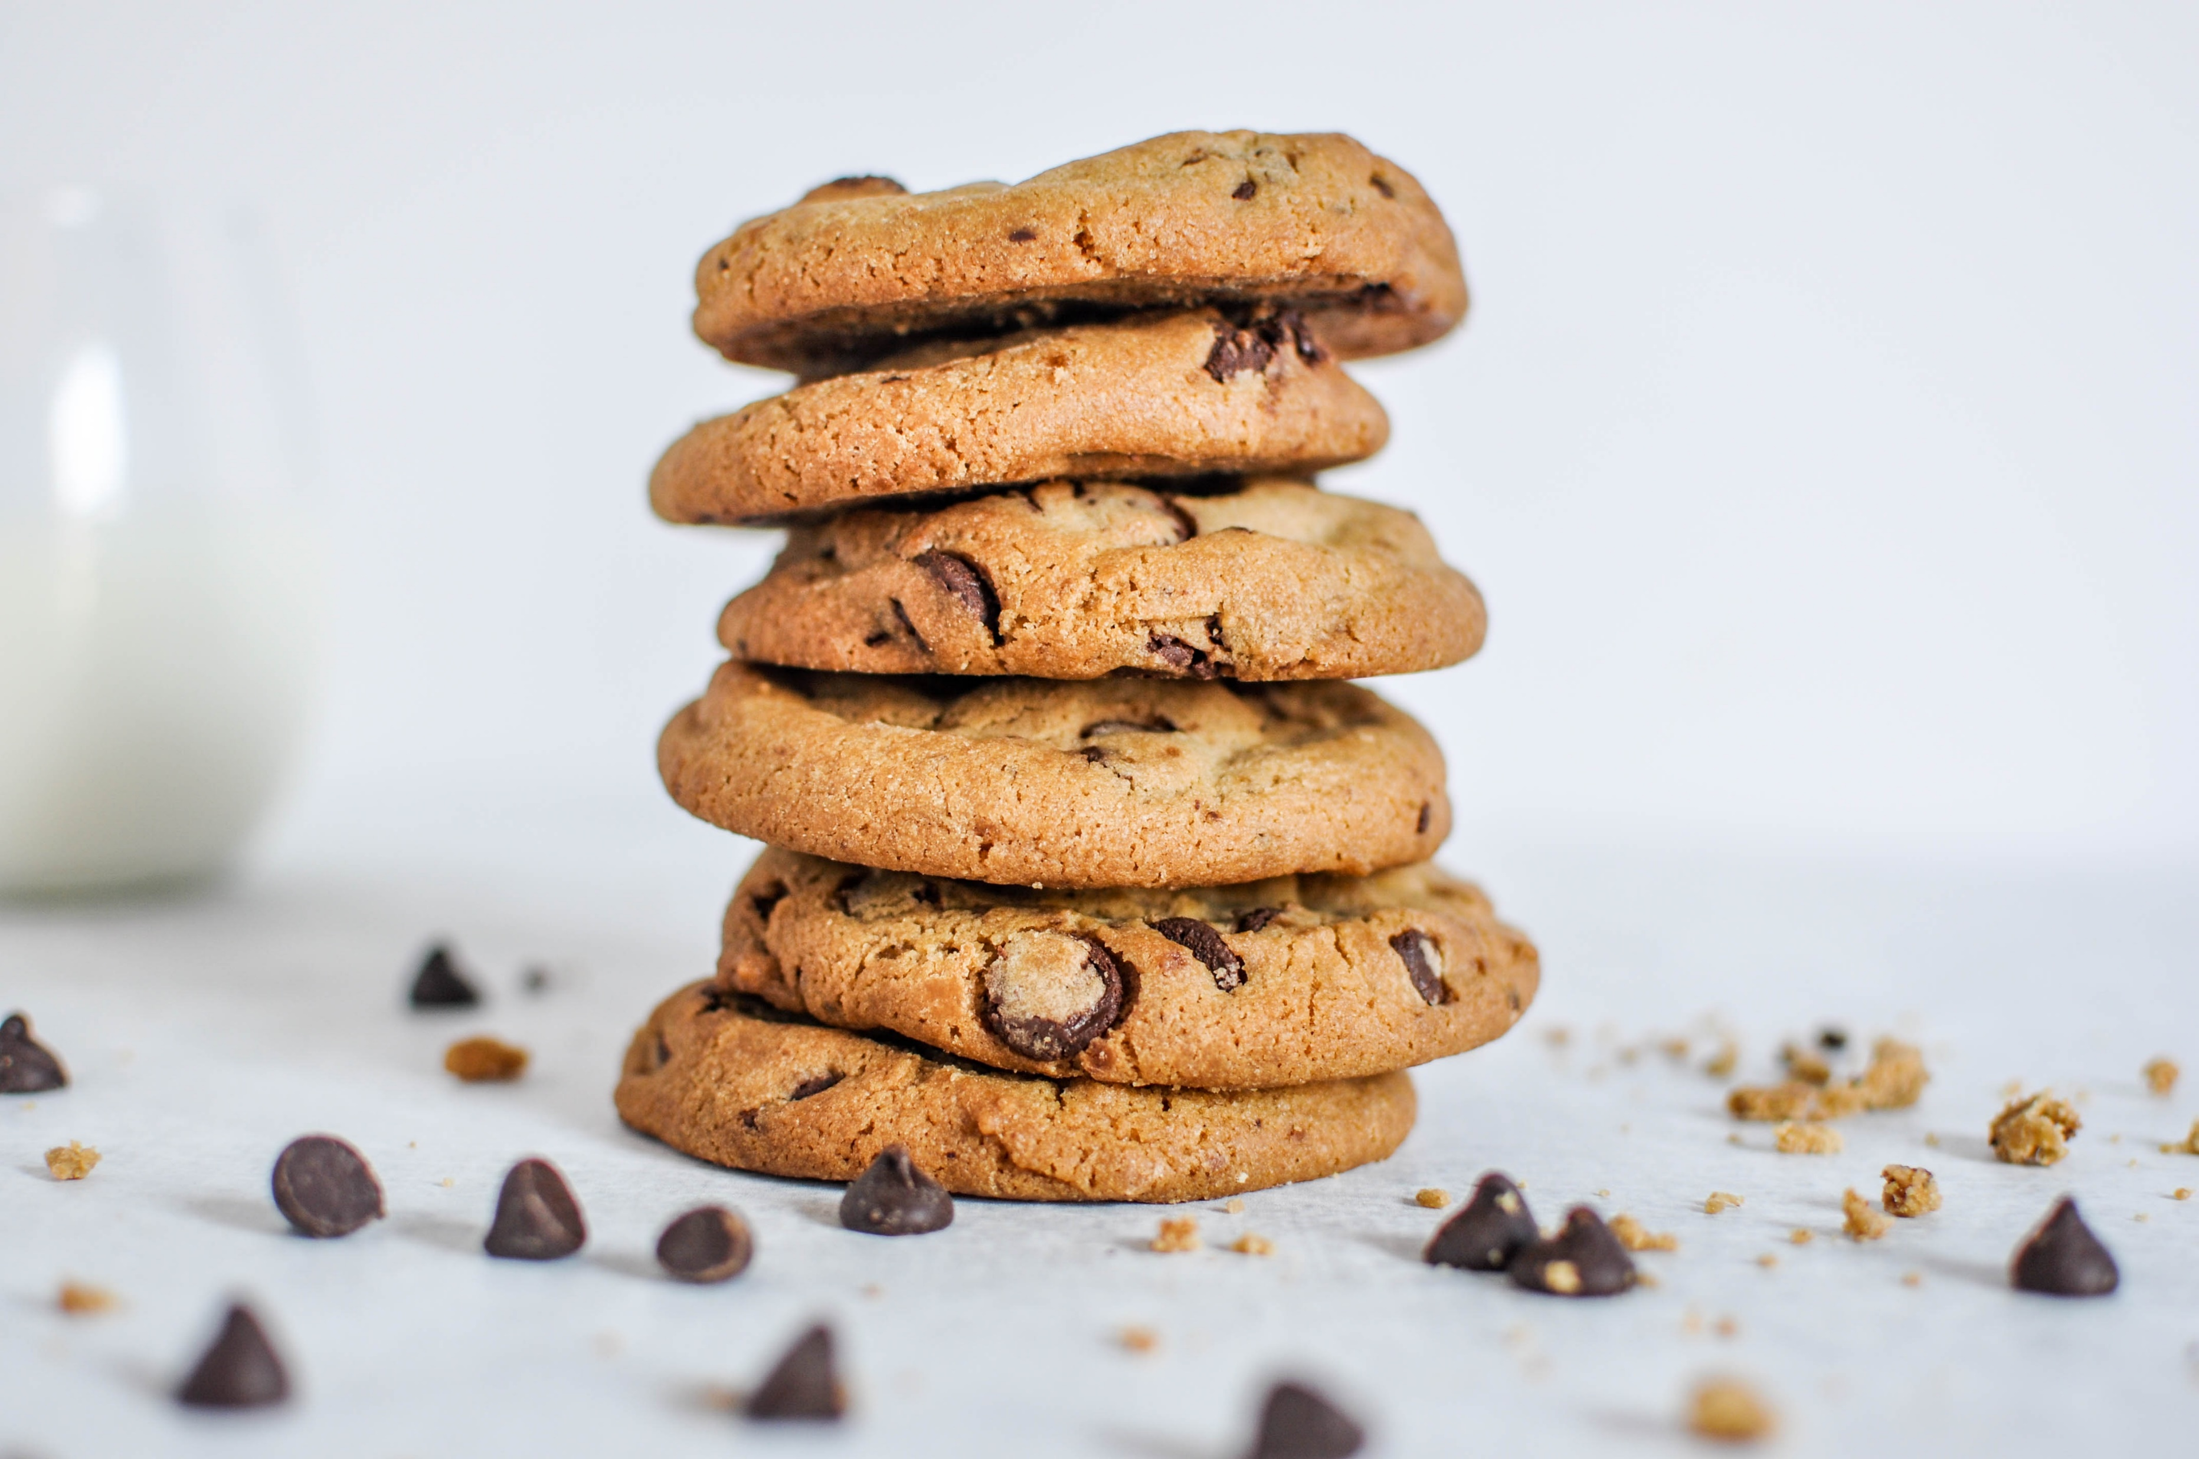
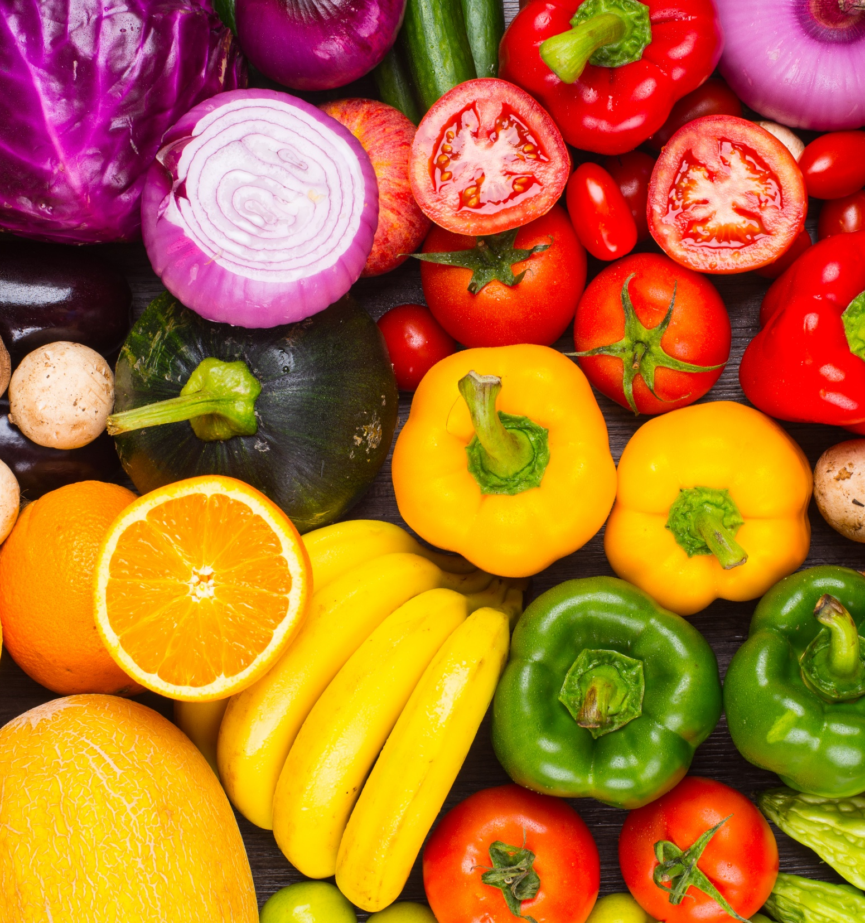
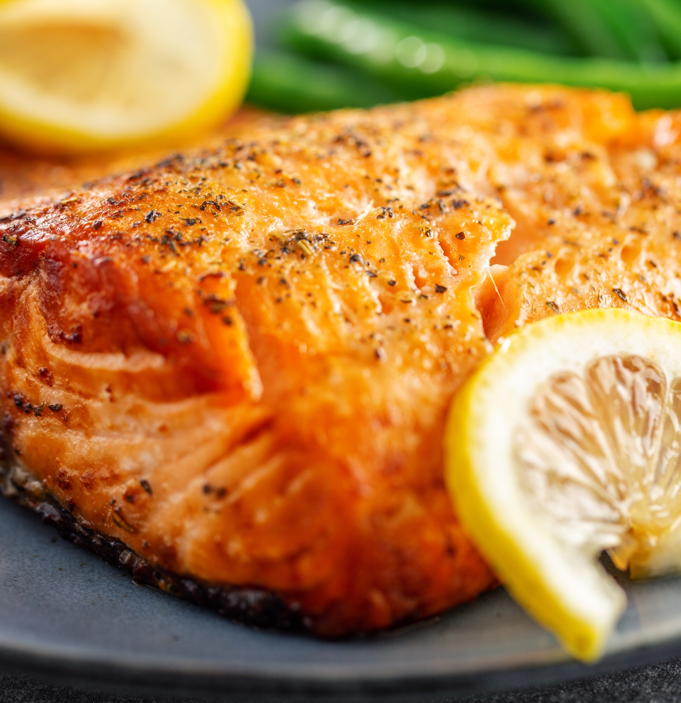
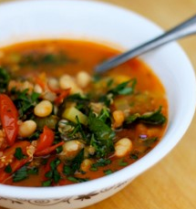
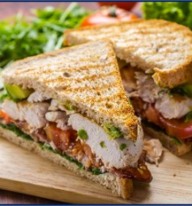
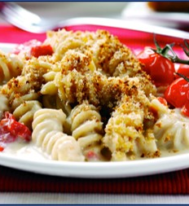
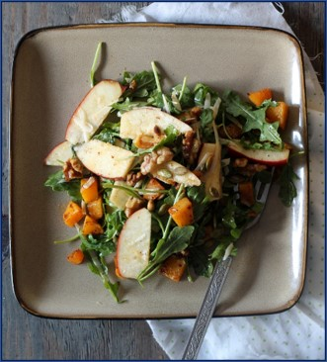
Treating SAD with a healthy diet → Let’s do an activity!
A
B
C
D
E
Avoiding all carbs to keep my glucose levels down
Eating whenever I have time as long as it’s healthy
F
G
H
I
J
Notes:
Say, “In order to help you treat SAD in a more practical way, your task is to determine which items belong in the “Good” category and which belong in the “Bad” category. The “Good” category items help decrease SAD symptoms whereas the bad category items will increase the symptoms”
Go one by one from A to J and get the audience to determine what belongs and what doesn’t belong in the good category. Take up the answers on the next slide once you reach “J”
A: rice and potatoes
B: fruit and veggies
C: fish or salmon
D: Cookie
E: Stew
F: Various white carbohydrates
G: White pasta
H: Salad with squash, nuts, and apples
I: Avoiding all carbs to keep my glucose levels down
J: Eating whenever I have time as long as it is healthy

Slide 9
Treating SAD with a healthy diet
A
B
C
D
E
Avoiding all carbs to keep my glucose levels down
Eating whenever I have time as long as it’s healthy
F
G
H
I
J

Slide 10
Treating SAD with a healthy diet
Good Choices
Reduce SAD symptoms
Notes:
Good: Increase your vegetable and fruit intake, omega 3 proteins (salmon), and have more hearty soups that still have complex carbohydrates and lean protein (squash, barley, sweet potato, quinoa, chick peas, kale). Also, it’s not about avoiding ALL carbs but replacing white carbs (white bread, white rice, white pasta) which complex carbs (whole grains) such as the whole grain sandwich with chicken and veggies.

Slide 11
Treating SAD with a healthy diet
Eating whenever I have time as long as it’s healthy
Bad Choices
Increase SAD symptoms
Avoiding all carbs to keep my glucose levels down
Notes:
Bad: Avoid heavy carb meals like rice and potatoes or white pasta, and high-sugar foods like cookies. We tend to crave carbohydrate-rich food in the winter, but it might be a wise idea to minimize carbs in your diet. Our bodies like the feeling of high sugar and high carb food because boost serotonin levels in the brain. Unfortunately, this can result in a crash later on after the spike in your blood glucose levels have gone down. As said, you do not want to avoid all carbs! This will cause other problems where your body will go in “starvation mode” and deplete other resources that your body needs. Lastly, it is important to eat 3 regular meals with snacks in between to regulate glucose levels – NOT eating whenever you have time even if it’s healthy.

Slide 12
Treating SAD with exercise → Let’s do another activity!
I want to walk outside, but it’s already dark out by the time I leave and get back from work.
I feel very unmotivated to exercise when the weather is bad. I’d rather watch a movie.
I like going outside and running during the warmer months, but not in the Winter!
I have a gym membership but I only go on weekends. I’m too tired to go after work.
Notes:
Activity: Each thought bubble represents a typical challenge or excuse that people make to stay active during the Winter. The audience must come up with solutions to each challenge.
ANSWERS (no specific answer for each challenge, but answers are on their handout … don’t let them to read the handout until the activity is over!):
Blue bubble: Go for walks outside during lunch or before work when there is still light!
Orange bubble: I hate to say it, but you live in Canada and you need to embrace the Winter sports! Try cross-country skiing, snowboarding, or skating. You can even join a walking or running group that occurs during the Winter.
Yellow bubble: Our lack of motivation is one of the hardest things to fight. Set a small goal for yourself each day on how you will stay active and meet that goal! For example, I will only take the stairs today; I will park further from the building; I will take the stairs to go to the washroom one floor above me; I will do a 10 minute YouTube workout video right when I get home. Once you start achieving more goals each week, you will gain the confidence to set bigger goals and try to keep them.
Red bubble: Sometimes, we’re too tired after work because we haven’t been eating foods that can fuel us for a workout afterward. Try snacking on fruit, nuts or yogurt and granola mid-afternoon to help you get energized. If you set a schedule of which weekdays you will go to the gym, make sure you are eating enough to fuel your workout. On the other hand, you might truly be too tired (even if you snack) and an at-home workout DVD (yoga, pilates, kickbox, etc) may be a better choice.

Slide 13
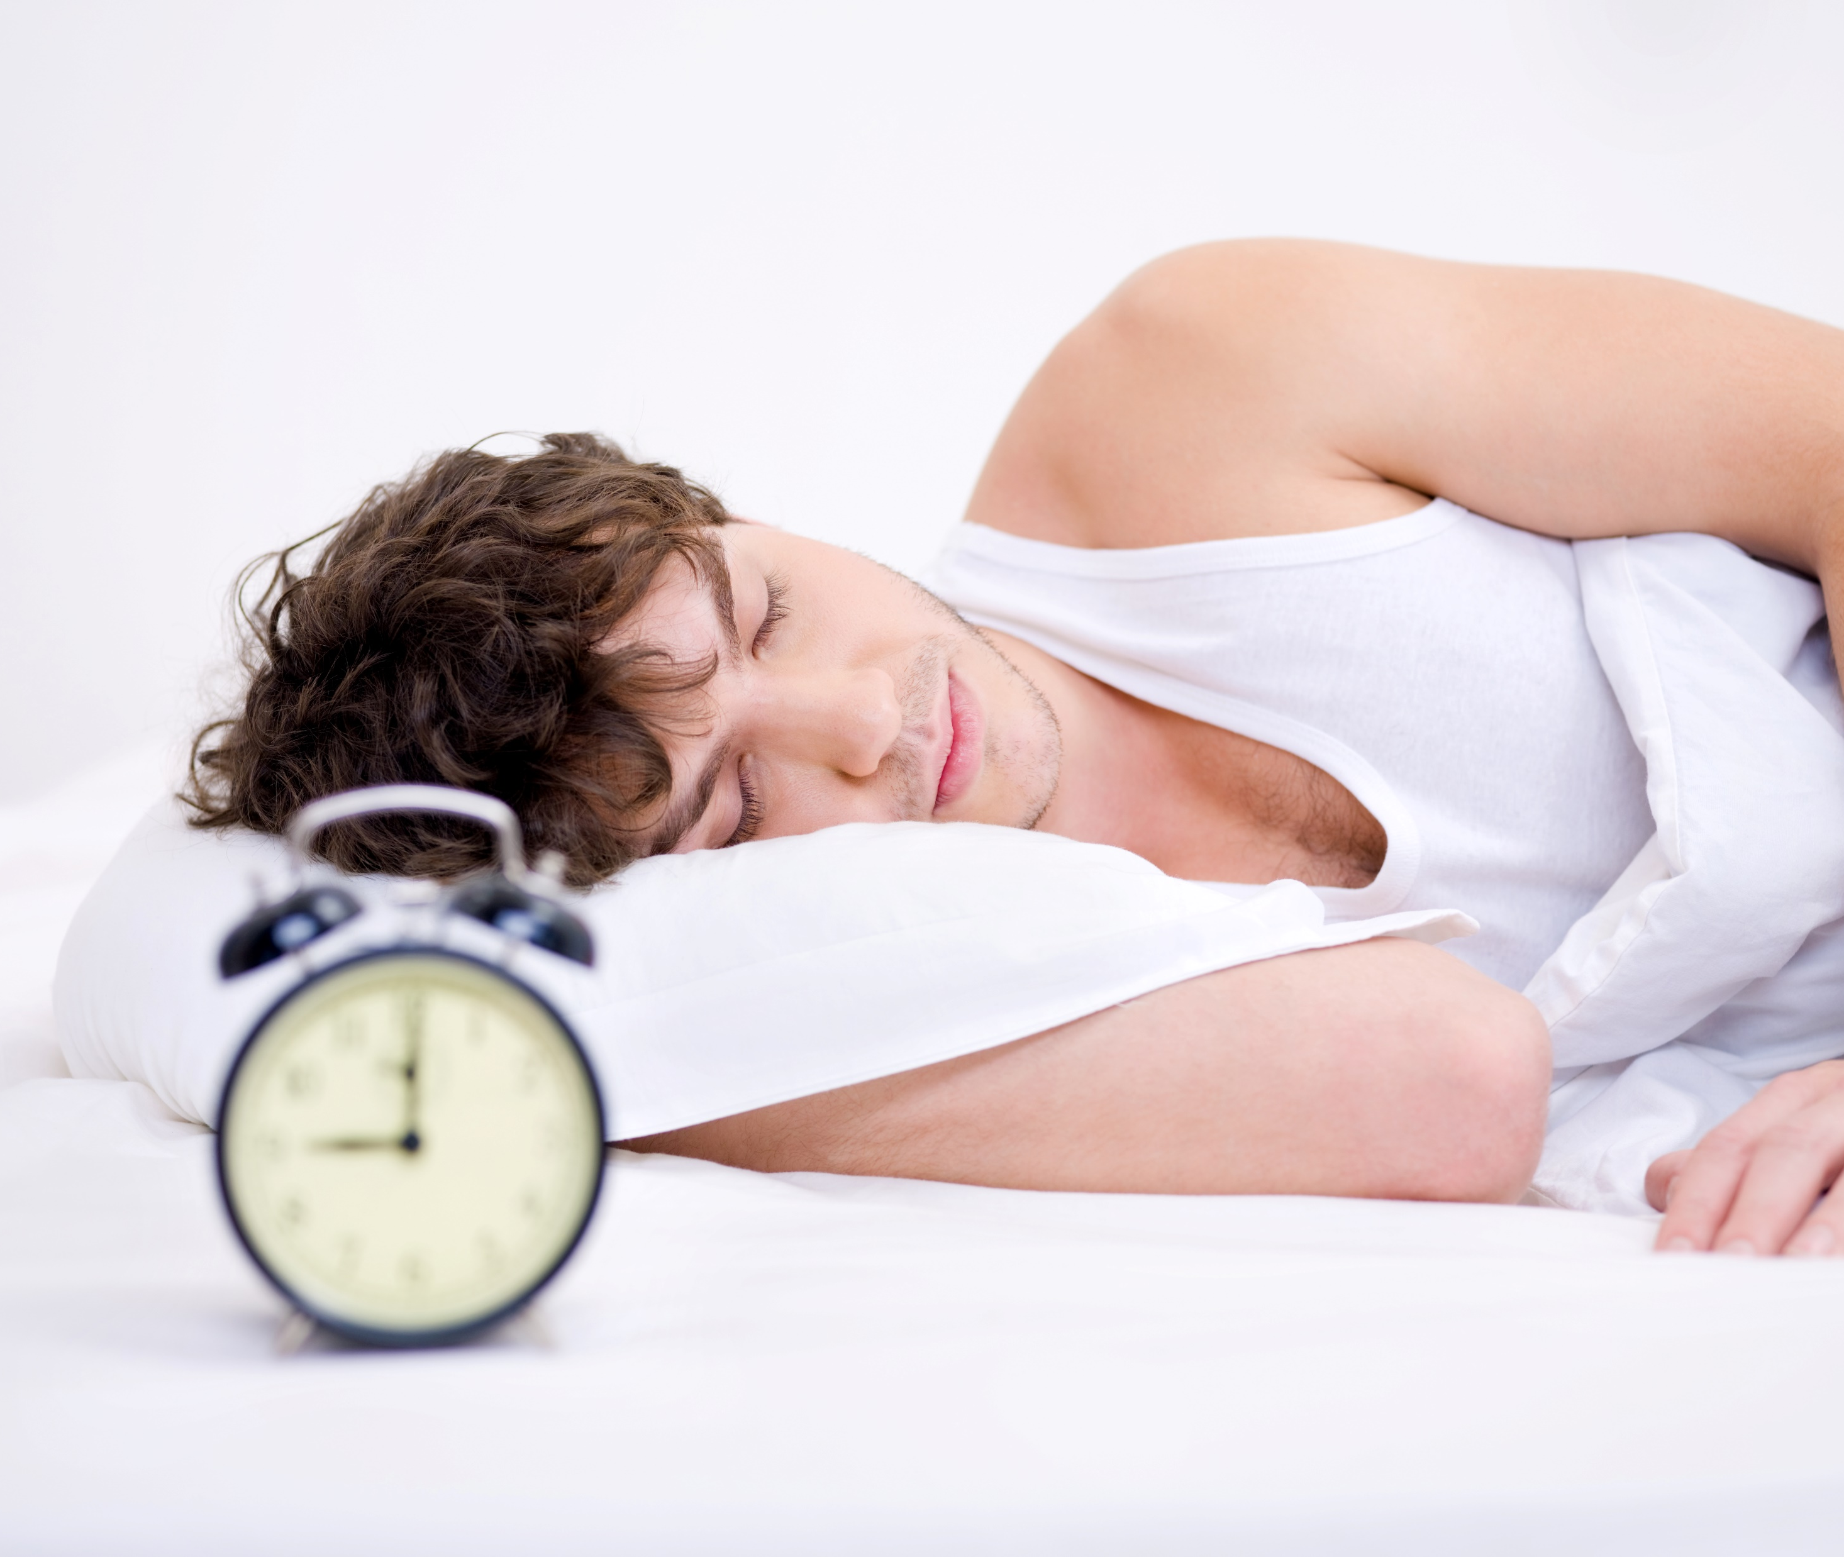
Treating SAD by regulating sleep
Set a regular sleep schedule
Go to bed earlier so you don’t over-sleep
Remember… increased melatonin may lead to increased feelings of depression
Notes:
Here are other ways to treat SAD
If you want to get the most sunshine out of your day, it is really important to be up during the sunlight hours. Set a regular sleep schedule and go to bed earlier so you do not oversleep. Oversleeping and fluctuations in the sleep-wake schedule causes increases in melatonin levels, which can contribute to feelings of depression. Aim to sleep for 7 to 9 hours per night

Slide 14
Treating SAD with light therapy
Uses a light box that is much brighter than indoor lighting
Increases melatonin, decreases serotonin
Effective for 70% of participants after a few weeks¹
Long-term benefits unclear
Commercially available
Compliance and consistency is crucial!
¹National Institute of Health, 2013
Notes:
Light therapy is meant to replace the missing daylight hours with a light box that shines much brighter than ordinary indoor lighting. How it works is it emits a controlled amount of cool, white fluorescent or full spectrum light with a built-in screen to filter out harmful ultraviolet rays.
This encourages your brain to reduce melatonin levels (which makes you sleepy) and increase serotonin levels (which heightens your mood).
Research has shown that light therapy relieves SAD symptoms for 70% of patients after a few weeks of treatment (National Institute of Health, 2013). Although research suggests a positive short-term effect, there is no strong evidence to support its long-term benefits. They are commercially available so make sure you choose a light box that is medically proven to treat SAD and produced by a certified manufacturer
Clinical practice guidelines for SAD recommend daily use of light therapy each year from onset of the first symptom until the time in the spring when SAD symptoms would naturally resolve on their own. Compliance and consistency with the daily regimen are very important for benefits.

Slide 15
Treating SAD with CBT
Cognitive behavioural therapy is based on the idea that the way we think and act may affect the way we feel
Therapist fosters behavioural skills (identify, schedule, doing enjoyable things), and cognitive skills (identify and challenge negative thoughts)
Should counteract the lethargic moods and “hibernation” tendencies
Notes:
CBT starts with the idea that the way we think and behave may affect the way we feel. Changing the way you think about circumstances and how you deal with them can help you feel better. A CBT trained therapist will meet with you over several weeks either through an individual, group, or computer-based program depending on your needs
The therapist works with the patient to foster two types of skills: behavioral (doing) skills and cognitive (thinking) skills. The behavioral skills involve identifying, scheduling and doing pleasurable, engaging activities every day in the winter. Over time, these proactive behaviors are meant to counteract the down, lethargic mood and the tendency to give in to “hibernation” urges that are so common in SAD. The cognitive skills involve learning to identify and challenge negative thoughts when experiencing SAD symptoms.

Slide 16
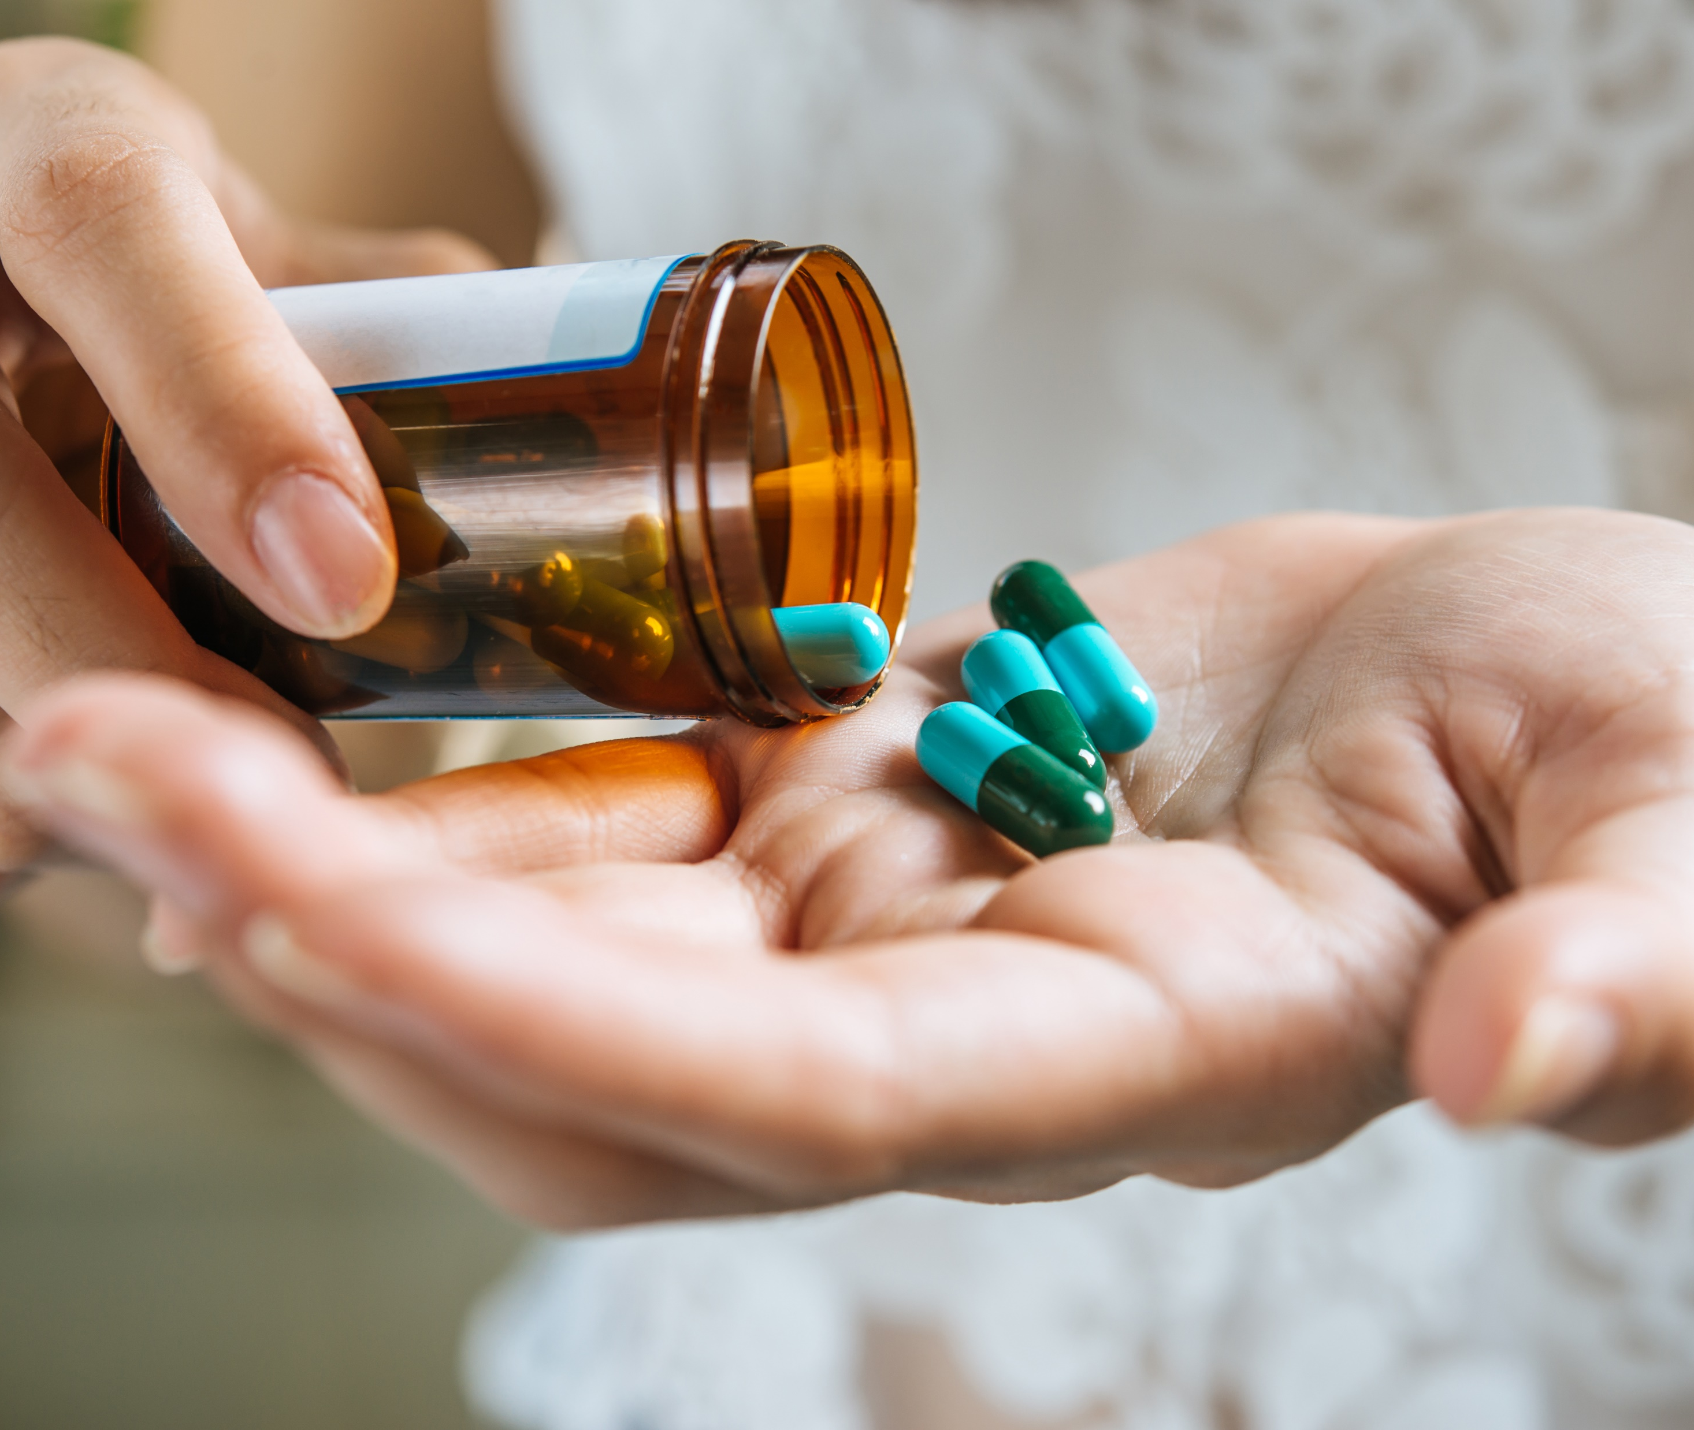
Treating SAD with medication
When severe, SAD can be treated with selective serotonin reuptake inhibitors (SSRIs)
Increases serotonin, which lifts mood
MUST be taken as prescribed and even when you begin to feel better
Notes:
Antidepressants are sometimes used to treat SAD when the symptoms are severe. Selective serotonin reuptake inhibitors (SSRIs) are the preferred type of antidepressants for SAD. It works by increasing the serotonin levels in your brain, resulting in an uplifted mood. Be aware of that it can 4-6 weeks to kick in, should be taken as prescribed and even when you start to feel better, and a common side effect is an upset stomach

Slide 17
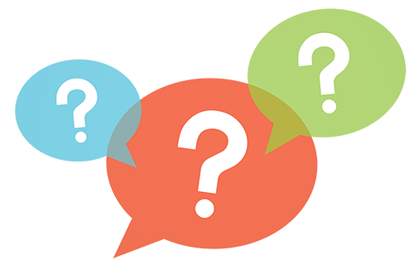
QUESTION TIME!

Slide 18
Armstrong, R. (2007). How to beat the winter blues. The Independent.
Canadian Mental Health Association. (2004). Seasonal Affective Disorder.
Mayo Clinic Staff (2007). Seasonal Affective Disorder. Retrieved from www.mayoclinic.com
National Health Service Choices. (2013). Seasonal affective disorder – treatment. Retrieved from www.nhs.uk
National Institute of Health. (2013). Beat the winter blues: Shedding light on seasonal sadness.
Piccoli, G. (2007). Beating the Winter Blues: A practical guide on how to get through winter at Cornell. Cornell University, Gannett Health Services.
Images by freepik
Resources

