Slide 1

Your Logo Here
We have a
Notes:
WELCOME to the program!
We are very excited to introduce the NEW Corporate Wellness Starter Kit Program that has been offered to us through EWSNetwork. For the next three months they will be sharing some fantastic awareness and educational tools for us to use and share with our families and friends.

Slide 2



“We are passionate about helping people
achieve health and wellness!”
Established in 2003
Amazing Team
Amazing Corporate Clients
Meaghan Jansen, Owner
meaghan@ewsnetwork.com
Notes:
This is Meaghan Jansen – Owner of EWSNetwork
Meaghan leads a team of 30 amazing people - Company was started with one client in London Ontario, now we have clients across Canada
Came out of her masters thesis on health promotion at work.
Meaghan loves all things wellness – she has a very active family (2 kids), loves educating on wellness (presents all over the world) and has a passion for helping people! She also loves distance running.

Slide 3

Wellness Toolbox
Group Wellness
Fun Challenges
Personal Awareness Programs
Onsite Promotions
Family Wellness
Kids’ Wellness Bursaries
Individual Wellness Challenges
Health Coaching
Notes:
Wellness toolbox has evolved over the years – this is a snapshot listing of some of the main categories of wellness and health promotion initiatives. These are additional offerings that can be added to the Starter Kit program if wanted.

Slide 4
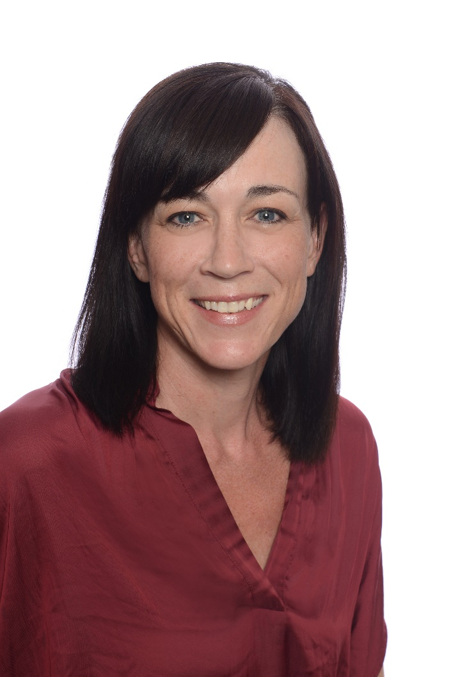

Wellness Program Management
Director of Program Management
  Main contact for Wellness Program and Wellness Team
Communications, messaging, promotion
Group, Awareness, Virtual Wellness
Heather Barrett
hbarrett@ewsnetwork.com
Notes:
Heather has worked with EWSN for the last 9 years. Her 25 year background is in account management and human resources but her personal passions are in all things wellness. She creates, implements and manages the onsite wellness programs for all our clients. Any questions, requests, suggestions on the wellness program offerings can be sent directly to her!
Home base is London
Mom of three sons
Long distance runner
Guilty pleasures – chips!

Slide 5
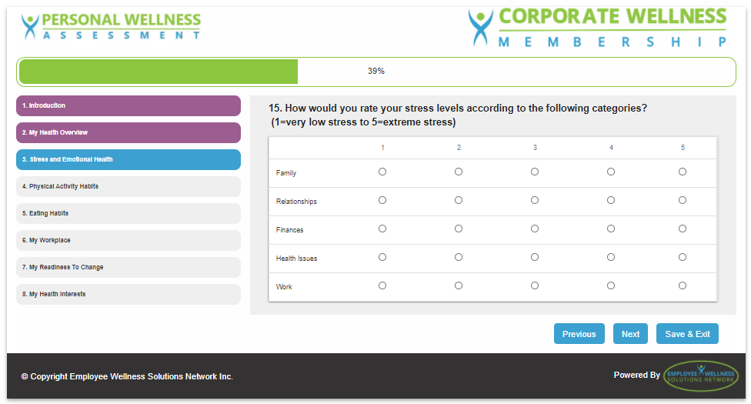
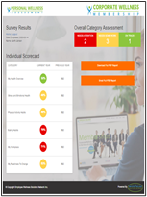


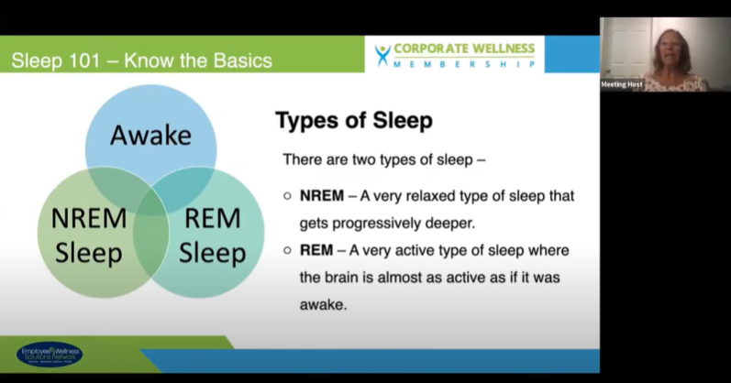
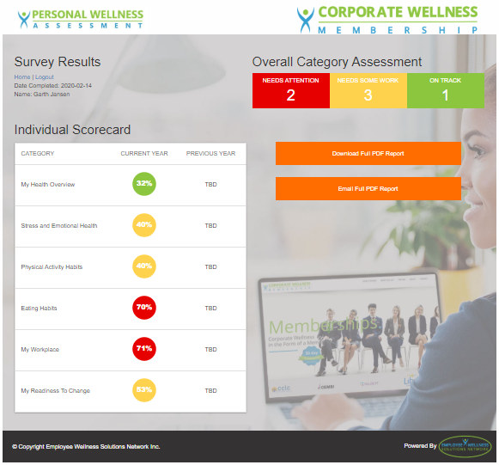
Wellness Membership Starter Kit
Monthly Newsletter
Individual Health Assessment Survey
Mental Wellness E-campaign –
Challenge of Change
Various Wellness Blogs
Family Wellness Webinar – Mike Masse “Mindfulness and Self Compassion”
Notes:
These are all items that will be shared over the next three months.

Slide 6
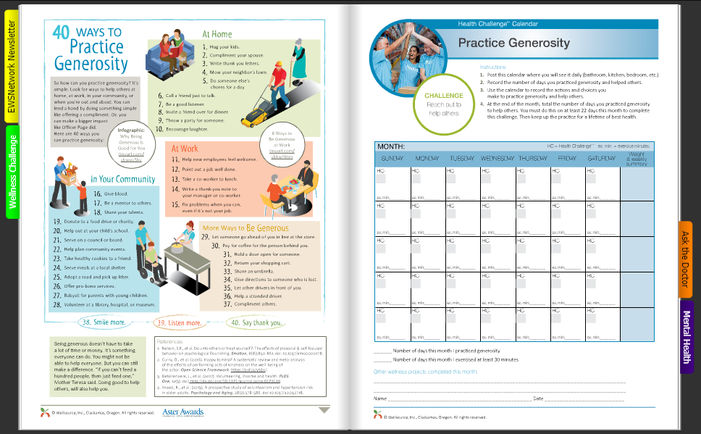
Newsletter and Individual Challenge
Newsletter
Wellness Challenge
Ask the Doctor
Notes:
Newsletter – every month you will receive this. It has different articles each month, a healthy recipe to try at home, the Ask the Doctor section and the individual awareness challenge – these can be nutrition, exercise, sleep, stress, me time, etc. The challenge covers all aspects of wellness. 100% voluntary but great to do with your families

Slide 7

Thank You!
Notes:
We hope you are excited about the wellness program! We start right now!
**indicate the communication chain – identify the main contact person within your organization**

