Slide 1



THE POWER OF
POSITIVE THINKING
Practice Makes Progress
Powered by:
©2019 EMPLOYEE WELLNESS SOLUTIONS NETWORK INC. – ALL RIGHTS RESERVED

Slide 2


The Power of Positive Thinking
I
You Have the Power
What is positive thinking?
Neuroplasticity and the creation of new patterns of thinking
Start with yourself - Positive self-talk, gratitude, practice and assess
Then Others – Positive relationships and interactions
And All Around You – Fostering a positive influence on your environment
www.EWSNetwork.com
Notes:
What is the science behind positive thinking and what are its benefits in our lives
Training a positive brain, positive thought patterns.
Positive thinking begins with you and is something that has to be practiced and used to become a natural attitude
You have the ability to be a positive influence on others by creating positive relationships, building Cognitive flexibility, gratitude & letting go of the past, fostering a positive environment,
Create a positive environment by being responsible for your energy in a room

Slide 3

I
Is it Science or Wishful Thinking?
Psychoneuroimmunolgy (PNI )
Your body’s biochemistry is heavily influenced by what you think, feel, and believe.
Our thoughts can nourish or harm us.
Negative thoughts stem from our beliefs, experiences and the resulting fears.
Our body reflects our mindset.
Positive Thinker!
www.EWSNetwork.com
Notes:
Psychoneuroimmunology: the study of the interaction between psychological processes and the nervous and immune systems of the human body.
https://en.wikipedia.org/wiki/Psychoneuroimmunology
What we think or believe can actually affect the biochemical makeup of our bodies and affect our immune system. Negative thoughts and fears can change a healthy alkaline blood system into an unhealthy acidic one, suppress the immune system, make you more vulnerable to disease, viruses and can lead to illness.
https://www.forbes.com/sites/quora/2016/06/24/this-is-what-negativity-does-to-your-immune-system-and-its-not-pretty/#6137f5ae173b

Slide 4
I
2 – Is it Science or Wishful Thinking?
Positive Thinker!
Psychoneuroimmunolgy (PNI )
Our beliefs and thoughts can influence our
Heart rate,
Blood Pressure,
Digestion,
Immunity,
Ultimately all of our bodily functions.
www.EWSNetwork.com

Slide 5

I
3 - Is it Science or Wishful Thinking?
Benefits to psychological and physical health.
Builds better coping strategies.
Improves positive healthy behaviours.
Widens our perspective
www.EWSNetwork.com
Notes:
-Positive thinking is connected to positive physical health outcomes decreasing hospital stays, decreasing the risk of heart disease and mortality.
*People with a family history of heart disease who also had a positive outlook were one-third less likely to have a heart attack or other cardiovascular event within five to 25 years than those with a more negative outlook. https://www.hopkinsmedicine.org/health/wellness-and-prevention/the-power-of-positive-thinking
-Mental/Emotional health outcomes: lower levels of depressed mood, anxiety, and general distress, when facing life’s difficulties.
https://www.mayoclinic.org/healthy-lifestyle/stress-management/in-depth/positive-thinking/art-20043950
-Positive thinkers tend to be problem solvers and accept the realities of life rather than avoid them. Can look for and see the bigger picture.
-They're less likely to smoke, drink, and more likely to exercise, sleep well, and eat well.
http://andrewrudinmd.net/can-a-positive-outlook-lower-your-risk-of-heart-problems/

Slide 6
I
1 - What’s Your Focus?
Positive Energy
Circle of Concern
Circle of Concern
Circle of
Influence
Circle of
Influence
REACTIVE FOCUS
PROACTIVE FOCUS
www.EWSNetwork.com
Notes:
We all have a wide range of concerns - our health, our children, problems at work, the national debt, nuclear war, etc.
Some of these things we have no real control over such as; the past and other people’s behaviour.
- Let’s call these things our circle of concern
Some of these things we can do something about such as; our own behaviour, attitude and thoughts.
- Let’s call these things our circle of influence
A concept created by author Steven Covey who describes a proactive focus as being responsible for our own lives. Our behaviour is a function of our decisions, not our conditions. Proactive people focus on issues within their circle of influence. They work on things they can do something about and are driven by values and not feelings. The nature of their energy in doing this is positive, enlarging and magnifying. They increase their Circle of Influence
Reactive people focus their efforts in the Circle of Concern and react based on their feelings. Their focus results in blaming and accusing attitudes, reactive language, and increased feelings of victimization. The negative energy generated by this type of focus, combined with neglect in the areas they could do something about, causes the Circle of Influence to shrink.
What are you focussing your time and energy on?
Are you PROACTIVE FOCUSSED or REACTIVE FOCUSSED?
http://uthscsa.edu/gme/documents/Circles.pdf

Slide 7
I
2 - What’s Your Focus?
Where Do You Tend to Focus?
The Circle of Concerns is filled with Have’s
The Circle of Influence is filled with Be’s
The PROACTIVE approach is character focussed and promotes
change from the inside-out:
If I could just HAVE…
I can BE more…
to BE different, and by being different,
we affect positive change in what’s out there.
If only I HAD…
www.EWSNetwork.com
Notes:
When we view the problem as “out there”, and not within ourselves, that thought is the seed of the negative.

Slide 8

Fear
I
1 - What influences your influence?
Underneath negative thoughts lie fears, repressed feelings, and issues we haven't dealt with. These take a constant toll on our health.
Fear often arises when change appears in our life, whether positive or negative.
We need to try and move away from the pessimism to find a more useful and inspiring point of view.
Fear is not a real thing.
It is a result of our beliefs.
www.EWSNetwork.com
Notes:
-The roots of our fears and beliefs about ourselves are buried in our subconscious minds.
-It is important to recognize the fear as just a reaction, and then let it go.
-Fear is not a real thing. It is a result of our beliefs.
https://psychcentral.com/blog/get-unstuck-from-negative-fearful-thoughts-with-6-simple-steps/

Slide 9

Letting Go of the Past
I
2 - What Influences Your Influence?
The past has no power to stop you from thinking positive.
It is grievance, the baggage of thoughts and emotions about the past, that acts as a barrier to forward movement.
Forgiveness means letting go.
Learning to change unhelpful patterns is tough work but well worth the effort.
www.EWSNetwork.com
Notes:
A grievance is a strong negative emotion connected to an event in the past that is being kept alive by compulsive thinking, by re-telling the story in your head or out loud of what someone did to you or said about you. A grievance will contaminate not only your mind but many other areas of your life.
We must forgive our self (let go) for any harm we may have caused our self; forgive all others for any harm they may have caused us; and allow others to forgive us for any harm we may have caused them. Learning to change unhelpful patterns is tough work, but well worth the effort.

Slide 10

In Class Task
I
Practice Makes Progress
Write down one or two grievances you currently hold.
Start practicing letting go of the negative emotions that stem from holding onto these past experiences.
www.EWSNetwork.com

Slide 11
Neuroplasticity
I
Feeling Stuck? –Train Your Brain
“Among other things, neuroplasticity means that emotions such as happiness and compassion can be cultivated in much the same way that a person can learn through repetition to play golf and basketball or master a musical instrument, and that such practice changes the activity and physical aspects of specific brain areas.” –Dr. Andrew Weil
The brain’s ability to adapt and create physiological changes through a reorganization of brain structures based on interactions with the environment.
Pathways can either form or fall dormant.
Learning something new can create new connections and rewire the brain.
www.EWSNetwork.com
Notes:
“One could speculate that this process opens up the possibility to reinvent yourself and move away from the status quo or to overcome past traumatic events that evoke anxiety and stress. Hardwired fear-based memories often lead to avoidance behaviors that can hold you back from living your life to the fullest.” (Bergland, 2017)
https://www.psychologytoday.com/us/blog/the-athletes-way/201702/how-do-neuroplasticity-and-neurogenesis-rewire-your-brain
https://meteoreducation.com/how-does-thinking-positive-thoughts-affect-neuroplasticity/
https://positivepsychologyprogram.com/neuroplasticity/
https://psychcentral.com/blog/humor-neuroplasticity-and-the-power-to-change-your-mind/

Slide 12
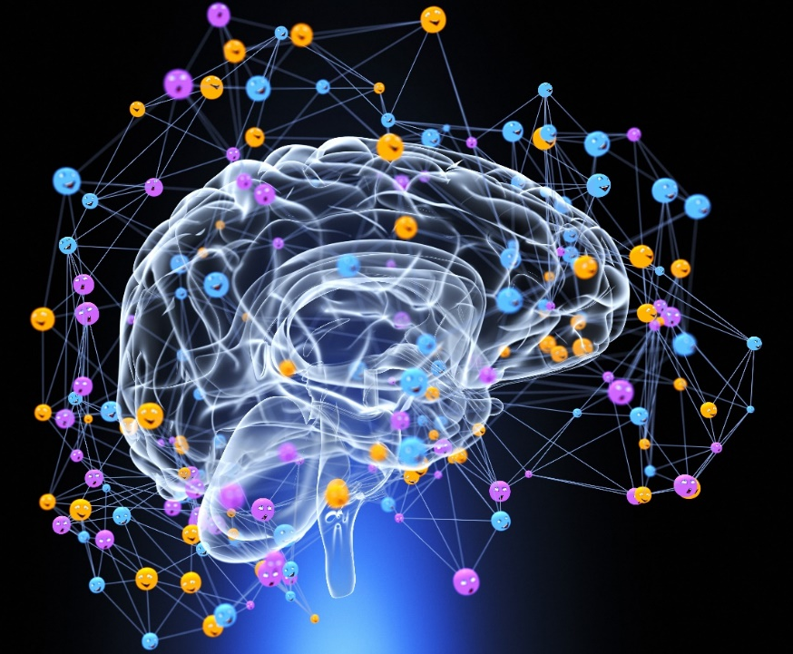
How Does Positive Thinking Affect Neuroplasticity?
I
Feeling Stuck? –Train Your Brain
Positive thoughts release positive chemicals creating positive connections.
Positive emotions widen our span of attention and changes our perception on more of the “we” instead of the “me”.
We become more aware of our emotions, the ability to reflect, and be aware of our own thought processes.
Neuroplasticity simply means an opportunity for change!
www.EWSNetwork.com
Notes:
Every thought releases some type of chemical. When positive thoughts are generated, when you’re feeling happy, or optimistic, cortisol decreases and the brain produces serotonin, creating a feeling of well-being. When serotonin levels are normal, one feels happy, calmer, less anxious, more focused and more emotionally stable Dopamine is also a neurotransmitter that helps control the brain’s reward system and pleasure center.
https://content.acsa.org/articles/how-does-positive-thinking-affect-neuroplasticity
There is growth and new connections made in the prefrontal cortex of the brain when positive thoughts are generated and reinforced.
(Goleman, 2013. pg. 170)
https://hbr.org/2013/12/the-focused-leader

Slide 13
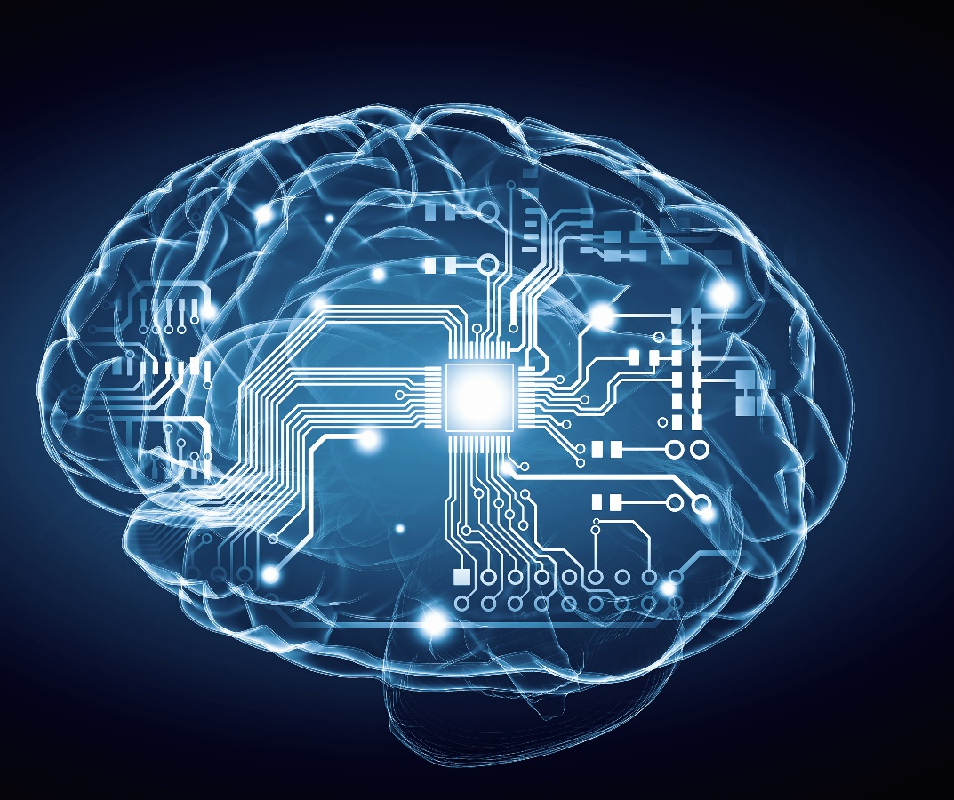
Hebbs Theory – Donald Hebb
I
Feeling Stuck? –Train Your Brain
“Cells that fire together wire together.”:
  The brain is made up of neurons that adapt and grow
  When one cell fires another there is growth and a metabolic process of change forming a stronger relationship between the cells.
  When there is a relationship between groups of neurons, a pattern is formed.
  Healthy habits and dysfunctional habits are create by neural patterns.
  “Use it or lose it!”
www.EWSNetwork.com
Notes:
Hebbs Rule
http://www.awarefulness.com/neurons-that-fire-together-wire-together-but-why-hebbs-rule-and-synaptic-plasticity/
https://www.psychology-lexicon.com/cms/glossary/41-glossary-h/2466-hebb-s-rule.html

Slide 14
Are We Wired to Be Negative?
I
Feeling Stuck? –Train Your Brain
Try this self test:
  You just won $500 on a scratch ticket – Feel the pleasure
  You just lost $500 at a slot machine – Feel the distress
Focus on the feeling of each of those emotions.
Which do you feel more intensely and where are you feeling it?
www.EWSNetwork.com

Slide 15

Are We Wired to Be Negative?
I
Feeling Stuck? –Train Your Brain
Negative information has a greater impact on the brain because of the implication of danger.
Positive information takes more effort
www.EWSNetwork.com
Notes:
https://psychcentral.com/blog/humor-neuroplasticity-and-the-power-to-change-your-mind/

Slide 16
Are We Wired to Be Negative?
I
Feeling Stuck? –Train Your Brain
Fight/Flight
Pleasure
Yes!
Ugh..
Distress
The emotion of the distressing experience outweighs the pleasurable experience because of the body’s fight or flight response.
www.EWSNetwork.com
Notes:
The intensity of the negative feeling is a result of a chemical reaction that takes place in the fight or flight response. The adrenaline rush, a rise in blood pressure, and an increase in heart rate signals a crisis to the brain and the feeling becomes overpowering.
https://psychcentral.com/blog/humor-neuroplasticity-and-the-power-to-change-your-mind/

Slide 17
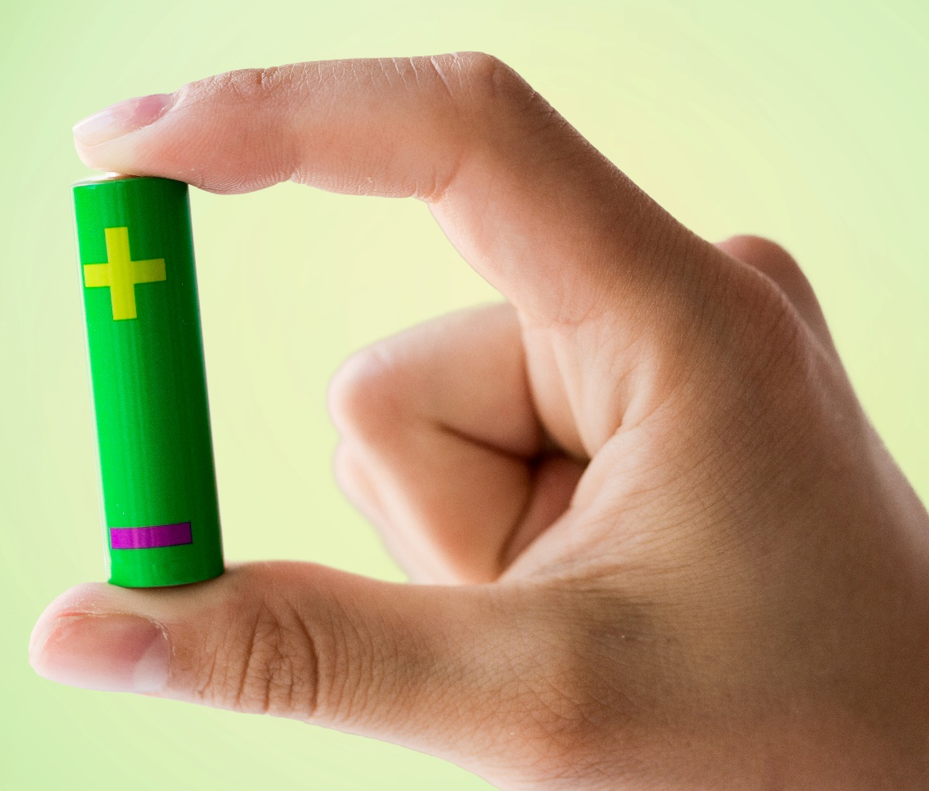
What’s Your Charge ? + or -
I
Feeling Stuck? –Train Your Brain
If the negative is so easily imprinted on the brain, how can we ensure that the positive thoughts have a greater impact? Train the brain! Here’s how!
Build your brain!
Focus!
Reduce stress!
Laughter!
Brain food!
Recharge your negative to a positive! 3 R’s
www.EWSNetwork.com
Notes:
1) When faced with a challenge, something difficult or something new don’t overthink it, go for it. MRIs reveal that learning to play a new musical instrument, perform a complex dance such as the tango, or to master a learning a new language, computer or spoken, increases the size of the engaged areas of the brain. This is called “whole brain thinking” utilizing both the right and left hemispheres.
2) Develop and practice daily positivity focus. Reflect on one small positive part of your day. Take 30 seconds to let it soak in, form a mental snapshot using all of your senses to strengthen the neural pathways and write it down. The point is to train your brain to notice, appreciate, and spend a little more time with positive things you experience throughout your day, even if they are just small things. You will become more conscious of positive moments have an easier time recollecting experiences as time goes on.
3). The body cannot build new brain pathways when there is constant stress. Stress can actually damage the brain by pruning back the number branches and synaptic connections made and increase the rate of cell death. Practice meditation, breathwork, yoga..etc...
4) Laughter can put us into the positive mindset to begin brain training exercise. Studies show that redefining negative situations in more positive or humorous terms counters the adverse psychological effects that would otherwise be experienced. E. Perreau-Linck, et al., “Serotonin Metabolism During Self-Induced Sadness and Happiness in Professional Actors,” program 669.3 presented at the 34th annual meeting of the Society for Neuroscience, San Diego, Calif., October 23-27, 2004
5) The brain uses up to 20% of the nutrients we consume. Eat green leafy vegetables, good fats, raw nuts and seeds and stay hydrated!
When brain health is supported, it is easier for new connections to be made.
6) Actively rethink the situation to take it from a stumbling block to an achievable challenge in your mindset. When faced with a negative thought - rename, reframe and redirect.
https://youtu.be/7XFLTDQ4JMk

Slide 18
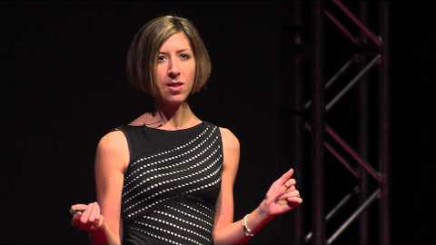
I
Feeling Stuck? –Train Your Brain
Getting Stuck in the Negatives
(and how to get unstuck)
Alison Ledgerwood | TEDxUCDavis
www.EWSNetwork.com

Slide 19

I
Start with yourself
Positive Self-Talk
.
77% of the self-talk people use is very negative, counter-productive and self-defeating.
If you tell yourself you are “weak”, “dumb”, “ugly”..etc... the brain will accept it as we give it.
Positive self-talk is a tool to reverse the damaging affects of negative thinking/programming
www.EWSNetwork.com
Notes:
Any time you make a statement about yourself that is negative you are directing your subconscious mind to make you become the person you just described.
The subconscious mind does not know the difference between the statement that we are weak and the statement that we are strong. It accepts our programming just as we give it. It treats everything we tell it with equal indifference. The end result, we end up becoming the result of what we constantly think and say to ourselves and others.
https://www.npr.org/sections/health-shots/2014/10/07/353292408/why-saying-is-believing-the-science-of-self-talk
Harnessing the neuroplasticity of your brain can help you create change in your own world first and foremost. It begins with how we speak to ourselves. Interrupting the negative voices and encourage more supportive ways of speaking about and to ourselves to create change.
https://anniewrightpsychotherapy.com/neuroplasticity/
Qualities of attraction:
When we feel positive about ourselves we are more attractive to others around us. So positive thinking has to start with ourselves to affect others! ‘With positive emotion there's more of an easiness in the torso, and I think that's consequential because other people can pick that up and it's a safety signal for others that this person is safe to approach. There's ways in which openness both characterizes the mindset and the posture and certainly the face too, because when someone's face is more relaxed and smiling, that grabs our attention very quickly and it is, again, another safety signal.’
https://www.ncbi.nlm.nih.gov/pmc/articles/PMC3156028/

Slide 20

I
Extend it to Others
Positive Relationships
Get out of your comfort zone – even with friendships.
Try a new group activity
Appreciate what others can offer you
www.EWSNetwork.com
Notes:
-Opposites attract? New stimulating friendships exploring new topics, interests, and perspectives can build neuroplasticity
-Groups have new ideas and learning a new hobby or interest helps to build the brain! book club, walking group, travel group.
-Teaching, sharing and empathizing are all activities that boost new neural development. You obtain these through your relationships and interactions with others.
https://remedygrove.com/wellness/Brain-Training-Improve-Your-Neuroplasticity-with-10-Easy-Tips

Slide 21

I
Extend it to Others
Positive Affirmation
Affirmation is a win-win situation for everyone.
Building yourself and others up and encouraging them.
Finding reasons for praise and applause.
Nurturing and being supportive.
Giving yourself and others reasons to celebrate.
www.EWSNetwork.com
Notes:
-Building people up is more effective than tearing them down!
-Nothing feels better than genuine praise from others!
-We all need recognition and encouragement!
-It feels good to make someone else feel good!

Slide 22
I
Practice Makes Progress
In Class Task
Take a look at your handout.
Check off the negative self talk you currently use in column B.
Start exchanging those statements for the positive words of affirmation in column A.
It takes practice!!
www.EWSNetwork.com

Slide 23

Cognitive Flexibility
I
Be a Positive Influence
Negative thinking patterns don’t only affect you, they affect your relationships.
Positive thinking can affect the quality of your relationships.
Ask Yourself:
Is my contribution to the relationship an uplifting one?
Does my presence lift their spirits?
Do they seem happy to see me and optimistic about our communication?
www.EWSNetwork.com
Notes:
Cognitive flexibility – see a situation from multiple points of perspectives and find possible solutions.
Correlational analyses indicated strong positive relationships between aspects of cognitive flexibility and use of problem-focused coping, suggesting that greater ability to generate and implement effective approaches is linked to greater use of pragmatic strategies to improve a situation.
https://epublications.marquette.edu/theses_open/354/
In a positive relationship you will help to build self esteem, choose beneficial thoughts, and aid in releasing control, fear, and the past to help move them forward.

Slide 24

An Attitude of Gratitude
I
2 - Be a Positive Influence
Positive people live with a sense of gratitude.
Positive people have the ability to turn misery into something to be grateful for.
Gratitude makes us more resilient through the most difficult of time. It changes your brain!
A good habit to get into is to write down at least three things that you are grateful for in your life every day.
“When we are happy, we are truly grateful.
The reverse also holds true.
When we are grateful, we are truly happy.”
www.EWSNetwork.com
Notes:
In spite of all the catastrophes that might occur we have the ability to cut through all of the misery by simply turning our attention to being grateful for something. “gratitude stimulates the hypothalamus (a key part of the brain that regulates stress) and the ventral tegmental area (part of our “reward circuitry" that produces the sensation of pleasure)." https://www.nytimes.com/2015/11/22/opinion/sunday/choose-to-be-grateful-it-will-make-you-happier.html?smid=fb-nytimes&smtyp=cur&_r=1
Gratitude increases mental strength. “Research has shown gratitude not only reduces stress, but it may also play a major role in overcoming trauma. A 2006 study published in Behavior Research and Therapy found that Vietnam War Veterans with higher levels of gratitude experienced lower rates of Post-Traumatic Stress Disorder. A 2003 study published in the Journal of Personality and Social Psychology found that gratitude was a major contributor to resilience following the terrorist attacks on September 11. Recognizing all you have to be thankful for – even during the worst times of your life – fosters resilience.” https://www.forbes.com/sites/amymorin/2014/11/23/7-scientifically-proven-benefits-of-gratitude-that-will-motivate-you-to-give-thanks-year-round/#6615f0da183c
https://www.sciencedirect.com/science/article/abs/pii/S0005796705000392
Whenever we notice that joy is absent from our lives, we seem to be complaining, blaming and making excuses for everything, we can look around and find a host of things, events and people to appreciate. Gratitude is necessary to changing your brain. When you can get out of your own way and stop focusing on your “problems” you can experience a shift in your perception.

Slide 25

Make Positivity a Part of Your Day!
I
3 - Be a Positive Influence
Comment on things you see going right, rather than waiting to criticize what goes wrong.
When you start focusing on what is good and admirable in yourself and others, life will automatically improve.
The more you give the more you get.
Ask for what you need. Don’t demand it.
www.EWSNetwork.com
Notes:
-Start keeping your eyes open and catch yourself and others doing things right instead of always seeking out and criticizing for what you think is wrong.
-Remember that the law of attraction tells us that we will most likely start witnessing more of the things we express gratitude and appreciation for and less of what we don’t.
-If you want something from someone, learn to ask for what you want instead of demanding it. We tend to TELL others what to do instead of ASKing them.

Slide 26
I
Practice Makes Progress
In Class Task – You Get What You Give
Step 1 - List 3 things that you grateful for today?
Step 2 - Who is someone in your life that you consider a positive influence? Write their name down. Now send that positivity back! Write a reminder to write a thank you note, send email, or make a phone call extending your gratitude for their positive influence in your life.
www.EWSNetwork.com

Slide 27

View challenges as learning opportunities
Anything new takes practice
1) You will need to remind yourself.
2) It will be uncomfortable.
3) It my feel awkward and forced.
4) There will be slips but the new habit will feel more comfortable and real as it Is practiced.
I
Practice Makes Progress
www.EWSNetwork.com
Notes:
Peaks are moments when you appreciate what you have.
Valleys are moments when you long for what is missing.
- You can change a valley into a peak by changing your thinking.
- The path out of a valley opens when you choose to see things differently
- Find and use the good that is hidden in the bad time
Plateaus if you use them as an opportunity to rest and rejuvenate your mind and body.

Slide 28
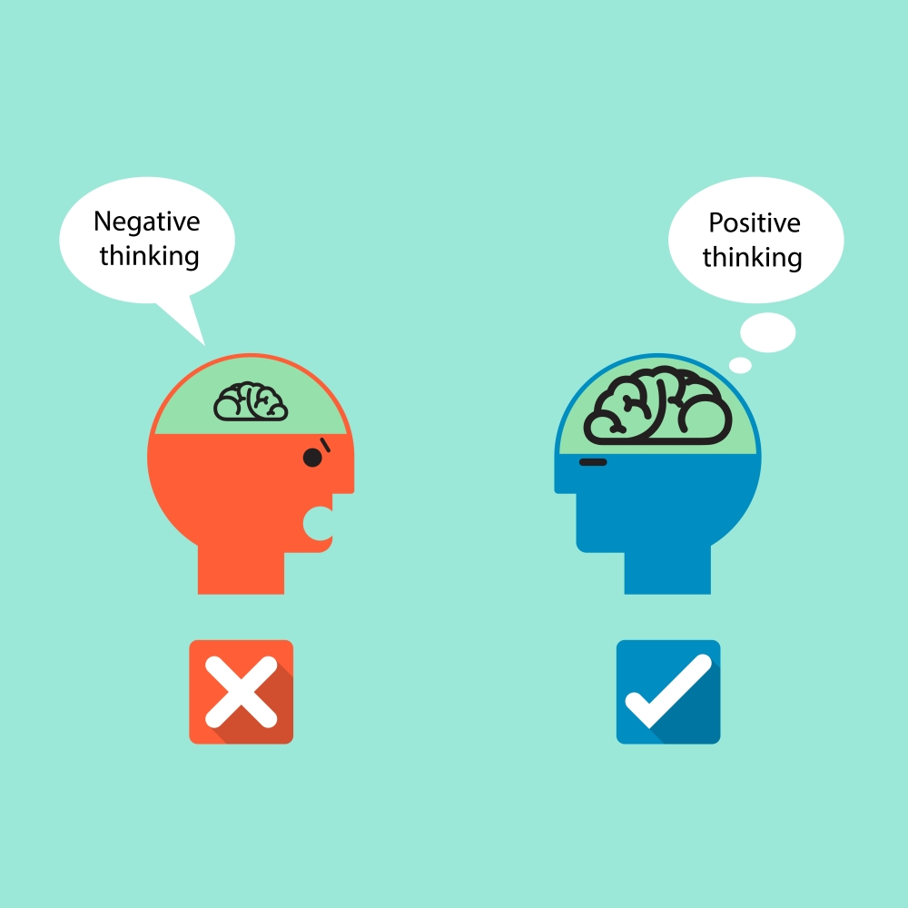
I
Where There is Good There is Bad
How to Deal with Negativity
When you come across negativity think about the following:
Practice your cognitive flexibility
Know the truth
Recognize construction through destruction
Spin the negative to a positive
Create a positive environment
www.EWSNetwork.com
Notes:
It’s inevitable. Where there is positive there is negative. So how do you deal with negativity when you are trying to focus on building a positive mindset?
PRACTICE YOUR COGNITIVE FLEXIBILITY Rather than focusing on the negativity, reflect on where it might be coming from
KNOW THE TRUTH The truth of the emotion likely doesn’t have much to do with you.
CONTRUSTION THROUGH DESTRUCTION People with low self esteem will often find faults to build themselves up.
SPIN THE NEGATIVE TO A POSITIVE The brain will almost always choose the negative first. Pause and try to change the thought.
CREATE A POSITIVE ENVIRONMENT Don’t contribute to the negativity

Slide 29
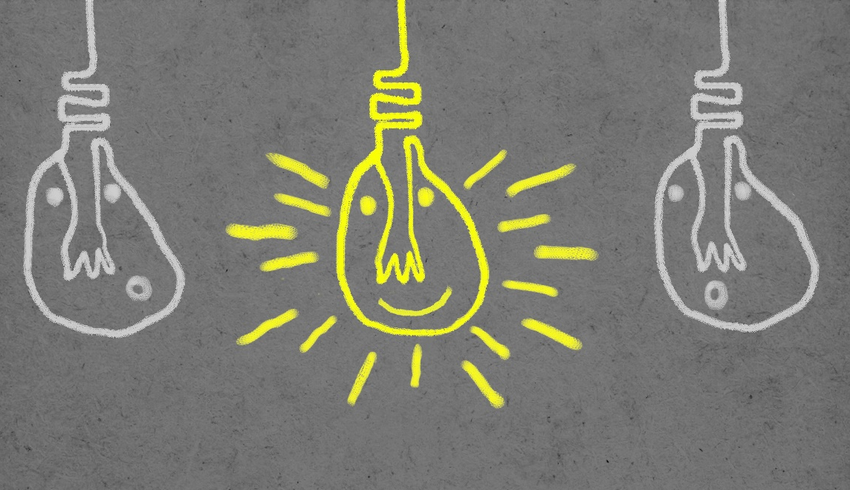
I
Create a Positive Environment
Have you ever been in a room and just sensed someone’s negative energy?
“I choose to remove any negative thoughts or feelings. My intention is to share a positive energy with those around me.”
Here is how to ensure you create a positively charged environment:
Take a deep breath…..
Clear your head, (meditate if you have time)
Set a positive intention for the day, the moment, the meeting…etc.
www.EWSNetwork.com
Notes:
You enter happy and joyful and leave the room feeling somewhat sullen. Don’t be that person! YOU are responsible for the energy you bring into a room.
Leaving a positive energy impression can serve you in so many ways…not only will you connect better with others, but you will also feel a much greater sense of fulfillment and support in your life.

Slide 30

I
2 - Create a Positive Environment
Share your positive energy in the workplace:
Share yourself!
Speak positively about others and stay away from gossip.
Support other people’s work.
Include others in your projects.
Express gratitude to those who help you.
Create 2 way interactive relationships.
www.EWSNetwork.com
Notes:
Share more of yourself at meetings. When you share your knowledge and expertise in a respectful way you are sharing your personality making you more approachable.
Speak positively about the people you work with and avoid gossip. People enjoy hearing that people are speaking supportive things about them. This builds trust. No one wants to be known as the office gossip.
Have a team attitude and support the work of others. Ask how you can get involved or support their goals. Support is always appreciated.
Ask others to become involved in your projects or activities. In the same context, invite others into what you are working on. The team approach builds trust and gives team members a chance to get to know each other.
Write thank you notes. When someone helps you or extends themselves to you, show your appreciation through a thank you note on their desk or via email. Words of affirmation can make others feel closer to you and recognized/validated for their contributions.
Initiate conversations by asking questions about the person you are speaking to. This gives you the chance to learn and listen and also to share something about your self and establish a 2 way interaction that helps to bond. Continue to interact with this person that you are getting to know.
https://garfinkleexecutivecoaching.com/articles/build-positive-work-relationships/building-positive-relationships-at-work
Building positive relationships at work and influencing a more positive environment makes for more efficient workers and happier workplace

Slide 31

I
Summary
You Have the Power…
Every moment we have the power to change our mindset based on how we think and act.
You wire your brain to follow certain patterns.
Creating more opportunity for the formation of positive pathways increases our health and well-being
Neuroplasticity is our opportunity to rewire a negative mindset to a positive one
If we start to work on our own positive mindset, we influence others and can even transform our environments.
It takes practice. Get started today!
www.EWSNetwork.com

Slide 32

Thank You for Your Time
I
Question & Answers
Santiago Ramóny Cajal:
“Any man could, if he were so inclined, be the sculptor of his own brain.”
©2019 EMPLOYEE WELLNESS SOLUTIONS NETWORK INC. – ALL RIGHTS RESERVED
Notes:
https://en.wikipedia.org/wiki/Psychoneuroimmunology
https://www.forbes.com/sites/quora/2016/06/24/this-is-what-negativity-does-to-your-immune-system-and-its-not-pretty/#6137f5ae173b
https://www.hopkinsmedicine.org/health/wellness-and-prevention/the-power-of-positive-thinking
https://www.mayoclinic.org/healthy-lifestyle/stress-management/in-depth/positive-thinking/art-20043950
http://andrewrudinmd.net/can-a-positive-outlook-lower-your-risk-of-heart-problems/
http://uthscsa.edu/gme/documents/Circles.pdf
https://garfinkleexecutivecoaching.com/articles/build-positive-work-relationships/building-positive-relationships-at-work
https://psychcentral.com/blog/humor-neuroplasticity-and-the-power-to-change-your-mind/
http://www.awarefulness.com/neurons-that-fire-together-wire-together-but-why-hebbs-rule-and-synaptic-plasticity/
https://www.psychology-lexicon.com/cms/glossary/41-glossary-h/2466-hebb-s-rule.html
https://content.acsa.org/articles/how-does-positive-thinking-affect-neuroplasticity
https://psychcentral.com/blog/get-unstuck-from-negative-fearful-thoughts-with-6-simple-steps/
https://www.psychologytoday.com/us/blog/the-athletes-way/201702/how-do-neuroplasticity-and-neurogenesis-rewire-your-brain
https://meteoreducation.com/how-does-thinking-positive-thoughts-affect-neuroplasticity/
https://positivepsychologyprogram.com/neuroplasticity/
https://psychcentral.com/blog/humor-neuroplasticity-and-the-power-to-change-your-mind/
https://www.npr.org/sections/health-shots/2014/10/07/353292408/why-saying-is-believing-the-science-of-self-talk
https://anniewrightpsychotherapy.com/neuroplasticity/
https://remedygrove.com/wellness/Brain-Training-Improve-Your-Neuroplasticity-with-10-Easy-Tips
https://epublications.marquette.edu/theses_open/354/
https://www.nytimes.com/2015/11/22/opinion/sunday/choose-to-be-grateful-it-will-make-you-happier.html?smid=fb-nytimes&smtyp=cur&_r=1
https://www.forbes.com/sites/amymorin/2014/11/23/7-scientifically-proven-benefits-of-gratitude-that-will-motivate-you-to-give-thanks-year-round/#6615f0da183c
https://www.sciencedirect.com/science/article/abs/pii/S0005796705000392

