Slide 1
Your Logo Here
We have a Corporate Wellness Membership!
www.ewsnetwork.com

Slide 2
“We are passionate about helping people
achieve health and wellness!”
Established in 2003 – YUP, 15th year!
Amazing Team
Amazing Corporate Clients
Meaghan Jansen, Owner
meaghan@ewsnetwork.com

Slide 3
Wellness Toolbox
Group Wellness
Fun Challenges
Personal Awareness Programs
Onsite Promotions
Family Wellness
Kids’ Wellness Bursaries
Individual Wellness Challenges
Health Coaching
Notes:
What they get, linking what they get to what they said – address issues

Slide 4
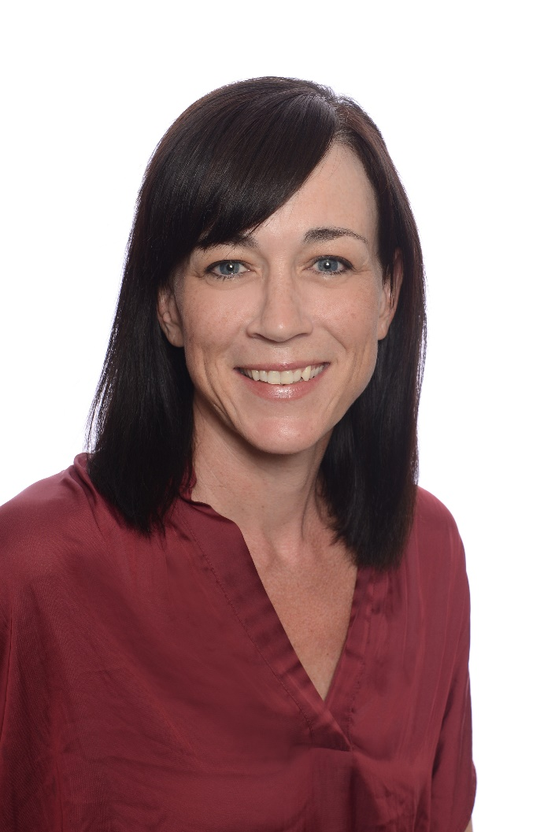
Wellness Program Management
Director of Program Management
Main contact for wellness program and wellness team
Communications, messaging, promotion
Group, Awareness, Virtual Wellness
Heather Barrett
hbarrett@ewsnetwork.com

Slide 5
Starter Kit Membership January-December
COMPONENT | JAN | FEB | MAR | APR | MAY | JUN | JUL | AUG | SEP | OCT | NOV | DEC
WELLNESS STRATEGY CALL | Wellness Strategy Call
NEWSLETTER | Monthly Newsletter
INDIVIDUAL CHALLENGES | Monthly Individual Challenge
SEASONAL E-CAMPAIGNS |  |  |  |  |  |  | Seasonal E-Campaign |  |  |  | Seasonal E-Campaign
FAMILY WEBINAR SERIES | Family Webinar |  |  |  | Family Webinar |  |  |  |  | Family Webinar
E-CAMPAIGNS |  | E-Campaign |  |  | E-Campaign |  |  |  | E-Campaign
POSTER SETS |  | Poster Set |  |  | Poster Set |  |  |  | Poster Set
KIDS’ WELLNESS BURSARY |  |  |  |  |  | Base Members Only
TEAM CHALLENGE |  |  | Base Members Only
INDIVIDUAL HRA | Individual HRA
CORPORATE HRA REPORT | Corporate HRA Report
CWM CREDITS | Base Members Only

Slide 6
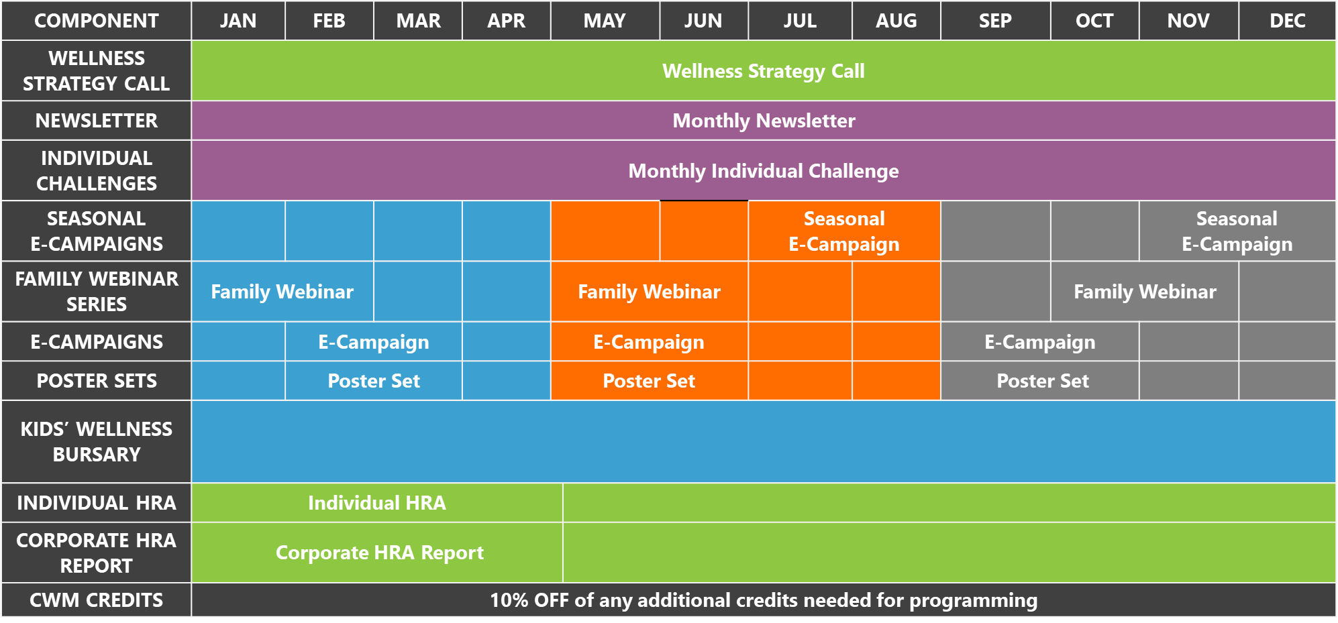
Your 3 Health
Campaigns
Diabetes
Sleep
Healthy Eating
Mental Wellness
Moving More

Slide 7
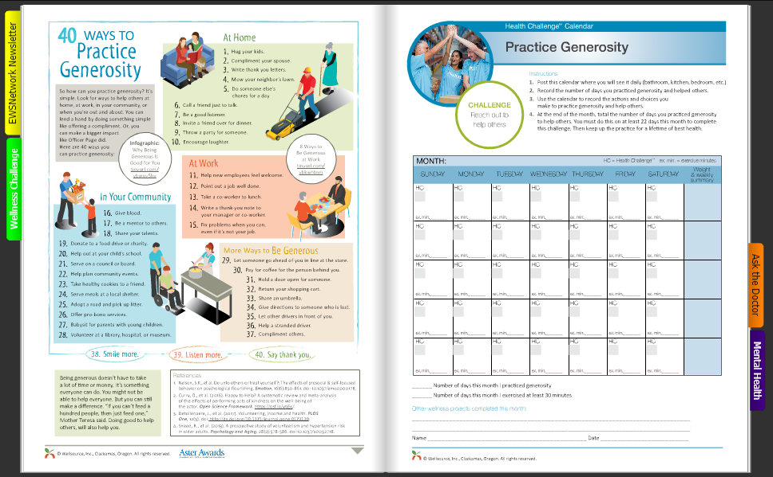
Newsletter and Individual Challenge
Newsletter
Wellness Challenge
Ask the Doctor

Slide 8
Posters and
e-Campaigns
Visual cues
High level
3 times per year to coincide with e-campaign
e-Campaign is 4-5 weeks in length

Slide 9
100% PRIVATE
100% CONFIDENTIAL
10 minutes
Personalized Report
Corporate Trend Report
Notes:
Clicking on website, you’ll be asked to complete health survey. Takes 10 mins to do.

Slide 10
Family Wellness Webinar Series

Slide 11
Thank You!

