Slide 1

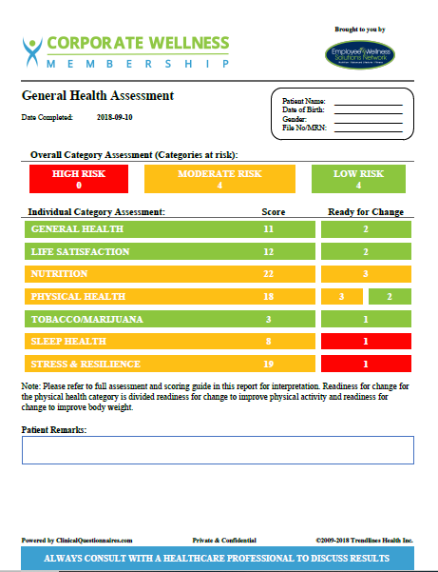


INDIVIDUAL HEALTH RISK ASSESSMENT
CAMPAIGN OPEN FROM NOVEMBER 15th-30th
Your health is important! We encourage you to participate in an Individual Health Risk Assessment, quite simply – a Health Questionnaire! It will provide you with some great feedback regarding your individual health risks. And, it will help shape your wellness program. It’s 100% private and 100% confidential!
www.ewsnetwork.com/hra
Access Code: CWM007
100% Private
100% Confidential
10 minutes
Personalized report
CONFIDENTIAL INDIVIDUAL REPORT INCLUDES
PERSONAL CATEGORY ASSESSMENT
1) General Health
2) Life Satisfaction
3) Nutrition
4) Physical Health
5) Tobacco/Marijuana
6) Sleep
7) Stress & Resilience
INDIVIDUALIZED REPORT EMAILED DIRECTLY TO YOU!!
Powered By:
©2018 EMPLOYEE WELLNESS SOLUTIONS NETWORK INC. – ALL RIGHTS RESERVED

