Slide 1
Fit Brain
Fit Life
www.corporatewellnessmembership.com
Powered by:
©2018 EMPLOYEE WELLNESS SOLUTIONS NETWORK INC. – ALL RIGHTS RESERVED

Slide 2
I
“The root of all health is in the brain. The trunk of it is in emotion. The branches and leaves are the body. The flower of health blooms when all parts work together.”
Author Unknown
www.corporatewellnessmembership.com

Slide 3
I
Introduction
BRAIN TEASERS
How old is your brain?
www.corporatewellnessmembership.com
www.ewsnetwork.com
Notes:
Your brain age may not coincide with your chronological age. Run the brain teasers video. Poll the group to see who has a mature brain, a younger brain, and a young brain. Use as a motivational tool to the information presented in the Lunch n Learn.

Slide 4
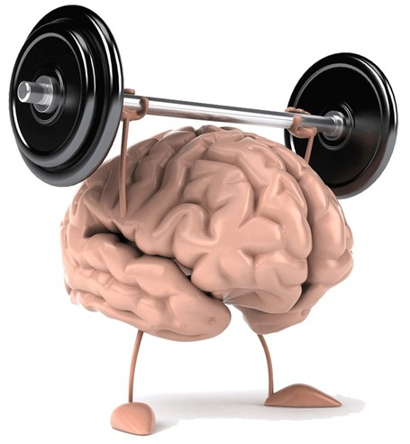
Redefine “Fit
I
Redefine “Fit”
Often refers to everything from the neck down.
A healthy brain plays a critical role in everything you do.
Thinking, Feeling, Working, Playing, Sleeping…etc.
We may be active about keeping our muscles strong, and our skin wrinkle free, but what can we do for our brains.
www.corporatewellnessmembership.com
Notes:
When the things that you do and the way you behave match your values, you’ll feel a sense of satisfaction with life and feel content.
When you aren’t honoring your personal values, that’s when things feel wrong and can cause a feeling of unfulfillment and unhappiness.
If you value family, but you have to work 70-hour weeks in your job, will you feel internal stress and conflict? And if you don't value competition, and you work in a highly competitive sales environment, are you likely to be satisfied with your job?
In these types of situations, understanding your values can really help. When you know your own values, you can use them to make decisions about how to live your life,
Values are usually fairly stable, yet they don't have strict limits or boundaries. Also, as you move through life, your values may change. For example, when you start your career, success – measured by money and status – might be a top priority. But after you have a family, work-life balance may be what you value more.
As your definition of success changes, so do your personal values. This is why keeping in touch with your values is a lifelong exercise. You should continuously revisit this, especially if you start to feel unbalanced... and you can't quite figure out why.
As you go through the exercise below, bear in mind that values that were important in the past may not be relevant now.

Slide 5
Healthy Eating
Exercise
Fit Life
Sleep
Emotional Balance
I
A Lifestyle Change Like
Any Other
Healthy Eating
Exercise
Fit Brain
Sleep
Emotional Balance
www.corporatewellnessmembership.com
Notes:
Any healthy lifestyle change has the same components. It takes a fit life to create a fit brain.

Slide 6
A Lifestyle for Change
I
Let’s Look At:
Healthy Eating: What nutrients are most critical to brain health?
Exercise: What types of exercise does the brain benefit from?
Emotional/Spiritual Balance: Protect your brain through rest and repair.
Sleep: What is the role of sleep in brain health and how much do we really need?
www.corporatewellnessmembership.com

Slide 7
Nutrition Matters
I
Nutrition influences the brain in both positive and negative ways.
Positive Influences | Negative Influences
Fats | Sugar
Antioxidants | Alcohol
Hydration | Deficiencies
www.corporatewellnessmembership.com
www.ewsnetwork.com

Slide 8
Get Fat Get Rich
I
Specific nutrients help to build & preserve our brains and it’s functions. Two of the greatest contributors are foods rich in:
Omega 3 Fats & Antioxidant Vitamins
More than 2/3 of the brain is made up of DHA which is critical to brain function and the nervous system.
Protective compounds called polyphenols can pass through the blood brain barrier to protect oxidation and inflammation.
www.corporatewellnessmembership.com
Notes:
Understanding the effect that food has on cognition allows us to make changes to our diet that can help protect from degeneration and promote mental fitness.

Slide 9
Get Fat Get Rich
I
Anti-nutrients such as sugar and alcohol can deplete the brain
of vital nutrients needed for cognition.
Sugar & Alcohol
Shown in study to contribute to memory problems, neuro-inflammation, and impact learning.
Studies have shown that alcohol shows an impact on memory after only a few drinks. Heavy drinkers can experience brain shrinkage and irreversible damage.
www.corporatewellnessmembership.com
Notes:
Effect of sugar: https://www.integrativepsychiatry.net/blog/the-effects-of-sugar-on-the-brain-and-memory/
Benefits of eliminating these things as a healthy lifestyle change. You can discuss how the body and brain utilize glucose and how difficult it can be to get sugar out of the diet because of its addictive qualities. You could also discuss brain fog as I am sure many in your audience would relate to mid afternoon fog.

Slide 10
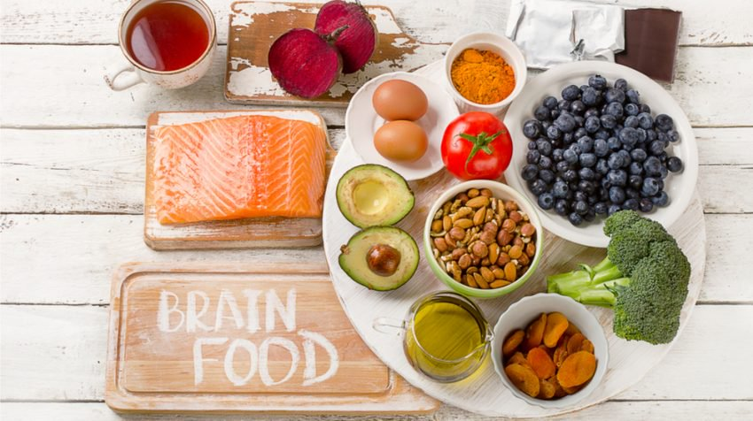
Super Food Super Power
I
Super Food Super Power
www.corporatewellnessmembership.com

Slide 11
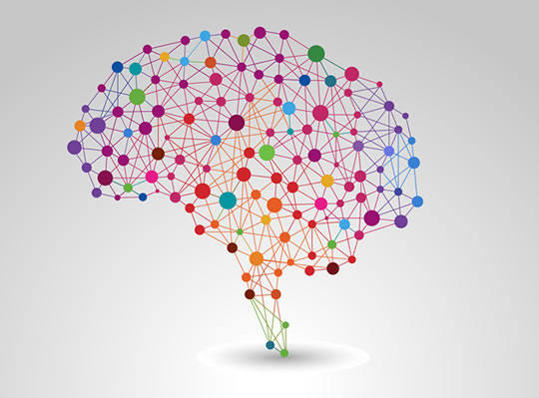
Top 5 Dietary Tips
I
Increase intake of good fats.
Increase intake of antioxidant rich fruits & vegetables. Think COLOUR!
Manage your body weight.
Lower bad fats, cholesterol, sugar, and alcohol.
Consider a multivitamin to avoid deficiencies in the diet.
www.corporatewellnessmembership.com
Notes:
Body weight: - Studies have shown that obese individuals were twice as likely to develop symptoms of dementia in later life
Cholesterol – Research show that those with high cholesterol and high blood pressure had 6x the risk of dementia
Multivitamin – Importance of a balanced diet. Other necessary nutrients responsible for brain health. Esp important Vitamins A< C< E< S, B12 and Folate.

Slide 12
Exercise: Physical
I
The brain is a muscle and like any muscle requires exercise to function at its best, to grow bigger and strong, and prevent degeneration!
MOST IMPORTANT:
Consistency and in combination with other healthy lifestyle factors such as mental activity and a healthy diet.
Aerobic exercise is most beneficial.
It improves oxygen consumption and utilization which benefits brain function. It reduces brain cell loss in the elderly.
www.corporatewellnessmembership.com
www.ewsnetwork.com

Slide 13
Aerobic Activities for the Brain
I
www.corporatewellnessmembership.com
Notes:
I would suggest a body break here. A quick tabata maybe, a few seconds of cardio, a quick walk, …etc. You could really make this interactive and fun.

Slide 14
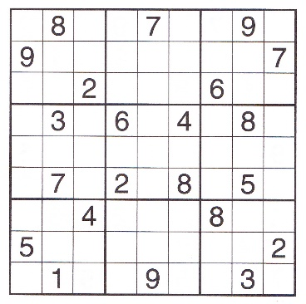
Exercise: Mental
I
Keep your brain active and challenged everyday!
Stay curious and involved in lifelong learning.
Read, write, do crosswords, puzzles and games.
Attend lectures and plays.
Enroll in courses at your library, community college, or within your community.
Try some memory exercises.
Join a dance class, arts class, or other social group, and stay socially active.
Travel and experience new cultures.
www.corporatewellnessmembership.com
Notes:
I would play a quick memory game here, or do a quick crossword or word scramble. I have added a word scramble from the portal to the handout.

Slide 15
Rest, Repair, Repeat
I
Allowing time for rest and repair is just as important for the brain
as keeping in active and engaged.
MAKE TIME FOR A
“A new study by UCLA found that meditation helps to preserve gray matter, the tissue that contains neurons. While all participants showed a loss of gray matter as they aged, researchers found that among those who meditated, the volume of gray matter did not decline as much as it did among those who didn’t.”
http://newsroom.ucla.edu/releases/forever-young-meditation-might-slow-the-age-related-loss-of-gray-matter-in-the-brain-say-ucla-researchers
www.corporatewellnessmembership.com
www.ewsnetwork.com

Slide 16
Benefits of Meditation
I
Delays aging of the brain.
Changes structures by expanding essential areas and strengthens connections.
Improvement in cognition and attention.
BE REALISTIC
Match your meditation to something that works for you!
Types of Meditation
BASIC
ACTIVITY BASED
MINDFULNESS
SPIRITUAL BASED
www.corporatewellnessmembership.com

Slide 17
Benefits of Meditation
I
LET’S PRACTICE!
www.corporatewellnessmembership.com

Slide 19
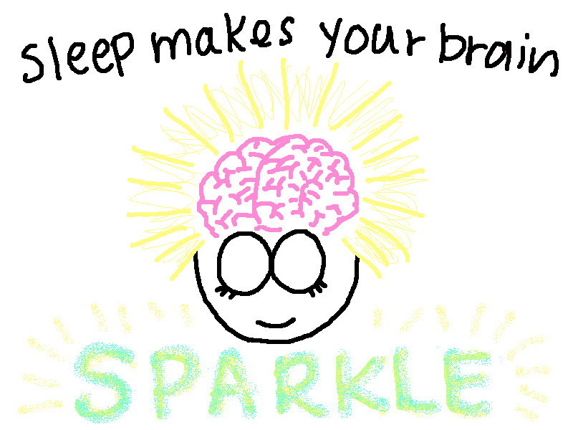
Feeling Relaxed?
I
GREAT! You have just experienced the benefits of a quiet mind.
A GOOD NIGHT’S SLEEP
MAY LITERALLY CLEAR YOUR MIND!
You may want to consider a meditation before bedtime!
Sleep is a time for housekeeping.
Activates the glymphatic system of the brain.
Sleep deprivation can cause a build up of toxicity.
Aim for between 7-8 hours of quality sleep per night.
www.corporatewellnessmembership.com
Notes:
The glymphatic system is really interesting. You could google how this works and integrate it into the discussion here.

Slide 20
Take Home Message
I
Brain health is critical for daily functioning like thinking, feeling, working…etc.
Eat a healthy diet full of good fats and antioxidants.
Stay physically active with various kinds of aerobic activity.
Incorporate small ways to keep mentally active: games, puzzles, travel, or social activities.
Give your brain a timeout through rest and meditation
Recognize the importance of quality sleep and aim for 7-8 hours per night.
www.corporatewellnessmembership.com
www.ewsnetwork.com

Slide 21
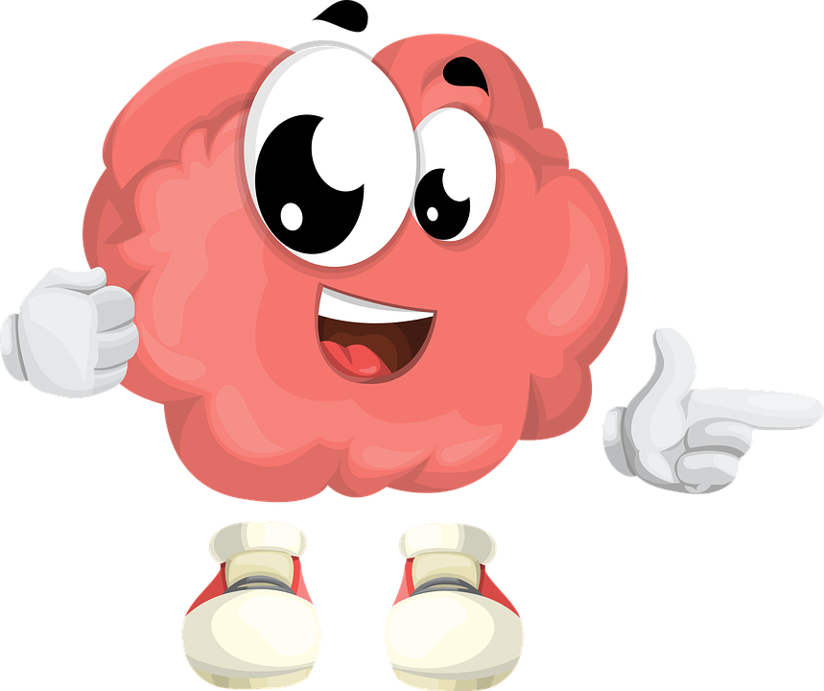
YOUR BRAIN AND I SAY:
“THANK YOU FOR YOUR TIME TODAY!”
Powered by:
©2018 EMPLOYEE WELLNESS SOLUTIONS NETWORK INC. – ALL RIGHTS RESERVED

