Slide 1
It’s Your Time,
Use it Wisely
www.ewsnetwork.com
Meaghan Jansen, Owner EWSNetwork
meaghan@ewsnetwork.com
519-860-6727

Slide 2
I
“Dost thou love life, then do not squander time, for that's the stuff life is made of.”
-Benjamin Franklin
www.ewsnetwork.com

Slide 3
Introduction
Intr
Our Two Best Teachers
Life & Time
Life teaches us to make good use of time.
Time teaches us the value of life.
www.ewsnetwork.com
Notes:
Take the time management quiz

Slide 4
What Do You Value Most?
Your values are the things that you believe are important in the way you live and work…are unstable and need to re-visited.
They (should) determine your priorities, and, measure your sense of satisfaction with life.
Values always exist, but are you living by them, making decisions around them?
Your definition of success may determine your values.
What is important to you?
www.ewsnetwork.com
Notes:
When the things that you do and the way you behave match your values, you’ll feel a sense of satisfaction with life and feel content.
When you aren’t honoring your personal values, that’s when things feel wrong and can cause a feeling of unfulfillment and unhappiness.
If you value family, but you have to work 70-hour weeks in your job, will you feel internal stress and conflict? And if you don't value competition, and you work in a highly competitive sales environment, are you likely to be satisfied with your job?
In these types of situations, understanding your values can really help. When you know your own values, you can use them to make decisions about how to live your life,
Values are usually fairly stable, yet they don't have strict limits or boundaries. Also, as you move through life, your values may change. For example, when you start your career, success – measured by money and status – might be a top priority. But after you have a family, work-life balance may be what you value more.
As your definition of success changes, so do your personal values. This is why keeping in touch with your values is a lifelong exercise. You should continuously revisit this, especially if you start to feel unbalanced... and you can't quite figure out why.
As you go through the exercise below, bear in mind that values that were important in the past may not be relevant now.

Slide 5
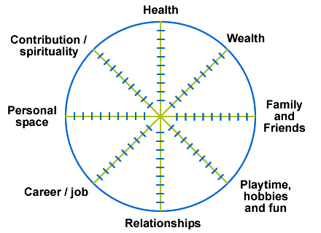
Life Wheel – how balanced are you?
I
www.ewsnetwork.com
Notes:
Life wheel

Slide 6
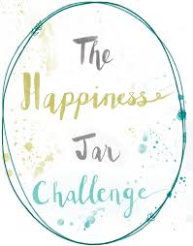
Focus on the Positive
I
www.ewsnetwork.com
Notes:
Life wheel

Slide 7
Meet Lisa….
www.ewsnetwork.com
Notes:
Lisa is a 41 year old married woman with 2 children. Jaden age 12 and Natalie age 7. She works a full time job as a Supervisor in Data Management at a bank. She rushes to get to work in the morning after dropping the kids off at school. She knows that when she arrives to work, she will have to complete a list of tasks from the previous day that she didn’t have the time to complete. She sits down and intends on prioritizing those tasks but decides to start her day by checking her email first thing in the morning. Two urgent requests have come in for data reports that require her immediate attention, and one of her staff has emailed her asking for her direction on a client file. She chooses what she think can be dealt with the most quickly, helping her staff member, however this help as added more work to her plate than she had initially thought. By the time she settles the matter, she is able to “quickly” complete the tasks from the previous day and has full intention on spending her afternoon getting to the urgent requests. She has a quick bite to eat at her desk but mostly works through her lunch hour and completes the urgent requests by days end feeling unsatisfied with the quality of the work due to the demands on her time. She rushes home to find the morning dishes left on the counter and in the sink, and nothing prepped for dinner. Jaden has hockey in an hour and her 7 year old is wanting to tell her about his day. She begins to prepare a quick dinner, throws the dishes in the dishwasher and does her best to show interest in her day. Her husband arrives home, she barely greets him at the door, and serves dinner. Jaden and her husband are off to hockey! Lisa is grateful to have a couple of hours to get the kitchen cleaned and go over the report she rushed through at work today. She sits down to do her final edits, and is reminded that the 7 year old has a field trip tomorrow. He needs his form filled out, transportation money and a lunch. To the grocery store! She arrives home exhausted. Her husband and Jaden return home from hockey. She and her husband spend a half hour talking about the frustrations of their work day and she heads off to bed. Until tomorrow begins…..

Slide 8
Why is Time Management Important?
By implementing some time management, taking into consideration what Lisa values, she can:
Balance the conflicting demands of work and personal life
Determine priorities and set boundaries
Reduce stress and pressure
Maintain positive relationships both personal and professional
See the problem, find the solution.
www.ewsnetwork.com
Notes:
If Lisa can manage her time she can find a more balance separation of work and personal life
Reduce the stress and pressure…etc. touch on all point.
Can you relate?
Is Lisa fulfilled?
Is she making decisions and behaving in a way that honors her values?

Slide 9
Effective Time Management
Concentrate on results, not on being busy.
80:20 Rule
80% unfocussed effort generates only 20% results.
80% results achieved with only 20% effort.
www.ewsnetwork.com
Notes:
Many people spend their days in a frenzy of activity, but achieve very little because they are not concentrating on the right things.
80:20 Rule: typically 80% of unfocussed effort generates only 20% of results. The remaining 80% of results are achieved with only 20% of the effort.
Time management is not just for work, but our personal lives! The moment you stop time managing your personal life is the moment your work time management falls apart

Slide 10
Top 5 Tips
Set Goals
Manage Distractions
Don’t Procrastinate
Breakdown Tasks and Delegate
Keep a To-Do List
www.ewsnetwork.com
Notes:
Set Goals: Do you know where you'd like to be in six months or this time next year? Personal goal setting is essential to managing your time well, because goals give you a destination and vision to work toward. When you know where you want to go, you can manage your priorities, time, and resources to get there. Goals also help you decide what's worth spending your time on, and what's just a distraction.
Manage Distractions : Do you know that some of us can lose as much as two hours a day to distractions? Whether they come from emails, IM chats, colleagues in a crisis, or phone calls from clients, distractions prevent us from achieving flow, which is the satisfying and seemingly effortless work that we do when we're 100 percent engaged in a task. If you want to gain control of your day and do your best work, it's vital to know how to minimize distractions and manage interruptions effectively.
Don’t Procrastination: Sometimes we spend more time thinking about a task and putting it off than we would actually completing it. Stay on track and complete tasks in a timely manner.
Know when to say No. We simply can’t say yes to everything. This leads to burnout and poor quality of work at times. It's impossible for anyone to focus and produce really high-quality work without giving their brains some time to rest and recharge. Don’t dismiss breaks as "wasting time." They provide valuable down-time, which will enable you to think creatively and work effectively. If it's hard for you to stop working, then schedule breaks for yourself, or set an alarm as a reminder. Try to take a five minute break every hour or two.
Keep a to do list: The trick with using to do lists effectively lies in prioritizing the tasks on your list. Many people use an A - F coding system (A for high priority items, F for very low priorities). Alternatively, you can simplify this by using A through D, or by using numbers.
If you have large projects on your list, then, unless you're careful, the entries for these can be vague and ineffective. The lack of specifics here might cause you to procrastinate, or miss key steps. So make sure that you break large tasks or projects down into specific, actionable steps - then you won't overlook something important.

Slide 11
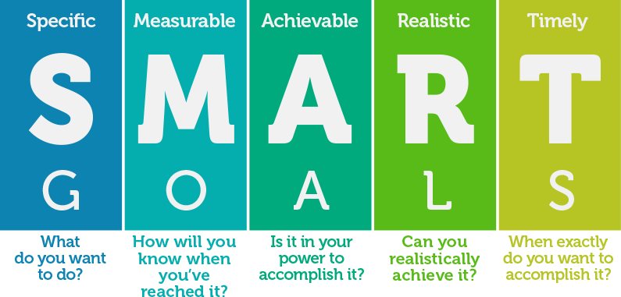
#1 - Set Goals
www.ewsnetwork.com
Notes:
90 second rapid goal setting
Set Goals: Do you know where you'd like to be in six months or this time next year? Personal goal setting is essential to managing your time well, because goals give you a destination and vision to work toward. When you know where you want to go, you can manage your priorities, time, and resources to get there. Goals also help you decide what's worth spending your time on, and what's just a distraction.

Slide 12
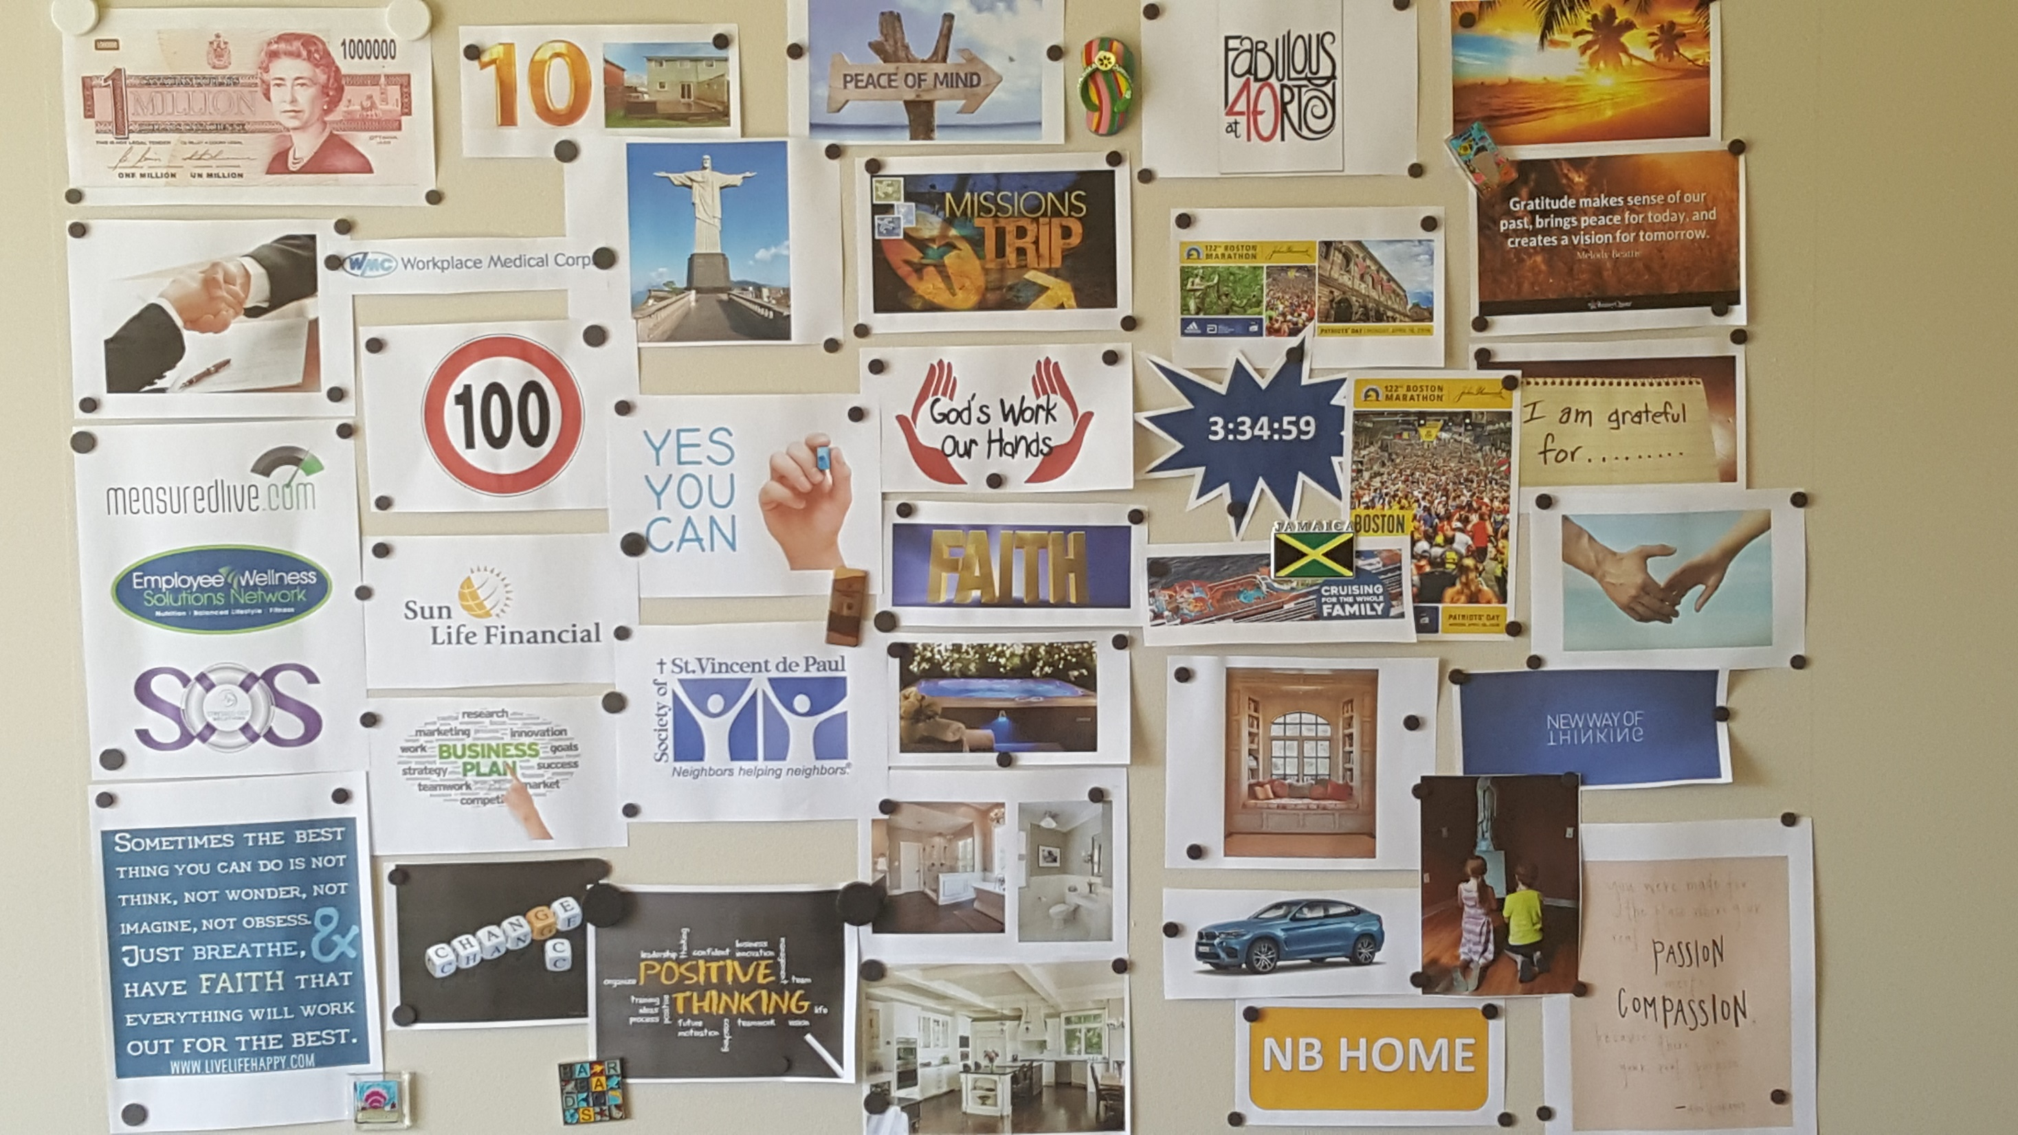
Vision Board
www.ewsnetwork.com
Notes:
90 second rapid goal setting

Slide 13
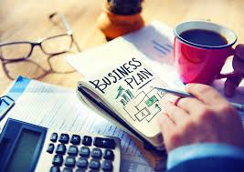
Worry Board
www.ewsnetwork.com
Notes:
90 second rapid goal setting

Slide 14
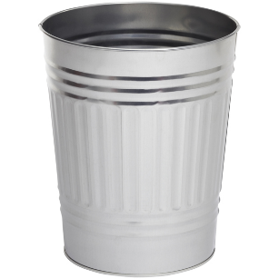
#2 - Avoid/Manage Distractions
Take control of time wasters.
Identify distractions and aim to minimize them.
Feeling productive? Get productive!
Find the time of the day when you have most energy, and plan your important work for that time.
Most Common Distractions:
Emails/Texts/Social Media/
Phone Calls
Turn off your notifications
Schedule a time to check it – 2-3x/day
Unexpected Visitors
Suggest meeting later.
“Let’s talk Tuesday at 10:20 when I can give you my full attention.”
Stand up when someone comes to visit, sending the message that this visit needs to be brief.
www.ewsnetwork.com
Notes:
Manage Distractions : Do you know that some of us can lose as much as two hours a day to distractions? Whether they come from emails, IM chats, colleagues in a crisis, or phone calls from clients, distractions prevent us from achieving flow, which is the satisfying and seemingly effortless work that we do when we're 100 percent engaged in a task. If you want to gain control of your day and do your best work, it's vital to know how to minimize distractions and manage interruptions effectively.

Slide 15
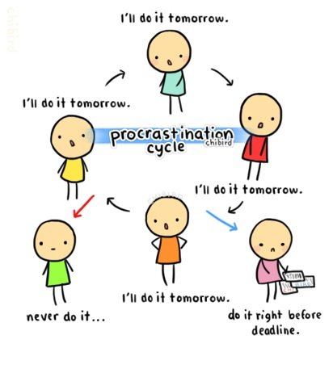
#3 Avoid Procrastination &
Create Habits
Commit to a task and follow through.
Be accountable.
Take care of things as they come up
Tackle the tasks you don’t enjoy
early in the day.
Match to your energy cycle….
www.ewsnetwork.com
Notes:
Don’t Procrastination: Sometimes we spend more time thinking about a task and putting it off than we would actually completing it. Stay on track and complete tasks in a timely manner.

Slide 16
#4 Breakdown Tasks & Delegate
(it’s OK to say no…)
Be realistic as to what you take on.
Overloading yourself means nothing gets done efficiently.
It’s ok (and necessary) to take a break
Saying yes to everything leads to rushed work.
www.ewsnetwork.com

Slide 17
Delegate! How?
1. Clarify your expectations – why is it important?
2. Establish checkpoints – not every hour!
3. Delegate the results, not the process – doesn’t mean micro-manage
4. Define your role – what support you will provide
5. Talk about consequences – results and expectations
www.ewsnetwork.com
Notes:
Delegation is a time management strategy that takes practice. When you learn to delegate effectively, you'll be rewarded with a win-win situation – more time to yourself and a staff that is more confident and empowered.
Clarify your expectations – Tell the person to whom you are delegating what you need accomplished and why it's important.
Establish checkpoints – Track his/her progress by establishing checkpoints at the end of project stages. This doesn't mean asking, "How's it going?" every hour but by being proactive and staying in the loop at key points within the project.
Delegate the results, not the process – Focus on the end result and, unless the person to whom you're delegating is inexperienced, allow him or her to determine how best to achieve it. If you dictate exactly what to do, when to do it, and how to do it, you limit the learning potential, and you risk not taking proper advantage of the person's experience.
Define your role – Explain how much support you'll provide. Should he/her wait for your instructions or make independent recommendations and decisions? Often, the more authority you give, the better the end result will be – however, use your own discretion.
Talk about consequences – Inform him/her of the consequences of both successful and unsuccessful results. What rewards can they expect if they do a great job? What will happen if they don't achieve the expected results?

Slide 18
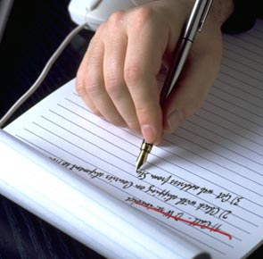
#5 Use Lists and Prioritize
Is Your To-Do List Growing?
List all of the tasks you need
to complete.
Organize tasks based on priority.
Task of high priority should be at
the top of the list.
www.ewsnetwork.com

Slide 19
Stay Organized
R - READ
A - ACTION
F - FILE
T - TOSS
www.ewsnetwork.com

Slide 20
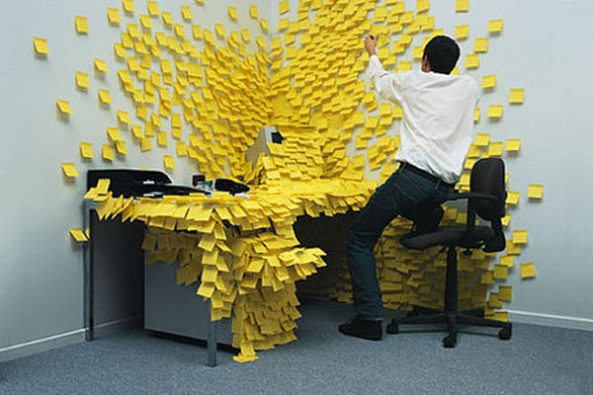
Action Program
Is “plan B” for growing to-do lists
(over 20 tasks)
Short, medium and long term goals
Delegation
1. Collect
2. Prune
3. Organize
4. Prioritize
www.ewsnetwork.com
Notes:
Action Programs is the “plan b” for to-do lists. When to-do lists has over 20 tasks, it becomes cumbersome and difficult to use. This is where action programs become useful. It does require more work than to-do lists but it incorporates short, medium, long term goals. It is more suitable for people with several things to do and teaches you how to delegate tasks.
Collect - make a long list of all the things that need to be completed – whether it’s urgent or not, big or small, personal or professional. Ex. emails, memos in your inbox, ideas in your head (projects you want to run, ideas written on post-it notes). Make sure your personal goals are brought to the list.
Prune - Looking carefully at your list, decide whether you should actually take action on it. Is it really relevant to you? A lot of what comes our way is really not important in the scale of things. If that’s the case, take it off your list.
Organize-
First, group together the separate individual actions that are part of larger projects. Ex. under “home” some tasks may include repaint living room, and clean bathroom.
Prioritize - review these projects and prioritize them from A to F (important to unimportant)

Slide 21
Meet Rebecca
Rebecca has been experiencing tremendous stress at her job.
She's leading a large team through an important project, and it seems
like every day finds her further and further behind with what she
needs to get done.
www.ewsnetwork.com
Notes:
Action Programs is the “plan b” for to-do lists. When to-do lists has over 20 tasks, it becomes cumbersome and difficult to use. This is where action programs become useful. It does require more work than to-do lists but it incorporates short, medium, long term goals. It is more suitable for people with several things to do and teaches you how to delegate tasks.
Collect - make a long list of all the things that need to be completed – whether it’s urgent or not, big or small, personal or professional. Ex. emails, memos in your inbox, ideas in your head (projects you want to run, ideas written on post-it notes). Make sure your personal goals are brought to the list.
Prune - Looking carefully at your list, decide whether you should actually take action on it. Is it really relevant to you? A lot of what comes our way is really not important in the scale of things. If that’s the case, take it off your list.
Organize-
First, group together the separate individual actions that are part of larger projects. Ex. under “home” some tasks may include repaint living room, and clean bathroom.
Prioritize - review these projects and prioritize them from A to F (important to unimportant)

Slide 22
Step 1: Collect
Research our target market .
Finish cost-comparison report.
Research local MBA programs.
Speak with employer about getting
help with funding for MBA.
Meet with Anthony to ensure he's
acclimated to the team; find out
if he's on schedule with his project commitments.
www.ewsnetwork.com
Notes:
(Read first) Ex Case Study: Rebecca has been experiencing tremendous stress at her job. She's leading a large team through an important project, and it seems like every day finds her further and further behind with what she needs to get done.
Step 1: Collection. After spending an hour brainstorming, Rebecca comes up with this list of current commitments (read bullets)

Slide 23
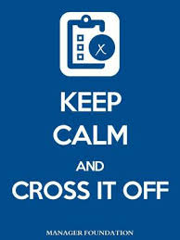
Step 2: Prune
After considering each task, Rebecca realizes she doesn't really need to meet with her new team member, Anthony.
She spoke to him yesterday at lunch and he assured her that he was acclimating well to his new role, and was on track to get all his personal projects completed by deadline.
www.ewsnetwork.com
Notes:
Now that Rebecca has made a list of everything she needs to complete, she takes a closer look at her list to see if any items could be pruned.
After considering each task, she realizes she doesn't really need to meet with her new team member, Anthony. She spoke to him yesterday at lunch and he assured her that he was acclimating well to his new role, and was on track to get all his personal projects completed by deadline.

Slide 24
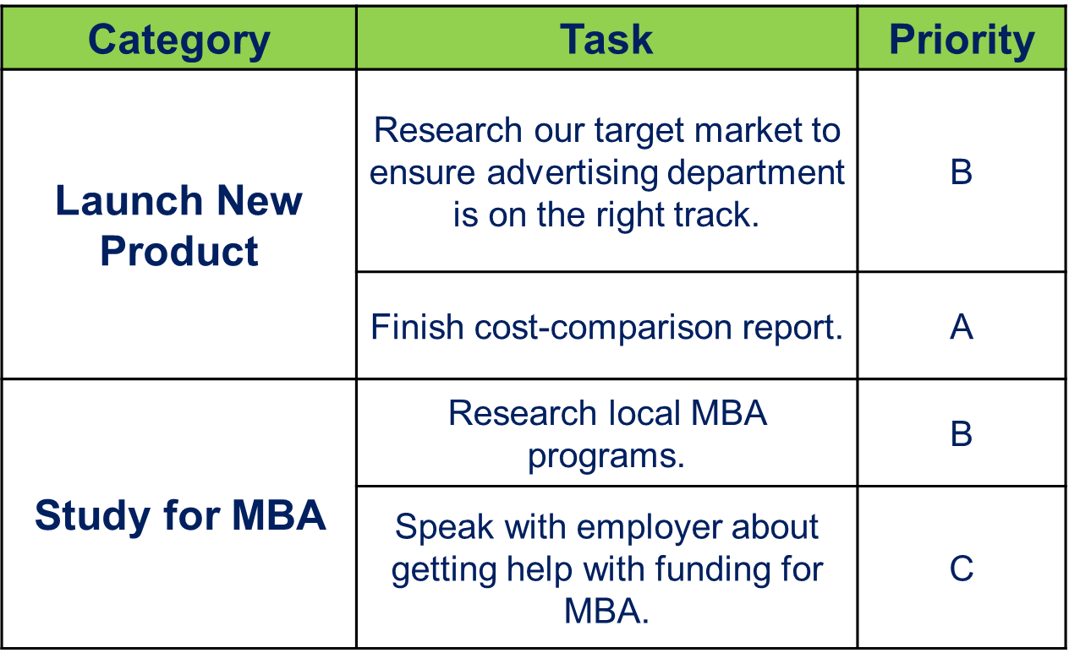
Step 3 Organize/Prioritize
www.ewsnetwork.com
Notes:
Rebecca is now ready to inventory her items. She realizes she can group her to-dos into two major categories. As she groups her tasks, she assigns each one a priority from A-C, with A being top priority.

Slide 25
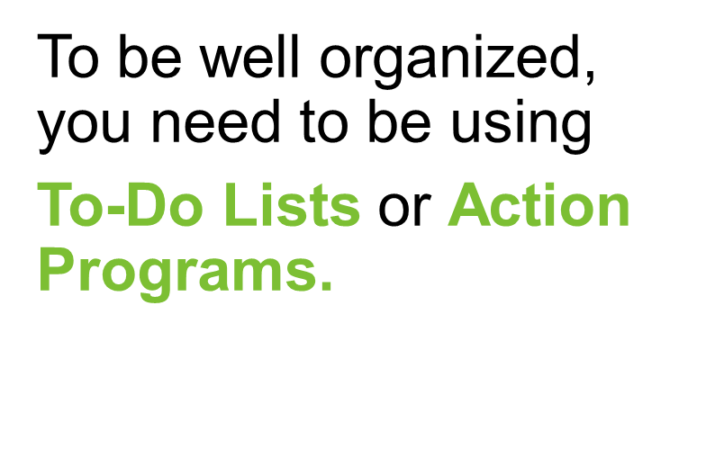
How does this apply?
www.ewsnetwork.com
Notes:
1. You remember to carry out all necessary tasks.
2. You tackle the most important job first, not wasting time on trivial tasks.
3. You manage stress by identifying, delegating or deleting unimportant jobs.

Slide 26
Time Management Apps
APP | Notes
Remember the Milk | Compatible with outlook, gmail, mobile, computer For managing several work and home tasks
Focus Booster | Help for procrastinating and feelings of being overwhelmed, anxiety with time pressures
Toggl | Alternative to time sheets Helps with clarity on time spent on projects
Dropbox | Sending large files, send the link instead! Free Access from anywhere – files are on a cloud
Evernote / Mind42 | Productivity tool that captures ideas, thoughts, images
Trello | Tracks tasks on a dashboard (to do, in progress, completed)
www.ewsnetwork.com

Slide 27
Thank you for your time today!
www.ewsnetwork.com
Meaghan Jansen, Owner EWSNetwork
meaghan@ewsnetwork.com
519-860-6727

