Slide 1
It’s Your Time,
Use it Wisely
www.ewsnetwork.com
Meaghan Jansen, Owner EWSNetwork
meaghan@ewsnetwork.com
519-860-6727
Notes:
https://www.youtube.com/watch?v=k6JoWaBf4II
https://www.youtube.com/watch?v=gsSQkDzJzHY
https://www.youtube.com/watch?v=P6PsgAqES2s
https://www.youtube.com/watch?v=ZtFuDilQzpE
Office
https://www.youtube.com/watch?v=XjQxRrlbP2w
Plant floor
https://www.youtube.com/watch?v=caVTeMdf3lo
Self respect
https://www.youtube.com/watch?v=vmKyM1z3r1g
Respect in workplace

Slide 2
Outline:
Introduce the value of life and time - Building on content in video sent by Meagan
Reuse some of the practical content of the previous time management lunch n learn
Incorporate RAFT
End off with Skills and Self Assessment
Game

Slide 3
Introduction
Intr
Our Two Best Teachers
Life & Time
Life teaches us to make good use of time.
Time teaches us the value of life.
www.ewsnetwork.com

Slide 4
What Do You Value Most?
Your values are the things that you believe are important in the way you live and work.
They (should) determine your priorities, and, measure your sense of satisfaction with life.
Values always exist, but are you living by them, making decisions around them?
Your definition of success determines your values.
What Are Your Values Assessment
www.ewsnetwork.com
Notes:
When the things that you do and the way you behave match your values, you’ll feel a sense of satisfaction with life and feel content.
When you aren’t honoring your personal values, that’s when things feel wrong and can cause a feeling of unfulfillment and unhappiness.
If you value family, but you have to work 70-hour weeks in your job, will you feel internal stress and conflict? And if you don't value competition, and you work in a highly competitive sales environment, are you likely to be satisfied with your job?
In these types of situations, understanding your values can really help. When you know your own values, you can use them to make decisions about how to live your life,

Slide 5
Case Study Evaluation
From the description of Lisa, what would you say are her top
3 values?
Is Lisa fulfilled?
Is she making decisions and behaving in a way that honors her values?
Lisa’s Actual Values
Faith
Family
Hard Work
www.ewsnetwork.com
Notes:
Lisa is a 41 year old married woman with 2 children. Jaden age 12 and Natalie age 7. She works a full time job as a Supervisor in Data Management at a bank. She rushes to get to work in the morning after dropping the kids off at school. She knows that when she arrives to work, she will have to complete a list of tasks from the previous day that she didn’t have the time to accomplete. She sits down and intends on prioritizing those tasks but decides to start her day by checking her email first thing in the morning. Two urgent requests have come in for data reports that require her immediate attention, and one of her staff has emailed her asking for her direction on a client file. She chooses what she think can be dealt with the most quickly, helping her staff member, however this help as added more work to her plate than she had initially thought. By the time she settles the matter, she is able to “quickly” complete the tasks from the previous day and has full intention on spending her afternoon getting to the urgent requests. She has a quick bite to eat at her desk but mostly works through her lunch hour and completes the urgent requests by days end feeling unsatisfied with the quality fo the work due to the demands on her time. She rushes home to find the morning dishes left on the counter and in the sink, and nothing prepped for dinner. Jaden has hockey in an hour and her 7 year old is wanting to tell her about his day. She begins to prepare a quick dinner, throws the dishes in the dishwasher and does her best to show interest in her day. Her husband arrives home, she barely greets him at the door, and serves dinner. Jaden and her husband are off to hockey! Lisa is grateful to have a couple of hours to get the kitchen cleaned and go over the report she rushed through at work today. She sits down to do her final edits, and is reminded that the 7 year old has a field trip tomorrow. He needs his form filled out, transportation money and a lunch. To the grocery store! She arrives home exhausted. Her husband and Jaden return home from hockey. She and her husband spend a half hour talking about the frustrations of their work day and she heads off to bed. Until tomorrow begins..

Slide 6
Objectives
Time Management Quiz
Why is Time Management Important
What Do You Value the Most
Build An Action Plan
RAFT - Control of Time Wasters & Distractions
www.ewsnetwork.com

Slide 7
Why is Time Management Important
By implements some time management, taking into consideration what Lisa values, she can
Balance the conflicting demands of work and personal life
Determines priorities and set boundaries
Reduce stress and pressure
Maintain positive relationships both personal and professional
See the problem, find the solution.
*USE THE CASE STUDY TO DISCUSS EACH OF THESE POINTS. HOW CAN TIME MANAGEMENT HELP SUSAN ACHIEVE THESE THINGS.
www.ewsnetwork.com
Notes:
If Lisa can manage her time she can find a more balance separation of work and personal life
Reduce the stress and pressure…etc. touch on all point.

Slide 8
Action Plan
Use Lists and Prioritize
Break Down Tasks & Delegate
Progress Positively
Organize Time
Set Goals
Avoid Procrastination & Create Habits
Avoid Distractions
www.ewsnetwork.com
Notes:
How is she going to do this. Discuss each point and also relate back to Lisa and her situation.

Slide 9
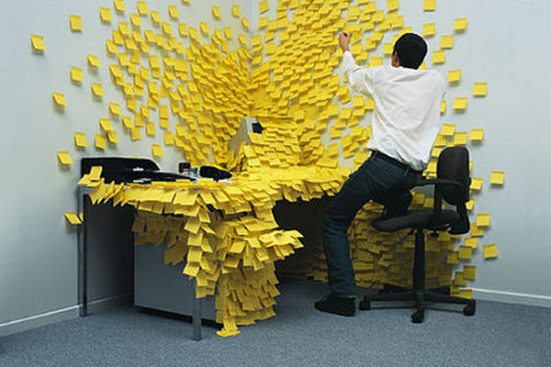
Use Lists and Prioritize
Is Your To-Do List Growing?
List all of the tasks you need
to complete.
Organize tasks based on priority.
Task of high priority should be at
the top of the list.
*THIS IS WHERE YOU CAN DISCUSS RAFT PROCESS. PERHAPS ON ANOTHER SLIDE?
The Secret Formula to Prioritizing Lists
REFER
ACT
FILE
TRASH
www.ewsnetwork.com

Slide 10
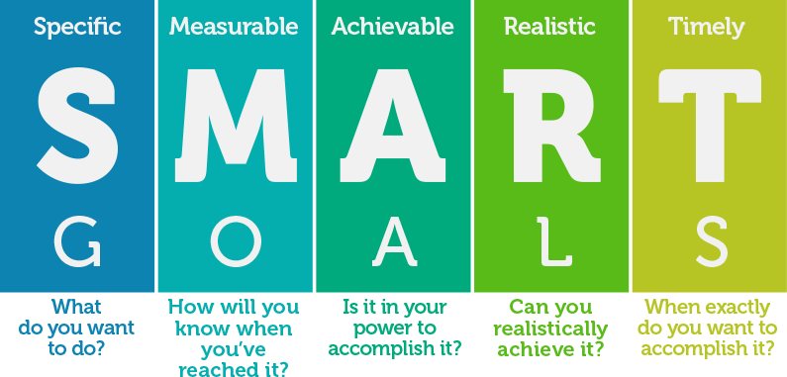
Set Goals
www.ewsnetwork.com

Slide 11
Breakdown Tasks & Delegate
Be realistic as to what you take on.
Overloading yourself means nothing gets done efficiently.
It’s ok (and necessary) to take a break
Saying yes to everything leads to rushed work.
www.ewsnetwork.com

Slide 12
Avoid/Manage Distractions
Take control of time wasters.
Identify distractions and aim to minimize them.
Feeling productive? Get productive!
Find the time of the day when you have most energy, and plan your important work for that time.
.
Most Common Distractions:
Emails/Texts/Social Media/
Phone Calls
Turn off your notifications
Schedule a time to check it – 2-3x/day
Unexpected Visitors
Suggest meeting later.
“Let’s talk Tuesday at 10:20 when I can give you my full attention.”
Stand up when someone comes to visit, sending the message that this visit needs to be brief.
www.ewsnetwork.com

Slide 13
Organize Time
I like the idea of a Time Budget here. Here is the link to a couple of articles I was going to source from:
https://www.wm.edu/offices/deanofstudents/services/academicenrichment/timemanagement/index.php
https://litemind.com/time-budget/
Again …relate back to Lisa. You can create her own time budget.
www.ewsnetwork.com

Slide 14
Progress Positively
Henry Ford said: "If you think you can or you think you can't, you're absolutely right."
Optimists are more likely to perservere through a set back. Pessimists are more likely to give up
A positive attitude takes practice
People who believed that they could achieve a certain goal did so in 80% of cases whereas people who did not believe they could achieve their goal only achieved it 20% of the time.
www.ewsnetwork.com
Notes:
nd the latest research on this has suggested he is correct. Professor Suzanne Segerstrom, University of Kentucky found that when optimists encounter a setback they are less likely than pessimists to just give up.

Slide 15
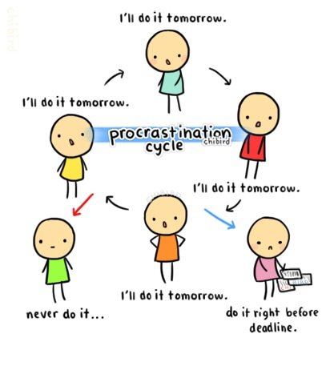
Avoid Procrastination &
Create Habits
Commit to a task and follow through.
Be accountable.
Take care of things as they come up
Tackle the tasks you don’t enjoy
early in the day.
www.ewsnetwork.com

Slide 16
Title
Text
www.ewsnetwork.com

Slide 17
Title
Text
www.ewsnetwork.com

Slide 18
Thank you for your time today!
www.ewsnetwork.com
Meaghan Jansen, Owner EWSNetwork
meaghan@ewsnetwork.com
519-860-6727

