Slide 1
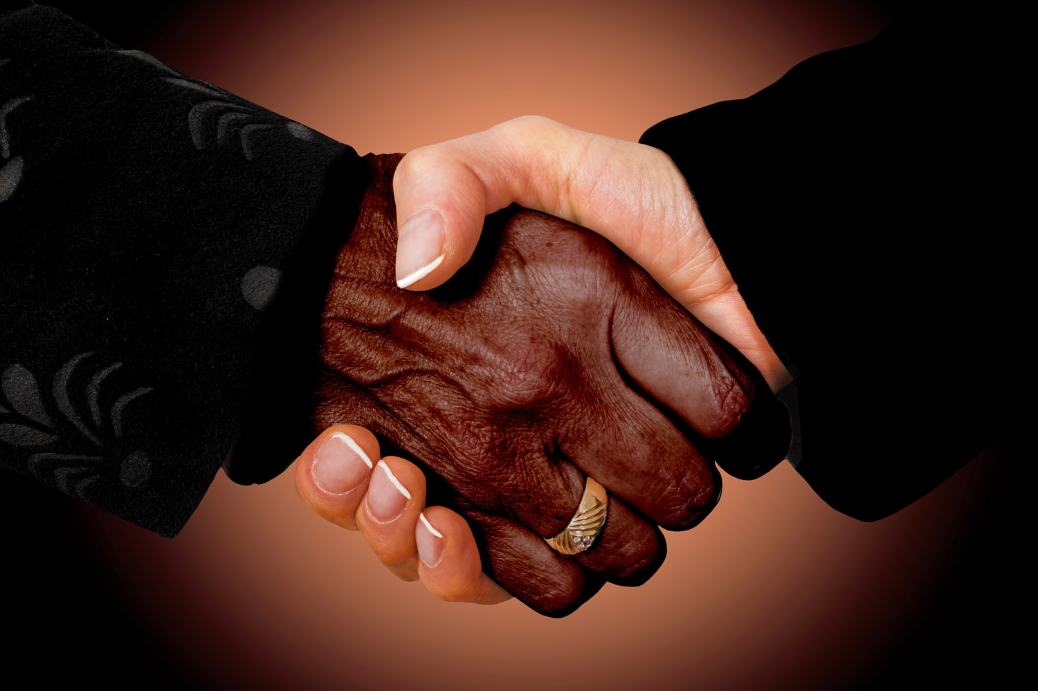
Respect in the Workplace
www.ewsnetwork.com
Meaghan Jansen, Owner EWSNetwork
meaghan@ewsnetwork.com
519-860-6727
Notes:
https://www.youtube.com/watch?v=k6JoWaBf4II
https://www.youtube.com/watch?v=gsSQkDzJzHY
https://www.youtube.com/watch?v=P6PsgAqES2s
https://www.youtube.com/watch?v=ZtFuDilQzpE
Office
https://www.youtube.com/watch?v=XjQxRrlbP2w
Plant floor
https://www.youtube.com/watch?v=caVTeMdf3lo
Self respect
https://www.youtube.com/watch?v=vmKyM1z3r1g
Respect in workplace

Slide 2
Objectives
Respect in the Workplace
Why?
Examples of Disrespectful Behaviour
Workplace Bullying Defined
Types of Bullies
Gossiping, Social Exclusion/Isolation, Intimidation
Self Respect/ Self Care
It’s All in the Language
Walk the Talk
Take the Pledge!
www.ewsnetwork.com

Slide 3
R-E-S-P-E-C-T
Golden rule…..
Treat people with courtesy, politeness, kindness.
Listen to what others have to say before expressing your viewpoint.
Never insult, name call, disparage or put down people or their ideas.
Include all coworkers in meetings, discussions, training, events.
www.ewsnetwork.com

Slide 4
Examples of Disrespectful Behaviour
Any act of violence
Leering at a coworker
Ignoring a coworker
Rolling your eyes when you’re talking to someone
Bullying
Gossiping
Making racist, religious, or sexist jokes
Abuse of authority
www.ewsnetwork.com

Slide 5
Why Respect in the Workplace?
Improve team communication.
Strengthen employee retention.
Enhance organization health.
Increase morale.
Reduce absenteeism.
Create stronger corporate culture and reputation.
Makes work a nicer place to be!
www.ewsnetwork.com

Slide 6
What is it?
Workplace Bullying…..
…..the repeated, health or career
endangering mistreatment of one
employee, by one or more employees.
The mistreatment is a form of
psychological violence and is often
a mix of verbal and strategic insults
preventing the target from performing
work well.
www.ewsnetwork.com
Notes:
2:50
https://www.youtube.com/watch?v=YmRKlZEXVQM
Toolkit
7:35

Slide 7
Workplace Bullying Facts
Targets endure bullying for almost two years before filing a complaint.
17% of targets have to transfer to other jobs.
Only 13% of bullies are punished or terminated.
71% of bullies are in positions of authority.
Bullying is 3X more prevalent than sexual harassment.
www.ewsnetwork.com
Notes:
Typically not on the new guy, rather long-term employees. Easier targets…

Slide 8
Types of bullies
Subtle bullies
Abusive bullies
Controlling bullies
Raging bullies
Opportunistic bullies
Critic bullies
www.ewsnetwork.com
Notes:
Typically not on the new guy, rather long-term employees. Easier targets…

Slide 9
The Workplace Bully
Persistent
Offensive
Abusive
Intimidating
Upset
Threatened
Humiliated
Vulnerable
*It’s important to note that not all negative behavior in the workplace is bullying.
A demanding boss
Normal conflict with a coworker
Poor communication
Dealing with an assertive/directive personality
www.ewsnetwork.com

Slide 10
Dealing with a Bully
See it…..SAY it!
Stick up for co-worker
Be clear with disapproval
Ask for a change
Honestly and directly challenge the specific behaviour and the impact of it.
Address the issue.
Present with confidence.
Report it…..
https://www.youtube.com/watch?v=XjQxRrlbP2w&t=2s
www.ewsnetwork.com
Notes:
If your supervisor or manager is bullying, contact Human Resources or Occupational and Environmental Safety and Health to bring the matter to someone's attention.
Honestly and directly challenge the specific behaviour and the impact of the behaviour. Do not use labels or exaggerations. For example: "When you tell me I'm a snivelling ankle biter, I feel attacked. It makes me wary to approach you when I need to talk to you about something work related.”
Show respect for the person. This doesn't mean respecting their behaviour. It means respecting they also deserve to be treated with dignity and respect.
Address the issue. Ignoring or denying the situation will not make them go away or improve. Thoughtful action is required.
Present with confidence. A person who owns their power and speaks up for themselves is typically an unlikely target for workplace bullying.
Choose your company wisely. If people ignore or support a bully's behaviour, choose to spend time with other people.

Slide 11
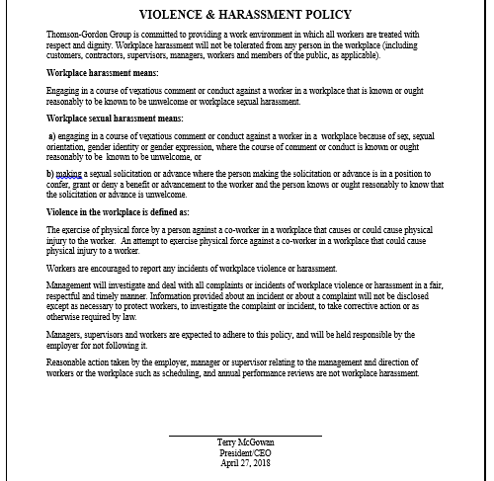
Be Aware
www.ewsnetwork.com
Notes:
Harrassment and violence complaint form – complete one!

Slide 12
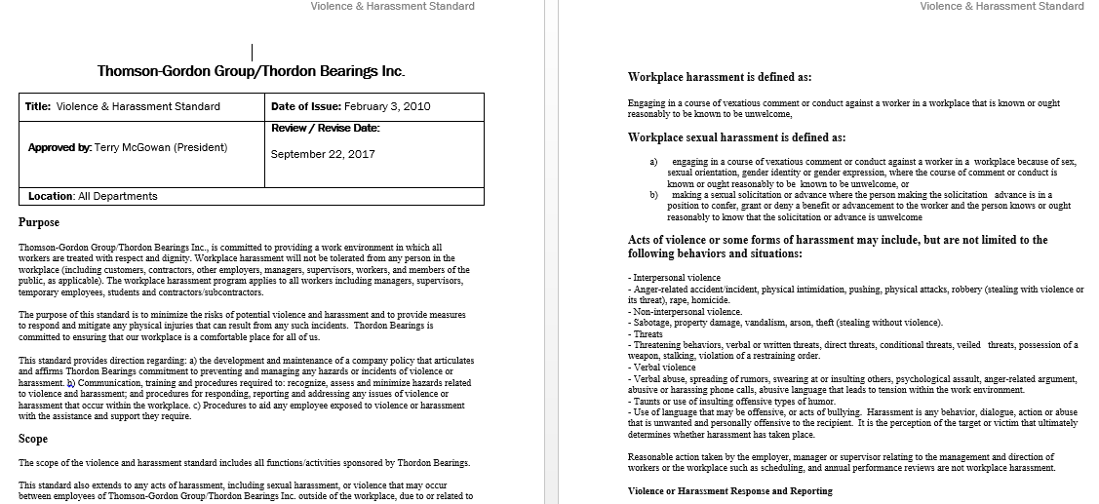
Review the Standard
www.ewsnetwork.com
Notes:
Harrassment and violence complaint form – complete one!

Slide 13
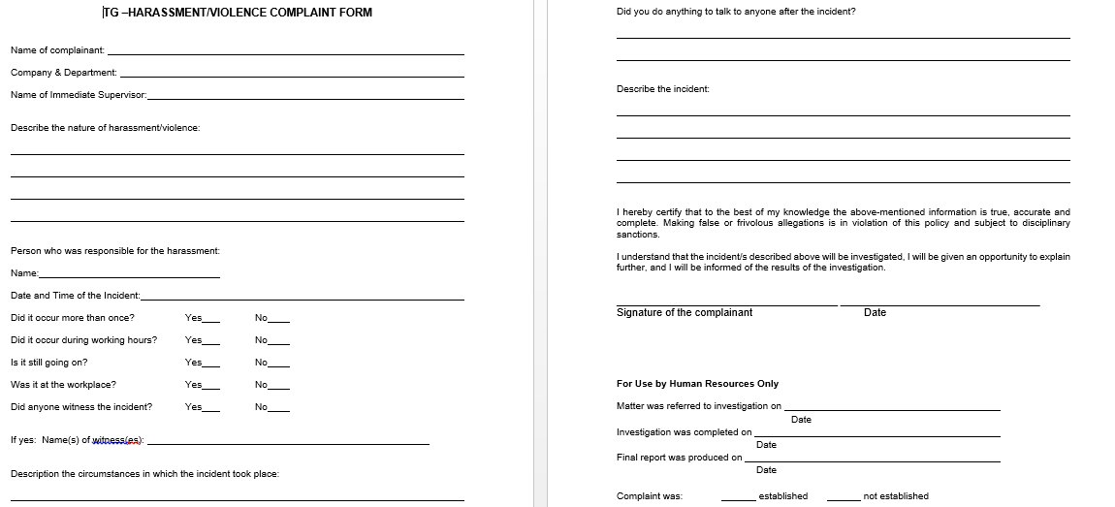
Report It!
www.ewsnetwork.com
Notes:
Harrassment and violence complaint form – complete one!

Slide 14
Gossiping
Gossip:
idle talk or rumors, especially about the personal or private affairs of others.
Is gossip bullying?
It can be.
What can I do?
Go to the source and find out if it is true or not.
www.ewsnetwork.com
Notes:
Is Gossip Bullying? It is a form of harassment: personal harassment can be any behaviour which demeans or humiliates someone…spreading information that may or may not be true meets this definition and we must act to stop it.
What can I do? Make a team ‘pact’, Create a gesture that reminds people in a non confrontational way that you will not engage in the “gossip” or rumor. Go to the source to find out if the information is true or not true rather than speculate. Encourage others to go to the source.

Slide 15
Social Exclusion or Isolation
Exclude: to shut or keep out
Isolate: to set or place apart; detach or separate so as to be alone.
What does this look like? Silent treatment, refuse to make eye contact, avoid working with specific people, invite specific people and intentionally leave someone out.
What can I do? Inclusion is a mind set and choice. Smile!
www.ewsnetwork.com
Notes:
What does this look like? Have you ever given or observed someone giving people the silent treatment at work, have you ever refused to make eye contact or to say hello, avoid working with specific people that you need to work with to do your job? Have you ever invited specific groups to join in on something and intentionally left someone out?
What can I do? Inclusion is mind set & a choice – we don’t have to like or agree with everyone at work, everyone deserves the common courtesy to be welcomed and feel welcome – if there is some unfinished business you have with someone, mend it , get support to mend it or get over it and move on. Hold each other accountable for including others and helping everyone feel welcome in your work space, SMILE – someone may just smile back at you, make a pact on how we will treat each other, have some fun with making people feel welcome in your areas.

Slide 16
Intimidating a Person
Intimidate: to make timid; fill with fear; force into or deter from some action by inducing fear.
What does it look like? Forced into doing a task you did not want to do.
What can I do? Speak up! Tell the person intimidating you and your supervisor.
Other Examples…
Belittling a person’s opinion
Criticizing someone persistently or constantly
Taking credit for another person’s ideas or successes
www.ewsnetwork.com
Notes:
What does intimidation look like? Have you been deliberately forced into doing a task that you did not want to do? Has someone used authority or their physical size in order to change your actions and opinions?
How can we put an end to this behaviour? Speak Up! Let the person know that you are uncomfortable and hurt by the behaviour. Look for support and try to solve the problem as soon as the behaviour starts occurring.
What should we do when we see this behaviour? It is important if you observe this behaviour or know that it is occurring to speak up and tell someone. You can seek guidance on how to handle this situation from a Manager, Union Steward or an HR Representative.
BELITTLING A PERSON’S OPINIONS
What does this behaviour look like? Laughing at a person’s opinions; being told that your ideas are unrealistic or stupid; Having your idea or opinion shot down before being able to explain.
CRITICIZING A PERSON PERSISTENTLY OR CONSTANTLY
What does this behaviour look like? Criticizing a person constantly; mocking a person’s possessions; picking apart their work on a regular basis
Why does this behaviour occur? This behaviour occurs when an individual feels that they can build themselves up by putting another person down. It often occurs when a person is envious and wishes they had the ideas or possessions that another person has.
TAKING CREDIT FOR ANOTHER PERSON’S IDEAS OR SUCCESSES
What does this behaviour look like? Stealing ideas and claiming them as their own; Not giving the credit where credit is due
Why does this behaviour occur? This behaviour occurs because an individual is envious of the idea or success that another person has. There is a need to look good in front of others and they believe the idea will give them greater opportunities within the organization.

Slide 17
Effective Communication
We need to educate people on how to express things respectfully.
CHECK IN WITH YOURSELF
How can I have this conversation that has less focus on emotion and more on problem solving so we're not defending power?
www.ewsnetwork.com

Slide 18
It’s All in the Language
"It makes me uncomfortable to hear the way you speak to so and so. Is there a more respectful way you could address them?"
"Please don't talk to me that way. I have always treated you with professional courtesy. I'm willing to talk about how this document could be improved but I need you to tell me what I could do to improve the document.”
"I can see you're very angry. Perhaps it might be a good idea for you to take a few minutes before we continue discussing this further."
www.ewsnetwork.com
Notes:
Tips for Communicating with a Bully:
Let them know what they are doing that is problematic, be specific (no generalizations).
Let them know the impact of their behaviour on you.
Always treat them with respect.
Treat them how you would like to be treated if someone thought you were a bully.

Slide 19
Self Respect & Self-Care
Regard and respect the person you spend the most time with … yourself.
Protect the most precious resource: YOU
Speak honestly
Set boundaries
Ask for help
Be compassionate with yourself
Think about how your behaviour affects others
Think before you speak
Take responsibility for yourself and your behaviour
Build your TOOLKIT
“Respect Yourself and You Will Be Respected.”
www.ewsnetwork.com
Notes:
If you want to better care for and relate to others, health experts encourage you to put yourself first. Regard and respect the person you spend the most time with…yourself. The most important relationship - the one you have with yourself - sets a tone for all of our other reactions.
A person who respects themselves treats themselves and others in a healthy way. When you respect yourself, you are mindful of how you move in the world. You can set boundaries with your time and energy so you can work in the most effective way to meet your identified objectives and goals in your position. You can manage realistic expectations about what you can accomplish and ask for help when you need it.

Slide 20
I Pledge….
www.ewsnetwork.com

Slide 21
Thank you for your time today!
www.ewsnetwork.com
Meaghan Jansen, Owner EWSNetwork
meaghan@ewsnetwork.com
519-860-6727

