Slide 1
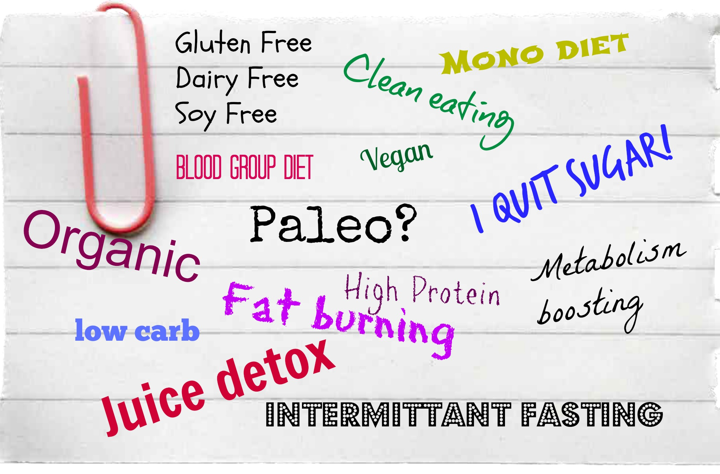
The Diet Dilemma Which one is right for me?

Slide 2
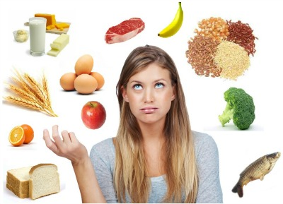
Changing dietary trends means..
Conflicting information
Lofty promises
Confusing scientific claims
Why so many diets?

Slide 3
Get the scoop on the latest dietary trends. The Platform The Pro’s The Con’s and the answer to… Which one is right for me? We’ve done the work!
We compare some of
the most popular plans!
Level of Control
And the answers to…

Slide 4
See your EWSNetwork Consultant on a Walkaround!

