Slide 1
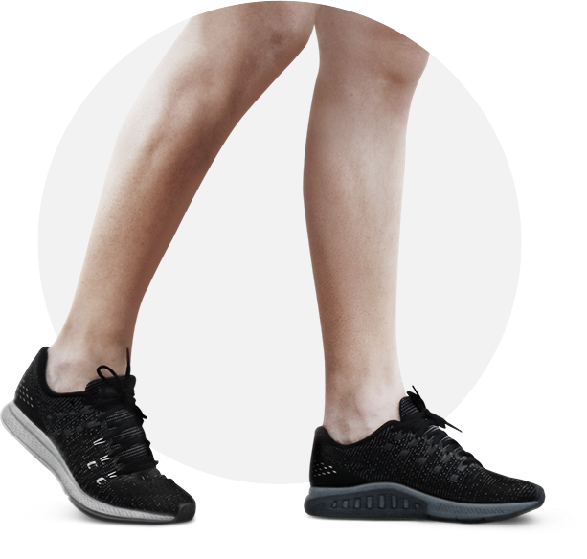


WALK YOUR WAY
TO BETTER HEALTH
Building a Walking Strategy
Powered by:
©2019 EMPLOYEE WELLNESS SOLUTIONS NETWORK INC. – ALL RIGHTS RESERVED

Slide 2
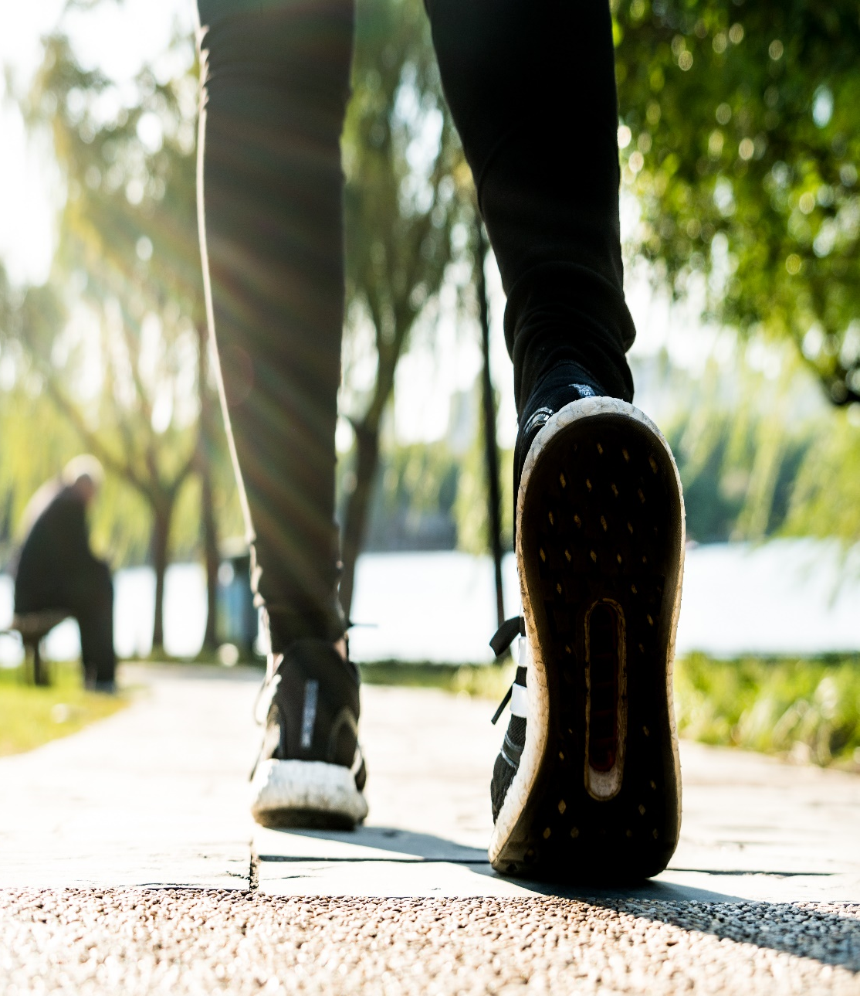
I
Moving Matters!
Physical activity is a lifesaver – literally.
A sedentary lifestyle is a silent killer - a leading cause of disease and disability.
Being inactive increases the risk of:
Heart disease, stroke, diabetes, and obesity (2x the risk)
Colon cancer
High blood pressure
Osteoporosis
Lipid disorders
Depression & Anxiety
www.EWSNetwork.com
Notes:
Information is from the World Health Organization https://www.who.int/mediacentre/news/releases/release23/en/

Slide 3

I
Walk – It’s Natural!
More than half the body’s muscles are designed for walking -
works many muscles and burns lots of calories!
Easy and least expensive
Can be done anywhere any time.
No special equipment or expertise is required to get started.
Progress is easily measured.
Isn’t hard on the body.
Can be a group or individual activity.
Increases metabolism.
www.EWSNetwork.com
Notes:
It is one of the easiest and least expensive exercises to do.
It can be done almost anywhere at any time.
No special equipment or expertise is required to get started.
Progress is easy to plan and measure over time.
It isn't too taxing on the body and can be done daily.
It can easily be done with others making motivation easier.
Even a little bit can produce beneficial results.
It increases metabolism.

Slide 4
I
Why Should I Walk?
Regular, brisk walking can prevent and control physical risk factors and markers for chronic disease.
Body
Spirit
Mind
Why?
Refreshes the mind, resets the brain, and relieves stress.
Boosts mood, self esteem, connects you to nature, calms and relieves stress.
www.EWSNetwork.com
Notes:
It trains your heart, lungs, and muscles to work more efficiently making each subsequent workout more effective.

Slide 5

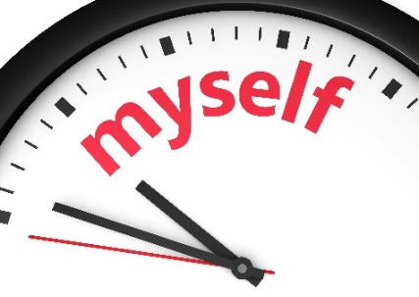

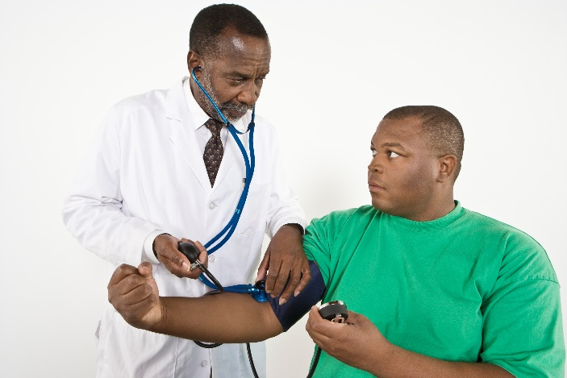
I
Define Your Purpose
What is your Why?
Find Your Purpose
Manage health issues like high blood pressure, blood sugar imbalance…etc.
Boost mood and emotional well-being.
Reduce stress and clear your mind.
A meditative practice.
Weight loss.
Overall health and wellness.
Is it physical, mental, or emotional/spiritual?
www.EWSNetwork.com
Notes:
It can be difficult to find the motivation to exercise. It takes time, effort, and persistence to stay committed to any lifestyle change. Research has shown that over 50% of people who begin a fitness program will drop out over the first 6 months. (Berger, Pargman, & Weinberg, 2002; Matsumoto & Tekenaka, 2004). Here’s a truth you already know:
No amount of outside motivation, research and information, or anecdotal stories will motivate you to do something that you don’t have a purpose for.
Ready to commit to a regular walking fitness routine?
Put yourself in the right state of mind.
Define why it is important to you and be honest with yourself.
You’ll find your purpose by asking “Why”?

Slide 6

I
Moving Matters – Physical Benefits
30 to 60 minutes a day, most days of the week:
Lowers your risk of heart disease and stroke.
Prevents and controls risk factors such as high blood pressure, high cholesterol, diabetes, and obesity.
Increases your lungs' ability to take in oxygen which gets more difficult with age.
Better bone density.
Reduces risk of cancers including breast and colon.
www.EWSNetwork.com
Notes:
Benefits to the heart: increases blood circulation through your body, bringing more oxygen and nutrients to your organs.
Walking increases heart rate and strengthens your heart. Mortality rates among retired men who walked less than one mile per day were nearly twice that among those who walked more than two miles per day. Women who walked three hours or more per week reduced their risk of a heart attack or other coronary event by 35% compared with women who did not walk.
Walking prevents type 2 diabetes. Walking 150 minutes per week and losing just 7% of your body weight (12-15 pounds) can reduce your risk of diabetes by 58%.
As is
Walking is good for your bones. Postmenopausal women who walk around one mile each day have higher whole-body bone density than women who walk shorter distances. It is also effective in slowing the rate of bone loss from the legs.
Walking reduces the risk of breast and colon cancer. Women who performed the 1h 15min – 2.5h per week of brisk walking had an 18% decreased risk of breast cancer compared with inactive women. Many studies have shown that exercise can prevent colon cancer, and even if an individual person develops colon cancer, exercise can increase quality of life and reduce mortality – for both men and women

Slide 7

I
Moving Matters – Mental Benefits
Regular walking can have exceptional effects on the mind and mental wellness.
Decreases risks and symptoms of anxiety and depression.
Improves productivity & mental cognition.
Improves executive functions such as focus, memory, recall, and problem solving.
www.EWSNetwork.com
Notes:
Walking directs the release of endorphin, the body’s natural medicine for happiness. Countless doctors of medicine suggest including walking and other forms of physical workout as a natural management of depression, stress and anxiety. Time to gather thoughts, clear your head, and escape acute stressors.
https://www.treadmillreviews.net/health-benefits-of-walking/
Walking helps alleviate symptoms of depression. Walking for 30 minutes, three to five times per week for 12 weeks reduced symptoms of depression as measured with a standard depression questionnaire by 47%. Exercise removes the build-up of stress hormones in the body which can undermine wellbeing, causing problems such as headaches, fatigue, loss of concentration, problems sleeping and many other mental and physical symptoms.
Walking is good for your brain. Women who walked the equivalent of an easy pace at least 1.5 hours per week had significantly better cognitive function and less cognitive decline than women who walked less than 40 minutes per week.
“A group of "professional couch potatoes," as one researcher described them, has proven that even moderate exercise in this case walking at one's own pace for 40 minutes three times a week can enhance the connectivity of important brain circuits and combat declines in brain function associated with aging and increase performance on cognitive tasks.
The walkers also had increased connectivity in parts of another brain circuit which aids in the performance of complex tasks, and they did significantly better on cognitive tests than their toning and stretching peers.
Previous studies have found that aerobic exercise can enhance the function of specific brain structures, Kramer said. This study shows that even moderate aerobic exercise also improves the coordination of important brain networks.
"The higher the connectivity, the better the performance on some of these cognitive tasks, especially the ones we call executive control tasks things like planning, scheduling, dealing with ambiguity, working memory and multitasking," Kramer said. These are the very skills that tend to decline with aging, he said.”
This study was supported by the National Institute on Aging at the National Institutes of Health.
Even if you do not suffer from depression or low self-esteem, you will benefit emotionally from half an hour of exercise; feeling instantly invigorated, lighter and happier. Everyone needs to get out and exercise every day to help keep your body and your brain healthy.

Slide 8

I
Moving Matters – Spiritual Benefits
Walking is peaceful and restorative to your spirit.
Replenishment of the soul
Connection to nature
Personal problem-solving
Improved self-esteem
Activates imagination and creativity
www.EWSNetwork.com
Notes:
Walking can become a ritual of everyday connection to the spirit, providing peace and contentment in a stressful society.
Walking solo or with a friend can be deeply restorative.
Walking with a friend, or in the neighborhood can encourage dialogue and conversations with friends and strangers.
Create a sense of community
Connection to nature and creativity study: https://news.stanford.edu/2014/04/24/walking-vs-sitting-042414/

Slide 9
I
Moving Matters – Spiritual Benefits
Walk Solo
Walk With a Friend
Focus on your needs
Conversation with neighbors/strangers
Listen to music or meditation
Be more mindful
Let your mind wander
Encourages dialogue
Sense of Community
Social connection with a friend
Bonding
Encouragement
www.EWSNetwork.com
Notes:
• Self-care and self improvement. Having new goals provide direction and obtaining those goals, however big or small, breeds a sense of achievement and self confidence.
• Release from emotional stressors. You can abandon responsibilities and concentrate on the purely physical, controlling your breathing, walking or running for that extra half a mile.
• A walk can provide a change of scene, getting people out of their homes and routines, meeting new people and feeling less isolated. Group walking can provide a sense of belonging, even if it is just smiling at the other runners or walkers in the park. Joining a walking group provides opportunities for social contact beyond the normal sphere of your life and its attendant stresses, and can make a refreshing change and a boost to the spirit.
• Exercise can boost self-esteem. One can gain new skills, improve body image - becoming fitter and healthier.
• The benefits of exercise last longer than quick-fixes for comfort such as comfort-eating, smoking, or drinking tea or coffee, all of which may contribute to health problems.

Slide 10
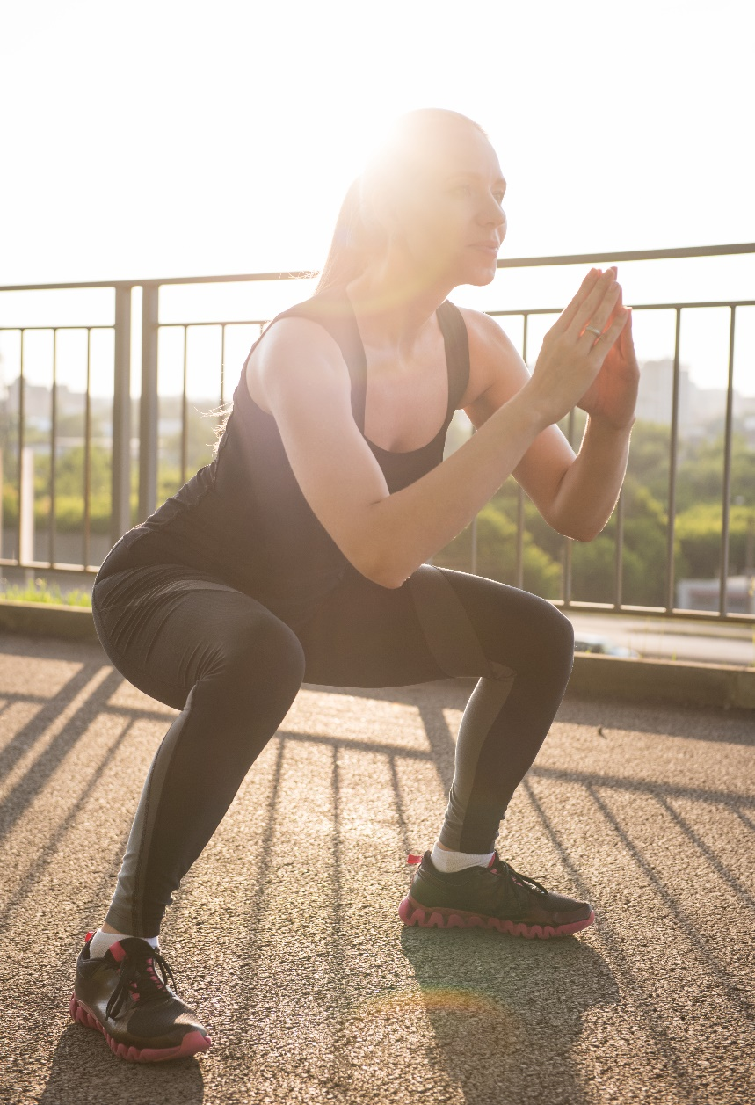
I
How to Get Started – Build Your Strategy
Think of your walk as a strategy divided into 3 parts:
The Warm Up – Before you start to walk, use dynamic stretches to warm-up.
The Walk – 30-60 minutes of a moderate intensity most days per week.
The Cool Down – Perform a stretch routine again focussing more on static stretching.
www.EWSNetwork.com

Slide 11
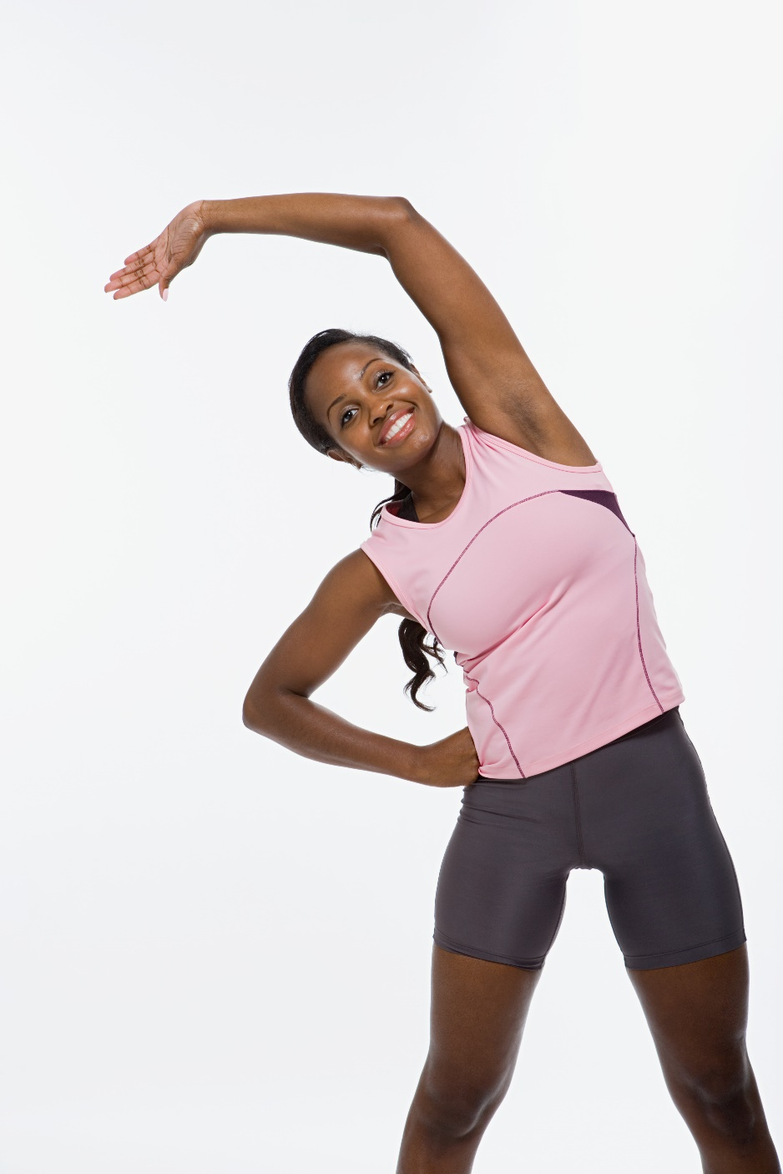
Strategy – Part 1 – The Warm Up
Benefits of a Proper Warm Up
• Increases movement of oxygen and blood.
• Prepares muscles for exercise.
• Prepares the heart for an increase in activity.
• Prepares the mind for the upcoming exercise.
• Improves coordination and reaction times.
Dynamic stretching is ideal.
Follow the principles of FITT
www.EWSNetwork.com
Notes:
• Increased movement of blood through the tissues.
• Increased delivery of oxygen and nutrients to muscles/organs.
• Prepares muscles for exercise.
Primes your nerve-to-muscle pathways to be ready for exercise.
• Prepares the heart for an increase in activity.
• Mental prep for the upcoming exercise.
• Improved coordination and reaction times.
Dynamic stretching is a form of stretching as you are moving. Simple movements like arm circles and hip rotations, flowing movements as in yoga, or walking or jogging exercises.
See Warm Up for Walkers in Handout
Frequency: As often as you are working out.
Intensity: Start with low intensity and progress to the intensity of your planned workout. The more intense your workout, the longer the warm up should be. Focus on the large muscle groups involved in whatever activity you are participating in. Nice and easy, slight sweat, slight increase in temperature, and don’t tire.
Time: 5-10 minutes
Type: See handout and review with group. Usually you want to do a lower intensity version of your workout to work out the muscles that you will be using. Or different exercises that also focus on these muscles.
or Walkers Handout

Slide 12
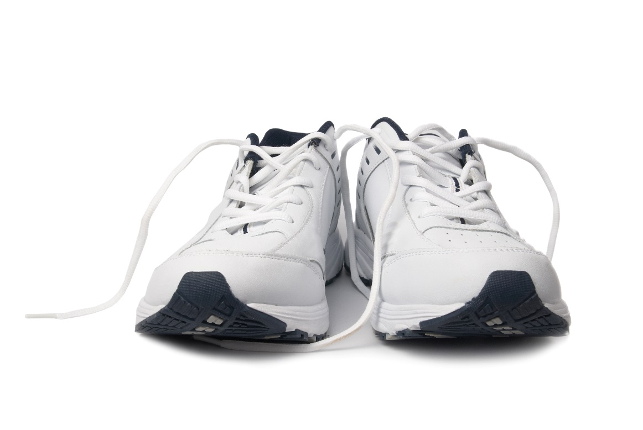
I
Strategy – Part 2 -The Walk
How to Get Started:
  Establish a regular walking routine/schedule.
  Know your fitness level.
  Decide if you will walk with a partner or on your own.
  Learn proper form and posture.
  Have proper clothing and footwear.
www.EWSNetwork.com
Notes:
Establish a regular walking routine/schedule that works for you.
Know your fitness level.
Decide if you will walk with a partner or on your own.
Learn proper form and posture.
Ensure you have proper clothing and footwear for the seasons and weather changes that you will have to deal with to remain committed.

Slide 13
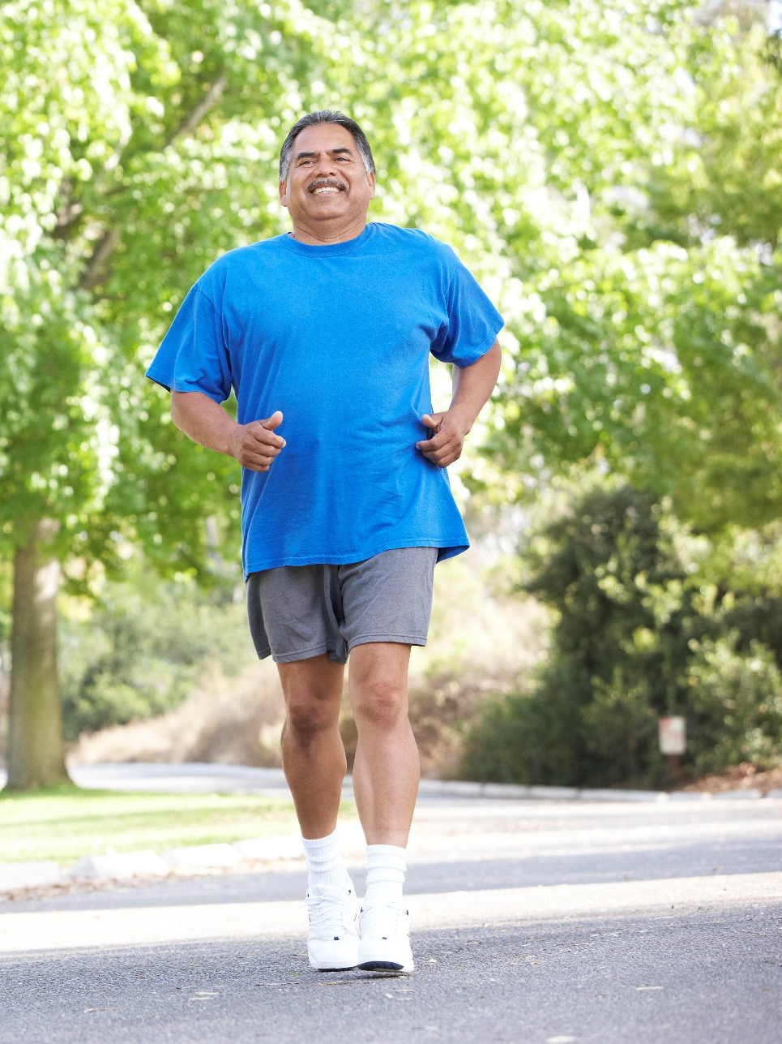
I
The Walk - Know Your Fitness Level
Beginners
(concerned about motivation or ability to walk far):
Five minutes out, five minutes back
Power walkers
(aka speed walking):
Warm up
Power-walk (7-9 km/hr) 10-15 minutes
Cool down
Interval Training
(after 30 minutes of power walking achieved)
Increase speed and duration of walk at intervals in a 30 minute period.
Repeat cycle until reach total time 30 min
www.EWSNetwork.com
Notes:
Beginners (concerned about motivation or ability to walk far):
Five minutes out, five minutes back plan:
Walk for 5- 10 minutes,
Turn around, and walk back.
Increase by two to three minutes per week and before you know it you’ll be up to 30 minutes.
Power walkers (aka speed walking):
Start with normal pace for 5-10 minutes to warm up.
Power-walk (7-9 km/hr) 10-15 minutes
Last 5-10 minutes at a normal pace to cool down.
Interval Training (after 30 minutes of power walking achieved)
Week 1 Walk at normal pace 3 min
Increase speed 1 min
Normal pace 3 min
Repeat cycle until reach total time 30 min
Week 2 Walk at 3.5 mph 10 min
Increase speed to 3.8 mph 1 min
Walk at 3.5 mph 3 min
Increase speed to 3.8 mph 1 min
Repeat cycle until reach total time 30 min
Week 3 Walk at 3.5 mph 10 min
Increase speed to 3.8 mph 1.5 min
Walk at 3.5 mph 2.5 min
Increase speed to 3.8 mph 1.5 min
Repeat cycle until reach total time 30 min
Note on interval training: Once you reach a baseline of 30 minutes of power-walking, you can speed up even more by training with intervals. Intervals are where you set up work to active rest ratios (work: active rest) to push your body and improve your cardiorespiratory fitness. You will improve after six to eight weeks if you continue with this type of training. You may even notice more endurance after just one or two sessions:

Slide 14
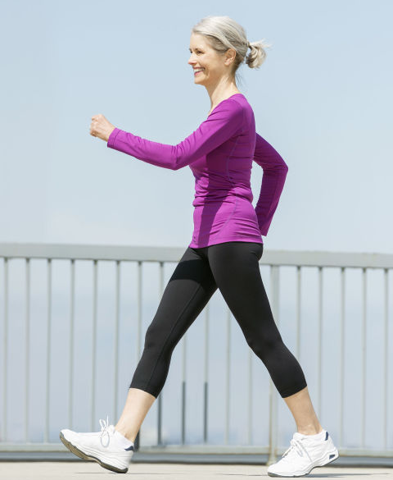
I
The Walk - Check Your Form
A good stride means proper form and a purpose to every move you make.
To avoid injury, lessen the impact on joints, and move more efficiently to meet your fitness goals.
Remember to always consult with your physician prior to making any changes to your physical activity.
Stand Tall
Look Ahead
Keep Your Chin Up
Relax
Get to the Core
Tuck the Tush
Roll With It
www.EWSNetwork.com
Notes:
Stand tall - Stand up tall, like a tree with a straight back. Avoid strain on the back muscles from leaning forward or back.
Look ahead - Head and eyes should be forward. Don’t look at your feet. Focus 20 feet ahead of you to engage full peripheral vision.
Keep your chin up - Keep your chin parallel to the ground to avoid strain in the neck and upper back. (A good reason to leave your phone at home!)
Relax - Shoulders back and relaxed. Shrug and release to let your shoulders naturally fall to relieve tension. You can do this during your walk to ensure that you a e keeping them relaxed.
Get to the core - Engage your core. This will help to maintain good posture and resist slouching. Keep your stomach pulled in just slightly while still being able to take deep full breaths.
Tuck the tush - and rotate your hips slightly forward to eliminate an arch in the back.
Roll with it – Roll your foot in a heel to toe motion. Keep your feet always pointed forward.

Slide 15
I
The Walk - Count Your Steps
If you are walking to increase your endurance and fitness levels, or you like to set a quantitative goal to stay motivated:
3 Steps to Step Counting:
Choose your Pedometer or App
Set your Daily Step Goal
Keep a Weekly Walking Log
ACTIVITY LEVEL | # OF STEPS
Very Active (fit adults) | 10,000 – 16,000
Active (adults) | 10,000
Somewhat active (older adults) | 7,000 – 9,999
Low active (adults with chronic health condition) | 4,000 – 7,000
www.EWSNetwork.com
Notes:
Choose your pedometer or app and test it out
Set the counter to zero and walk 20 steps. Check to see that it accurately records the number of steps.
Set your Daily Step Goal
Keep a Weekly Walking Log
App Suggestions:
Map My Run
Ease into 5k
RunKeeper
Runtastic
Use a Fit Bit or electronic pedometer

Slide 16
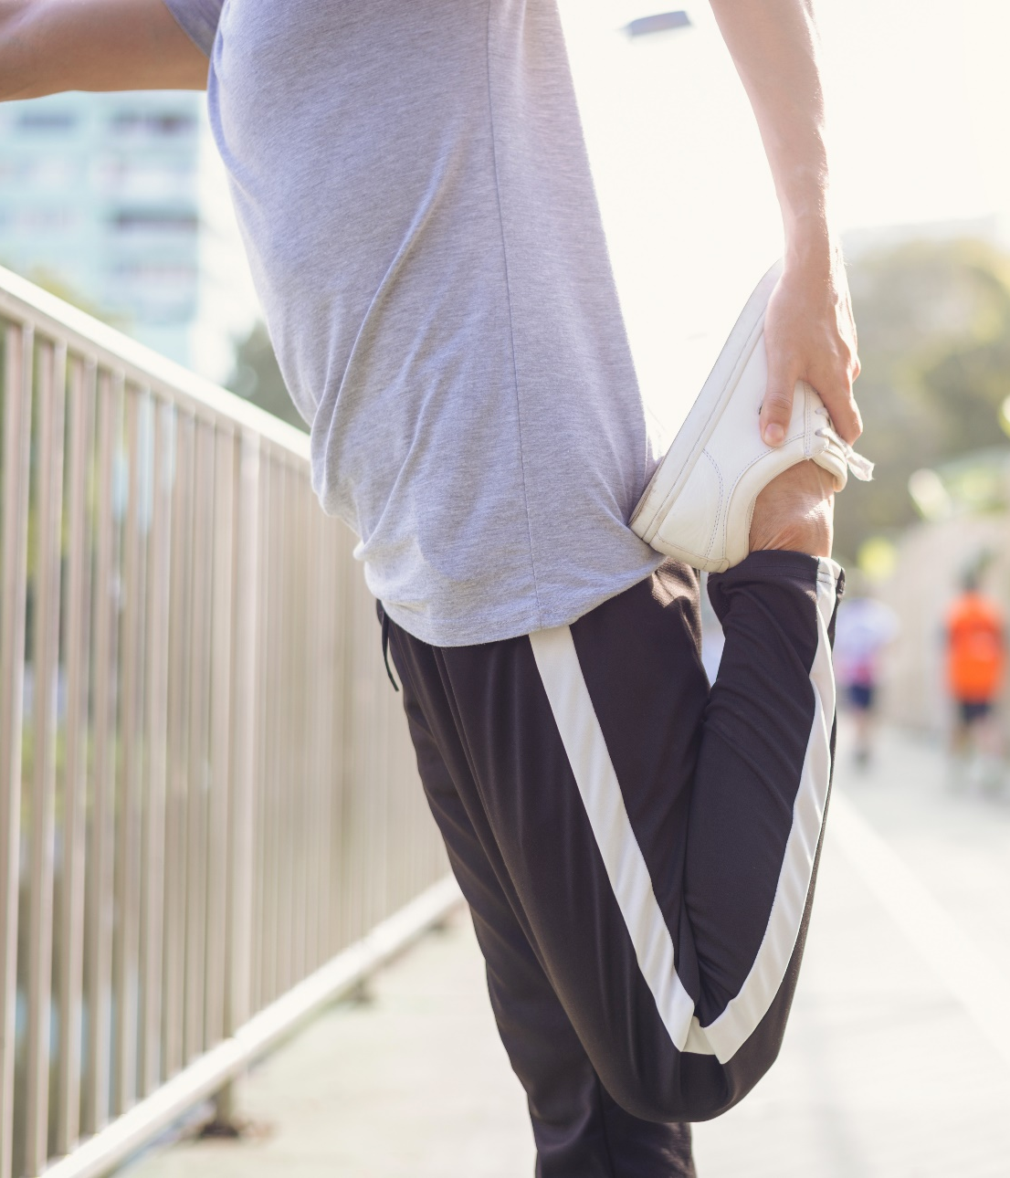
I
Strategy – Part 2 - The Cool Down
Benefits of a Proper Cool Down
A cool-down provides the body with a smooth transition from exercise back to a state of rest.
Reduces heart and breathing rates.
Cools body temperature.
Returns muscles to their optimal length-tension relationships.
Prevents blood from pooling in lower extremities.
Returns the body to rest.
Reduces pain and lactic acid buildup.
Prepares muscles for next exercise session.
Static stretches held for 15-30 seconds are ideal.
www.EWSNetwork.com
Notes:
Reduce heart and breathing rates
Gradually cool body temperature
Return muscles to their optimal length-tension relationships
Prevent blood from pooling in lower extremities
Return the body to rest and normalizing body systems
Reduce pain and lactic acid buildup
Prepares muscles for next exercise session.
Slowly lessen the speed and intensity of your walk
Static stretches are ideal and can include quad, calf, and hamstring stretches held for 15-30 seconds.
See Cool Down Stretches in handout.

Slide 17

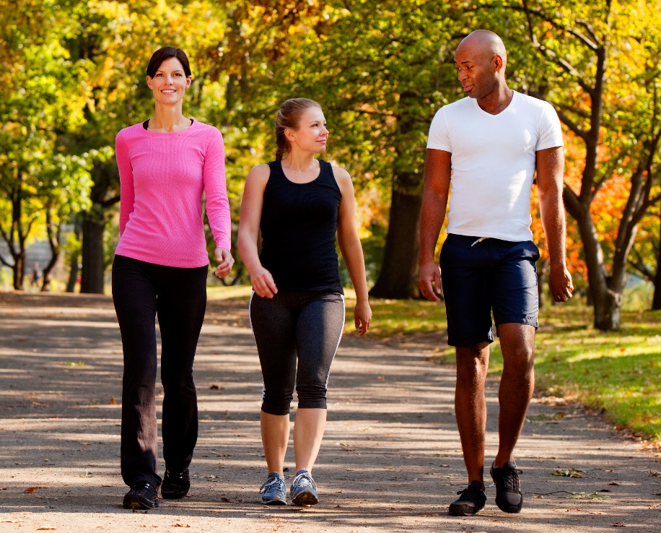
I
Make Fitness Fun!
Making walking interesting
Walk your neighborhood
Walk different times of day
Walk with a friend for safety
Have a walking meeting
Enjoy nature reserves and parks
Use your senses
Walk a dog
Use a walk as social time
Look for guided tours or walks
www.EWSNetwork.com
Notes:
Walk your neighborhood streets, choose different routes.
Walk at various times of the day and experience different sights and sounds.
Walk with a friend or family member for safety if your only time to exercise is at night.
Brainstorm or problem solve through a walking office meeting.
Drive to different nature reserves, or local parks and enjoy the view.
Be mindful but observant of all of your senses.
A dog that needs regular exercise gives you the motivation to walk every day. Yours, a friends, or a dog from a local shelter.
Walking with other people can turn exercise into an enjoyable social connection.
Look for the self-guided or guided nature walks that have been set up in many parks.
Ask neighbors or friends if they would like to join you on your walks.
Think of starting or joining a walking or hiking group in your community.

Slide 18

Thank You for Your Time!
Question & Answer
I
©2019 EMPLOYEE WELLNESS SOLUTIONS NETWORK INC. – ALL RIGHTS RESERVED
Notes:
Sources:
https://www.webmd.com/fitness-exercise/features/new-ideas-on-proper-stretching-techniques#1
https://jamanetwork.com/journals/jama/fullarticle/197257
https://www.treadmillreviews.net/health-benefits-of-walking/
https://www.livescience.com/34850-walking-boosts-brain-function-study-shows.html
https://www.psychologytoday.com/us/blog/high-octane-women/201201/6-reasons-you-should-spend-more-time-alone
https://www.mayoclinic.com
https://www.sparkpeople.com/resource/fitness_articles.asp?id=1036
https://www.sharecare.com/health/flexibility-training/why-important-cool-down-exercise

