Slide 1



NIGHT NIGHT SLEEP TIGHT
Building a Sleep Strategy
Powered by:
©2019 EMPLOYEE WELLNESS SOLUTIONS NETWORK INC. – ALL RIGHTS RESERVED

Slide 2
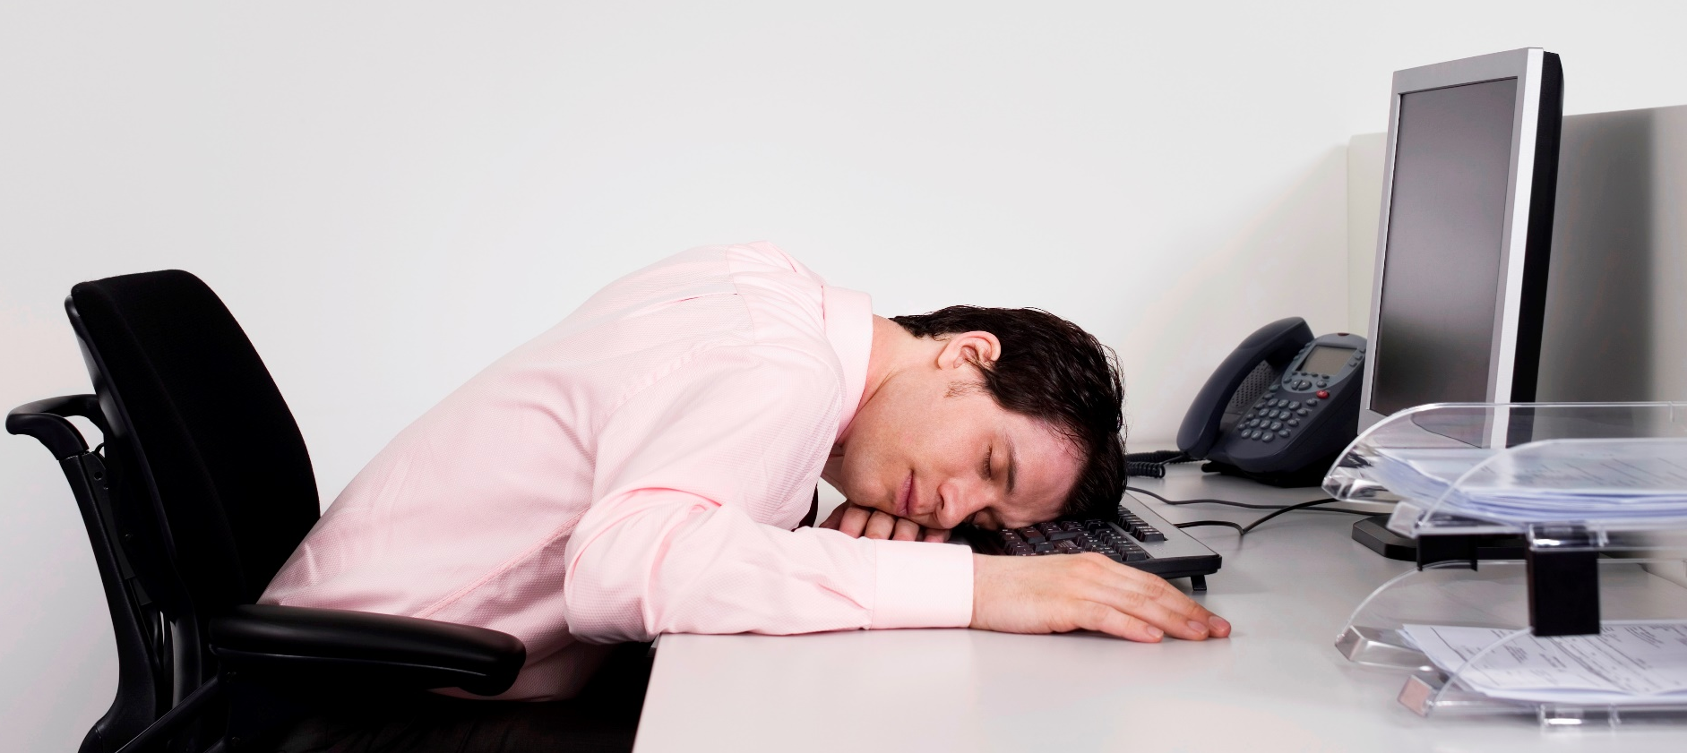
I
Are You Getting Enough?
Experts recommend that adults get 7-9 hours of quality sleep each night.
Are you one of the 30% of Canadians who is sleep deprived?
www.EWSNetwork.com
Notes:
In our hectic society, where it always seems like there aren’t enough hours in the day to get everything done, many people are sacrificing a good night’s sleep to check a few more things off the to-do list.

Slide 3
Types of Sleep
I
Sleep 101 – Know the Basics
Awake
REM Sleep
NREM Sleep
There are two types of sleep –
NREM – A very relaxed type of sleep that gets progressively deeper.
REM – A very active type of sleep where the brain is almost as active as if it was awake.
www.EWSNetwork.com
Notes:
NREM: Deep sleep is essential for restoring energy and allowing the body to undergo maintenance. While in NREM sleep:
Wounds are healed
white blood cells are created to aid your bodies defenses
The muscles are restored
The growth hormone is released
Without enough deep sleep, all of these processes will be hampered.
While under the deepest levels of sleep the brain reorganizes the many mental pathways within the cortex. This process is critical for learning and ongoing brain development.
REM:
Whilst in NREM sleep the brainwaves become progressively slower and deeper, while in REM sleep the brainwaves are almost identical as if you’re awake. REM sleep is known as paradoxical sleep. It may look like you’re fast asleep, but there’s a lot happening inside your brain.
For this reason REM isn’t really what we would consider sleep. We’re not asleep in the sense that the body turns itself off, but we’re not awake either. So what’s the point of REM if we’re neither asleep nor awake?
When you’re awake the majority of your mental input is coming from your surroundings, but when you’re in REM, all this mental stimulus being generated by the brain itself.
This internal mental processing is believed to help to process memories and form new skills. The brain is awake but the body isn’t, so it’s the perfect time for your brain to reorganize the vast amount of thoughts gained during the day.
Dreams, which make up a lot of REM sleep, are believed to help you with this too. Songbirds have been shown to practice new mating calls in their dreams that they heard then they were awake.
Which type of sleep is most important?
You go into NREM sleep as soon as we fall asleep, suggesting that NREM might be the most important. REM only gets its turn later in the night after you’ve first completed a cycle of NREM sleep.
When you’re deprived of NREM sleep, the body tries to make up for it whenever it next gets the chance. The body also tries to make up for REM, although not as much as it does for NREM.
While we need NREM, we don’t appear to need REM sleep after childhood. The brain stimulation is critical for proper brain development. When we were still a fetus or a small child who hadn’t yet developed the senses, REM sleep is the only proper stimulation the brain would get. But when we’re older we can get this stimulation from the outside world.
People deprived of REM sleep, either through an experiment or through the use of some types of antidepressants (that have the effect of blocking REM sleep) don’t appear to develop any major health problems.
REM interrupts deep sleep in 90 minutes cycles throughout the night. Maybe this is because deep sleep cannot be sustained for long periods of time. Such inactivity could be bad for the brain. Maybe coming out of deep sleep prevents us from having too much sleep, which we know can be harmful.
Maybe then REM is a way of waking up the body, without causing you to regain awareness. If the body woke you up then you would be faced with having to fall asleep again. Many people find it hard to fall asleep the first time at night, never mind after every 90 minutes of previous sleep. Instead, if the brain becomes active but keeps you asleep, it removes the need to wake up and fall back to sleep, and the brain can send you back to sleep whenever it wishes.
Source: http://www.sleepforall.com/types-of-sleep.htm

Slide 4
I
Sleep 101 – The 5 Stages of Sleep
1
Interim between consciousness and sleep
2
Heart rate and brain activity slows
3
Hormones are released to make necessary repairs
4
Body temperature and blood pressure decrease
5
Increase in eye movement, breathing, blood pressure and temperature
REM Sleep
5-15 minutes
Sleep is prompted by natural cycles of activity in the brain, consisting of the two basic sleep types (NREM & REM).
90 minutes after first feeling sleepy
15 minutes
www.EWSNetwork.com
Notes:
The period of NREM sleep is made up of stages 1-4. Each stage can last from 5 to 15 minutes. A completed cycle of sleep consists of a progression from stages 1-4 before REM sleep is attained, then the cycle starts over again.
Stage 1: Polysomnography (sleep readings) shows a reduction in activity between wakefulness and stage 1 sleep. The eyes are closed during Stage 1 sleep. One can be awakened without difficulty, however, if aroused from this stage of sleep, a person may feel as if he or she has not slept. Stage 1 may last for five to 10 minutes. Many may notice the feeling of falling during this stage of sleep, which may cause a sudden muscle contraction (called hypnic myoclonia).
Stage 2: This is a period of light sleep during which polysomnographic readings show intermittent peaks and valleys, or positive and negative waves. These waves indicate spontaneous periods of muscle tone mixed with periods of muscle relaxation. The heart rate slows and the body temperature decreases. At this point, the body prepares to enter deep sleep.
Stages 3 and 4: These are deep sleep stages, with stage 4 being more intense than Stage 3. These stages are known as slow-wave, or delta, sleep. If aroused from sleep during these stages, a person may feel disoriented for a few minutes.
During the deep stages of NREM sleep, the body repairs and regenerates tissues, builds bone and muscle, and appears to strengthen the immune system. As you get older, you sleep more lightly and get less deep sleep. Aging is also associated with shorter time spans of sleep, although studies show the amount of sleep needed doesn't appear to diminish with age.
Usually, REM sleep occurs 90 minutes after sleep onset. The first period of REM typically lasts 10 minutes, with each recurring REM stage lengthening, and the final one may last up to an hour. Polysomnograms show brainwave patterns in REM to be similar to that recorded during wakefulness. In people without sleep disorders, heart rate and respiration speed up and become erratic during REM sleep. During this stage the eyes move rapidly in different directions.
Intense dreaming occurs during REM sleep as a result of heightened brain activity, but paralysis occurs simultaneously in the major voluntary muscle groups. REM is a mixture of encephalic (brain) states of excitement and muscular immobility. For this reason, it is sometimes called paradoxical sleep.
The percentage of REM sleep is highest during infancy and early childhood. During adolescence and young adulthood, the percentage of REM sleep declines. Infants can spend up to 50% of their sleep in the REM stage of sleep, whereas adults spend only about 20% in REM.
Source: http://www.webmd.com/sleep-disorders/excessive-sleepiness-10/sleep-101

Slide 5
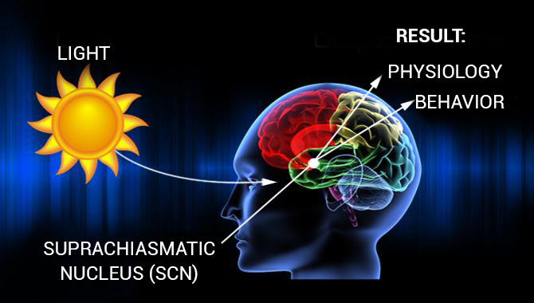
I
Sleep 101 – Seeing the Light
Human sleep is regulated by exposure to light or to darkness.
Exposure to light stimulates a nerve pathway from the retina to an area in the brain called the hypothalamus.
The supra-chiasmatic nucleus (SCN) initiates signals to other brain areas which control hormones, body temperature & other functions that play a role in making us feel sleepy or awake.
Once exposed to the first light of day, the SCN begins raising body temperature and releasing stimulating hormones, such as cortisol. It also delays the release of melatonin for when darkness arrives.
www.EWSNetwork.com
Notes:
Source: http://www.sleepfoundation.org/article/sleep-topics/melatonin-and-sleep
Note that this is why it is important to ensure people are being exposed to daylight for at least 15 minutes a day.
RE: Melatonin:
Melatonin is a natural hormone made by your body's pineal (pih-knee-uhl) gland. This is a pea-sized gland located just above the middle of the brain. During the day the pineal is inactive. When the sun goes down and darkness occurs, the pineal is "turned on" by the SCN and begins to actively produce melatonin, which is released into the blood. Usually, this occurs around 9 pm. As a result, melatonin levels in the blood rise sharply and you begin to feel less alert. Sleep becomes more inviting. Melatonin levels in the blood stay elevated for about 12 hours - all through the night - before the light of a new day when they fall back to low daytime levels by about 9 am. Daytime levels of melatonin are barely detectable.
Besides adjusting the timing of the clock, bright light has another effect. It directly inhibits the release of melatonin. That is why melatonin is sometimes called the "Dracula of hormones" - it only comes out in the dark. Even if the pineal gland is switched "on" by the clock, it will not produce melatonin unless the person is in a dimly lit environment. In addition to sunlight, artificial indoor lighting can be bright enough to prevent the release of melatonin.
The amount of melatonin released at night varies among individuals, but it is somewhat related to age. Children on average secrete more melatonin than adults, which decreases further with age. However, research has shown that older people with sleep problems do not always have lower melatonin levels than people who experience normal sleep.

Slide 6

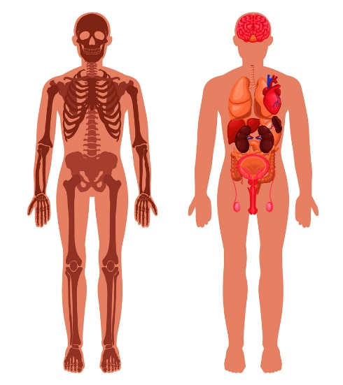
I
Why is Sleep Important?
Sleeping is almost as important as eating or breathing!
Immune system suppression
Higher risk of chronic illness
Impact on cognition and brain function
Gain weight
3x more likely to be in a car accident
Appearance suffers
Affects mood and emotions
What effect does a lack of sleep have on your health and wellness?
www.EWSNetwork.com
Notes:
Immune system: Research shows a close relationship between sleep and your immune system. Losing sleep can impair your body’s ability to fight off illness.
Chronic illness: Both short sleep durations (less than 5 hours per night) and long sleep durations (9 or more hours per night) have been shown to have a negative impact on heart health, according to an analysis published in the European Heart Journal.
In particular, your chances of developing heart disease or having a stroke are greatly increased with less sleep.
Shortened sleep is associated with higher rates of breast, colon and prostate cancers. Overnight shift workers may take the brunt of this burden. People who don’t get enough sleep increase their risk of developing diabetes.
7 to 8 hours of rest is the optimal range to keep blood sugar balanced and insulin regulated.
Brain: Even missing one night of sleep can lead to cognitive issues. Brain functions like memory, decision making, reasoning and problem solving (executive functions) are impacted along with focus, alertness, locking in memory, and overall learning. Confirmed by a study in Experimental Brain Research. These effects on the brain have a major impact on productivity
Weight gain : Lack of sleep can cause you to pack on pounds.
A study examined the relationship between sleep and weight in 21,469 adults over the age of 20. The people who slept less than 5 hours each night over the course of the three-year study were more likely to gain weight and eventually become obese.
Those who slept between 7 and 8 hours gained less weight. Chronic sleep deprivation may cause weight gain by affecting the way our bodies process and store carbohydrates and by altering levels of hormones that affect our appetites.
Accidents: 4 hours less or sleep at night increases your risk of a car accident by 3 times. Those working shift work, commercial drivers, business travelers and those working odd hours were more vulnerable.
Appearance: Lack of sleep ages you faster causing an impact on your skin such as fine lines, wrinkles, uneven skin color, and marked looseness of the skin. It also impacted self esteem with subjects being more dissatisfied with their appearance in comparison to their counterparts.
Mood: Studies have shown that even partial sleep deprivation has a significant effect on mood. University of Pennsylvania researchers found that subjects who were limited to only 4.5 hours of sleep a night for one week reported feeling more stressed, angry, sad, and mentally exhausted. Sleep loss may result in irritability, impatience, inability to concentrate and moodiness. Too little sleep can also leave you too tired to do the things you like to do.

Slide 7


I
Tips for Better Sleep
The noise of life can add up
to big time sleep loss.
Tip #1 – Neutralize Noise
Napping makes matters worse
if you have trouble falling asleep.
Tip #2: Avoid Naps
www.EWSNetwork.com
Notes:
Tip #1 – Neutralize Noise
Soothing white noise covers up the bumps in the night that can keep us awake.
Use a fan, an air conditioner or a simple pair of ear plugs to cover up superfluous noise which may keep you up at night.
Tip #2: Avoid Naps
If you must nap, keep it brief, 10-15 minutes is all you need and do it early in the day.
Any sleep within 8 hours before your bedtime can sabotage a good night’s sleep.

Slide 8


I
Tips for Better Sleep
Glancing at the clock during the night
affects your sleep.
Tip #3 – Block the Clock
Your bedroom could be causing
agitation and restlessness.
Tip #4 – Keep the Bedroom a Sanctuary
www.EWSNetwork.com
Notes:
Tip #3 – Block the Clock
Seeing the hours turn can cause you to worry about how many hours of sleep are left before your busy day begins.
Clock watchers should turn the clock away from view or cover it at night.
Tip #4 – Keep the Bedroom a Sanctuary
A bedroom should be a place of peace and relaxation.
Try removing the television and digital devices such as computers, phones or tablets from the bedroom for one month and see the difference in your quality of sleep.

Slide 9

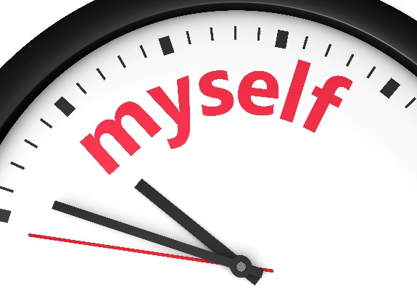
I
Tips for Better Sleep
Is your body clock confused?
Tip #5 – Set Your Body Clock
Tossing & turning creates more stress.
Tip #6 – Don’t Toss & Turn
www.EWSNetwork.com
Notes:
Tip #5 – Set Your Body Clock
Go to sleep and wake up at the same time every day, including weekends.
This puts your brain & body on a healthy sleep-wake cycle, making it easier to fall asleep and sleep soundly through the night.
Tip #6 – Don’t Toss & Turn
If you can’t fall asleep within 15-20 minutes, move to another room and try reading a calming book.
Return to your bedroom only when drowsy.

Slide 10


I
Tips for Better Sleep
Nicotine is a stimulant, just like caffeine.
Tip #7 – Skip the Smoke
A pet’s movements can interrupt your sleep.
Tip #8 – Keep Pets Out of the Bed
www.EWSNetwork.com
Notes:
Tip #7 – Skip the Smoke
Need another reason to quit smoking?
Smoking can keep you from falling asleep.
While working on your quitting strategy, you may sleep better if you smoke fewer cigarettes in the 3-4 hours before bed.
Tip #8 – Keep Pets Out of the Bed
Fleas, pollen, fur & dander brought into the bed can also trigger sleep-wrecking allergies.
Train Fluffy & Fido to sleep happily in their own beds or keep your bedroom door closed.

Slide 11

I
De-Stress Before Bed
One of the best things you can do to train your body to get into sleep mode is to create and implement a de-stress routine to help your body unwind after your busy day.
An hour before your scheduled bedtime:
Try reading a calming book
Meditate or pray
Write in a gratitude journal
Listen to soft music
Take a warm bath
www.EWSNetwork.com
Notes:
If you are going to read in bed, switch your bedside lamp to a 15 watt bulb. Low lighting is key to signaling your body to prepare for sleep.

Slide 12

I
Destress Before Bed: Worry Journal
“Anything that worries me now can be dealt with tomorrow.”
How many times have you kept yourself awake at night?
Worrying about a bill you forgot to pay?
Big work presentation tomorrow?
We all have worries but learning to purge these thoughts before bed can be infinitely helpful to your well-being. If you know you are a habitual bedtime worrywart, try keeping a “worry journal”!
www.EWSNetwork.com
Notes:
No later than one hour before bedtime, jot down all those nagging thoughts into your journal and if you know how you want to resolve those items, feel free to include a game plan for resolution as well. Once you’ve written in the notebook, close the book while you tell yourself “I will worry about this in the morning, not now”.

Slide 13

I
Destress Before Bed: Exercise
Regular exercise has been shown to improve sleep quality, as long as you don’t work out too close to bedtime.
Aim to finish any vigorous exercise 3-4 hours before your bedtime.
Gentle exercise, like stretching, yoga and tai chi, are perfect matches for a pre-bedtime sleep-inducing nightcap!
www.EWSNetwork.com

Slide 14


I
Ideal Evening Snacks
Food can help or hinder sleep.
While these foods have qualities that can be beneficial before sleep, it is recommended that you stop eating one hour before bedtime and keep portion sizes small so that your body can complete digestion before it’s time to get to sleep.
Cherries
Cherries are one of the few natural foods to contain melatonin, the chemical that helps control our body’s internal clock.
Bananas
Bananas can help promote sleep because they contain the natural muscle relaxants magnesium and potassium.
www.EWSNetwork.com

Slide 15


I
Ideal Evening Snacks
Milk or Warm Beverage
Having a glass of warm milk before bed is not just an old wives’ tale! Milk contains a small amount of amino acid tryptophan (the same sleepy chemical found in turkey), a precursor to the brain chemical serotonin (promotes relaxation and happiness). A warm tea or beverage can be just as comforting.
Jasmine Rice
Jasmine rice ranks high on the glycemic index. While low glycemic foods are the healthier recommendation, clinical nutritionists speculate that high-glycemic index meals may increase the production of tryptophan. Regular consumption should be avoided due to rapid spikes in blood sugar. Reserve for when needed for sleep.
www.EWSNetwork.com

Slide 16


I
Ideal Evening Snacks
Nuts & Seeds
Chamomile Tea with Honey
This herbal tea is caffeine free and has a calming effect on the body. - It's calming effects are due to Apigenin - an antioxidant found in chamomile that binds to receptors in the brain that decrease anxiety and induce sleep.
Normalizing blood calcium levels was shown to improve REM deep sleep. Insomnia can often be due to a lack of magnesium. Agitated broken sleep can be remedied with foods high calcium and magnesium such as nuts and seeds, nut butters, tahini..etc.
www.EWSNetwork.com

Slide 17



I
Bedtime No No’s
What’s Keeping You Awake?
Heartburn – Did you eat a heavy fat-based meal?
Gas and bloating – Too much protein like beans or red meat?
Feeling Wired – Caffeine is a stimulant to the body and the brain.
Restlessness – Are you drinking a glass of wine to make you drowsy?
Too warm - Spicy foods like curry and chili can raise the metabolism and body temperature at a time when it should be slowing down.
www.EWSNetwork.com
Notes:
Heavy Fats: Fat stimulates production of acid in the stomach which can spill up into your esophagus, causing heartburn.
Protein: Digestion is supposed to slow by about 50% while you’re sleeping but if you consume a lot of protein, you digest even more slowly. Instead of focusing on sleeping, your body is focusing on digestion. Keep protein portions small and light and preferably vegetarian like beans, nuts, or hummus.
Caffeine: a well-known stimulant, you should try and avoid consumption after noon. Caffeine can be found in coffee, tea, chocolate & energy drinks.
Alcohol: although the tranquilizing effects of alcohol may make you sleepy, after the initial effects wear off, it actually causes more frequent wake periods at night and less restful sleep.
Heavy spices can keep you awake at night and cause heartburn. Spicy & high-fat in the same late day meal can be a potentially sleep-wrecking combo! Avoid spicy foods 3-4 hours before bedtime.

Slide 18

I
Better Sleep Goals
SLEEP CHALLENGE, ANYONE?
I went to sleep and woke up at about the same time every day this week.
I made my bedroom dark , quiet and comfortable.
I didn’t eat a big meal close to bedtime any night this week.
When I couldn’t sleep, I got up and read a book.
I took the computer and TV out of my bedroom.
I didn’t take a nap today.
I moved my pet out of my bed.
www.EWSNetwork.com
Notes:
We hope that you have learned some new tips and had some refresher lessons as well!
Here is a handy goal checklist to help put you on the path to blissful, restful sleep.
See how many you can check off over the next 30 days!

Slide 19


I
Better Sleep Goals
I brought up any sleep worries at my last medical.
I tried to stick to a relaxing bedtime routine most nights this month.
I didn’t drink caffeine before bed any night this week.
I exercised almost every day this month, but not close to bedtime (with exception of yoga/tai chi).
I started a worry journal this month.
I tried to get at least 7 hours of sleep every night this week.
I didn’t drink any alcohol last night.
I wore sunscreen and spent some time in the sunlight today.
www.EWSNetwork.com

Slide 20
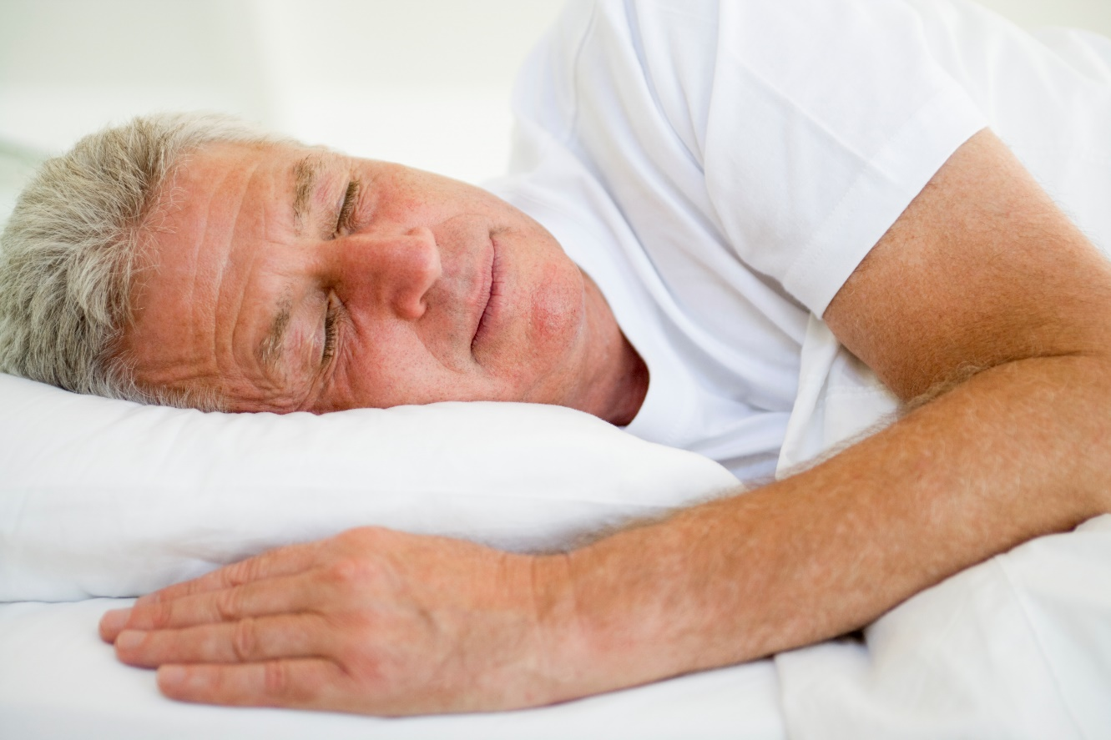
Thank You for Your Time!
Question & Answer
I
©2019 EMPLOYEE WELLNESS SOLUTIONS NETWORK INC. – ALL RIGHTS RESERVED
Notes:
Sources:
http://healthysleep.med.harvard.edu/need-sleep/whats-in-it-for-you/mood
http://www.sleepforall.com/types-of-sleep.htm
http://www.health.harvard.edu/press_releases/importance_of_sleep_and_health
https://academic.oup.com/eurheartj/article/32/12/1484/502022
http://www.architalbiol.org/aib/article/view/15293
https://link.springer.com/article/10.1007%2Fs11325-011-0583-0
https://link.springer.com/article/10.1007%2Fs00221-011-2605-3
http://media.cleveland.com/health_impact/other/Lauder%20Sleep%20Skin%20Study%202013%20IID%20Poster%20%202013%20final.pdf
http://healthysleep.med.harvard.edu/healthy/matters/benefits-of-sleep/learning-memory
https://academic.oup.com/sleep/article/41/10/zsy144/5067408

