Slide 1



GETTING & STAYING CONNECTED
Social Support for Mental Wellness
Powered by:
©2019 EMPLOYEE WELLNESS SOLUTIONS NETWORK INC. – ALL RIGHTS RESERVED

Slide 2
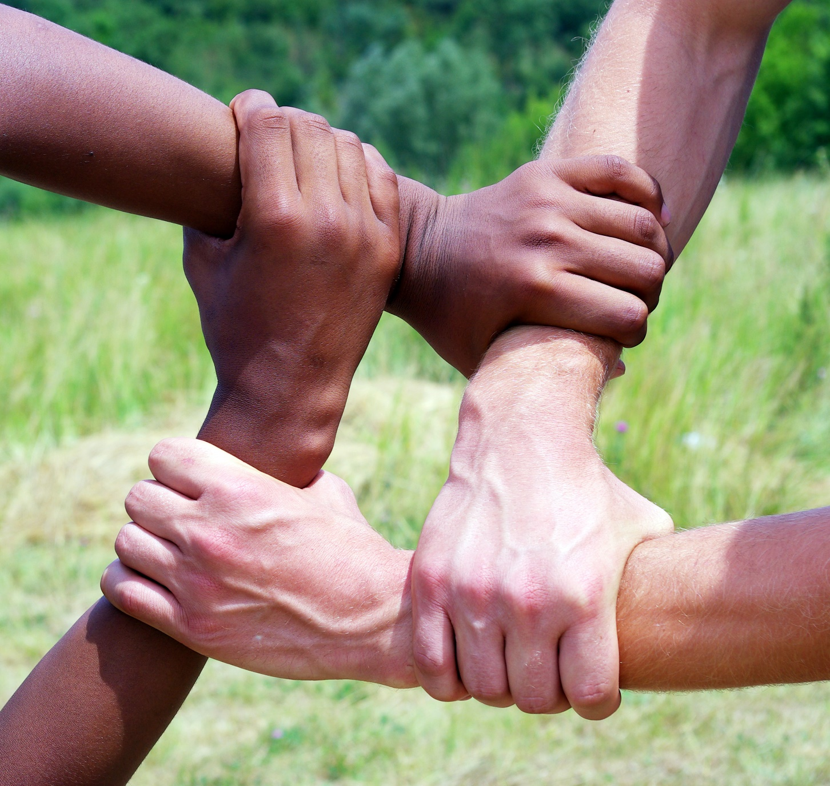
I
What is a Support Network?
Are there people in your life with whom you feel you can talk about anything?
Who do you call in a home emergency or to watch the kids in a time of need?
You just got a promotion at work! Who will you share this with?
www.EWSNetwork.com
Notes:
A social network is a community of people who can provide physical and emotional comfort Usually consisting of family, friends, co-workers and others. It gives us a sense of community where we feel valued and cared for. A support network shares in the triumphs and the trials. It takes an ongoing effort to ensure that you have social support that works for you, that builds you up and supports you!
Optional Group exercise demonstrating what a support network does for the one who requires support: FROSTBITE
Instructions
Break everyone up into groups of four or five. Each group acts as though they are stranded in the Arctic. Each group must elect a leader and erect a mini version of a shelter in order to survive (size will depend on time and materials used). The catch is, the leader is suffering from frostbite and cannot physically help in building the shelter. The other team members are suffering from snow blindness and must be blindfolded. The leader (the person who is relying on their support network) must describe and instruct how to build the shelter (communicate their needs of support) and the team must do so without being able to see. The team (the support network) builds the shelters (supports) through the instruction of the leader (communicated needs of the person who requires support).
Materials needed: popsicle sticks and something for the roof (cotton balls, fake grass…etc)
https://www.bing.com/videos/search?q=popsicle+stick+barn+instructions&view=detail&mid=FF2F21E6958F654B2420FF2F21E6958F654B2420&FORM=VIRE
Instruction handout for leader is provided.

Slide 3
I
Why is a Support Network Important?
Alleviates Stress
Decreases Feelings of Loneliness & Isolation
Increases Self-Confidence
A strong social support system can improve your mental wellness and can be reciprocated back to the individuals you support.
www.EWSNetwork.com
Notes:
Alleviating stress – A strong social support system can alleviate stress by having people to share problems with. Challenges can be easier when there are individuals that you can trust to confide in. Someone who care about what you are going through and who will listen to the issues you are facing. Research has also shown that having strong social support in times of crisis can help reduce the consequences of trauma-induced disorders including PTSD. Having a support network can also help give new ideas and perspectives to problem solve life’s challenges.
Increasing a person’s self confidence and feelings of value – Everyone wants to feel loved, and important. Feeling valued increases self esteem which can encourage healthy choices and positively impacts mental wellness. Helping others navigate through conflict can also be a confidence booster.
Decreasing feelings of loneliness and isolation – Social support systems can also be a resource for fun! Want to participate in a new activity but not alone? Call up a friend or family member to create some fun with! Or get together for tea and just chat about what is going on in your life. Without friends or close family, the lack of connection can increase the risk of depression.
Overall health can be influenced by multiple factors, including a person's psychological, behavioral, and social well-being. Studies have demonstrated an association between increased levels of social support and reduced risk for physical disease, mental illness, and mortality (1,2)
https://www.cdc.gov/mmwr/preview/mmwrhtml/mm5417a4.htm

Slide 4

I
Who Do You Trust?
Social support systems should be an important part of our lives.
Who do you go to for advice, help, or emotional support?
FAMILY MEMBERS
FRIENDS
HEALTH CARE PROFESSIONAL
CO-WORKERS
TEACHERS
Who’s In Your Circle?
www.EWSNetwork.com
Notes:
You might feel like you have that “one” person in your life that you can rely on to be there through thick and thin. But when building a support network, it is important to have different people in your life who can provide different types of support. It would be unfair to rely on one person to be your sole support system, and it also puts them at risk of burn out and overwhelm as well, affecting their own mental wellness.
Consider choosing different roles for your support people. For example, rely on your parents for childcare, your neighbor for last minute emergencies, and your best friend for relationship advice. This circle of support can be diverse. Those you are close with, casual acquaintances, or those you rely on when other support can’t be found, such as teachers and health care professionals.

Slide 5
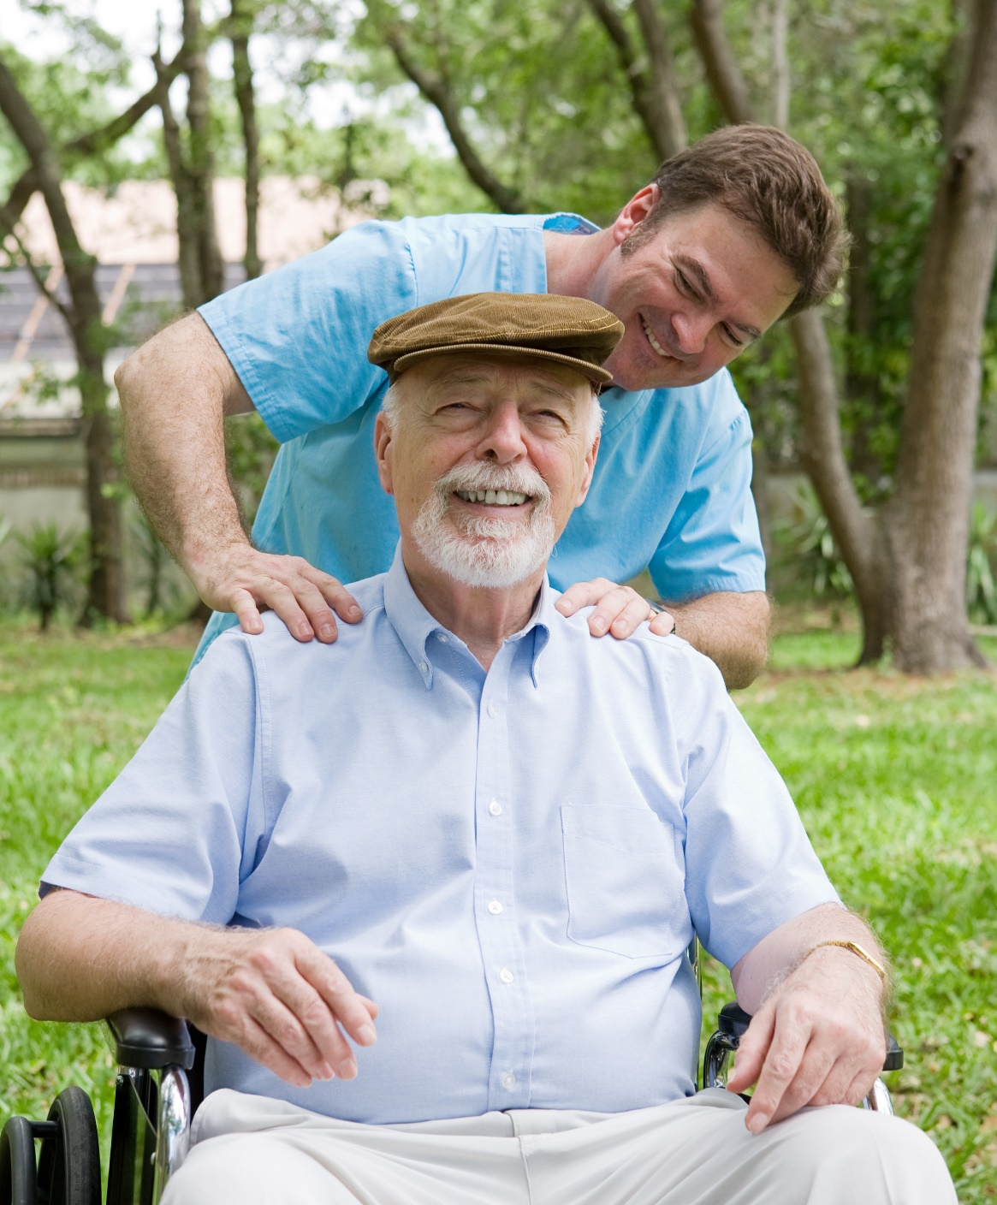
I
Strengthen the Connections
Make a plan to keep and strengthen the positive relationships in your life.
Make a list of the supportive and positive people in your life.
Who do you feel the need to stay in touch with?
Make one emotional social connection per day.
Be honest, open, and direct about your needs.
Ask for opinions, and show that you value them.
Listen and respond.
Offer help or advice if asked.
Make plans to spend quality time together.
www.EWSNetwork.com
Notes:
-Make a short list of friends and family members who are supportive and positive.
-Who do you feel like you want to stay in touch with? Set up a schedule to reach out through phone, email, or social media. Whatever works best and easiest for you.
-Sharing open and honestly is the best way to access support. Be direct about your needs. Do you need problem solving, a soft shoulder or listening ear. Maybe just distraction and a good laugh. Whatever you need and whatever they deliver, make sure that you show that it is valued and appreciated.
-Listen and respond. Don’t get caught up in your head thinking about what to say next. Truly and intently listen. Ensure the conversation is 2 way as you ask about their day, or who interest in the support person’s life and relationships. Showing sincere interest builds quality relationships.
-Make future plans to have fun to boost your mood, have something to look forward to, and strengthen the relationship.
http://www.mentalhealthamerica.net/stay-connected

Slide 6

I
Don’t Feel Connected?
Neighbour
Co-worker
Someone in your exercise class
A cousin you were once close with
Someone in a support group
A friend on social media
It’s ok to not have a network in place.
Make new connections with the people around you!
www.EWSNetwork.com
Notes:
You may not have people that you feel you can talk to. It’s worth the effort to find those connections.
It can be easy to make friends but difficult if you are anxious or timid.
Group Exercise: Make a meaningful connection with someone you don’t know!
Instructions:
Have participants close their eyes and think of their first and fondest memory. Give them a few moments to think, then ask them which memory they would want to relive if they had 30 seconds left to live. Then ask everyone to share what their choice was an why.
Consider talking to a therapist who can be a support and also offer ideas and strategies to make meaningful connections.

Slide 7

I
Types of Support
What Types of Support Do You Require?
Emotional Support
Tangible/Practical Help
Informational: Perspective & Resources
www.EWSNetwork.com

Slide 8

I
Emotional Support
Emotional Support
“The Forgotten Need”
Are you surviving or thriving?
Physical Needs
Food Water Shelter Sleep
SURVIVE
Emotional Needs
Support Love Heard Affection
THRIVE
www.EWSNetwork.com
Notes:
It’s expected that we are going to take care of our physical needs, we have to eat, drink, sleep, in order to survive.
Emotional needs are often the forgotten needs, because often we can simply ignore them and still survive.
Emotional needs include the need to feel supported, loved, heard, displays of affection. And while we may survive without our emotional needs being met, we definitely cannot thrive and feel fulfilled.
When our emotional needs are not met we might engage in destructive behaviours as a means of coping. Emotional eating, casual sex, drug/alcohol, overworking…etc.
It’s ok to not feel comfortable with emotional support from others. For some who struggle, they may not feel deserving, guilty, or worthy of attention to their emotional needs. If in childhood their caregivers ignored this need, it may not feel safe to have them and therefore it can feel uncomfortable to lean on others. The services of a therapist can be helpful in dealing with this inner conflict.

Slide 9

I
Practical Support
Practical Help
A helping hand to make the
day to day easier
Money for hospital parking
Freezer meals
Fill out insurance forms
Child care
House cleaning
Purchase a book to read
Fill the car with gas/shovel driveway
Cut the grass
www.EWSNetwork.com
Notes:
People who care about us give us practical help such as gifts of money or food, assistance with cooking, child care, or help moving house. This kind of support helps us complete the basic tasks of day-to-day life making life easier.
People can have difficulty accepting practical help. Ask a professional to find solutions or be subtle and do things that you know they will appreciate without being overt about it.

Slide 10

I
Informational Support
Sharing Perspective & Problem Solving
A fresh take…
Some people help by sharing how they might handle a similar problem.
Advice
Guidance
Mentorship
Support
“I want to hear and understand your perspective AND I want to add my perspective.”
www.EWSNetwork.com
Notes:
When you share points of view, you can develop a better understanding of a situation and different ways to handle it. It’s important to not argue a point of view but to collaborate to solve a problem and engage in shared learning and understanding. Sometimes we can be so involved in our own set way of thinking, we aren’t able to consider the variety of ways that we could handle a problem. Our thinking can be clouded and a good friend or coworker can offer a fresh perspective that can be helpful in solving the issue at hand. When we feel bad or down we see the world differently and our perception can be skewed. By having this form of support, people may feel less anxious and stressed out about the problems they are trying to solve thanks to the advice of a trusted friend, mentor, or loved one. It can be tempting for people to want to jump in and try to solve the problem for you. It’s important to have boundaries.

Slide 11

I
Informational Support
Sharing Helpful Information
Get the Facts
You can gain factual and resourceful information by connecting with people who have gone through a similar experience.
Undergoing cancer treatment and unsure what to expect?
Unsure of how to handle your teen’s transition to high school?
Dealing with an emotionally abusive family member?
www.EWSNetwork.com
Notes:
This can come from someone in your existing support network or someone that you will need to include.
Cancer Treatment – Connect with someone in your circle who has gone through it or knows someone who has
Transition to high school – Connect with your child’s teacher, meet with the principle of the new high school, attend an information night
Emotionally abusive family member – Attend a support group in person or online, speak to psychologist who can educate you on the root of the abuse or perhaps the science behind a particular disorder.

Slide 12

I
Change is Good
Sometimes your social network needs to change
Assess who’s in your life.
Adjust with a change in lifestyle.
Interests change: Find a like-minded community.
Complex issues: Find an expert opinion.
www.EWSNetwork.com
Notes:
ASSESS Worksheet on Handout
Sometimes life dictates a need for our social support to change.
Perhaps you don’t have people available in a specific area of support. Lots of listening ears but not enough practical support? Find people who can provide what you need.
Lifestyle changes like divorce, death, marriage, parenthood all require an adjustment to the circle of support around you. Your current support may not longer fit your needs and circumstances. Have you recently quit drinking, smoking, or taken on clean eating? Your monthly wine and cheese won’t serve your new set of values or help you maintain your goals.
Need for a like-minded community: You may wish to join a community or communities that you identify with, or make friends with people who share your values. Perhaps you have started to work out, have connected to your spirituality/meditation, or a specific religion. When you can identify with others it can boost your self confidence and give you a sense of community and belonging that we all crave.
When people haven’t had the same experiences as you it can be difficult to connect. You may feel judged, blamed, or shamed for a circumstance that you are dealing with. An education group of professional can provide specialized advice and practical support. For example, have you recently discovered your troubled relationships are due to ADHD? You need specialized practical support that your current network likely can’t provide. Empathy is essential to connection and healing.

Slide 13

I
A Personal Touch..
BUILDING A SUPPORT NETWORK
A Personal Story…
www.EWSNetwork.com

Slide 14

Thank You for
Your Time!
Question & Answer
I
©2019 EMPLOYEE WELLNESS SOLUTIONS NETWORK INC. – ALL RIGHTS RESERVED
Notes:
Sources:
http://www.ddssafety.net/sites/default/files/attachments/10-06-11/FASocialSupportSystem.pdf
http://cmhaff.ca/social-support
http://www.heretohelp.bc.ca/sites/default/files/wellness-module-3-social-support.pdf
https://www.selfgrowth.com/articles/emotional-support-is-emotional-support-important
https://www.cdc.gov/mmwr/preview/mmwrhtml/mm5417a4.htm
Print off and distribute the following questionnaire to help the client assess their level of social support and where it comes from.
http://docs.wixstatic.com/ugd/5119f9_2f88fadcd382463daf5821e8af94a865.pdf It is free to download and distribute as long as you credit the source which is: Zimet GD, Dahlem NW, Zimet SG, Farley GK. The Multidimensional Scale of Perceived Social Support. Journal of Personality Assessment 1988;52:30-41.

