Slide 1
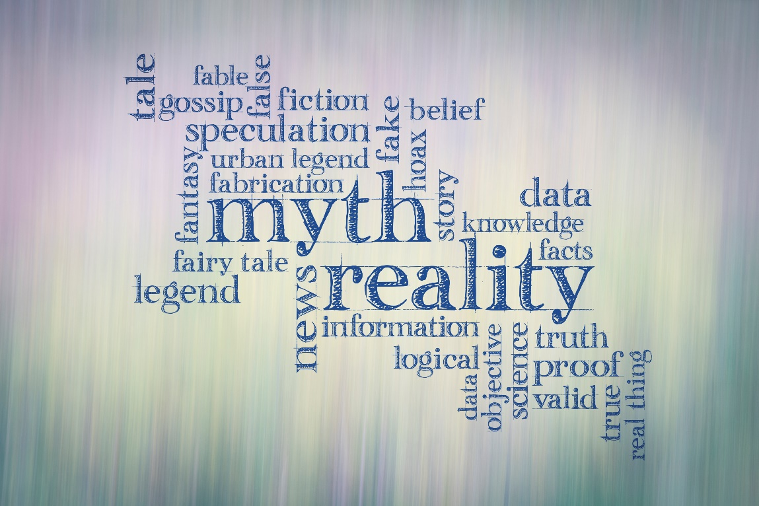
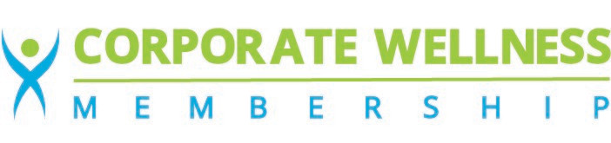
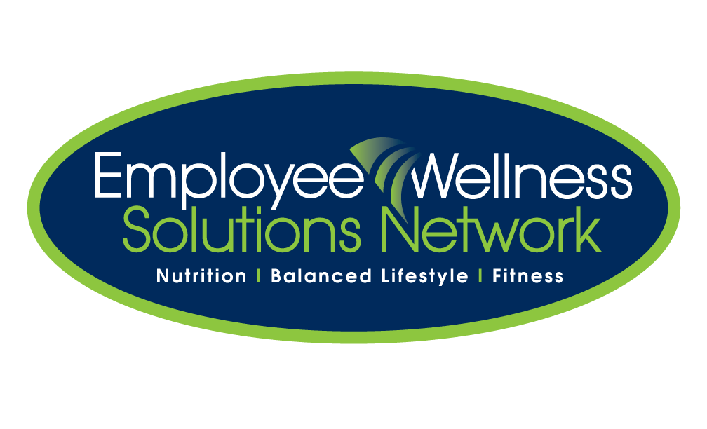
Nutrition Myths
You’re Probably
Still Believing
Powered by:
©2019 EMPLOYEE WELLNESS SOLUTIONS NETWORK INC. – ALL RIGHTS RESERVED

Slide 2

I
Objectives:
Where Do You Get Your Nutrition Information?
Common Nutrition Myths Debunked
Reliable Sources
www.EWSNetwork.com

Slide 3

I
Where Do You Get Your Facts?
I trust Dr. Oz. He is a leader in his field.
I trust social media. When something is shared, it is fact.
I trust my mother. She has my best interests at heart.
I trust my best friend. She seems to “know her stuff!”
I trust the health food store. They know their product.
I trust the cover of a magazine.
I trust any study I read, because studies are evidence- based.

Slide 4

I
Where Do You Get Your Facts?
I trust Dr. Oz. He is a leader in his field.
  He is a cardiothoracic surgeon.
  Often promotes miracles in a bottle.
I trust social media. When something is shared, does that make it fact?
  How much nutrition information do you see come across your social media and newsfeed?
  You can’t be sure that what you are reading is fact.
Notes:
Dr Oz: Only 46% of his advice was evidence based.
Recommendations have been connected marketing strategies on promoted product.
Often celebrities have little or no experience with overall nutrition and their advice is not science based. “Marketing studies explained that celebrities’ characteristics are transferred to endorsed products which lends credibility to these products. These findings were supported by emerging neuroscience research which showed that brain regions involved in making positive associations are activated by seeing or hearing celebrity endorsements. The review of psychology literature showed that people are conditioned to react positively to celebrity advice and that are subconsciously pushed to follow it to avoid cognitive dissonance and to become more like those celebrities they admire. “https://archpublichealth.biomedcentral.com/articles/10.1186/2049-3258-73-3
-as we tweet it, blog it, Facebook it...etc. The scope of social media makes misinformation spread faster. Difficult to gain control of misinformation
Social Media: Questions to ask:
Does it sound to good to be true?
Are you restricting entire food groups?
Is weight loss quick and easy?
Is the answer to a health issue, related to one particular food?
Find the original article and check the source. Is it reputable?

Slide 5

I
Where Do You Get Your Facts?
I trust my mother. She has my best interests at heart.
I trust my best friend. He/she seems to “know their stuff!”
  One person’s experience is not another’s.
  Their version of the “facts” can be open to interpretation (like a game of telephone).
  You don’t know who or what they are being influenced by.
  Nutrition facts can change as new research emerges. Mom’s advice from decades earlier likely isn’t accurate.
Notes:
While the important people in your life may have your best interests at heart, what worked for them may not be what is going to work for you.
Open to their interpretation.
Influenced by media? Friend? Doctor? Magazine cover?
Often second hand information

Slide 6

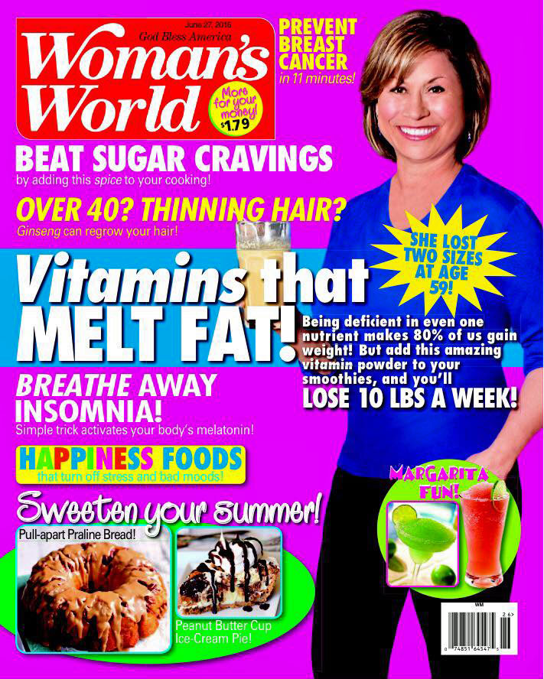

I
Where Do You Get Your Facts?
I trust the health food store. They know their product.
  They do! And their job is to sell it.
  Supplement recommendations may not be the best first option.
  Influenced by training provided by companies that they purchase and sell.
I trust the cover of a magazine.
  Magazine covers are meant to peak your interest so you purchase the magazine.
  The cover can be misleading and is not the whole story.
  Influenced by the graphics and headlines used which can be misleading.
Notes:
Retail industry: The wellness industry is now a 3.72 TRILLION GLOBAL INDUSTRY – WITH 10.6% GROWTH FROM 2013-2015. https://globalwellnessinstitute.org/press-room/press-releases/wellness-now-a-372-trillion-global-industry/ Includes beauty and anti-aging, organic foods, supplements, spa care…etc.. Food industry influences our choices at the grocery store, keeps our taste buds craving through the addition of salt, fat, sugar, and additives…etc
Magazine : Women’s World Cover June Vitamins that melt fat” Use as an example and group discussion
When looking more closely at the article, it promoted a powdered vitamin drink with false claims of weight loss of 10 lbs./week when used daily as well as promotion of the “Micronutrient miracle 28 day program”. Created by Calton Nutrition. Calton nutrition put out a statement that they were in no way associated with the powdered drink advertised in the article and stated that they never claimed their program was a “miracle weight loss solution” as the article led readers to believe.
What are you led to believe by the cover alone? And then how might you have been influenced by the article.
https://www.caltonnutrition.com/womans-world-wrong/
A Headline is not the whole story!

Slide 7
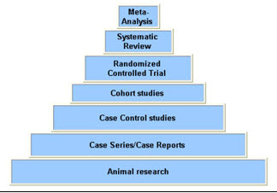

I
Where Do You Get Your Facts?
  I trust any study I read because I know it is evidence-based.
    Not always! Can be influenced by companies with a vested interest. The source of funding for a research project could influence the results.
    Different types of studies –was a control group used? How big was the group who was studied?
    Does it contradict the existing body of knowledge? Was it a single study?
Notes:
Please view the study of oatmeal and vitamin C funded by Tropicana and Quaker: https://www.livescience.com/5208-oatmeal-oj-breakfast-champions.html. Quaker and Tropicana used the study to their advantage to promote their specific products of oatmeal and orange juice however the study was focused on the energy density of food and not oatmeal or orange juice specifically. Makes the public believe that oatmeal and orange juice make the perfect breakfast but so do many other lower energy density foods.
Everyone is an “expert”. Are they selling a product? What are their credentials? Even studies differ. Use examples of coffee, coconut oil. This example of fibre: “One of my favorite examples is a pair of studies released 10 days apart — one concludes fiber in the diet helps prevent colon cancer; the other concludes fiber has no effect on colon cancer risk. Both are well designed, well constructed double-blind studies. The science of what people should eat is still open to discovery and interpretation.” https://www.foodprocessing.com/articles/2005/195/ No one wants to give up the food that they love. So we hear what we want to hear and pick and choose the nutritional information we want to incorporate.

Slide 8
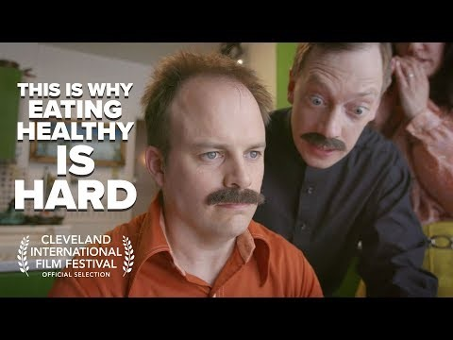
This is Why We Are So Confused!
I
What Am I Supposed to Do?
www.corporatewellnessmembership.com
Notes:
This is a VIDEO to click on

Slide 9
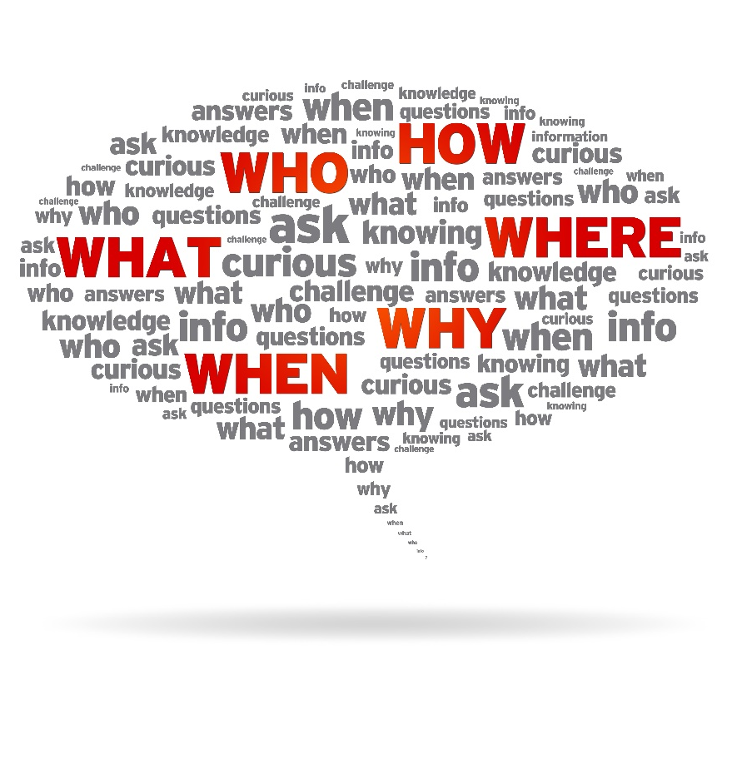
I
Is it Best for ME?
As individuals we all need different nutrition!
- Too heavy a focus on a quick fix. Epidemics do not have a “quick fix”. Complex issues end up being simplified into a dietary change.
-We are passionate about food. When we find what has “worked” for us we spread the word.
-View through a holistic lens:
Gender Biochemical Make-up
Age Medical History
Life stage Emotional/Mental Health
Lifestyle Needs Health & Wellness Goals
www.EWSNetwork.com
Notes:
We are passionate about food. When we find what has worked for us we spread the word. But what worked for one may not at all be suitable for the next person. Individuals can have opposite responses to the same diet, therapy, trends..etc. i.e.: “An Israeli study tracking the blood sugar levels of 800 people over a week suggests that even if we all ate the same meal, how it's metabolized would differ from one person to another. The findings, published November 19 in Cell, demonstrate the power of personalized nutrition in helping people identify which foods can help or hinder their health goals.”
https://www.sciencedaily.com/releases/2015/11/151119133230.htm
Science tells us that obesity is a complex condition influenced by genetics, food choices, portion sizes, personality traits, physical activity and sometimes a disease process like metabolic syndrome or other physical ailment. Yet we want to simplify a very complex condition down to food choices and calorie intake. Eliminate fruit, soda, gluten, fat, carbs…etc. making a “diet” the answer to a complex potentially lifelong problem. While they may help with weight loss, it is rarely a sustainable answer that addresses the overall health of an individual.

Slide 10

I
Common Myths Debunked
Whether it’s at the grocery store, in the schoolyard, or at a company party, we are faced with a lot of misinformation when it comes to nutrition.
We are debunking some of the common myths you’ve heard and likely need clarified! BUT ….
Keep in mind that these are general recommendations and not for everyone!
www.corporatewellnessmembership.com

Slide 11
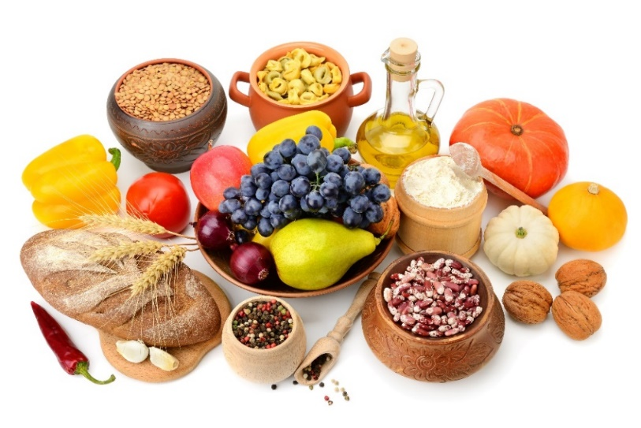
I
MYTH: Carbs Are BAD!
Don’t eat the potato!
Don’t eat the bread!
Bad reputation for their effect on blood sugar
TRUTH: Carbohydrates are an important nutrient to be included in a healthy diet.
    Healthy carbs absorb slowly in your system
    Can improve your digestion
    Great source of fibre
    Add essential nutrients to your diet
    Promote serotonin production
    Main source of fuel
Recommendation:
TIP: Eat the potato but a small portion WITH the skin. Pair with some protein, a add ½ teaspoon of olive oil and vinegar dressing!
Mashed potatoes, white breads, refined cereals, commercial baked goods and candies are quickly absorbed. Choose slowly digested and absorbed carbohydrates such as sweet potatoes, steel-cut oats, whole grain pasta, barley, quinoa, beans, lentils, non-starchy vegetables and fruits instead.
Notes:
The average 1,800-calorie diet should contain between 210 and 290 grams of carbohydrates each day, which is equal to 45 to 65 per cent of your daily calories.
About half of your daily calories! Since carbohydrates are the main source of energy for the body and brain, they are an important component of a healthy diet.
When carbohydrates are digested, they turn into sugar, or glucose, which is then absorbed into your blood. The faster carbohydrates are digested and absorbed, the more quickly and the higher your blood sugar levels can rise after eating. Complex carbohydrates contain fibre which keeps your blood sugar levels lower by slowing down the digestion and absorption of carbohydrates. this can help control your cravings, weight and reduce your risk of chronic disease. The glycemic index measures the rate of digestion and absorption of carbohydrates and the way this effects your blood sugar levels. The glycemic index is a system used to classify the speed at which different carbohydrate-rich foods are absorbed and elevate your blood sugar levels.
Study that showed the addition of vinegar lowers glycemic index https://www.ncbi.nlm.nih.gov/pubmed/16034360
Relationship between Blood Glucose & Insulin
-Blood Glucose – Carbs increase blood glucose levels
-Insulin – When insulin is high, fat building is high
-When glucagon is high, fat burning is high

Slide 12
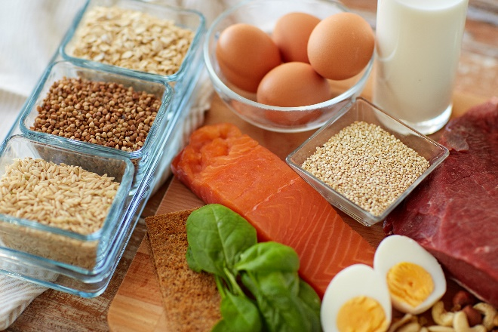


I
MYTH: More Protein = More Muscle
TRUTH: Muscle is made from protein but….
Studies show that protein had no benefits on muscle growth past the upper limit of approx. 30g.
Body tries to conserve energy
Insufficient protein will affect muscle mass
Recommendation:
  0.8 grams of protein per kilogram of body weight, or 0.36 grams per pound.
  Examples of healthy protein include lean proteins like chicken, turkey, eggs, and fish, beans and legumes, nuts and seeds, protein powders free of chemicals, preservatives, and artificial flavours.
Notes:
Body is always trying stay balanced and conserve energy to maintain other bodily functions and processes and protect from any crisis. Building muscle takes a lot of energy
Once past the upper limit, body uses the additional protein for other body processes.
Protein powder should never replace adequate food based protein in your diet. For use to supplement when necessary or when transitioning into a vegetarian lifestyle.

Slide 13
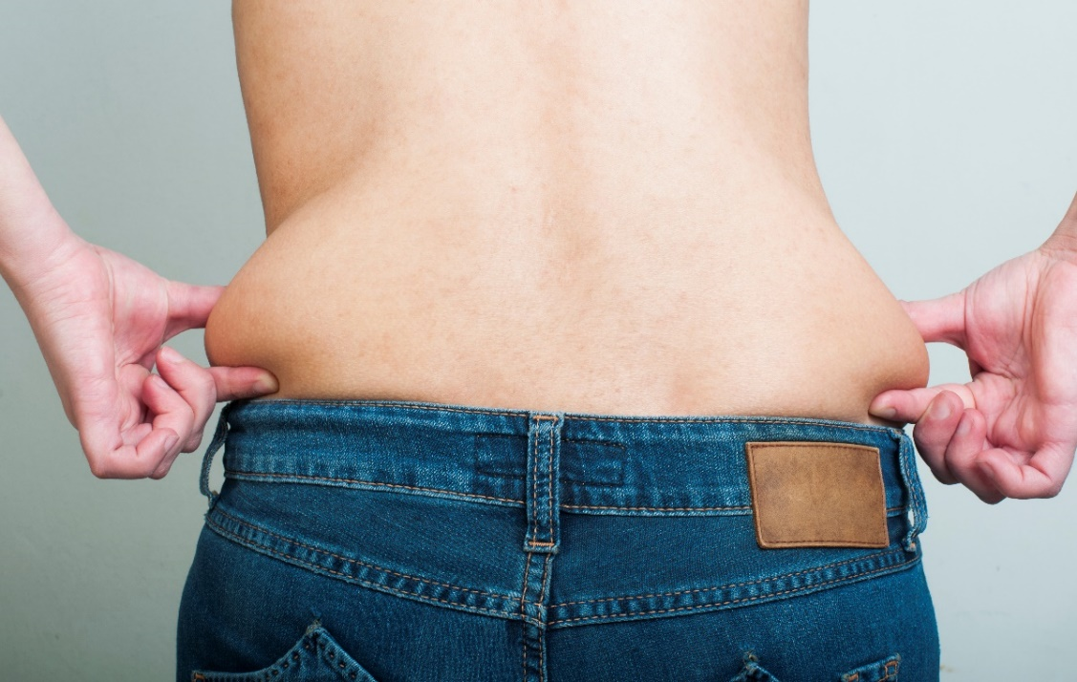
I
MYTH: Eating Fat Makes You Fat
If you don’t eat fat, you can’t get fat!
Carbs = Energy
Protein = Muscle
Fat = Fat?
TRUTH: Fat is essential!
Essential for biological functions
Essential fats aren’t produced by the body
Dietary fat is not a determinant of body fat
(Walter Willett study)
Recommendation:
Include a variety of good fats like olive and grapeseed oil, raw nuts and seeds and avocado in your diet. They should make up 25%-35% of your daily intake.
Notes:
Famous Walter Willett study showed that as dietary fat decreased calories and bodyweight increased. https://www.amjmed.com/article/S0002-9343(01)00992-5/abstract?code=ajm-site

Slide 14

I
MYTH: Don’t Eat After 8:00pm!
This doesn’t give you permission to eat a sleeve of Oreo’s!
TRUTH: It’s not so much the timing of the eating but rather the choices that are made.
Eating past 8pm is not unhealthy, but usually the choices made are.
Small healthy whole food choices may help to balance your blood sugar and help you to sleep.
There should still be a predictable cut off point.
Recommendation:
  Preplan some healthy smaller snacks and keep them to 150 calories or less. Make it yourself and avoid processed foods.
Notes:
-Eating past 8pm is not unhealthy if you choose small portions of healthy foods Nighttime eating can be a sign of needing to make up calories from your day and your body may respond by needed a quick source of fuel in the form of sugar or carbohydrates.
-When healthy choices are made, evening eating may help you to lose weight
-Be mindful –Are you actually hungry? Thirsty? Bored? Lonely?...etc
-Being in tune with your evening hunger and satisfying it can help you avoid choices that will sabotage your weight loss goals.
-Important to have a set time that your body knows consumption has ended.
IDEAS: Ideas: protein balls, small smoothie, roasted chickpeas, baked banana chips, kale chips, veggies and hummus, avocado and cottage cheese

Slide 15
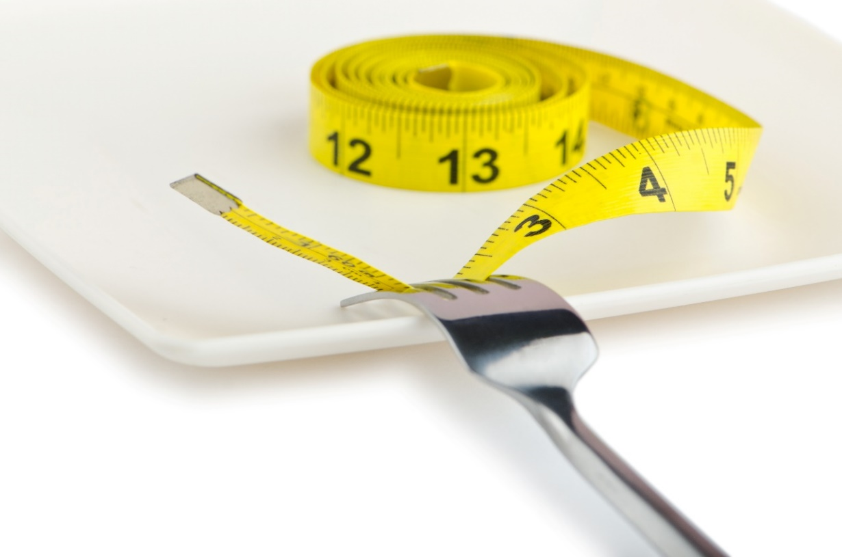
I
MYTH: Skip Meals to Lose Weight
Skipping meals reduces calorie intake, is this a solution for weight loss?
Slow your metabolism
Rebound overconsumption
Increase in cravings
TRUTH: Eating at intervals of approx. every 3 hours:
Keeps your blood sugar balanced
Provides opportunity for adequate nutrition
Provides fuel for the body and its functions
May help you lose weight when combined with smart food choices and physical activity.
Recommendation:
  Eat 5-6 small balanced meals per day to promote a healthy metabolism…OR
  Implement a structured protocol of intermittent fasting
Notes:
A new study in animals suggests that skipping meals sets off a series of metabolic miscues that can result in abdominal weight gain. https://news.osu.edu/in-study-skipping-meals-is-linked-to-abdominal-weight-gain/
This study supports the idea that more small meals are more effective for weight loss .
-Skipping meals to save calories results in larger fluctuations in insulin and glucose which support abdominal weight gain.
-In order to lose weight, a person must expend more calories than gained at a faster rate. When done in a non structured method (like intermittent fasting which is discussed next slide) skipping meals can cause the Basal Metabolic Rate to lower burning less calories and may affect metabolism.
When BMR falls, the calories from food burn at a slower rate which increases the potential for those calories to be stored as fat.
-Not eating proper meals and deprivation of essential nutrients can cause people to feel hungry later and crave unhealthy foods.

Slide 16

I
Skip Meals to Lose Weight - MYTH or TRUTH?
TRUTH: Intermittent Fasting can be an effective tool for weight loss and a health management protocol.
Not just a random “don’t eat” approach, it’s a plan.
Intermittent fasting is a structured way of fasting
(not just skipping meals).
Fasting for short periods helps people eat fewer calories, and also helps optimize some hormones related to weight control.
Studies show promise in using IF for chronic disease management and increasing lifespan.
Recommendation:
  If healthy food choices and physical activity are in place and you are in good health, IF may be of benefit to you.
  Try a trial fast for 24 hours, notice and get familiar with the feeling of hunger and perhaps your relationship with food.
  *The importance of making healthy food choices is paramount whatever you choose!
Notes:
To learn and review more about intermittent fasting: https://www.precisionnutrition.com/intermittent-fasting
Employees may want to access the free download.
Structured short-term fasting leads to several changes in the body that make fat burning easier.
This includes reduced insulin to promote fat burning, increased growth hormone aiding in fat loss and muscle gain, enhanced epinephrine signaling to break down body fat, and a small boost in metabolism.
How is it different from skipping meals?
Skipping meals isn’t usually structured, it is simply random calorie restriction. In the calorie restriction studies, 25% of the weight lost was muscle mass, compared to only 10% in the intermittent calorie restriction studies.
https://www.ncbi.nlm.nih.gov/pubmed/21410865
Intermittent Fasting! Intermittent fasting is compressing your eating time in the day to MAXIMIZE the time that we are at low (baseline) insulin. Easiest form is to eliminate nighttime eating past 7 or 8pm and skip breakfast with the first meal occurring around noon. This gives your body about a 16 hour break with 12 of those at a base insulin level which gives your body time to release fat and get its energy from fat. This can also produce more fat burning enzymes converting you from a sugar burner to a fat burner or somewhere in between.

Slide 17

I
MYTH: Organic Food is More Nutritious
TRUTH: Sometimes...but not always!
Organic produce shipped globally is not as nutrient dense as local produce.
Organic products can still fall in the processed food category.
Many farmers use natural practices but aren’t certified “organic”.
Organic food is not necessarily better for the environment.
Recommendation:
  Shop at your local farmer’s market.
  Follow the dirty dozen/clean 15 list to buy organic where it matters.
  Assess your budget to see where organic will be of most benefit.
Notes:
-When organic food is shipped globally it can suffer nutrient loss through time and storage. Local food is not only fresher, and tastier, but it also can be more nutrient dense. If organic is your preference, find organic foods grown close to home to get all the benefits organic can offer.
-Many companies are capitalizing on consumer demand for more organics in the food industry. Processed foods such as organic cookies, organic potato chips, and organic mac and cheese are still processed products that have the same health concerns as other processed products
-Many farmers opt to use natural based pesticides and herbicides, don’t use antibiotics, steroids or hormones in their animals. Small scale farmers can’t afford the expensive certification to deem their fields and animals organic. Speak to your farmer at the local farmer’s market, get to know their practices if these are concerns for you and where you can, support small and local!
-Local food doesn’t need to be transported long distances. The carbon footprint of organic food could potentially offset the environmental benefits of a lower pesticide use.

Slide 18
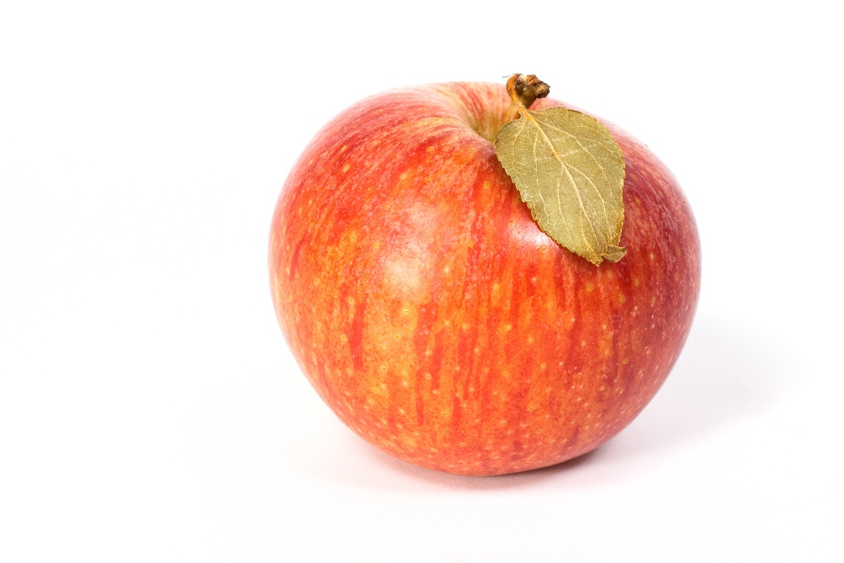
I
MYTH: Take Vitamins to Get All You Need
TRUTH: Foods have more than just vitamins!
Other components have health promoting properties.
Isolating vitamins very different from whole food nutrition
Food first; vitamin = insurance
Recommendation:
  A multivitamin as insurance that you are getting any vitamins and minerals you may be lacking but not at the expense of whole food, balance and variety.
  Eat food in its whole form where possible.
Notes:
Polyphenols/antioxidants, hydration, fibre,
Nutrients work better together as they are found in nature. I.e. vitamin c is always found with bioflavonoids. Food that contains calcium always has at least traces of its cofactors for absorption such as magnesium, biotin, zinc, manganese…etc.
When isolate, they can cause damage. I.e. calcium supplements causing arterial plaque because of the lack of co factors which help with its direction into the bone and absorption.
-Aim to get more nutrient dense foods in your diet.
-Better absorption from food which is meant for your body
-Use this example of an apple:
Apples are full of vitamins, minerals and antioxidants. Researcher found that those who consumed an apple a day actually took fewer medications.
Their soluble fibre (apple pectin) helps to regulate blood sugar and lower cholesterol. Some people will choose to take apple pectin in supplement form for these benefits. But they are also a good source of potassium for blood pressure, vitamin c and it’s the combination of nutrients that helps to protect against cardiovascular disease.
This combination of nutrients means eating apples can help protect against cardiovascular disease.
For the biggest health advantage from apples, eat the whole apple. There are many nutrients in the peel and the flesh that work together for your benefit.

Slide 19

I
What is the Solution?
Always question the source!
Ask yourself
“Does this recommendation seem logical or “trendy”?
Does the recommendation require a life long restriction?
www.EWSNetwork.com
Notes:
Is this person a nutrition expert? If not, follow up with your own research
Is the article written by a reputable source? Who is the study funded by?
Does it seem logical to eliminate all carbohydrates from your diet?
What is the science behind eliminating gluten for a lifetime? While some may benefit, if you aren’t fully allergic and just experience gas and bloating, perhaps working on your digestion and reducing your consumption would be enough to feel better.

Slide 20

I
Who Has the Facts?
Speak to your on-site wellness consultant.
Speak to your doctor but follow up with the services of a Nutritionist or Registered Dietitian.
Do your own research and look at both sides.
www.EWSNetwork.com
Notes:
Reputable university, governmental and/or organizational websites. They are going to be the most reliable, accurate and peer-reviewed sources.

Slide 21
Time for Q & A
Thank you for your time today!
Powered by:
©2019 EMPLOYEE WELLNESS SOLUTIONS NETWORK INC. – ALL RIGHTS RESERVED
©2018 EMPLOYEE WELLNESS SOLUTIONS NETWORK INC. – ALL RIGHTS RESERVED
Notes:
Sources:
https://blogs.plos.org/obesitypanacea/2014/12/23/the-demise-of-dr-oz/
https://guides.mclibrary.duke.edu/c.php?g=158201&p=1036068
https://www.cdc.gov/des/consumers/research/understanding_deciding.html
https://www.livescience.com/5208-oatmeal-oj-breakfast-champions.html
https://www.amjmed.com/article/S0002-9343(01)00992-5/abstract?code=ajm-site
https://www.ncbi.nlm.nih.gov/pmc/articles/PMC3197704/
https://www.fitday.com/fitness-articles/nutrition/healthy-eating/food-myths-debunked-if-you-eat-after-8pm-you-will-gain-weight.html
https://www.caloriesecrets.net/these-5-foods-are-better-than-a-multivitamin/
https://archpublichealth.biomedcentral.com/articles/10.1186/2049-3258-73-3
https://www.sciencedaily.com/releases/2015/11/151119133230.htm
https://www.foodprocessing.com/articles/2005/195/
https://conservationfolks.com/are-organic-foods-better-for-you-common-myths-about-organic-food/
https://www.ncbi.nlm.nih.gov/pubmed/21410865
https://www.precisionnutrition.com/intermittent-fasting/compare-popular-if-programs
https://www.livestrong.com/article/500047-what-factors-slow-the-absorption-of-carbohydrates/

