Slide 1



Breaking the Bond: The Relationship Between
Sugar Cravings and
Emotional Eating
Powered by:
©2019 EMPLOYEE WELLNESS SOLUTIONS NETWORK INC. – ALL RIGHTS RESERVED

Slide 2
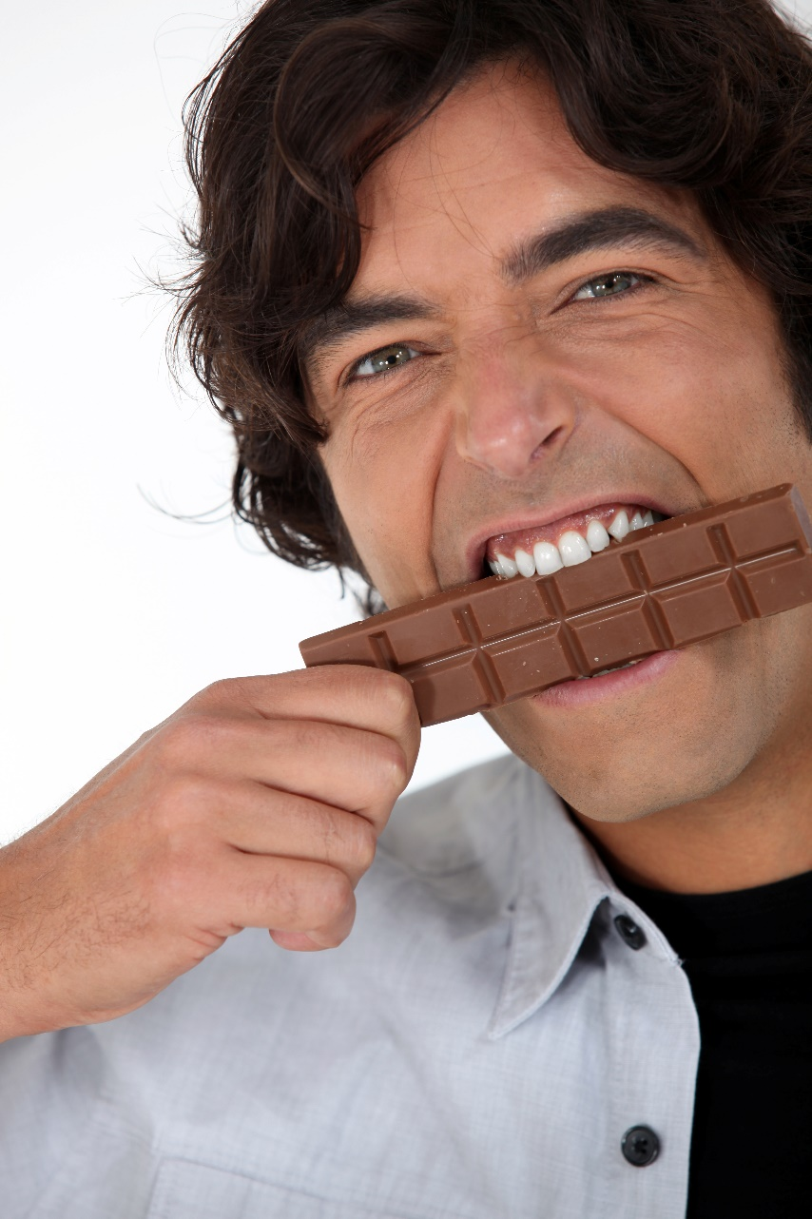
I
Objectives
What is Emotional Eating?
Why Do We Crave Sugar?
Are Emotions the Cause of Your Sugar Cravings?
How to Tell the Difference?
The HALT Method
How to Identify Eating Triggers
Dealing with Withdrawal
Tips on Stopping Emotional Eating & Handling Your Cravings
The Cycle of Success
Q & A
www.EWSNetwork.com

Slide 3

I
What is Emotional Eating?
Emotional Eating is the practice of consuming large quantities of food—usually “comfort” or junk foods – in response to feelings instead of hunger.
Experts estimate 75% of overeating is caused by emotions.
Food can bring short-term comfort and as a result, we often turn to food to heal emotional problems.
Depression, boredom, loneliness, chronic anger, frustration, stress, problems with interpersonal relationships, and poor self-esteem can result in overeating and related health problems.
Research shows that the top foods overeaten by females are ice cream, chocolate and cookies.
Sugar tricks our body and mind into serving as this emotional crutch. Leaning on sugar to cope puts us at a higher risk of insulin resistance, pre-diabetes and diabetes. But how does it work?
Notes:
-An Internet survey of 17,000 failed dieters (almost 90% were women) found that virtually all of them had relapsed because of emotional issues
-Emotional Eating becomes a habit which prevents people from learning skills that can effectively resolve emotional distress and increasing risk of health issues associated with a higher risk of diabetes.
-Emotional Eating can be learned in childhood: i.e.: child is sad, give the child a treat to make them feel better, child equates comfort with food

Slide 4
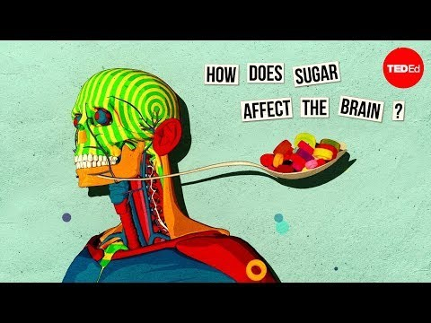
It’s a Vicious Cycle and Related to Addiction!
I
Why Sugar?
Notes:
-Our brains are wired for survival. Evolutionary mechanisms such appetite and hunger cues drive us to eat to remain nourished.
-Sometimes what we eat can trigger a group of neural structures that activate a sense of enjoyment releasing the neurotransmitter Dopamine.
-Dopamine is a neurotransmitter that makes us feel good and sends a message to the brain that we should repeat the behaviour (aka eat the second piece of cake).
-This reward system is a primal process that was meant to improve our survival. In a society that over consumes sugar, this evolutionary doesn’t serve us in the same way.
-Sugar alters the brain’s reward system causing us to overeat, self medicate, and sets up a system of cravings.
-Over time, the repetition of the above cycle requires greater amounts are needed to sustain the same level of reward.

Slide 5
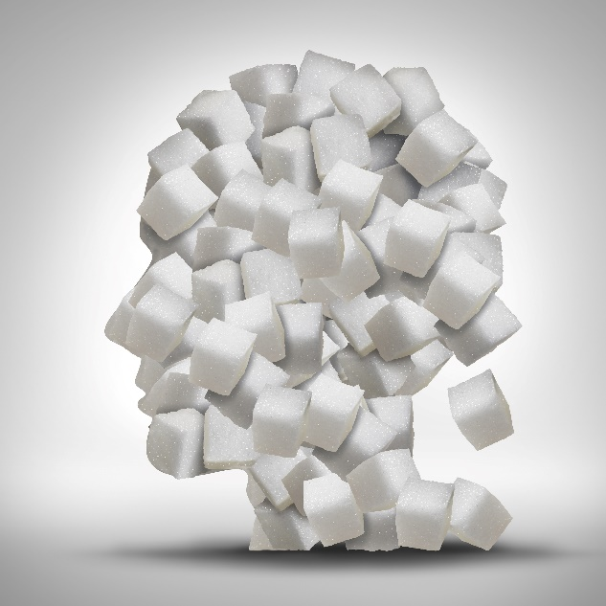
I
The Vicious Cycle
Sugar Consumption
Hunger & Craving for More
Body Crash
Insulin Secretion
Blood Sugar Spike & Dopamine Release
Notes:
-Our brains are wired for survival. Evolutionary mechanisms such appetite and hunger cues drive us to eat to remain nourished.
-Sometimes what we eat can trigger a group of neural structures that activate a sense of enjoyment releasing the neurotransmitter Dopamine.
-Dopamine is a neurotransmitter that makes us feel good and sends a message to the brain that we should repeat the behaviour (aka eat the second piece of cake).
-This reward system is a primal process that was meant to improve our survival. In a society that over consumes sugar, this evolutionary doesn’t serve us in the same way.
-Sugar alters the brain’s reward system causing us to overeat, self medicate, and sets up a system of cravings.
-Over time, the repetition of the above cycle requires greater amounts to sustain the same level of reward leading to insulin resistance, prediabetes and possibly a diagnosis of diabetes.

Slide 6
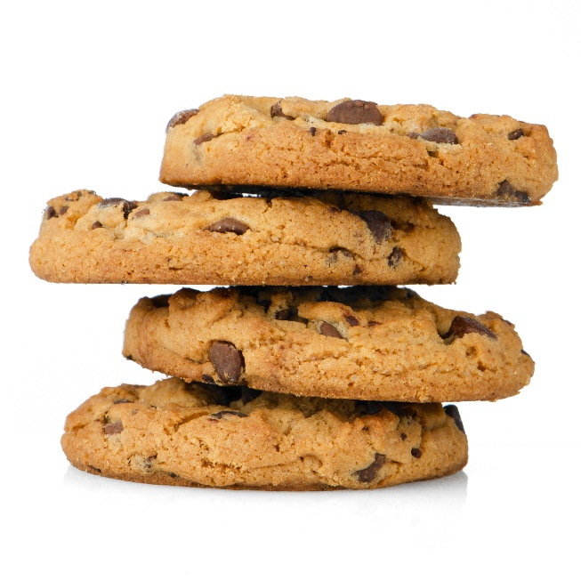
I
Are You an Emotional Eater?
Ask yourself these questions:
Do you often eat regardless of physical hunger?
When you feel stressed/upset/overly happy/etc., do you turn to food for comfort or reward?
Do you eat to feel better?
Do you feel like you have no will-power or control when it comes to food?
Do you feel like food is always there for comfort when other things or people aren’t?
Notes:
- You may mindlessly be eating while cooking dinner, going to the fridge out of habit. It may sound good so you go for it! Are you still tasting and enjoying your food?
- You’ve had a bad day, and the first thing you think about is some sweet treat, the drive thru on the way home, or the dinner you are going to make. This can happen with positive and negative feelings. You feel you “deserve” it.
- You’re just not feeling well either physically or emotionally, and you decide to eat something pleasurable rather than rest, hydrate, or take an over the counter medication or supplement.
“I can’t control myself when it comes to chocolate.” I have no will power. You can’t seem to talk yourself out of a bad choice.
Is food your comfort, your friend, your outlet? If you eat, do you feel like you are less of a burden to your support network because you are satisfied by the sweet pleasure in your life?

Slide 7

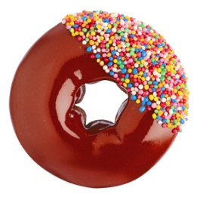
I
Emotional Craving & Physical Hunger
Is it Hunger or a Craving?
Emotional Craving | Physical Hunger
Comes on suddenly | Hunger occurs gradually
Specific food cravings (i.e.: pizza ice cream, candy...etc.) | Open to options
Feels as if it needs to be satisfied instantly | Physical hunger feels as if it can wait
Even when full, more likely to keep eating | More likely to stop eating when full
Leaves behind feelings of guilt | No feelings of guilt when eating to satisfy physical hunger

Slide 8

I
Identify Your Triggers: HALT Your Emotional Eating
Before You Eat:
Are you H-ungry?
Are you A-ngry?
Are you L-onely?
Are you T-ired?
HALT
By identifying what triggers emotional eating, we can substitute more appropriate techniques to manage our emotional problems and take sugar out of the equation.
Notes:
H:If you are hungry, by all means, eat. Choose a balanced meal or snack that is not high in fat or sugar as this will be more satisfying
A:Deal with anger directly, if at all possible. If it isn’t possible to deal with anger in a direct or healthy way, find a physical outlet (walking/running)
L: Engage in social activities. Withdrawing only makes loneliness worse. Call someone or get out of the house.
T: Get plenty of sleep on regular basis. If you are tired and can’t take a nap, get moving. Physical activity increases energy levels.
Note that T can also represent “Thirst” – dehydration also masks itself as hunger. Drink a glass of water and wait a few minutes and see if the hunger feelings dissipate.

Slide 9




Lifestyle Tips to Reduce Emotional Eating
I
    Develop alternatives to eating: when you start to reach for food in response to a trigger, try one of the following activities instead:
    Read a book Listen to music Go for a walk
    Have a bath Meditation Play a game
    Call a friend Do housework Any other pleasurable activity
    Keep a food diary that records what and when you eat, as well as stressors, thoughts, or emotions you identify as you eat.
    Boredom Tension Loneliness
    Anger Sadness Negative Talk
    Hunger Physical Cue Social opportunity
Notes:
Make your alternative strategy enjoyable. If it feels like a chore it won’t be successful. It may take some time to change the habit, but practice patience. The neurons associated with a certain activity function together and form a neural pathway. Through repeated action, the connections of these neural pathways become established and stronger. With continuous practice and training, you are also re-wiring your neural pathways according to the habit you want to form.
Keep food diary – this will help identify patterns to excessive eating and help train you to identify when a trigger occurs and how to avoid emotional eating

Slide 10

I
Dealing With Withdrawal!
Feeling Motivated
Cravings
Symptoms Peak
The American Journal Of Clinical Nutrition found that added sugars account for approximately 14% of total calorie intake!
The sugar in our diets used to come from natural sources like fruit and natural starches. Today sugar is added to almost every processed food available. Because of the dopamine release, sugar works like other types of drugs. Removing it from your diet, can cause temporary symptoms of withdrawal!
Feeling Better
Notes:
-Find your motivation. Is it health? Energy..etc. What is motivating you for the change?
-Cravings are the early signs of sugar withdrawal. Keep healthy snacks on hand to avoid reaching for sweets.
-As you eliminate sugar, withdrawal symptoms will peak which can also initiate strong cravings which can easily sabotage your goals. Remind yourself of your motivation, accept that symptoms will peak, and be kind to yourself..
-After a few days, the symptoms and cravings will subside and you will feel better than ever. As the sweet taste buds become less sensitive, the bitter taste buds will have you craving more nutrient dense foods like fruits and vegetables, more specifically greens.
If coping skills are not strong or there are underlying, serious mental/emotional health issues, seeking help from a psychological health professional may assist in overcoming emotional eating behaviours

Slide 11
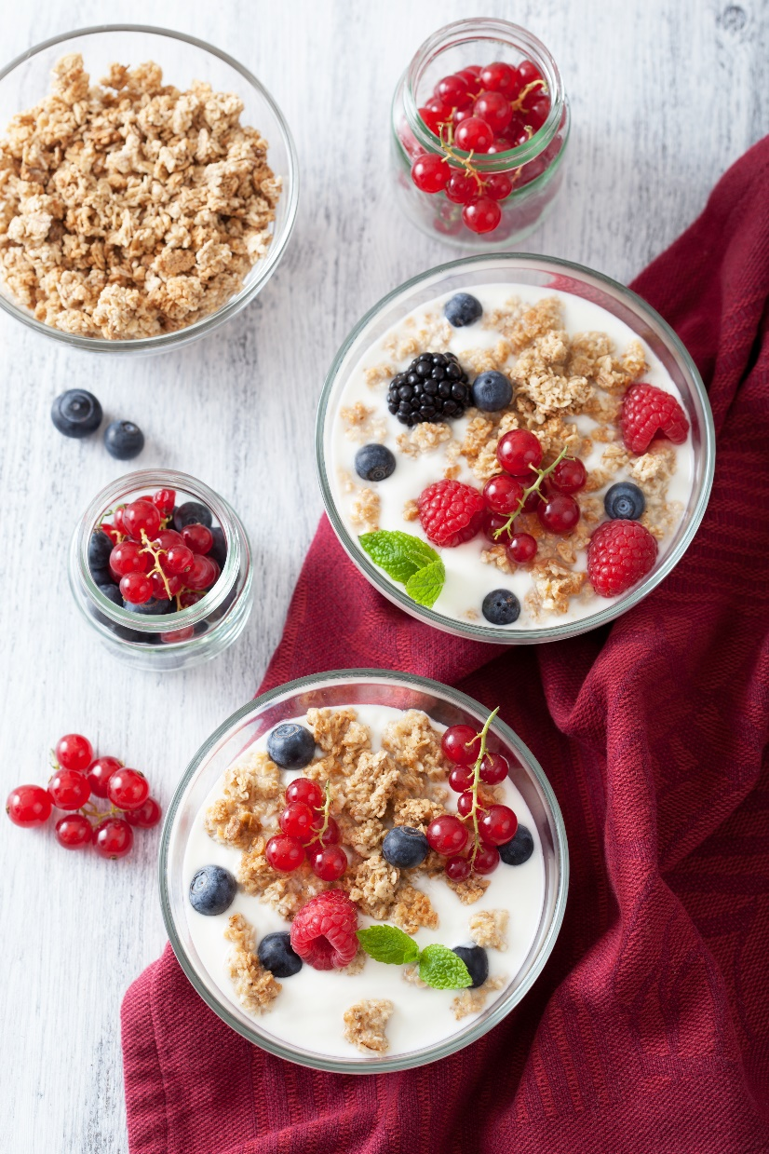
I
Practical Tips to Break the Habit
Here are some practical tips to more effectively cope with sugar cravings at a time when you are most susceptible to emotional eating.
Remove the temptation
Don’t expect perfection
Use natural sweeteners and sweeten yourself
Have healthy alternatives ready to go
Notes:
Here are some practical tips to more effectively cope with sugar cravings at a time when you are most susceptible to emotional eating.
Remove the temptation: Don’t stock the fridge or pantry with sugar, cookies, ice cream…etc. When it takes effort to satisfy the craving, you will be less likely to engage in emotional eating and find a different strategy to cope.
Don’t expect perfection: Give in a little but don’t go overboard. Feeling the need for chocolate? Purchase a small single square. If you purchase a whole chocolate bar, odds are you will start small but end up sabotaging your goal.
Use natural sweeteners and sweeten yourself: While you still may be perpetuating the sugar cycle, finding alternatives to store bought processed foods is a step in the right direction. Buy unsweetened yogurt and add some honey or berries. Purchase some carbonated water and add a splash of fruit juice for flavor, colour and sweetness…etc.
Have healthy alternatives ready to go: Simple things like a xylitol sweetened gum, a serving of fruit, or a ¼ cup of fruit juice could be enough to stave off the craving. Research has actually shown that chewing gum can be an effective deterrent to sugar cravings!

Slide 12
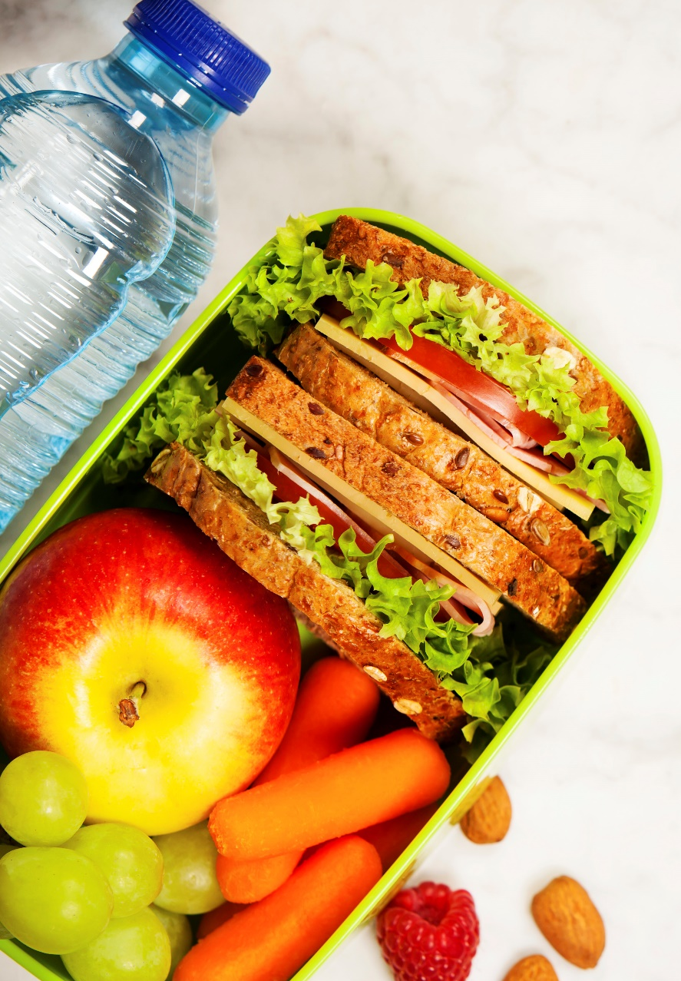
I
Stay Nourished!
Cravings of any kind can be a sign of a vitamin or mineral deficiency or simply a lack of balance in the diet. Be sure you are eating a well balanced diet to also aid in the craving for sugar.
Drink water
Eat protein, fibre & fat
Plan your meals
Practice mindfulness
Notes:
Cravings of any kind can be a sign of a vitamin or mineral deficiency or simply a lack of balance in the diet. Be sure you are eating a well balanced diet to also aid in the craving for sugar.
Drink Water: Thirst can often be confused with a hunger craving. Try drinking a glass of water to stave off the craving.
Eat Protein, Fibre & Fat: These three nutritional components work together to help to balance blood sugar and keep you satiated. It can reduce your cravings by up to 60%!
Plan Your Meals: Meal planning is your defense system against impulse eating and emotionally based food choices. With a plan in place, there is no excuse to reach for that chocolate bar in the vending machine. A meal plan can also ensure that there is variety and rotation in your diet, giving you access to a wide variety of vitamins and nutrients to keep you well balanced.
Practice Mindfulness: Taking time to chew, digest, and absorb, as well as appreciate the food that fuels our body, mind, and spirit can be helpful in understanding the difference between a physical hunger and an emotional need.

Slide 13
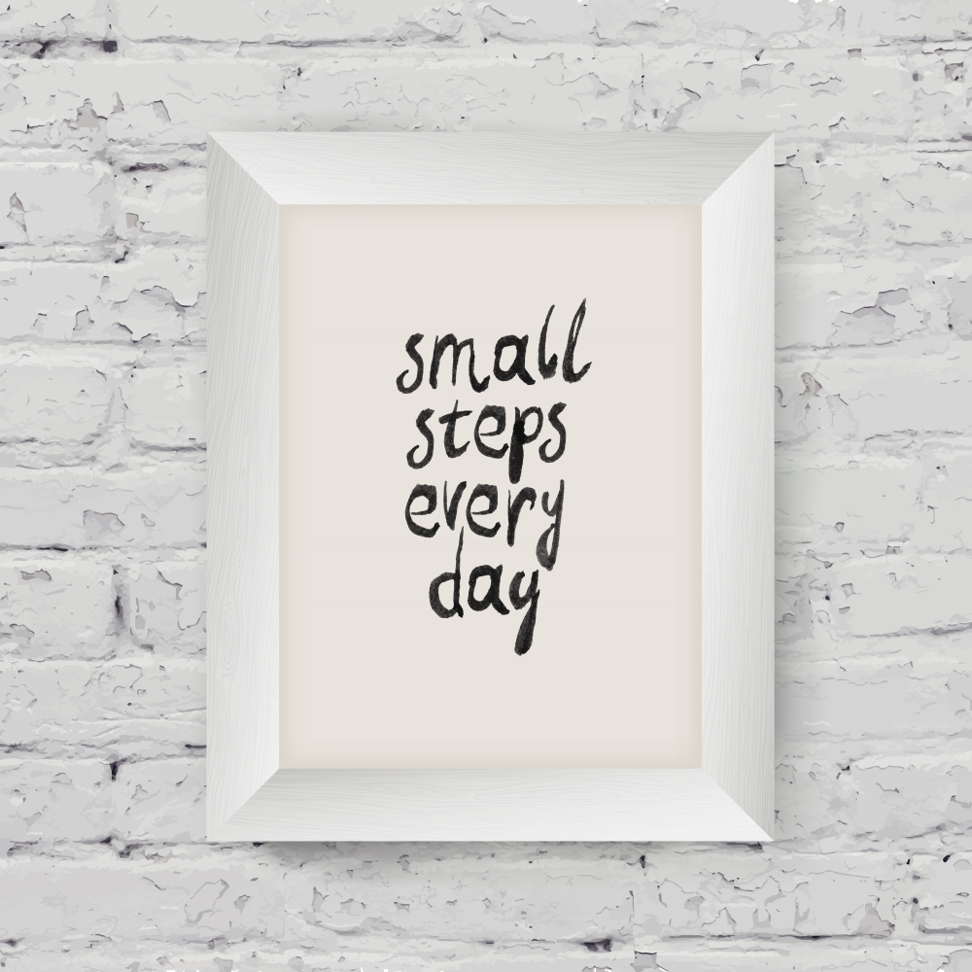
I
Keep Focused on Wellness
Think wellness, not loss!
Focus on what is going right
Choose one or two new, healthy habits to take on – NOT 10 or 20!
Use your social network!
www.EWSNetwork.com
Notes:
Think wellness, not loss!
Making good food choices to reach one set goal could lead to rebound bingeing once the goal is achieved.
Focus on what is going right
Acknowledge the actions you are taking and the small successes along the way rather than focusing on feeling discouraged by your barriers.
Choose one or two new, healthy habits to take on – NOT 10 or 20!
Small, simple changes can help you reap large results. A few small, daily steps can help you stick with changes and avoid feeling overwhelmed.
Use your social network!
Post it, tweet it, blog it but put it out there! By sharing your goals and vulnerability online, you may find someone else who shares your challenges and can add to your support system. The larger and more diverse your support network, the greater your success in finding coping strategies other than food and sugar.
Think Wellness: Look at any change as a step to long term wellness, rather than a short term goal. Otherwise, it is mostly likely that you will return to old habits once you succeed.
Focus on what is going right
Choose one or two habits: Try drinking a smoothie made with protein, fat, and fibre (to balance your blood sugar) every, or carry a water bottle during the day to stay hydrated!
Social network:

Slide 14

I
The Long Road to Success
Virtually any lifestyle or dietary change will go smoothly at the beginning because you are motivated and eager to do what it takes to reach your goal. But over time, the challenge to continue with your goal can lessen the inner spark.
How Can You Re-Spark Your Motivation?
Reconnect with the reasons you initially wanted to get a handle on your cravings.
Why was that goal so important to you?
Re-assess your plan and tweak where you need to.
Create new coping strategies if others haven’t worked.
Fall off the wagon?
www.EWSNetwork.com
Notes:
-Why did you want to quit sugar to begin with? For health? For more energy? To manage a symptom? For prevention of diabetes? We all can benefit! Ensure that these reasons are still important to you.
-Consider your plan - is dissatisfaction stemming from setting unrealistic guidelines? Is it too strict? Try exploring some different options. Maybe 100% restriction will result in you bingeing. Can you find ways to enjoy an indulgence while still moving forward with your goals?
-Sometimes coping strategies work for a while but then become a chore. Create coping tools or distraction strategies that you can be excited about.
-Turn setbacks into comebacks – it’s not how many times you fall that counts, it’s how many times you get back up.

Slide 15
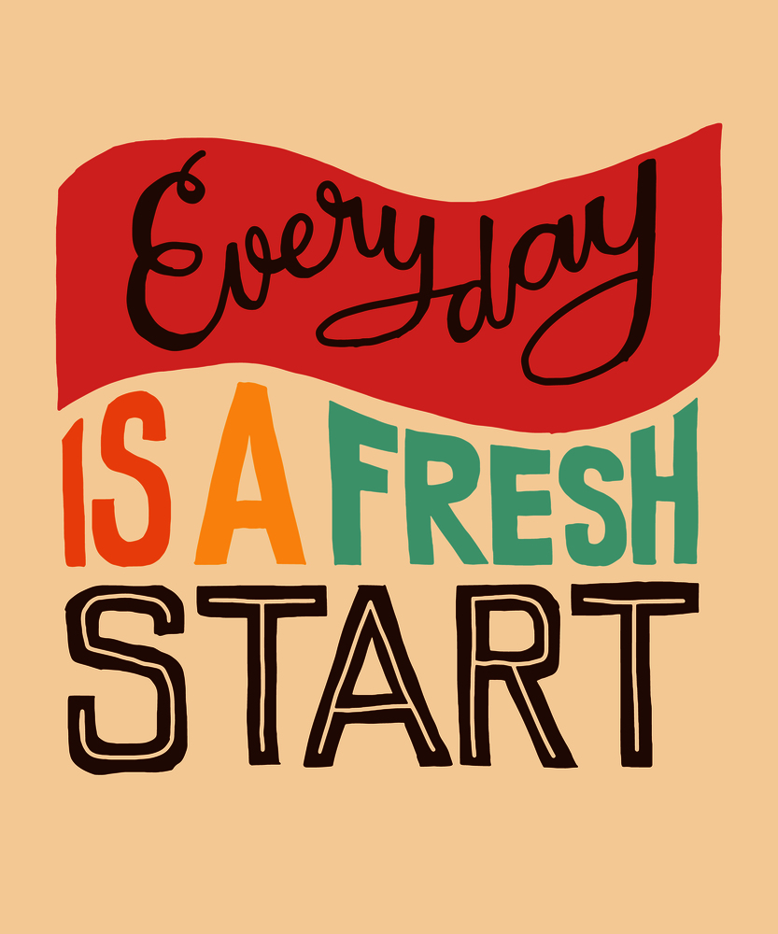
I
Start Fresh!
Don’t Wait for Monday!
Everyday is a great day for a fresh start!
Make your next choice one that supports your goals and makes you the best version of yourself!
www.EWSNetwork.com
Notes:
Why did you want to lose weight initially? For health? For more energy? To look good in your favourite jeans? Ensure that these reasons are still important to you.
Consider your weight loss program – is dissatisfaction stemming from not enjoying the plan itself? Is it too strict? Does it require excessive amounts of time & energy to follow? Try exploring other plans or combining components of different programs into a program that better suits your personality and your lifestyle.
Create coping tools (see emotional overeating) and distraction strategies
Turn setbacks into comebacks – it’s not how many times you fall that counts, it’s how many times you get back up. Every minute is a new opportunity to start fresh!

Slide 16
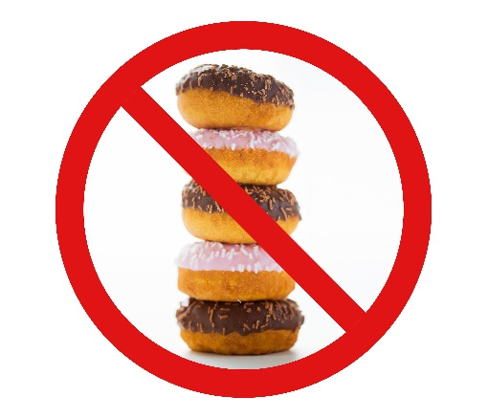

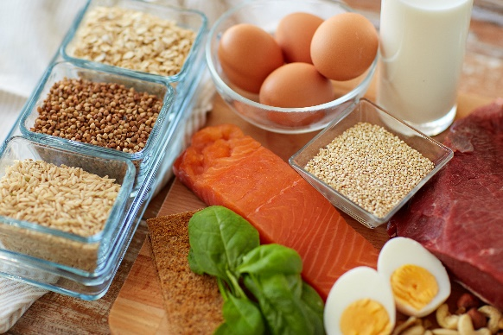

I
The Cycle of Success
Break the bond between sugar and your emotions by managing what you are feeling in healthy ways, breaking the sugar habit, and making better choices.
Emotional or Physical
Identify the Trigger
Stay Nourished
Focus on Wellness
Stay Motivated
Break the Habit
Manage the Emotion
www.EWSNetwork.com

Slide 17
Question Time!
I
©2018 EMPLOYEE WELLNESS SOLUTIONS NETWORK INC. – ALL RIGHTS RESERVED

