Slide 1
Know Your Limits: October Too Much Cheer?

Slide 2
Do you know how to estimate a serving size for vegetables? Rice? Chicken? Do you know how to control your portions?

Slide 3
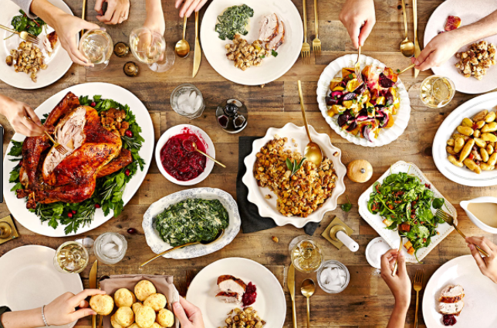
Come out for an interactive session with our coaches to learn how to control your portions by using your own hand and other practical ways. Be ready to eat smart, especially during Thanksgiving!

Slide 4
This session is on _____ Sign up at ____ Contact ___ for more information.
Hope To See You There!

