Slide 1
Company logo
employee wellness program

Slide 2
Personal Awareness
Newsletters
Individual challenges
Posters
E-mail campaigns
Engagement
2, 30 Day Challenges
Family Wellness
Kids Wellness Bursary
Family Webinars
Corporate Wellness Strategy Support
platinum membership
Notes:
If they are silver or gold, you can copy and paste the symbols in the Membership Presentation 20170815 on the portal

Slide 3
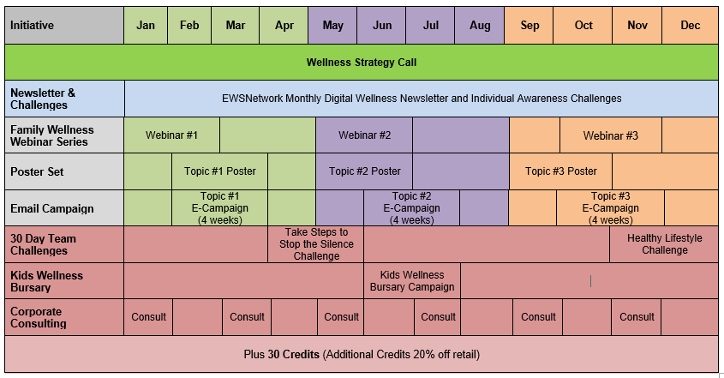
platinum membership january to december

Slide 4
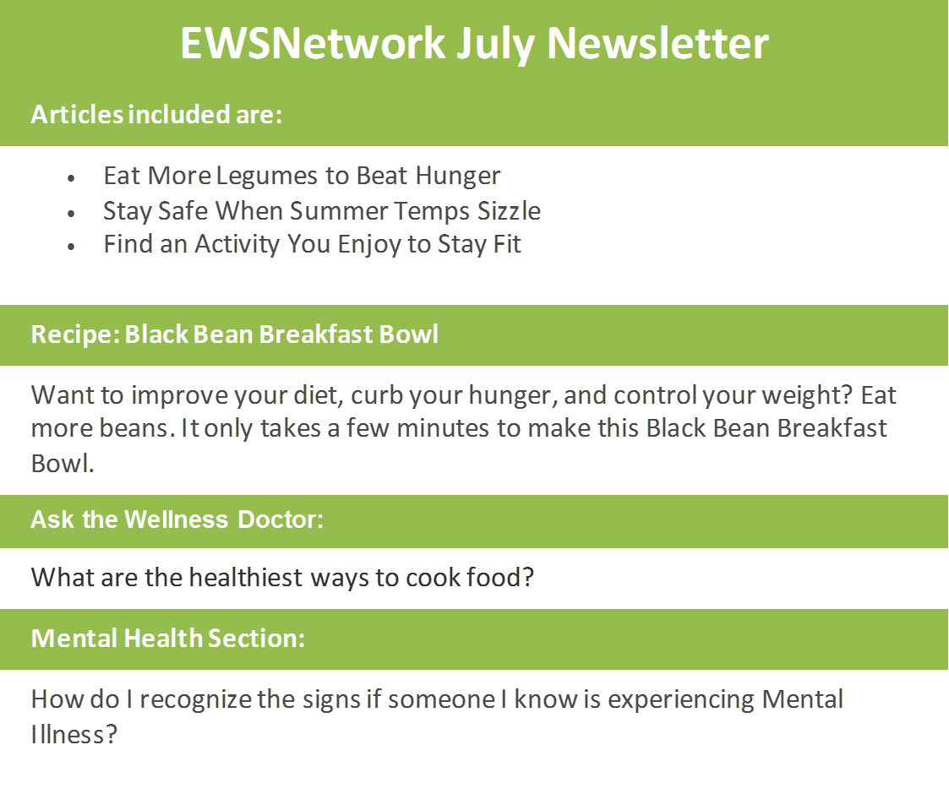
ewsnetwork newsletter & individual challenge

Slide 5
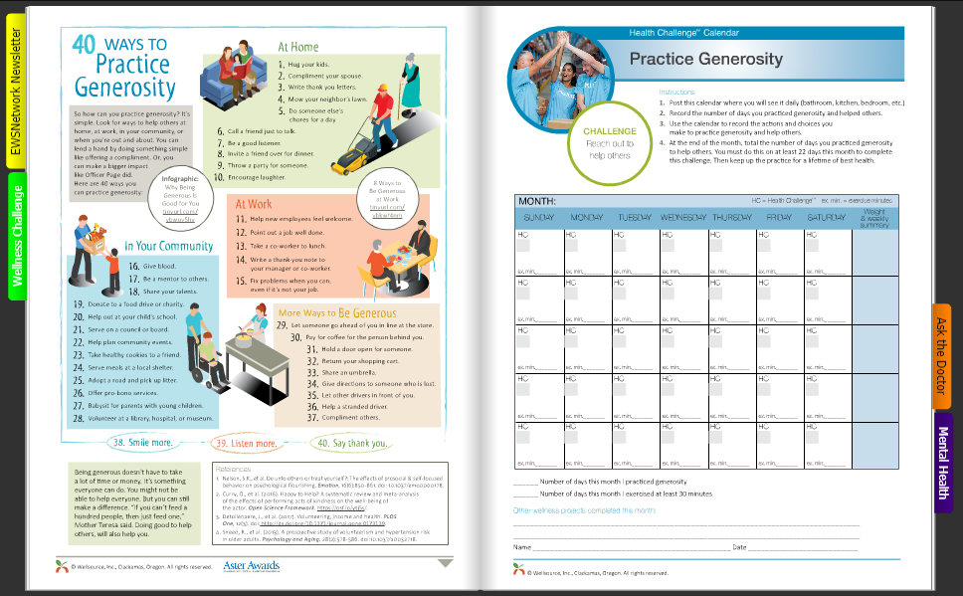

Slide 6
posters and e-campaigns
Heart Health
Stress
Weight Management
Nutrition
Mental Health

Slide 7
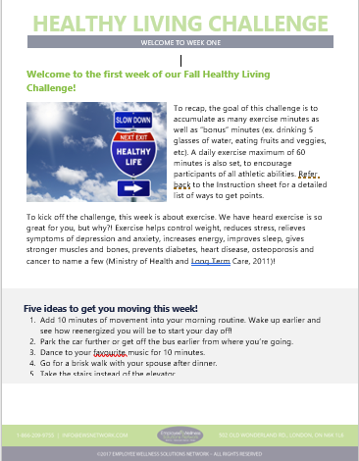
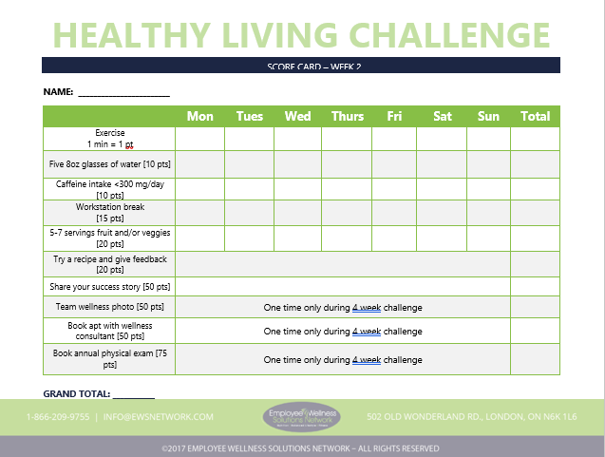
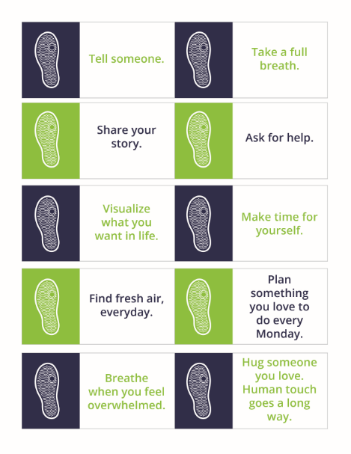
group challenges
Healthy Living Challenge
Stop the Silence Pedometer Challenge

Slide 8
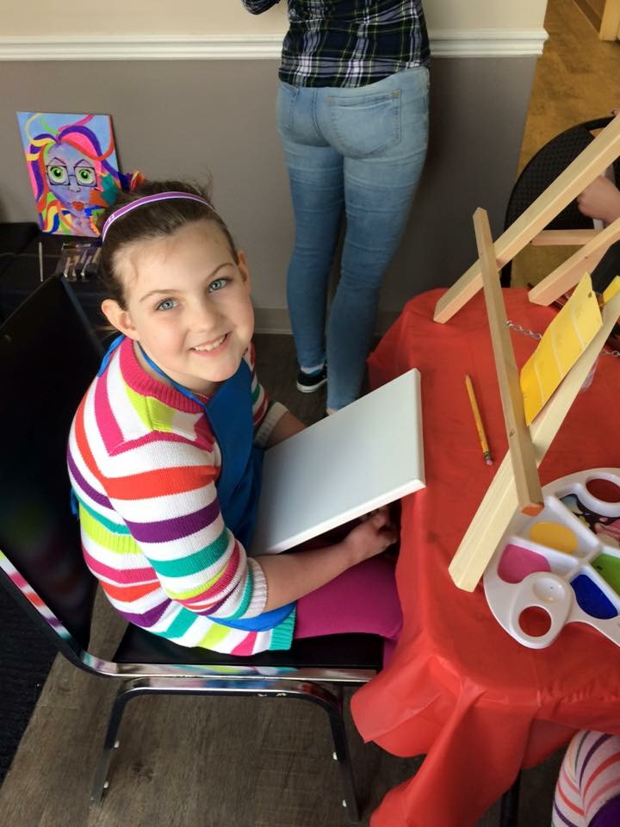
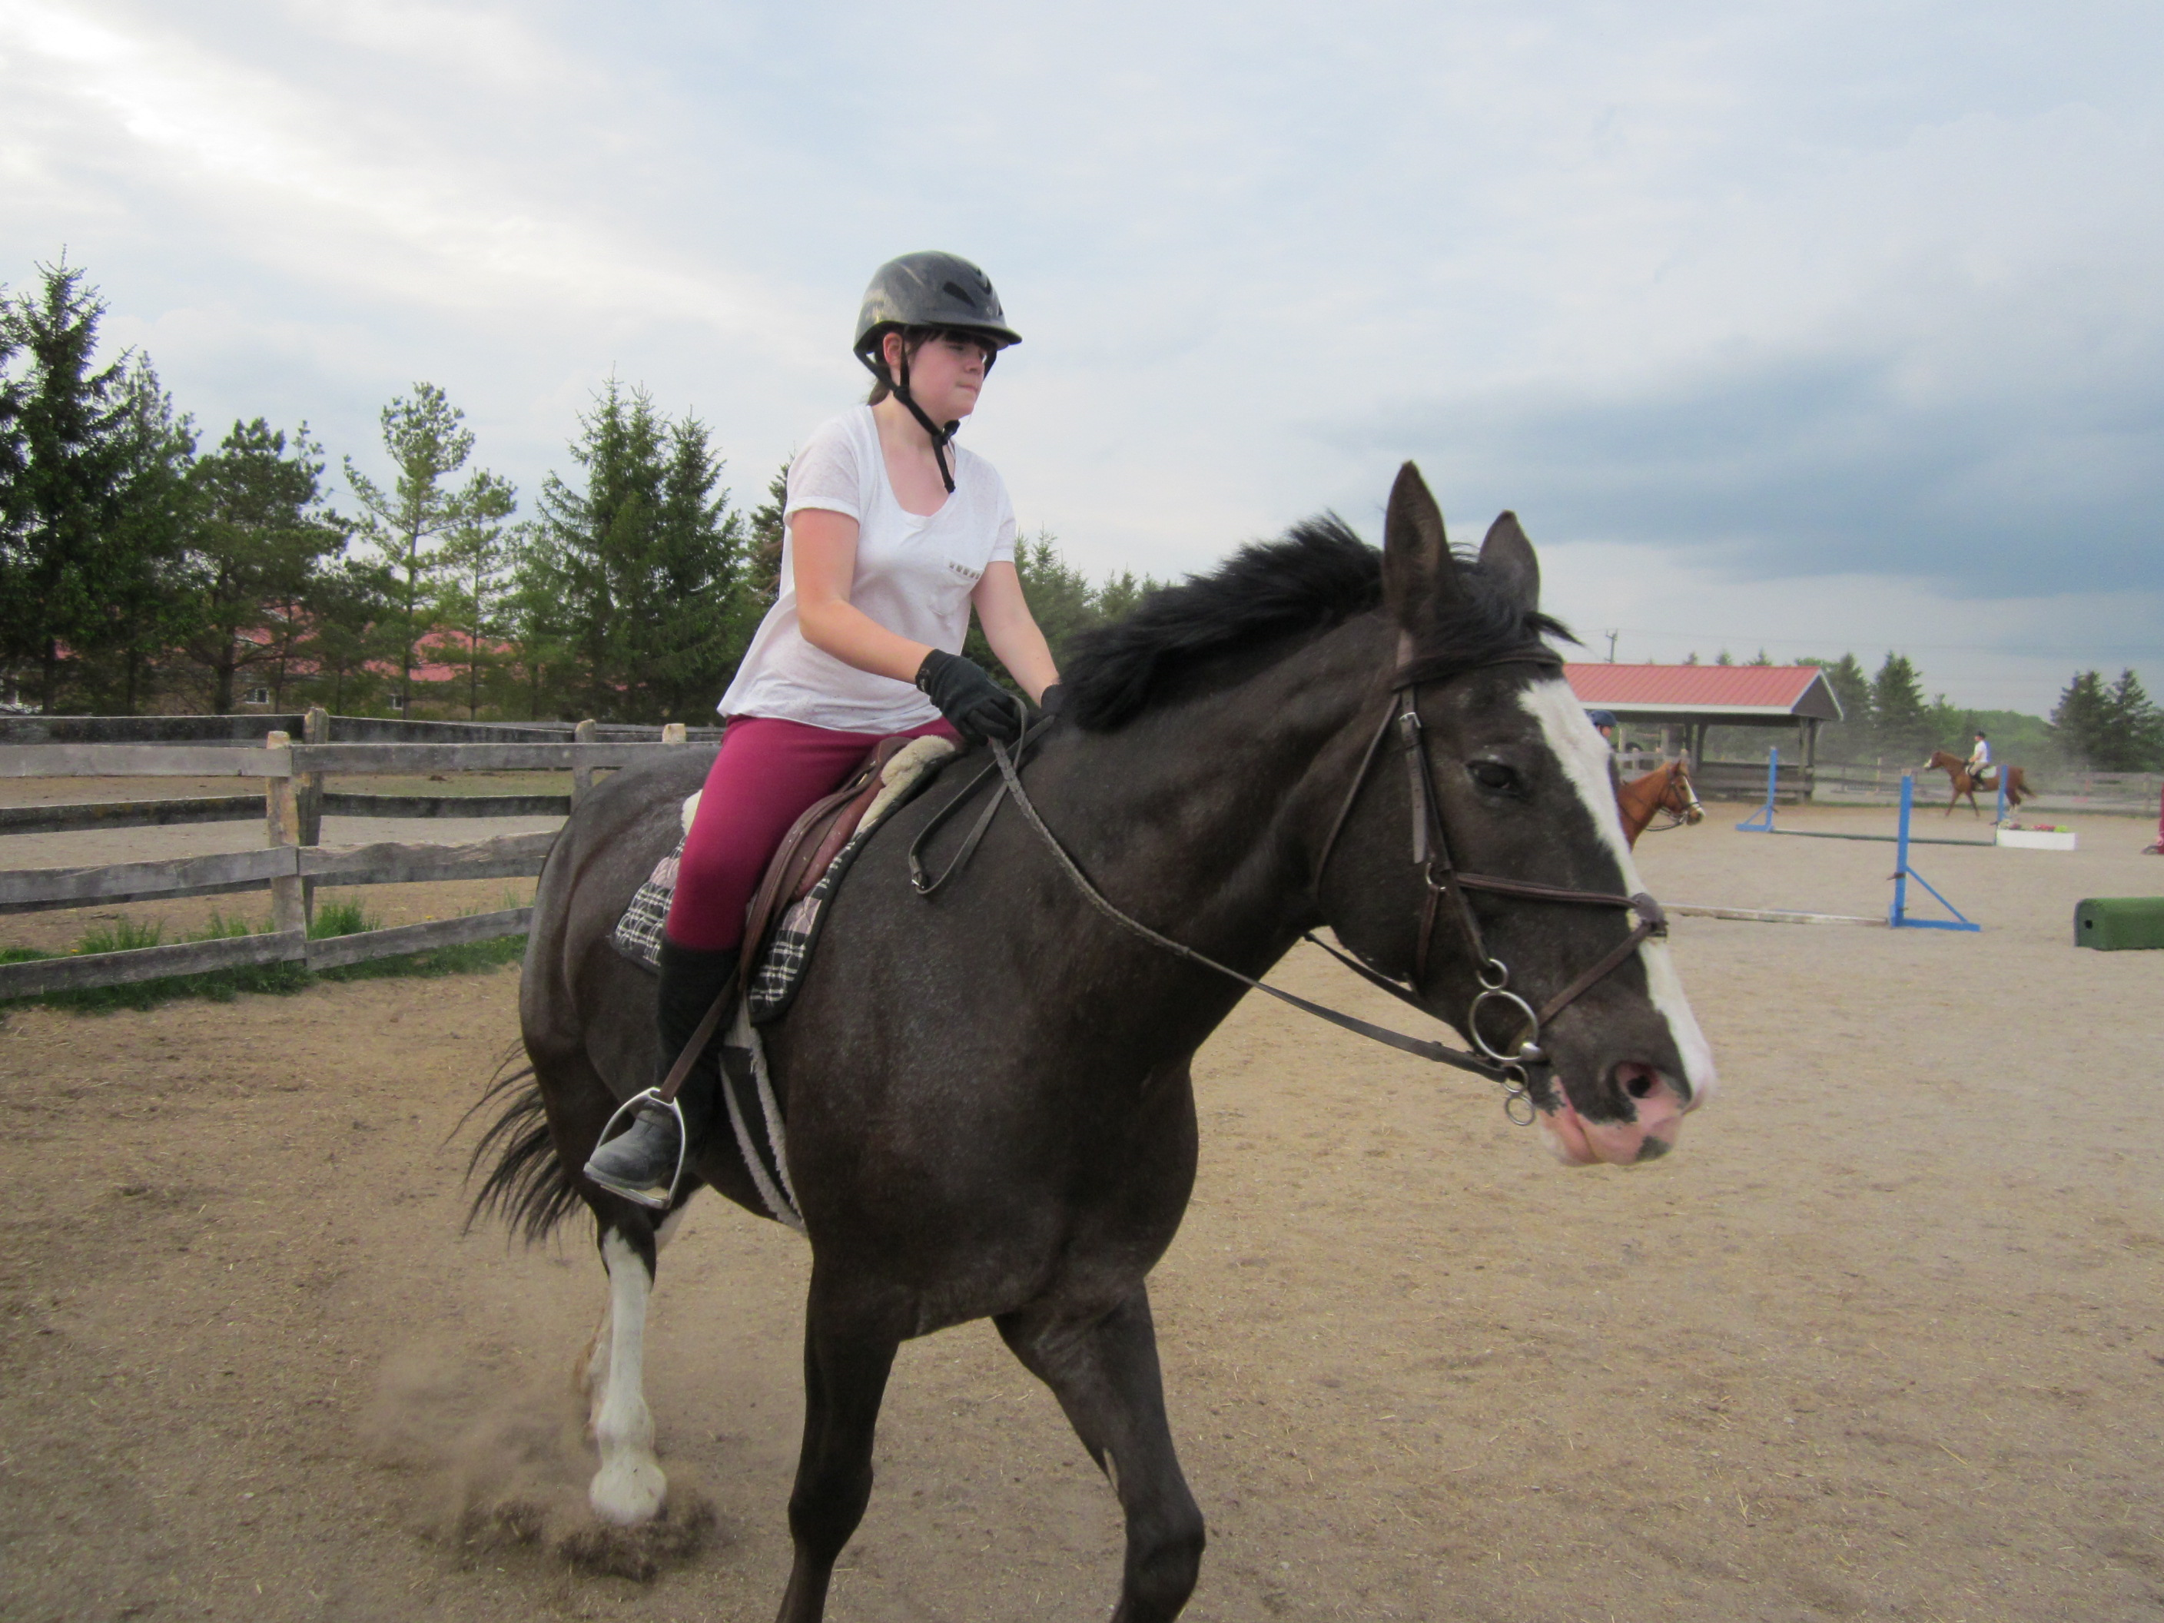
june 1 - july 31

Slide 9
family wellness webinar series
Notes:
Three topics per year – stay tuned for details for healthy workplace month this October

