Slide 1
corporate wellness membership
A starting point for any-sized organization!

Slide 2
great wellness programs
Supportive Leadership
Integrative and Strategic Planning
Promotion of Sustainable Behaviour Change

Slide 3
adult learning
What works?
Repetition
Bite-size messages
Meaningful to individual
Supportive environment

Slide 4
membership program components
Ongoing Strategy
Individual Programming
Awareness Programming
Team Building
Ongoing Support and Coaching

Slide 5
corporate wellness membership
silver membership
gold membership
platinum membership

Slide 6
Includes:
Wellness Strategy Call
Family Webinars
Monthly Newsletter
Individual Challenges
3 Poster Sets
3 E-Campaigns
5 EXTRA Credits
10% off Additional Credits
silver membership
$145/month

Slide 7
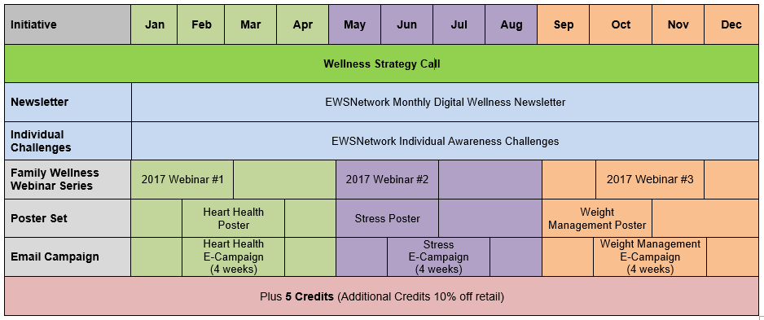
silver membership january to december 2017

Slide 8
Includes:
Wellness Strategy Call
Family Webinars
Monthly Newsletter
Individual Challenges
3 Poster Sets
3 E-Campaigns
2, 30-Day Team Challenges
Kids Wellness Bursary
15 EXTRA Credits
15% off Additional Credits
gold membership
$245/month

Slide 9
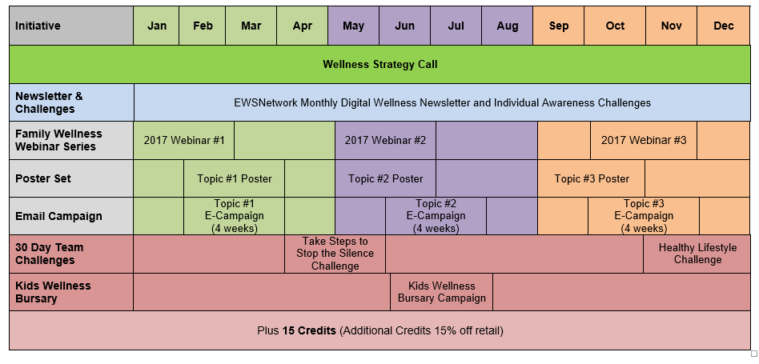
gold membership january to december 2017

Slide 10
Includes:
Wellness Strategy Call
Family Webinars
Monthly Newsletter
Individual Challenges
3 Poster Sets
3 E-Campaigns
2, 30-Day Team Challenges
Kids Wellness Bursary
6 Corporate Consulting Sessions
30 EXTRA Credits
20% off Additional Credits
platinum membership
$345/month

Slide 11
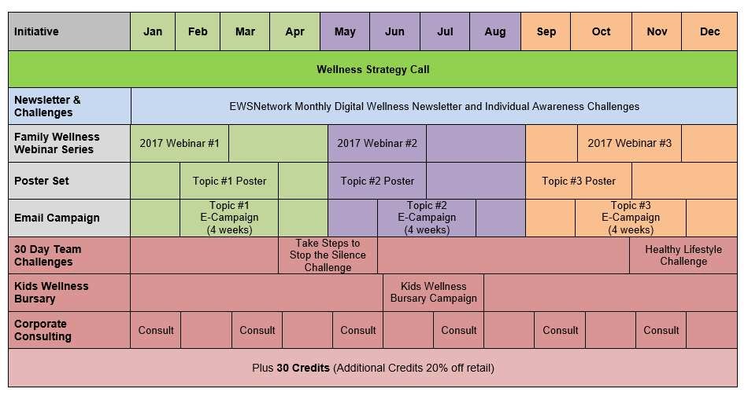
platinum membership january to december 2017

Slide 12
comprehensive membership
Additional Options:
Lunch ‘n Learns
Workshops
1-on-1 Coaching for Staff
Onsite Events
Group Exercise Classes
Health Fairs
Analysis
Reporting
Wellness Committee
… and more
Includes:
Wellness Strategy Call
Family Webinars
Monthly Newsletter
Individual Challenges
3 Poster Sets
3 E-Campaigns
2 30-Day Team Challenges
Kids Wellness Bursary
6 Corporate Consulting Sessions

Slide 13
comprehensive and strategic wellness program
Company ABC Jan-June At-A-Glance [subject to change as per wellness committee, needs and interests] HRA Focus [weight management, improved fitness, nutrition, heart health, stress]
Initiative | Jan | Feb | March | Apr | May | June
Consultations | One-on-One Consultations – on-site
Individual | NEW Virtual Online Profile, Wellness Tracking, Calendar of Events
HRA |  |  |  |  |  | HRA
Exercise Class/Series |  |  |  | Walking routes/groups; site specific Yoga/morning stretching
Lunch n’ Learns/Webinars | Healthy Weights | Healthy Weights | It’s In You to Move (coincide with site visit)
Workshop
Group Challenge [team] |  |  | Healthy Potluck |  | Pedometer Challenge
Virtual Challenge [team] | Portal and Challenge
Newsletter | Ongoing Monthly Newsletter and Personal Challenge
Kiosk / Poster Display | A Healthy Weight for You |  |  | It’s in You to MOVE
POD Posters | ongoing
BPOS Sleeve Posters | ongoing
Email/On-site/Pay-Stub Campaign | Healthy Weights | Healthy Weights |  | Taking Breaks | Step Into Summer
Walk Around |  | Healthy Snacking with almonds |  | Desk Stretches |  | PWP Instructions
Promo Day | Healthy Eating Yogurt Parfaits – month tba
Wellness Challenge [Individual] |  |  | Low GI Foods |  | Step Check IC
Virtual Challenge[individual] | Individual Challenge
Health Fair | Fall 2014
Corporate Reporting |  |  | Q1 Report |  |  | PWP & Q2 Report

Slide 14
how to use your credits
Program | Credits
Administrative Duties | 1/hr
Poster Sets (4 copies of 3) | 1
Corporate Consulting | 2/hr
E-campaigns | 2
Lunch 'n Learns & Workshops | 5
Group Exercise Classes (4sessions) | 5
½ Day Health Education Outreach Days | 5
½ Day One-on-one Coaching | 5
Program Launch/Orientation Session | 5
Reports | 5
Team Challenges | 10
Team Building Events | 15
Wellness Committee Certification | 15
Health Fair Organization | 20
Corporate Wellness Audit | Starts at 50

Slide 15
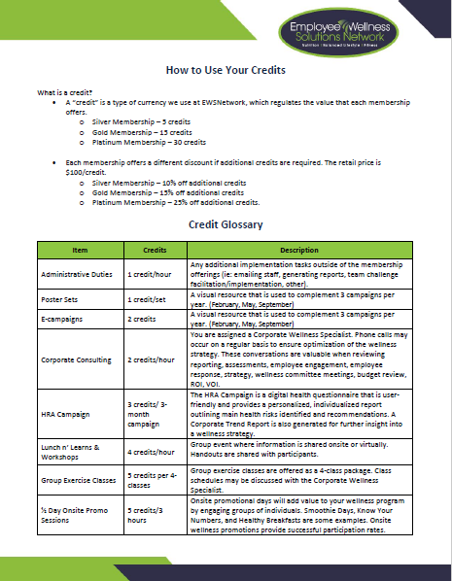
employer experience
Wellness Strategy Call
Alignment of Objectives
Strategic and Integrative Approach
Membership Guide

Slide 16
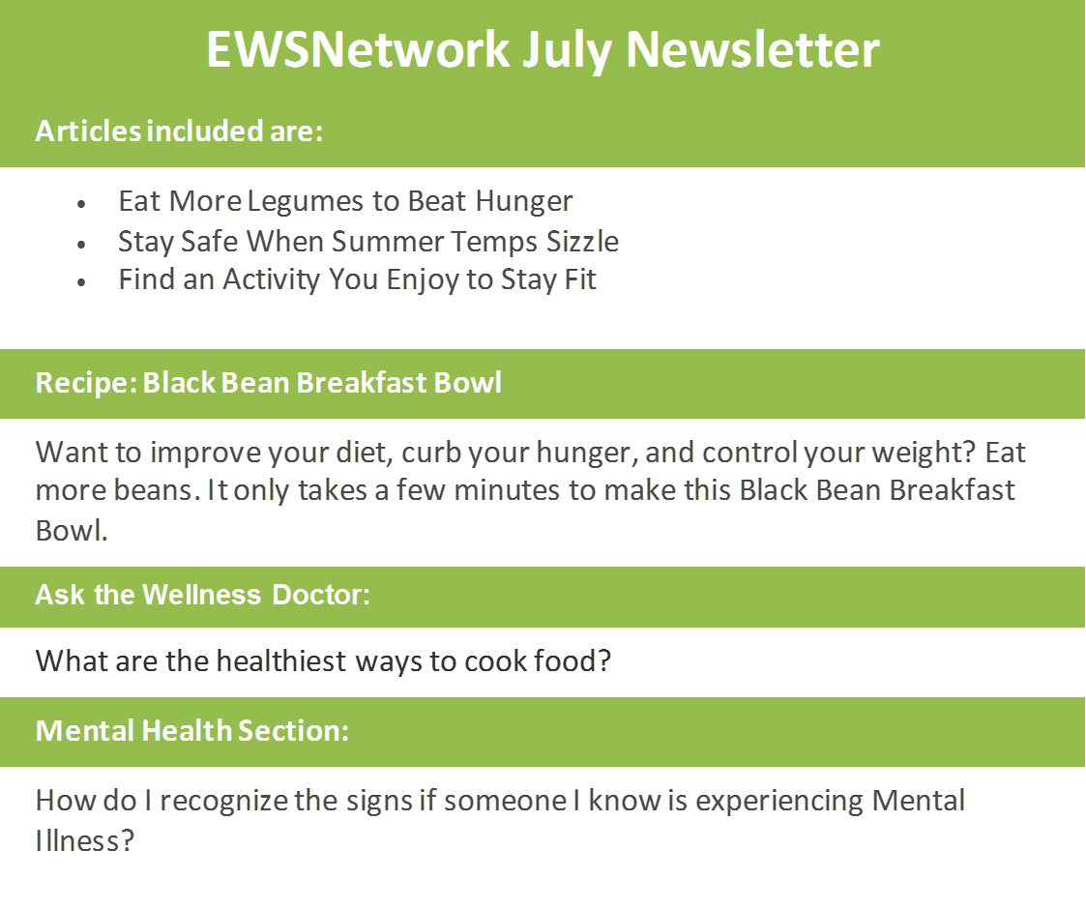
ewsnetwork newsletter and individual challenge

Slide 17
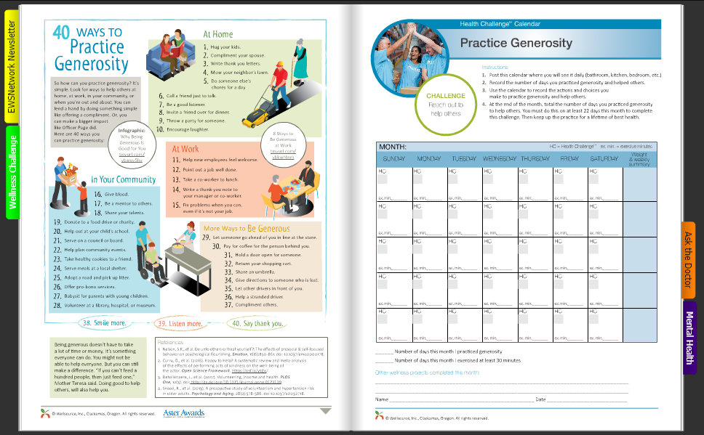

Slide 18
posters and e-campaigns
Heart Health
Stress
Weight Management
Nutrition
Mental Health

Slide 19
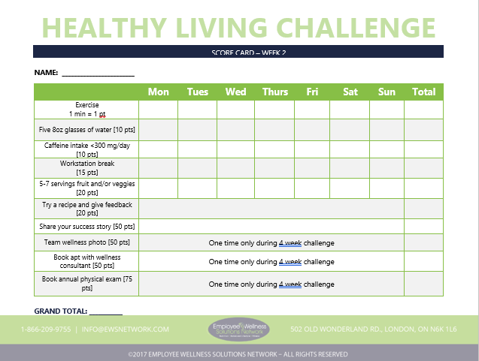
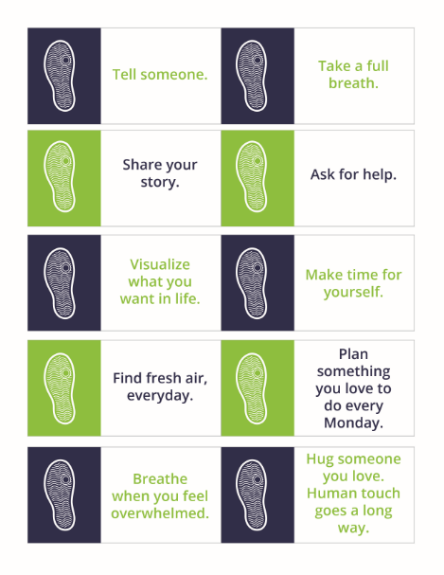
group challenges
Healthy Living Challenge
Stop the Silence Pedometer Challenge

Slide 20
$145/month
$245/month
$345/month
silver membership
gold membership
platinum membership
Includes:
Wellness Strategy Call
Family Webinars
Monthly Newsletter
Individual Challenges
3 Poster Sets
3 E-Campaigns
5 EXTRA Credits
10% off Additional Credits
Includes:
Wellness Strategy Call
Family Webinars
Monthly Newsletter
Individual Challenges
3 Poster Sets
3 E-Campaigns
2, 30-Day Team Challenges
Kids Wellness Bursary
15 EXTRA Credits
15% off Additional Credits
Includes:
Wellness Strategy Call
Family Webinars
Monthly Newsletter
Individual Challenges
3 Poster Sets
3 E-Campaigns
2, 30-Day Team Challenges
Kids Wellness Bursary
6 Corporate Consulting Sessions
30 EXTRA Credits
20% off Additional Credits

Slide 21
client experience
CAA Atlantic’s Wellness Program provided by Employee Wellness Solutions Network is an invaluable component of our commitment to the well-being of our staff.
- Morag Duncan, HR Manager
Since we introduced the EWSNetwork Wellness Program, wellness has become part of the culture at Libro. Staff are more aware of the importance of living a healthy lifestyle.
- Steve Bolton, CEO
The success of the TRW wellness program is due to EWSNetwork being able to listen to our employees and senior management team, identify priorities, consider alternatives, and provide suggestions and solutions. The leadership role they take with our program makes it easier for us to achieve our goals.
- Mark Hammond, H&S Manager

