Slide 1
Look at the Salt

Slide 2
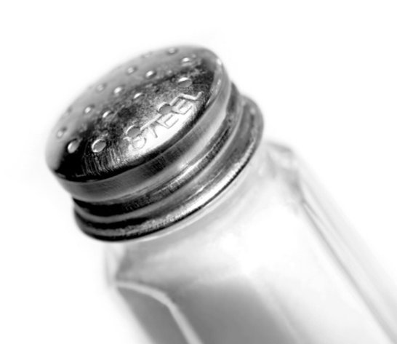
The average Canadian is eating 1000 mg over the advised daily intake of sodium.

Slide 3
What can we do about it? EWSNetwork will show you how. We created an easy to use tracking sheet to make sure you’re on the right path.

Slide 4
Where: When: How to Sign Up: For More Info, Contact ______
For More Information,
Hope You Can Join Us!

