Slide 1
Look at the sugar

Slide 2
“The Canadian Diabetes Association recommends Canadians limit intake of free sugars to less than 10% of total daily calorie intake. This is approximately 50g (12 teaspoons) of free sugars consumption per day based on a 2000-calorie diet.”
Notes:
“The Canadian Diabetes Association recommends Canadians limit intake of free sugars to less than 10% of total daily calorie intake. This is approximately 50g (12 teaspoons) of free sugars consumption per day based on a 2000-calorie diet.” – Canadian Diabetes Association

Slide 3
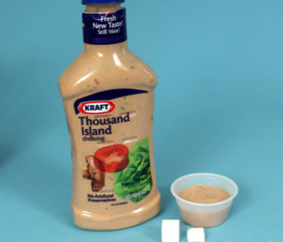
Sugar is hidden in all of your favourite foods.
Be SMART and know the different names for sugar.
Notes:
Picture from sugarstacks.com

Slide 4
Ever had these sugary questions?
What are the effects of sugar?
What are some symptoms of sugar intoxication?
What are some practical ways to decrease sugar in my diet?
What happens to my body when I decrease sugar in my diet?
How can I substitute sugar for other alternatives?

Slide 5
“Look At The Sugar” Come join us for a fun Wellness Q & A!

