Slide 1

CRAPPY TO HAPPY

Slide 2

Exercise is crucial to your mental health
It can be very challenging to see exercise as a priority, especially when we are feeling stressed, depressed and anxious.
But that is exactly when we need it the most!
“Exercise is often-neglected intervention in mental health care”
Notes:
Already know there are PHYSICAL health benefits of exercise, but there are also MENTAL health benefits too
McLafferty C, Wetzstein C, Hunter G. Resistance training is associated with improved mood in healthy older adults. Percept Mot Skills 2004; 93(3):947–957
24 week resistance training program for older adults
Found that there were significant reductions in confusion, anger, and tension
Janisse H, Nedd D, Escamilla S, Nies M. Physical activity, social support, and family structure as determinants of mood among European-American and African-American women. Women Health 2004; 39(1):101–116
Walking program for women
found that physical activity is associated with a positive mood

Slide 3
Linking Exercise to Mental Health
Improved sleep
Better endurance
Reduced cholesterol
Weight loss
Improved cardiovascular fitness
____________________________________
Improvement in mood
Increased alertness and energy
Higher self-esteem
Less stressed
More self-confidence
Reduced anxiety
“Exercise is often-neglected intervention in mental health care”
Notes:
Already know there are PHYSICAL health benefits of exercise, but there are also MENTAL health benefits too
McLafferty C, Wetzstein C, Hunter G. Resistance training is associated with improved mood in healthy older adults. Percept Mot Skills 2004; 93(3):947–957
24 week resistance training program for older adults
Found that there were significant reductions in confusion, anger, and tension
Janisse H, Nedd D, Escamilla S, Nies M. Physical activity, social support, and family structure as determinants of mood among European-American and African-American women. Women Health 2004; 39(1):101–116
Walking program for women
found that physical activity is associated with a positive mood

Slide 4

Cognitive Function
Physical activity is associated with lower rates of cognitive decline regardless of age
Helps working memory
Faster reaction times
Better ability to multitask
Notes:
The JAMA Network Journals. (2015, August 25). Effect of physical activity on cognition. ScienceDaily. Retrieved September 5, 2016 from www.sciencedaily.com/releases/2015/08/150825115022.htm
Exercise improved cerebral blood flow, neuronal connectivity, and maintains/improves brain volume to allow better cognitive functioning
Tomporowski PD. Effects of acute bouts of exercise on cognition. Acta Psychologica. 2003;112:297–324. doi: 10.1016/S0001-6918(02)00134-8.
Reviewed 43 studies, bouts of exercise improved cognitive functioning in simple reaction time tasks, response inhibition, and creative thinking
Colcombe SJ, Kramer AF. Fitness effects on the cognitive function of older adults: A meta-analytic study. Psychological Science. 2003;14:125–130. doi: 10.1111/1467-9280.t01-1-01430
Improves working memory, able to inhibit processes better and multitask
http://www.alcoa.ca/research_u_docs/2006_04apr_en_update.pdf
Review of intervention studies with adults aged 55-80 performed better on their cognitive task with exercise
Improved @
Tasks requiring speed
Remembering and redrawing a picture
Responding to certain cues and suppressing others

Slide 5
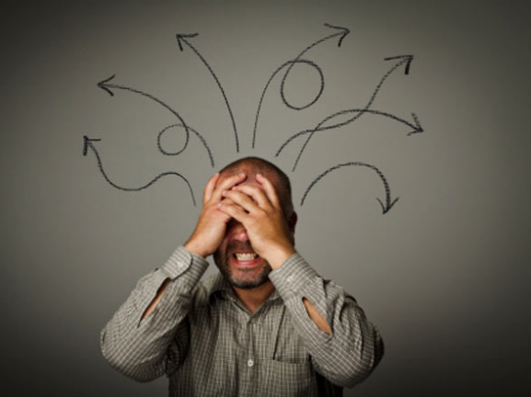
Hormones: Stress
  Because adrenaline initiates the “fight or flight” response, regular exercise allows adrenaline levels to be lowered at rest, as well as the immediate relief felt during cardiovascular exercise.
  The same is true for cortisol, the “stress hormone”.
Notes:
Adrenaline
Heightens up your senses
Increases your heart rate, breathe faster, sweat more, surge of energy, ability to feel pain decreases
Breakdown of sugar and fat
Blood vessels redirect blood towards major muscle groups
Cortisol
too much cortisol can suppress the immune system, increase blood pressure and sugar, contribute to obesity, impair cognitive functioning
Both of these hormones spike up temporarily during exercise, but they return back to normal after your workout – these levels will be lowered if exercise regularly, leading to reduction in symptoms of stress
“The Internet Journal of Allied Health Sciences and Practice reports that aerobic exercise seems to have the greatest effect on reducing cortisol levels.”

Slide 6


Hormones: Mood
Get your DOSE
Dopamine – “reward” drug
Oxytocin – “love hormone”
Serotonin – “happy molecule”
Endorphins – “runner’s high”
Notes:
dopamine: motivates us to take actions towards goals and desires and needs
“reward” drug
Released during pleasurable situations
If low levels: procrastination, self-doubt, lack of enthusiasm
Exercise increases dopamine production
Endorphins: elevated during exercises
Feel the “runner’s high”
Positive mood state and feel calm after exercising
Serotonin: affects our mood, memory and learning, some social behaviour
Sometimes called the “happy molecule”
When low levels of serotonin, may feel lonely and depressed
Exercises increases your brains ability to take up serotonin
Oxytocin: linked to intimacy, trust, and builds healthy relationships
Increases during exercise

Slide 7

Social Support
Exercising especially at a community centre or at a gym is a great way to connect with others.
Notes:
Exercise can alleviate symptoms of social withdrawal
Opportunity for social interaction and social support
Surrounding yourself with people with similar goals
Gain a sense of meaning, purpose, and achievement
Mutual support you can get while doing a challenging activity or trying something new
Janisse H, Nedd D, Escamilla S, Nies M. Physical activity, social support, and family structure as determinants of mood among European-American and African-American women. Women Health 2004; 39(1):101–116
- Not only did the walking program show how physical activity is associated with a positive mood, but they also found greater support

Slide 8

Find out for Yourself!
Experiment Guidelines
Talk to Jen to get your individual exercise guidelines.
Make an absolute commitment to workout 5 out of 7 days for weeks and track your mood.
Determine for yourself if exercise is a friend or foe.
Notes:
http://www.helpguide.org/articles/exercise-fitness/emotional-benefits-of-exercise.htm#started
Schedule your workout during the time when your energy is highest
As you move, greater sense of control over your well-being
Focus on activities you enjoy – window shop, throwing a frisbee with dog, gardening, home improvement project
Reward yourself – bubble bath, smoothie
Make exercise a social activity

