Slide 1
Self-Massage Myofascial Release

Slide 2
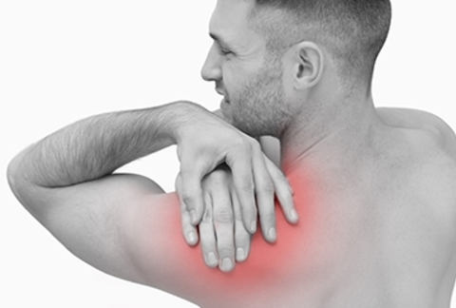
Do you have tight areas of your body? How do you relieve the tension of your body? What are muscle knots?

Slide 3
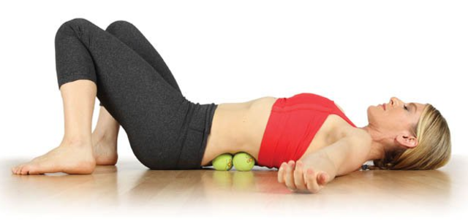
Come for an interactive session with our coaches to learn how to decrease any pressure you may be feeling. Let’s work toward having optimal health!

Slide 4
This session is on _________________.
Sign up at _____________
Contact ___________ for more information.
www.ewsnetwork.com

