Slide 1
Know Your Limits: De-Stress By Goal-Setting

Slide 2
Do you feel like you need to organize your goals? Are you feeling a little scattered?

Slide 3
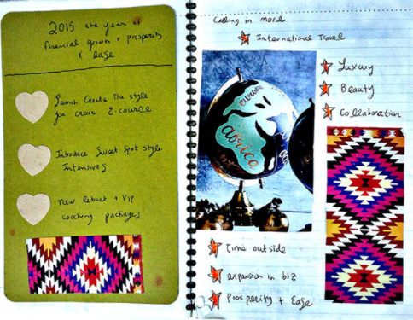
Come for an interactive session with our coaches to learn how to make a Vision Book! Let’s work toward being the joyful people are meant to be!

Slide 4
This session is on _____ Sign up at ____ Contact ___ for more information.
Hope To See You There!

