Slide 1
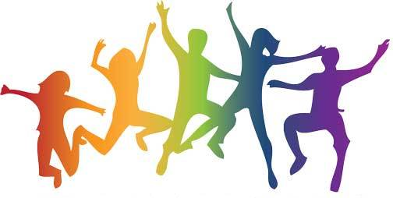
Fitness Jeopardy
How many can you answer correctly?

Slide 2
Rules
2 people face off
Coach gives the answer. Those playing race to respond in the form of a question.
When one has the answer, he/she grabs a piece or fruit or other “healthy item” that is in between them to indicate they have an answer!

Slide 3
Round 1

Slide 4
1. This is one benefit of flexibility.

Slide 5
2. This form of exercise requires muscular endurance.

Slide 6
3. Effectively changing direction of body position.

Slide 7
4. Adults aged 18-64 should be active for this many minutes in one week.

Slide 8
5. This is an example of moderate-intensity physical activity.

Slide 9
6. Being active for at least 150 minutes per week can reduce the risk of these things.

Slide 10
7. kg/height in cm squared

Slide 11
8. This is one exercise to improve your cardiovascular endurance.

Slide 12
9. When this chemical is released, it triggers a positive feeling as you exercise.

Slide 13
10. This is one of the top 5 strongest muscles in your body.

Slide 14
Round 2

Slide 15
1. This is the number of muscles we have in our body.

Slide 16
2. This muscle is only attached at one end.

Slide 17
3. This is the normal range for blood pressure.

Slide 18
4. This is how many calories you need to burn to lose 1 pound of fat.

Slide 19
5. These are the three types of skeletal muscle fibers.

Slide 20
6. For the first 15 minutes of exercise, your body burns mainly this type of nutrient.

Slide 21
7. These are 2 brain benefits of exercise.

Slide 22
8. These are two roles fat plays in our health.

Slide 23
9. An active lifestyle can reduce this disease, which is caused by a loss of bone density.

Slide 24
10. This acronym is used for goal setting.

Slide 25
END

