Slide 1
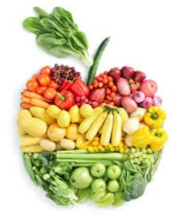
Nutrition Jeopardy
How many can you answer correctly?

Slide 2
Rules
2 people face off
Coach gives the answer. Race to respond in the form of a question!
When you have the answer, grab a piece of fruit or other “healthy item” that is in between you to indicate you have an answer.

Slide 3
Round 1

Slide 4
1. This drink has been shown to sharpen your concentration, improve your memory, and reduce the effects of stress.

Slide 5
2. This is one source of protein often consumed by vegetarians.

Slide 6
3. Adults (aged 19-50) should have this many servings of fruits and vegetables in a day.

Slide 7
4. Fatty fish is a good source of this type of fat.

Slide 8
5. A deck of cards is considered the serving size for which food in this protein group.

Slide 9
6. This is an alternative name for “bad” cholesterol.

Slide 10
7. This is one sugar substitute you can use.

Slide 11
8. Eggs belong to this food group.

Slide 12
9. This vitamin is important for healthy eye care.

Slide 13
10. This vegetable is used to make pickles.

Slide 14
Round 2

Slide 15
1. Spinach and liver provide a good source of this mineral.

Slide 16
2. This type of fat is produced by a process called hydrogenation and is associated with increased risk of heart disease.

Slide 17
3. This is one health benefit of eating fruits and vegetables.

Slide 18
4. These are five items you would find on a "Nutrition Facts" label.

Slide 19
5. This vitamin helps with blood clotting.

Slide 20
6. Red meat is rich in iron. When too little is consumed, it can lead to this.

Slide 21
7. Adequate calcium intake helps prevent this disease of weakened bones.

Slide 22
8. Peanut butter belongs to this food group.

Slide 23
9. These are 4 ways to eat eggs.

Slide 24
10. This is a healthier alternative to french fries.

Slide 25
END

