Slide 1
Healthy Retirement
Module #5: mental and emotional health

Slide 2
Module #5: Mental and Emotional Health
Setting the Facts Straight! (Canadian Coalition for Seniors’ Mental Health, 2009)
Mental health is the capacity of each person to feel, think and act in ways that allow them to enjoy life and deal with all the challenges they face.
Mental health problems are NOT a normal part of aging. Difficulties with mood, thinking and behaviour are not an inevitable part of aging. Nor are they signs of personal weakness. They may be signs that something is wrong that requires attention from a health care professional.
Mental and emotional health can be promoted and improved at all stages of life – even if someone currently lives with a mental health problem or illness.
Notes:
Canadian Coalition for Seniors’ Mental Health. (2009). Depression in older adults: A guide for seniors and their
families. Retrieved from www.ccsmh.ca/

Slide 3
Mental Disorders
Dementia
What is it? The loss of intellectual abilities that is severe enough to interfere with a person’s ability to function. It results in the way a person thinks, feels, and behaves, as well as memory impairment. It tends to develop slowly over a period of months of years. Alzheimer’s disease is an example of dementia.
Depression
What is it? Depression is more than feeling the “blues.” It can be feelings of sadness, hopelessness, and a loss of interest or pleasure in things you usually like to do. You might be worried about depression if you’ve felt this way for a couple weeks or longer.
Depression is the most common mental health problem in older adults. Symptoms can be successfully treated in almost all cases!
Notes:
Mental Disorders (Canadian Coalition for Seniors’ Mental Health, 2009)
Over 20% of adults aged 60 and over suffer from a mental or neurological disorder and 6.6% of all disability among over 60s is due to neurological and mental disorders. The most common neuropsychiatric disorders in this age group are dementia and depression (WHO, 2013).
- Although depression can be quite common in later life, depression is not a typical part of aging.

Slide 4
Depression: Risk Factors
History of depression
Biological relatives have depression
Female
Widowed or divorced
Changes in the brain resulting from stroke, Parkinson’s disease, or Alzheimer’s disease
Trouble developing close relationships or having low self esteem
Certain medications
Drinking too much alcohol or abusing drugs
Illnesses that last a longtime and cause pain and disability
Sleep problems that last a long time
Weak social network
Taking care of a family member who has a serious illness such as dementia
Notes:
Risk Factors
**Even if you have some or many of these risk factors, it does not mean you are depressed or will experience depression in the future. **

Slide 5
Depression: Symptoms
Feeling sad
No interest or pleasure from the things you used to enjoy
Less energy and feeling tired
Not feeling well, having aches and pains
Feeling guilty or worthless
Difficulties thinking and concentrating
Problems sleeping
Changes in appetite and weight
Feeling agitated, restless, and/or sluggish
Thoughts of suicide or death
Depression is not caused by personal weakness. It’s a medical illness that can be treated.
Notes:
Depression does not get better on its own. If you have experienced many of these symptoms for a long time, talk to a health care provider.
Noticing symptoms of depression?
If you think you are depressed, get help from a health care provider. Depression is an illness like any other so it’s okay to be as open and honest as possible. You may feel uneasy but this is an important step in getting the help you need to feel better. You are not alone.
A final note on depression. People with depression CAN get better. More than 80% of older adults with depression can be treated successfully when treated quickly and properly.

Slide 6
Alzheimer’s Disease: Risk Factors
Age: While 6 to 8% of adults 65 and older have Alzheimer’s disease, nearly 30% of 85 year olds do.
Family history: About half of those who have a parent or sibling with Alzheimer’s develop the disease by age 90.
Depression
Downs syndrome
Serious head injury
Fewer years of formal education
Delirium
Notes:
Health in Aging. (2013). Dementia. Retrieved from http://www.healthinaging.org/

Slide 7
Alzheimer’s and Vascular Disease: Symptoms
Increasing confusion and growing difficulty with:
Remembering
Paying attention
Recognizing objects
Using and understanding language
Making decisions, planning, and getting organized
Finding their way from one once-familiar place to another
Walking – people with dementia have a high risk of falls
Carrying out daily tasks such as shopping, cooking, taking medications, dressing, bathing, and, eventually, eating
Controlling their bowels and bladder
Also “behavioral symptoms of dementia,” if they:
Show changes in mood, becoming more agitated, anxious, or depressed
Seem drained of energy, or as though they don’t care
More aggressive (cursing, spitting, physical attacks) or behaving inappropriately
Wander
Have hallucinations (seeing or hearing things that aren’t there) or delusions (false beliefs, such as the belief that a family member, friend or caregiver is trying to hurt them)
Notes:
Health in Aging. (2013). Dementia. Retrieved from http://www.healthinaging.org/

Slide 8
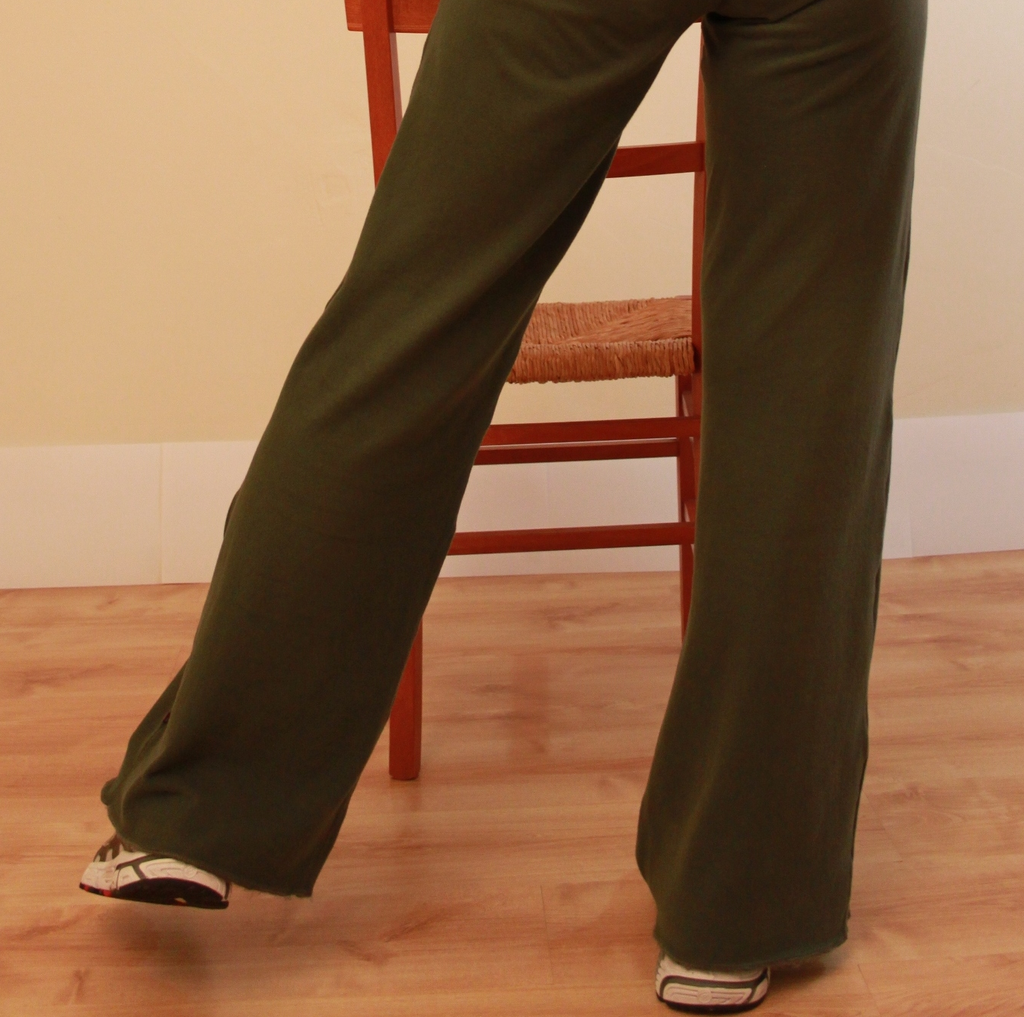
Daily Dose: Alternating Side-Leg Lift
Complete these leg lifts in the bathroom when brushing your teeth.
Tuck in your pelvis and tighten your stomach muscles (like when coughing). Stand tall with your legs apart and knees slightly bent. You can hold counter for support.
Moving from the hip, lift your right leg out to the side with controlled speed. Slowly bring the leg back to starting position.
Repeat on other leg 10x.
**contact your EWSNetwork wellness coach to help you with proper technique. Contact your doctor for further direction on exercise.

