Slide 1
Healthy Retirement
Module #4: physical activity

Slide 2
Module #4: Physical Activity
Make physical activity a part of your daily routine. Start by doing more of what you are already doing.
1. Walk whenever you can.
2. Get a good pair of shoes for walking.
3. Start slow and build up gradually.
4. Short, 10-minute bouts of activity all add up.
5. Build up to a total of 150 minutes of moderate to vigorous intensity aerobic activity per week.

Slide 3
Tips for Success
Active time can be social time – look for group activities or things in the community
Walking can be done anywhere, anytime, without special equipment
Find an activity you like and keep doing it
Increase your activity level 10 minutes at a time
Carry your groceries home
Find an activity that will keep you active even when the weather is bad
Take the stairs instead of the elevator

Slide 4
Canada’s Physical Activity Guideline for Older Adults
Take part in at least 2.5 hours of moderate-vigorous intensity aerobic activity per week.
Spread out activities into sessions of 10 minutes or more.
Add muscle and bone strengthening activities using major muscle groups at least twice a week.
Did you know?
Research has shown that a loss of about 5% of excess body weight can reduce the risk of developing type II diabetes by almost 60%.
Notes:
Public Health Agency of Canada. (2012). Physical activity tips for older adults (65 years and older). Retrieved from http://www.phac-aspc.gc.ca/

Slide 5
Moderate Aerobic Activity Are you breathing harder? Is your heart beating faster? Can you talk but not sing? | Vigorous Aerobic Activity Is your heart rate much faster? Are you unable to say more than a few words without needing to catch your breath? | Strengthening Activity Are you doing push and pull movements that involve your muscles?
Examples brisk walking bike riding mowing the lawn | Examples taking a dance class jogging cross country skiing | Examples lifting weights yoga climbing stairs digging in the garden push ups, curl ups
Notes:
Public Health Agency of Canada. (2012). Physical activity tips for older adults (65 years and older). Retrieved from http://www.phac-aspc.gc.ca/

Slide 6
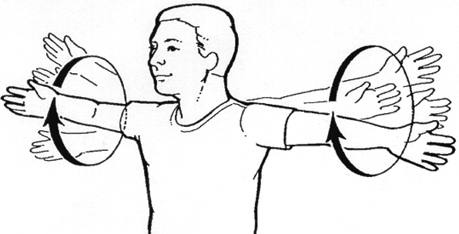
Daily Dose: Tight Grip Shoulder Circle
Complete these curls in the bedroom when getting dressed.
Standing tall, raise both arms to shoulder height, making a tight fist with each hand.
Do 10 large circles with your arms moving forward, then 10 circles going backwards. Don’t forget to breathe!
Repeat the exercise 3-5x per day.
**contact your EWSNetwork wellness coach to help you with proper technique. Contact your doctor for further direction on exercise.
Notes:
Beattie-Huggan, P., MacDougall, S., Sajdak, L., & Smith, N. (2013). Leader’s tool kit for healthy living workshops for older adults. Retrieved from http://www.alcoa.ca/

