Slide 1
Healthy Retirement
Module #2: fall prevention

Slide 2
Module #2: Fall Prevention
Fall Facts in Canada (Public Health Agency of Canada, 2011)
Fact: 1 in 3 seniors will experience a fall each year, and half of those more than once.
Fact: 40% of seniors' falls result in hip fractures.
Fact: 20% of injury-related deaths among seniors can be traced back to a fall.
Fact: Seniors are injured at home more than any other location. The bathroom and stairs are particularly dangerous.
Notes:
Public Health Agency of Canada. (2011). You CAN prevent falls! Retrieved from http://www.phac-aspc.gc.ca/

Slide 3
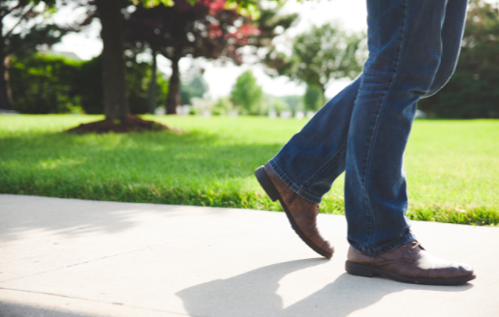
Risk Factors
Muscle weakness especially in the leg
Balance and gait (how you walk)
Slower reflexes
Wearing unsafe footwear
Sensory problems
Poorer vision
Poorer hearing
Taking many kinds of medication
Blood pressure that drops too much when getting up from lying down
Notes:
Muscle weakness especially in the leg: One of the most important risk factors! Those with weak muscles are more likely to fall than those with good muscular strength.
Balance and gait (how you walk): Poorer balance and difficulty walking increases the chances of you falling.
Slower reflexes: As you age, our reflexes slow down and this makes it harder to catch your balance if you start to fall.
Wearing unsafe footwear: Ex. Backless shoes and slippers, high heels, shoes with smooth leather soles
Sensory problems: Your senses may not be as sharp. Biggest example is numbness in your feet may mean you don’t sense when you are stepping.
Poorer vision
Poorer hearing
Taking many kinds of medication: People who take four or more prescription drugs have a greater risk of falling than do people who take fewer drugs. You should check with your doctor if you think your medications are causing dizziness or unsteadiness.
Blood pressure that drops too much when getting up from lying down. Also known as postural hypotension that may result from dehydration, medications, diabetes or Parkinson’s disease.

Slide 4
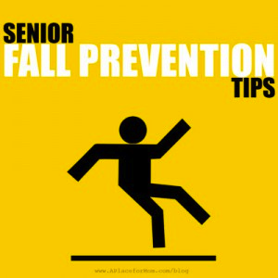
Preventing Falls
Bathroom
Non-slip surfaces in tub/shower
Install grab bars by toilet and bath
Raised toilet seat and bath seat in shower
Wipe up moisture or spills immediately
Kitchen
Store kitchen supplies in easy-to-reach locations
Store heavy items in lower cupboards
Use stable step stool with a safety rail
Wipe up spills immediately
Ask for help with tasks that you feel you can’t do safely
Living Room & Bedroom
Reduce clutter
Cordless phone to avoid rushing to answer
Good lighting in house and install night lights
Move slowly out of your bed or chair
Stairs
Make sure stairs are well lit
Have solid handrails
Remove reading glasses when you go up or down the stairs
Never rush when you’re on the stairs
Exterior
Keep front entrance well lit
Keep front steps and walkway in good repair and free of snow, ice, & leaves
Put gardening implements like hoses and rakes away when not in use

Slide 5
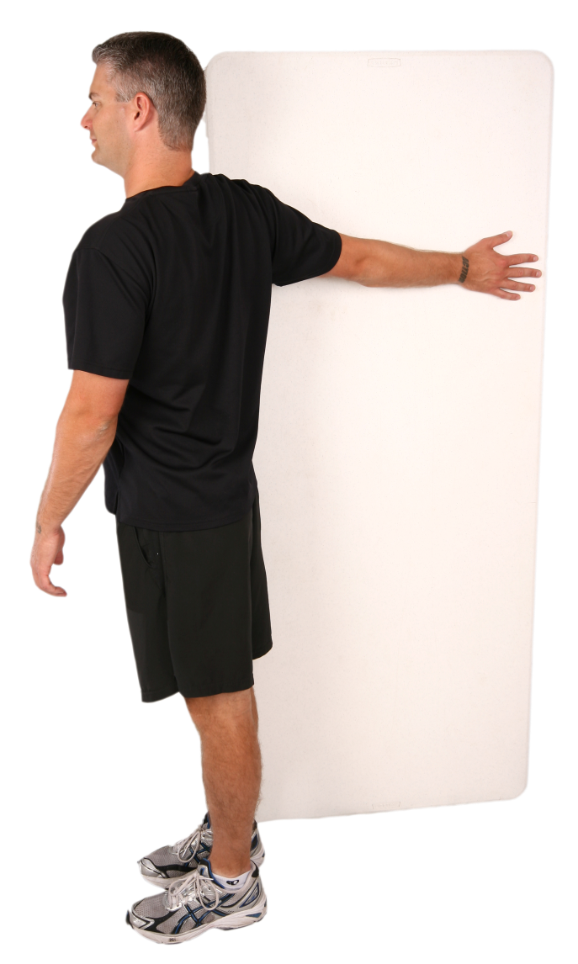
Daily Dose: Single Arm Wall Stretch
Try these stretches in the bedroom when getting dressed.
With a straight arm, put your right hand on the wall at shoulder height.
Slowly turn your body away from the wall to gently stretch the chest.
Hold for 15 seconds. Alternate arms, to complete one set.
Complete 3-5 sets per day.
****contact your EWSNetwork wellness coach to help you with proper technique. Contact your doctor for further direction on exercise.

