Slide 1
Look at My Lunch
www.EWSNetwork.com

Slide 2
Think you can bring the healthiest lunch?
We’re challenging you to bring the healthiest lunch you can!
Our consultants will give you points based on:
Appropriate food groups represented
Portion size
Creativity
Will you be the winner?

Slide 3
Recommended Number of Food Guide Servings Per Day
 | Adults
 | 19-50 Years |  | 51+ Years
 | Female | Male | Female | Male
Vegetables and Fruit | 7-8 | 8-10 | 7 | 7
Grain Products | 6-7 | 8 | 6 | 7
Milk and Alternatives | 2 | 2 | 3 | 3
Meat and Alternatives | 2 | 3 | 2 | 3
Notes:
http://www.hc-sc.gc.ca/fn-an/food-guide-aliment/basics-base/quantit-eng.php

Slide 4
Notes:
Picture from: https://isolatorfitness.com/all-about-meal-prep

Slide 5
Here are a few ideas
Protein: chicken, turkey, tofu, fish, chili soup, hard-boiled eggs, greek yogurt
Carbs: whole-grain, whole wheat pasta, brown rice, quinoa, sweet potato
Veggies: salad, broccoli, carrots, celery, cucumber, asparagus
Snacks: raw almonds, homemade trail mix, fruits, carrots and hummus
Fruit: berries, apples, bananas, oranges, grapes, cherries

Slide 6
Pick this, not that!
Whole grain bread over white bread
Natural or organic peanut butter over peanut butter with added sugar
Fresh fruit over fruit cups with sugary syrups
Oil and vinegar-based dressing over creamy salad dressing
Water over juice or soda

Slide 7
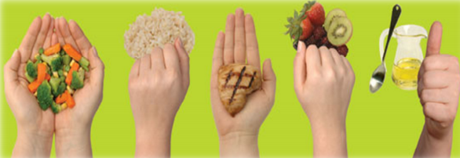
What Does a Serving Look Like?
2 hands = a cup (for veggies)
1 hand = ½ cup (whole grains, rice, or fruit)
Palm of hand = 3-4oz (protein)
Thumb = 1 tbsp
(for healthy fats like olive oil)

Slide 8
Good luck!
Lunches will be checked on ______________.

