Slide 1
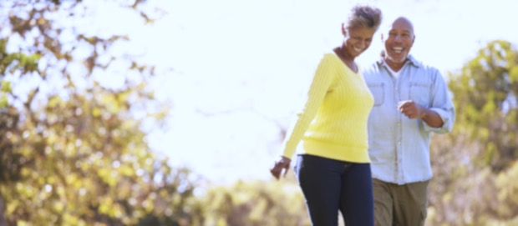
Aging with Vitality

Slide 2
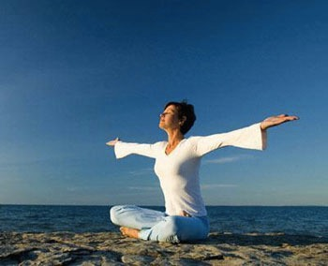
How to Age Gracefully
Nutrition for the Body & the Mind
Exercise for the Body & the Mind
Physical Health
Positive and Healthy Mental and Emotional Health
Stress Management
Social Support

Slide 3
What is Aging?
Process of growing old
When the human body becomes more vulnerable to wear and tear
Cellular wear and tear, DNA damage, hormone changes, immune system changes, & free radicals
No quick solution to slowing or reversing the process of aging
Researchers are studying antioxidants, hormone replacement, and other therapies
Best to focus on lifestyle strategies for a long and healthy life!

Slide 4
Ways to Live a Really Long Time (as shared by a centenarian)
Eat until you’re 80% full
Eat quality food
Shut down stress
Prioritize sleep
Move every day
Never act your age (e.g. travel adventurously, dance during weddings, etc)
Connect with people all ages
Just believe
Notes:
http://www.chatelaine.com/health/how-to-live-to-100-years-old-as-shared-by-a-centenarian/

Slide 5
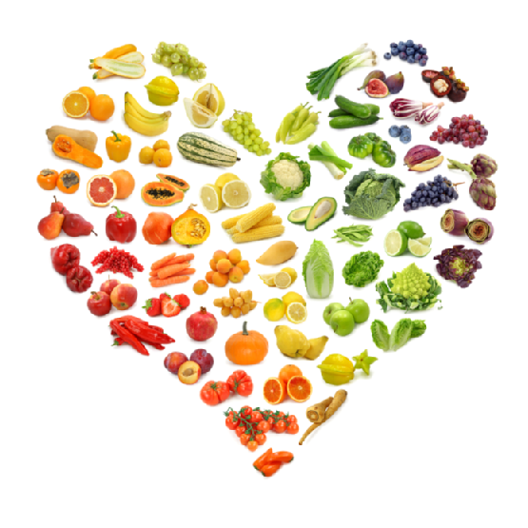
Nutrition
Eat foods dense in essential nutrients
Healthy fats, whole grains, fresh vegetables, fruits, and legumes
Limit your alcohol intake
Alcohol weakens immune system, affects your cognitive abilities, increases risk of falling
Avoid tobacco use
Linked to cancer, stroke, lung disease, ages your skin, high blood pressure

Slide 6
Food for the Brain & Body
Avocados
Garlic
Soy
Water
Fish
Watermelon
Mushrooms
Sea veggies
Berries
Ginger
Cruciferous vegetables
Whole meal pasta and rice
Tomatoes
Nuts and seeds
Sesame and olive oil
(kelp, sea, wed, dulce, kombu)
Notes:
All of these foods have been shown to slow the aging process, fight disease and boost the immune system.

Slide 7
Anti-Aging Nutrition Habits
Drink MORE water
Consume 5 small meals and snacks daily
Reduce fat intake
Reduce salt and sugar intake
Control your portion sizes
Minimal consumption of processed foods
Check your calcium intake
Notes:
Lack of water can cause headaches, lack of energy, tired and lethargic sensations, injuries, hot flashes and achy joints and muscles
Lack of water is linked to a loss a concentration
Every tissue, cell, organ and system is composed of water and functions optimally only in the presence of adequate water levels. Degeneration associated with ageing will occur at a quicker rate if you are dehydrated. And you can't use thirst to help you determine when you should be drinking water, because as you age your thirst mechanism does not function as well as it should.
5 small meals speeds up your metabolism. A diet that is not consistent in calorie and nutrient intake will lead to a more rapid loss of muscle tissue, which we want to avoid at all costs. Do not go any longer than three or four hours during the daytime without eating something.
Dietary fat is very easily converted to body fat, so controlling your fat intake is important in controlling the weight gain associated with ageing → too much fat = clogged arteries
By controlling your salt and sugar intake, you can reduce the risk of developing hypertension and adult-onset diabetes. Do away with the salt shaker; there is enough salt in most of the foods we eat without our adding more. If you want to boost taste of certain foods, use salt-free spices such as basil, oregano or pepper.
When it comes to watching your sugar intake, choose products with a sugar content that is less than 10 per cent of the total carbohydrate content → if don’t use up excess calories, turn to fat → consequences to aging (especially since metabolism slows down)
Our bodies are constantly assaulted from pollution, stress, bad posture, sedentary jobs and our own bad eating habits. Over the months and years, the effects build up and emerge in many different forms- from skin eruptions, to headaches, ulcers, cancer and heart disease.

Slide 8
Healthy Eating
Increased mental acuteness
Resistance to illness and diseases
Foods in antioxidants → stops the production of free radicals that have the potential damage cells
Vitamin-rich food → boosts immunity
Fiber from vegetables reduce blood cholesterol levels
Omega-3 and B vitamins from vegetables are proven to reduce anxiety and depression
Vitamin K2 in vegetables helps to move calcium into teeth and bones
Also directs calcium AWAY from areas like arteries and soft tissues (or else it would be problematic)

Slide 9
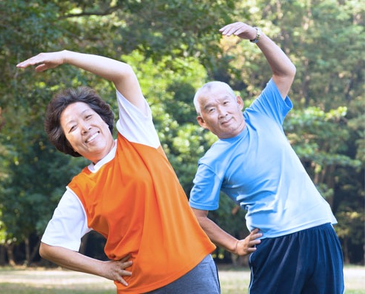
Be Physically Active
Avoid sedentary behaviour
Aim for ~30 minutes of daily exercise
Even walking can be effective
Maintain or lose weight
Studies show improvement in balance, strength, gait (walking), muscular power, blood pressure, endurance, and bone density with regular physical activity
Benefits include improved blood circulation, increased muscle mass, greater flexibility, more endurance, improved balance, increased concentration, more energy
Notes:
Something as simple as walking is beneficial
Exercise IS medicine
Doing this like cleaning, washing dishes, gardening will cut your risk of heart disease, diabetes, and depression
Exercise lowers risk of Alzheimer's, dementia, heart disease, high blood pressure, certain cancers, obesity
Maintain or lose weight
Metabolism slows down naturally as you age (if you keep with the same habits as you age, you will gain weight)
Exercise to build muscle mass
Exercise builds strength and stamina → prevents loss of bone mass and improves balance (REDUCE risk of falling)

Slide 10
Be Physically Active
Increases your VO2 max by 30% (maximum volume of oxygen you can use - measure of aerobic fitness)
Able to endure longer through everyday activities
Decreases shortness and breath and promotes independence
Exercising (weight-bearing exercises) will build bones and make them strong (reduce risk of osteoporosis, falls, fractures)
Decreases your blood pressure
Exercises makes your heart stronger → heart can work less to pump blood
Increased energy and mood
Exercise releases endorphins
Endorphins produce feelings of euphoria
Notes:
In a study on 90 year old women, 12 weeks of strength training “took the equivalent of 20 years off their thigh muscle age” => therefore, improvement in walking and mobility
Euphoria = feeling on intense excitement and happiness

Slide 11
Your Physical Health
Check your blood pressure often
The only way to see if you have high blood pressure (hypertension)
Untreated hypertension can lead to serious diseases
Avoid excessive sun exposure
Linked to cancers
Wear protective sunscreen and sunglasses (even when it is cloudy!)
Look for areas of shade
Notes:
High blood pressure → almost no symptoms so have to check it
Serious diseases → stroke, heart disease, kidney failure

Slide 12
Mental and Emotional Health
Mental health problems are NOT a normal part of aging
Difficulties of mood, thinking, and behaviour are not inevitable → may be signs that something is wrong and requires attention from a health care professional
Most common mental disorders for adults over age 60: dementia and depression
Mental and emotional CAN be promoted and improved at all stages of life
Notes:
Dementia – loss of intellectual abilities that is severe enough to interfere with a person’s ability to function – memory impairment, develops over time
- Most common in older adults**
Depression – more than just feeling sad – constant state of sadness, hopelessness, loss of interest in things you usually do (for couple weeks or longer)

Slide 13
How to Improve Your Mental and Emotional Health
Acceptance of change
Do not deny the changes happening to your body → it is natural
Losing people and independence is a common and natural experience
Don’t focus on the things you can’t do, but enjoy the things that you CAN do
Avoid stereotyping
I should be doing “this” at this age
Set goals
Sense of purpose and accomplishment
Leads to feelings of satisfaction
Improves your outlook on life
Learn new things
Be a student for life
Notes:
As you deny changes (physically, energy-wise), it will make your life less enjoyable
Get things that will help you like reading glasses
Stereotyping
Everyone is on their own unique journey
Comparing ourselves to the “norm” causes us to experience greater stress, anxiety, and sadness
Use time to focus on YOURSELF, and be the best who you can be (to YOUR standards, not society’s)
Goals
Goals help you be who you want to be
Stretch your comfort zone (great way to grow as a person)
Boosts your confidence when you reach the goal
Goals who you and the world what you value
Goals make you self-reliant
Goals encourage you to trust your decisions
Learn new things
Don’t fall into the trap that as you grow older, your mind gets fuzzier
Go to lectures, museums, read books to keep your mind sharp
Learn new recipes, instruments, sports, etc
Travel someplace new to learn about history, and even yourself

Slide 14
Stress Management
Stress = compromised immune system
Chronic stress contributes to heart problems, diabetes, cancer, asthma, & depression
Be intentional about taking care of yourself
Talk about your worries with your friends, family, or a trained counselor
Practice daily stress management techniques: deep breathing, relaxation, imagery, and meditation
Step outside and take an exploratory walk, visit a garden or marvel at nature
Notes:
the reason why stress can have such a huge impact on our bodies is because it shortens telomeres, the protective caps at the end of chromosomes, which are associated with health and longevity. When telomere length is compromised, our cells age faster
Managing stress stops your telomeres from shortening
Stress and illness--not your birth date--may play more of a role in how quickly you age, according to research presented by the American Psychological Association.
If you can learn to cope with stress and adopt healthy habits, you may be rewarded with a healthy old age.

Slide 15
Connect with Others
Research has shown that people who maintain connections to others – whether through family, friends, co-workers – remain healthier in old age
Connect with people of ALL ages
Prolonged loneliness can weaken the immune system
Increases stress hormone cortisol and blood pressure
Reduces stress and risk of depression
Volunteer in your community or join and group focused on activities you enjoy (e.g. book club)
Notes:
http://www.livescience.com/18800-loneliness-health-problems.html (weakened immune system)
The #1 prescribed medication last year was antidepressants, more even so than statin drugs, because one of the real epidemics of our culture isn’t just heart disease; it’s depression. It’s important that people feel important, needed and connected. Everyone wants to know that someone cares about them and what’s going on in their lives
Stay socially connected and intellectually curious: Having strong ties to family and friends can buffer or reduce some health-related effects of aging and stress. Exercising your brain with classes, hobbies, reading and other mind-challenging activities can help you better maintain your memory.

